Slide 1
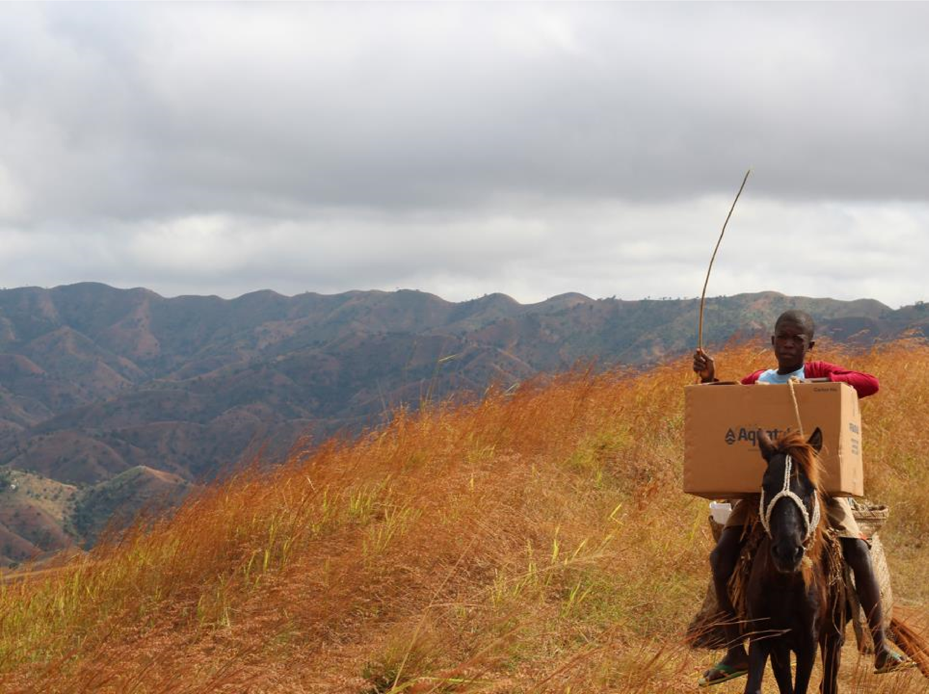



ENVIRO-PURE FOUNDATION PRESENTS > 40 YEARS OF EXPERIENCE IN WATER TREATMENT IN EUROPE, MIDDLE EAST AND S-E ASIA
Aquatabs Flo, InLine & Tab Cartridges ARE AVAILABLE FOR REPRESENTATIVES AND WHOLE SALE IN ASEAN FROM:
ENVIRO-PURE FOUNDATION ,
smart DUTCH WATER SOLUTIONS
with offices in The Netherlands and Thailand
40 years of experience in water treatment using innovative and appropriate technologies for remote locations and disaster struck situations
www.enviro-pure.nl
info@enviro-pure.nl
sales@smartdutchwater.nl
info@enviro-pure.asia* (active soon)
Phone: +66 806990742
Working to improve water quality for over 25 years
Working to improve water quality for over 25 years
Working to improve water quality for over 25 years
Wardwell : Mercy Corps 2016
Wardwell : Mercy Corps 2016
Wardwell : Mercy Corps 2016

Slide 2
ENVIRO-PURE FOUNDATION, based in The Netherlands with a Representative Office In Thailand:
Designs, Develops and Integrates Novel and Appropriate Technologies for Water and Wastewater for Industry, Condominiums, Resorts, Hotels, Villages, Cities, Rural Areas and Refugee-Camps in Close Cooperation with World Leaders
Medentech of Ireland are Disinfection Specialists Providing Products and Programs to Improve Human and Animal Health as Global Experts in Disinfection Tablet Production for over 25 Years

Slide 3





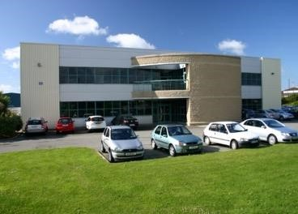



PARTNERS WITH:

Slide 4

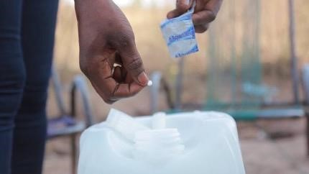
are self dissolving tablets which kill the bacteria in water to make it potable
keep the water safe by ensuring residual chlorine activity to combat recontamination
have been the subject of over 15 International studies to show its effectiveness

Slide 5
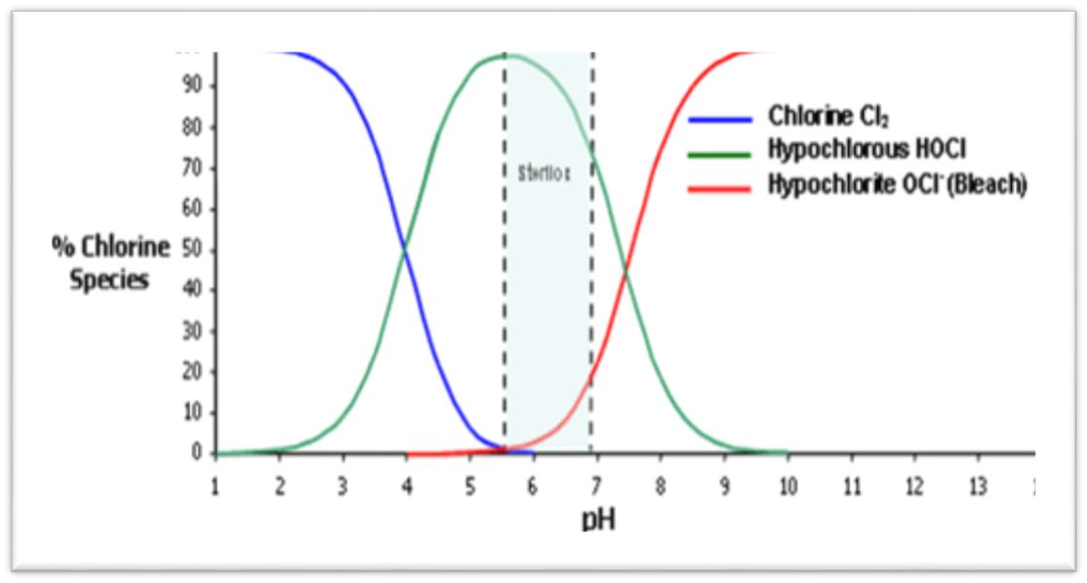


Dissolve in water & releases hypochlorous acid (HOCl) and monosodiumcyanurate
(a non-toxic biodegradable
compound)
HOCl is the biocidal agent
HOCl similar structure to
water (HOH) therefore less
resistance to penetrating
the cell wall
Acidic
Alkaline
HOCl
H
+
+
-
OCl
Undissociated
Dissociated

Slide 6
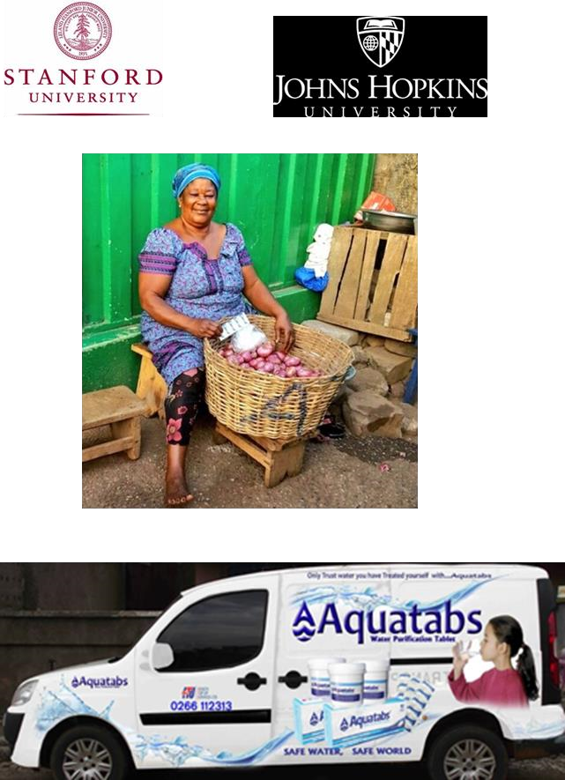









Slide 7
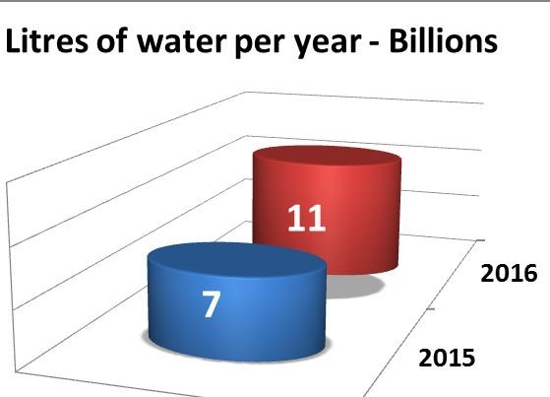
Millions of People Benefit
How many litres of water are treated each year with Aquatabs?

Slide 8
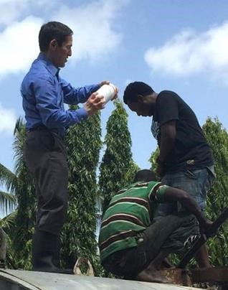

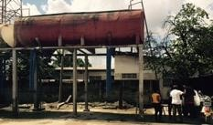

Bowser Station
Objective: to improve chlorination of water supply by
targeting bowsers (trucked water tanks)
Solution: Medentech has a specific size tablet for 5,000
litres at 1ppm
Results: water has residual during transportation
Status: Over 3 districts in Dar with supplies & mapping
undertaken > 1,000 stations

Slide 9
The ratio of “free” and “combined” available chlorine always remains at 50:50
As “free available” chlorine is used up (e.g. organic matter, microorganisms, etc) the balance is disturbed
Part of the “combined” available chlorine is then “freed” to restore the 50:50 ratio
This happens until all the “combined” available chlorine is used up

Slide 10
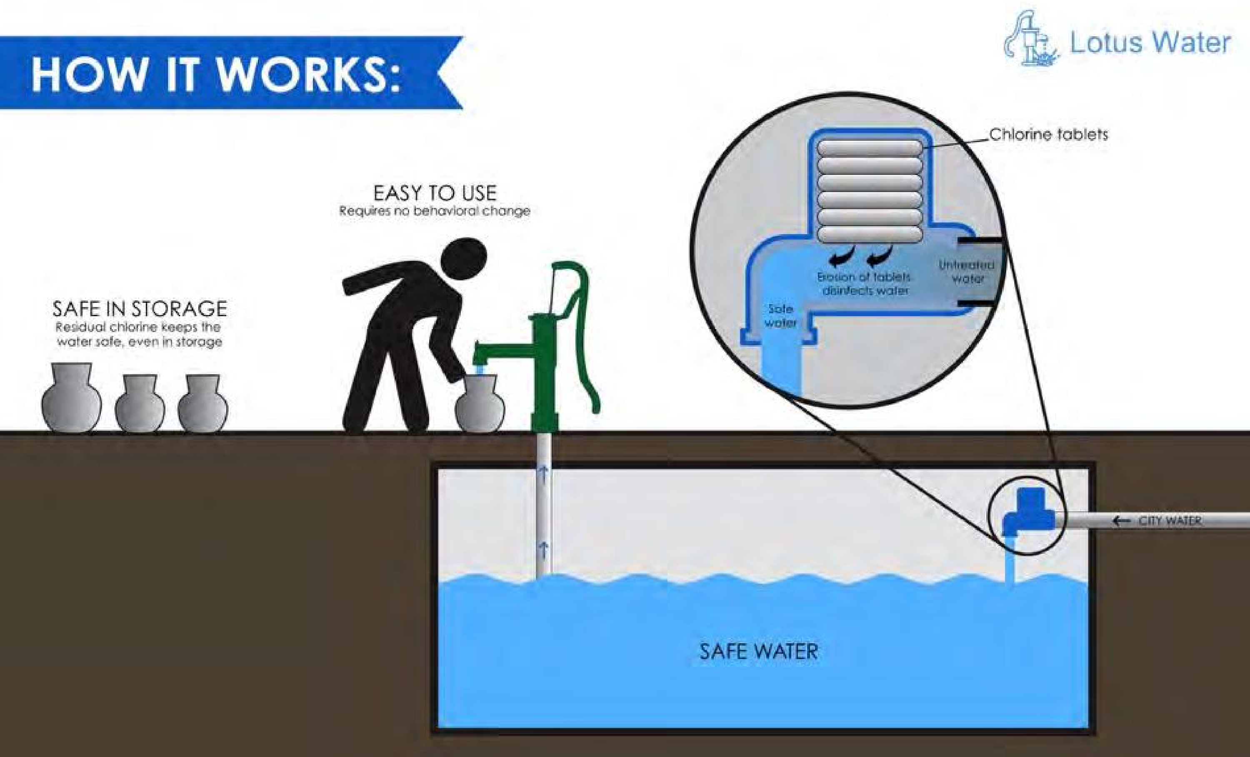
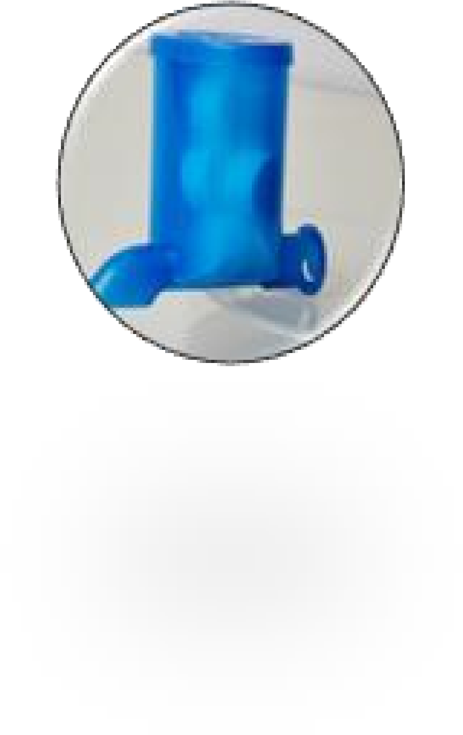

Slide 11
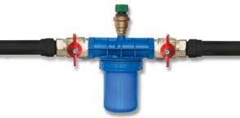

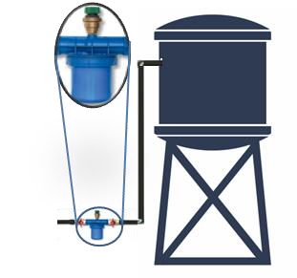
  up to 30 litres per minute
  360m³ per cartridge @2 to 3ppm
Easy installation
Simply replace a section of pipe with “Venturi housing” which forces a % of water down through “cartridge” around tablets which erode to mix the required level of chlorine into the water line.
Maintenance free-Replace cartridge when empty
No moving parts & No spares

Slide 12

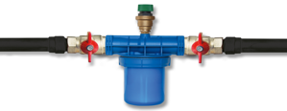

Easy to manage chlorine dosing
By Simply splitting the water / creating a by-pass you can lower the dosing
Untreated water and treated water will converge and mix in-line after the cartridge
50% of water through In-line cartridge: – up to 900m³ @ between 1 to 2ppm >60 litres per minute
25% of water through in-line cartridge: - 1,700m³ @ between 0.5 to 1ppm >120 litres per minute

Slide 13
A simple By-Pass system is created to split the water whereby all or a certain percentage of the mains water is directed through the cartridge of tablets. Water exiting from the cartridge mixes back into the mains flow to treat overall water
Mains Flow – Untreated Water
Treated Water
By-Pass
Untreated Water
Treated Water
“Batch Solution” created in cartridge as water mixes with Aquatabs

Slide 14
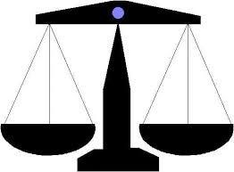
Aquatabs dissolve in water to release HOCl : measured as available chlorine
HOCL
-
available Chlorine
50% of the “total” available The remainder is “combined” in chlorine is actually present the form of mono – or as “free” available chlorine dichloroisocyanurate
50
%
50
%
Free
Combined
In Equilibrium

Slide 15
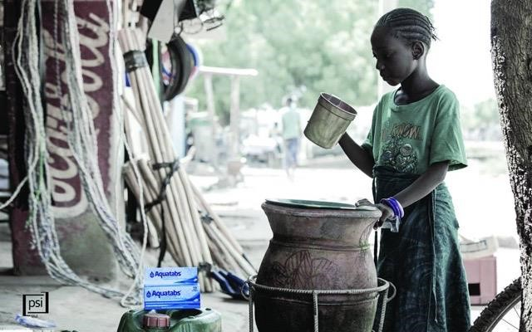
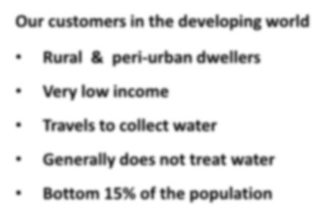

Our customers in the developing world
Rural & peri
•
-
urban dwellers
•
Very low income
•
Travels to collect water
•
Generally does not treat water
•
Bottom 15% of the population
30

Slide 16
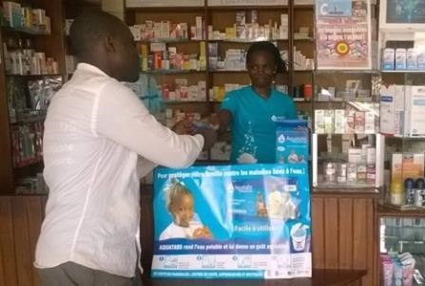
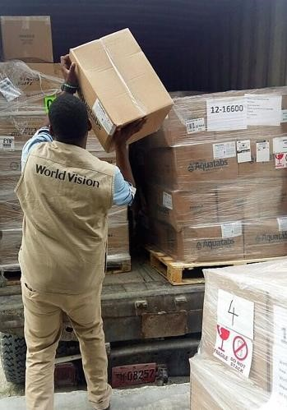
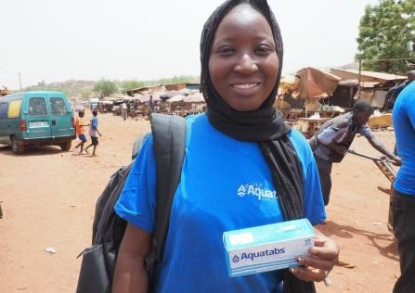
Emergency Relief
ABMS 2016
Social entrepreneurs
World Vision Haiti 2016

Slide 17

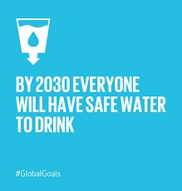
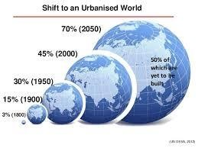

Aligning with the Strategy of the International Community
-
Water Quality
(
Study by WHO / UNC:
<
40
% of
“
improved sources
”
exceeded WHO recommended levels
of
Facal
Indicator Bacteria (FIB)
Aquatabs is now positioned to offer:
Alternative Solutions (
“
One Stop Shop
•
”
)
Affordability
–
low cost application
•
–
low capital costs
Low to zero maintenance
•
–
no management or Behaviour Change
required: purification at source/collection/entry
Urban / Peri
•
-
urban locations now addressed
Water Quality
•
–
makes water safe at point of source/collection/entry and
keeps it safe

Slide 18
Contact for ASEAN:
Mr. Dick van Dijk, Senior Water Consultant
ENVIRO-PURE FOUNDATION
info@enviro-pure.nl
info@enviro-pure.asia
sales@smartdutchwater.nl
Tel. +66 806990742
Line: Dick41
www.enviro-pure.nl

