Slide 1
“Water Treatment Systems”
Safe Tap and Drinking Water with New Approach
Eng. Dick Van Dijk, Chairman
ENVIRO-PURE FOUNDATION
Netherlands-Thailand

Slide 2
Sustainable Drinking Water Purification
FOR CONDOMINIUMS, HOTELS, HOSPITALS, RESORTS, PLANTATIONS, (RURAL) VILLAGES, CITIES,
REFUGEE-, WORK- & ARMY-CAMPS
& DISASTER STRUCK AREAS

Slide 3
INTRODUCTION
Clean and Safe Drinking Water to Urban, non-Urban & Rural People and Victims of Disasters
Key Focus Point of the WHO, UNESCO, NGOs

Slide 4
Millions of Deaths each Year
Every 2 Seconds a Child Dies from Drinking Contaminated Water(UN)!
60-80% of People Living on Farms Suffer from Intestinal Worms Chronic Diarrhea
WHO states: Emphasis must be on
PREVENTION and NOT ON CURE

Slide 5
Most People in Rural Areas Don’t have Potable Water
Surface Water contains Bacteria
Groundwater also may contain Harmful Micro-Organisms
After Floods or other Natural Disasters many Wells are Contaminated
Novel Technology is available

Slide 6
EXPERIENCE
Based on > 40 years of experience our Group Develops Systems Surpassing
all Key Targets Mentioned
by Prof. Mark Sobsey, WHO Consultant for Household Water Issues

Slide 7
CHALLENGES/ SUPPORT
Very Fine Filtration or Harsh and Dangerous Chemicals are Required to Remove Particles and Micro-Organisms
Scientific Support was received from the University of Mexico City, Universities In Europe(Spain+Turkey) and USA(UCAL) Testing was done by the Technical University of Marmara in Istanbul-Turkey

Slide 8
ULTRAFILTRATION is the State-of-the-Art Answer
Ultrafilters(UF) consist of many hollow fibers with a diameter of 1-2 mm. The walls of these fibers act as fine filters with a pore diameter of 10-25 nanometers.
The flow of raw water should be from inside-out, allowing backwashing from outside-in removing all trapped particles from the pores, including bacteria and viruses and eliminating dead pockets with accumulated dirt.

Slide 9
Ultrafiltration How does it work?
Bacteria are Larger than 0.5 ųm(microns)
Viruses are Larger than 0.05 ųm
Pores in UF membranes typically are between 0.01-0.03 ųm
No Micro-organisms will Pass this “Sieve”, nor will small Particles such as Colloids

Slide 10
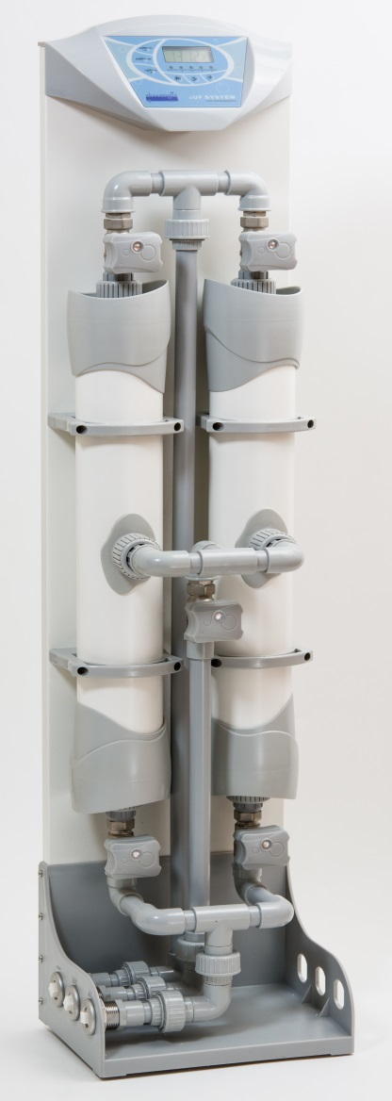
MEET THE ENVIRO-PURE smartUF
Stand-Alone Units
Pre-Filtration included
99.9999% Removal of Micro-Organisms
Fail Safe
Automatic Backwash
Low Maintenance

Slide 11
Combining up to 40 membrane- modules in a smart way gives a daily production of safe, clean water of up to 500 m3 from river water, sufficient for 4,500 people without large investments and use of chemicals that’s what we call smartDUTCH WATER SOLUTIONS

Slide 12
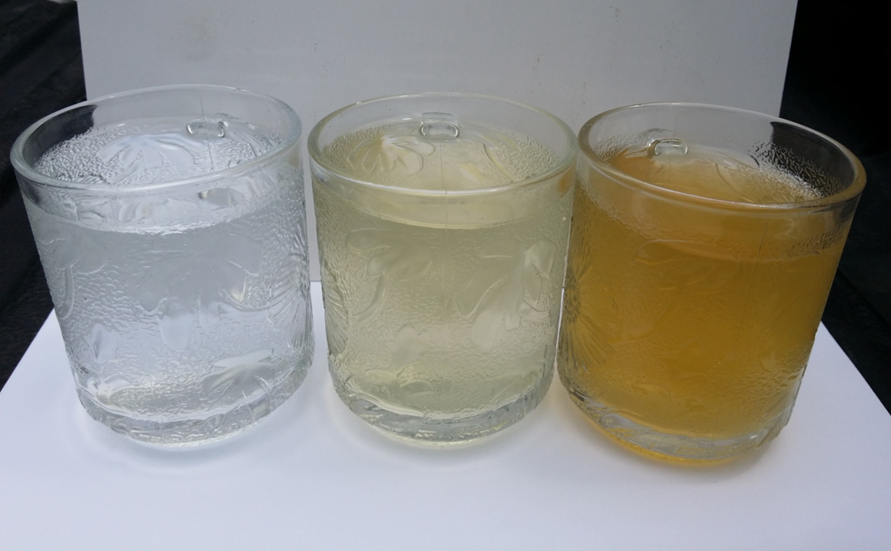
TEST RESULTS
Treated Water
0.22 NTU
Raw Water
13.30 NTU
Backwash Water
62.77 NTU

Slide 13
Enviro-Pure smartUF Series
Fully Automatic Backwash
Micro-Processor Controlled
Full Capacity Maintained
Backed by Leading UF-membrane Manufacturer
Lowest Cost per Liter

Slide 14
Enviro-Pure smartUF Series
Integrated Mechanics Ensure:
Pre-Filtration by Hydrocyclone
Automatic Cleaning of Membranes
Fully Automated Process
UF Membrane Life-Span > 5 years

Slide 15
ADDITIONAL TREATMENT
Besides Taste, Color or Odor,
Natural Waters may contain:
Chromium, Copper, Iron, Lead, Manganese, Mercury, Nickel, Zinc, etc.
Arsenic, Fluoride
These pollutants can cause Serious Negative Health Issues and need to be Removed

Slide 16
Arsenic, Fluoride, Iron Removal Cartridge

Slide 17
NEW APPROACH SUMMARY: Enviro-Pure smartUF Series
Safe Drinking Water at Lowest Cost
Eliminates Waste of Funds
Sustainable Solution: Powered by solar, wind, micro-hydro, grid or hybrids
Protects the Environment
Reduces Work-Load on Women
Provides Local Jobs

Slide 18
WHY TAKE OUT MORE?
Calcium, Magnesium and Other Minerals are Needed, even Copper, Iron and Zinc
Only Remove Them(Partially) if the Levels are TOO HIGH
NOT JUST BECAUSE SOME THINK IT IS THE LATEST TECHNOLOGY!

Slide 19
World Health Organization Issues Reverse Osmosis Water Warning
WHO released a report stating that such water
"has a definite adverse influence on the animal and human organism”
Ask for a copy from our library

Slide 20
RO VERSUS UF
RO uses up to 10 times more energy
RO has very high reject rates(50-95%!)
RO needs chemical treatment to prevent scaling/clogging
Life span is reduced
SO WHY USE IT IF NOT REQUIRED?

Slide 21
IS RO ALL BAD? ABSOLUTELY NOT
When only brackish- or sea-water is available, RO is the most practical solution
If Chloride and Nitrate levels in groundwater are too high, RO offers an excellent technology
Combination of UF and RO offers big savings and (health) advantages
It allows to re-mineralize the water with its natural components

Slide 22
RO-Desalination
Pores in RO membranes are 100 x smaller than those in Ultrafiltration
High pressure is required and equipment must be of expensive materials such as stainless steel, except when you do it
the Dutch Way
Pre-filtration is a must to prevent clogging. The best way is Ultrafiltration

Slide 23
RO-Desalination: Experience
Filtration Technology are leading in RO-systems for horticulture, and food-industry
Unique connection blocks combine the RO-filter elements, eliminating high-pressure SS-hoses and fittings

Slide 24
Filtration Technology
MOOR Patented Integrated Water RO-Distribution Blocks

Slide 25
RO-Desalination: New Approach
Compact, quick to build and leak-proof skids completely assembled and tested before shipping, but that is not all:
Simetra® communication-module for monitoring, trouble-shooting and assistance
On-line, via 3G or Internet, anywhere, in the local language.
That’s what we call smartDutch

Slide 26
RO-Desalination: Newest Approach
To make things even better, we have developed and are testing the smartBlueBox
Revolutionizing RO-Technology by:
Reducing reject water from 50% to 7% only
Reducing energy consumption by 18%
Reducing anti-scaling agent by 30%
smartDutch Water Technology

Slide 27
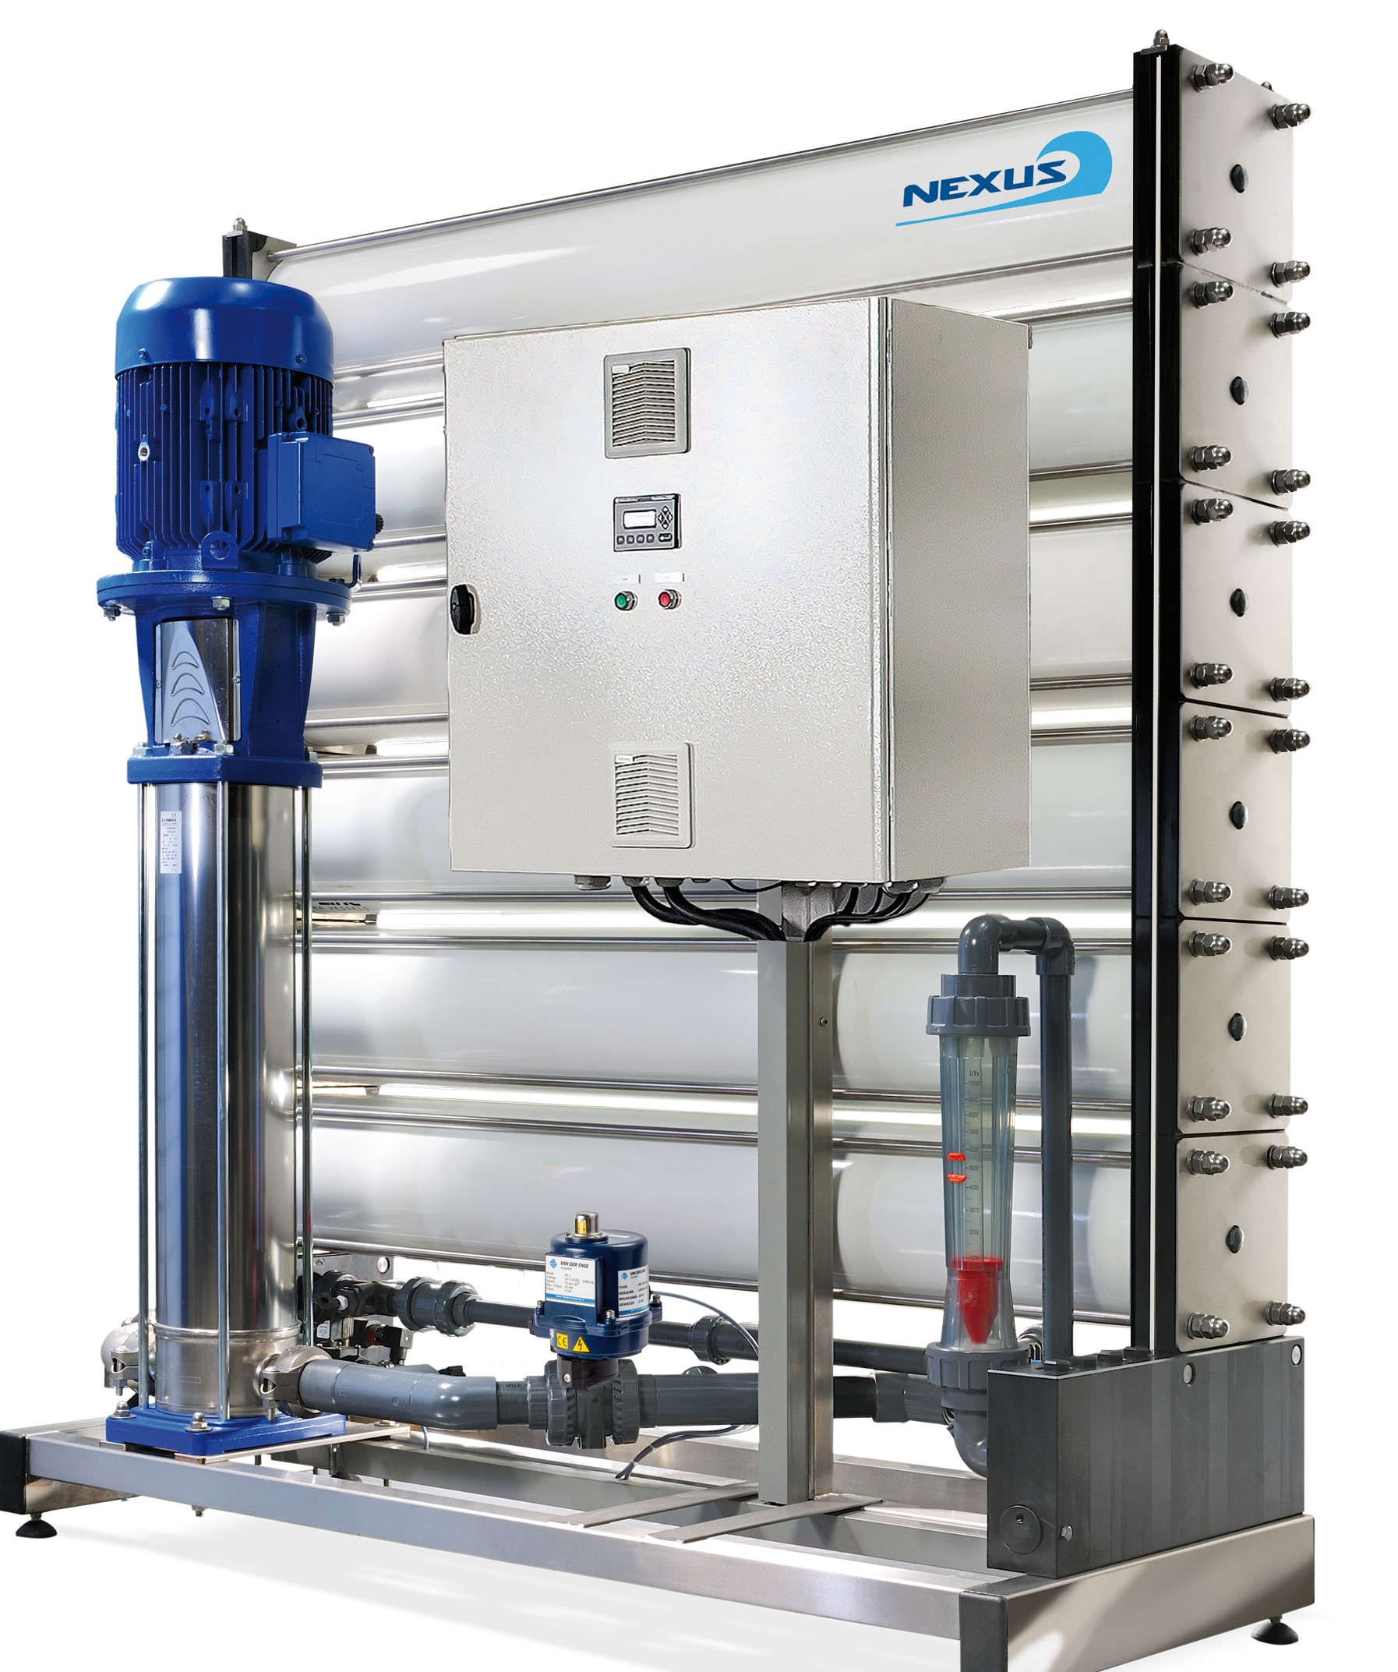
RO-Desalination
Meet the smartRO NEXUS Simetra and see the difference

Slide 28
Traditional RO plant

