Slide 1
Medicare 101

Slide 2
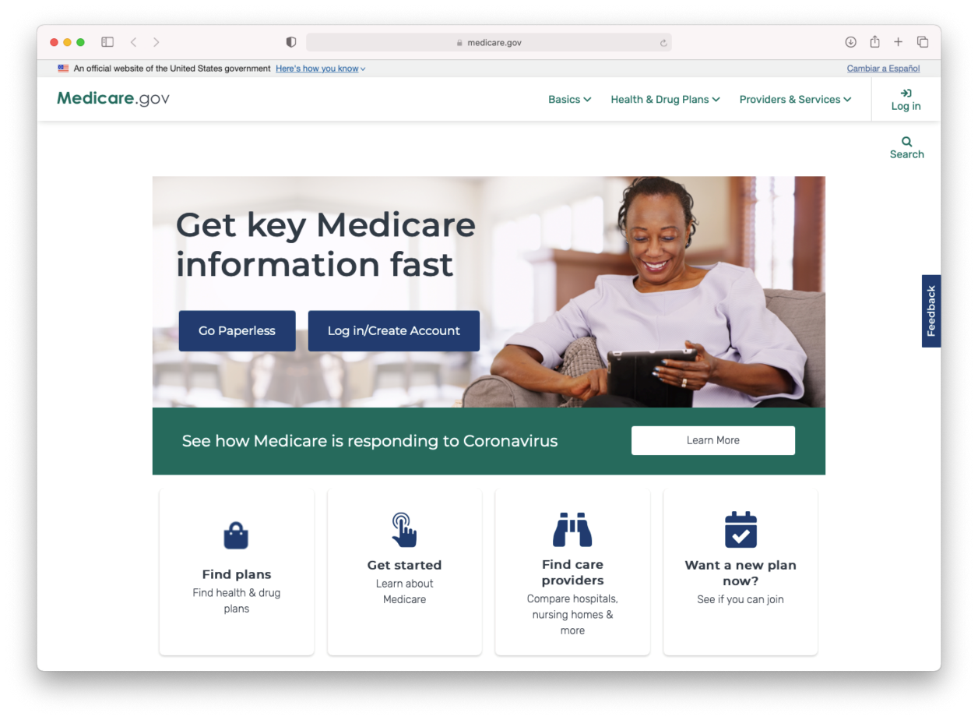
What is Medicare?
What is Medicare?
Federal health insurance program
Managed by the Centers for Medicare and Medicaid Services (CMS), a division of the Department of Health and Human Services (HHS)
Sources
https://www.medicare.gov/what-medicare-covers/your-medicare-coverage-choices/whats-medicare
https://www.medicare.gov/about-us/how-is-medicare-funded#:~:text=The%20Centers%20for%20Medicare%20%26%20Medicaid,and%20Human%20Services%20(HHS).

Slide 3
Parts of Medicare
Part A: hospital insurance
Part B: medical insurance
Part C: Medicare Advantage
Part D: prescription drug coverage
Sources
https://www.medicare.gov/what-medicare-covers/your-medicare-coverage-choices/whats-medicare
https://www.medicare.gov/sign-up-change-plans/types-of-medicare-health-plans/medicare-advantage-plans/how-do-medicare-advantage-plans-work

Slide 4
Medicare Part A
Part of original Medicare
Covers:
Inpatient hospital stays
Care received in a skilled nursing facility
Nursing home care (not for the purpose of custodial or long-term care)
Hospice care
Home health care (with exceptions)
Source
https://www.medicare.gov/what-medicare-covers/what-part-a-covers

Slide 5
Medicare Part B
Part of original Medicare
Covers:
Medically necessary services
Preventive health services
Source
https://www.medicare.gov/what-medicare-covers/what-part-b-covers

Slide 6
Medicare Part C (Medicare Advantage)
Provides Part A and Part B coverage
May include additional benefits for dental, hearing, vision, and/or health and wellness programs.
Most include Medicare prescription drug coverage (Part D).
Source
https://www.hhs.gov/answers/medicare-and-medicaid/what-is-medicare-part-c/index.html

Slide 7
Medicare Part D
Plans must cover a variety of prescription drugs options
Sometimes formatted in different levels called tiers
Pricing varies by tier
Source
https://www.medicare.gov/drug-coverage-part-d/what-medicare-part-d-drug-plans-cover

Slide 8
Who is eligible for Medicare?
Individuals age 65 and older
Individuals with disabilities who are younger than age 65
Individuals who have end-stage renal disease
Source
https://www.hhs.gov/answers/medicare-and-medicaid/who-is-elibible-for-medicare/index.html

Slide 9
How much does Medicare cost?*
Part A premium:
No charge for most individuals
Individuals who paid Medicare taxes for less than 30 quarters pay $499 per month
Individuals who paid Medicare taxes for 30-39 quarters pay $274 per month
Part A deductible and coinsurance:
Deductible for each benefit period is $1,556
$0 per day coinsurance each benefit period for days 1-60 of hospital stay
$389 per day coinsurance each benefit period for days 61-90 of hospital stay
$778 per day coinsurance each benefit period for days 91+ of hospital stay
Source
https://www.medicare.gov/your-medicare-costs/medicare-costs-at-a-glance
2022 figures listed

Slide 10
How much does Medicare cost?*
Part B premium:
$170.10 per month
May be higher depending on income
Part B deductible and coinsurance:
Deductible is $233
After deductible, coinsurance is 20% of Medicare-approved amount for most doctor services
Part C:
Cost varies based on plan selected
Part D:
Cost varies based on plan selected
Source
https://www.medicare.gov/your-medicare-costs/medicare-costs-at-a-glance
2022 figures listed

Slide 11
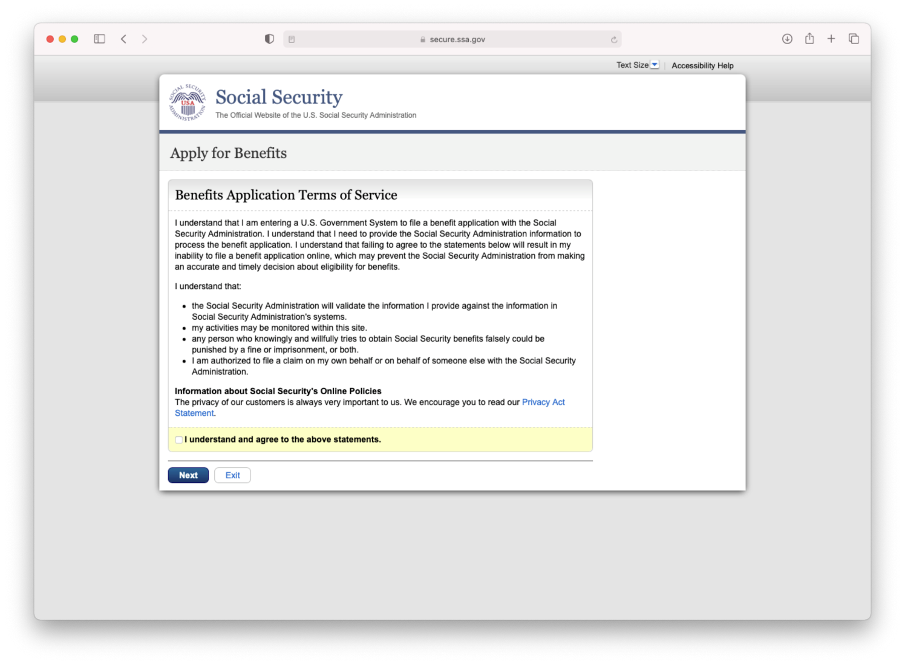
Signing up for Medicare
For Parts A and B: Enrollment through Social Security
For Parts C and D and other supplemental insurance options: Options offered by private companies that follow Medicare rules and guidelines
Source
https://www.ssa.gov/benefits/medicare/

Slide 12
When to sign up for Medicare
For original Medicare:
Initial enrollment period is 7 months total: begins 3 months before turning 65 years old and ends three months after the month of turning 65
For Medicare Advantage
General enrollment period:
Individuals with Part A coverage who sign up for Part B coverage for the first time are also eligible to sign up for a Medicare Advantage or Part D plan
Coverage may not begin until July 1
Open enrollment period:
Runs each year from Oct. 15 to Dec. 7
Individuals can join, switch, or drop a Medicare Advantage or Part D plan
Coverage begins Jan. 1
Source
https://www.medicare.gov/sign-up-change-plans/get-started-with-medicare/join-a-plan/how-can-l-sign-up-for-medicare-and-choose-a-plan

Slide 13
Getting started
Sign up for Medicare online or by calling Social Security.
Determine if you want additional coverage through a Medicare Advantage (Part C) plan, a Medicare Supplement plan, a prescription drug (Part D) plan, or other supplemental insurance.
Complete an authorization form to ensure someone you trust can talk with Medicare about your benefits, if needed.
Schedule an appointment for a free “Welcome to Medicare” preventive visit.
Research to learn more about what Medicare does and does not cover.
Create a secure Medicare account using your Medicare number.
Sources
https://www.medicare.gov/sign-up-change-plans/get-started-with-medicare/join-a-plan/how-can-l-sign-up-for-medicare-and-choose-a-plan
https://www.medicare.gov/sign-up-change-plans/get-started-with-medicare/year-1-your-medicare-checklist

Slide 14
Not connected with or endorsed by the United States government or the federal Medicare program. This is a solicitation of insurance and an agent may contact you. Medico® is a registered trademark owned and licensed by Medico Insurance Company. © 2021 Medico Insurance Company.
24 114 5454 1221 US
Thank you!

