Slide 2
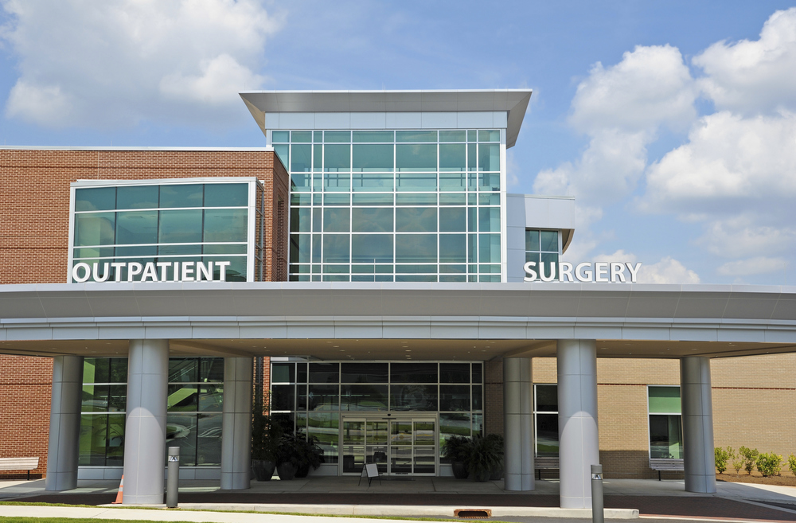
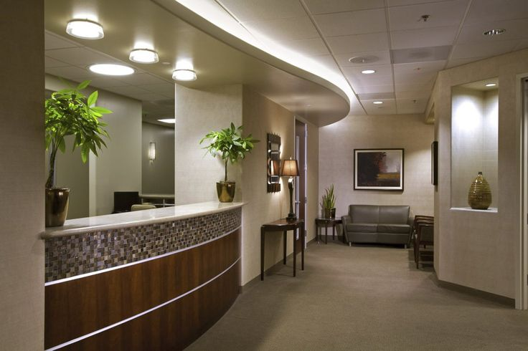
Evolution of Surgery
HOSPITAL
ASC
Office Based Surgery

Slide 3
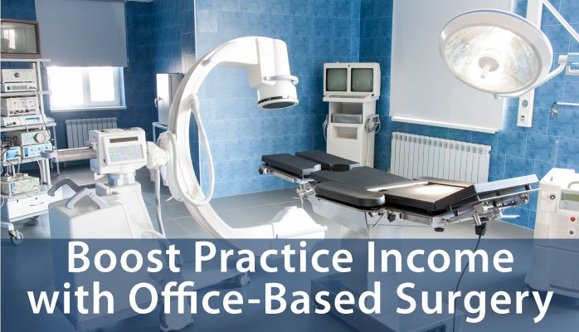
What is OBS?
Office Based Surgery
Integrated surgery suite in a doctor’s office
As more types of surgery migrate to the office setting, it’s important to ensure that procedures are done safely by qualified staff and that all patient experiences in the office setting are documented

Slide 4
Office Based Surgery
Office based surgery is any surgical or invasive procedure, utilizing minimal to moderate anesthetics, performed by a licensed physician in a location other than a hospital or ambulatory surgery center. These procedures are typically performed in a suite located within the physician's office.
The surgical parameters of procedures commonly performed in a office based surgery suite include:
Ability to safely perform surgical procedures on stable patients
Minimal to moderate sedation
Outpatient type procedures
Office based surgery suites are not always “accredited” by a Governing Agency. This is based upon each unique physician's needs and requirements. The highest appropriate standard of patient care and safety is always paramount in Office Based Surgery.
Examples of surgical procedures include:
Opthalmology - Cataract, RLE, ICL, Blephroplasty
GI - Endosuite (Colonoscopy & EGD)
Plastics - Mini-facelift, Rhinoplasty
LASIK suites and most existing procedure rooms can be converted for office based surgery.

Slide 5
Office Based Surgery
Office Based Surgery
Safely perform surgical procedures on healthy patients
Typically Class A level anesthesia w ophthalmologists
Valium, Xanax or Ativan (schedule 3 drugs)
Oral, local or topical medications only
No dissociative medications
Not unique to eye surgery
Not necessarily “accredited” by a governing body
Follows highest appropriate standard of patient care and safety
Not covered by Medicare
No facility fee is collected

Slide 6
History of Accredidation
Accreditation came about as a result of insurance companies needing a single standard nationwide
Medicare is a physical credential set by Federal the Government
Some states now only use “deemed” bodies to conduct their Medicare survey on behalf of the state

Slide 7
Physician Advantages
Increased revenue
Higher reimbursement
More financial independence
Patient convenience/ease of scheduling
Control of patient care from the beginning to end
Decrease burnout
Don’t have to give up ownership
More control over schedule, a better work-life balance can be achieved

Slide 8
Patient Advantages
Cost savings
Lower risk of infection
Comfort
Convenience
More personalized care
Patient satisfaction
Continuity of care

Slide 9
Process
Pre Development
Development
Initial consultation
Determine feasibility
Pro-forma
Understand facility requirements
Establish timeline
Governing body structure
Training
Equipment & supply
Inventory requirements
Infection control
Quality & risk program development

Slide 10
OBS Process
Operational Phase
Ongoing Support
First cases
First inspection
Mock surveys
Patient care protocols
Standards of care
Med logs
Surgical implant
sterilization
QA/QI program
Standards updates
Quality & risk management
Regulations
Policy & procedure
Marketing
Ongoing inspection support
Incident reporting
Credentialing
Accreditation

Slide 11
Considerations in OBS Suites
Potential revenue
State laws
Building, space selection
Equipment & supplies
Staffing
Case volume

Slide 12
Which Class?
ASC / OBS are classified by “Class” determined by type of anesthesia administered
ASC’s are Class B & C
OBS is Class A
Can possibly be Class B based upon doctor’s needs and desires
Class C is reserved for ASC procedures
May be able to upgrade to Class B in the future when/if Medicare allows OBS cataract procedures
May be labeled Class 1-4

Slide 13
Class A Facility
All endoscopic and/or pain management procedures may be performed under the following anesthesia:
Topical Anesthesia
Local Anesthesia
If oral medications are used, only minimal and moderate sedation levels are permitted in Class A Facilities.

Slide 14
Class B Facility
All endoscopic and/or pain management procedures may be performed under the following anesthesia:
Topical Anesthesia
Local Anesthesia
Parenteral Sedation
Regional Anesthesia
Dissociative Drugs (excluding Propofol)
Agents 3 thru 5 may be administered by:
Physician
Certified Registered Nurse Anesthetist (CRNA) under physician supervision if required by state or federal law, or by policy adopted by the facility
Anesthesia Assistant (as certified by the National Commission for the Certification of Anesthesiologist Assistants) under direct supervision of an Anesthesiologist
Registered Nurse, only under the supervision of a qualified physician.
The use of Propofol, Spinal Anesthesia, Epidural Anesthesia, Endotracheal Intubation Anesthesia, Laryngeal Mask Airway Anesthesia, and/or Inhalation General Anesthesia (including Nitrous Oxide) is prohibited in a Class B facility.
Class B Facilities must meet all Class A and Class B standards.

Slide 15
Class C Facility
All endoscopic, and/or pain management procedures may be performed under the following anesthesia:
Topical Anesthesia
Local Anesthesia
Parenteral Sedation
Regional Anesthesia
Dissociative Drugs (including Propofol)
Epidural Anesthesia
Spinal Anesthesia
General Anesthesia (with or without Endotracheal Intubation or Laryngeal Mask Airway Anesthesia)
Agents 3 thru 5 may be administered by:
Physician
Certified Registered Nurse Anesthetist (CRNA) under physician supervision if required by state or federal law, or by policy adopted by the facility
Anesthesia Assistant (as certified by the National Commission for the Certification of Anesthesiologist Assistants) under direct supervision of an Anesthesiologist
Registered Nurse only under the supervision of a qualified physician (excluding Propofol)
Propofol and agents 6 through 8 may be administered only by:
Certified Registered Nurse Anesthetist (CRNA) under physician supervision if required by state or federal law, or by policy adopted by the facility
Anesthesia Assistant (as certified by the National Commission for the Certification of Anesthesiologist Assistants) under direct supervision of an Anesthesiologist
Anesthesiologist
Class C facilities must meet all Class A, Class B, Class C-M, and Class C standards.

Slide 16
Level 1
Level I office surgery includes minor procedures performed under topical or local anesthesia not involving drug-induced alteration of consciousness other than minimal preoperative anti-anxiety medications.
These offices should maintain basic emergency equipment and have an established emergency transfer plan. It is recommended that the
surgeon obtain Advanced Cardiac Life Support certification.

Slide 17
Level 2
Level II office surgery includes any procedure which requires administration of
minimal or moderate sedation/analgesia making post-operative monitoring
necessary. The surgical procedures are limited to those in which there is only a
small risk of surgical and anesthetic complications and hospitalization as a result
of these complications is unlikely.
In addition to Level 1 requirements, these offices should maintain full emergency
equipment and medications. There should be established emergency transfer plans, peer review, and performance improvement programs. Accreditation by one of the agencies is required. The surgeon and one assistant should be currently certified in Basic Life Support and the surgeon or at least one assistant should be certified in
Advanced Cardiac Life Support or have a qualified anesthetic provider.

Slide 18
Level 3
Level III office surgery is a procedure which requires or reasonably should
require the use of deep sedation/analgesia, general anesthesia, or major
conduction blockade. The known complications of the surgical procedure may
be serious or life-threatening.
In addition to Level I and Level II requirements, these offices should maintain full
emergency equipment and medications. There should be established emergency transfer plans, peer review, and performance improvement programs. Accreditation by one of the agencies is mandatory. The surgeon and at least one assistant should be currently certified in advanced cardiac life support and recovery should be monitored by an ACLS trained practitioner.

Slide 19
American Society of Anesthesiologists Classification (ASA)
ASA Classification | Definition | Examples
ASA I | A normal healthy patient | Healthy, non-smoking, no or minimal alcohol use
ASA II | A patient with mild systemic disease | Mild diseases only without substantive functional limitations. Examples include (but not limited to): current smoker, social alcohol drinker, pregnancy, obesity (30 < BMI < 40), well-controlled DM/HTN, mild lung disease
ASA III | A patient with severe systemic disease | Substantive functional limitations; One or more moderate to severe diseases. Examples include (but not limited to): poorly controlled DM or HTN, COPD, morbid obesity (BMI ≥40), active hepatitis, alcohol dependence or abuse, implanted pacemaker, moderate reduction of ejection fraction, ESRD undergoing regularly scheduled dialysis, premature infant PCA < 60 weeks, history (>3 months) of MI, CVA, TIA, or CAD/stents.
ASA IV | A patient with severe systemic disease that is a constant threat to life | Examples include (but not limited to): recent ( < 3 months) MI, CVA, TIA, or CAD/stents, ongoing cardiac ischemia or severe valve dysfunction, severe reduction of ejection fraction, sepsis, DIC, ARD or ESRD not undergoing regularly scheduled dialysis
ASA V | A moribund patient who is not expected to survive without the operation | Examples include (but not limited to): ruptured abdominal/thoracic aneurysm, massive trauma, intracranial bleed with mass effect, ischemic bowel in the face of significant cardiac pathology or multiple organ/system dysfunction
ASA VI | A declared brain-dead patient whose organs are being removed for donor purposes

Slide 20
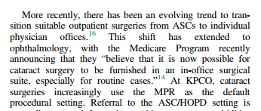
Kaiser Study

Slide 21
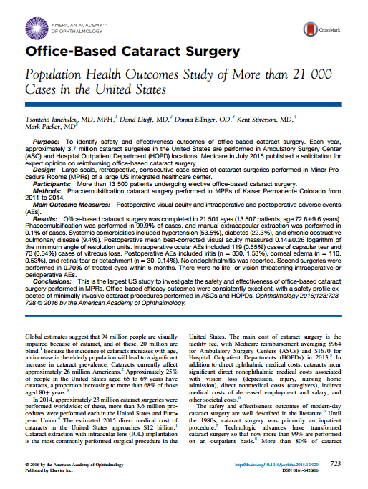
Kaiser Office Based Surgery Study

Slide 22
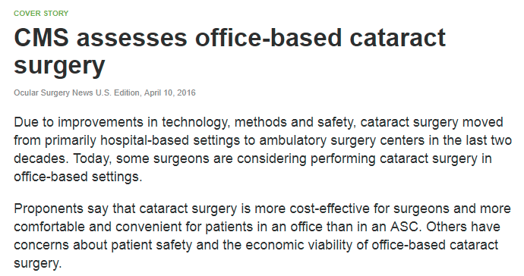
https://www.healio.com/ophthalmology/practice-management/news/print/ocular-surgery-news/%7B04bf9725-e0f6-42d7-bc18-b5345aaf3335%7D/cms-assesses-office-based-cataract-surgery

Slide 23
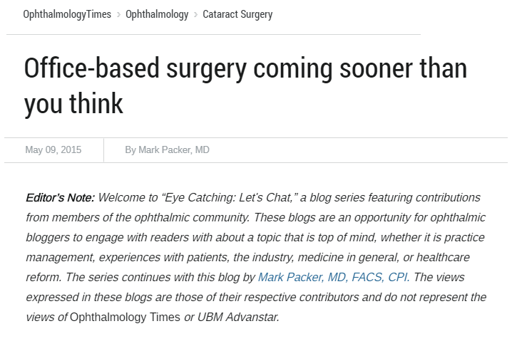
http://ophthalmologytimes.modernmedicine.com/ophthalmologytimes/news/office-based-surgery-coming-sooner-you-think?page=full

Slide 24
https://progressivesurgicalsolutions.com/wp-content/uploads/2017/04/Office_Based_Cataract_Surgery_QuestionsandConcerns.pdf

Slide 25
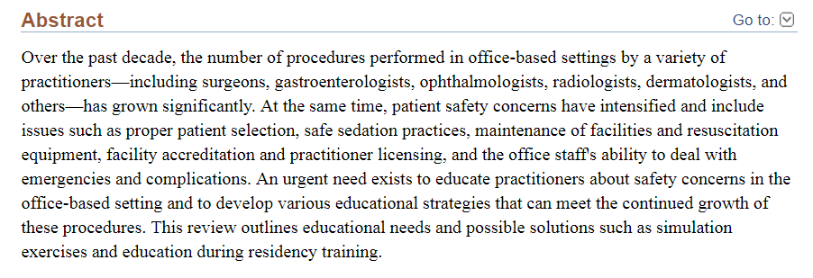
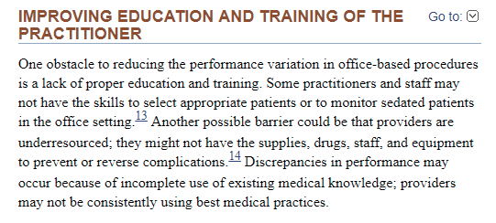

Slide 26
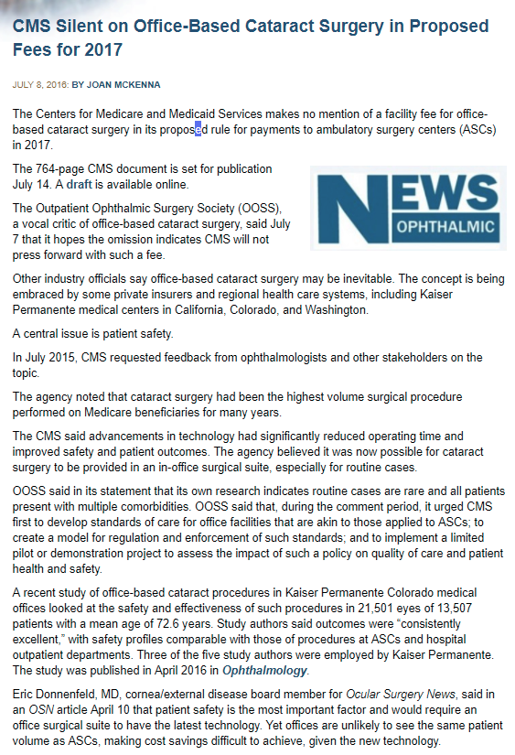
https://market-scope.com/breaking-post/cms-silent-on-office-based-cataract-surgery-in-proposed-fees-for-2017/

Slide 27
https://www.omic.com/wp-content/uploads/2012/07/Office-Based-Surgery-For-Adults.pdf

Slide 28
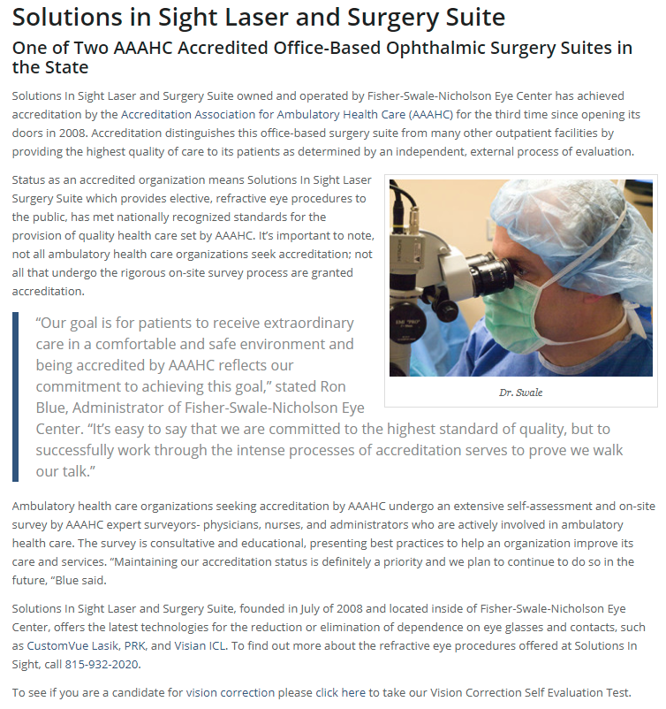
https://fisherswale.com/one-of-two-aaahc-accredited-office-based-ophthalmic-surgery-suites-in-the-state/

Slide 29
Governing Bodies
Joint
Commission on
Accredidation of
Healthcare
Organizations
American
Association for
Ambulatory
Health
Care
American
Association for
Accredidation of
Ambulatory
Surgery
Facilities

Slide 30
Our Services
Complete set-up for an in-office surgery suite
Operational assessments
Efficiency studies
Mock surveys
Policy and Procedure manuals
Accreditation preparation
Quality Assurance
Risk Management
Infection Control
Compliance with Medicare standards
AAAHC, Joint Commission and AAAASF inspections
Credentialing Services
Benchmarking with other facilities
Consultation
Phone conferencing with instruction
Access to billing services

