Slide 2
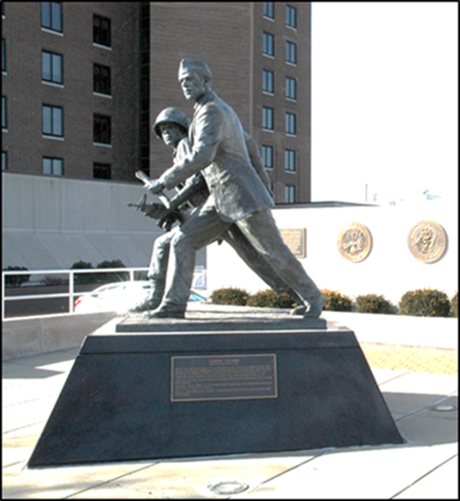
Discussion Topics
Legislative Advocacy
Veterans Service
PACT Act Info
BUT FIRST…
Michael Figlioli
Deputy Director, NVS
mfiglioli@vfw.org

Slide 3
Ice Breaker, Thank You Pennsylvania!
Notes:
What do you call a fat penguin?
What does a penguin do when it loses its tail?- it goes to a re-tail store!!!

Slide 4
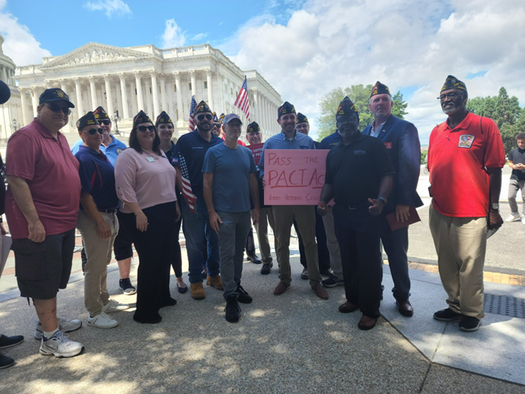
The Importance of Legislative Advocacy
Impacts every veteran and family member
Veterans Preference
GI Bill
Toxic Exposures
Veterans benefits don’t just happen
Stronger and better advocates together
Protect what we have secured
Elimination of IU after reaching retirement age
Round down of cost-of-living adjustment

Slide 5
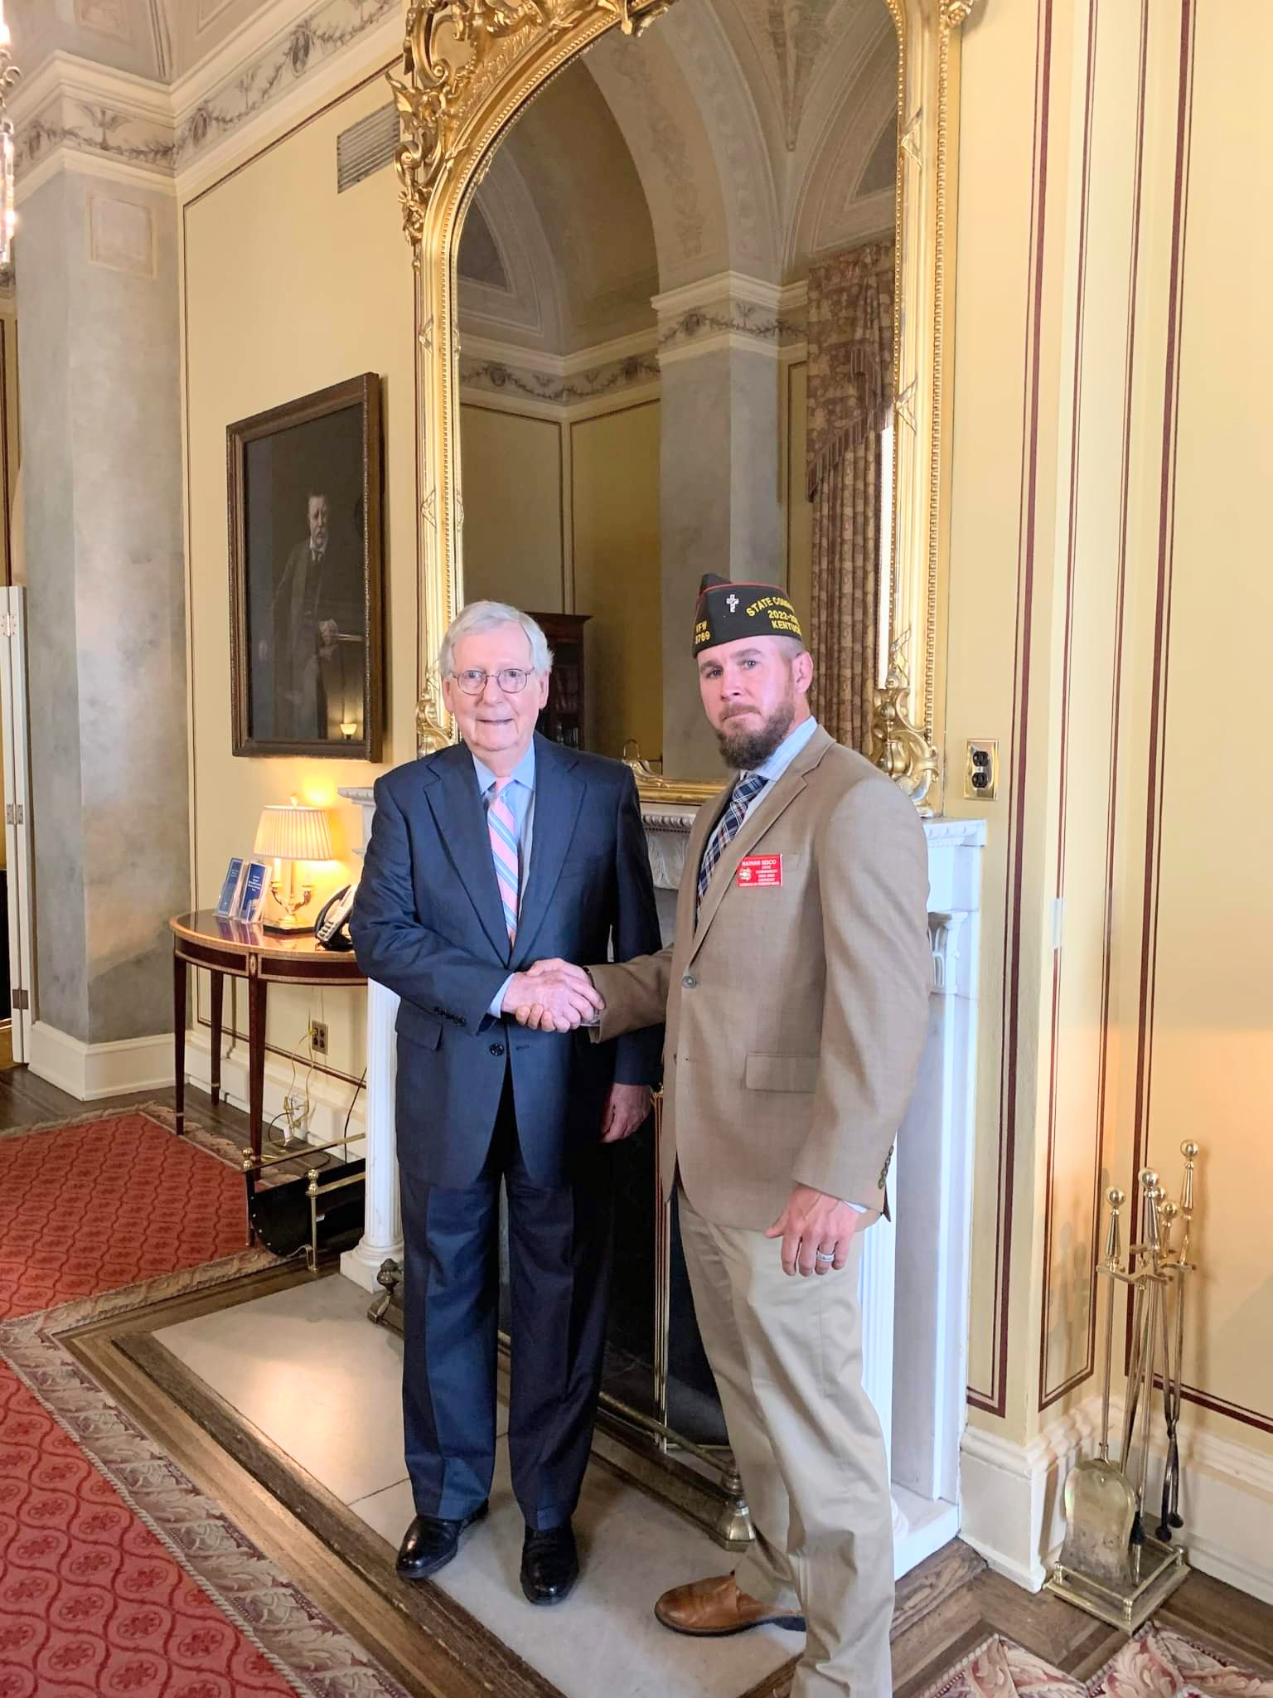
Make Legislative Advocacy a Priority
All politics is local!
Members of Congress will turn to you
Share your experience, but know the VFW’s stance
Campaign Season
Get Out the Vote
Work with your Legislative Committee Members
Requirement for All-American
Legislative Award
Notes:
Know the members of Congress and US Senators from your state. Use your status and access to garner support for the VFW’s legislative priorities.
Election:
DO’s
Do attend candidate Town Hall Meetings and other events and push our issues.
Do set up voter registration drives /Get Out the Vote Campaigns on the local level.
Do provide carpool service on Election Day to help the elderly and disabled get to the voting booth.
Do support and work for your favorite candidates as a voting constituent. As an individual and VFW member you can work or campaign on behalf of your favorite candidate - and are encouraged to do so. • Do wear your VFW cap.
DON’Ts
Don’t endorse candidates on behalf of the VFW as a Post, District, Department or National Leader.

Slide 6
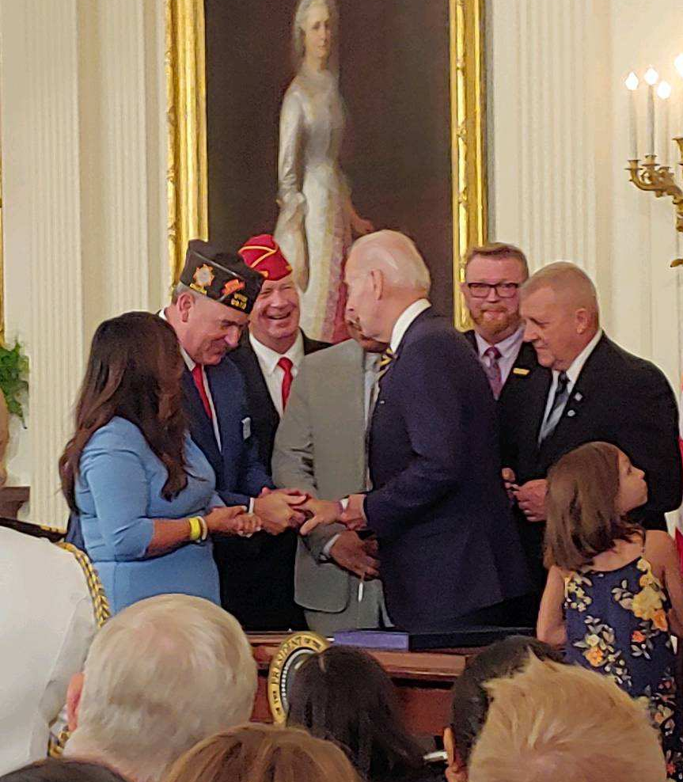
Recent Victories
Honoring our PACT Act
Global War on Terrorism Memorial Location Act – FY22 NDAA
S. 2102, Dr. Kat Hendricks Thomas SERVICE Act & S. 2533, Making Advances in Mammography and Medical Options for Veterans Act – Public Law
GI Bill protections
Renewing Automobile Grants

Slide 7
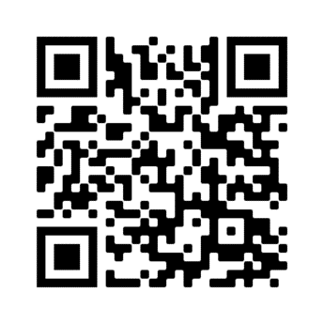
Join Action Corps
Weekly e-newsletter and Action Alerts
Be informed and involved
Take action and make a difference
Your engagement with your members of Congress is crucial in helping us get vital pieces of veterans legislation passed into law
Three ways to sign up
Visit www.vfw.org/JoinActionCorps
Text “VFW” to 50457
Scan the QR Code
Notes:
Identify and support the next generation of VFW leaders.
Involve younger members in legislative advocacy.
Provide a semester-long curriculum to receive academic credit at both the undergraduate and graduate level.
Foster collaboration between VFW and student veterans at the local and national levels.

Slide 8
Take Action
IMPORTANCE OF ACTION CORPS
RECENT ACTION ALERTS
Demand the PACT Act Passes
343,448 received / 6,844 took action
Eliminate Unjust Offset for Chapter 61 Retirees
337,372 received / 8,959 took action

Slide 9
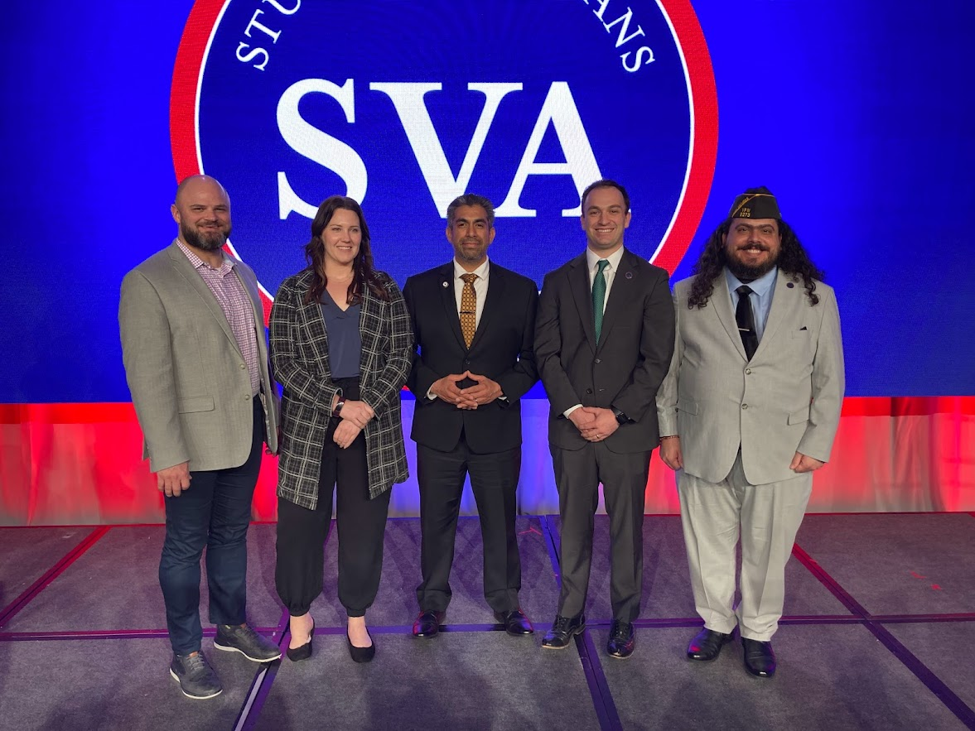
Student Fellowship
Selection Criteria
To Apply: VFW member or eligible for VFW membership (Must be a member once accepted)
Enrolled in an accredited institution of higher learning
Submission of an essay proposal addressing a key veterans’ policy issue
We need your help to recruit
Application period is open
www.vfw.org/studentfellowship
Notes:
Identify and support the next generation of VFW leaders.
Involve younger members in legislative advocacy.
Provide a semester-long curriculum to receive academic credit at both the undergraduate and graduate level.
Foster collaboration between VFW and student veterans at the local and national levels.

Slide 10
Current Priority Goals
Protect Veterans’ Benefits from Claim Sharks
Leverage VSOs to Improve Military Transition
Address Veteran Suicide Through Early Intervention
Full Concurrent Receipt for Medical and Longevity Retirees
Improve Military Quality of Life
Protect Veterans’ Health Care
Many more…

Slide 11
Notes:
Legislative Committee can get these from NLS and also downloadable from the VFW website

Slide 12
Political Activities
DO’s
Attend candidate town hall meetings and other events to ask candidates where they stand on our issues
Set up voter registration drives / Get Out the Vote campaigns on the local level
Provide carpool service on Election Day to help the elderly and disabled get to the voting booths
Support and work for your favorite candidates as an individual voting constituent
Wear your VFW cap at public events such as town halls, rallies, forums, or debates

Slide 13
Political Activities
DON’Ts
Don’t endorse candidates on behalf of the VFW National Organization, Department, District or Post
Don’t wear your VFW cap when actively campaigning for a candidate, such as soliciting donations or knocking on doors asking people to pledge their vote for a candidate

Slide 15
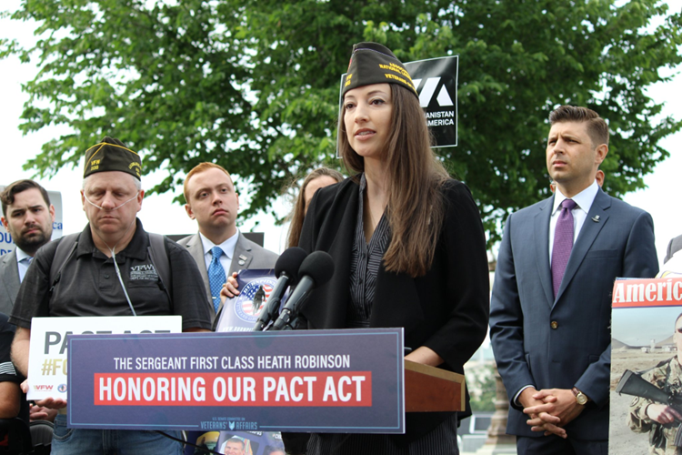
We’re Here to Help
www.vfw.org/advocacy
Talking points & priority goals
Congressional testimony
Action Corps
Read the weekly
Take Action
Sign up advocates
Do’s and Don’ts
More to come…

Slide 16
National Veterans Service:
Help veterans access earned benefits:
Accredit and train VFW’s global network of service officers
Provide direct assistance to separating service members and VFW client appeals
Provide referral and casework services
Work with federal agencies to ensure proper administration of veterans’ benefit programs
Manage VFW’s national network of volunteers at VA hospitals (VAVS)

Slide 17
Structure:
National Certifying Authority:
Director, National Veterans Service
National Veterans Service Advisory Committee amends and approves NVS Policy & Procedure:
Available on: www.vfw.org/NVS
National Veterans Service conducts required training for all accredited VFW representatives:
In-person training conferences
Quality Assurance site visits
Online training
National VFW Provides Restricted Grants to assist in funding service offices

Slide 18
Structure:
Department Commander appoints the Department Service Officer.
Departments employ support staff:
Usually managed by Adjutant/Quartermaster
Rules usually established by Department Service Committee
Departments prepare and submit all accreditation paperwork to NVS
Departments decide whether or not to cross-accredit State or County employees with VFW
*We’ll discuss District/Post Service Officers later…

Slide 19
Who We Are:
VFW Service Officers are…
…the best PROFESSIONAL, Trained, Accredited Advocates in the nation.
Professional: Our policy is that accredited reps must be employees of the VFW or state/county
Trained: Require up to 80 hours of classroom training, online training, and VA-required training each year
Accredited: VA Office of the General Counsel acknowledges our reps to prepare and prosecute claims before VA
Advocates: We help veterans achieve the highest rating allowable under the law.

Slide 20
Post Service Officers:
Posts & Districts are authorized to appoint Service Officers.
These officers are charged with assisting veterans locally in understanding and navigating benefits available to them.
These officers are NOT accredited and must not represent themselves as such.
MOP Sec. 218 (12) Service Officer: The work of a Service Officer shall be performed in accordance with the instructions contained in the VFW Guide for Service Officers under the general supervision of the Department Service Officer.
*Similar rules apply to District Service Officers.
MOP Sec. 518 (11) Service Officer. [Department Service Officer] work shall be performed in accordance with policies established by the National Veterans Service Advisory Committee.

Slide 21
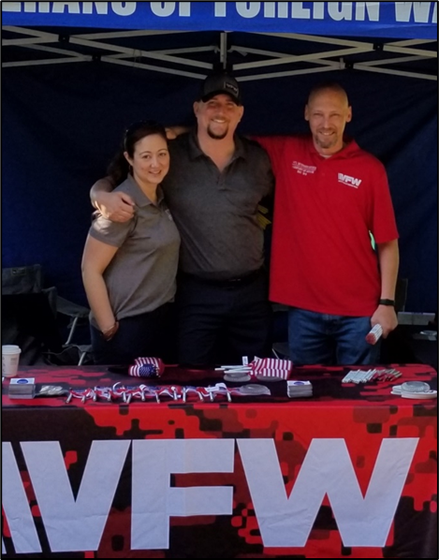
Post Service Officers:
NVS Policy & Procedure:
Requires the DSO to host/attend PSO training
Post Service Officers will not be provided information by a DSO without the express written consent of a claimant.
PSOs will not take possession of any form, record, application or evidence from a claimant.
Explicitly states that a PSO cannot retain any PII from a claimant.

Slide 22
Post Service Officers:
What does this mean???
Post/District Service Officers give general information on benefits, provide referral, serve as “scribe.”
Cannot represent veterans because they are not accredited.
Must not retain ANY records for the veterans they assist, as this is a violation of VFW policy and a violation of the veteran’s privacy.
Violating these policies can expose the Post/Department to potential liability for misfiled claims.
Post/District Service Officers CAN be critical to outreach to identify veterans in need of assistance.

Slide 23
Success Stories:
“Why Choose VFW?”
More than $11.2 billion in benefits in FY2022*
2,000+ advocates accredited worldwide
80 hours of training for service officers every year
More likely to WIN appeals at BVA
FREE services for ALL clients
Represented veterans get more benefits**
*According to VA Power of Attorney Summary for FY2022
**According to VA Office of the Inspector General

Slide 24
Your Role:
“VFW Accredited Service Officers lead the way”
Tell Veterans and their families to:
Never file a VA claim without accredited representation.
VFW’s Accredited Service Officers are the “go-to” people for all veterans’ benefits to include VA claims and VA health care issues.
All Service Officers should be your best recruiters.
Refer Folks to VFW DSOs for VA Assistance!
Learn More: www.vfw.org/NVS

Slide 25
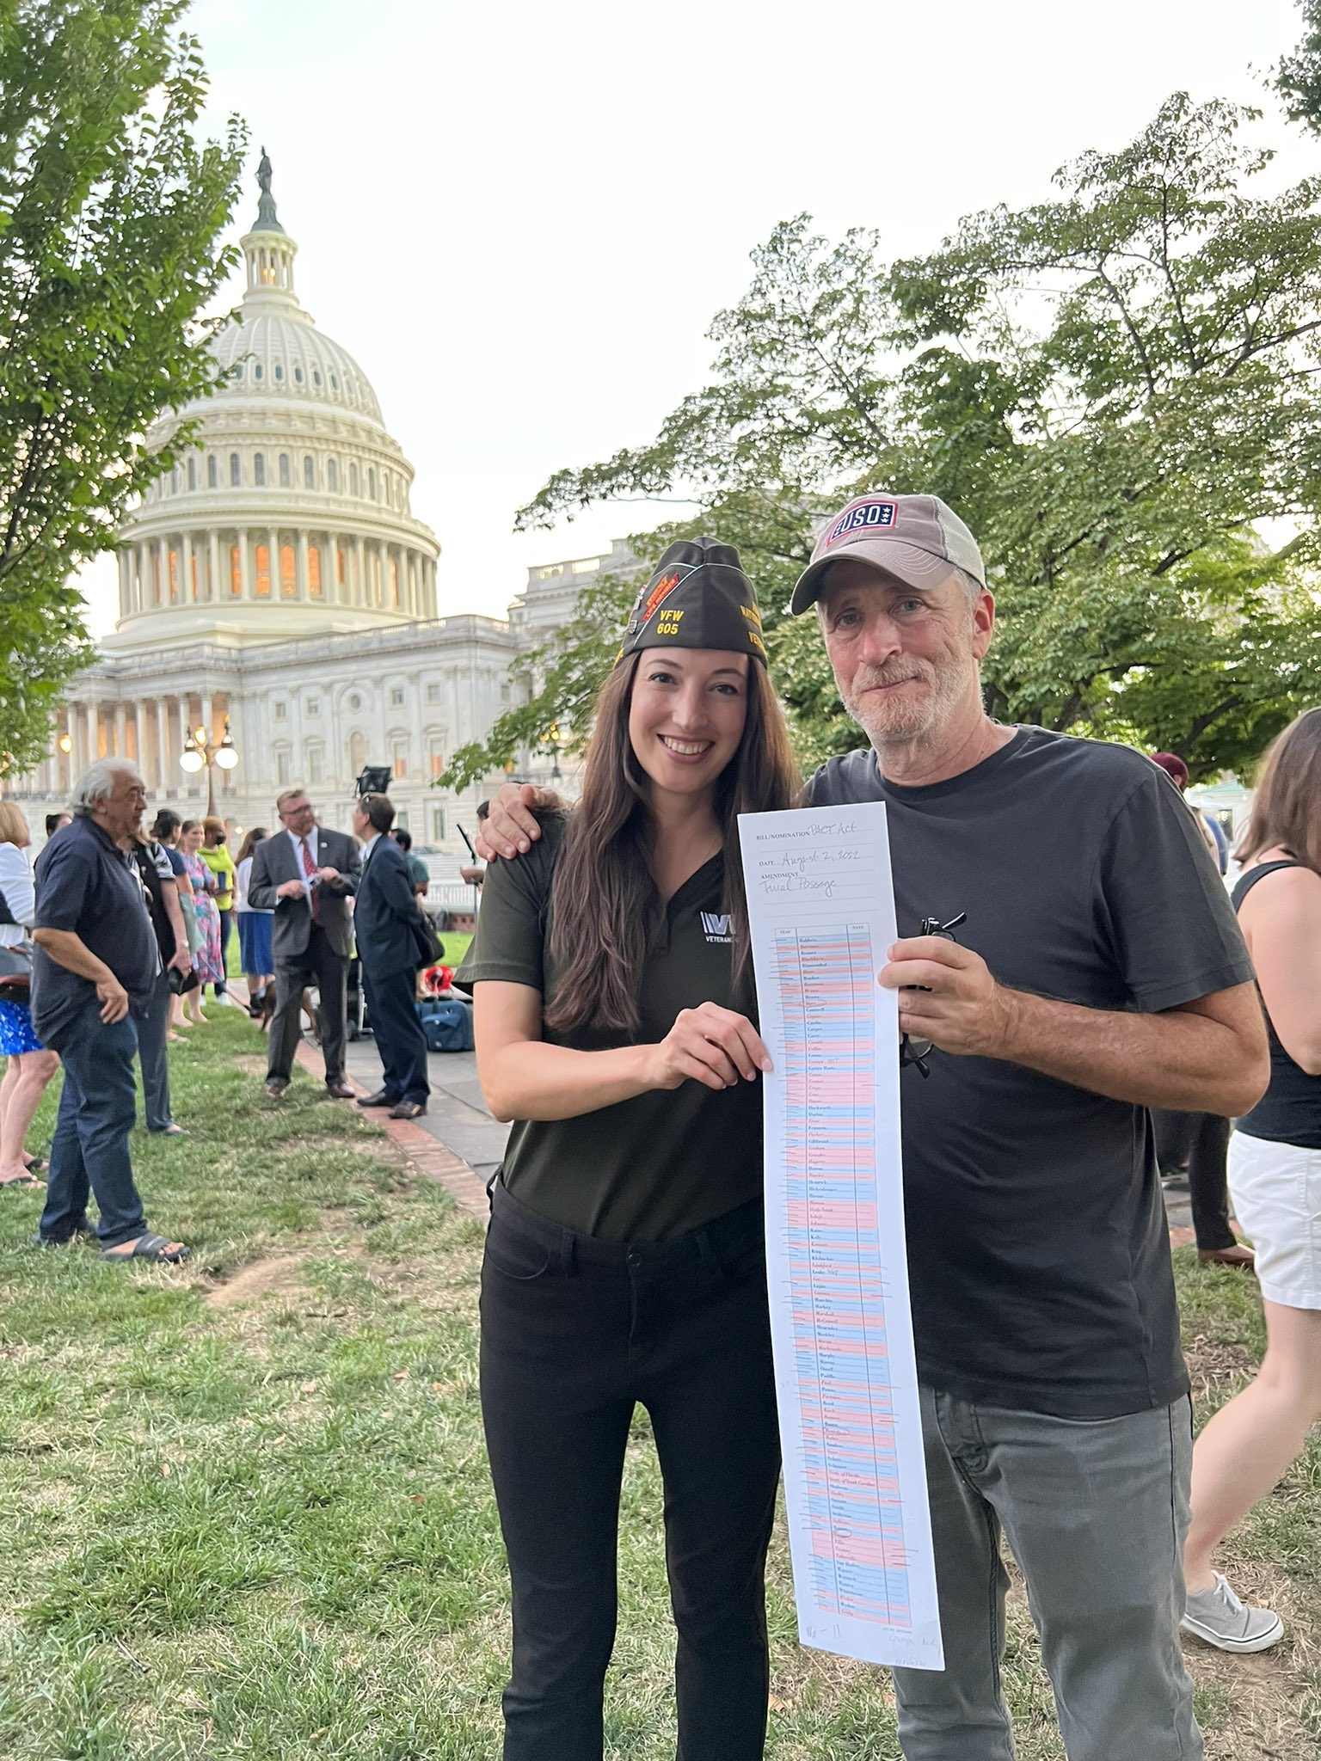
VFW’s Role in The PACT Act
Since the inception of the PACT Act, VFW’s National Legislative Service has been working with lawmakers to bring about Toxic Exposure Reform.
VFW deployed multiple “Take Action” campaigns through the VFW Action Corps to urge Americans to contact their senators and tell them to vote YES to the PACT Act.
The Call to Action reached American Personality Jon Stewart who played an instrumental role in assisting with getting the PACT Act passed.

Slide 26
The Sergeant First Class Heath Robinson Honoring our Promise to Address Comprehensive Toxics (PACT) Act
The Sergeant First Class Heath Robinson Honoring our Promise to Address Comprehensive Toxics (PACT) Act commonly referred to as “The PACT Act”
The new law is named for former Sgt. First Class Heath Robinson who died in 2020 after battling lung cancer for three years. Robinson’s illness was attributed to smoke exposure from burning trash pits during his deployment to Iraq in 2006 and 2007.
This law that expands VA benefits and health care to veterans exposed to burn pits and other toxic substances. This law provides generations of veterans and their survivors with the care and benefits they’ve earned and deserve.

Slide 27
The PACT Act and When to File for VA Benefits
VA is accepting claims NOW for service connection for the new presumptive conditions outlined in PACT ACT.
If a veteran applies for one of the presumptive conditions and VA grants service connection, the effective date of the claim may be retroactive to August 10, 2022, the date the law went into effect, if the claim or Intent to File was filed within 1 year of the law’s passing.
VA started rating claims on January 1, 2023
Notes:
This is not “liberalizing” like NEHMER or others. There is no earlier effective date for previously filed claims.
We were recently notified

Slide 28
PACT Act Eligibility Key Dates
August 10, 2022: PACT Act signed into law.
October 1, 2022: Veterans who served in the Republic of Vietnam, Thailand, Laos, certain provinces in Cambodia, Guam, or American Samoa (or their territorial waters), or the Johnston Atoll (or a ship that called there) during specific time periods may enroll in VA health care.
October 1, 2022 - October 1, 2023: Veterans who served on active duty in a theater of combat operations during a period of war after the Persian Gulf War or in combat against a hostile force during a period of hostilities after 11/11/98, and who were discharged or released between 9/11/01–10/1/13 may enroll in VA health care.
November 8, 2022: Toxic Exposure Screening starts for enrolled veterans.

Slide 29
The PACT Act and VA Health Care
Additional ways the PACT Act expands VA Health care include:
The Act expands and extends eligibility for VA health care for veterans with toxic-exposures and veterans of the Vietnam era, Gulf War era, and Post-9/11 era.
VA will improve the decision-making process for determining what medical conditions will be considered for presumptive status.
Every enrolled veteran in VHA will receive an initial toxic exposure screening and a follow-up screening every five years. Veterans who are not enrolled, but who are eligible to enroll, will have an opportunity to enroll and receive the screening.
Notes:
Expands locations associated with radiation exposure
Expands presumptive conditions and locations associated with herbicide exposure
Amends the statute involving Persian Gulf veterans (neutral zone)
Establishes presumptive conditions associated with TOXIC exposures
Provides an avenue for reevaluation of previously denied DIC claims that MAY be retroactive

Slide 30
The PACT Act and VA Health Care
VA health care staff and claims processors will receive toxic exposure-related education and training.
The Act requires research studies on the mortality of veterans who served in Southwest Asia during the Gulf War, Post-9/11 veteran health trends, and veteran cancer rates.
The Act authorizes 31 new medical facilities across the country, providing greater access to VA health care.
Notes:
This is in lieu of the now defunct AIR Commission

Slide 31
The PACT Act and VA Health Care Enhanced Enrollment
The PACT Act brought some changes to VHA enhanced enrollment, most notably:
Enhanced Enrollment Eligibility for VA Healthcare for new veterans has been extended from 5 years to 10 years
Open Enhanced Enrollment begins October 1, 2022, through October 1, 2023
*Special note: Enhanced Enrollment is Priority Group 6 within VHA.
Notes:
Enhanced enrollment at PG6 – veterans who served in a theater of operation are now granted 10 years of healthcare immediately following discharge unless they meet the criteria for a higher priority group.

Slide 32
The PACT Act and VA Health Care
Eligibility for Enhanced Enrollment has been made for veterans who served in any of the following capacities:
On or after August 2, 1990: Iraq, Kuwait, Bahrain, Oman, Qatar, Saudi Arabia, Somalia (new), or U.A.E.
On or after September 11, 2001: Afghanistan, Djibouti, Egypt (new), Jordan (new), Lebanon (new), Syria, Yemen (new), or Uzbekistan,
Any risk of exposure recorded in an exposure record tracking system, including ILER,
Operations Iraqi Freedom, Enduring Freedom, New Dawn, Freedom’s Sentinel, Inherent Resolve, or Resolute Support Mission,
Any other location the VA Secretary determines is appropriate
Notes:
ILER - Individual Longitudinal Exposure Record: An individual, electronic record of exposures for each service member.
ILER will contain:
Time of deployments
Locations and events during deployments
All-hazard occupational data
Environmental hazards that were known or found later
Any monitoring performed in the area(s)
Medical encounter information (e.g., diagnosis, treatment, and laboratory data)
Medical concerns that should be addressed regarding possible exposures
ILER will be available to VA and DoD healthcare providers; epidemiologists and researchers; and VA disability evaluation and benefits determinations specialists. It will be used to improve internal processes and will not be available for individual access.

Slide 33
The PACT Act and VA Presumptive Benefits
The PACT Act has added more than 20 new presumptive conditions that veterans can file for if they meet the requirements.
What is “Presumptive” Service Connection?
VA presumes that certain disabilities were caused by military service. This is because of the unique circumstances of a specific veteran’s military service.
If a presumed condition is diagnosed in a Veteran within a certain group, they can be awarded disability compensation.

Slide 34
The PACT Act Presumptive Areas
The PACT Act determined that veterans who served in any of the below locations on or after August 2, 1990 had exposure to burn pits or other toxins. We call this having a presumption of exposure.
Bahrain Iraq Kuwait
Oman Qatar Saudi Arabia
Somalia The United Arab Emirates (UAE)
**Includes the airspace above any of these locations

Slide 35
The PACT Act Presumptive Areas
The PACT Act determined that veterans who served in any of the below locations on or after September 11, 2001 had exposure to burn pits or other toxins. We call this having a presumption of exposure.
Afghanistan Djibouti Egypt
Jordan Lebanon Syria
Uzbekistan Yemen
**Includes the airspace above any of these locations

Slide 36
The PACT Act Presumptive conditions for Gulf War and Post 9/11 Veterans
Brain Cancer | Chronic Rhinitis
Glioblastoma | Chronic Sinusitis
Respiratory (Breathing-related) cancer of any type | Constrictive bronchiolitis
Gastrointestinal cancer of any type | Obliterative Bronchiolitis
Head cancer of any type | Emphysema
Lymphoma of any type | Granulomatous disease
Lymphatic cancer of any type | Interstitial lung disease (ILD)
Neck cancer | Pleuritis
Pancreatic Cancer | Pulmonary Fibrosis
Reproductive cancer of any type | Sarcoidosis
Kidney Cancer | Chronic Bronchitis
Melanoma | Chronic Obstructive Pulmonary Disease (COPD)
Asthma (Diagnosed after service)

Slide 37
The PACT Act Presumptive conditions for Vietnam Veterans and those exposed to Tactical Herbicides
For Vietnam veterans and other veterans exposed to tactical herbicides, the PACT Act includes two Agent Orange presumptive conditions:
Monoclonal gammopathy of undetermined significance (MGUS)
High blood pressure (hypertension).
Notes:
Any conceded exposure to herbicides will qualify for this. Including Vietnam, Korean DMZ, C-123 aircraft, etc.
Vietnam: January 9, 1962, through May 7, 1975
Thailand: January 9, 1962, through June 30, 1976
Guam or American Samoa: January 9, 1962, through July 30, 1980
Laos: December 1, 1965, through September 30, 1969
Cambodia at Mimot or Krek, Kampong Cham Province: April 16, 1969, through April 30, 1969
Korean DMZ: Sept. 1, 1967, through August 31, 1971.

Slide 38
The PACT Act and When to File for VA Benefits
VA is accepting claims NOW for service connection for the new presumptive conditions outlined in PACT ACT.
If a veteran applies for one of the presumptive conditions and VA grants service connection, the effective date of the claim may be retroactive to August 10, 2022, the date the law went into effect, if the claim or Intent to File was filed within 1 year of the law’s passing.
Notes:
This is not “liberalizing” like NEHMER or others. There is no earlier effective date for previously filed claims.

Slide 39
Appealing Previously Denied Claims Under the PACT Act
If a veteran was previously denied service connection for one of the new presumptive conditions, they can appeal this decision by submitting two forms:
VA Form 20-0995: Used to request a Supplemental Claim of a VA Rating Decision a veteran disagrees with
VA Form 21-4138: Used as a statement in support of the claim being appealed on the VA Form 20-0995

Slide 40
The PACT Act and Dependency and Indemnity Compensation (DIC)
Dependents wanting to submit a claim for DIC or accrued benefits under the Pact Act must first verify the veteran’s cause of death is due to a presumptive condition.
Things to consider when filing for a DIC Claim:
Make sure the death certificate states the cause of death as one of the new PACT Act Presumptive conditions
Direct and Secondary service-connection can be considered to qualify for DIC/accrued benefits
The veteran did not need to file for the condition in the past. Entitlement to benefits can be established for survivors after the veteran’s death.
The application process has not changed to submit a DIC claim
Notes:
If the death certificate does not include this information, the surviving family member will need to request an amended death certificate. VA will NOT develop for this.

Slide 41
The PACT Act Effective Dates
When you filed your PACT Act Claim | Claim Effective Date if Benefits are Granted
Compensation claim filed Within 1 Year of the PACT Act signed (08/10/2022) | August 10, 2022
Compensation claim filed After 1 Year of the PACT Act being signed into Law | The effective date is the date the claim was submitted
Compensation claim was denied prior to the PACT Act being signed and veteran submits an appeal for the previously denied condition. | The effective date will be August 10, 2022, or one year prior to the filing of the appeal, whichever is later.
Dependency Indemnity Compensation (DIC) Claim filed and denied BEFORE the PACT Act was signed | The effective date will be the date the original DIC claim was filed.
Dependency Indemnity Compensation (DIC) Claim filed After the PACT Act was signed | The effective date will be August 10, 2022, or one year prior to the filing of the claim, whichever is later.

Slide 42
The PACT Act Section 804 Camp Lejeune Justice Act
The PACT Act also includes the Camp Lejeune Justice Act of 2022 (CLJA). (Section 804)
This section allows individuals exposed to contaminated water at Camp Lejeune to file lawsuits against the Government.
CLJA Lawsuits will not influence VA’s decision to provide benefits or health care and will not affect the amount of benefits or health care VA can provide.
IMPORTANT: If a veteran or family member is awarded relief by the court in a lawsuit brought under the CLJA, the award must be offset by the amount of any disability award, payment, or benefit VA provided relating to exposure to water at Camp Lejeune. This would reduce the amount of the award veterans or family members receive from the court, but it will not affect their VA benefits.

Slide 43
The PACT Act Section 804 Camp Lejeune Justice Act
In addition to the CLJA award being offset by the amount of any VA disability award, payment, or benefit CLJA Awards are also offset by Medicare or Medicaid benefits.
The U.S. Department of Justice has set up a phone number and email address for questions about the status of cases filed in federal court under the CLJA.
The phone number is (202) 353-4426, and the email is camplejeune.pactact@usdoj.gov.
Notes:
Veterans that accept settlements MAY need to reimburse VA for care of those disabilities covered under the settlement and future care as well until the cost is reimbursed
Former VFW employee accepted a settlement for a neck injury (sued the county) that he was SC for but because he accepted the settlement, he had to pay VA back for the treatment and also the lawyer fees ($30k)

Slide 45
The PACT Act Section 804 Camp Lejeune Justice Act
Do I need a lawyer??
Yes. If you want to pursue litigation, you will need to consult an attorney.
www.vfw.org/CampLeJeuneHelp
Two firms have met VFW’s standards. Still a “buyer beware” situation.

Slide 46
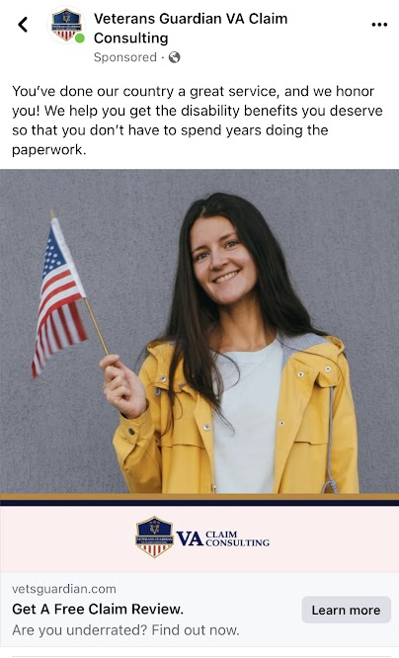

Slide 47
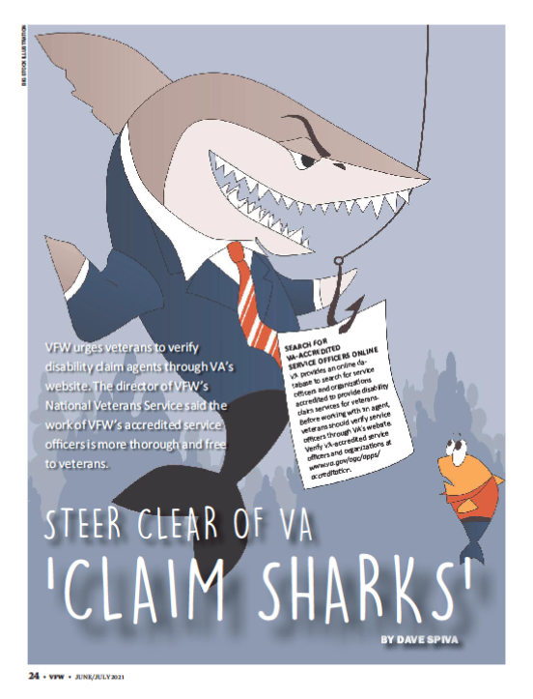
Predatory Claim Sharks are Circling…
A Claim Shark is an individual or company that “assists” or “consults” veterans with VA claims even though they are not accredited with VA
Many of these companies charge fees for their services, sometimes totaling in the tens of thousands of dollars for services that veterans can receive from VFW FOR FREE
These companies have used COVID to their advantage, offering fully remote “assistance” and easy to access “one click away buttons” in order to capitalize on the reduced resources available due to VA closures
Notes:
I learned of a veteran from PR that signed up with one of these predators who enticed him with flashy adds and over-reaching promises. He ended up paying them nearly $50k then his house burned down and he had NOTHING.
Know what you are signing. They cannot get you a claim any faster or more accurately then what the VFW or any other VSO can provide FOR FREE!!!

Slide 48
PACT Act Info Initiative
On Wednesday November 16, 2022, VFW launched www.pactactinfo.org, a website to streamline referrals to our cadre of accredited service officers for VA Disability Claims.
When a veteran visits the site, they can answer a short series of questions to determine if they are potentially eligible for benefits and can also request that an accredited representative contact them to discuss their claim.

Slide 49
PACT Act Info Initiative
When a veteran visits the site, they have three options to choose from:
Check Eligibility for VA Benefits
Learn More About the PACT Act
Join Our Efforts
Notes:
Since the launch of the PACT Act Info Initiative, VFW has received more than 600 referrals from veterans needing help

Slide 50
PACT Act Info Initiative
If a veteran wants to learn more about the PACT Act, they can select “Learn More” and they will be taken to a FAQ page

Slide 51
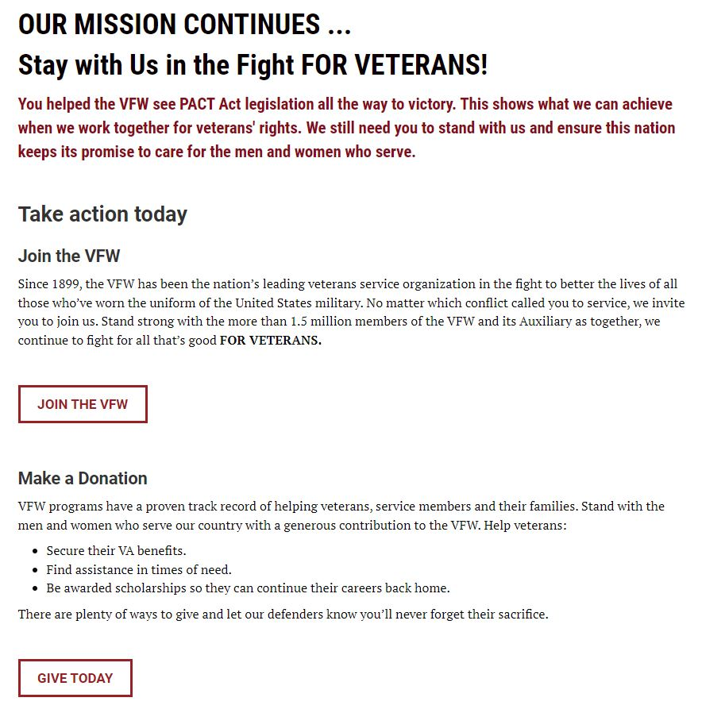
PACT Act Info Initiative
When a veteran selects “Join Our Efforts” they will see this page that offers options to join the VFW or make a donation.

Slide 52
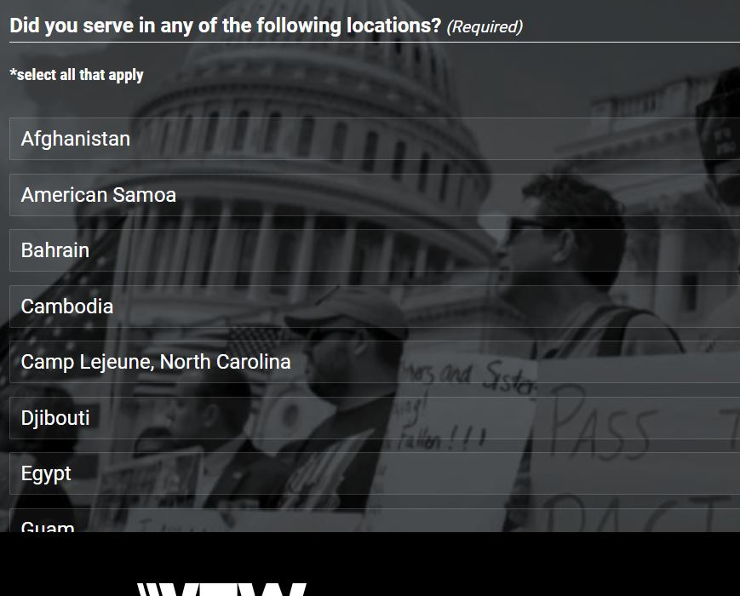
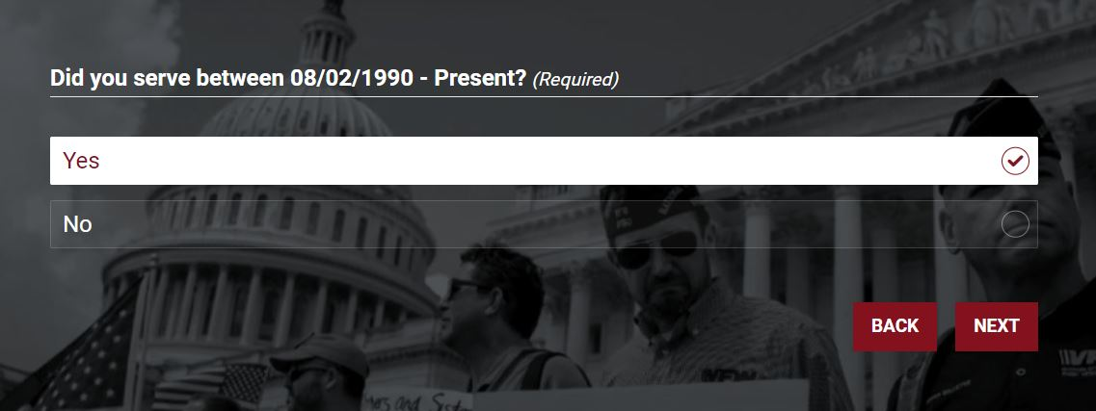
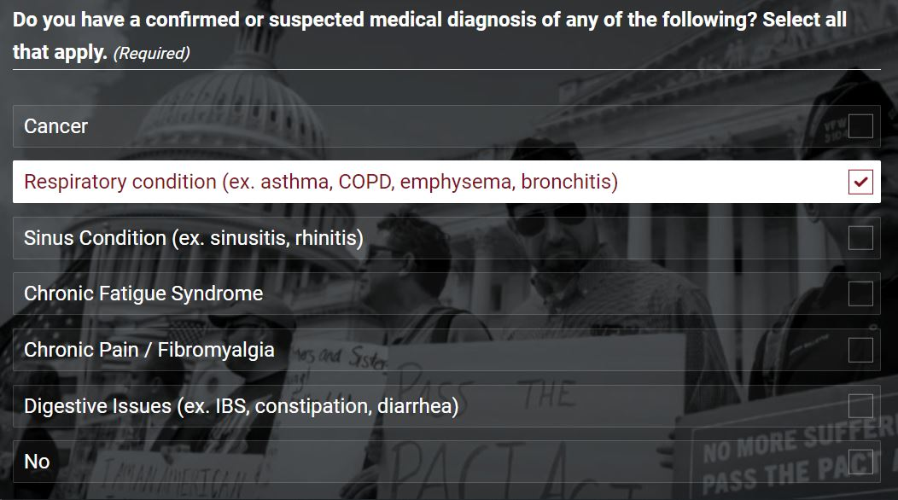
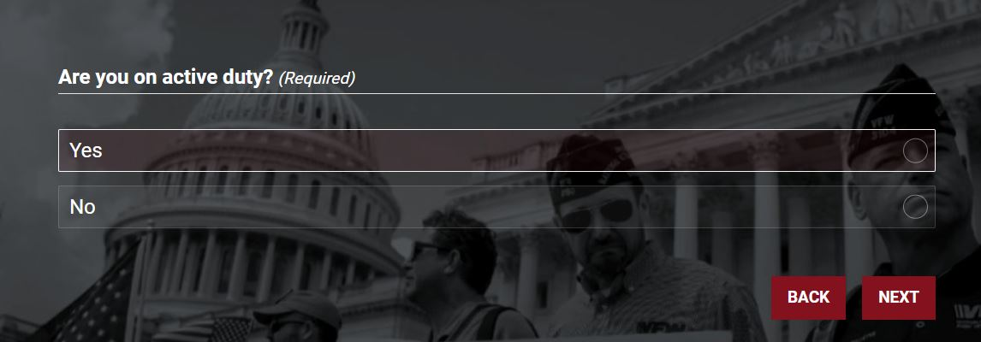
PACT Act Info Initiative – Am I Eligible for Benefits?
If a veteran chooses “Am I eligible for Benefits” they will be taken to a brief survey that asks questions about their military service and medical conditions

Slide 53
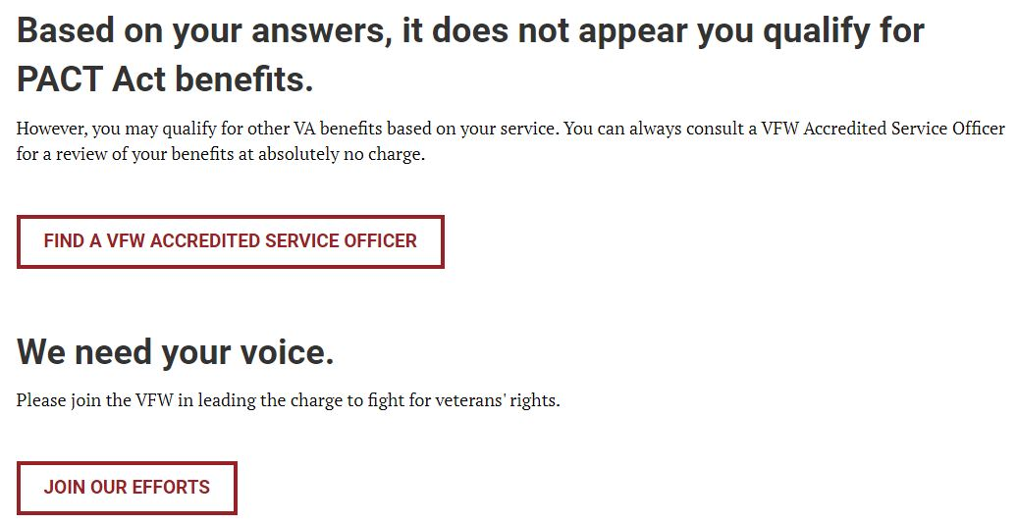
PACT Act Info Initiative – Am I Eligible for Benefits?
When finished with the survey, the veteran will receive one of two messages:
Yes you may be eligible: If the veteran selects yes, they will be asked for their contact information and a referral will be sent to their local VFW service officer via email
You do not appear to qualify: The veteran is given to option to find a local VFW service officer or join the VFW

Slide 54
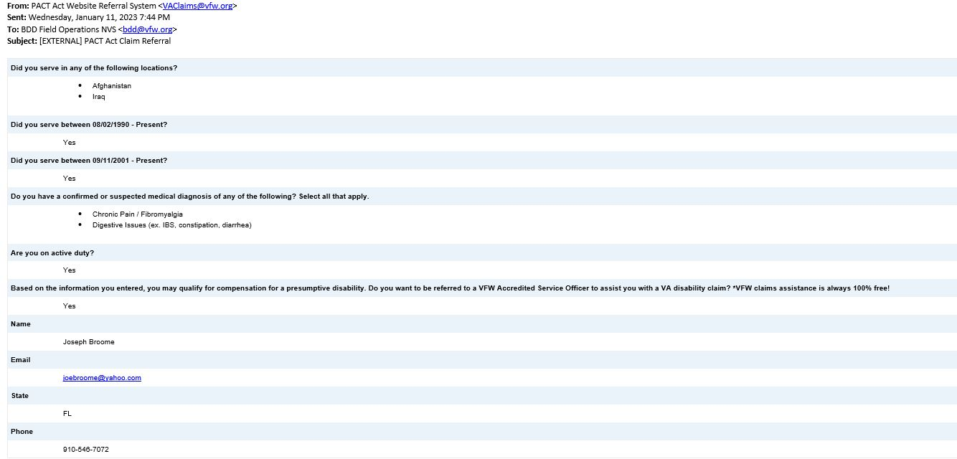
PACT Act Info Initiative – Automatic Referrals
If a veteran requests a referral, it is routed to their local VFW Service Office or the NVS BDD Field Operations Team
Once received the veteran will be contacted within one week by a VFW accredited representative to assist them with their claim for VA benefits
Since the launch of the PACT Act Info Initiative, VFW has received more than 400 referrals from veterans needing help
John Smith
email@email.com
555-555-5555

Slide 55
Assistance with filing a Claim?
If you know of a veteran who has been diagnosed with one of the presumptive conditions listed in this presentation, invite them to visit www.pactactinfo.org to see if they may qualify for benefits.
The VFW has a worldwide network of professionally trained, accredited service officers standing by to assist all veterans obtain the benefits they’ve earned.
To find a local service officer visit: www.vfw.org/nvs

Slide 56
Questions?
Michael Figlioli
Deputy Director, NVS
mfiglioli@vfw.org

