Slide 1
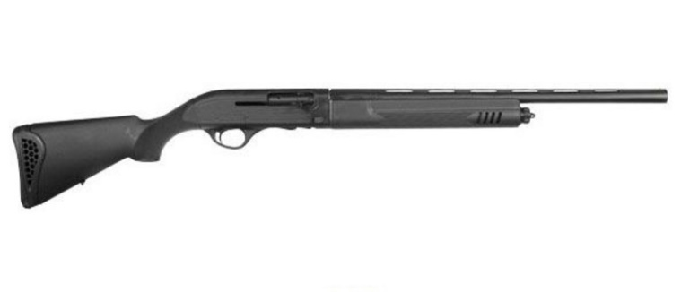
BLOCK SHOOT VFW POST 148 Feb 27/Mar 27/Apr, 2022 LOCATED AT VFW POST 148 5802 UNION DEPOSIT ROAD HARRISBURG PA 17112 QUESTIONS CALL 717-652-4094/717-554-7075
DOORS OPEN AT 11:00 SHOOTING STARTS AT 12:00 FACTORY GUNS ONLY UP TO 30 IN BARRELS
FOOD AND ADDITIONAL PRIZES AVAILABLE

