Slide 2
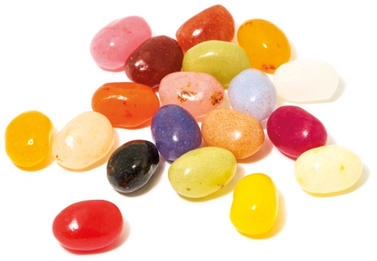
Power of One

Slide 4
Unwritten Rules
You scratch my back, I’ll…
You step on me, and I’ll…
You hurt me, and I’ll…
Don’t get mad, get…
It’s all about…

Slide 5
Unwritten Rules
You scratch my back, I’ll…
scratch yours.
You step on me, and I’ll…
step on you.
You hurt me, and I’ll…
hurt you.
Don’t get mad, get…
even.
one.
It’s all about…

Slide 7
Light or Darkness
Flashlight Dramas

Slide 9
Plant – Grow - Harvest

Slide 11
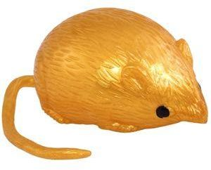
Game
Light
Darkness
&

Slide 14
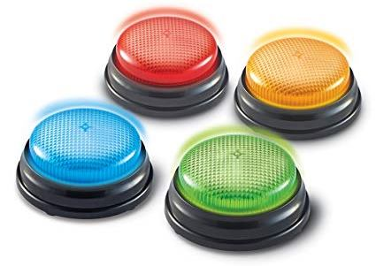
Game
Buzzer
Review

Slide 16
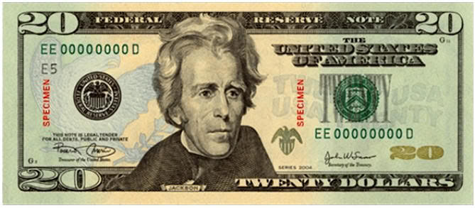
We All Have the Same Value

Slide 17
True Value
Our TRUE VALUE never changes!
Sense of Value
What I feel about myself.
What I think about myself.
What I believe to be true about myself.

Slide 19
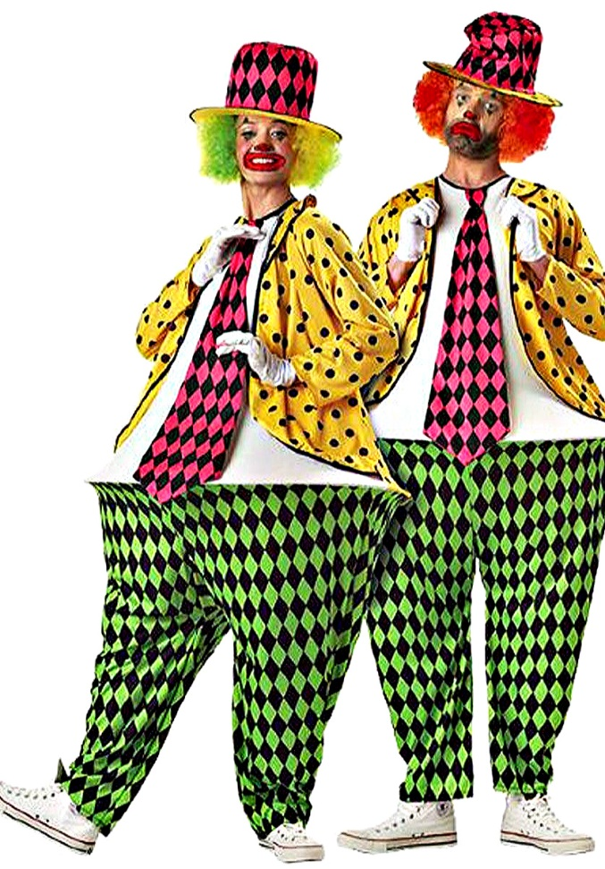
Hula-Hoop
Pants
Game

Slide 20
You Are Special Max Lucado & Sergio Martinez

Slide 21
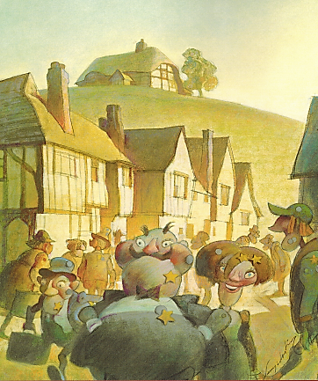
You Are Special – Max Lucado – Sergio Martinez

Slide 22
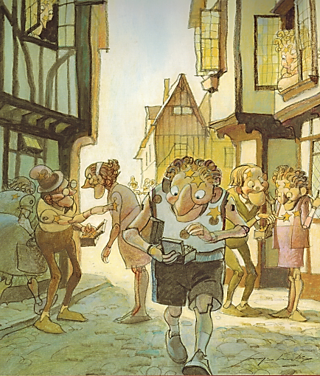
You Are Special – Max Lucado – Sergio Martinez

Slide 23
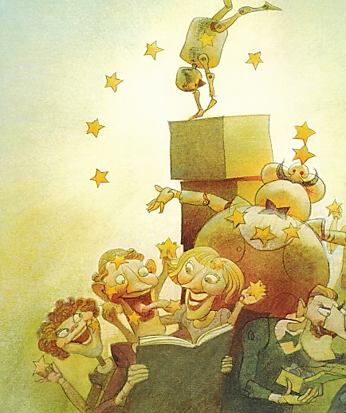
You Are Special – Max Lucado – Sergio Martinez

Slide 24
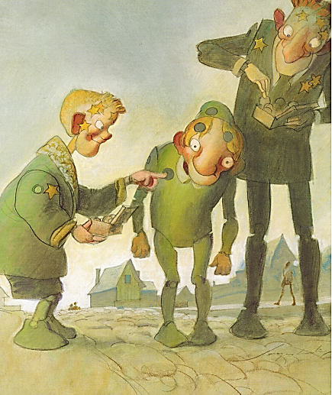
You Are Special – Max Lucado – Sergio Martinez

Slide 25
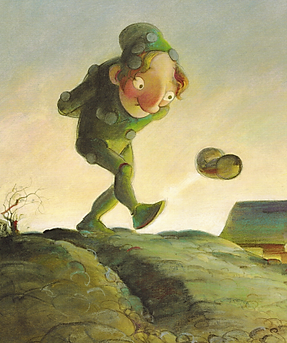
You Are Special – Max Lucado – Sergio Martinez

Slide 26
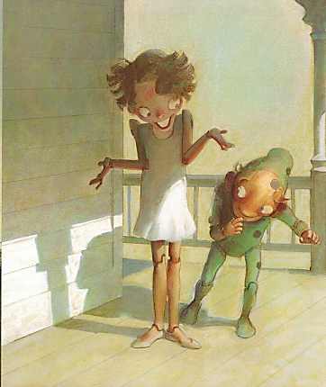
You Are Special – Max Lucado – Sergio Martinez

Slide 27
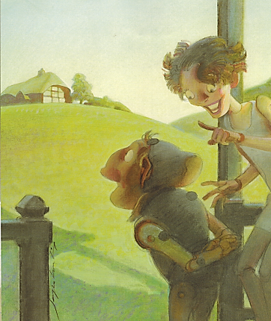
You Are Special – Max Lucado – Sergio Martinez

Slide 28
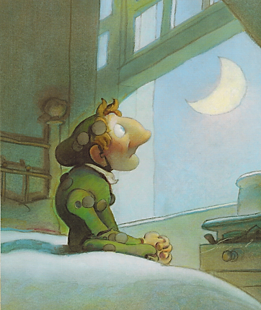
You Are Special – Max Lucado – Sergio Martinez

Slide 29
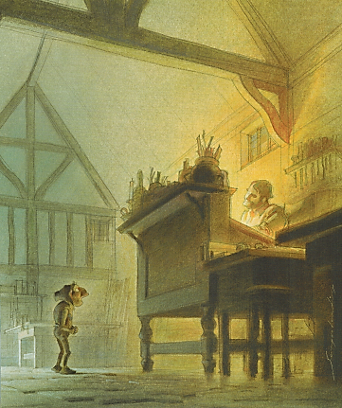
You Are Special – Max Lucado – Sergio Martinez

Slide 30
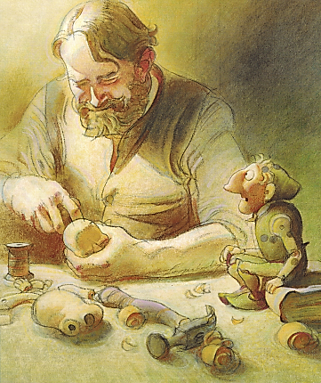
You Are Special – Max Lucado – Sergio Martinez

Slide 31
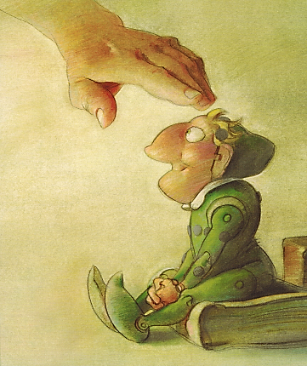
You Are Special – Max Lucado – Sergio Martinez

Slide 32
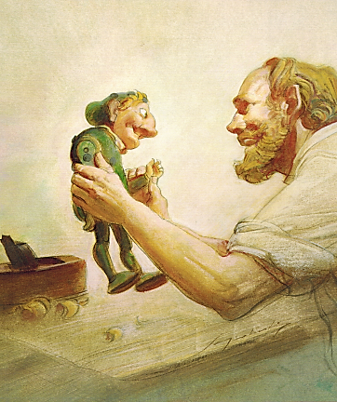
You Are Special – Max Lucado – Sergio Martinez

Slide 33
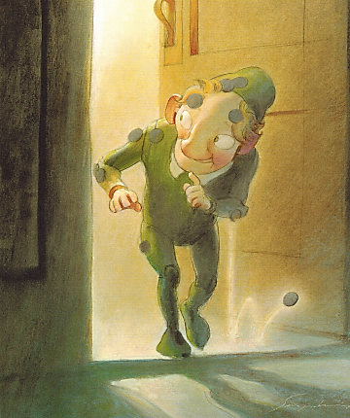
You Are Special – Max Lucado – Sergio Martinez

Slide 34
You Are Special
Max Lucado &
Sergio Martinez

Slide 36
False Labels
Removing

Slide 38
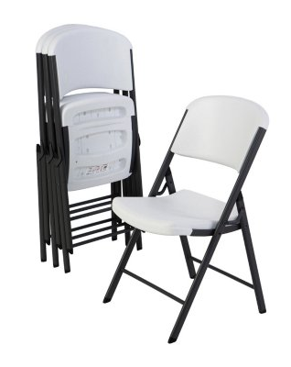
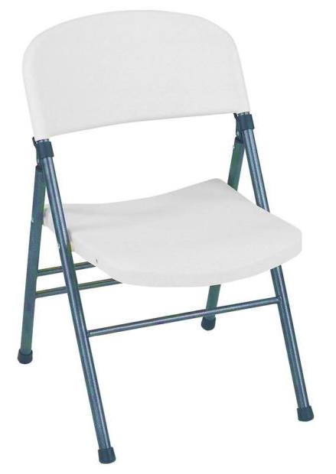
Value Seat
Speaking Truth:

Slide 40
Game
Buzzer
Review

Slide 43
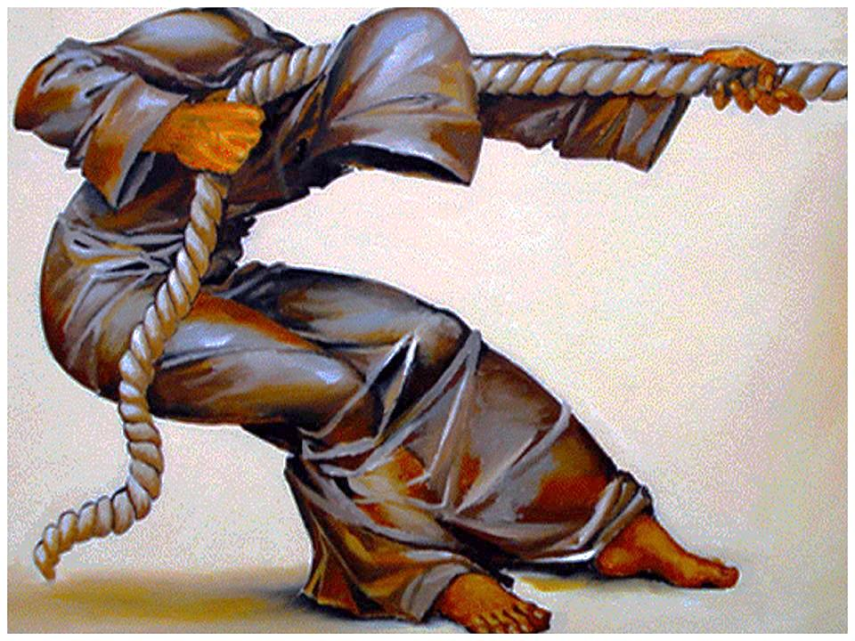
You Have a Purpose:
Dreams & Destiny

Slide 44
True Value
Our TRUE VALUE never changes!
Sense of Value
What I feel about myself.
What I think about myself.
What I believe to be true about myself.

Slide 45
Value Seat
Speaking Truth:

Slide 47
What happened when one student chose to bring Light to his school?
“The Doorman”

Slide 49
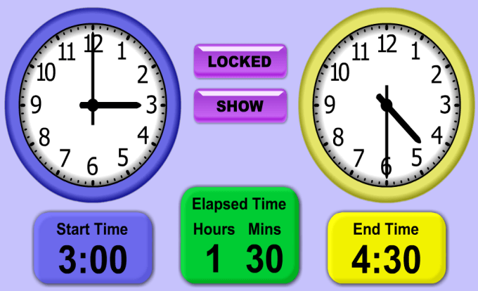
Game: TIME

Slide 50
Ways to Bring Light to BCA
Goal-setting:

Slide 52
You are a World Changer!

