Slide 6
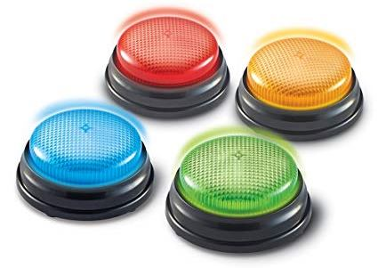
Game
Buzzer
Review

Slide 7
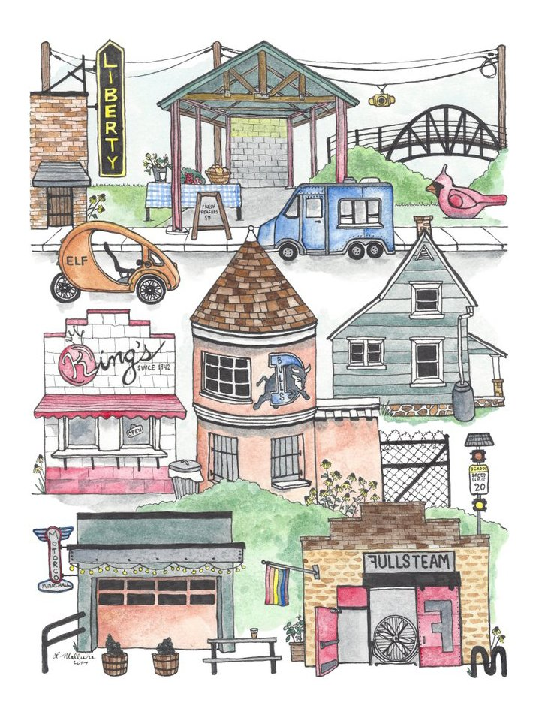

Slide 9
Fruit
Light
darkness
Good
Bad
&
planting good seeds
good choices

Slide 10
Ways to Bring Light to BCA
Goal-setting:
Reading buddies, care packages for homeless, making benches in reading room, study/tutor

Slide 11
Hula-Hoop
Group
Games

Slide 12
Students & Class Power of Teamwork

Slide 14
Game
Buzzer
Review

Slide 15
True Value
Our TRUE VALUE never changes!
Sense of Value
What I feel about myself.
What I think about myself.
What I believe to be true about myself.

Slide 16
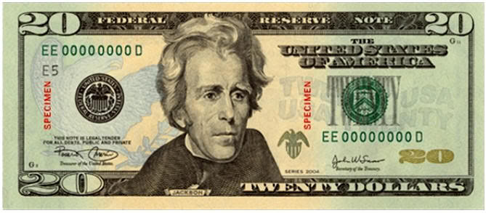
We All Have the Same Value

Slide 18
You Are Special
Max Lucado &
Sergio Martinez

Slide 19
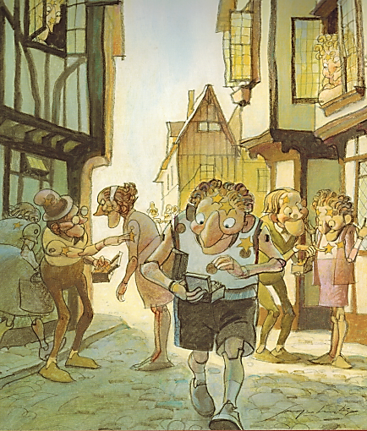
You Are Special – Max Lucado – Sergio Martinez

Slide 20
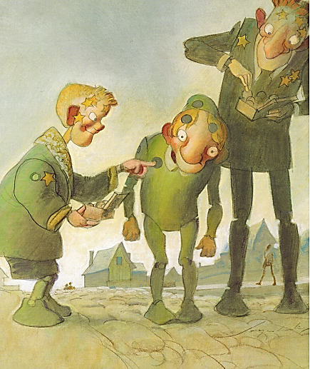
You Are Special – Max Lucado – Sergio Martinez

Slide 21
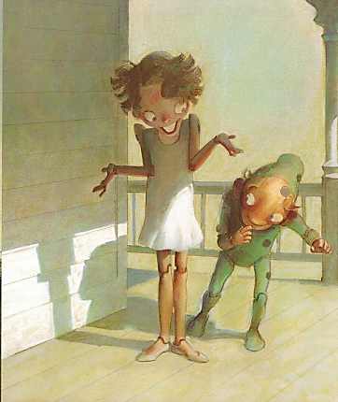
You Are Special – Max Lucado – Sergio Martinez

Slide 22
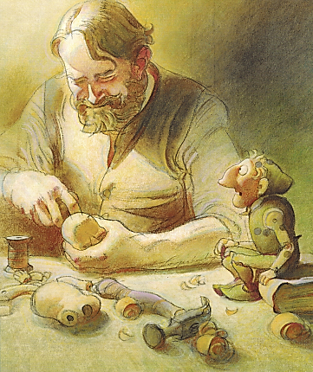
You Are Special – Max Lucado – Sergio Martinez

Slide 23
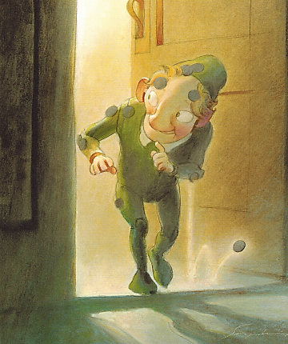
You Are Special – Max Lucado – Sergio Martinez

Slide 24
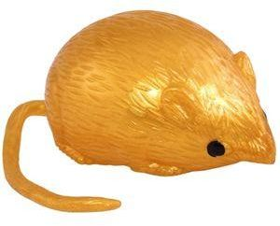
Splat Game
True
False
&
Light
Darkness
&

Slide 25
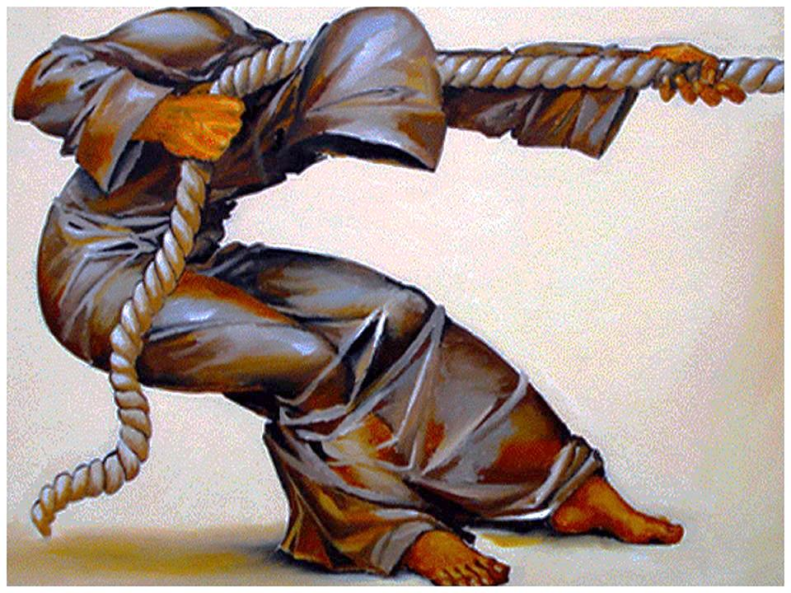
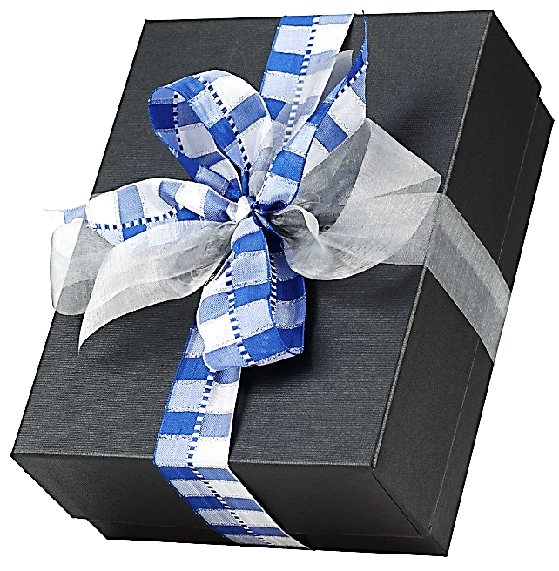
You Have a Purpose:
Dreams & Destiny

Slide 26
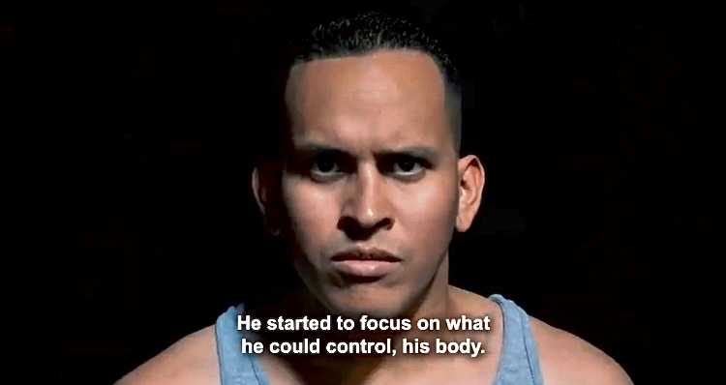
He was a broken and rejected athlete until: Regardless of what we achieve in life, we have to keep striving for our dreams and destiny.

Slide 27
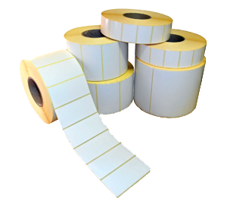
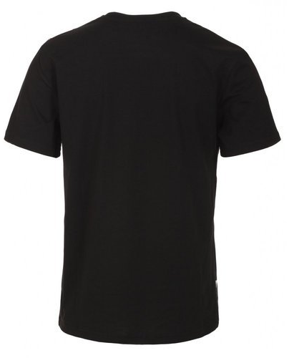
False Labels
Removing

Slide 29
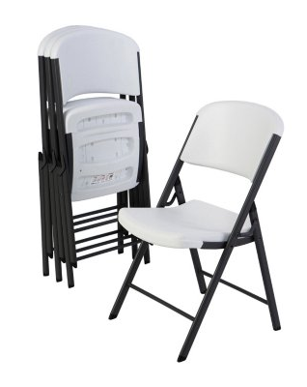
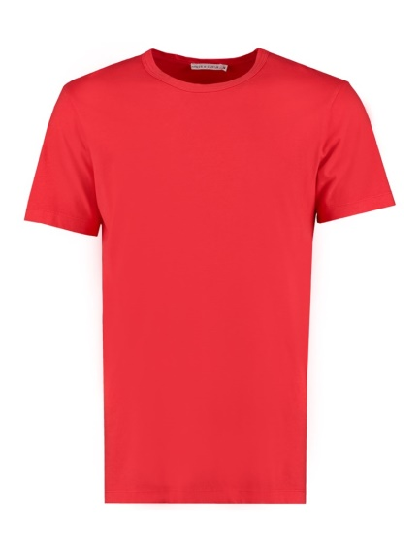
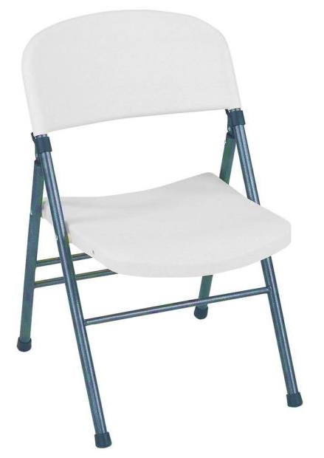
Value Seat
Speaking Truth:

Slide 31
Game
Buzzer
Review

Slide 33
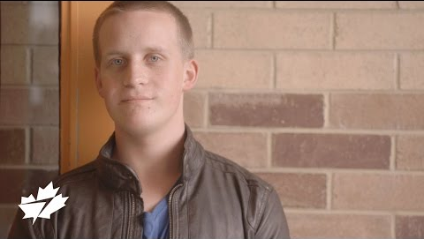
The Doorman:
What students said about impact on their school.

Slide 34
You Have a Purpose:
Dreams & Destiny

Slide 35
Hula-Hoop
Group
Games

Slide 36
Ways to Bring Light to BCA
Goal-setting:
Your class idea…

Slide 37
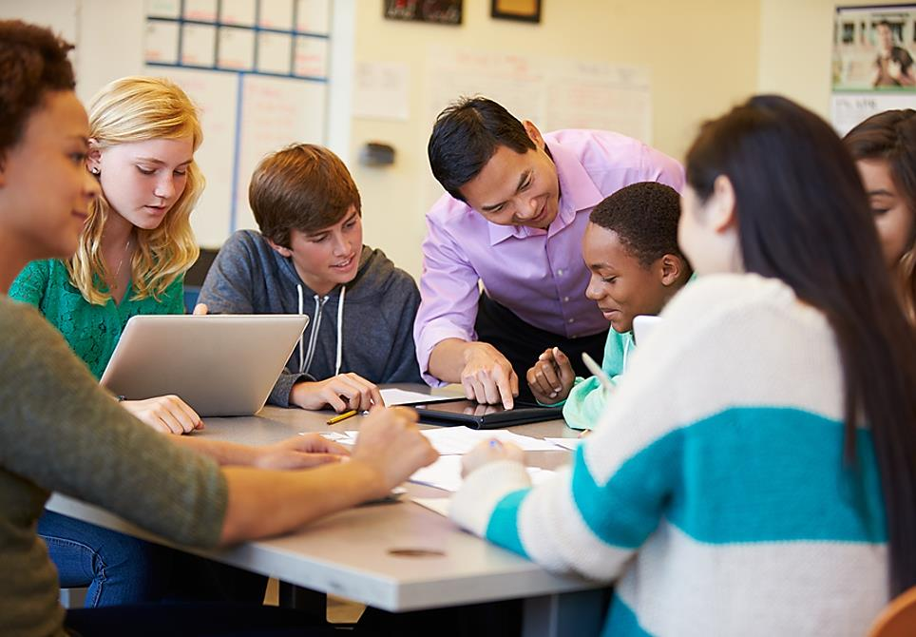
Class Project

Slide 38
Be a World Changer

