Slide 2
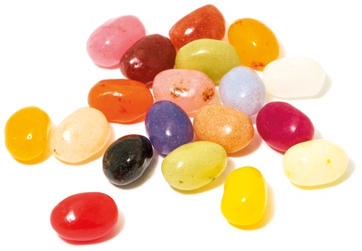
Power of One

Slide 4
Unwritten Rules
You scratch my back, I’ll…
You step on me, and I’ll…
You hurt me, and I’ll…
Don’t get mad, get…
It’s all about…

Slide 5
Unwritten Rules
You scratch my back, I’ll…
scratch yours.
You step on me, and I’ll…
step on you.
You hurt me, and I’ll…
hurt you.
Don’t get mad, get…
even.
one.
It’s all about…

Slide 7
Light or Darkness
Flashlight Dramas

Slide 9
Plant – Grow - Harvest

Slide 11
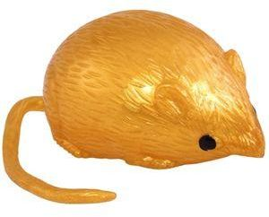
Game
Light
Darkness
&

Slide 14
Game
Buzzer
Review

Slide 16
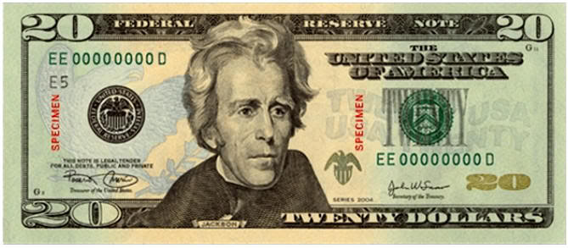
We All Have the Same Value

Slide 17
True Value
Our TRUE VALUE never changes!
Sense of Value
What I feel about myself.
What I think about myself.
What I believe to be true about myself.

Slide 19
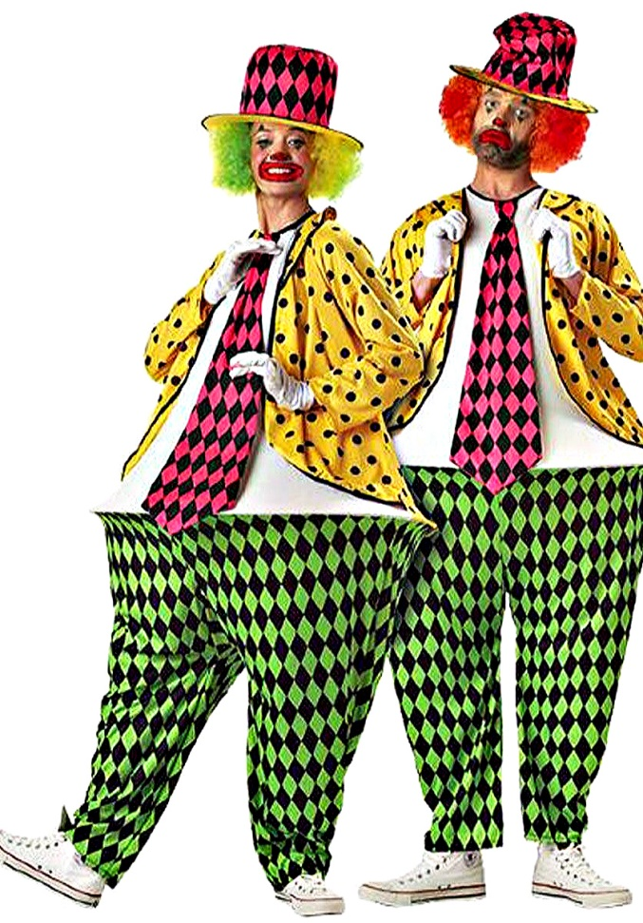
Hula-Hoop
Pants
Game

Slide 20
ABC News Bullying Ryan Halligan
https://www.youtube.com/watch?v=RGwYPAMJeh0&list=PLdvsI_MCEsHRDoP3PBAMzxsmgP4FQUBok&index=3
What was Ryan’s true value, false labels, and sense of value?

Slide 21
False Labels
Removing

Slide 23
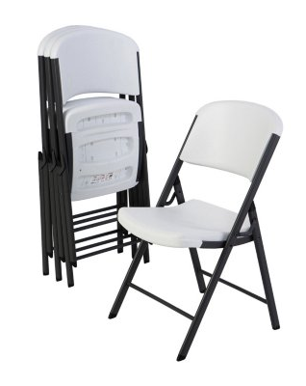
Value Seat
Speaking Truth:

Slide 25
Game
Buzzer
Review

Slide 28
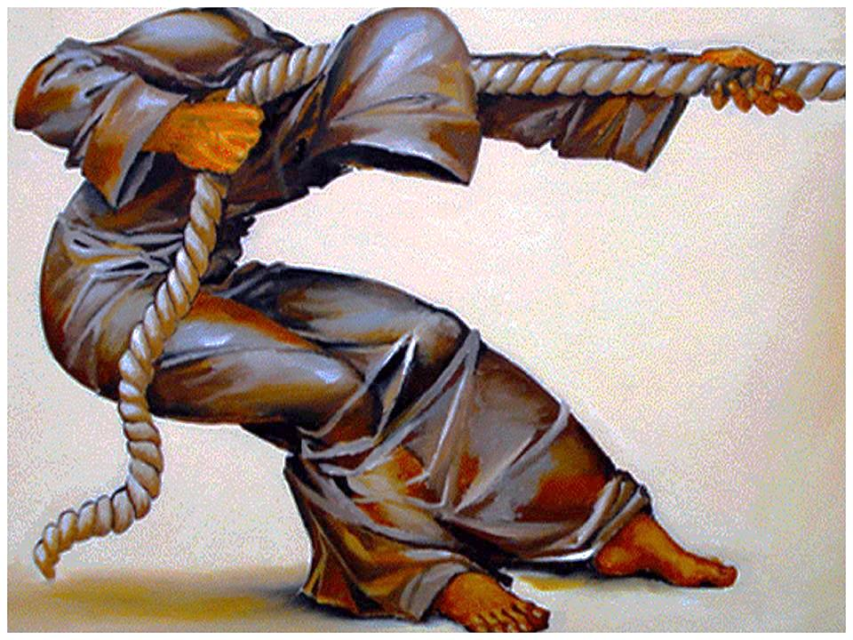
You Have a Purpose:
Dreams & Destiny

Slide 29
You Are Special Max Lucado & Sergio Martinez

Slide 30
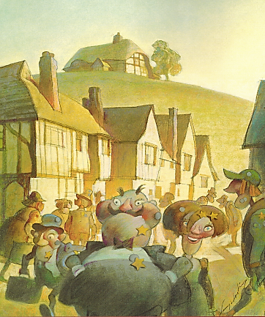
You Are Special – Max Lucado – Sergio Martinez

Slide 31
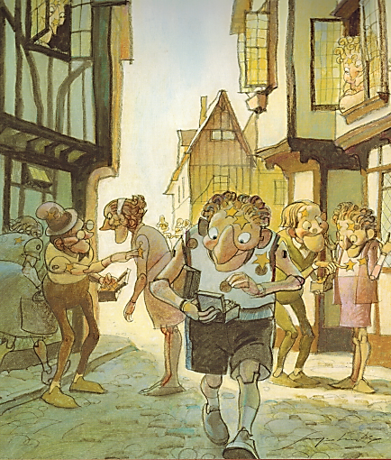
You Are Special – Max Lucado – Sergio Martinez

Slide 32
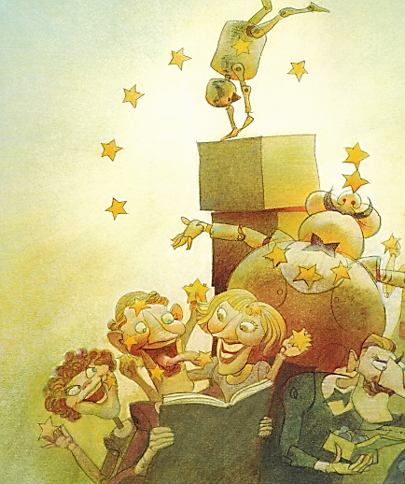
You Are Special – Max Lucado – Sergio Martinez

Slide 33
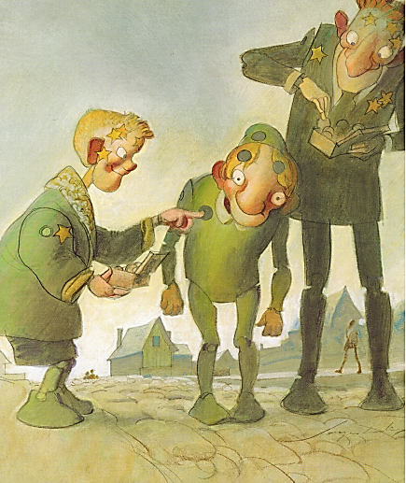
You Are Special – Max Lucado – Sergio Martinez

Slide 34
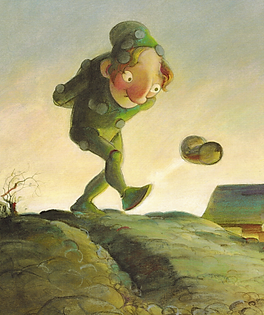
You Are Special – Max Lucado – Sergio Martinez

Slide 35
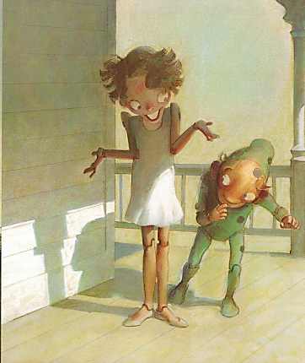
You Are Special – Max Lucado – Sergio Martinez

Slide 36
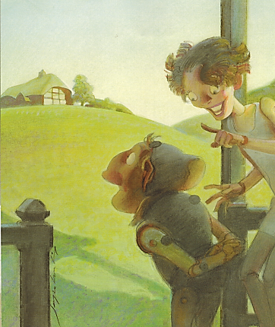
You Are Special – Max Lucado – Sergio Martinez

Slide 37
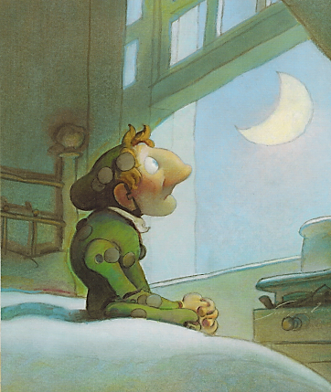
You Are Special – Max Lucado – Sergio Martinez

Slide 38
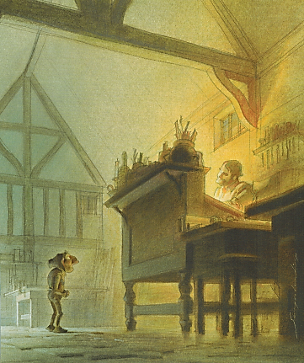
You Are Special – Max Lucado – Sergio Martinez

Slide 39
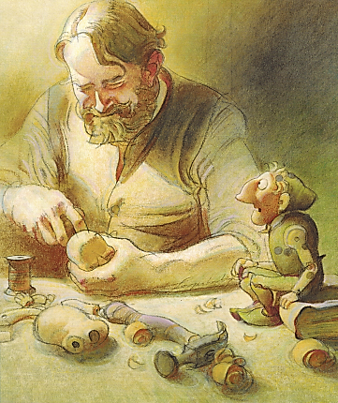
You Are Special – Max Lucado – Sergio Martinez

Slide 40
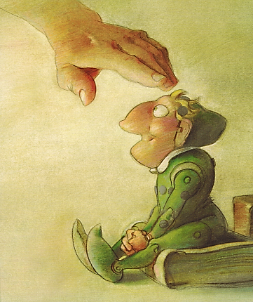
You Are Special – Max Lucado – Sergio Martinez

Slide 41
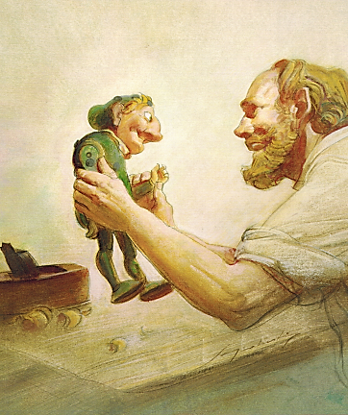
You Are Special – Max Lucado – Sergio Martinez

Slide 42
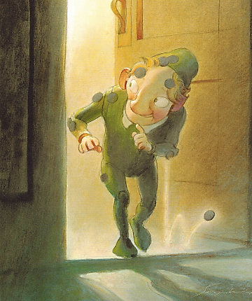
You Are Special – Max Lucado – Sergio Martinez

Slide 43
You Are Special
Max Lucado &
Sergio Martinez

Slide 45
True Value
Our TRUE VALUE never changes!
Sense of Value
What I feel about myself.
What I think about myself.
What I believe to be true about myself.

Slide 46
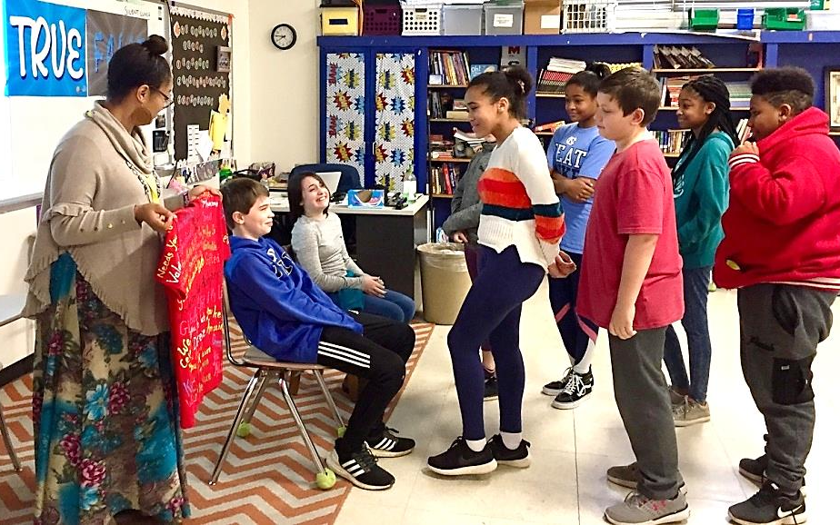
Value Seat
Speaking Truth:

Slide 48
What happened when one student chose to bring Light to his school?
“The Doorman”

Slide 50
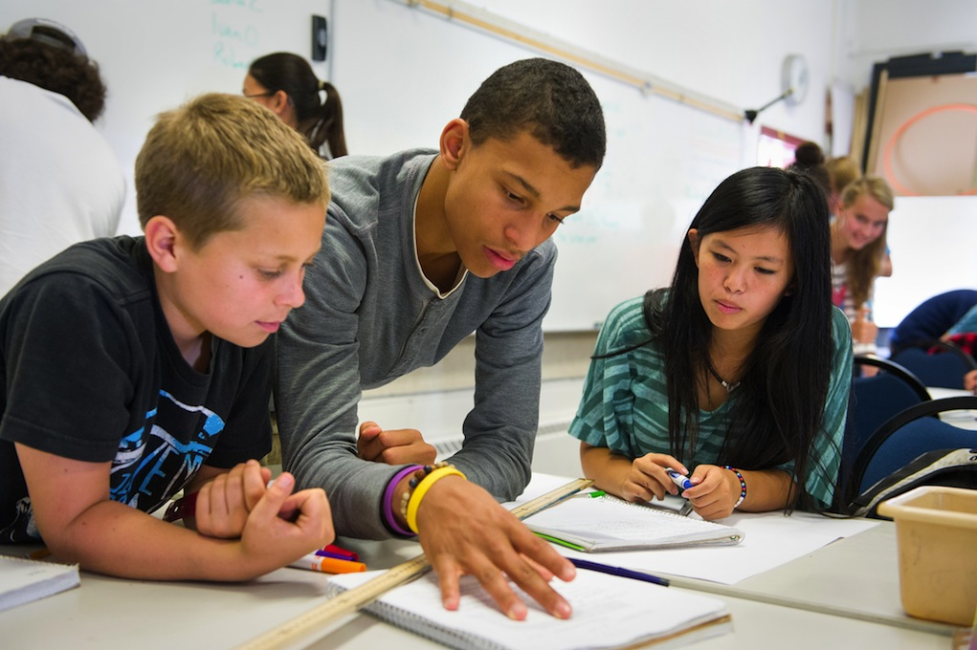
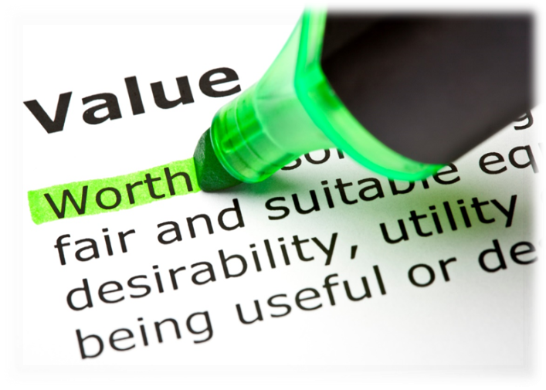
Remove
Speak
Truth
False Labels
You have dreams, a purpose, and a destiny that matters
Reject
Lies

Slide 51
Ways to Bring Light to DNS
Goal-setting:

Slide 52
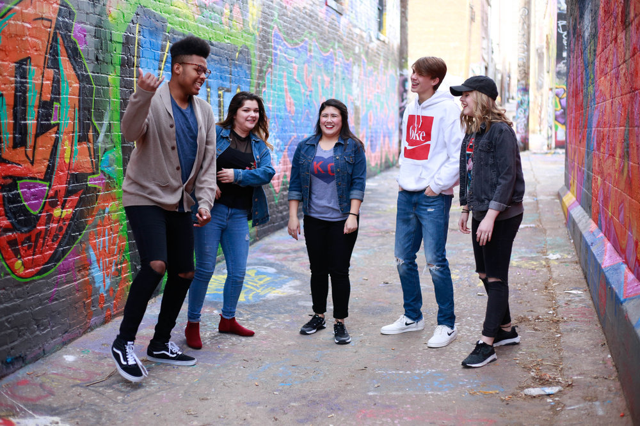
I have the
To choose and
To change
Ways to bring Light to your school: 1. 2. 3. 4.

Slide 54
You are a World Changer!

Slide 55
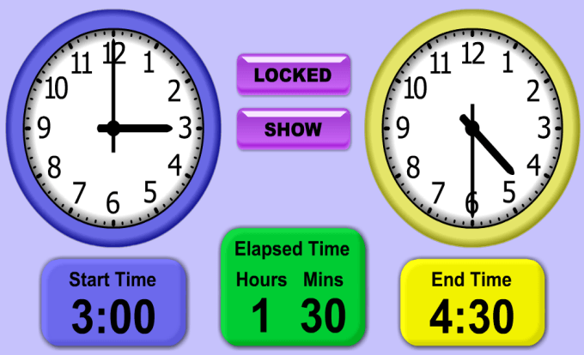
Game: TIME

Slide 56
https://www.youtube.com/watch?v=V4a7giVa2E0

