Slide 1
Be a World Changer

Slide 2
Review Buzzer Game

Slide 6
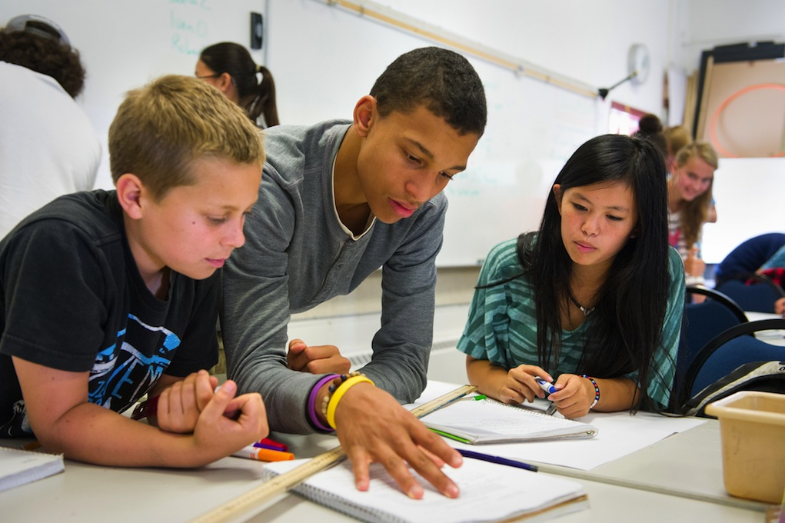
Remove
Speak
Truth
False Labels
You have dreams, a purpose, and a destiny that matters
Reject
Lies

Slide 7
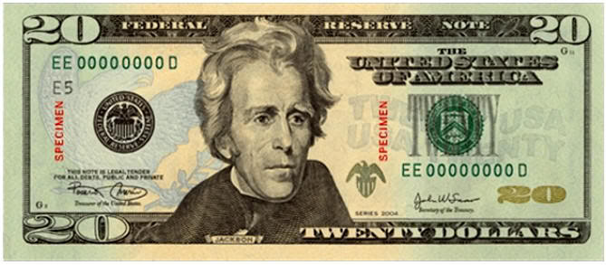
We All Have the Same Value

Slide 8
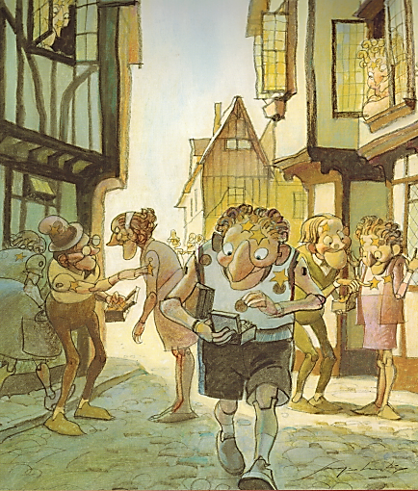
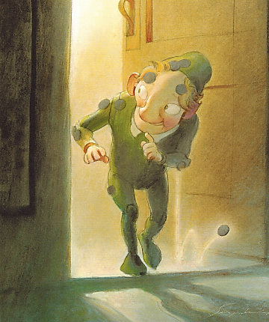
You Are Special – Max Lucado – Sergio Martinez

Slide 9
Splat Game
True
False
&
Light
Darkness
&

Slide 10
Be a World Changer

Slide 11
True Value
Our TRUE VALUE never changes!
Sense of Value
What I feel about myself.
What I think about myself.
What I believe to be true about myself.

Slide 12
False Labels
Removing

Slide 13
What were Ryan’s dreams, false labels, and sense of value?

Slide 14
Ryan’s Story – 3.5 mins
https://www.youtube.com/watch?v=daSdsh5ssdA&list=PLdvsI_MCEsHRDoP3PBAMzxsmgP4FQUBok&index=2

Slide 15
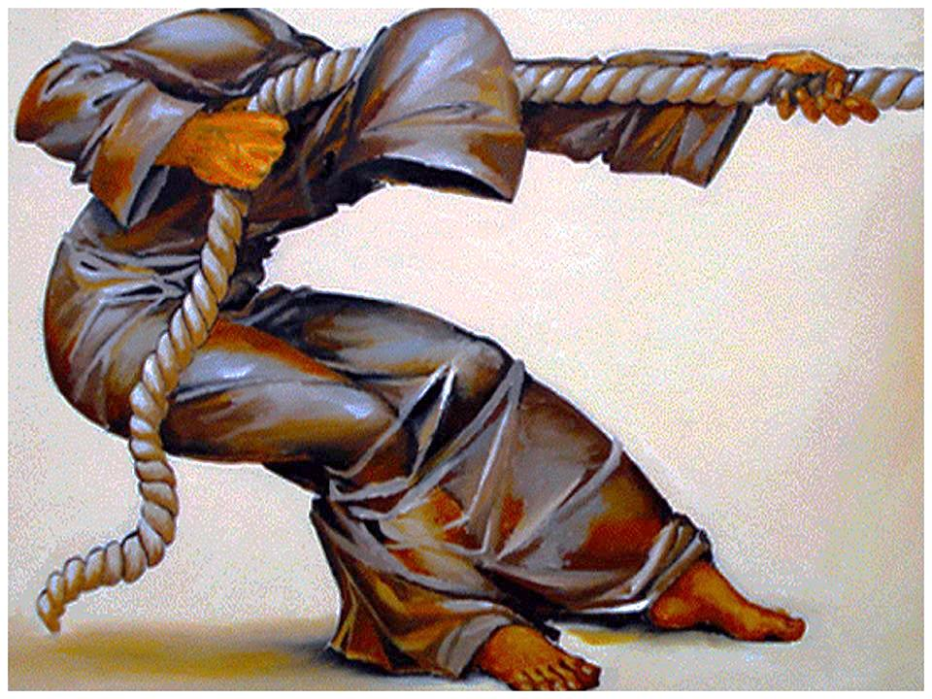
You Have a Purpose:
Dreams & Destiny

Slide 16
Broken & Rejected – 3.5 mins
https://www.youtube.com/watch?list=PLb0C_I-k2Ph8IZop2TiFutoYhhY6ELb8H&v=MJ6hCI-7uKI

Slide 17
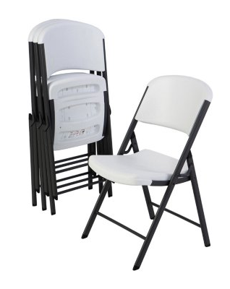
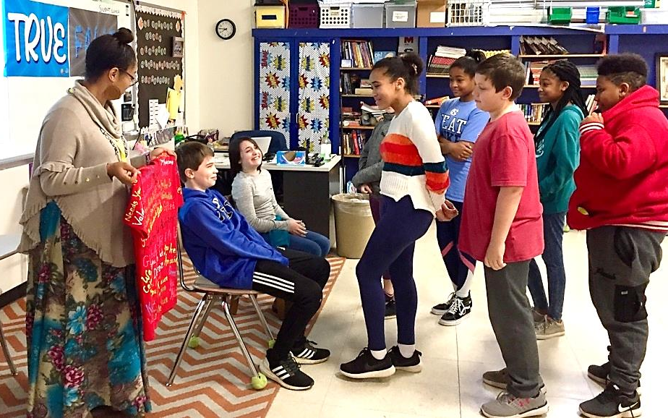
Value Seat
Speaking Truth:

Slide 19
Hula
Hoop
Games

Slide 20
Be a World Changer

Slide 22
Fruit
Light
darkness
Good
Bad
&
planting good seeds
good choices

Slide 24
impact of opening doors
Doorman

Slide 25
https://www.youtube.com/watch?v=4uPLzI6DNJ0

Slide 26
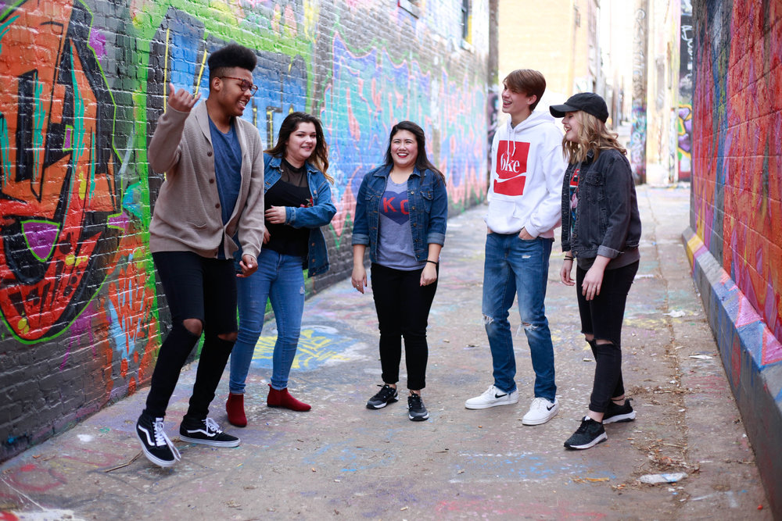
I have the
To choose and
To change
Ways to bring Light to your school: 1. 2. 3. 4.

Slide 27
Hula
Hoop
Games

Slide 28
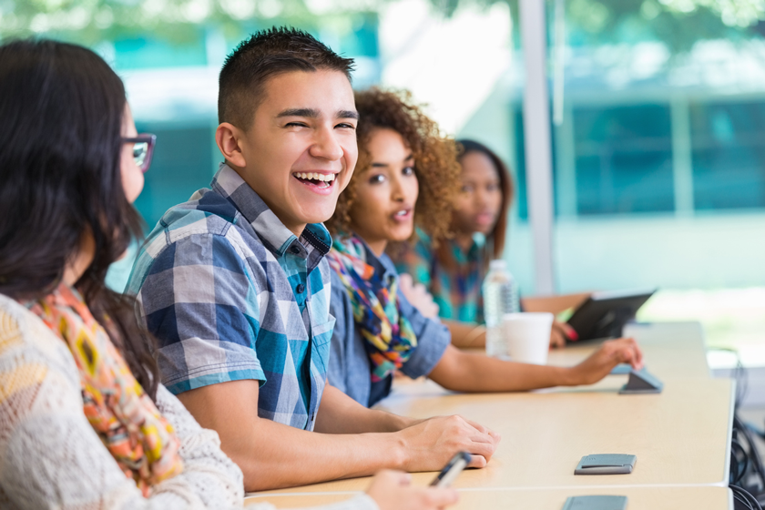
Class or Group Projects

Slide 29
Be a World Changer

Slide 30
https://www.youtube.com/watch?v=n5E8gyDPs70

