Slide 2
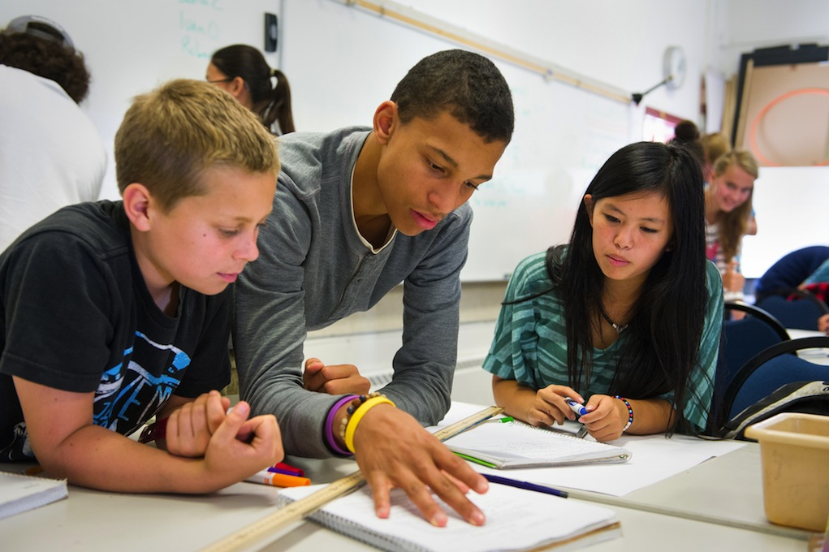
Remove
Speak
Truth
False Labels
You have dreams, a purpose, and a destiny that matters
Reject
Lies

Slide 6
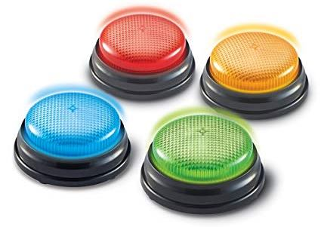
Game
Buzzer
Review

Slide 7
Fruit
Light
darkness
Good
Bad
&
planting good seeds
good choices

Slide 9
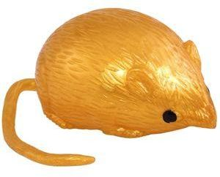
Splat Game
True
False
&
Light
Darkness
&

Slide 10
True Value
Our TRUE VALUE never changes!
Sense of Value
What I feel about myself.
What I think about myself.
What I believe to be true about myself.

Slide 11
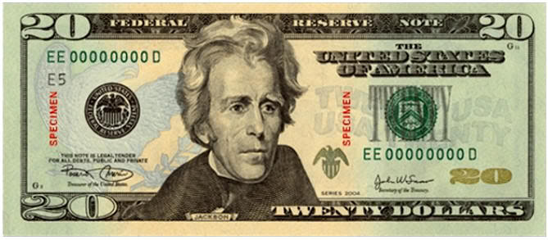
We All Have the Same Value

Slide 14
Game
Buzzer
Review

Slide 15
Cyber-bullying gone too far
What was Ryan’s true value, false labels, and sense of value?
P&L#1-2

Slide 16
What happened when one student chose to bring Light to his school?
“The Doorman”
P&L#3-4

Slide 17
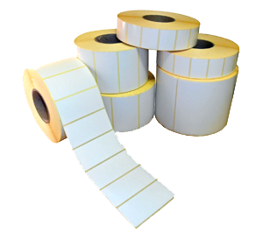
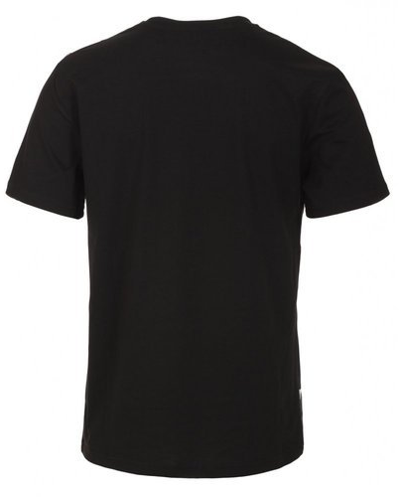
False Labels
Removing

Slide 19
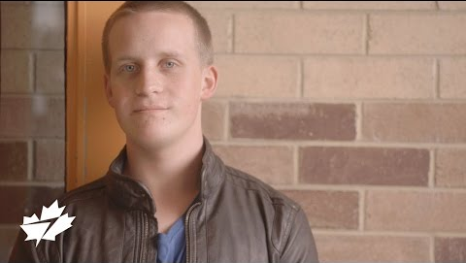
The Doorman:
What students said about impact on their school.
P&L#1-2

Slide 20
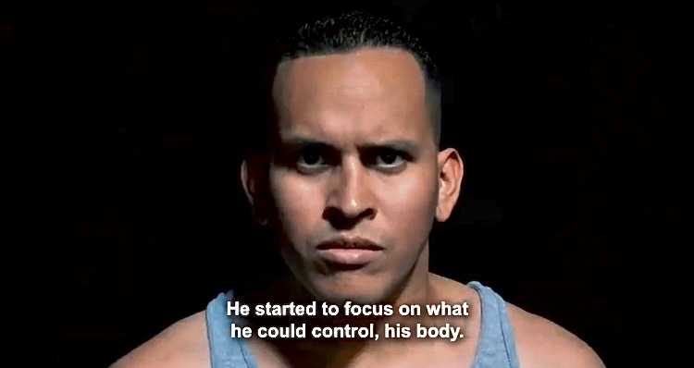
He was a broken and rejected athlete until: Regardless of what we achieve in life, we have to keep striving for our dreams and destiny.
P&L#3-4

Slide 21
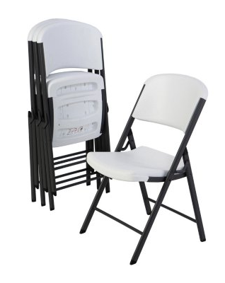
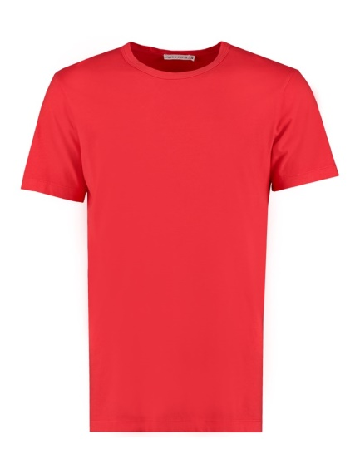
Value Seat
Speaking Truth:

Slide 23
Game
Buzzer
Review

Slide 25
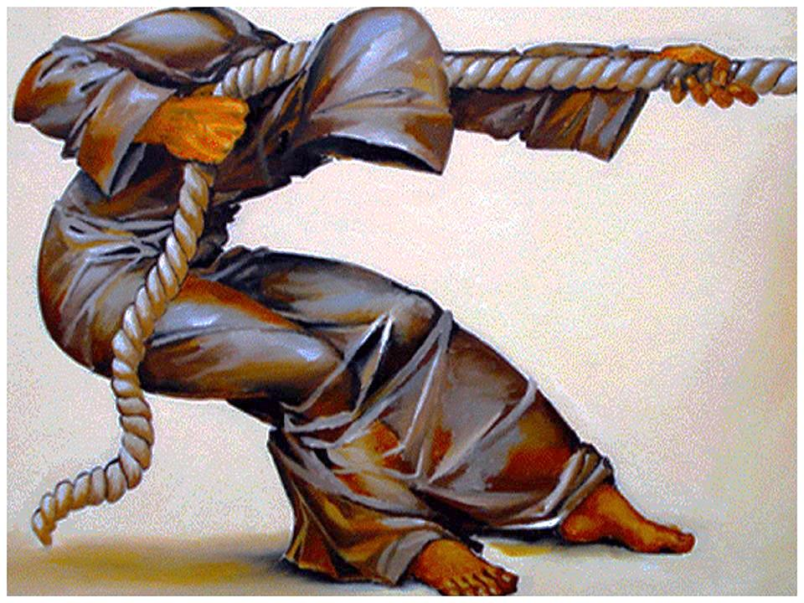
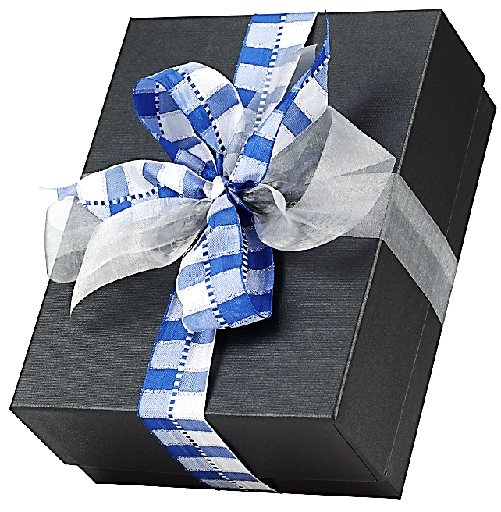
You Have a Purpose:
Dreams & Destiny

Slide 26
Open Mic Students & Staff

Slide 27
Ways to Bring Light
DNS Goal-setting:

Slide 28
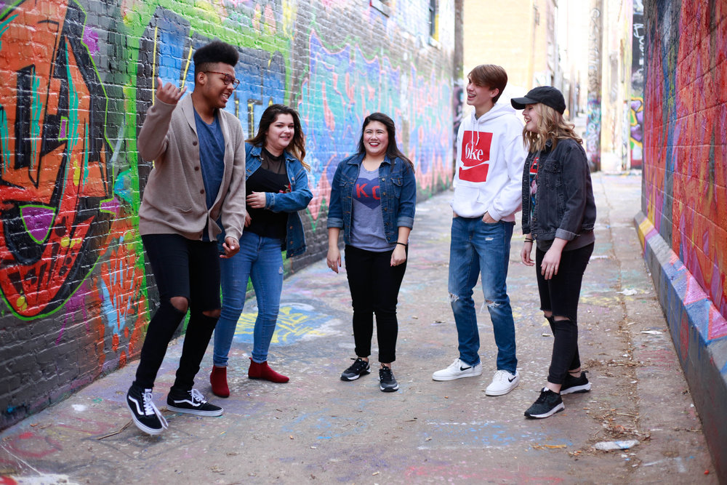
I have the
To choose and
To change
Ways to bring Light to your school: 1. 2. 3. 4.

Slide 29
Making benches for reading room
Reading Buddies
Care packages for homeless

Slide 30
Hula-Hoop
Group
Games

Slide 32
Students & Class Power of Teamwork

Slide 33
You are a World Changer!

