Slide 2
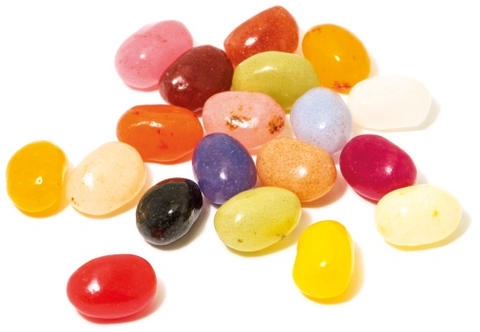
Power of One

Slide 4
Light or Darkness

Slide 7
Game
Light
Darkness
&

Slide 9
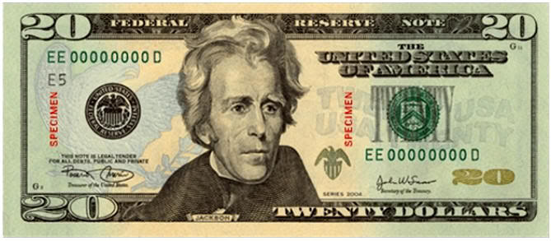
We All Have the Same Value

Slide 10
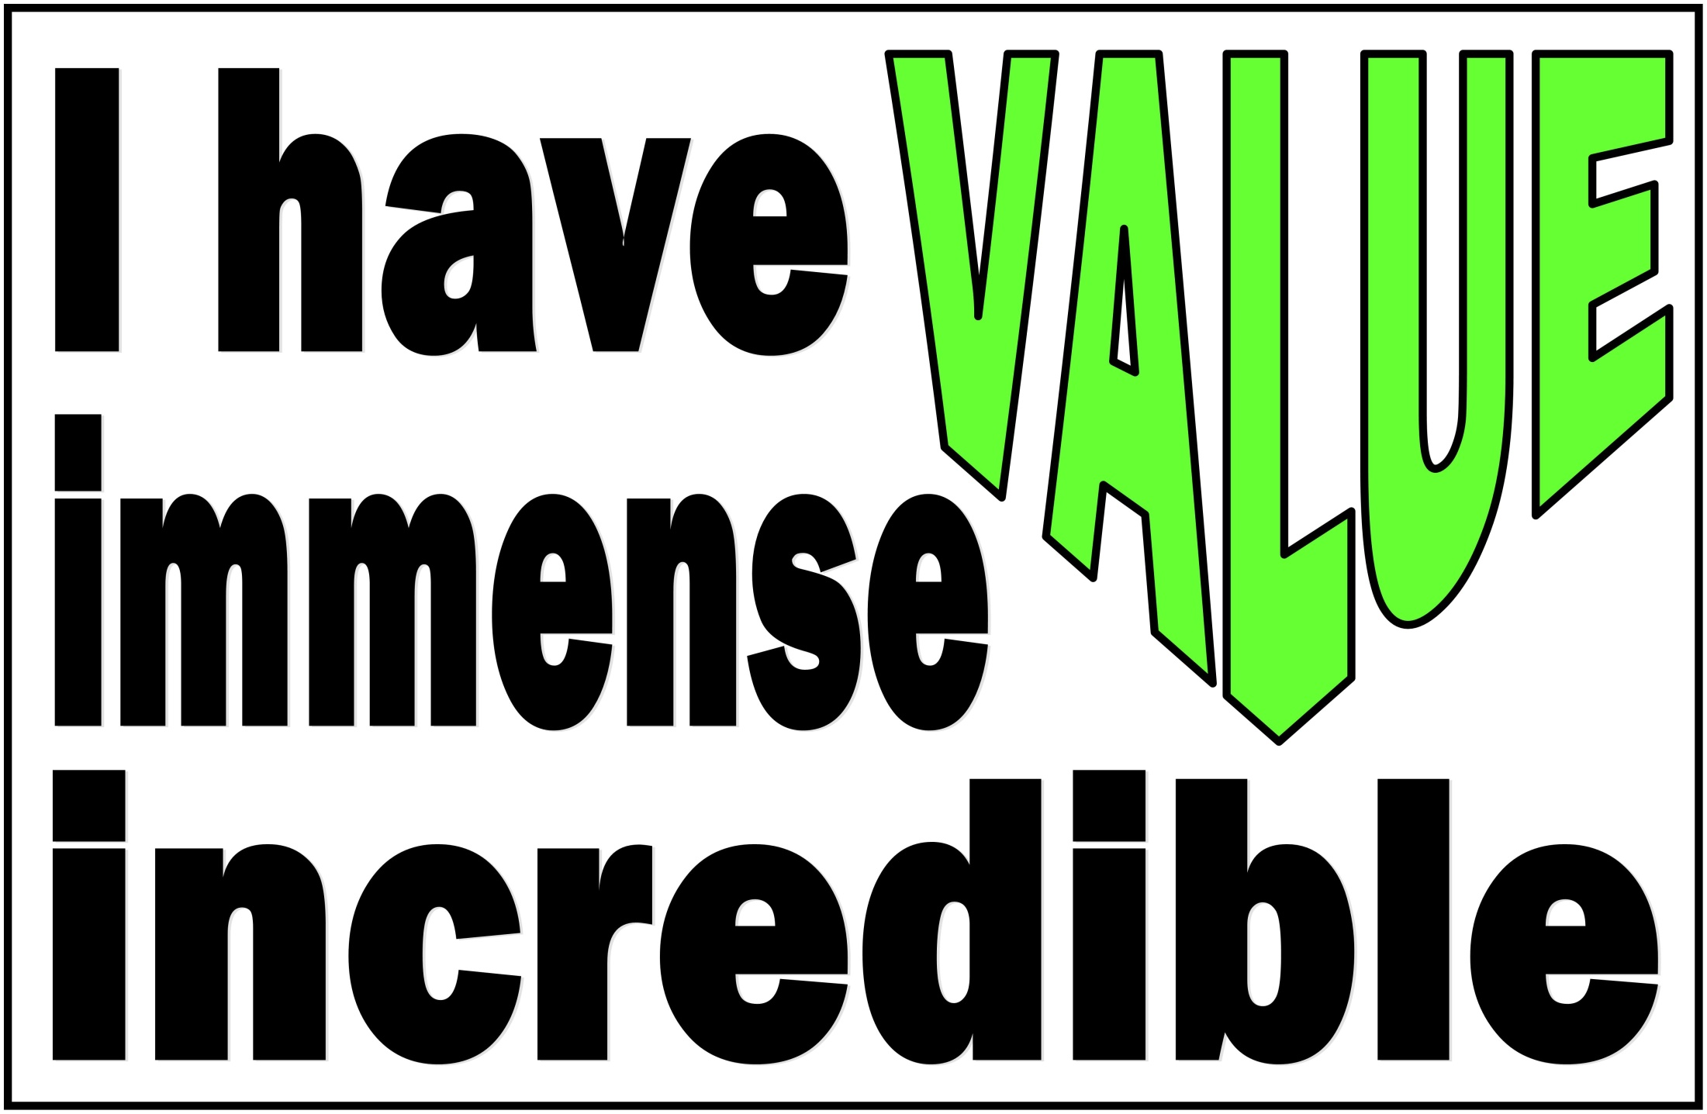

Slide 11
You Are Special Max Lucado & Sergio Martinez

Slide 12
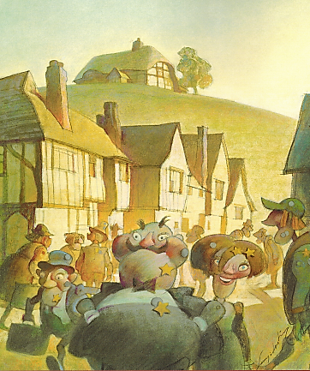
You Are Special – Max Lucado – Sergio Martinez

Slide 13
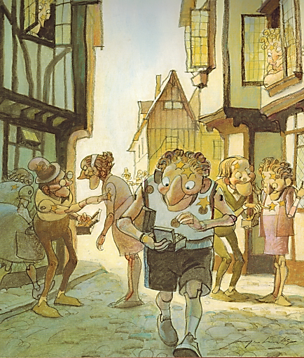
You Are Special – Max Lucado – Sergio Martinez

Slide 14
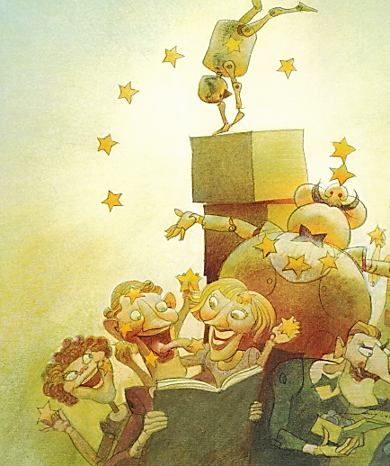
You Are Special – Max Lucado – Sergio Martinez

Slide 15
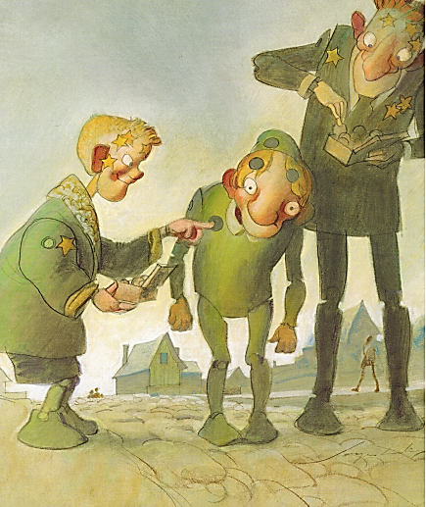
You Are Special – Max Lucado – Sergio Martinez

Slide 16
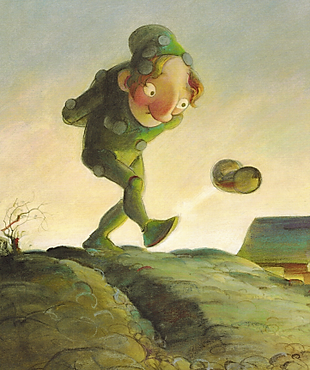
You Are Special – Max Lucado – Sergio Martinez

Slide 17
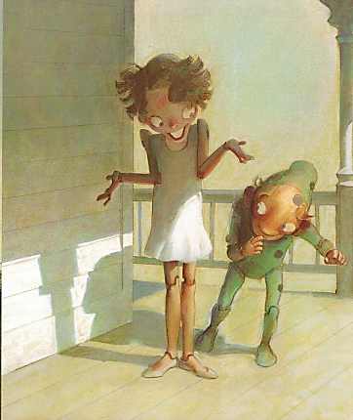
You Are Special – Max Lucado – Sergio Martinez

Slide 18
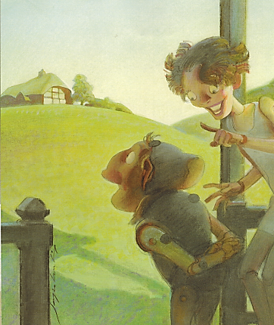
You Are Special – Max Lucado – Sergio Martinez

Slide 19
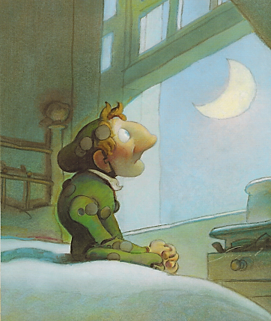
You Are Special – Max Lucado – Sergio Martinez

Slide 20
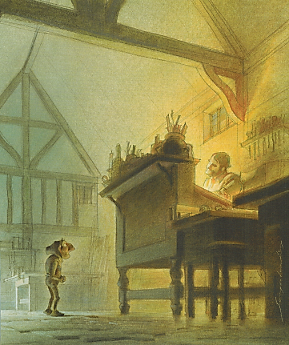
You Are Special – Max Lucado – Sergio Martinez

Slide 21
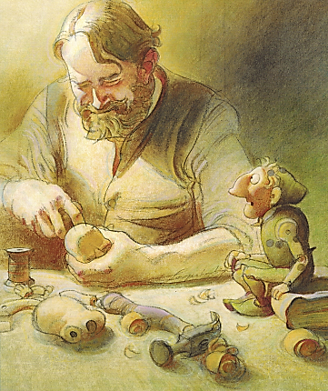
You Are Special – Max Lucado – Sergio Martinez

Slide 22
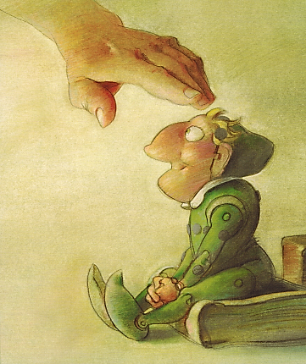
You Are Special – Max Lucado – Sergio Martinez

Slide 23
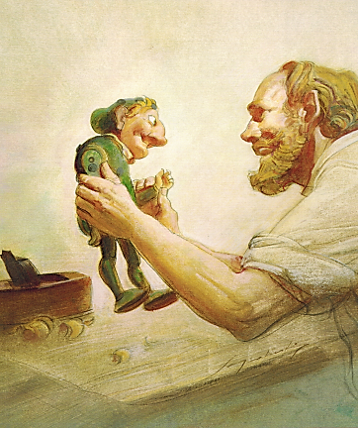
You Are Special – Max Lucado – Sergio Martinez

Slide 24
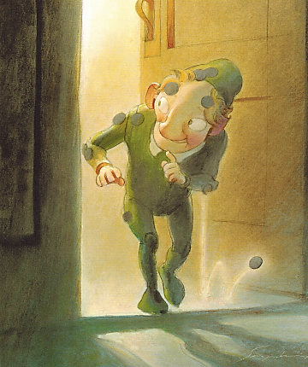
You Are Special – Max Lucado – Sergio Martinez

Slide 25
You Are Special
Max Lucado &
Sergio Martinez

Slide 27
True Value
Our TRUE VALUE never changes!
Sense of Value
What I feel about myself.
What I think about myself.
What I believe to be true about myself.

Slide 28
“Words Do Hurt” Alye Pollack

Slide 30
False Labels
Removing

Slide 32
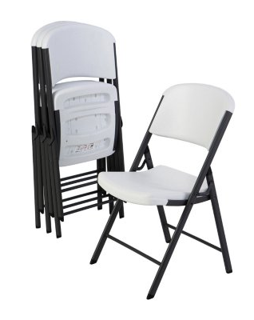
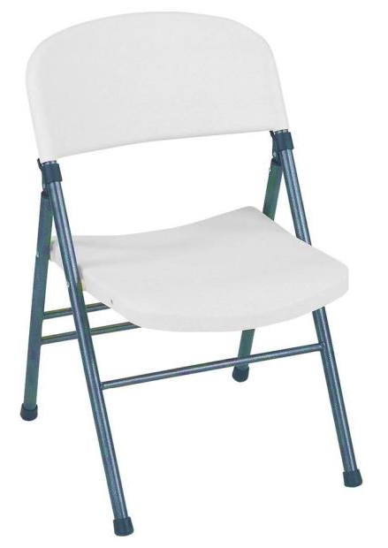
Value Seat
Speaking Truth:

Slide 34
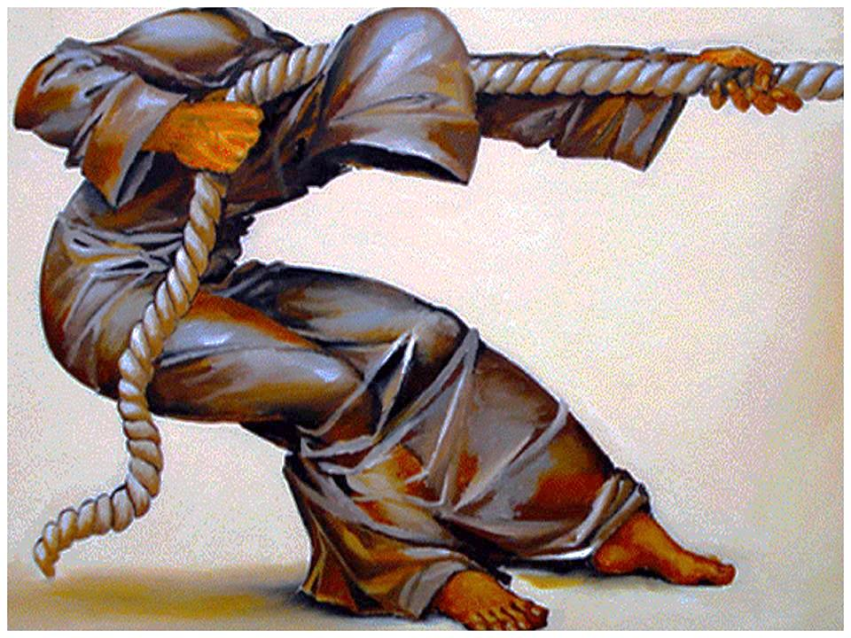
You Have a Purpose:
Dreams & Destiny

Slide 36
Ways to Bring Light to Githens
Goal-setting:

Slide 37
Be a World Changer

