Slide 1
Be a World Changer

Slide 3
Review Buzzer Game

Slide 6
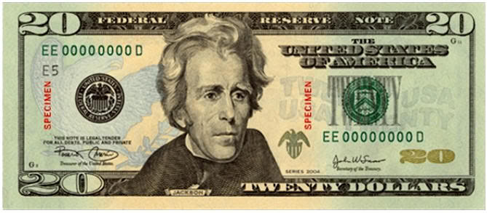
We All Have the Same Value

Slide 8
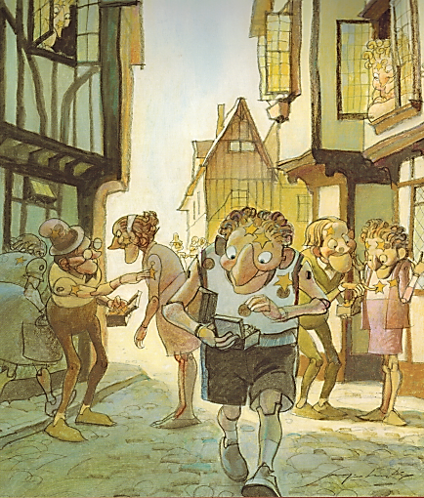
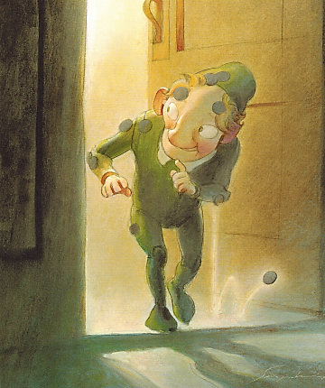
You Are Special – Max Lucado – Sergio Martinez

Slide 10
Be a World Changer

Slide 12
True Value
Our TRUE VALUE never changes!
Sense of Value
What I feel about myself.
What I think about myself.
What I believe to be true about myself.

Slide 13
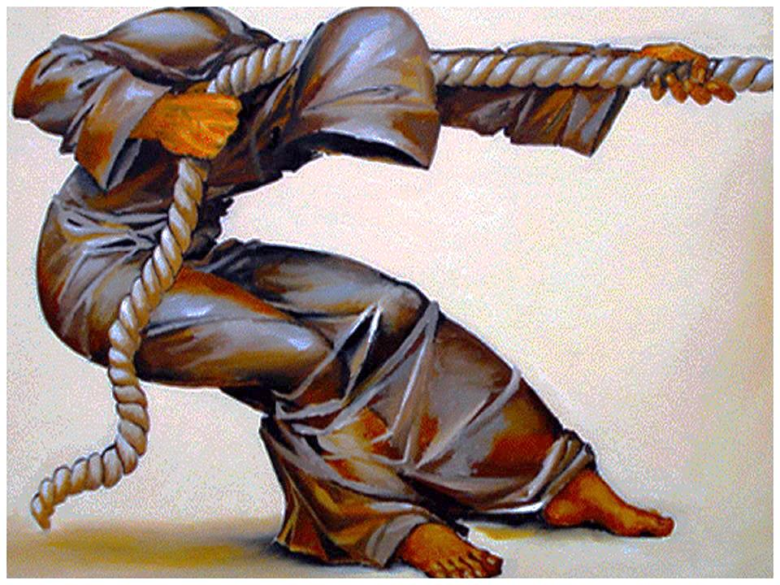
You Have a Purpose:
Dreams & Destiny

Slide 14
False Labels
Removing

Slide 15
How could you help
Josh?

Slide 16
https://www.youtube.com/watch?v=PIHtuKc3Gjg

Slide 17
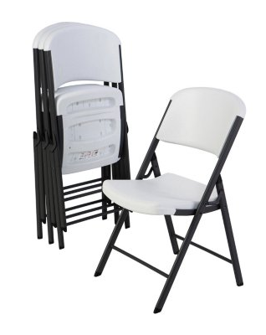
Value Seat
Speaking Truth:

Slide 18
Be a World Changer

Slide 20
Fruit
Good
Bad
&

Slide 21
Splat Game
True
False
&

Slide 23
gotta know Josh the
Doorman

Slide 24
https://www.youtube.com/watch?v=PIHtuKc3Gjg

Slide 26
Game
Hula
Hoop
Pass

Slide 27
Class Project

Slide 28
Be a World Changer

Slide 29
if you feel
pressure

Slide 30
https://www.youtube.com/watch?v=V4a7giVa2E0

