Slide 1
Be a World Changer

Slide 2
Review Buzzer Game

Slide 7
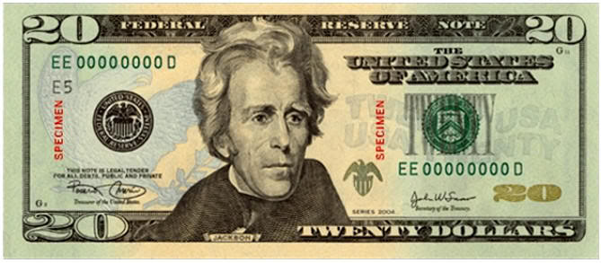
We All Have the Same Value

Slide 8
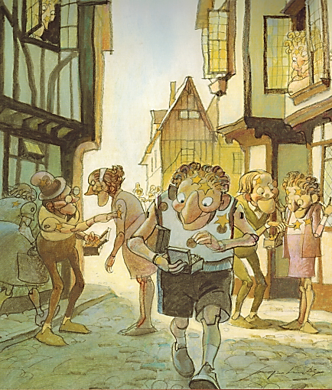
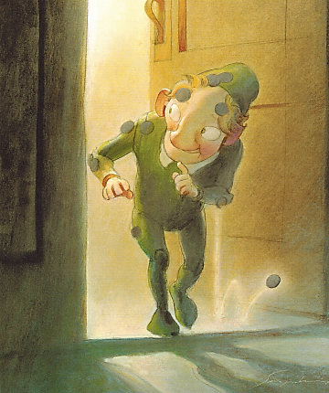
You Are Special – Max Lucado – Sergio Martinez

Slide 9
Be a World Changer

Slide 10
True Value
Our TRUE VALUE never changes!
Sense of Value
What I feel about myself.
What I think about myself.
What I believe to be true about myself.

Slide 11
False Labels
Removing

Slide 12
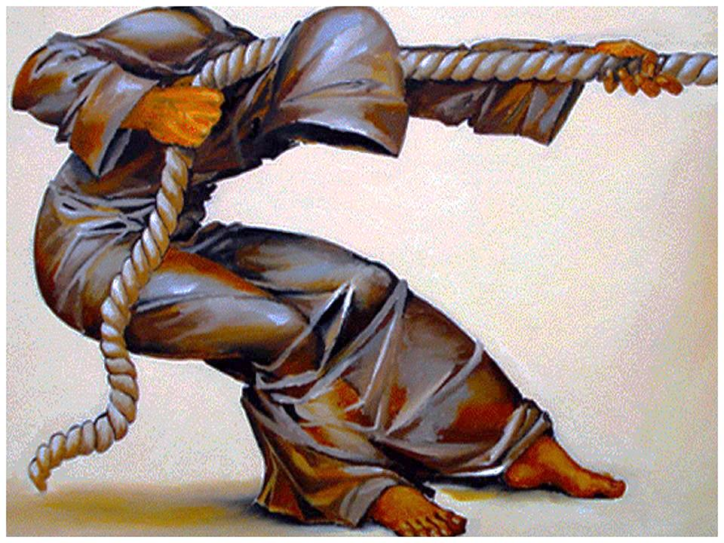
You Have a Purpose:
Dreams & Destiny

Slide 13
What were Ryan’s dreams, false labels, and sense of value?

Slide 14
ABC News Bullying Ryan Halligan - 9 mins
https://www.youtube.com/watch?v=RGwYPAMJeh0&list=PLdvsI_MCEsHRDoP3PBAMzxsmgP4FQUBok&index=3
Ryan’s Story – 3.5 mins
https://www.youtube.com/watch?v=daSdsh5ssdA&list=PLdvsI_MCEsHRDoP3PBAMzxsmgP4FQUBok&index=2

Slide 15
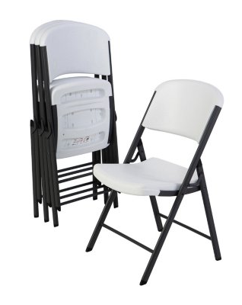
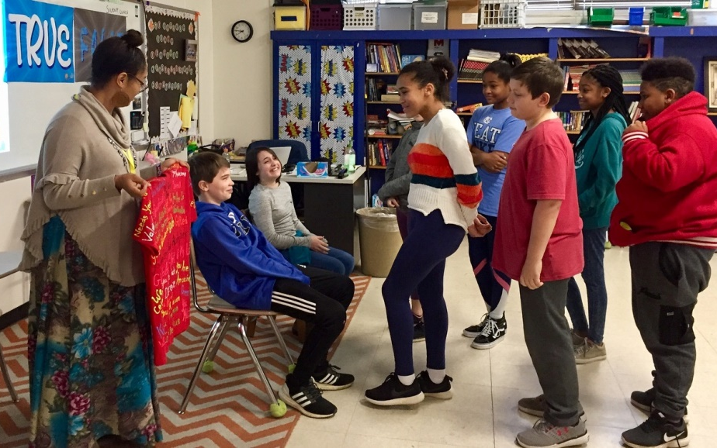
Value Seat
Speaking Truth:

Slide 17
Be a World Changer

Slide 19
Fruit
Light
darkness
Good
Bad
&
planting good seeds
good choices

Slide 20
Splat Game
True
False
&
Light
Darkness
&

Slide 22
impact of opening doors
Doorman

Slide 23
https://www.youtube.com/watch?v=4uPLzI6DNJ0

Slide 25
Hula
Hoop
Games

Slide 26
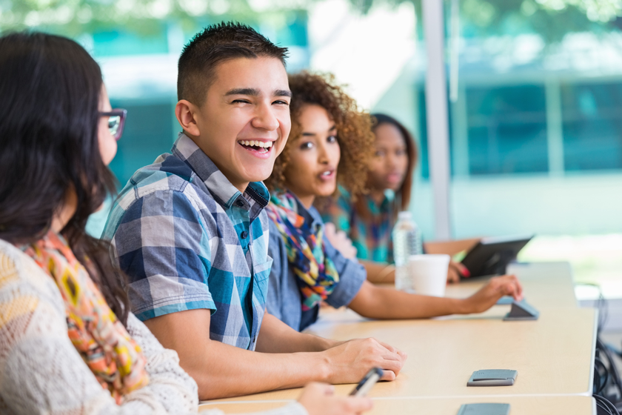
Class or Group Projects

Slide 27
Be a World Changer

Slide 28
https://www.youtube.com/watch?v=n5E8gyDPs70

