Slide 2
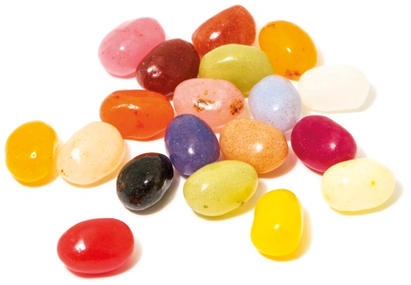
Power of One

Slide 4
Light or Darkness

Slide 6
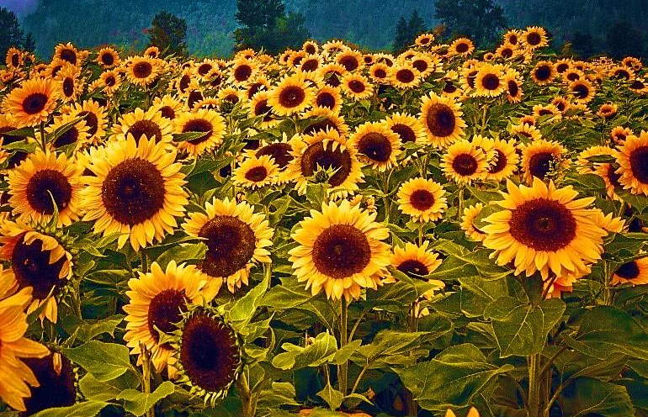

Slide 8
Game
Light
Darkness
&

Slide 10
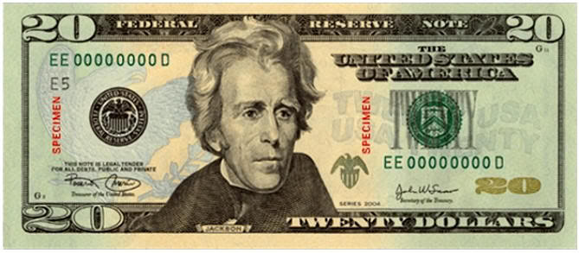
We All Have the Same Value

Slide 12
You Are Special Max Lucado & Sergio Martinez

Slide 13
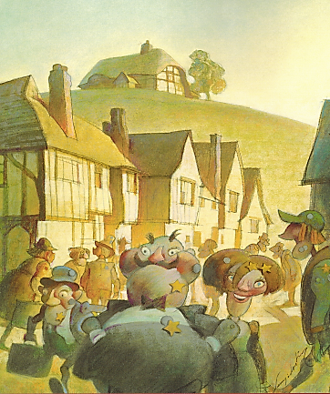
You Are Special – Max Lucado – Sergio Martinez

Slide 14
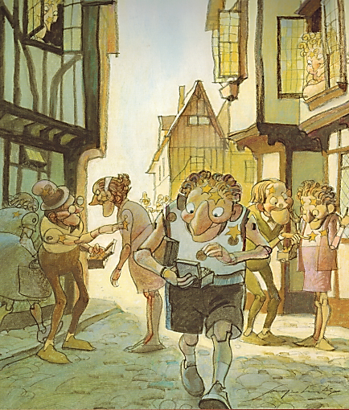
You Are Special – Max Lucado – Sergio Martinez

Slide 15
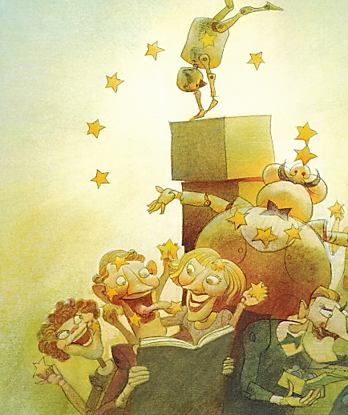
You Are Special – Max Lucado – Sergio Martinez

Slide 16
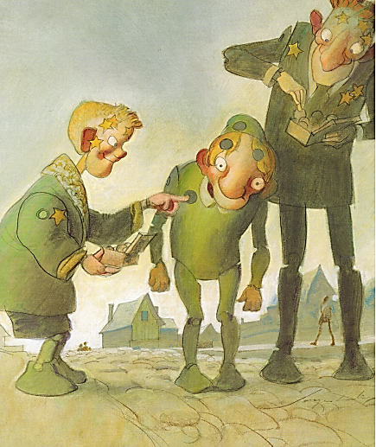
You Are Special – Max Lucado – Sergio Martinez

Slide 17
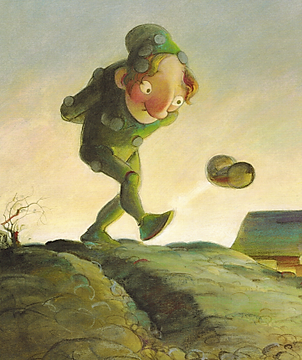
You Are Special – Max Lucado – Sergio Martinez

Slide 18
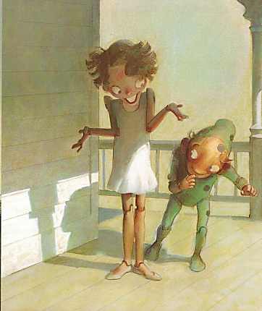
You Are Special – Max Lucado – Sergio Martinez

Slide 19
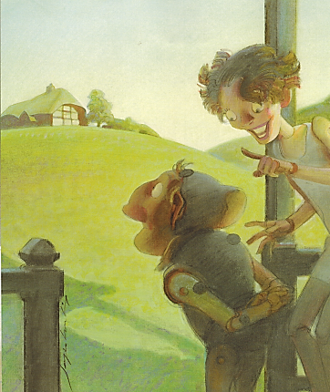
You Are Special – Max Lucado – Sergio Martinez

Slide 20
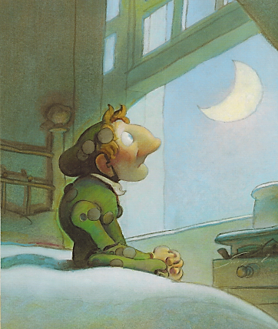
You Are Special – Max Lucado – Sergio Martinez

Slide 21
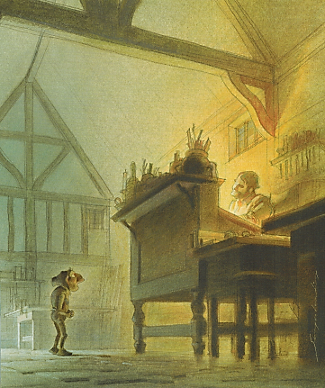
You Are Special – Max Lucado – Sergio Martinez

Slide 22
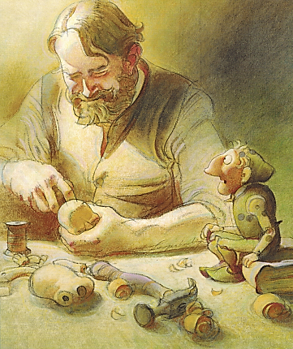
You Are Special – Max Lucado – Sergio Martinez

Slide 23
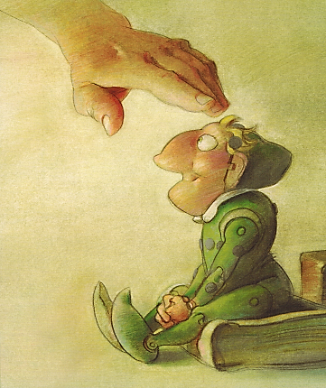
You Are Special – Max Lucado – Sergio Martinez

Slide 24
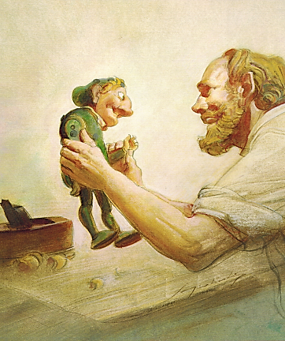
You Are Special – Max Lucado – Sergio Martinez

Slide 25
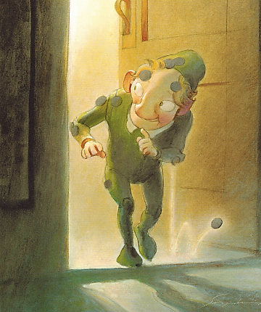
You Are Special – Max Lucado – Sergio Martinez

Slide 26
You Are Special
Max Lucado &
Sergio Martinez

Slide 28
True Value
Our TRUE VALUE never changes!
Sense of Value
What I feel about myself.
What I think about myself.
What I believe to be true about myself.

Slide 29
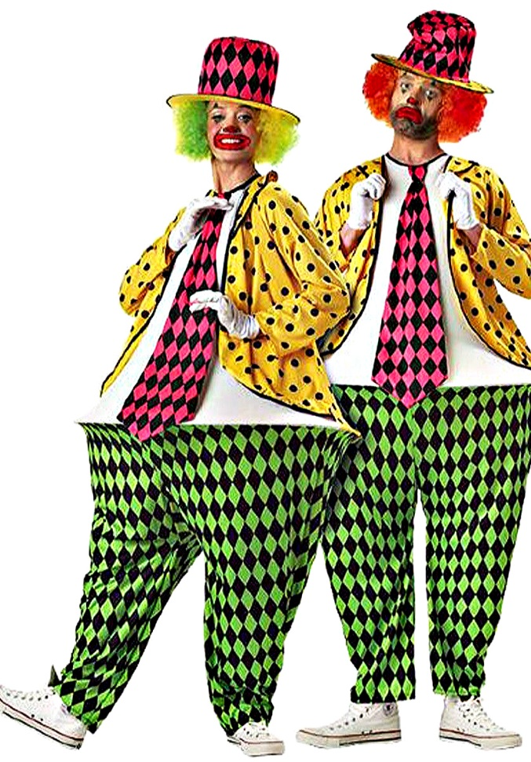
Hula-Hoop
Pants
Game

Slide 31
False Labels
Removing
Incorrect untrue distorted lies invalid inaccurate disloyal two-faced wrong unfaithful

Slide 32
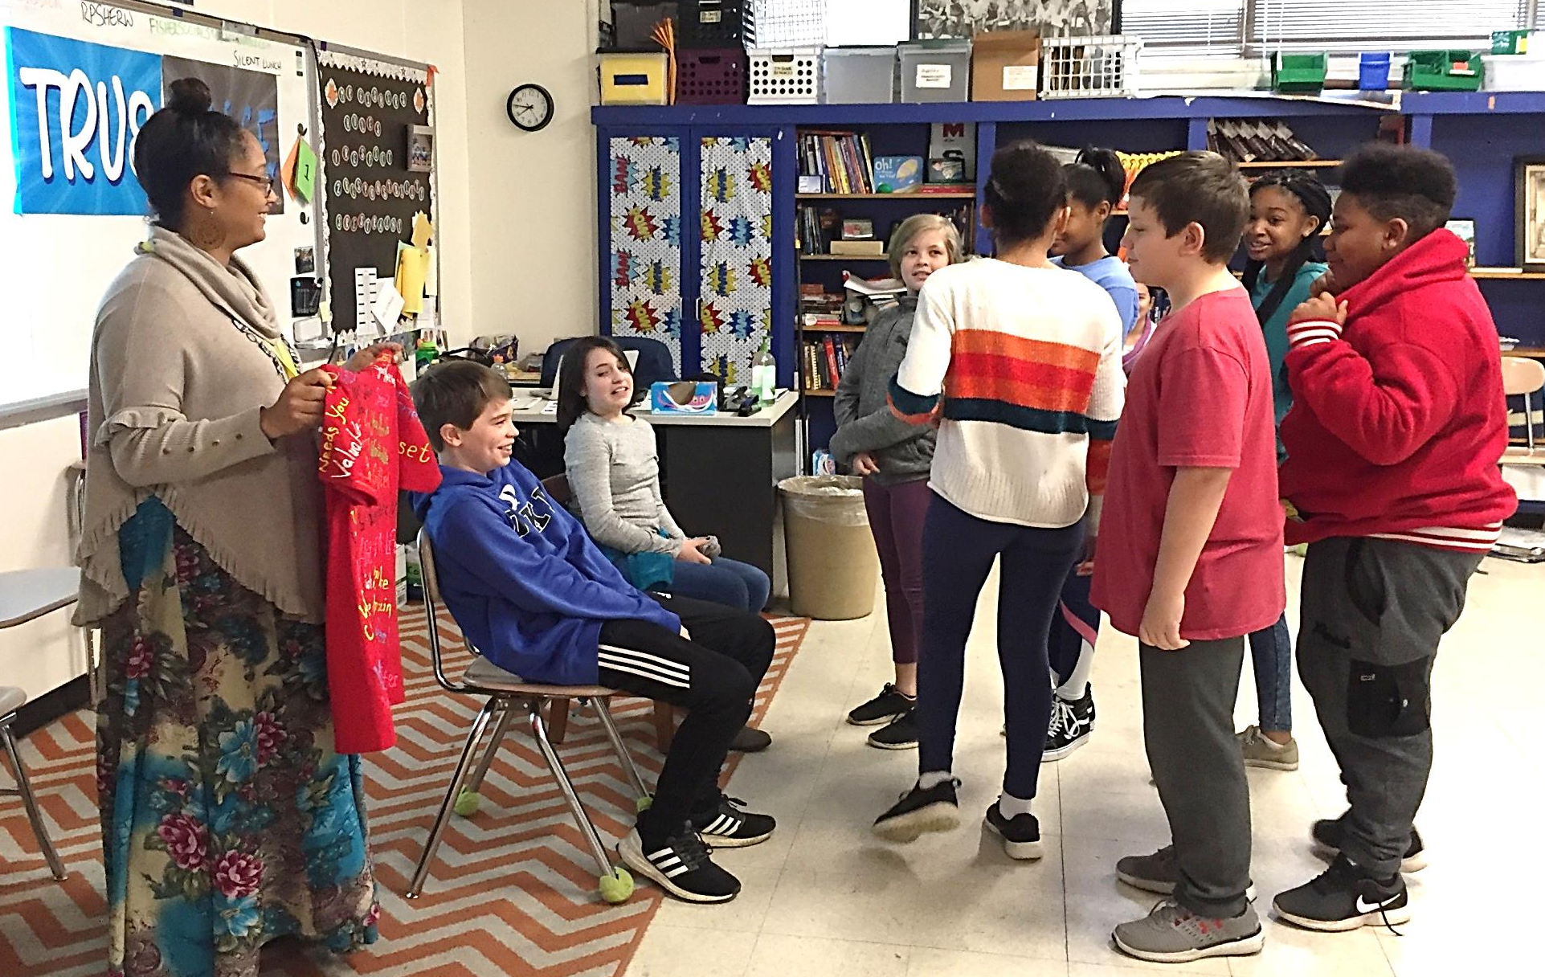
Speaking Truth

Slide 33
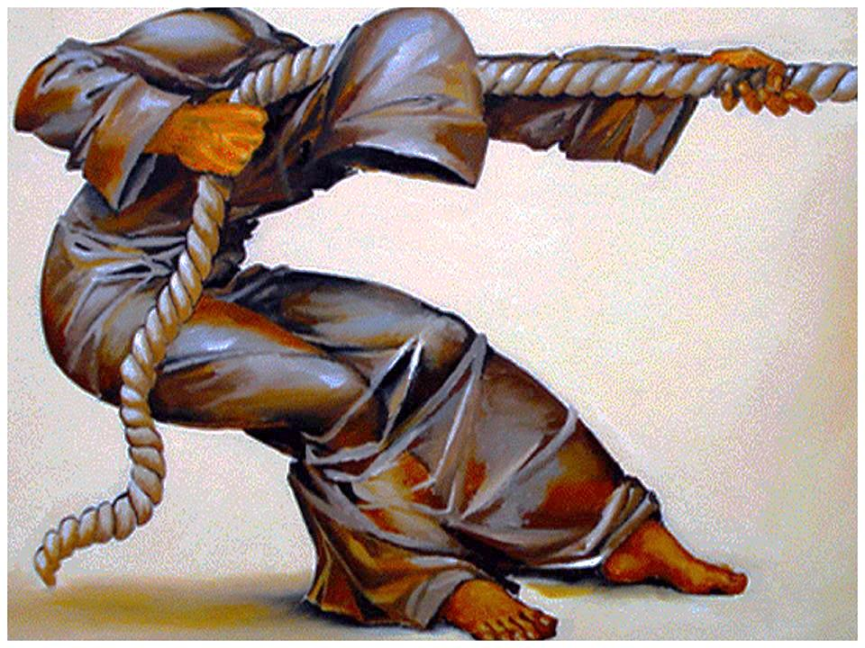
You Have a Purpose:
Dreams & Destiny

Slide 35
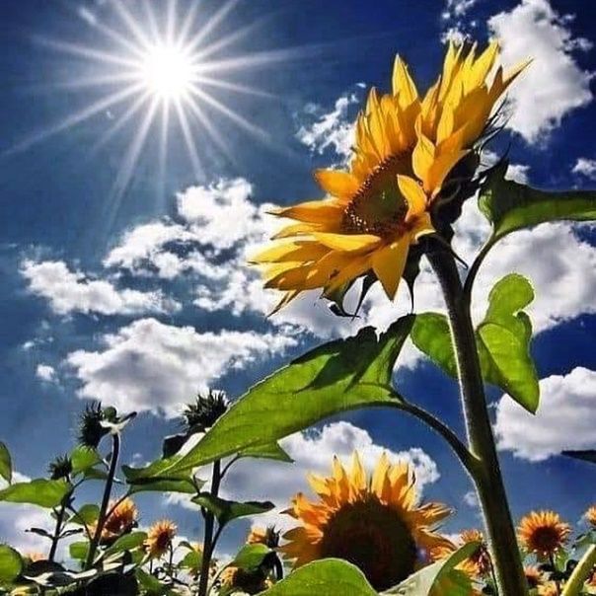
Ways to Bring Light to our camp
…this summer

Slide 37
Be a World Changer

