Slide 2
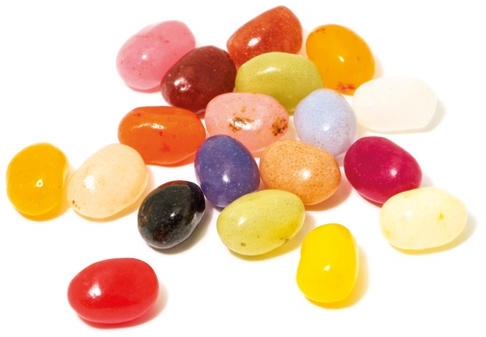
Power of One

Slide 4
Unwritten Rules
You scratch my back, I’ll…
scratch yours.
You step on me, and I’ll…
step on you.
You hurt me, and I’ll…
hurt you.
Don’t get mad, get…
even.
me.
It’s all about…

Slide 6
Light or Darkness
Flashlight Dramas

Slide 7
Flashlight Drama: Crowd

Slide 8
Flashlight Drama: Volleyball

Slide 10
Plant – Grow - Harvest

Slide 12
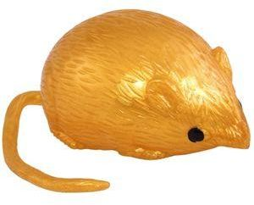
Game
Light
Darkness
&

Slide 15
True Value
Our TRUE VALUE never changes!
Sense of Value
What I feel about myself.
What I think about myself.
What I believe to be true about myself.

Slide 16
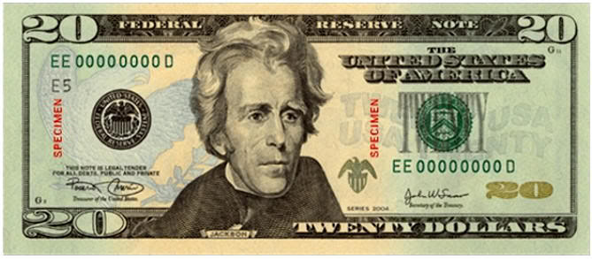
We All Have the Same Value

Slide 17
You Are Special Max Lucado & Sergio Martinez

Slide 18
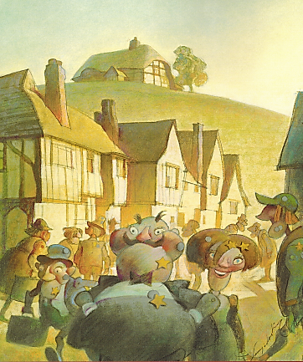
You Are Special – Max Lucado – Sergio Martinez

Slide 19
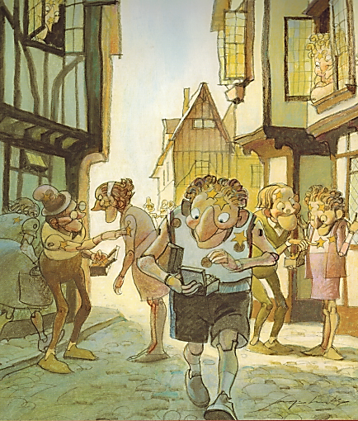
You Are Special – Max Lucado – Sergio Martinez

Slide 20
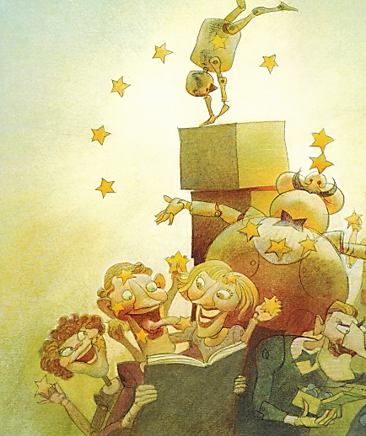
You Are Special – Max Lucado – Sergio Martinez

Slide 21
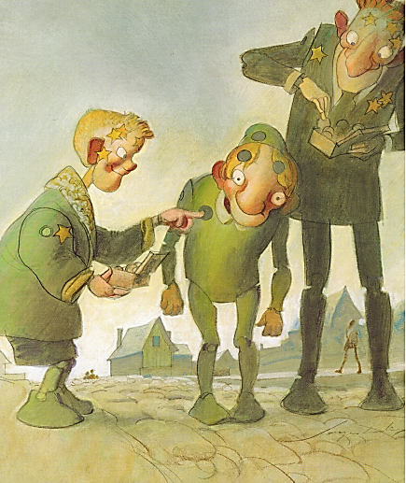
You Are Special – Max Lucado – Sergio Martinez

Slide 22
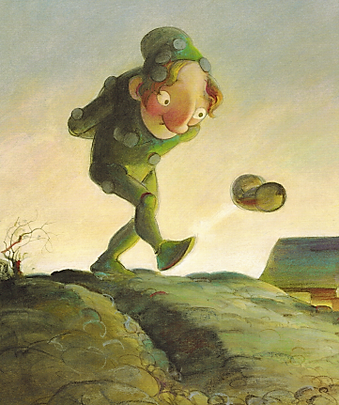
You Are Special – Max Lucado – Sergio Martinez

Slide 23
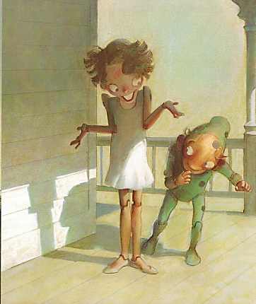
You Are Special – Max Lucado – Sergio Martinez

Slide 24
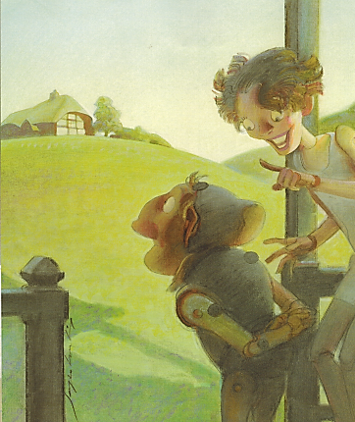
You Are Special – Max Lucado – Sergio Martinez

Slide 25
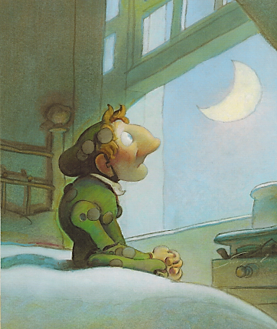
You Are Special – Max Lucado – Sergio Martinez

Slide 26
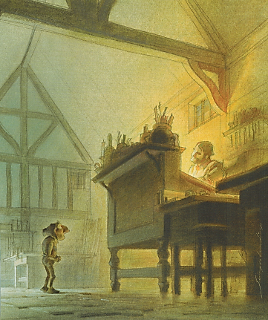
You Are Special – Max Lucado – Sergio Martinez

Slide 27
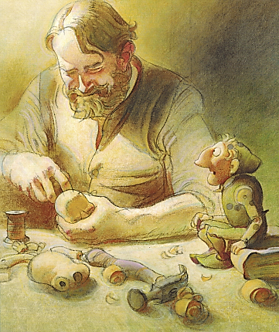
You Are Special – Max Lucado – Sergio Martinez

Slide 28
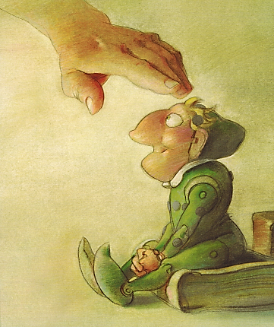
You Are Special – Max Lucado – Sergio Martinez

Slide 29
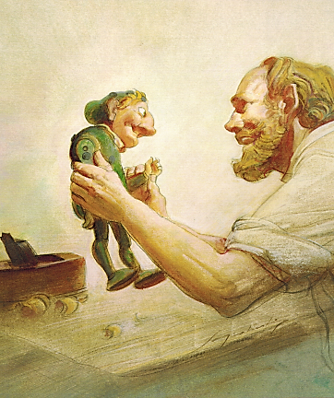
You Are Special – Max Lucado – Sergio Martinez

Slide 30
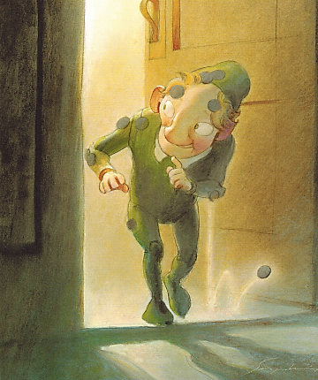
You Are Special – Max Lucado – Sergio Martinez

Slide 31
You Are Special
Max Lucado &
Sergio Martinez

Slide 34
End of Day #1

Slide 35
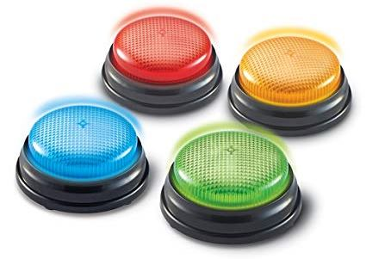
Game
Buzzer
Review

Slide 37
True Value
Our TRUE VALUE never changes!
Sense of Value
What I feel about myself.
What I think about myself.
What I believe to be true about myself.

Slide 39
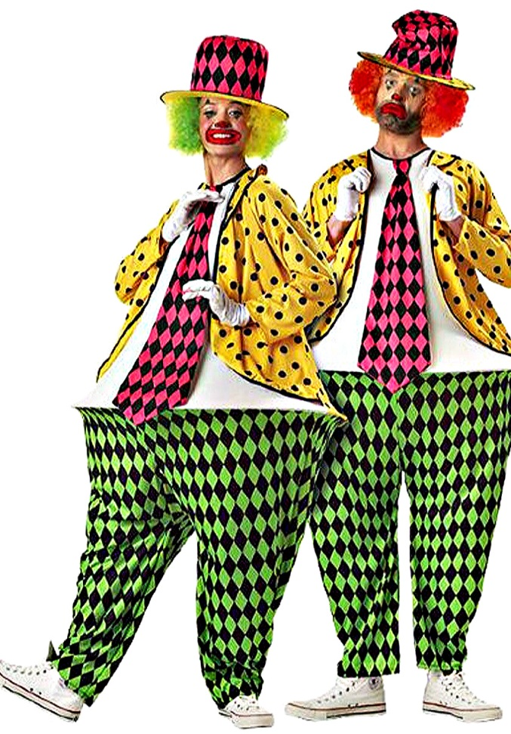
Hula-Hoop
Pants
Game

Slide 41
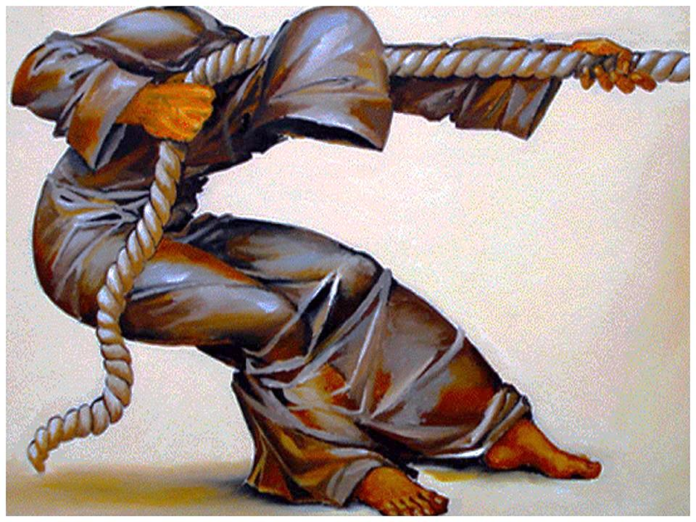
You Have a Purpose:
Dreams & Destiny

Slide 42
Broken Rejected “Guess Who?”
https://youtu.be/MJ6hCI-7uKI

Slide 44
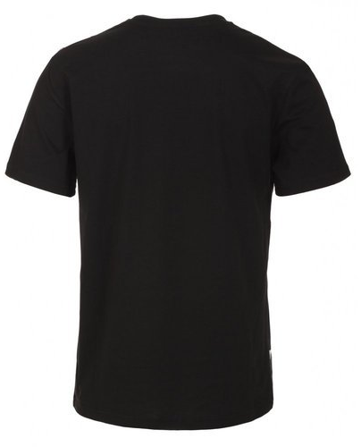
False Labels
Removing

Slide 45
True Value
Our TRUE VALUE never changes!
Sense of Value
What I feel about myself.
What I think about myself.
What I believe to be true about myself.

Slide 46
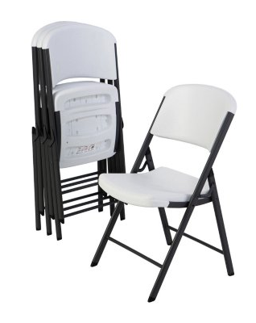
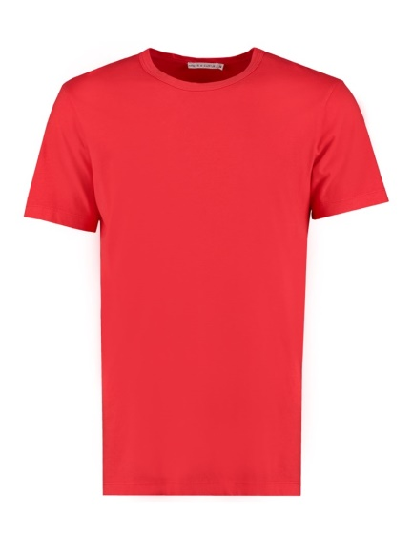
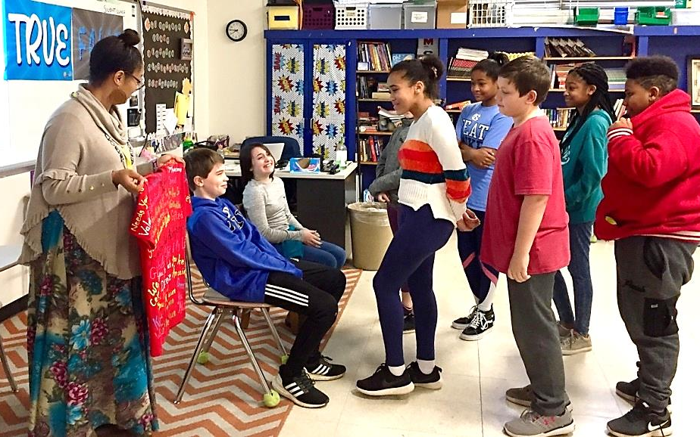
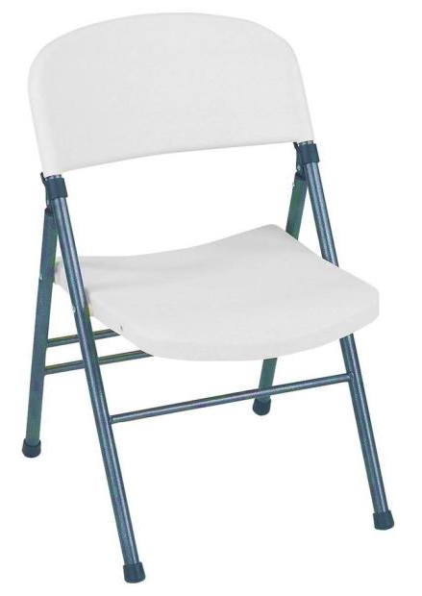
Value Seat
Speaking Truth:

Slide 47
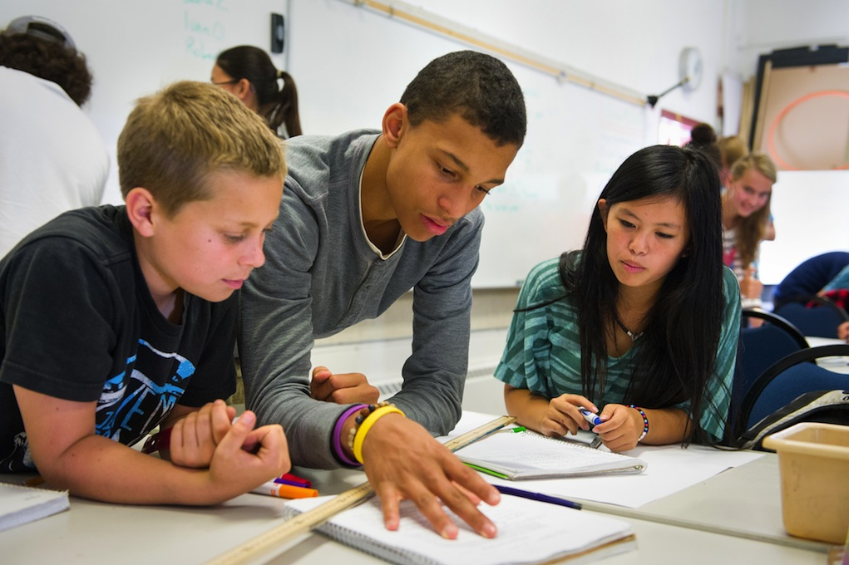
Remove
Speak
Truth
False Labels
You have dreams, a purpose, and a destiny that matters
Reject
Lies

Slide 51
Student Choices

Slide 52
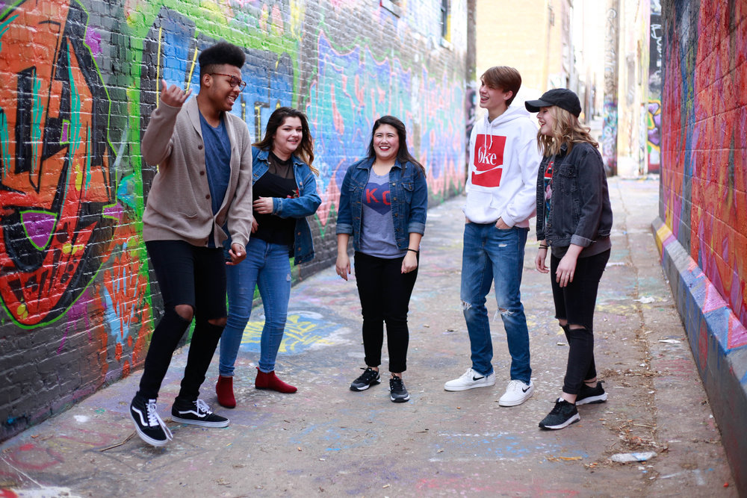
I have the
To choose and
To change
Ways to bring Light to your school: 1. 2. 3. 4.

Slide 54
You are a World Changer!

