Slide 1
thecenteroflight.org

Slide 2
Why values-based character education?
Responsibility allows us to make decisions; freedom allows us to make wrong decisions; wisdom allows us to make intelligent decisions; but only character allows us to make right decisions.
…I will walk in my integrity… Psalm 26

Slide 3
Key biblical insights motivate our purposes for values-based character education
Heart of the Father to the children… Malachi 4 …and the children to the Father
Expose the orphan heart… Luke 15 …Father gives things and/or must be obeyed prevents intimacy
Freedom via destiny vs. behavior… Galatians 3-4 …act, dress, talk, achieve, and do right for love and acceptance

Slide 4
Paradigm shifts for values-based character education over classroom management
We help students and faculty to discern and make choices that will affect their life and the world around them in a positive way. It gets underneath the issues of bullying, low self-esteem, and exposes often incorrect perceptions of themselves and their value in their world.
Truth vs. Lies
Value vs. Behavior
Discipline vs. Punishment
Identity vs. Labels
Destiny vs. Mediocrity

Slide 5
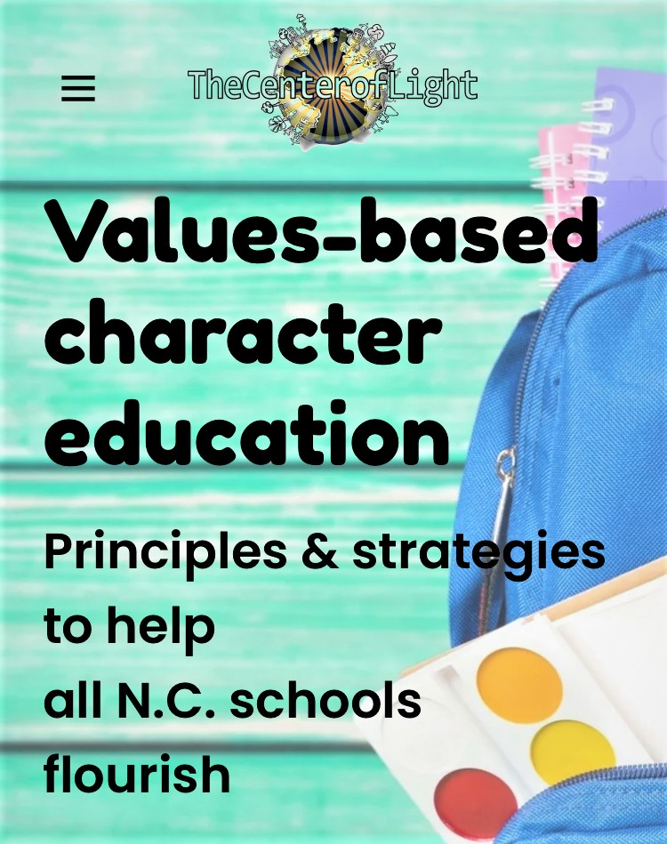

Slide 6
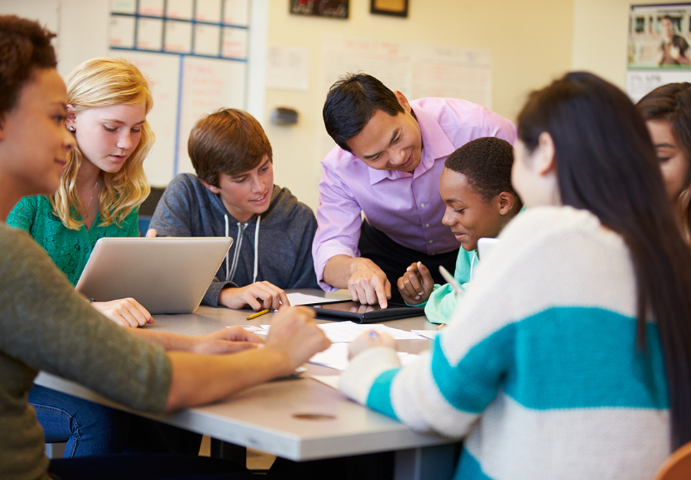
Schools

Slide 7
character education as a part of a safer school effort
Every person knows they can bring positive changes and make a difference in their school
Every student and staff understands their immense and incredible value
Every person is a unique, irreplaceable gift, and their world (school) needs them

Slide 8
Students learn to discern messages communicated as true or false about themselves
Everyone uses their power and responsibility to reject false labels (aka lies) communicated
Students help others understand their unchanging value and gifts to be a world changer
Students, individually and in groups, are organizing and implementing projects and campaigns to make their school better

Slide 9
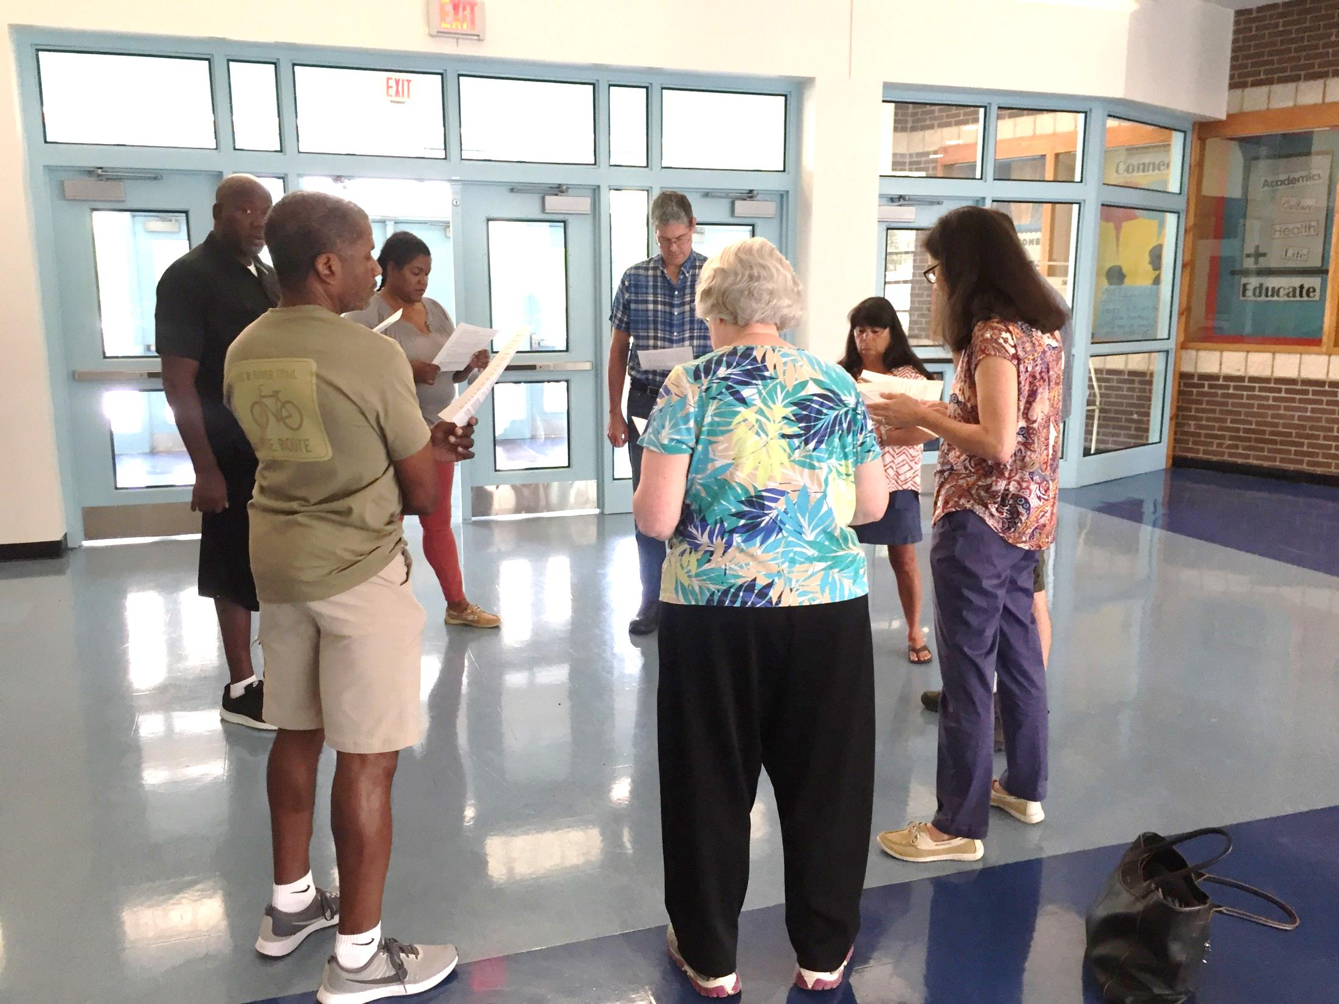
Prayer

Slide 10
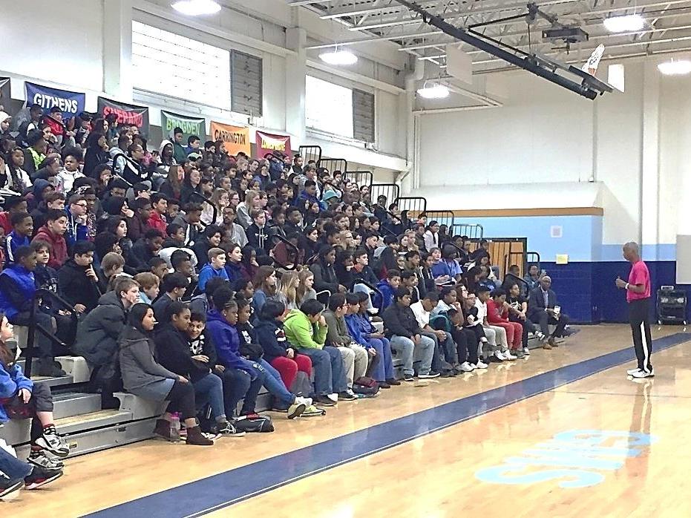
Assemblies

Slide 11
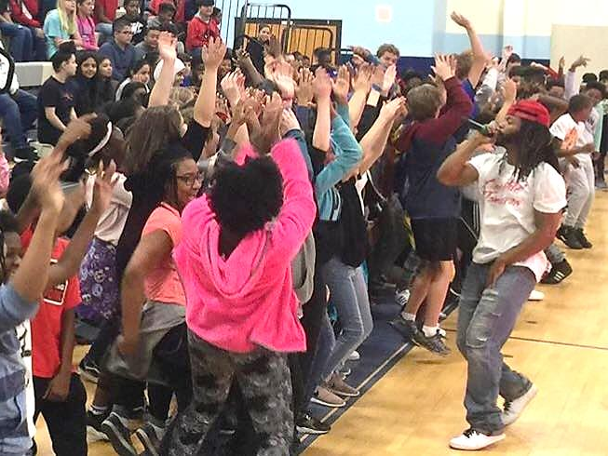

Slide 12
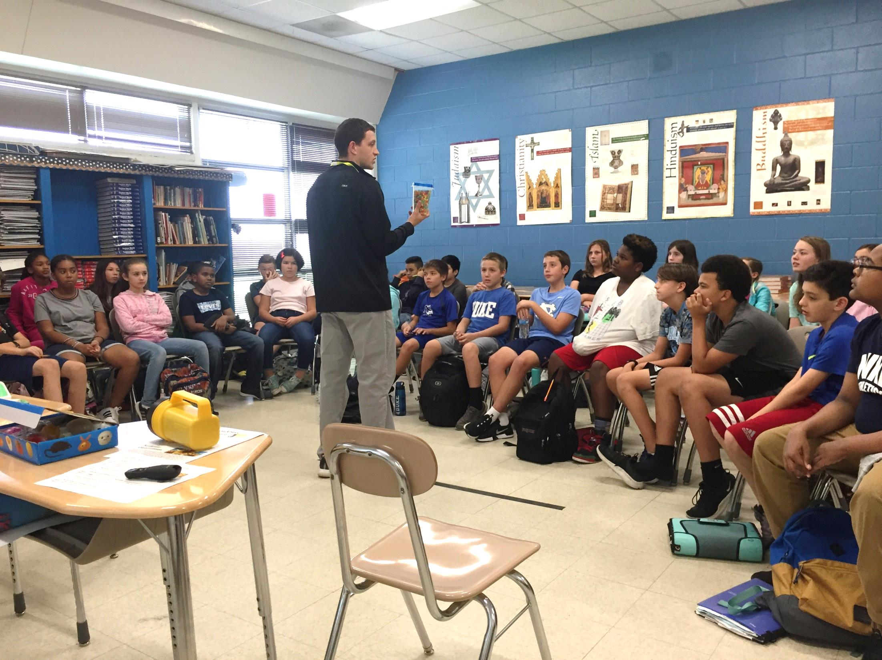
Classrooms

Slide 16
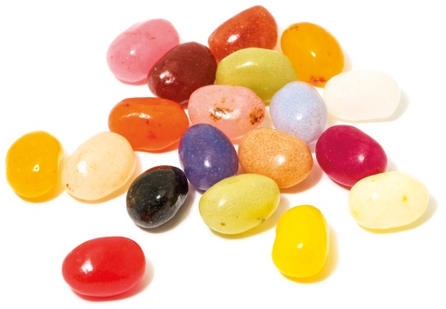
Power of One

Slide 17
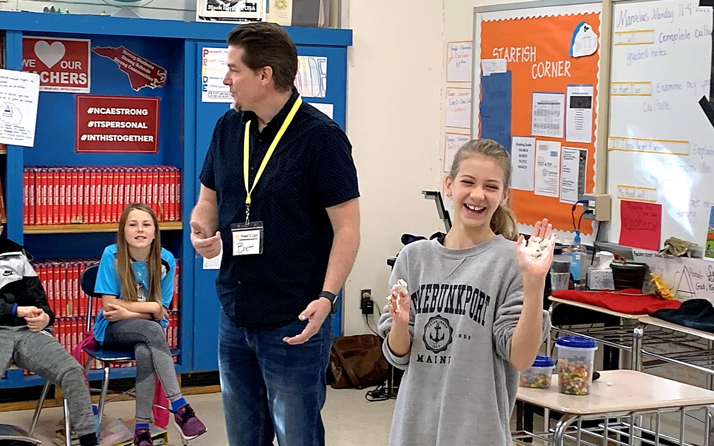

Slide 18
Unwritten Rules
You scratch my back, I’ll…
scratch yours.
You step on me, and I’ll…
step on you.
You hurt me, and I’ll…
hurt you.
Don’t get mad, get…
even.
one.
It’s all about…

Slide 20
Light or Darkness
Flashlight Dramas

Slide 21
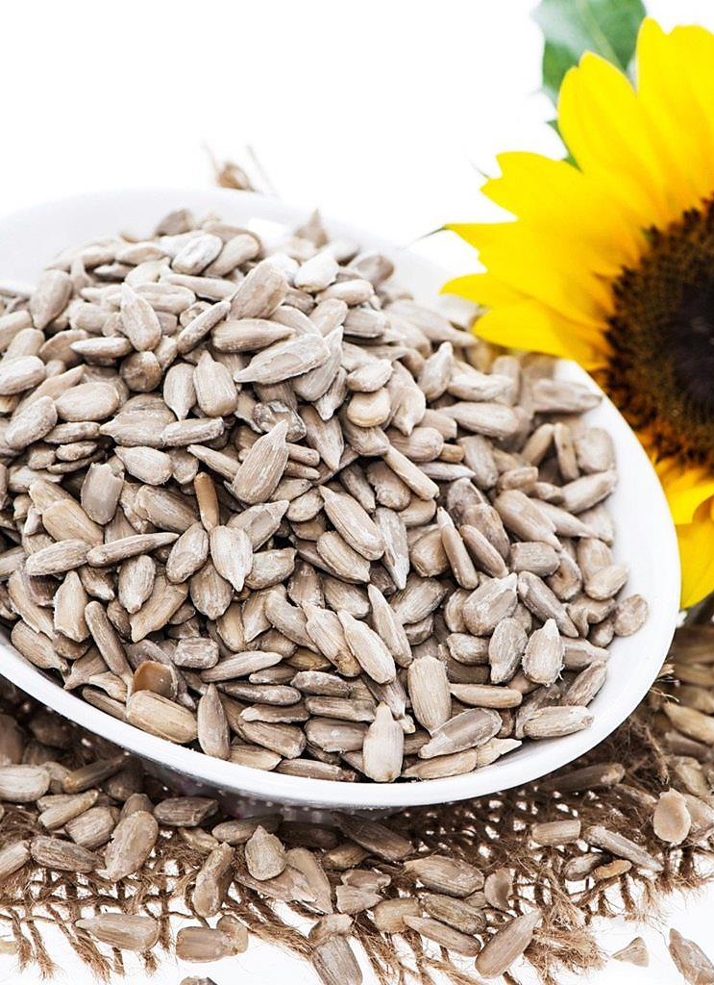
Plant – Grow - Harvest

Slide 22
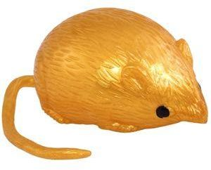
Game
Light
Darkness
&

Slide 23
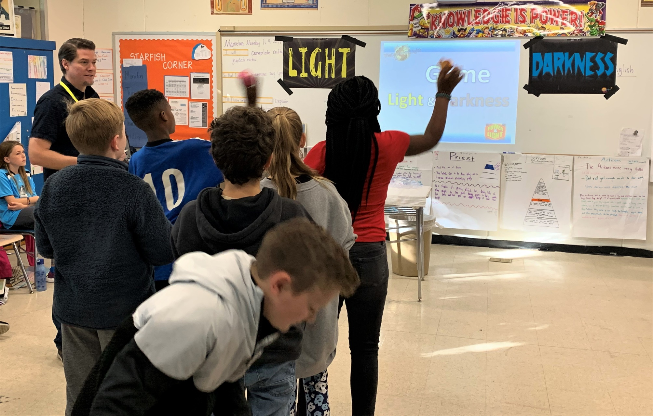

Slide 25
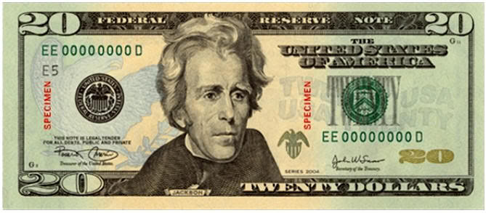
We All Have the Same Value

Slide 26
True Value
Our TRUE VALUE never changes!
Sense of Value
What I feel about myself.
What I think about myself.
What I believe to be true about myself.

Slide 27
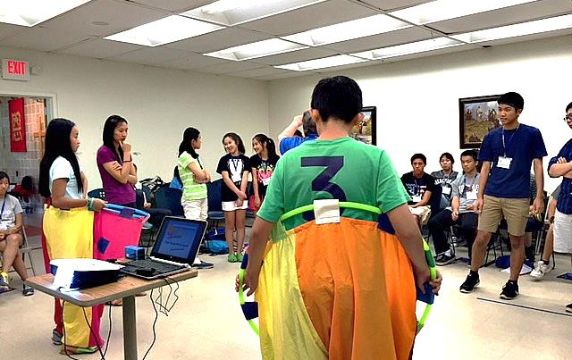

Slide 28
You Are Special
Max Lucado &
Sergio Martinez

Slide 29
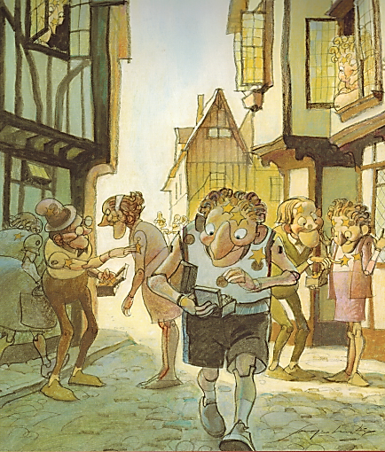
You Are Special – Max Lucado – Sergio Martinez

Slide 30
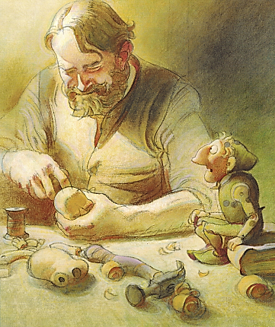
You Are Special – Max Lucado – Sergio Martinez

Slide 31
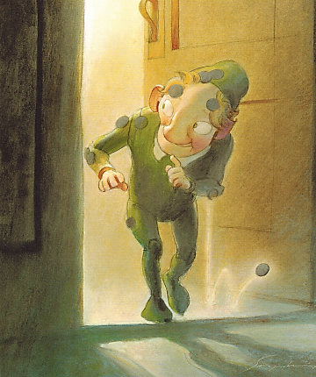
You Are Special – Max Lucado – Sergio Martinez

Slide 32
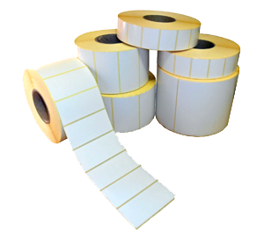
False Labels
Removing

Slide 33
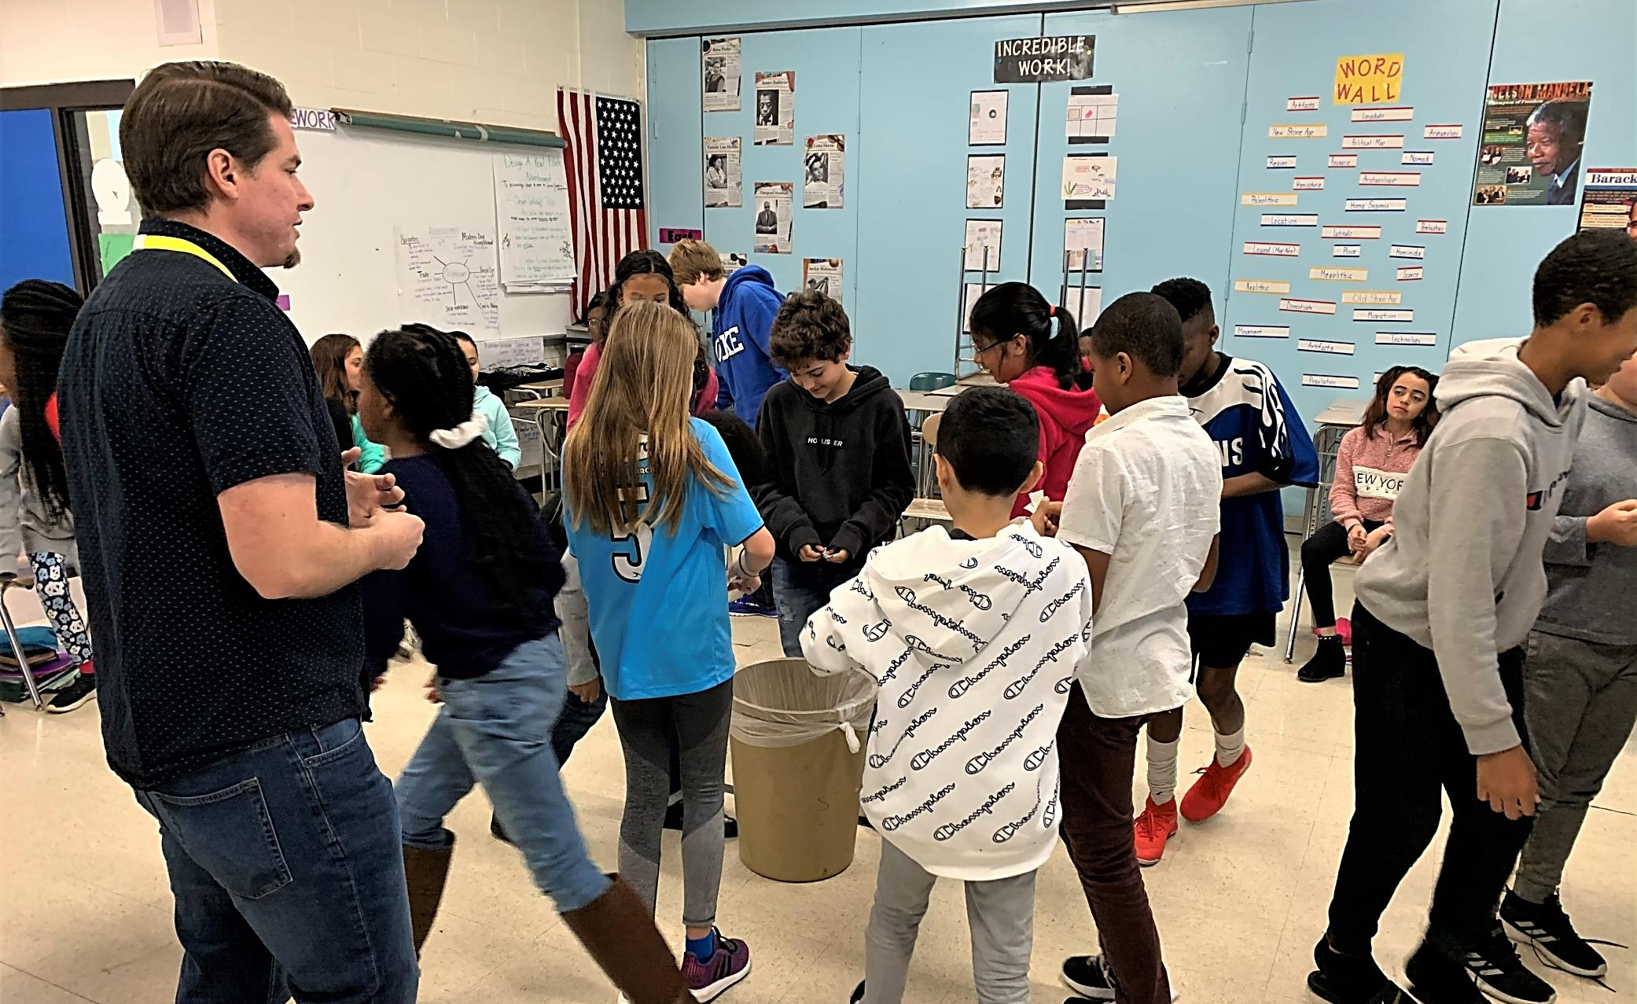

Slide 34
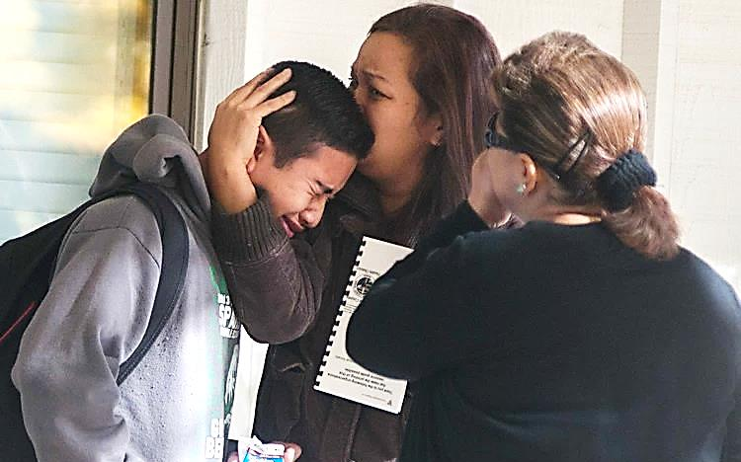

Slide 35
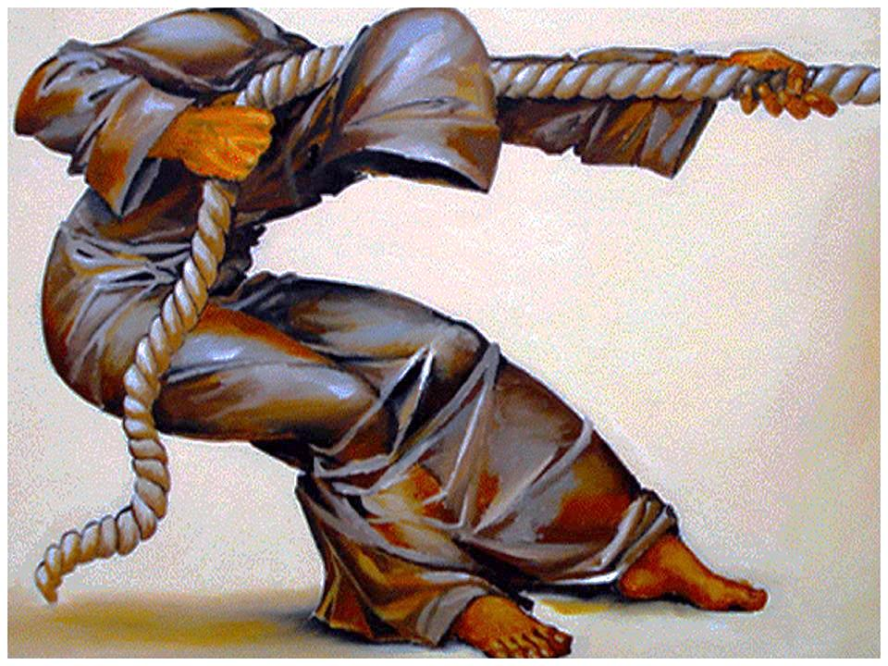
You Have a Purpose:
Dreams & Destiny

Slide 36
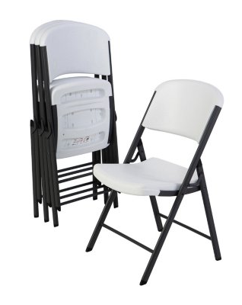
Value Seat
Speaking Truth:

Slide 37
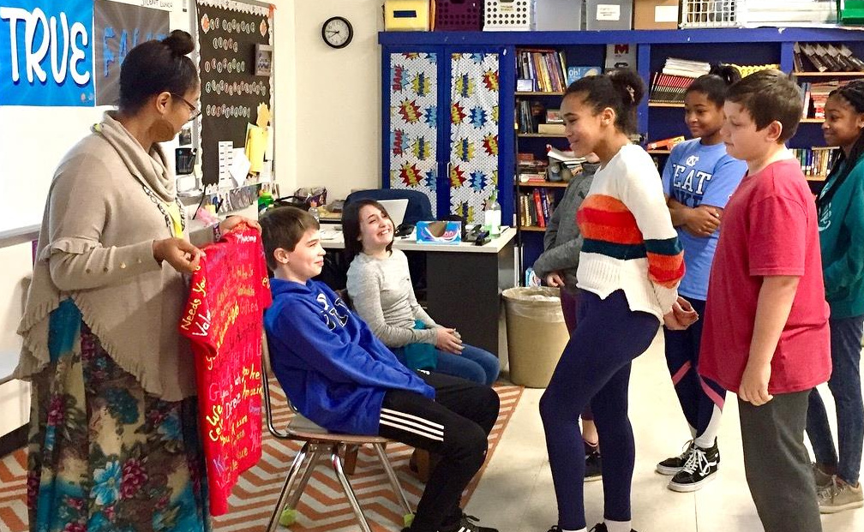

Slide 38
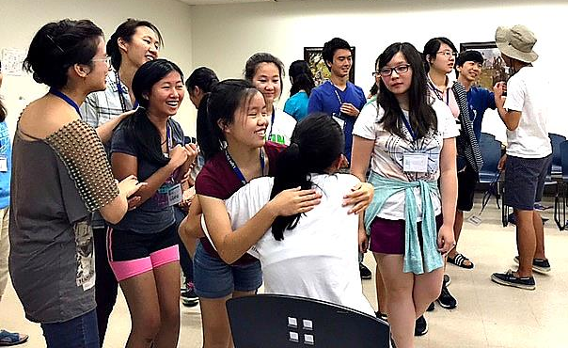

Slide 40
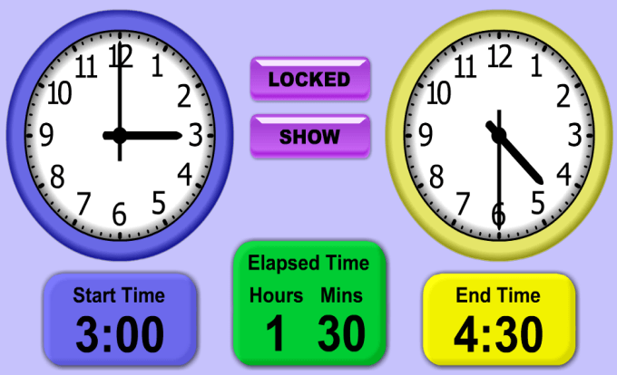
Game: TIME

Slide 41
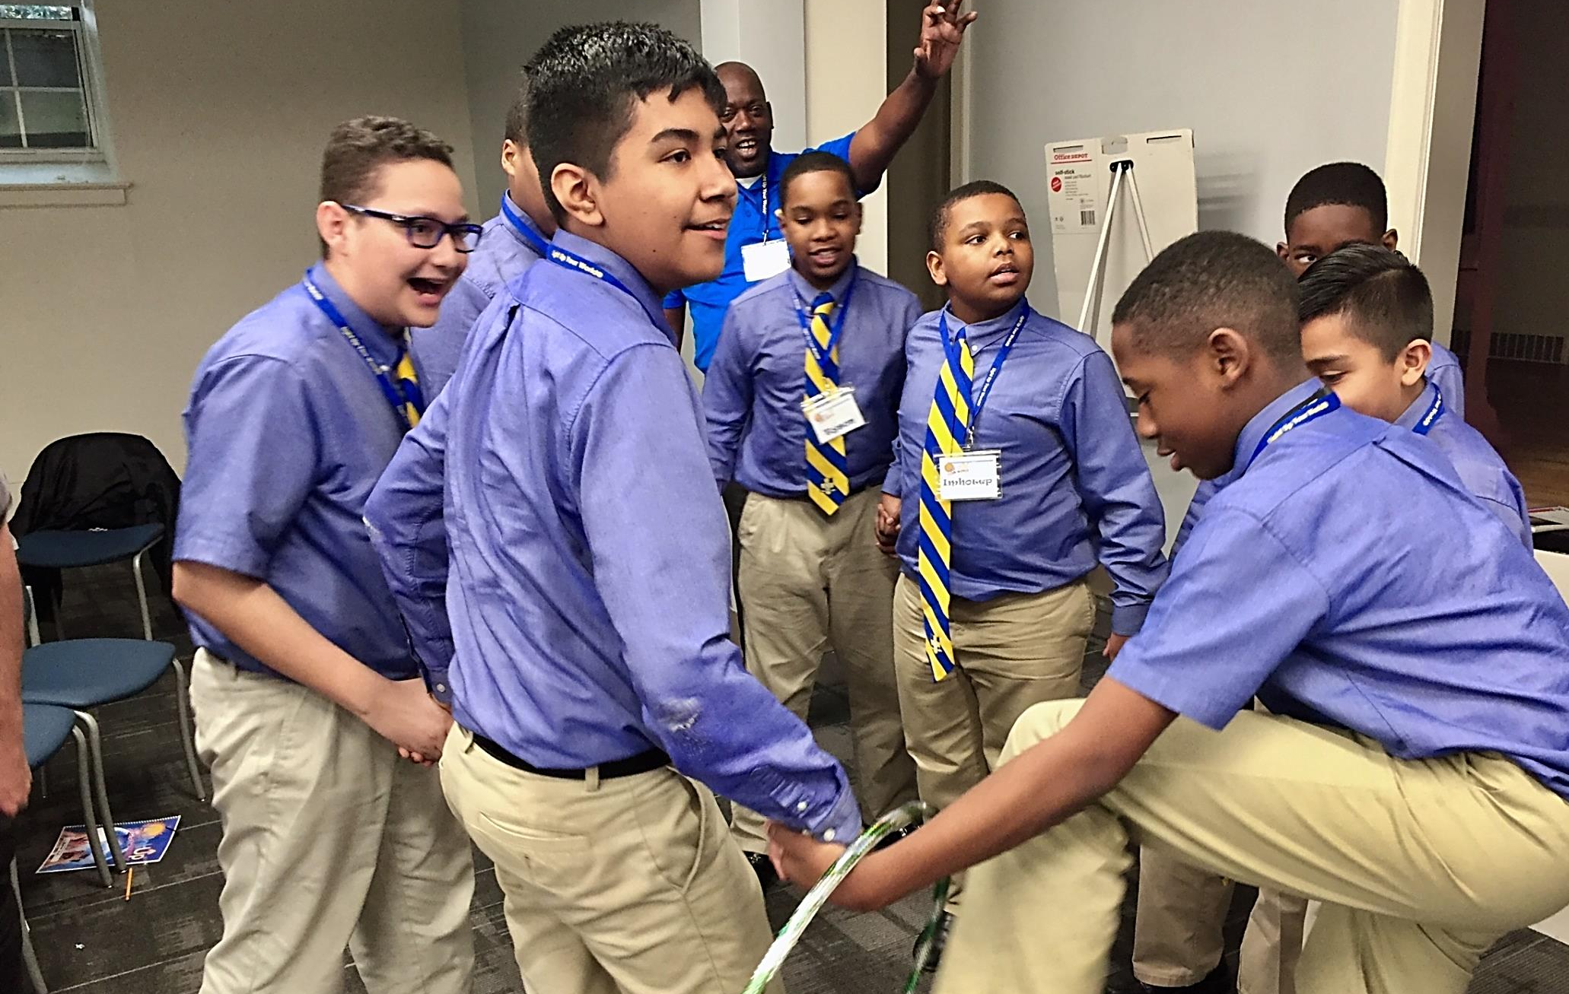

Slide 42
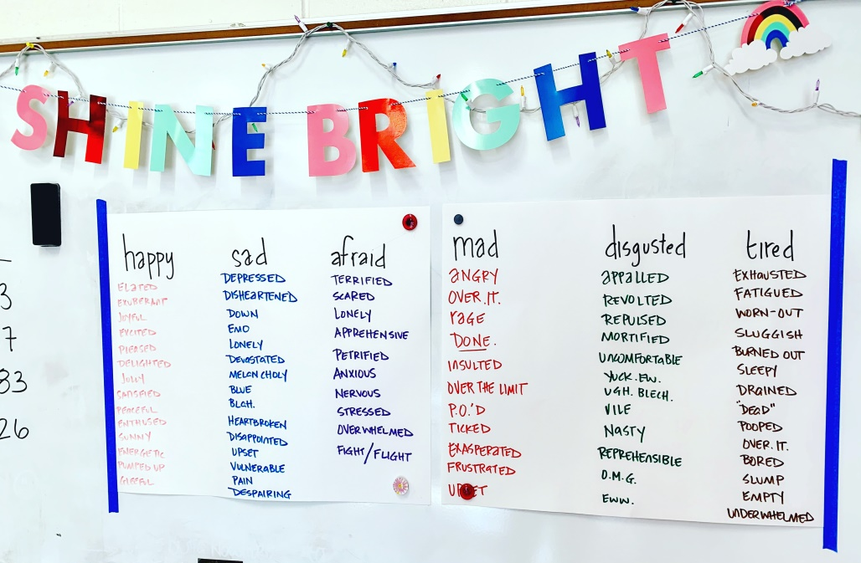
Ways to bring Light to your
school
Goal-setting:

Slide 43
Student Choices

Slide 44
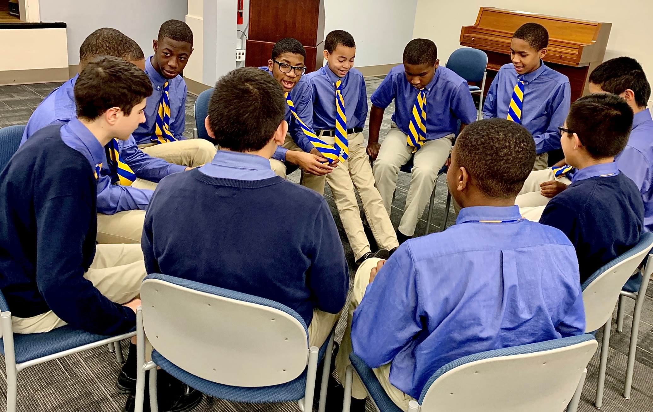

Slide 45
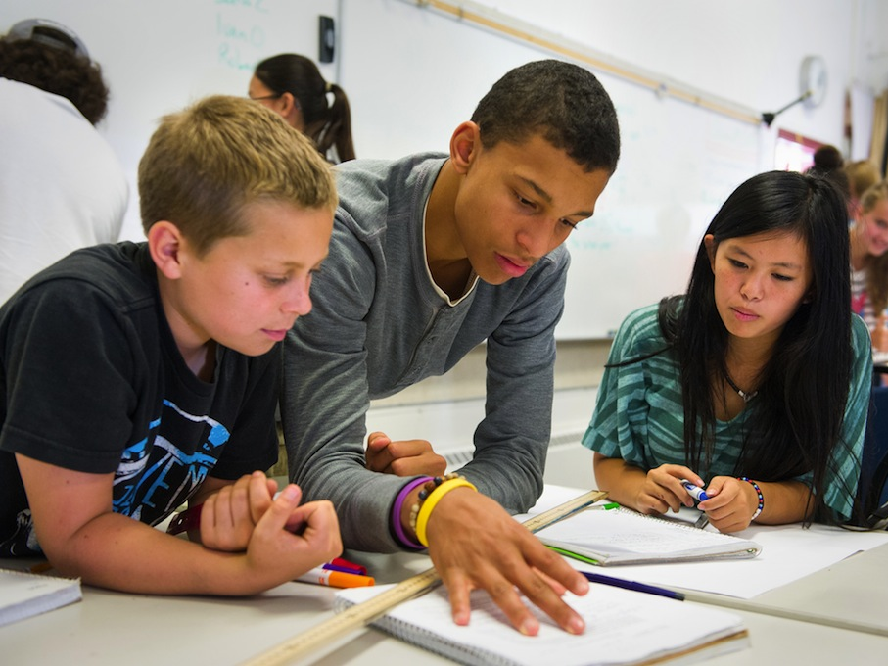
Class Project

Slide 46
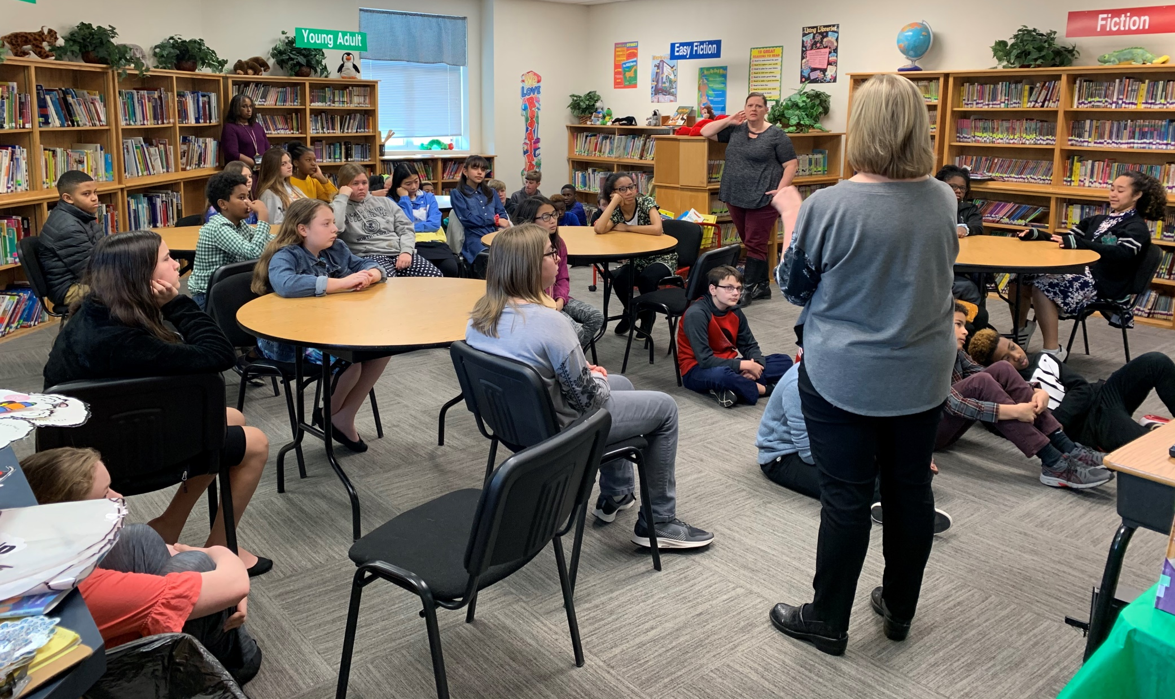

Slide 47
Be a World Changer

