Slide 1
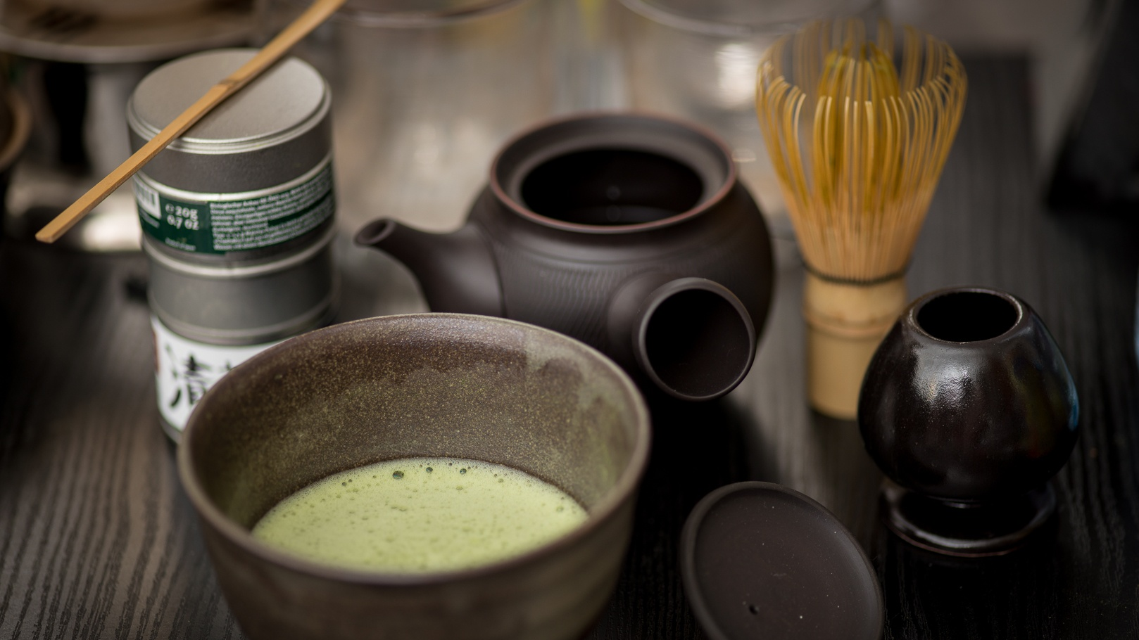
TEA CEREMONY IN JAPAN

Slide 2
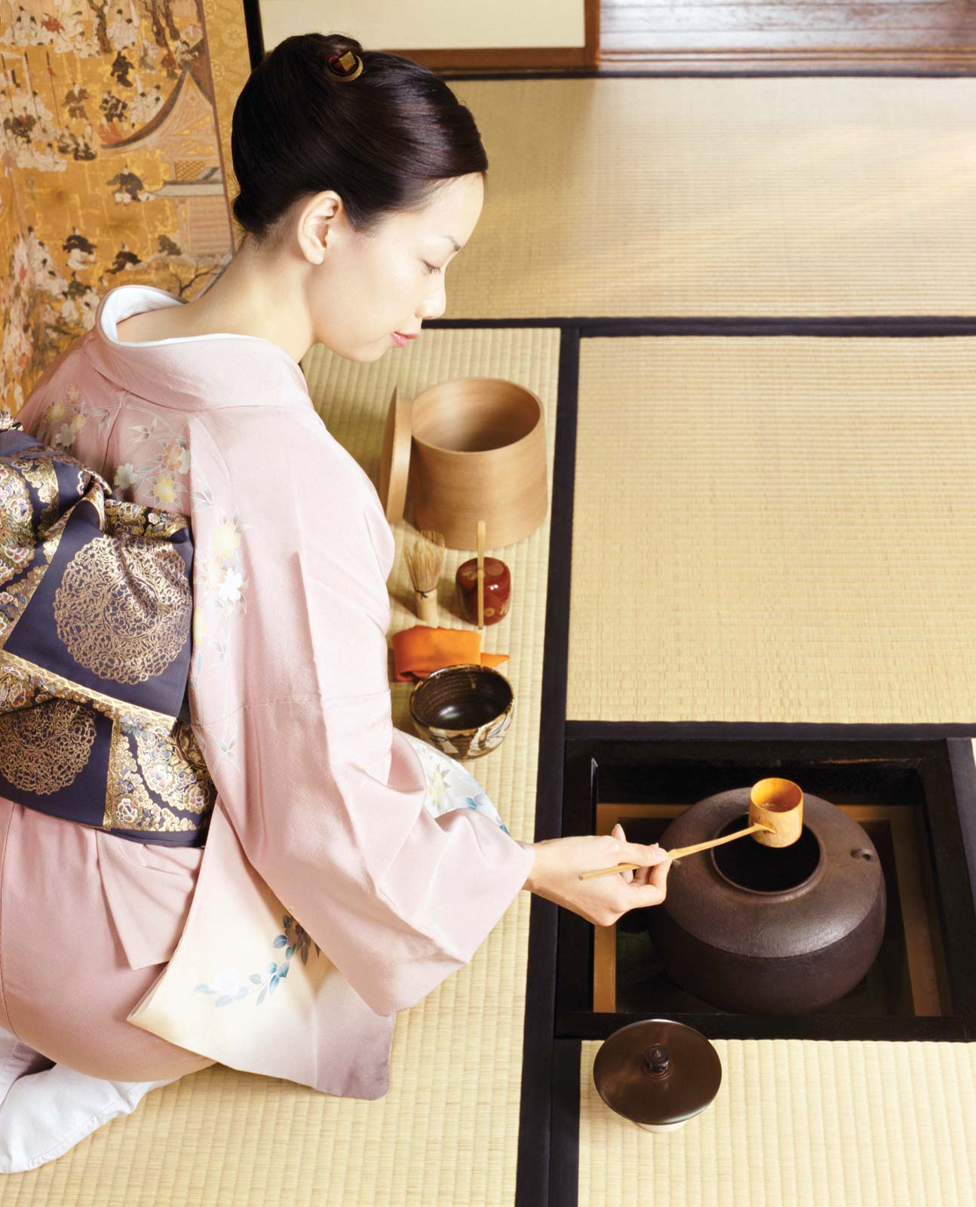
Tea Ceremony :
Tea ceremony, Japanese chadō or sadō (“way of tea”). The serving of tea ritualized over time and rooted in Zen Buddhism. It symbolizes aesthetic simplicity and represents the Fundamental Zen principles of harmony, respect, purity, and tranquillity. The word chanoyu (Chah-no-yoo) means "hot water for tea," but it’s simple art is a synthesis of many Japanese arts which focus on preparing and serving a bowl of tea. It is an aesthetic way of welcoming guests, in which everything is done according to an established order.

Slide 3
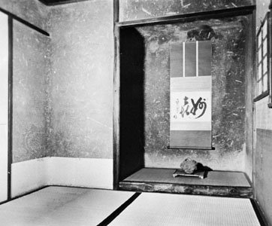
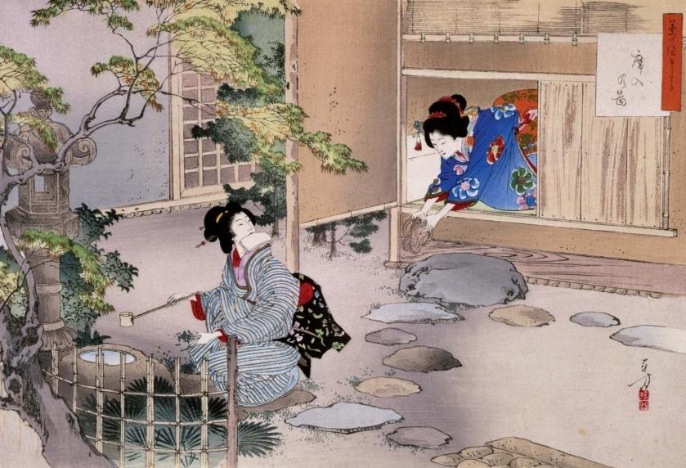
The ceremony takes place in a tea house (cha-shitsu ), which ideally is a small structure detached from the main house but which is often simply a special room of the house. Great care is taken in the choice of materials for and construction of the cha-shitsu to give it a sense of rustic yet refined simplicity. The room is usually about 3 m (9 feet) square or smaller; at one end there is an alcove, called the tokonoma, in which is displayed a hanging scroll, a flower arrangement, or both. The room also contains a small sunken fireplace (ro) that is used in the winter months for heating the tea kettle; in the summer a portable brazier is used. The cha-shitsu is entered through a small, low door, which is designed to suggest humility.

Slide 4
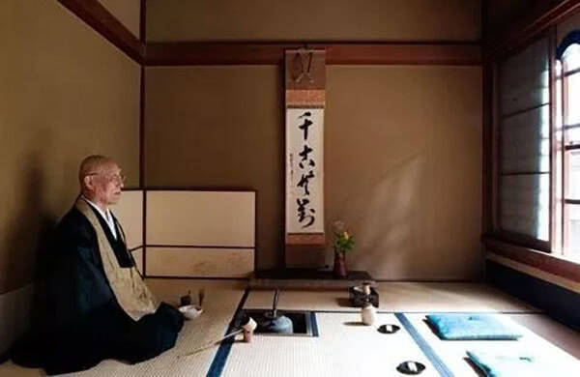
The tea ceremony consists of the host first bringing the tea utensils into the
room, offering the guests special sweets and then preparing and serving them
tea made of pulverized tea leaf stirred in hot water. The prepared tea is usually
thin and frothy with a mildly astringent flavour; on certain occasions a much
thicker “heavy tea” (koicha) is made. The serving of sweets and tea maybe
preceded by a light meal. After the tea
is consumed, the guests are free to
inquire about the various implements,
which are afterward carried from the
room and the ceremony concluded.

Slide 5
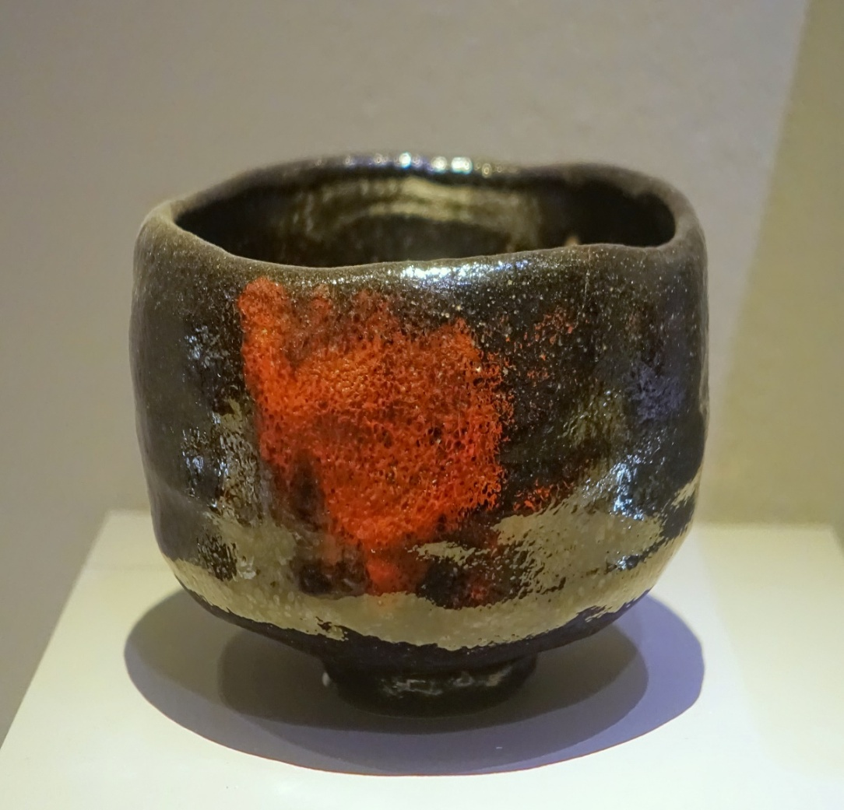
Ritual tea drinking, which originated in China, was first practiced in Japan during
the kamakura period (1192–1333) by Zen monks, who drank tea to keep awake
during long sessions of meditation. It later
became an active part of Zen ritual honouring
the first patriarch, Bodhi dharma (Japanese:
Daruma). During the 15th century it came to be
a gathering of friends in an isolated atmosphere
to drink tea and discuss the aesthetic merits of
paintings, calligraphy, and flower arrangements
displayed in the tokonoma or quite often to
discuss the merits of the tea utensils themselves.

Slide 6
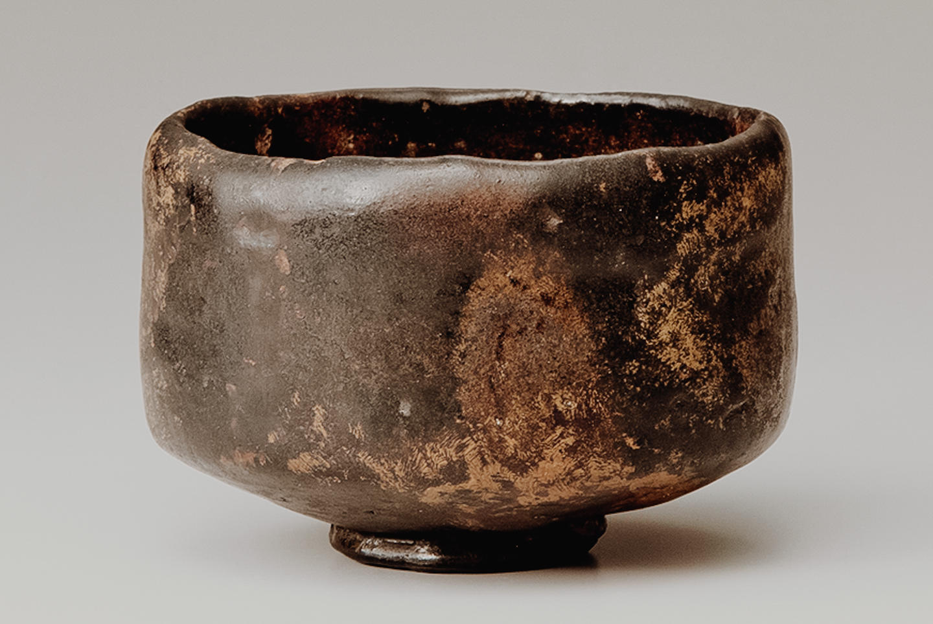
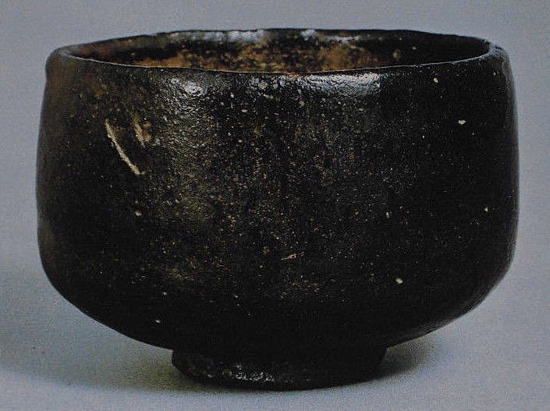
Ceramics ware for tea ceremony:
Raku-Yaki is among the most famous types of teaware in Japan. There are other popular earthenware including NI-HAGI and SAN-KARATSU. Raku-yaki is the first earthenware, Hagi-yaki is the 2nd, and Karatsu-yaki is the 3rd of all Japanese earthenware. In other words, Raku-yaki is the most prestigious and highest ranked earthenware in Japanese tea ceremonies.

Slide 7
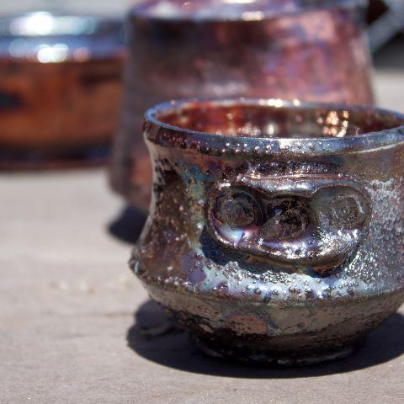
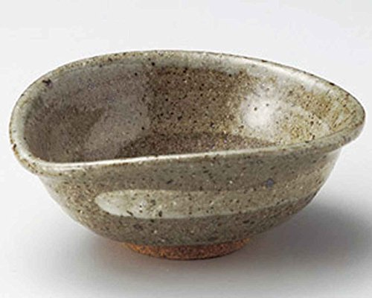
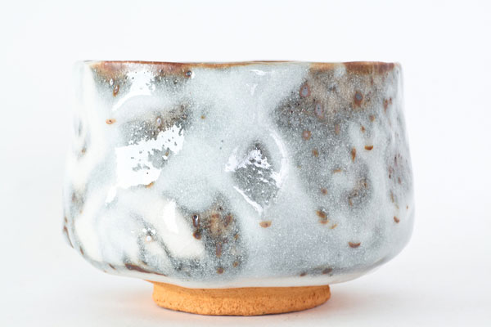
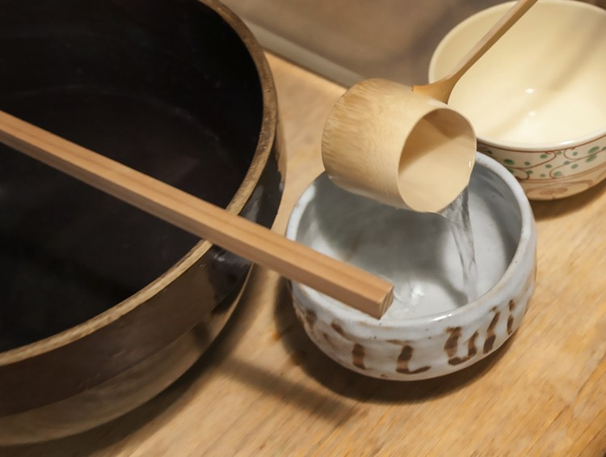
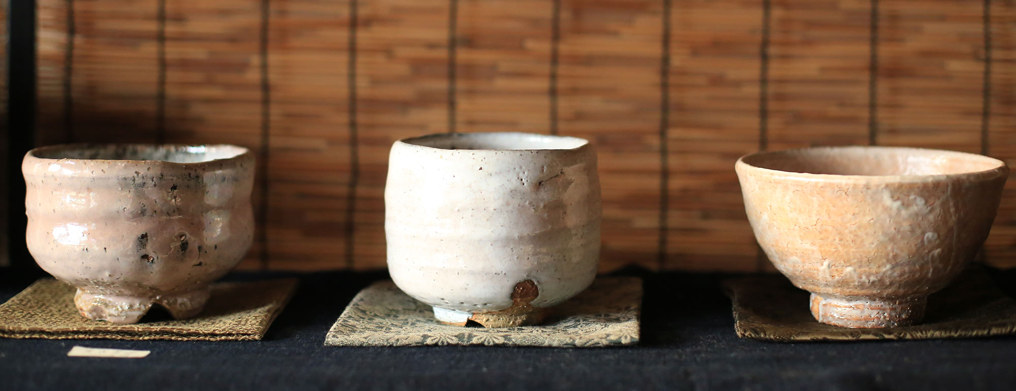
RAKU- YAKI KARATSU -YAKI HAGI-YAKI
HISHAKU (bamboo ladle) & CHAWAN (bowl) KARATSU - YAKI

Slide 8
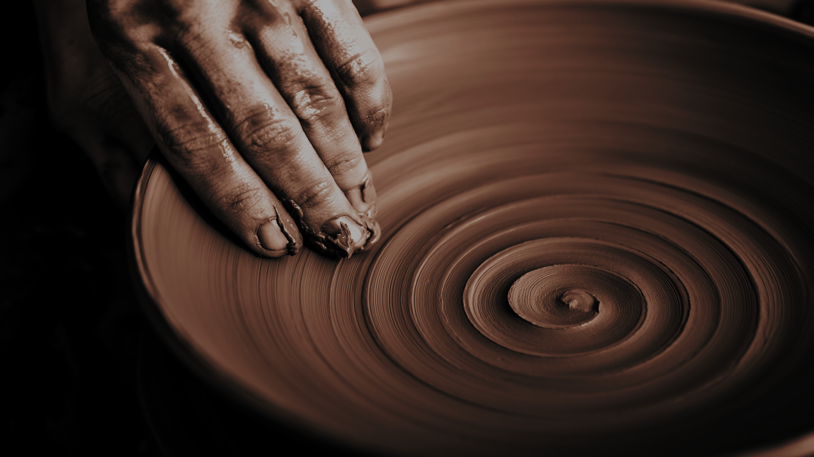

Suggestion:
Go through this content carefully because this will give you the understanding
and connection between the tradition and the process of ceramics.
References:
Google & Dictionary of art terms
Thanks……….
Madan Singh
www.madanceramics.com

