Slide 1
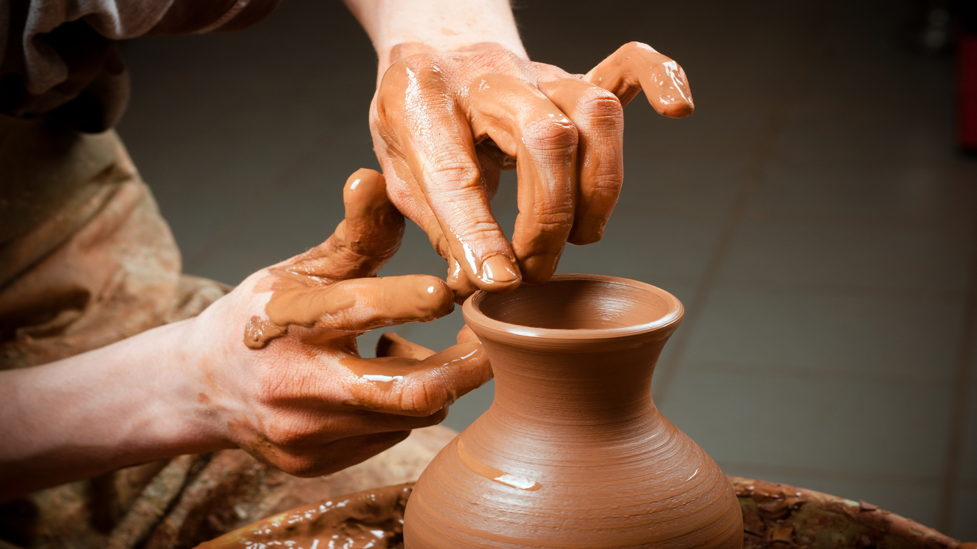
Contemporary Western Ceramics
Artist

Slide 2
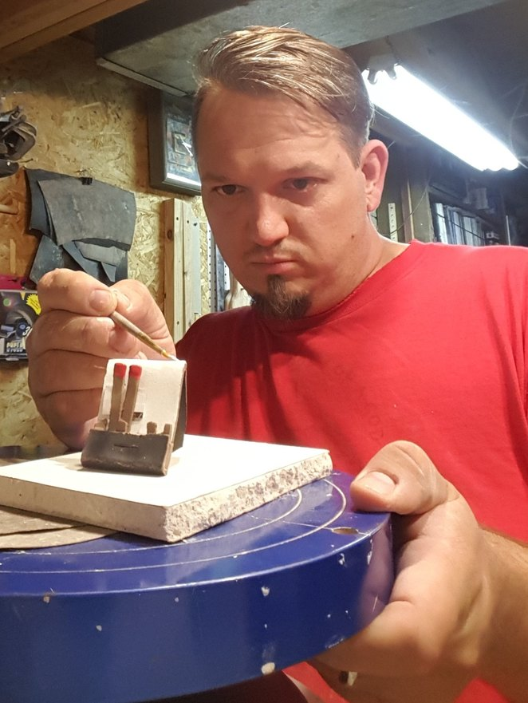
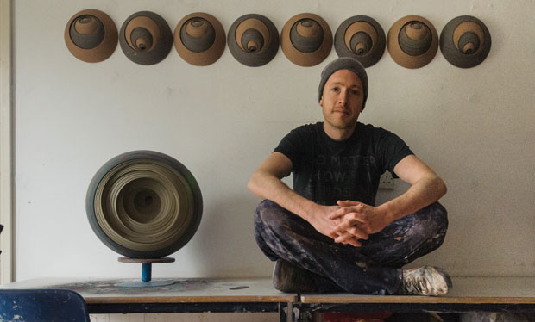
Matthew Chambers Tim Kowalczyk

Slide 3
Matthew chambers
Matthew chambers is an English ceramic artist living on the isle of
Wight just off the coast of England. Chambers studied ceramics at
the Royal College Of Art, graduating in 2004. His work is born from
a love of geometric and constructivist art and executed in earth
tone ceramics. Each piece is a constructed abstract Exploration of
shape and form that is made by layering many circular sections within a single form.
These forms are free standing and three-dimensional or wall mounted relief sculpture. The layering
technique chambers use is reminiscent of natural forms as well as technological lenses.

Slide 4
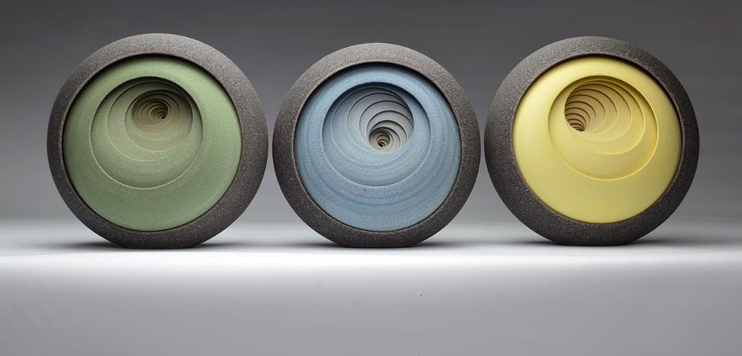
For the last 8 years Chambers has been working from a 215 square foot studio in Newport on the Isle of Wight where he creates each piece without the aid of sketches or designs, preferring to experiment as he works. Each “layer” is an individual section thrown on a potter’s wheel which he then assembles with other layers to make a solid sculpture. How something so precisely geometric can be formed from clay by hand is nothing short of astounding.

Slide 5
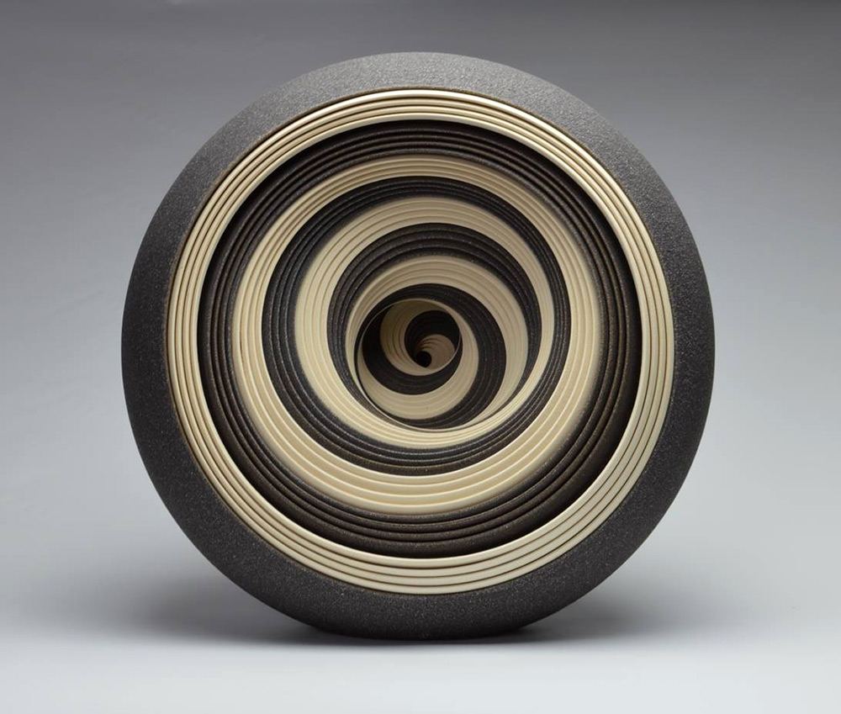
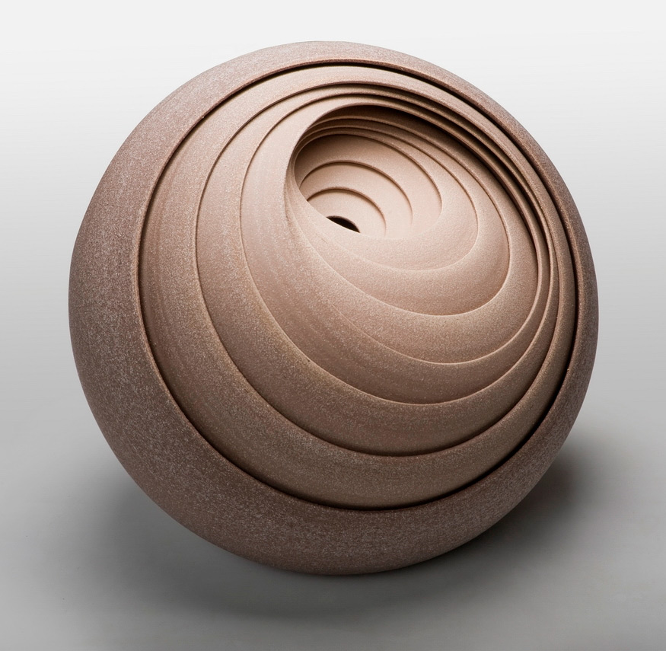
Usually people describe staring at a spinning pottery wheel as being somewhat hypnotizing, not staring at ceramic artworks themselves. But such is the case with these uncanny pieces by Matthew chambers (previously) who continues to push the limits of his concentric stoneware vessels.

Slide 6
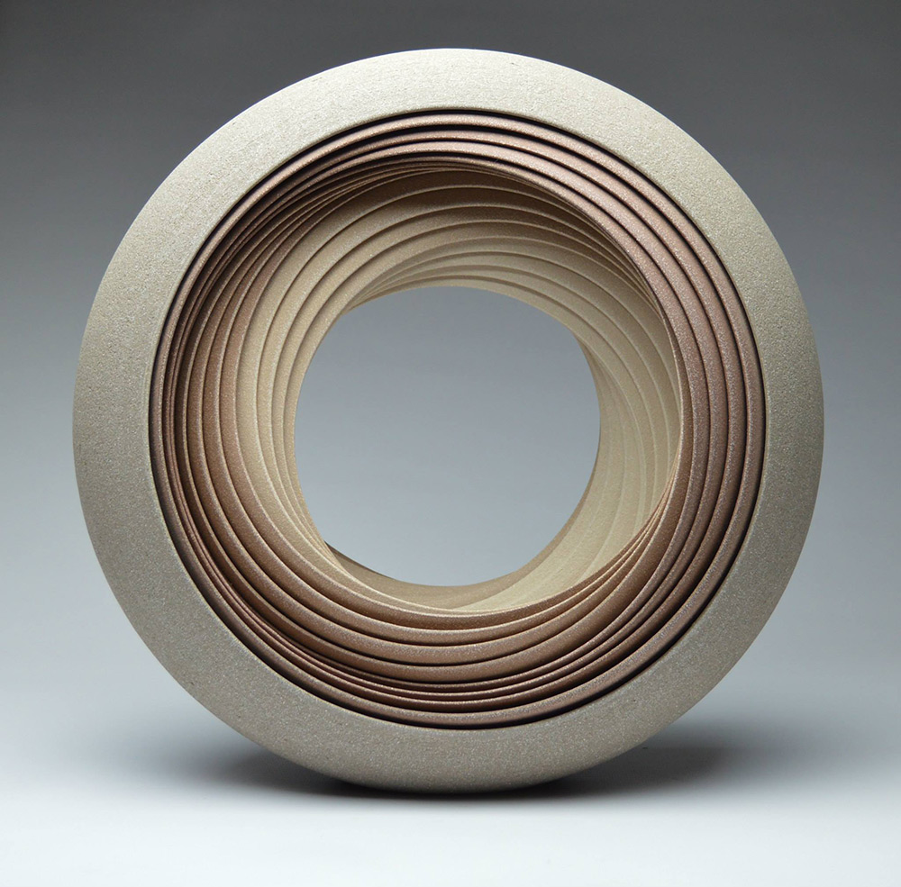
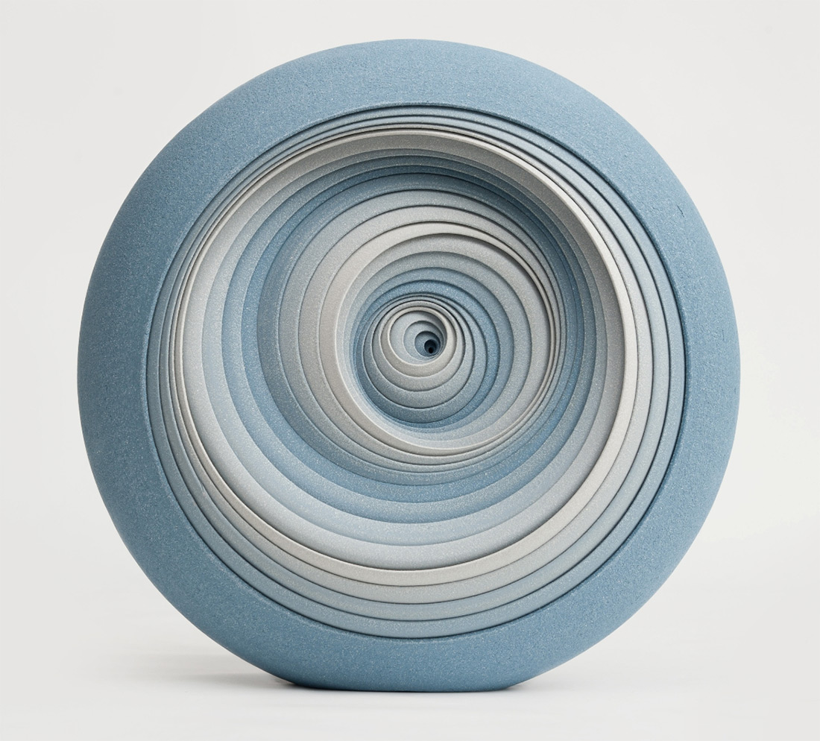
Every visible layer in his sculptures is individually crafted on a wheel before Chambers assembles them, with a single piece containing dozens of objects. The artist experiments with colour, scale, and the patterns by which each piece is internally situated to form colourful gradients or suggest motion across a sequences of sculptures.

Slide 7
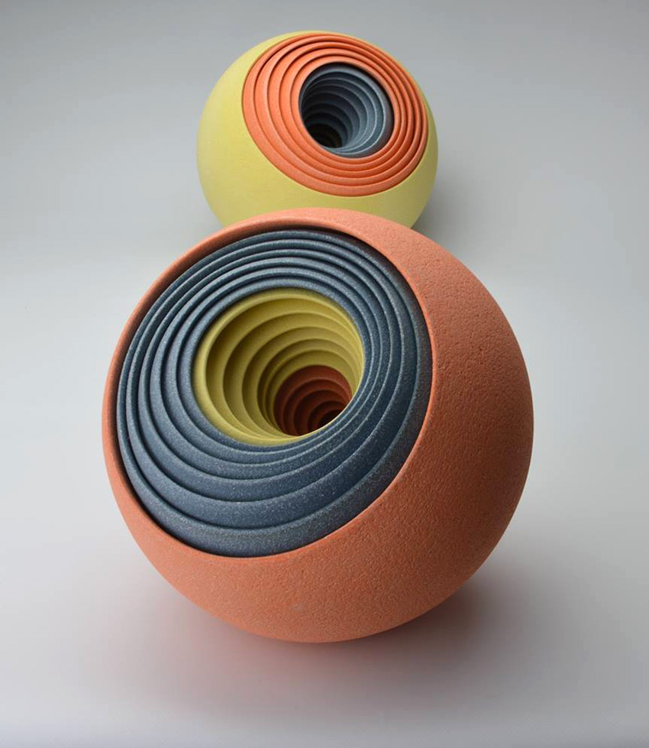
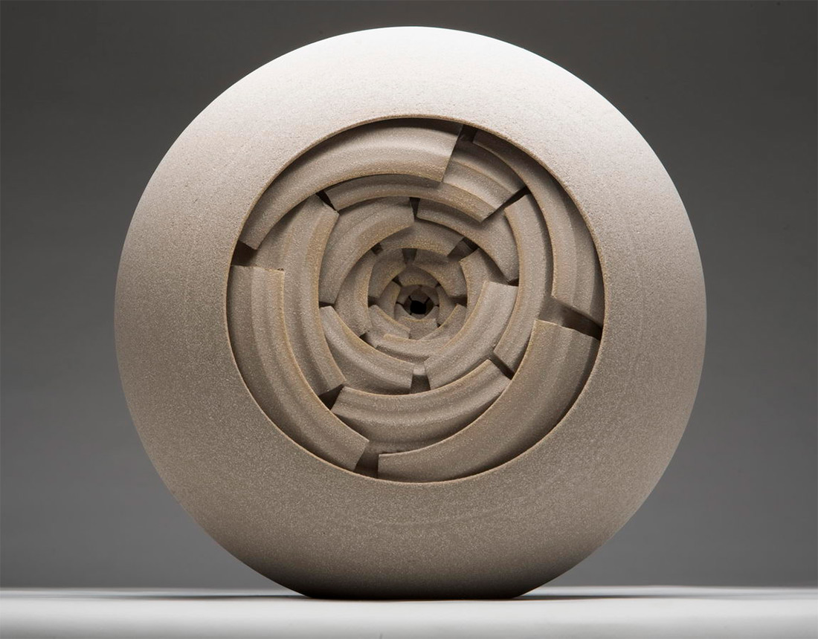

Slide 8
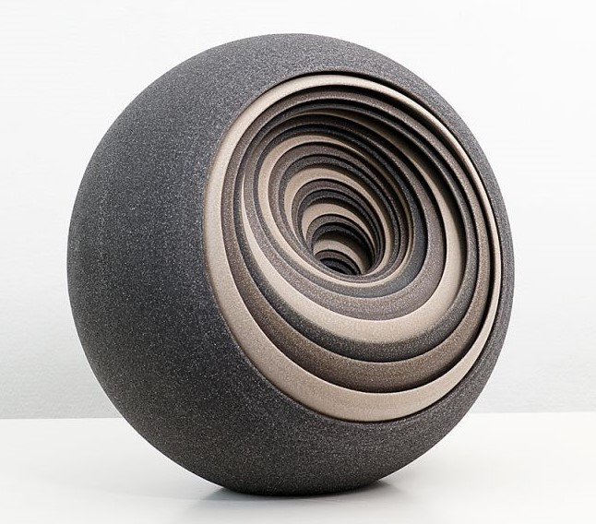
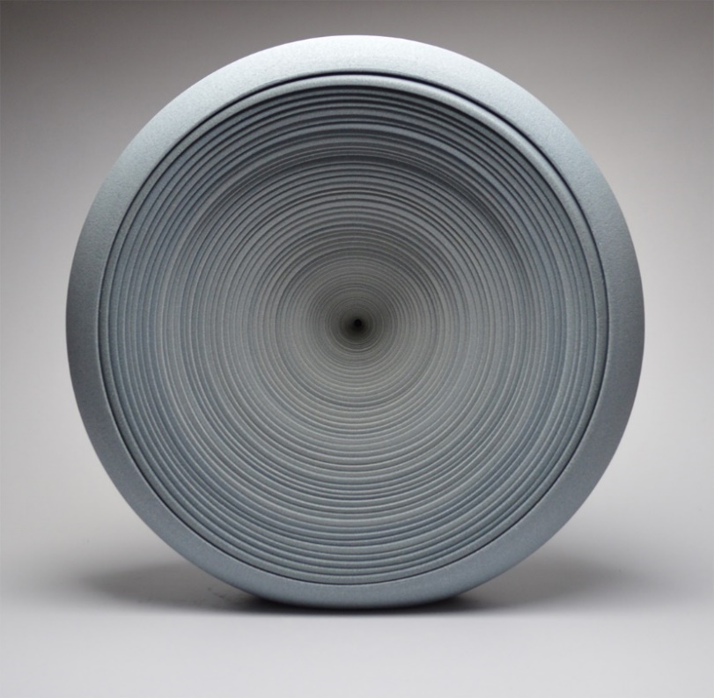
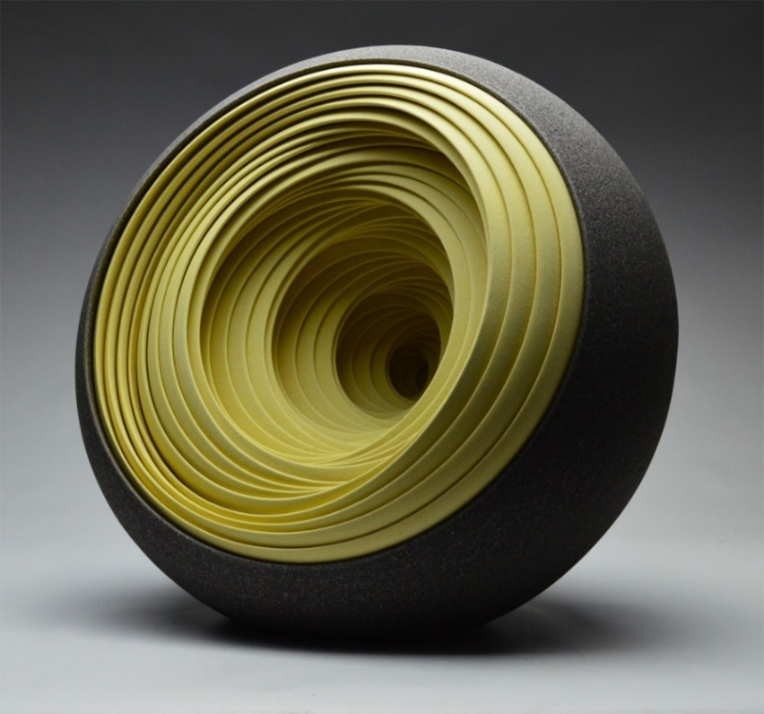
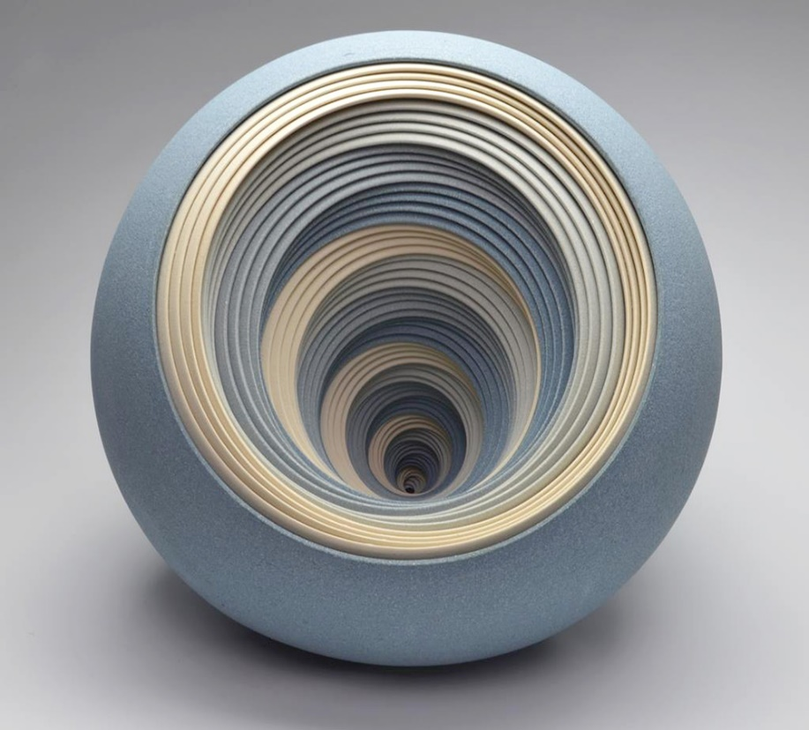
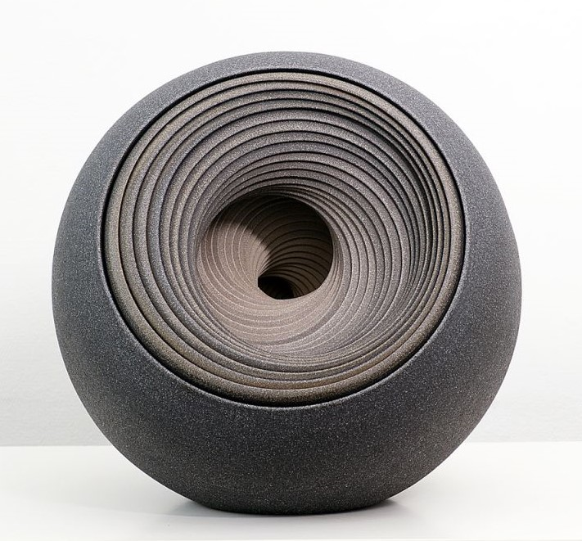
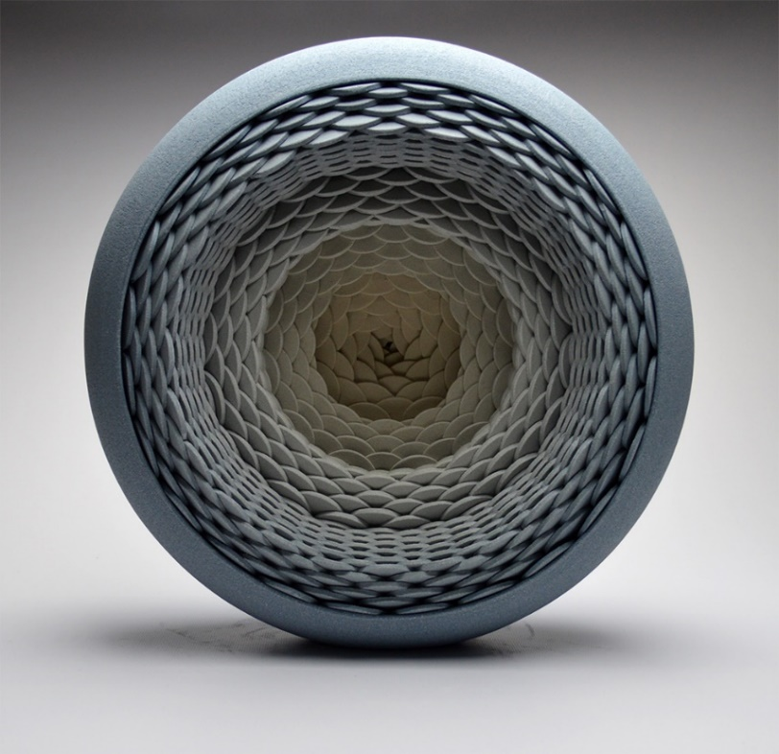

Slide 9
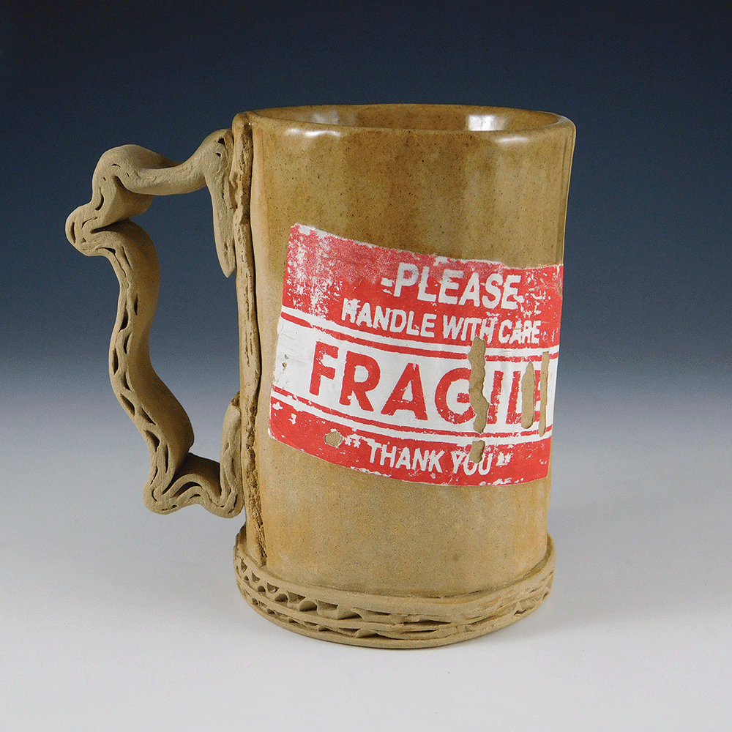
Tim Kowalczyk
Tim lives and works out of his home in Minonk, a
small town in Central Illinois, since graduating with
his MFA from Illinois State University in 2011. For
the past 6 years Tim has been in a steady stream of
Juried group, invitational, and solo exhibitions. Tim
has received several awards including the Presidential
Scholarship at Anderson Ranch Arts Center, Merwin
Medal: McLean County 82nd Annual Amateur Show,
and Best of Show: Water Street Studios Anniversary
Show. Tim’s work can be seen in private collections,
University collections, and in a recent American Craft Magazine article.

Slide 10
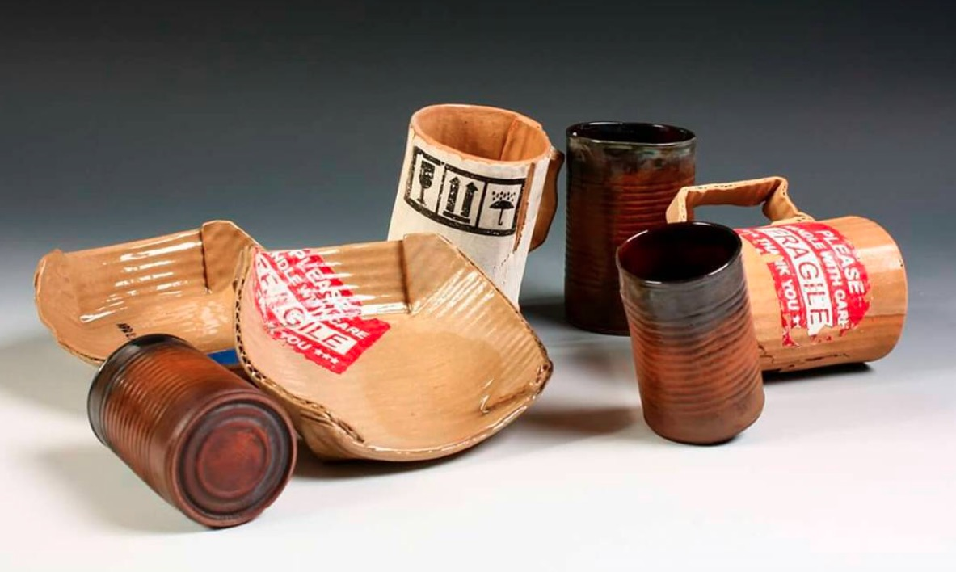
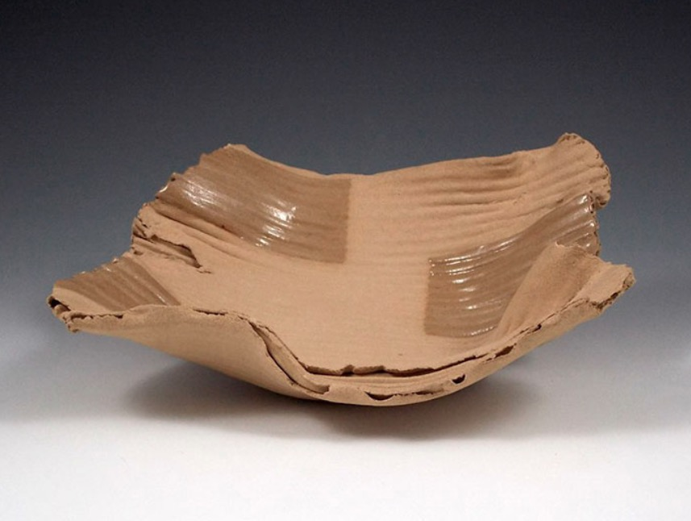
A true creative, Tim Kowalczyk finds beauty in unexpected objects. Kowalczyk is able to expertly craft ceramic pieces that emulate unconventional material muses ranging from dilapidated cardboard to tin cans. To the artist, reproducing these discarded items as ceramic wares is comparable to creating a poem. “I am able to sculpt, form, design and construct sculptures with sense of purpose, priority, and preciousness.

Slide 11
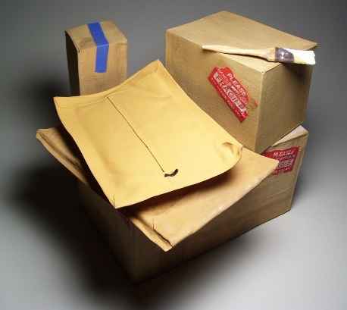
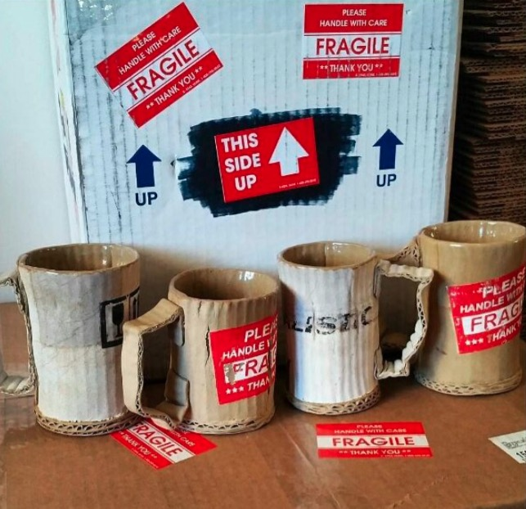

Slide 12
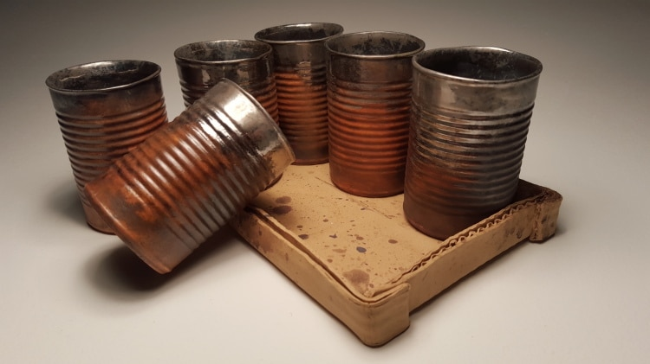
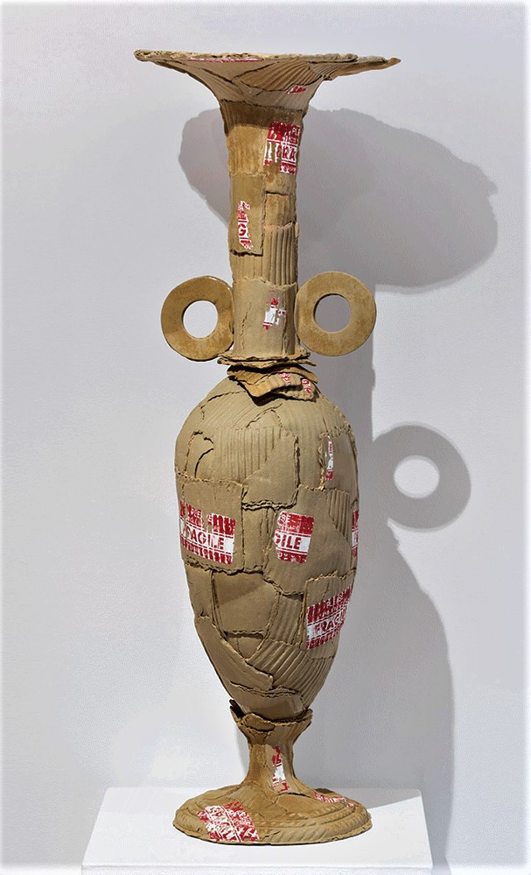
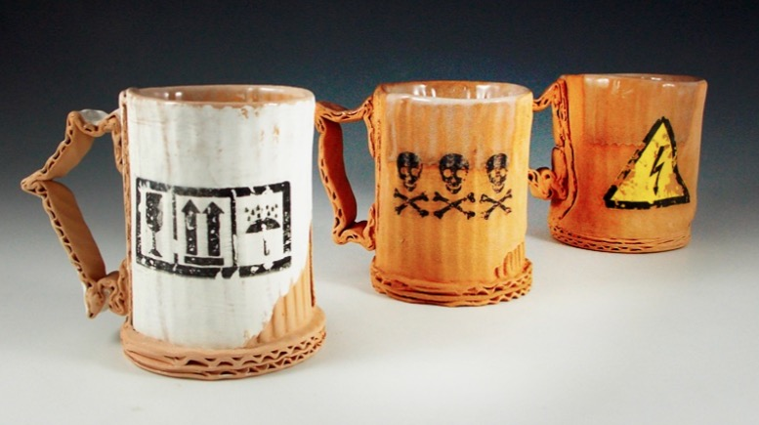

Slide 13
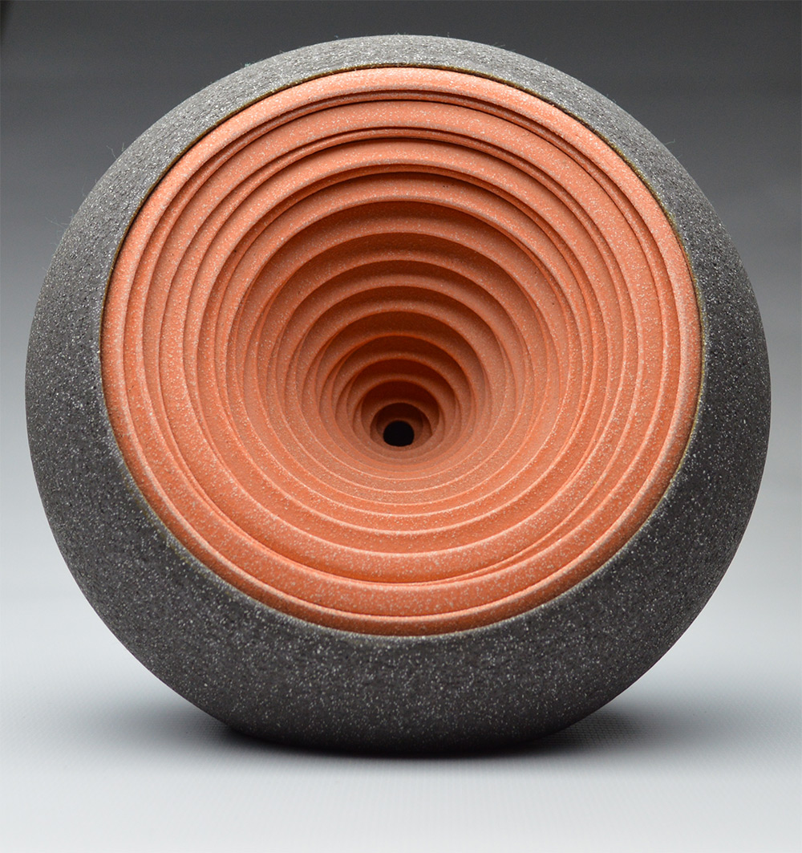
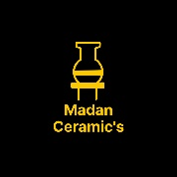
References: Google
Thanks……….
Madan Singh
www.madanceramics.com

