Slide 1
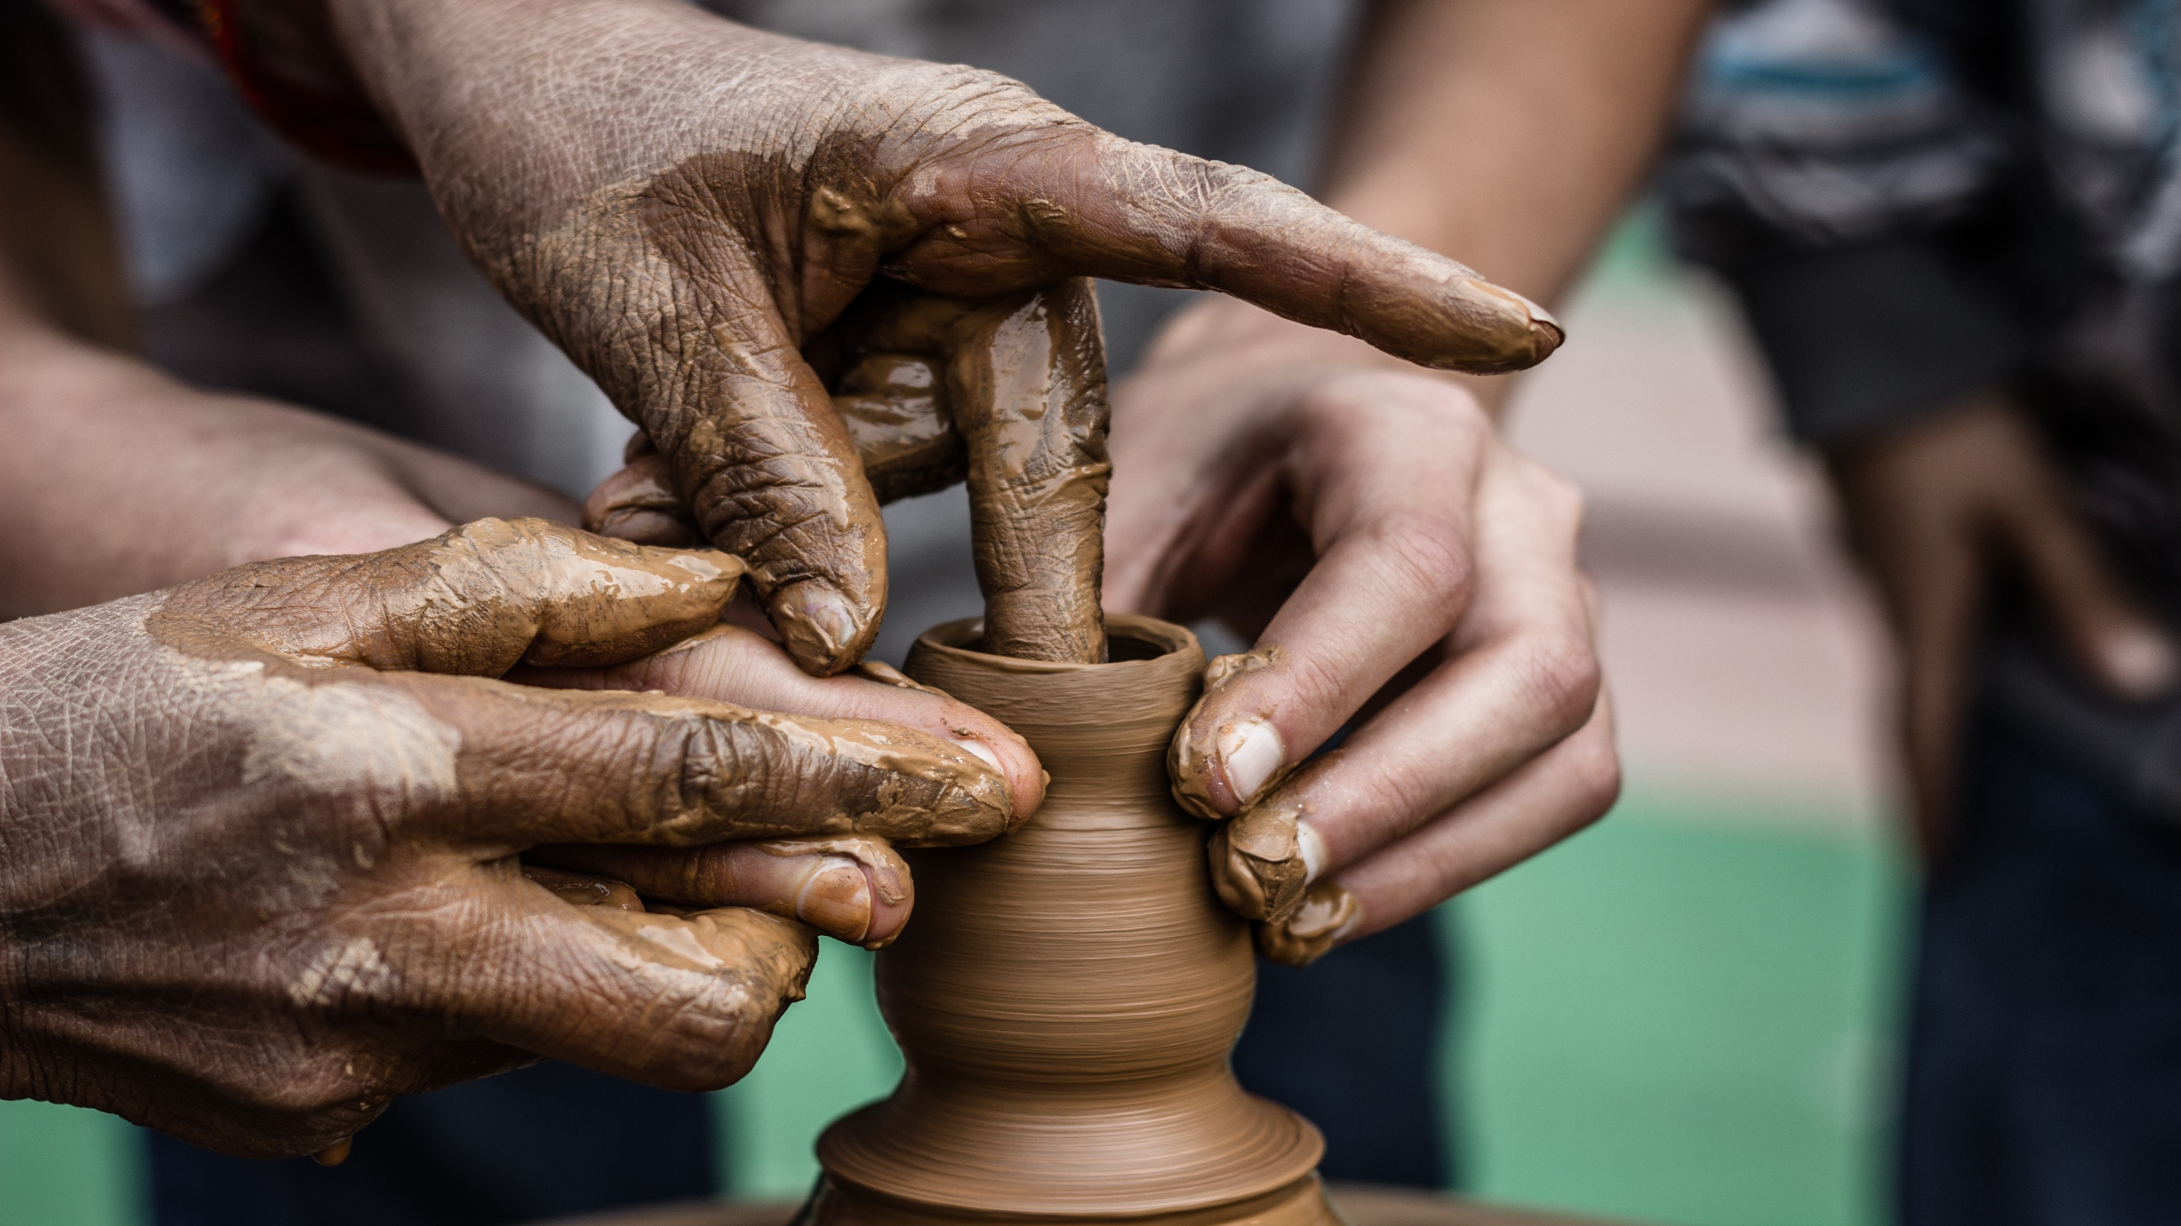
Contemporary Western Ceramics
Artist

Slide 2
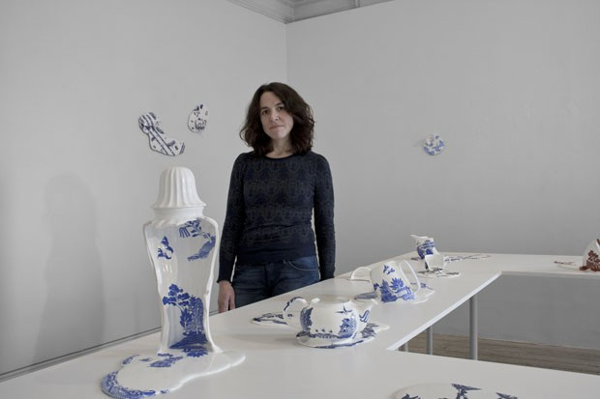

Livia Marin Tony Marsh

Slide 3
Livia Marin
Livia Marin is a London-based Chilean artist
whose work has been characterized
throughout by large-scale installations and
The appropriation of mass-produced and
mass-consumed objects. Her work was
initially informed by the immediate social
and political context of Chile in the 1990s
that amounted to a transition from a
profoundly overt disciplinary regime
(given by seventeen years of dictatorship) to
an economically disciplinary Regime with a strongly developed neo-liberal economic
agenda. She employs everyday objects to enquire into the nature of how we relate to
material objects in an era dominated by standardization and global circulation.

Slide 4
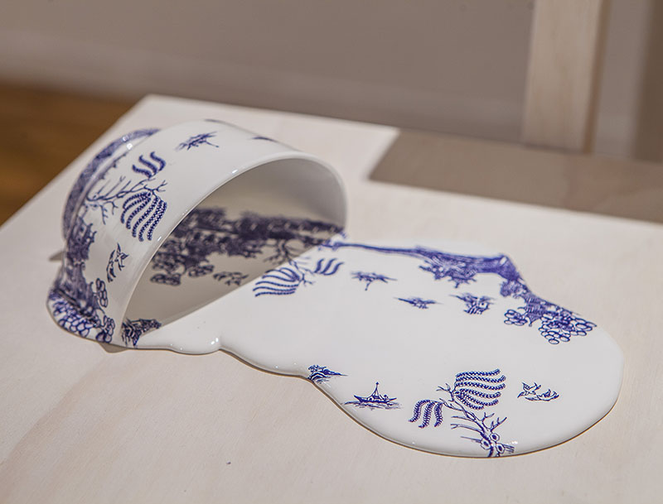
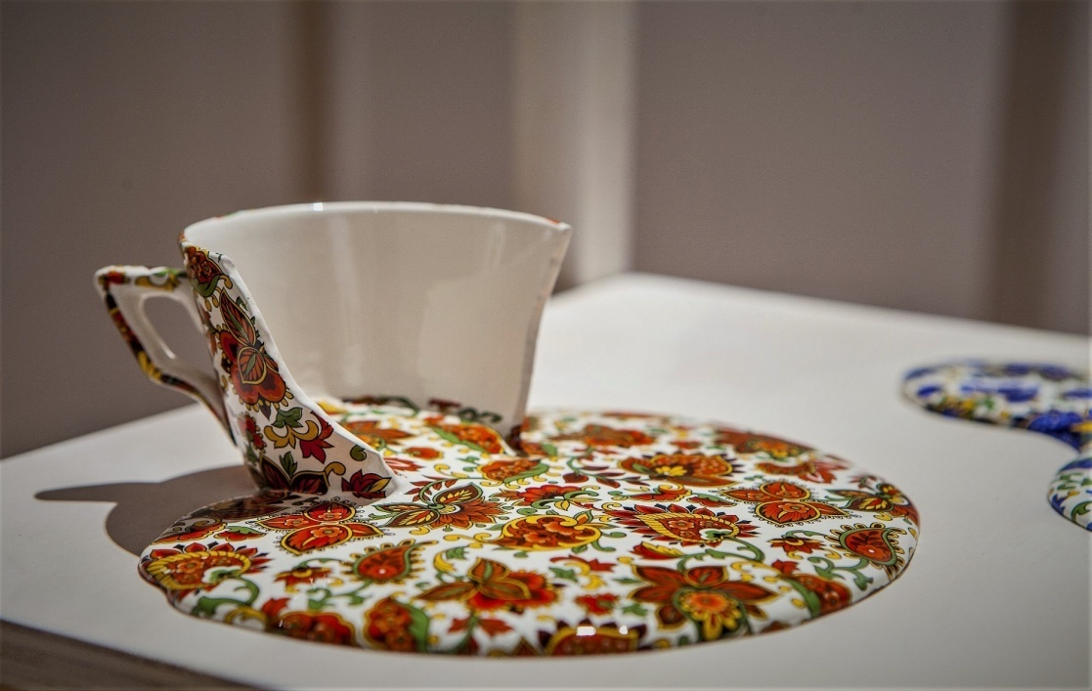
In Nomad Patterns, an avant-garde series by ceramic artist Livia Marin, traditionally-painted teapots, cups, and bowls appear to melt into patterned puddles. The decorations featured in the series range from paisley prints to plaid, and cleverly retain their integrity when seemingly liquefied. The intention of this “trope of estrangement” is to prompt the viewer to reflect upon the familiarity and predictability of everyday life.

Slide 5
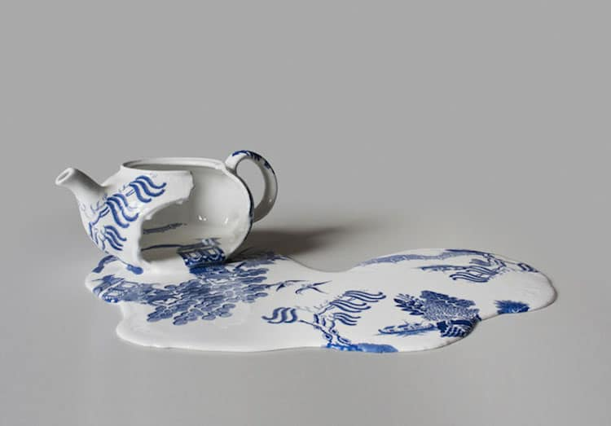
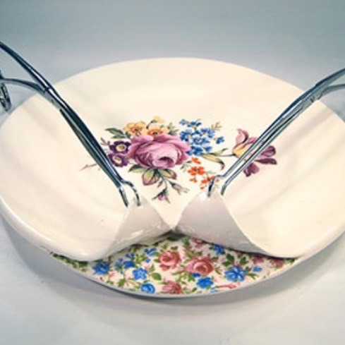
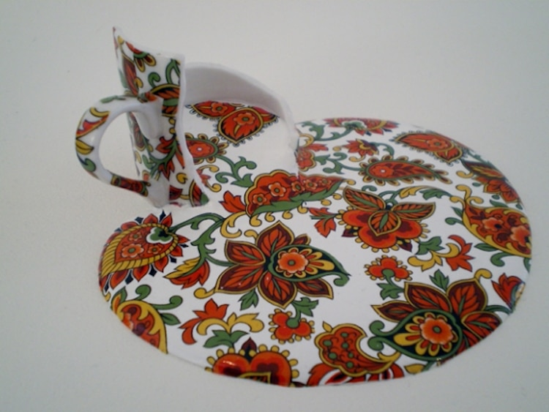

Slide 6
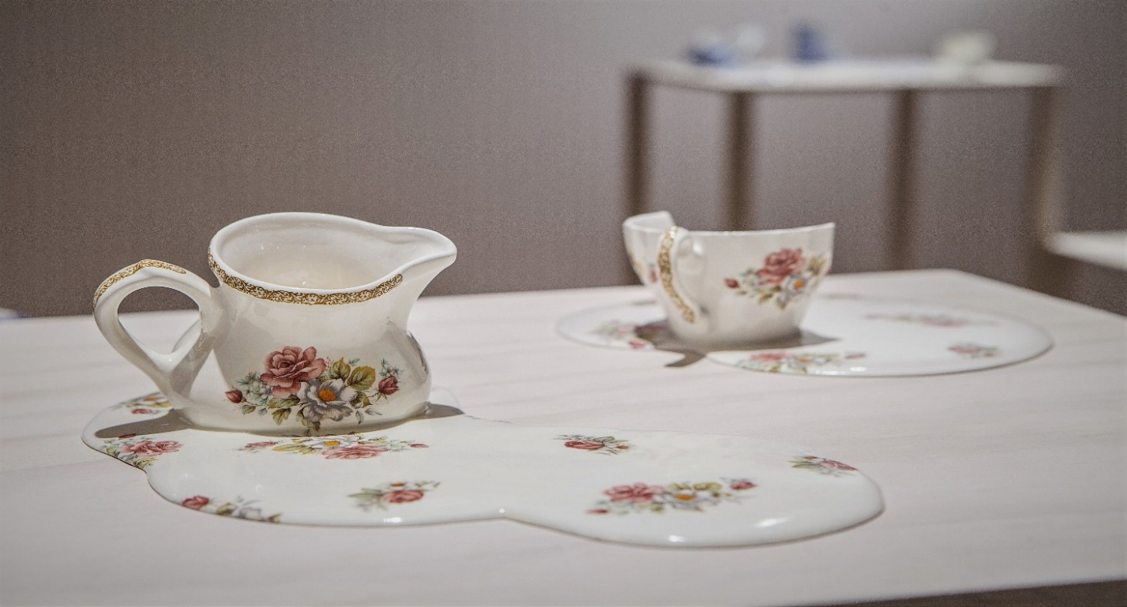
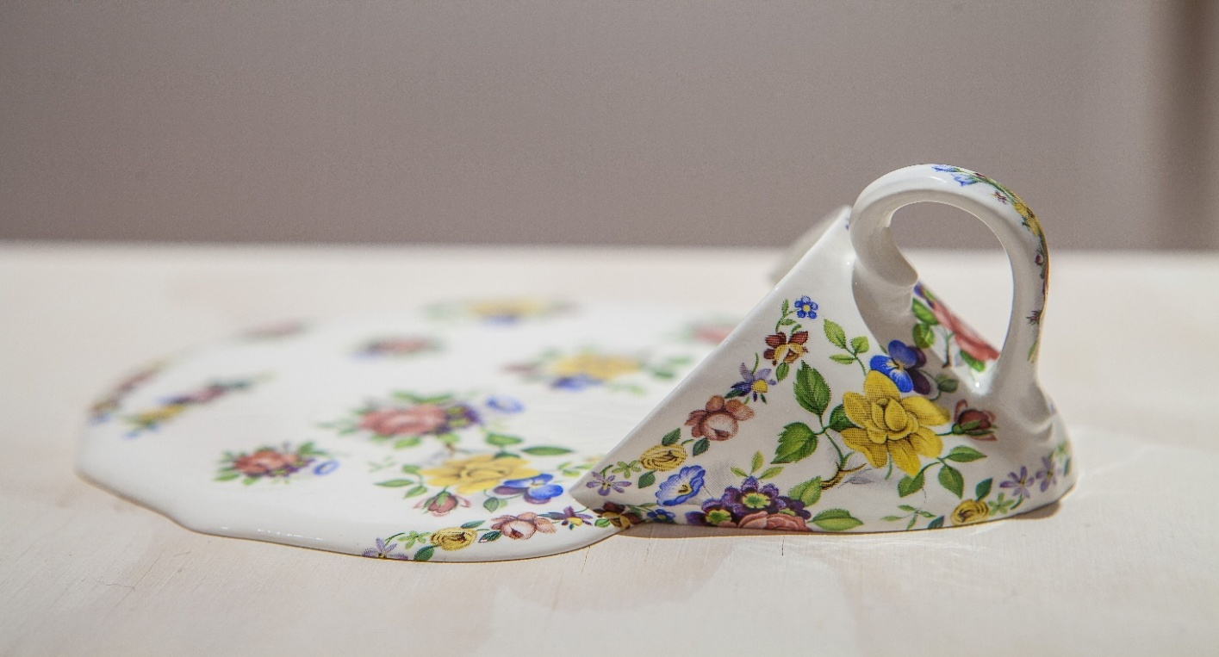
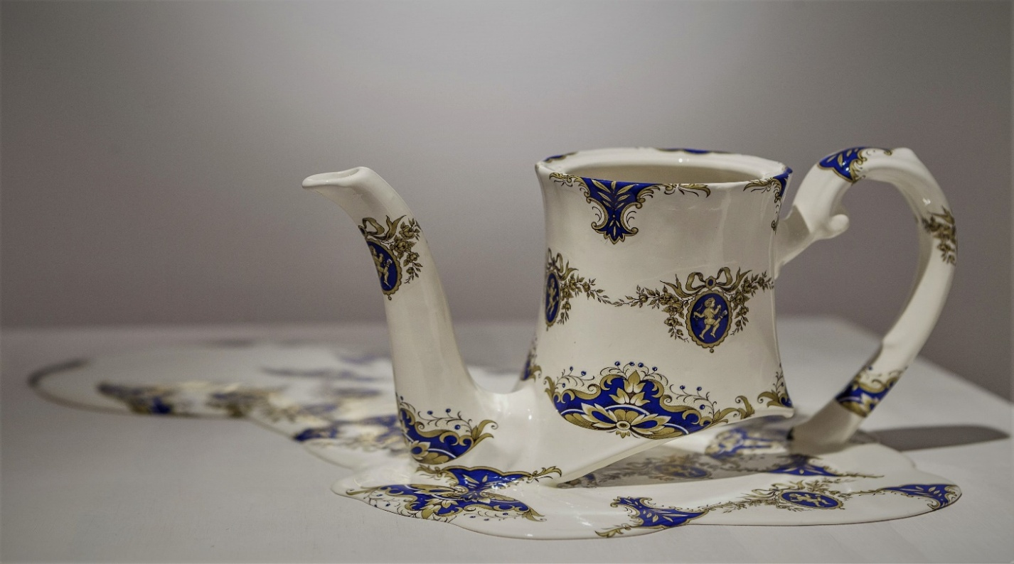
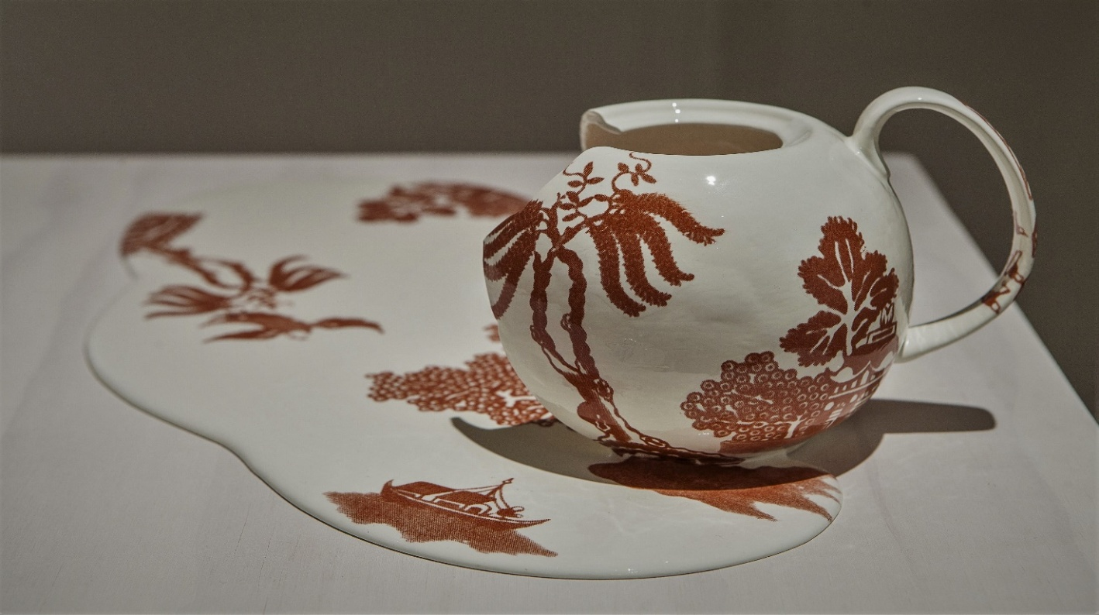

Slide 7
Tony Marsh
Tony Marsh works intuitively, creating allegorical works
that allude to the varied states of human experience.
Tony Dubis Marino states, “Viewers expect statements;
Marsh asks them questions. He is not a storyteller; he
is a puzzle maker. His images tend to be highly abstract,
providing the viewer with minimum information to
construct a relationship between the two objects.
This minimalism pushes the viewer. In his most successful pieces the viewer is as
much the author of the work’s narrative as the artist. Marsh’s images are so
abstract that each individual viewer can construct a narrative as idiosyncratic as
one’s own personality.”

Slide 8
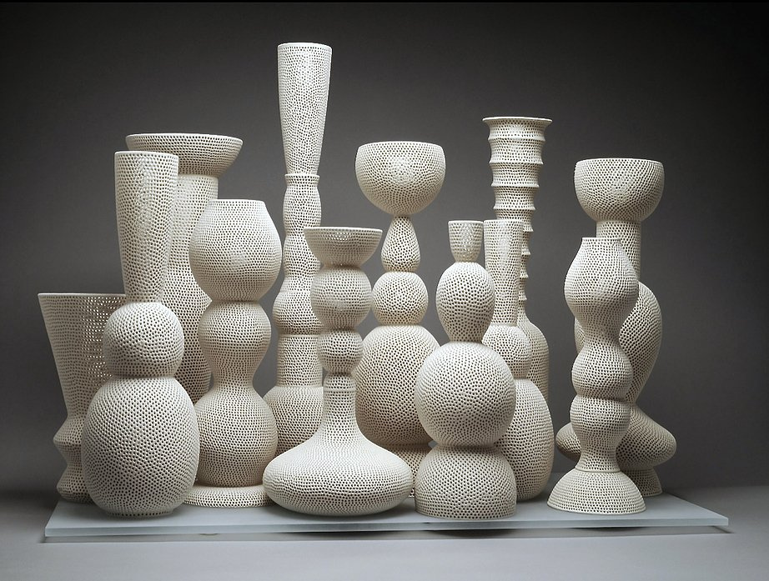
Marsh is best known for his perforated vessels filled with objects distilled to archetypal simplicity: spheres, bones, rings, rods, pods. Contents and container have matching skins of eggshell-like glazed stoneware, punctuated at regular intervals with small holes. Elegant and delicate, the sculptures appear almost weightless, their permeable membranes shaped of air as much as clay.

Slide 9
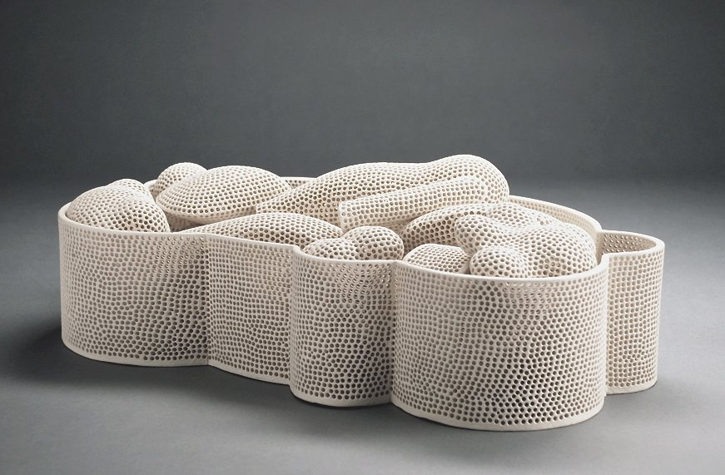
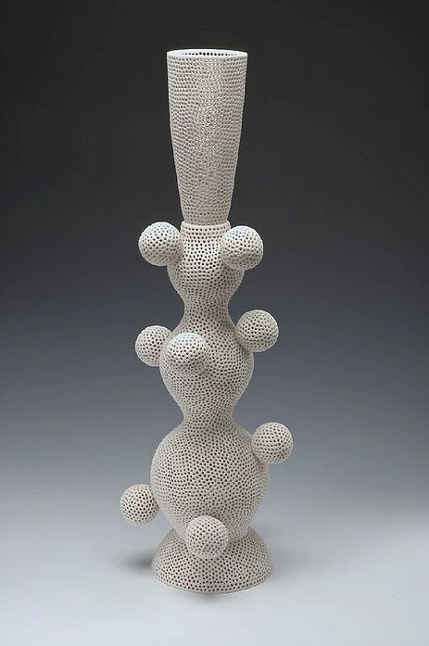
While those perforated works from the 1990s into the 2000s are tangible objects passing as lyrical suggestion, the new pieces flaunt their physical nature with conviction. Each piece is a basic cylindrical vessel, 13 to 19 inches in height, with more-or-less straight walls, thick and impenetrable. Gone are the grace and restraint of the perforated vessels. These pieces are unleashed, primal.

Slide 10
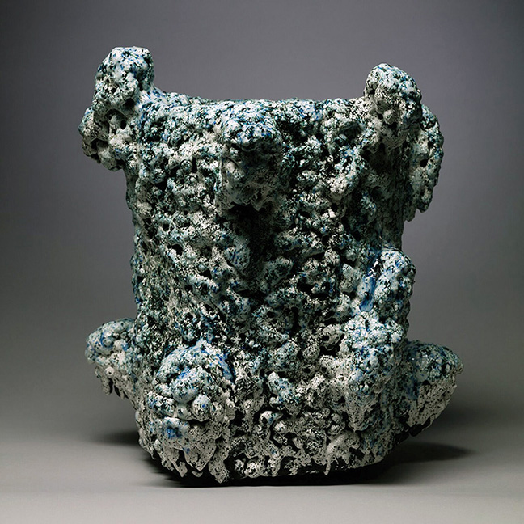
One is lava black throughout, its exterior teeming
with pitted bulges and extrusions, its inside walls
cracked and veined. Another is a ghostly
blue-black within, its bowl littered with an
assortment of melded clay chips, its outer surface
a fierce gold. One piece has a glossy, milky-aqua
petaled pelt; another a volcanic crust in all the
hues of heat. Marsh is fearless in his explorations
of texture and colour, applying multiple glazes and
mineral coatings. He subjects each piece to
numerous firings, letting chemistry and chance have at
it, over and over again.

Slide 11
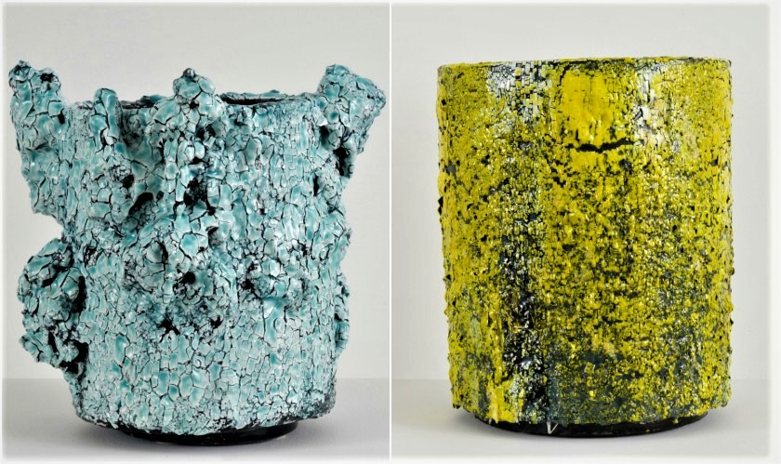
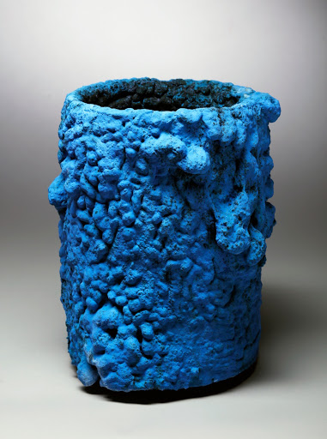
He calls these recent works “Crucibles” and “Cauldrons,” after functional instruments of transformation, vessels designed for fire and for catalyzing change. Each title carries an apt metaphorical load in addition to its descriptive one: A crucible is a rigorous test, just as these works are trials, under severe conditions; and a cauldron stands for an unstable, tempestuous situation, again not unlike what these pieces face in the kiln, what Marsh generates in the process of making them.

Slide 12
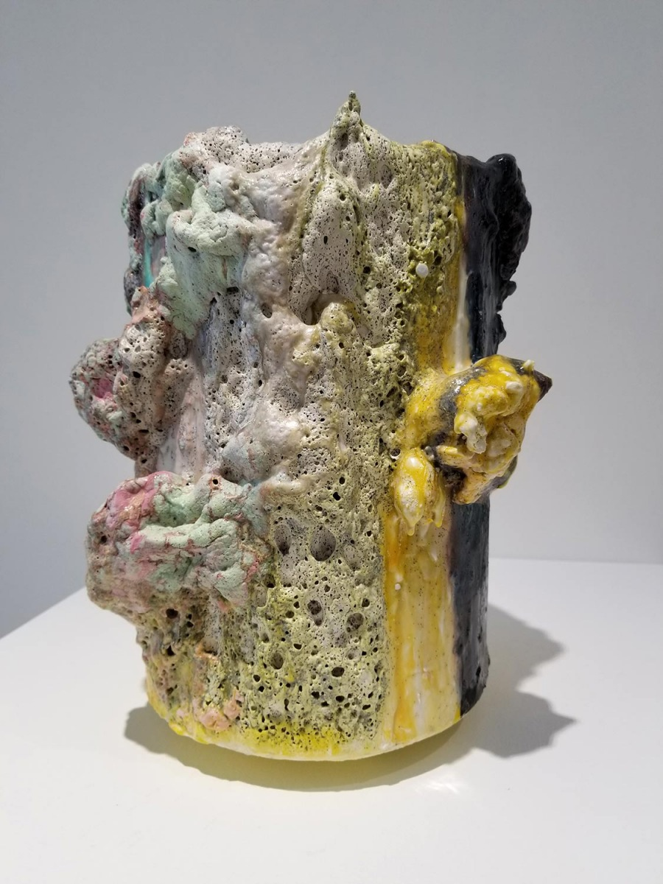
The materiality of these vessels is riveting. What
they do share with Marsh’s earlier work is a kind
of reduction to essence, and an exhilarating
beauty, this time rugged rather than refined,
improvisational instead of meticulously ordered.
Each “Crucible” and “Cauldron” is a singular
topography, earth inexhaustibly reinvented as
earth.

Slide 13
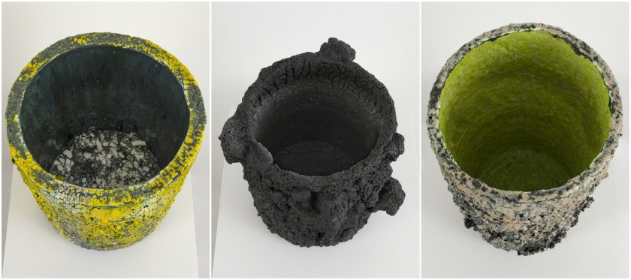
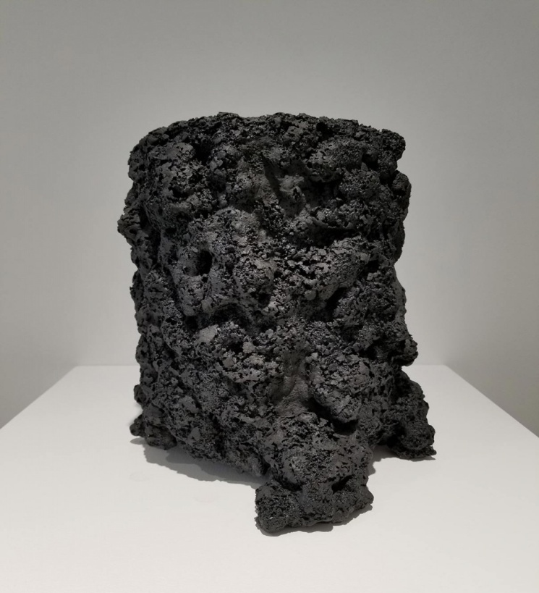
From this experience he derived an intense respect for production potters. Tony Marsh states, “I am not really a potter although I admire them deeply in many ways. I understand pots as occupying what is for me a profound position between nature and culture. What I make is homage to my curiosity about the history of ceramic vessels and what they have always been called on to do: to preserve, to offer, to contain, to commemorate and to beautify.”

Slide 14
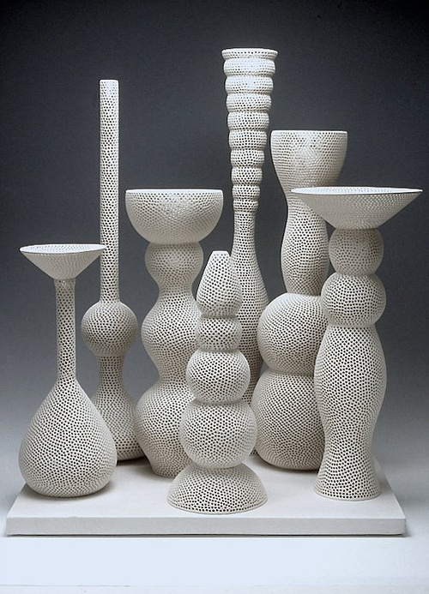
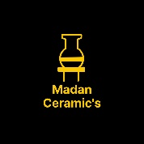
Reference-
Google & Own-Thinking
Thanks……….
Madan Singh
www.madanceramics.com

