Slide 1
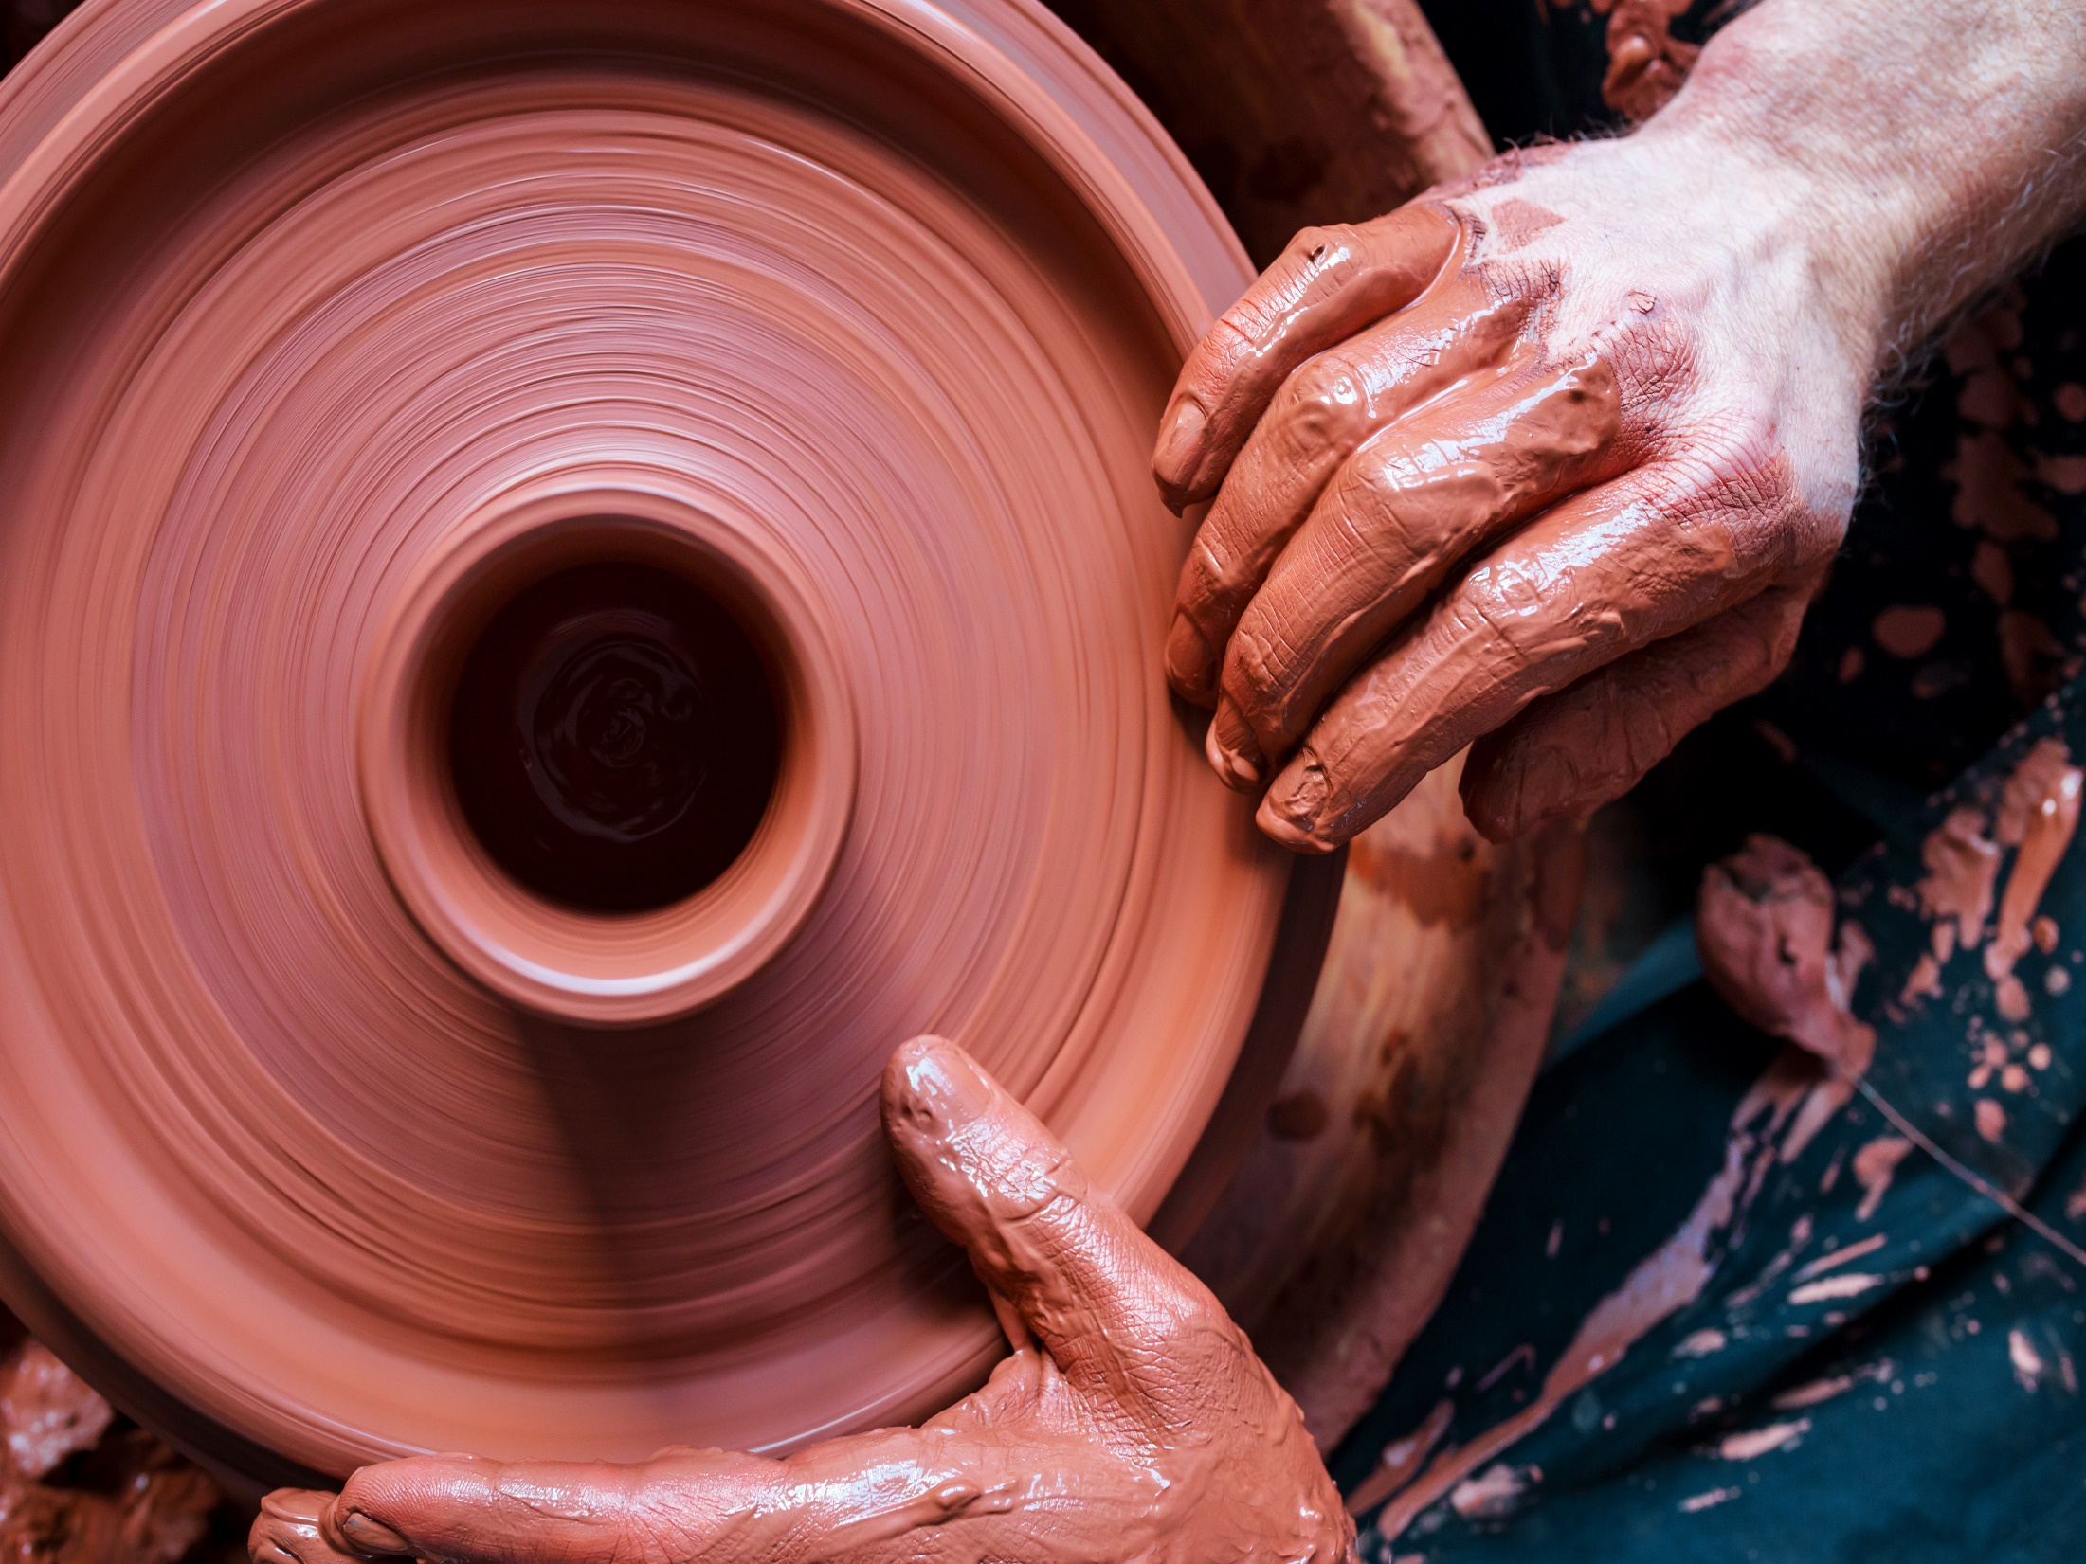
Stages of Clay

Slide 2
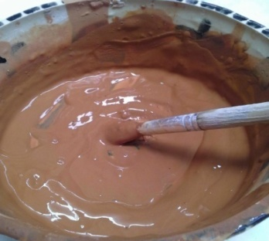
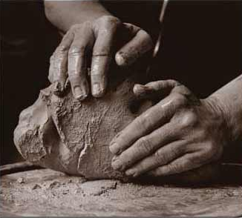
6 Stages of clay
1. Slip - Potters glue. Slip is used to join clay to clay and to decorate. It is the consistency of toothpaste when it is used like glue and paint when it is used like a glaze. It is usually a make of clay and water.
2. Plastic or wet - The best time for pinch construction, stamping and modelling. Cool the touch.

Slide 3
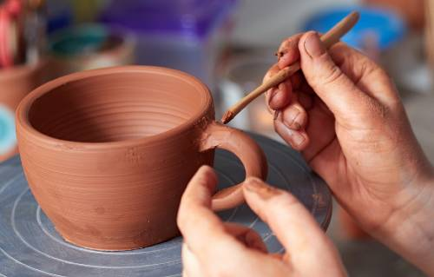
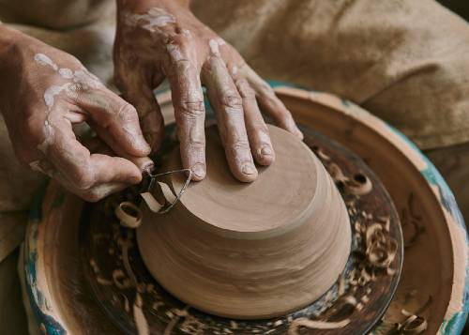
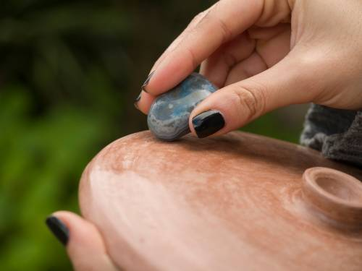
3. Leather hard - The best time to do slab construction or carve. It is cool to the touch and has the consistency of hard cheese or leather. There are 3 sub-categories within leather hard.
A. Early - Still able to move clay slightly without cracking or damage.
B. Middle - Can no longer move clay without cracking or damage. Good time to create texture or carve into clay.
C. Late - Clay is still cool to touch, good time to
do detail carving, clean edges, fine tune, etc.

Slide 4
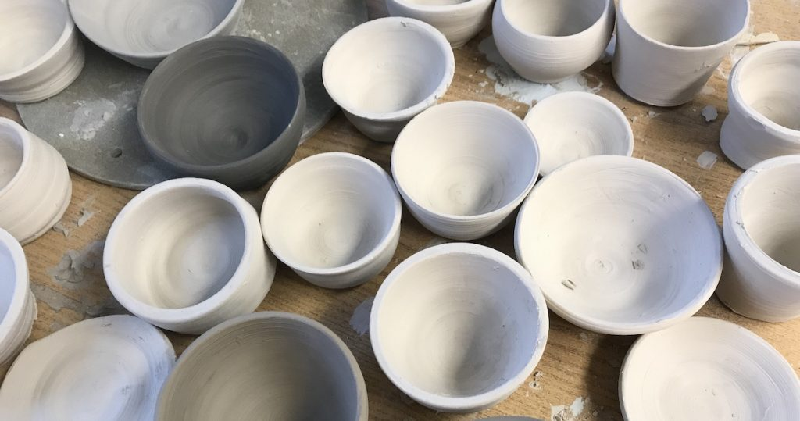
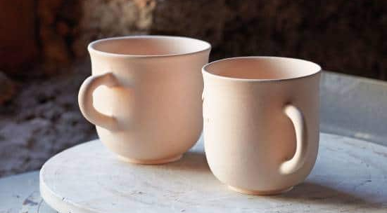
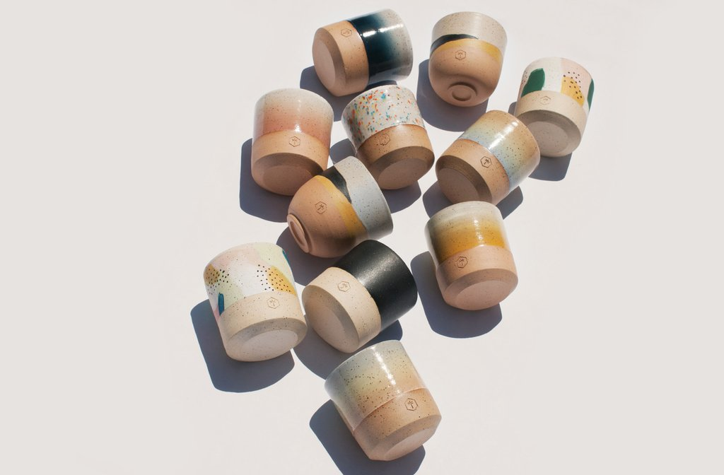
4. Bone dry - The clay is no longer cool to the touch and is ready to be fired.
5. Bisque - Finished ceramics that has been fired
once.
6. Glaze ware - Finished ceramics that has a coat
of glaze for decoration or to make it vitreous.

Slide 5
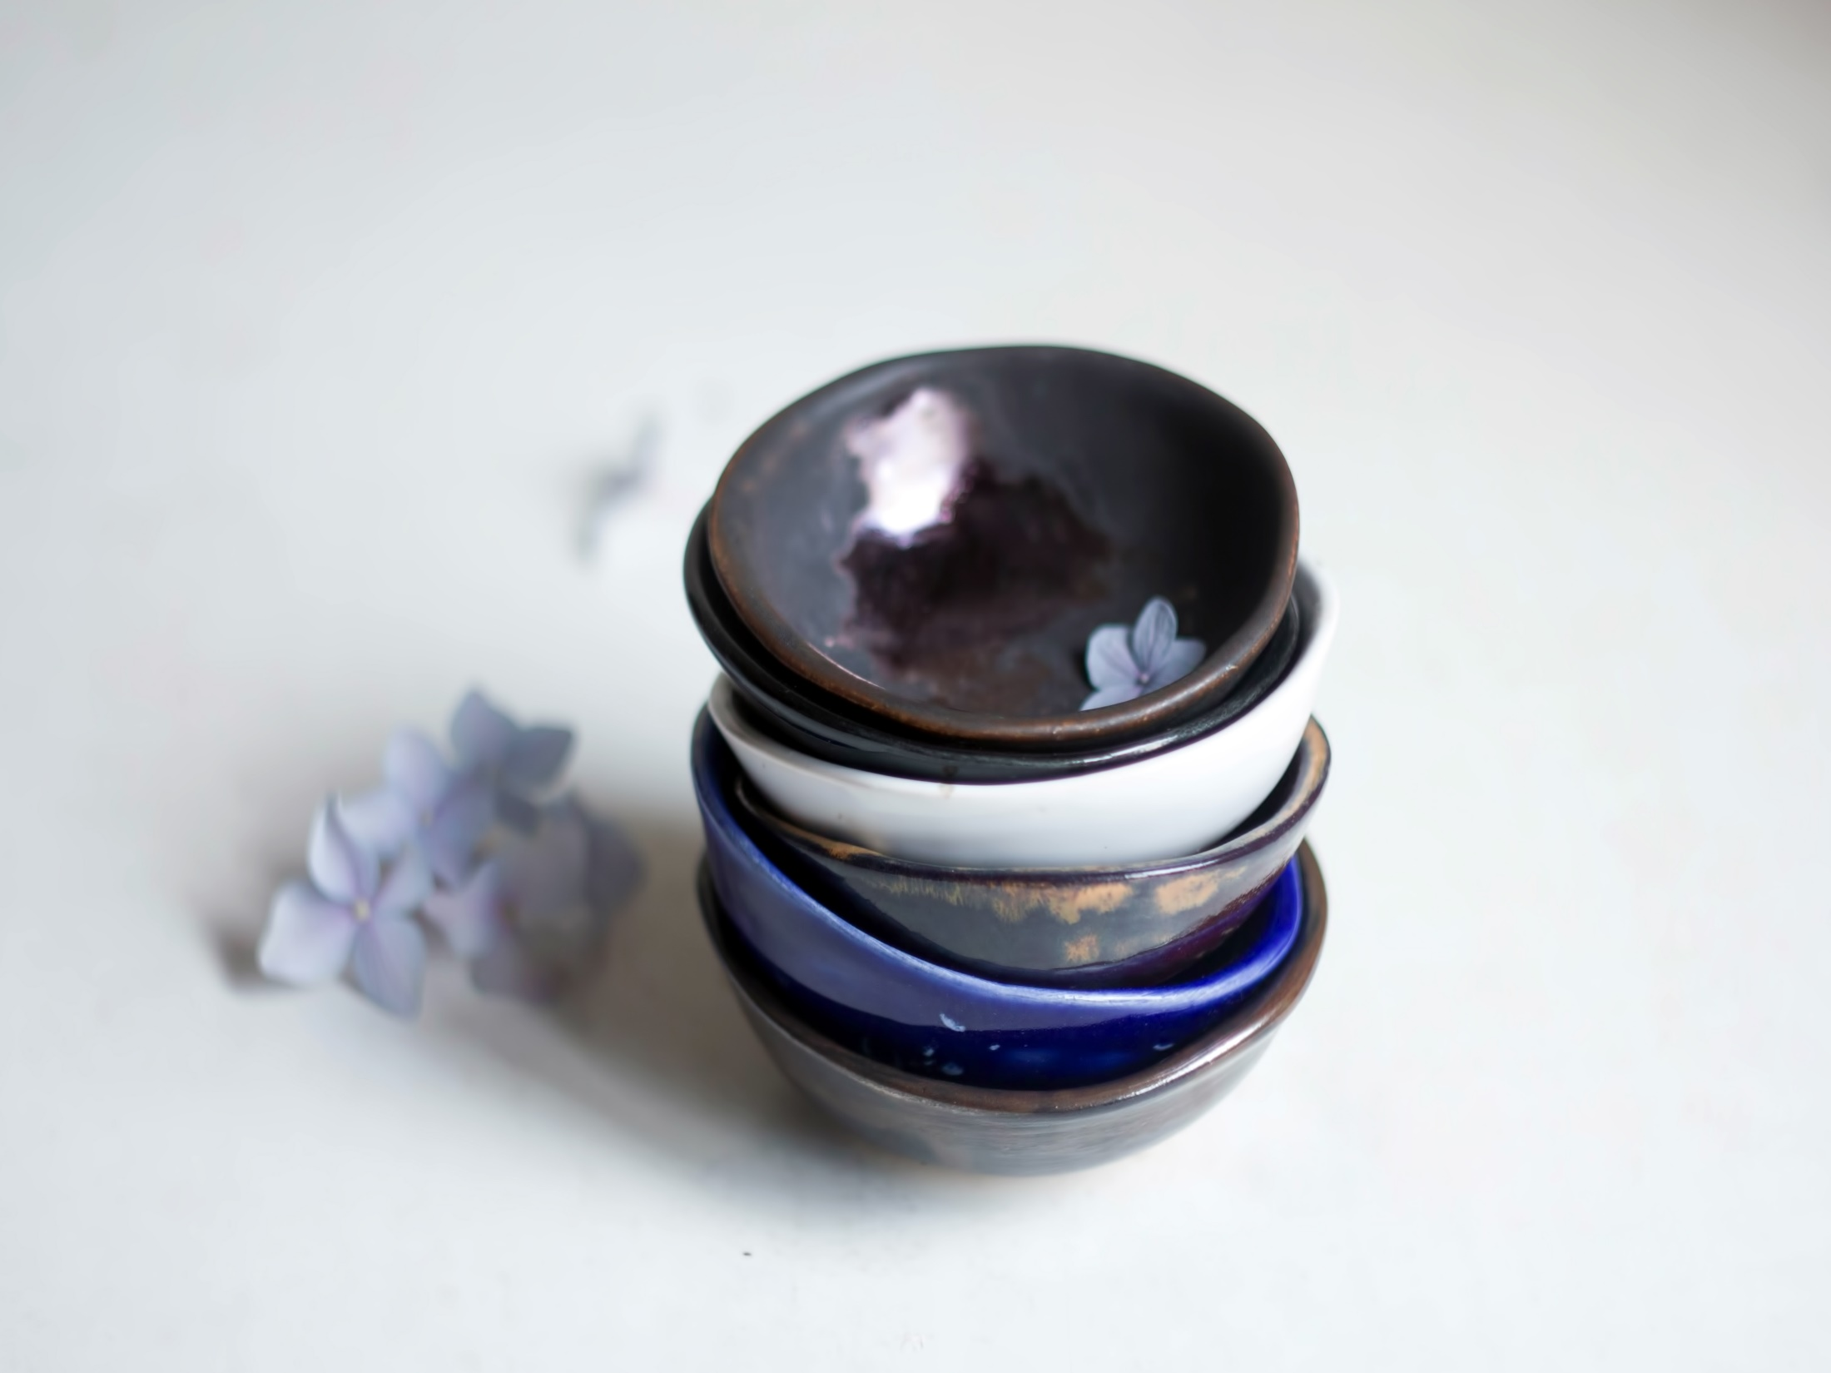
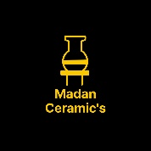
References:
Book: Ceramics (A beginner's guide to tool and techniques), Google and Own thinking
Thanks……….
Madan Singh
www.madanceramics.com

