Slide 1
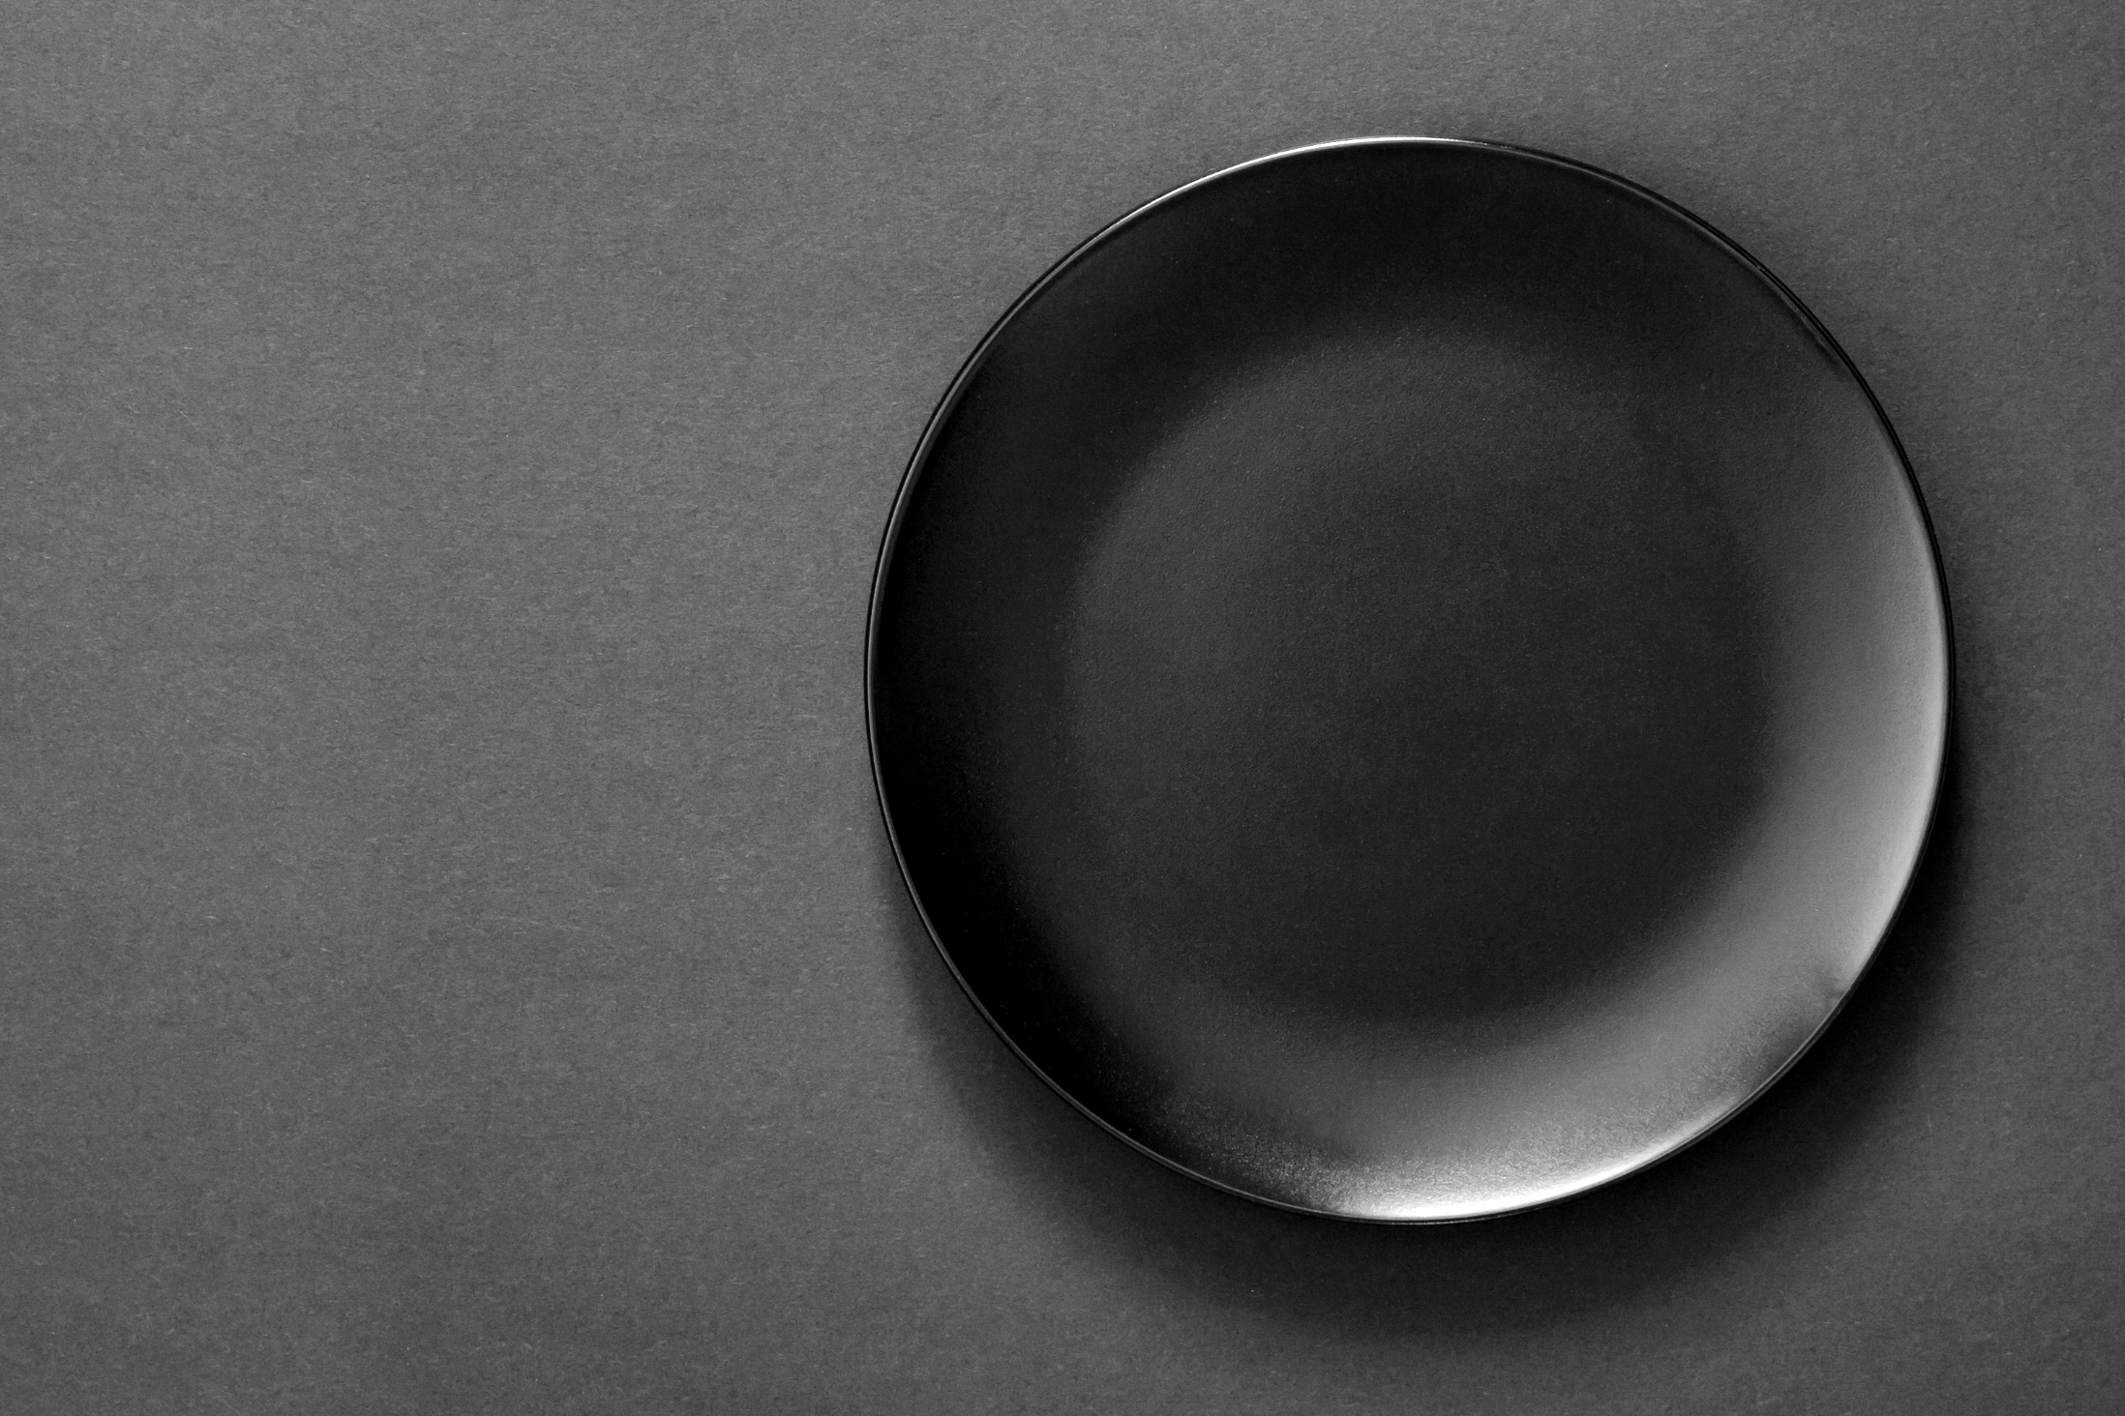
Variations and Importance of
Black Pottery

Slide 2
Variations of Black Pottery:
In India-
Black Potter (Nizamabad, U.P, India)
Longpi Black Pottery (Manipur, India)
A craft, a history in India:
“We have been hearing from our elders that once a kaji sahib (judge) in the Mughal administration saw black pottery by the Prajapati community in Gujarat. He was so impressed by the work that he brought some artisans to Uttar Pradesh, gave them land for housing and agriculture and asked them to continue the craft,” he recollects.

Slide 3
Centuries later, the descendants of those craftspeople, about 250 families, continue to make black pottery vases, tea pots, jars, utensils and decorative items for the domestic as well as overseas markets.
While black pottery is also practiced in some other places, he points out why Nizamabad is different. Manipur’s black pottery is without the silver patterns while Khurja pottery is glazed. Alwar in Rajasthan is well known for its sheer body pottery (kagzi) but the sandy soil is not suitable for Nizamabad-like black pottery.
How is black pottery made:
In Nizamabad, potters dig out clay from ponds during the dry months of April and May and store it inside their houses for use throughout the year. Their units have small pits into which the clay is filtered, mixed with water and left for some days.

Slide 4
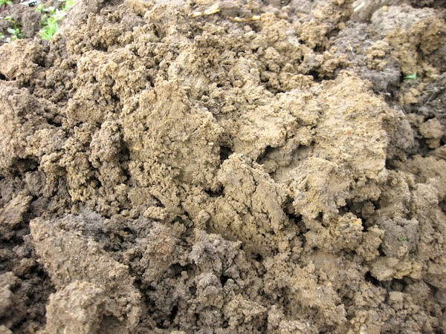
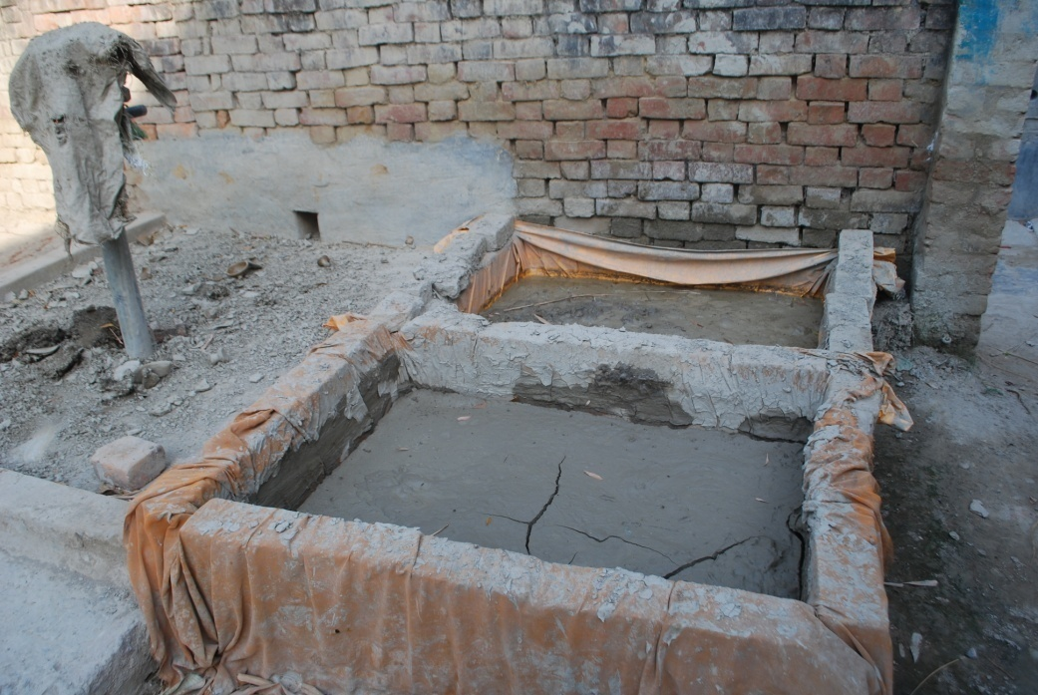
When it thickens, the clay is kneaded by feet or using machines to make it lump-free. It is then put on a potter’s wheel and shaped into utensils.
Prajapati points out that the pottery is partially dried in the sun to retain some moisture. It goes back on the wheel for ‘kharat’ or peeling off uneven surfaces. This also adds glaze. Kavis, a colour made using clay and water, is applied and the pottery is then left to dry. Mustard oil is then rubbed on it to make it shinier.

Slide 5
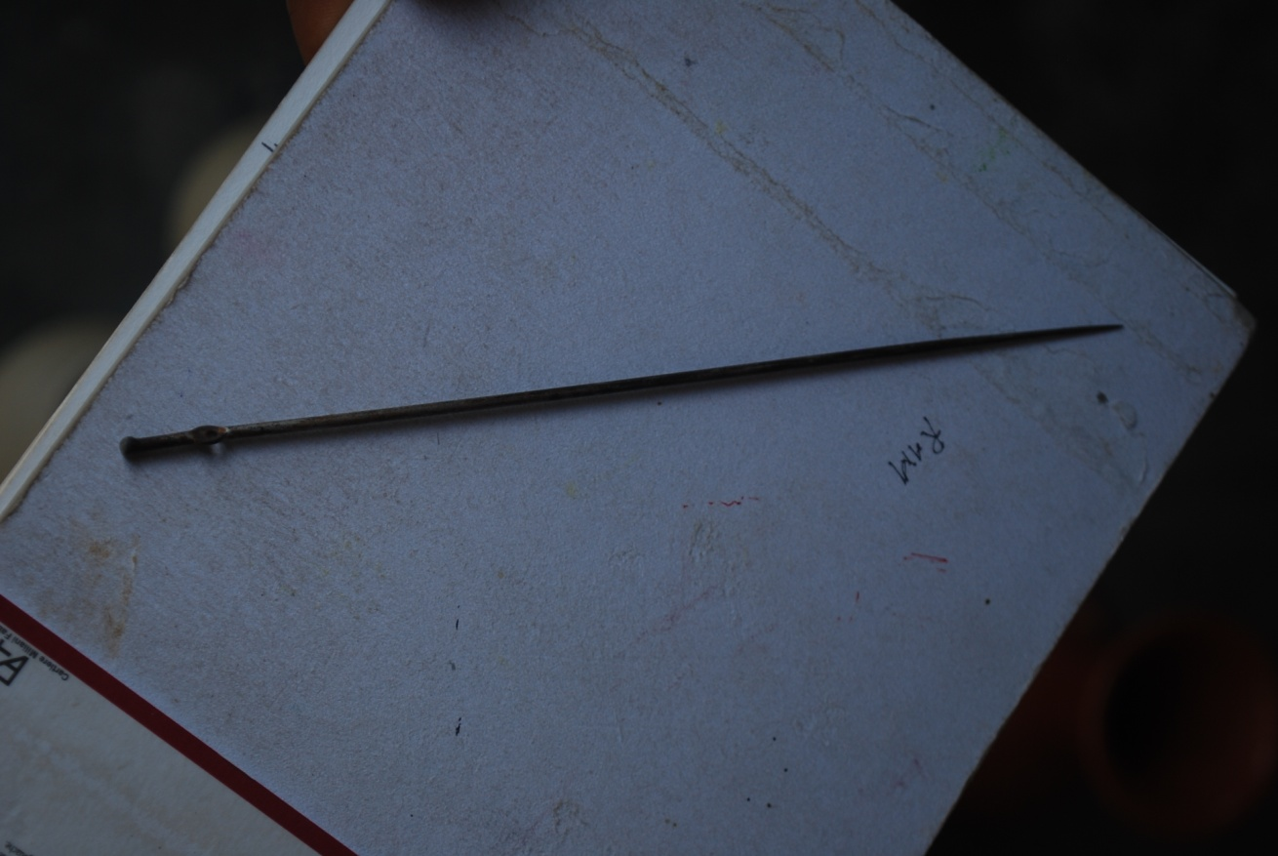
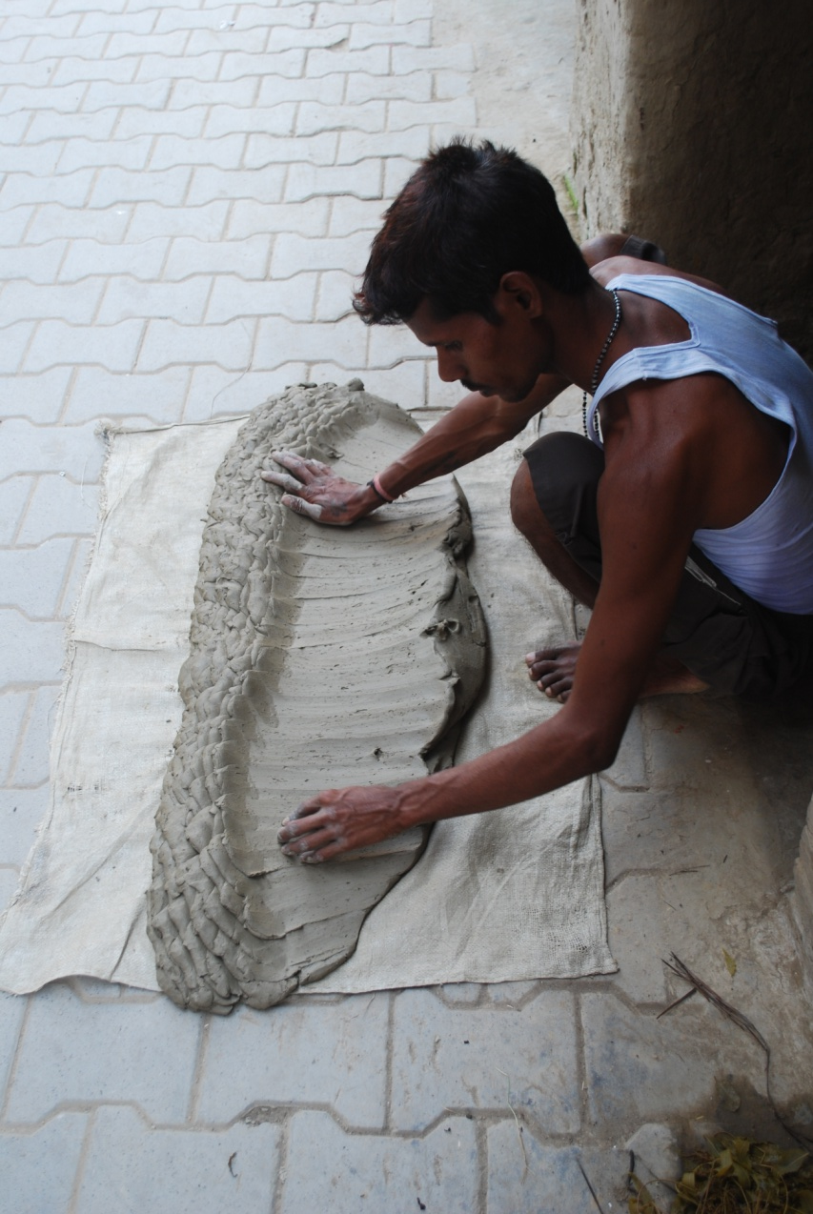
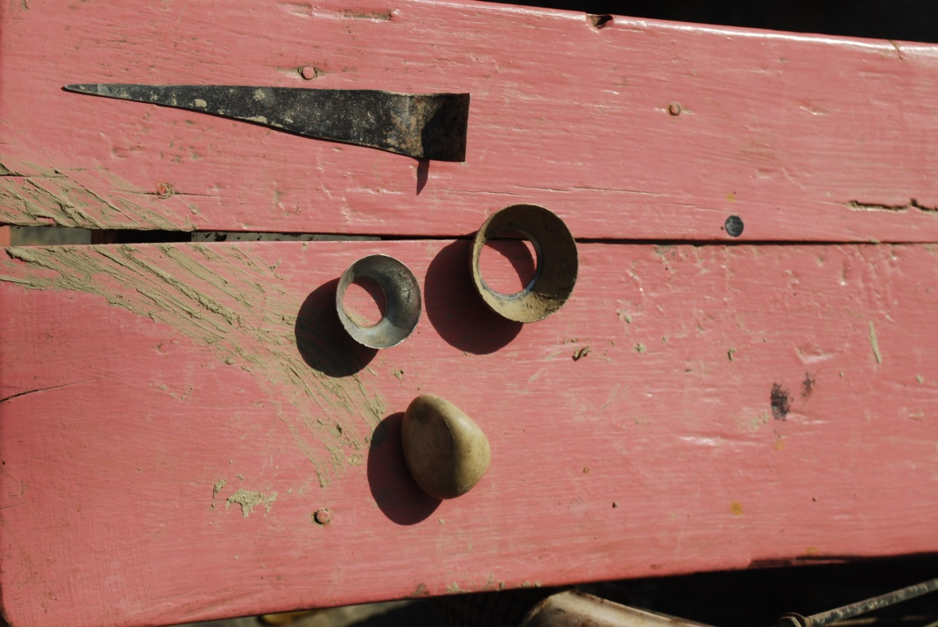

Slide 6
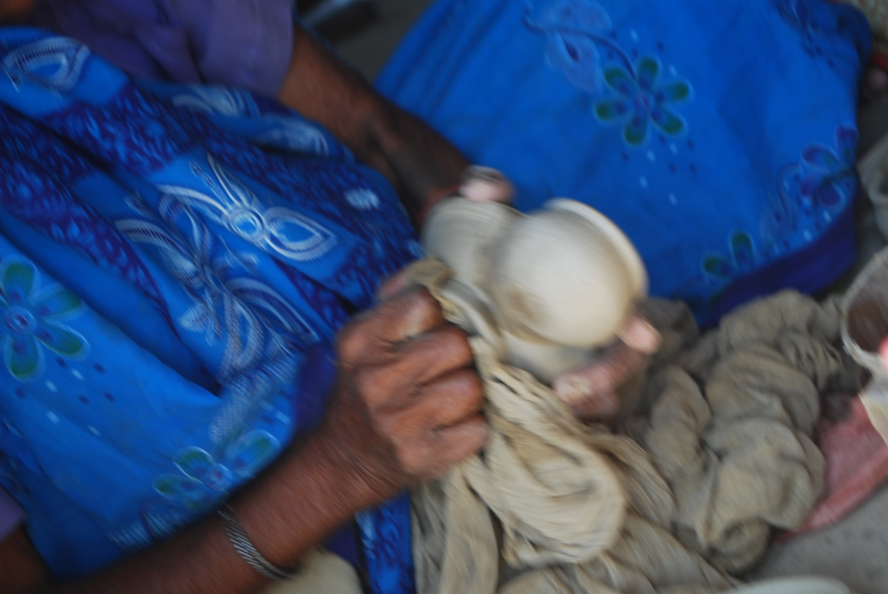
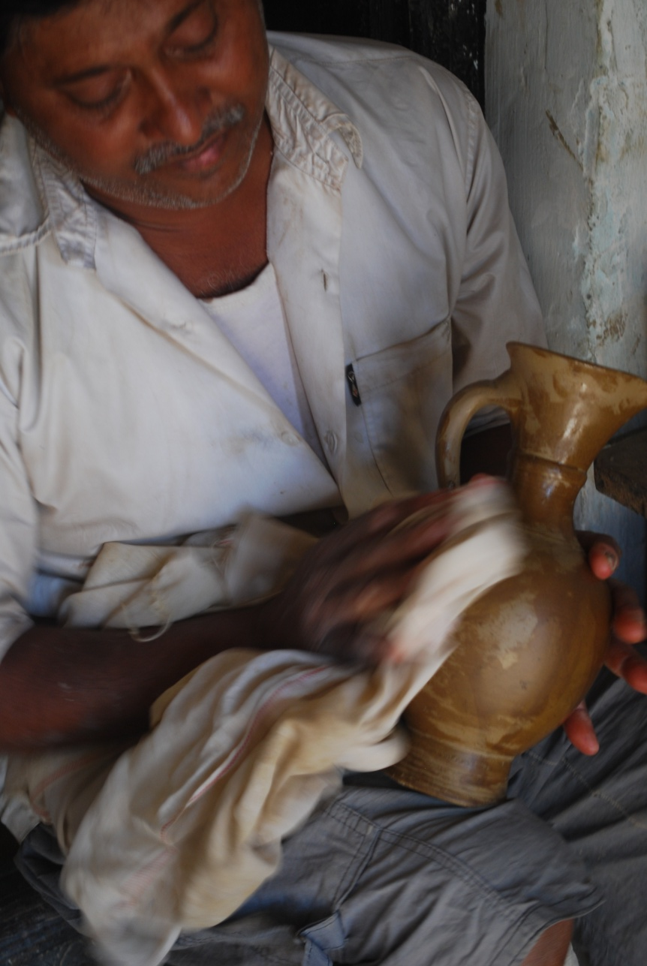
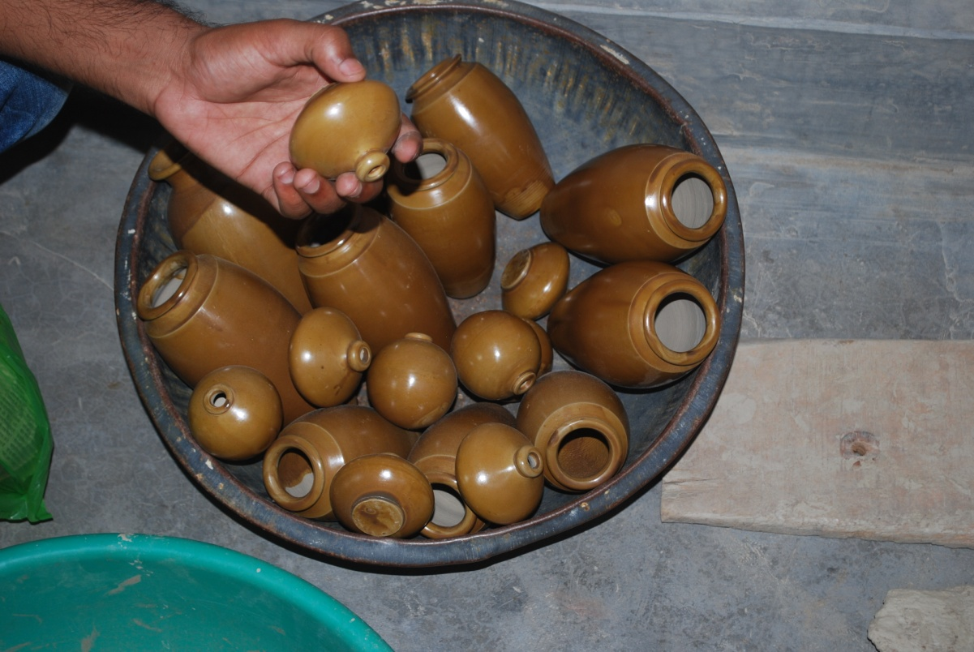

Slide 7
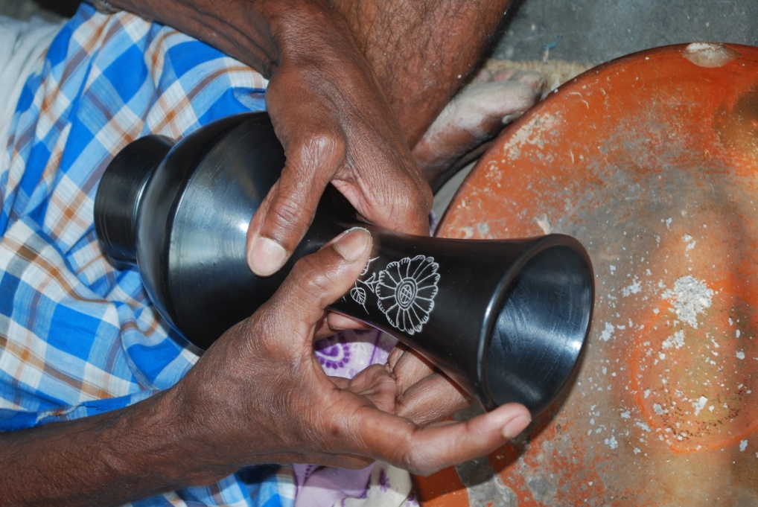
A fine iron needle is then used to draw intricate geometrical and floral patterns on the pottery. Women usually do this fine work though men also are experts in the art. The pottery then goes inside the bhatti (oven), which is then fully covered with cow dung cakes. “When the pottery is inside the oven, it is important to ensure that there is no scope for oxygen to enter and the heat level remains high.
The presence of oxygen can turn the pottery red and it won’t get the black colour, which is the hallmark of Azamgarh,”

Slide 8
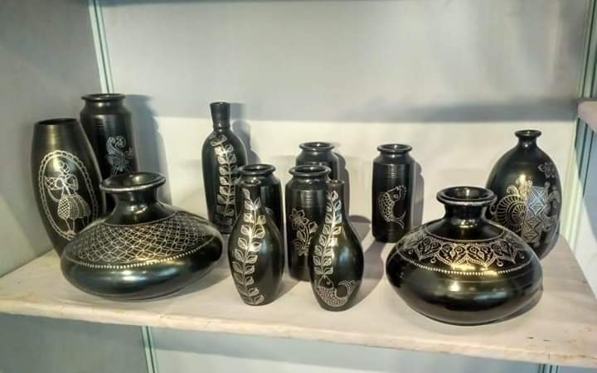

Slide 9
The story of Manipur’s black pottery from Longpi.
Longpi Pottery or Stone pottery is a traditional craft from Manipur, India. Commonly known as Black pottery, the original name is derived from the village of Longpi in Manipur. This is where Tangkhul Naga tribe, make this beautiful pieces of earthenware. The inhabitants of Ukhrul district of Manipur credit the origins of this craft to Goddess Panthoibi, who is the mother of artifact-making. She represents a process towards our creation. That is why Longpi Pottery is necessarily used in performing rituals on festive occasions like childbirth and marriage. Longpi Pottery is traditionally known as ‘Longpi Ham’, and was also called ‘Loree Hamlei’ or ‘royal pottery’ because only the royalty and the rich of Manipur could afford it. They used these pots to cook food especially during special occasions like marriages. Unlike in other parts of India, the craft is practiced both by men and women.

Slide 10
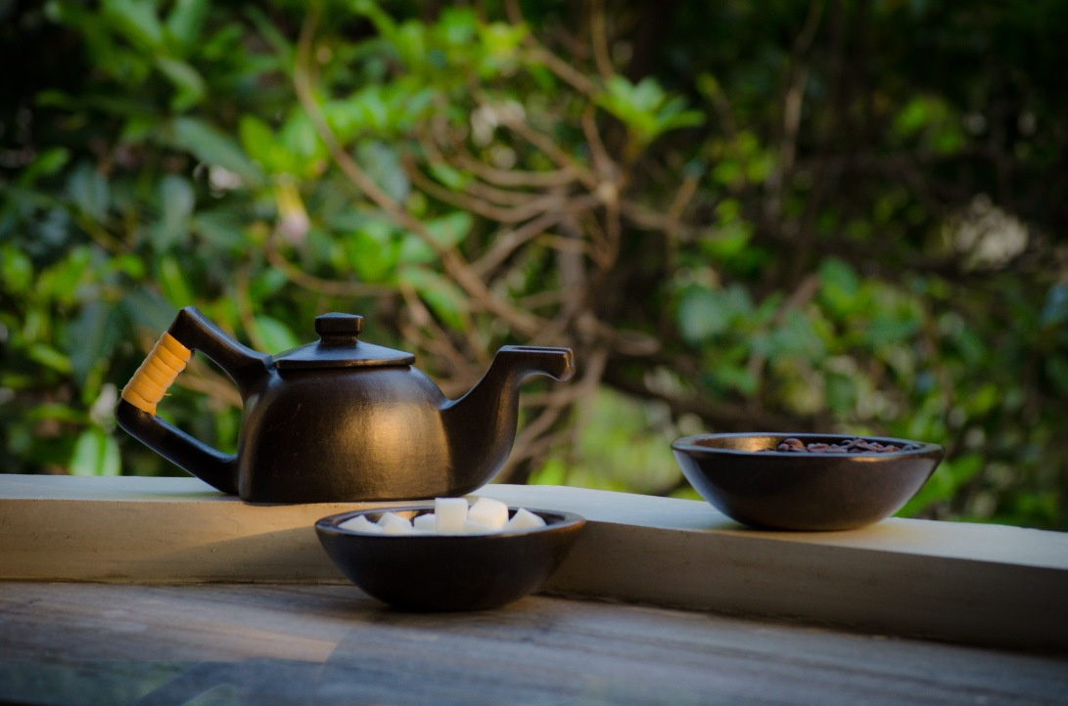

Slide 11
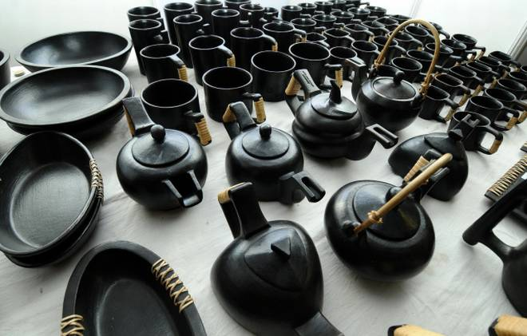

Slide 12
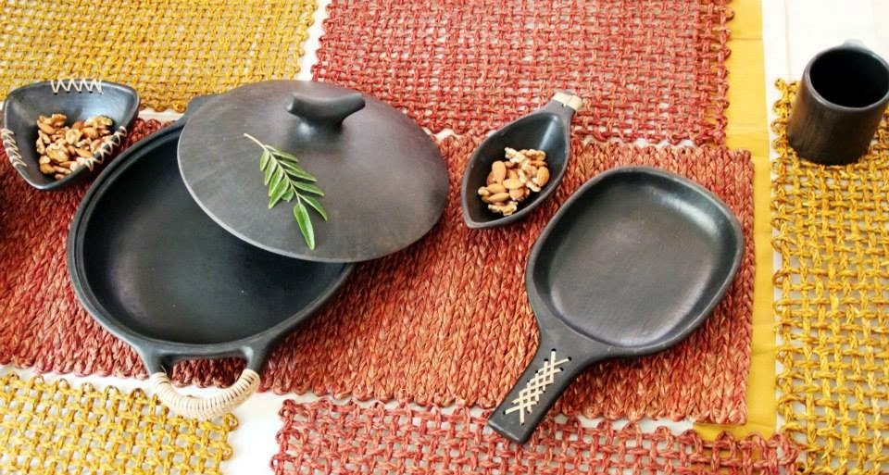

Slide 13
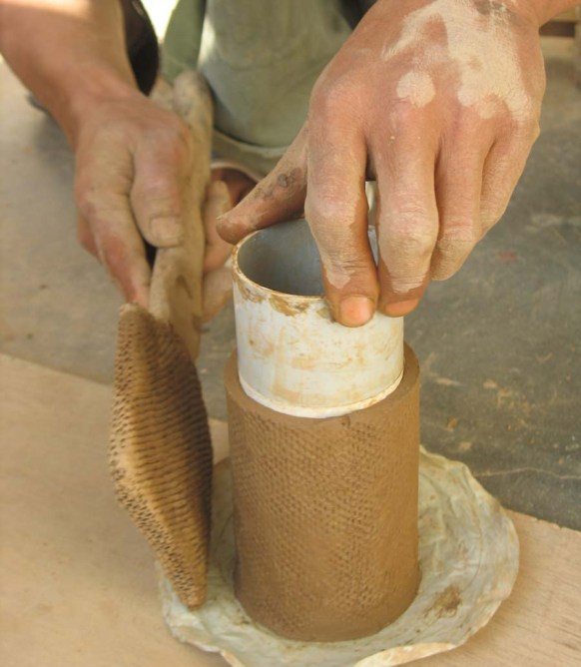
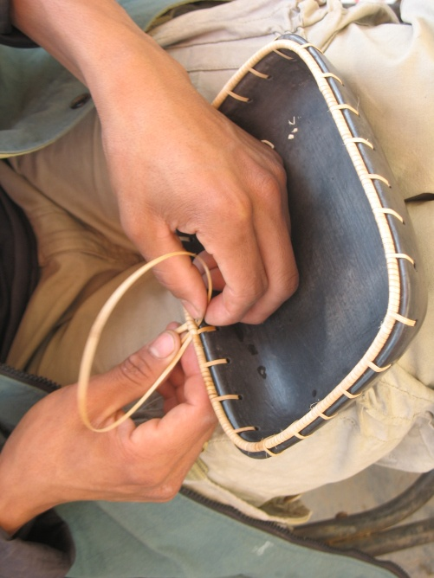
Craft Technique:
Manipuri pottery is unique in style and technique. The material used is a mixture of clay and powdered stone – Black Serpentite stone and weathered rock which are mixed in a three to one ratio. The strength is provided by the Serpentite rock and the weathered rock acts as a binding agent. The paste formed from these is then rolled by hand into desired shapes.

Slide 14
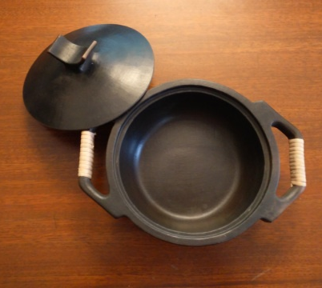
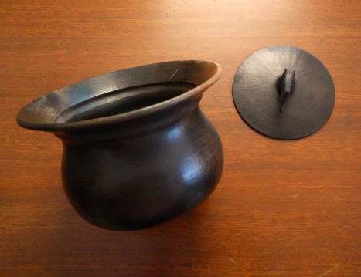
The Longpi do not use the potter’s wheel. All shaping is done with the hand and with the help of moulds. The potter then actually moves around the clay, shaping and forming the pot. The pot is supported from the inside with a rounded stone and beaten to the desired shape and thickness. Great dexterity is required as the internal pressure and external movement must be well co-ordinated to produce a perfect pot.

Slide 15
The structures of saucer cups, kettle, frying pan, fruit bowls, cooking pot etc are put in a kiln and set on fire for around five to nine hours till it reaches 900 – 1050 degree Celsius. The pottery is taken out when still hot and polished with local leaves called machee or beeswax giving it a smooth finish and providing luster to its surface. Finally finished gray-black cooking pots and kettles, mugs, trays and bowls are frequently accompanied with a lacing of fine cane at the handles and knobs.
The final products have a distinctly earthy, yet contemporary appearance. Beautifully Handmade Kitchenware.

Slide 16
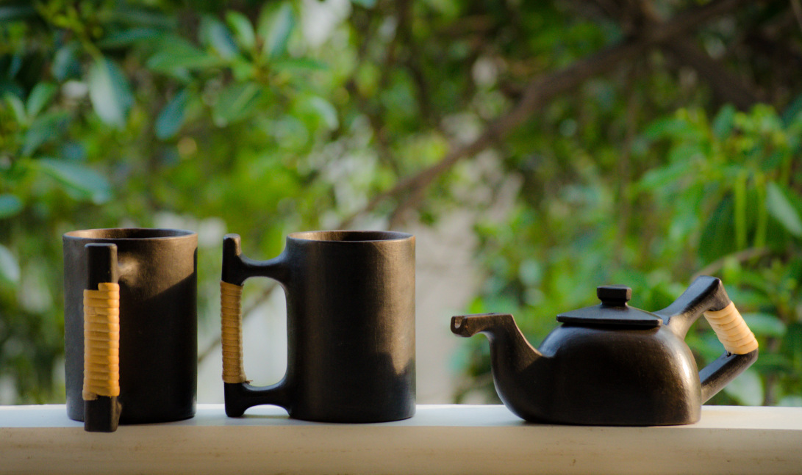
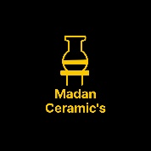
Resource: The Ants Craft Pvt Ltd
And self talk to local potter’s
Thanks……….
Madan Singh
www.madanceramics.com

