Slide 1
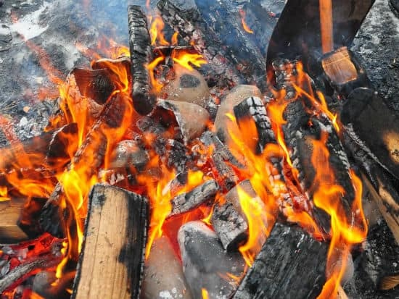
Function of Kiln, Contemporary Approach and Food Safety

Slide 2
Introduction:
Pottery has always had a special place in Indian society since ancient times. Starting from the unbaked clay pots, the unglazed terracotta pottery to the glazed pottery used in Modern times, there is a wide variety of pottery used even today. A large percentage of this pottery is being produced by the unorganized sector, in small scale, employing very primitive technology. As a result they have higher production costs, lower profit.
One aspect of pottery production which has particularly stayed at a very traditional level is the firing of pottery in kilns. The kilns used in the small scale industries are highly inefficient,

Slide 3
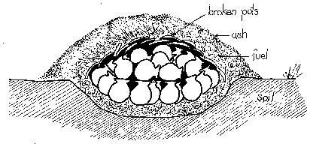
Bonfire kilns
The oldest type of kiln, dating back more than 10,000 years, is the bonfire kiln. These kilns are still widely used for firing traditional unglazed red ware terracotta or other pottery, because they are still the most suitable for small-scale production of low-fired pottery. This is due to the fact that no investment is needed for a permanent kiln, that the firing at most takes a few hours and that cheap and readily available fuel such as straw, grass and cow dung cake can be used.

Slide 4
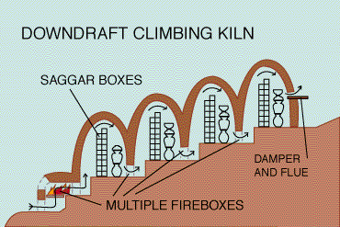
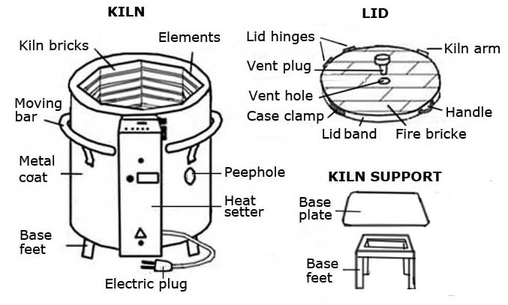
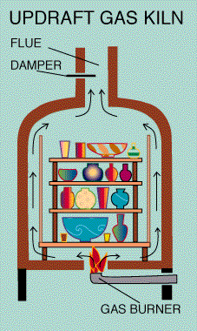

Slide 5
Primitive types of kiln:
In this section I will look at two primitive types of kiln: pit firing and sawdust kiln. Pit fires kiln and sawdust kiln both made out of the house. Pit firing is still a popular low technique of firing clay, as are sawdust kiln.
Pit firing:
One of the earliest primitive types of kiln is pit firing involves placing where in a pit in the ground a long with combustible material. Some of the fuel that has traditionally used is wood, straw and manure.
The pit is lined with combustible material and the where is placed on top of this. It is then covered with more material and once it is completely covered, the fire is set alight. The fire is left to burn until the combustible material has been consumed by the flamed.

Slide 6
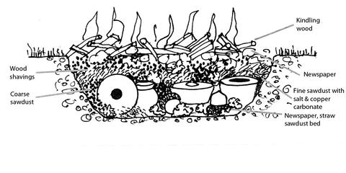
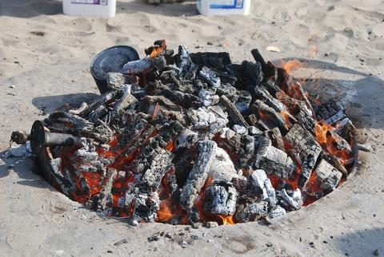
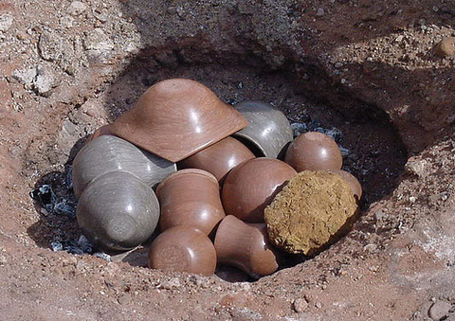

Slide 7
Sawdust kiln:
The principle behind the sawdust kiln is similar to pit firing. Like pit firing, the ceramics ware to be fired is buried in the combustible fuel, which is sawdust.
A layer of sawdust is placed on the base of the kiln and the pieces are positioned on that layer. These are then covered with more sawdust which is packed between the pottery. More layer of pottery can then be positioned on top of the first layer that is buried in sawdust.
There are many types of kiln that have been used over the years and that are currently available to potter’s. These kilns are so different that it’s almost a stretch to use the word ‘kiln’ to refer to them all. For example, consider the difference between a simple sawdust ‘kiln’ and a mass production continuous kiln.

Slide 8
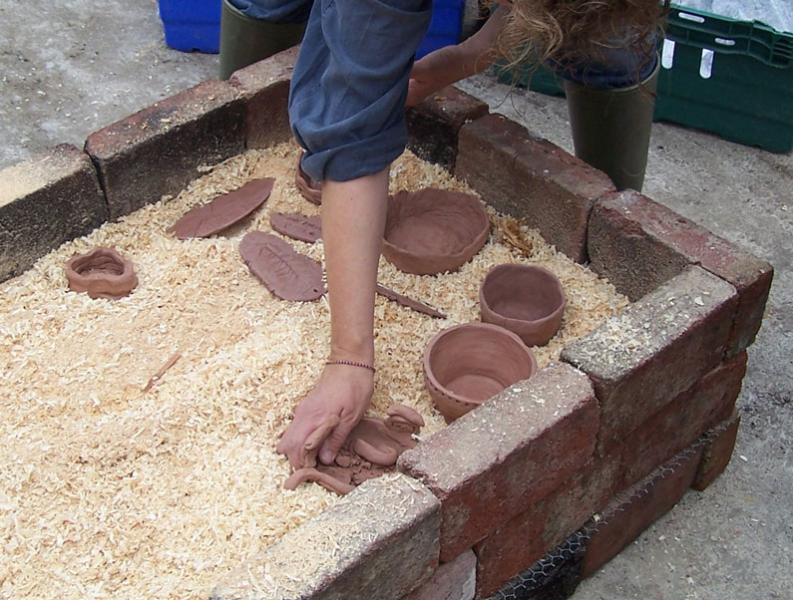
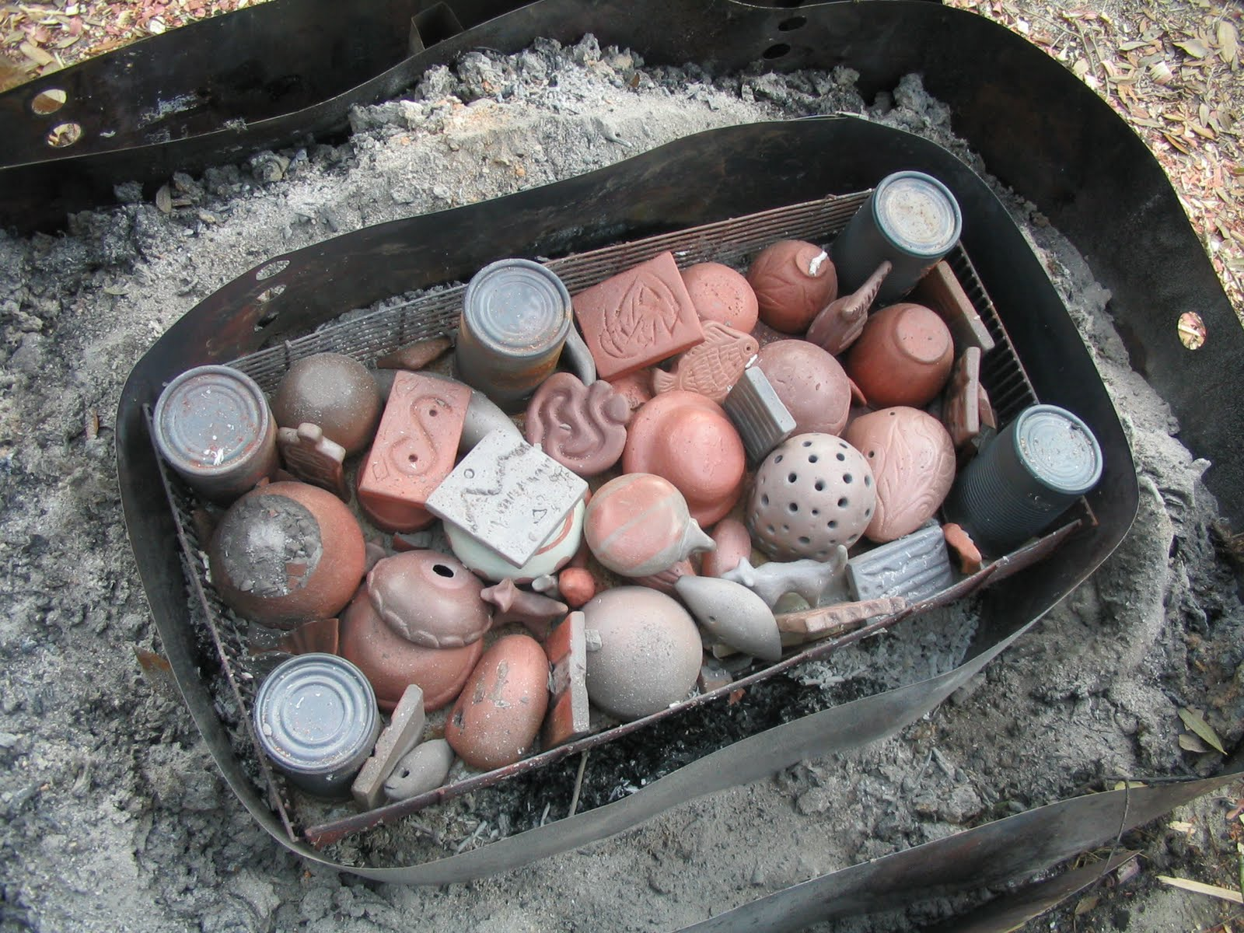
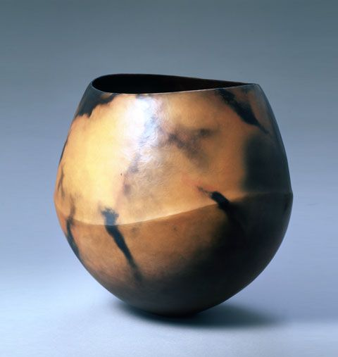
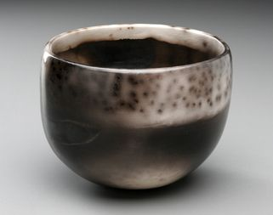

Slide 9
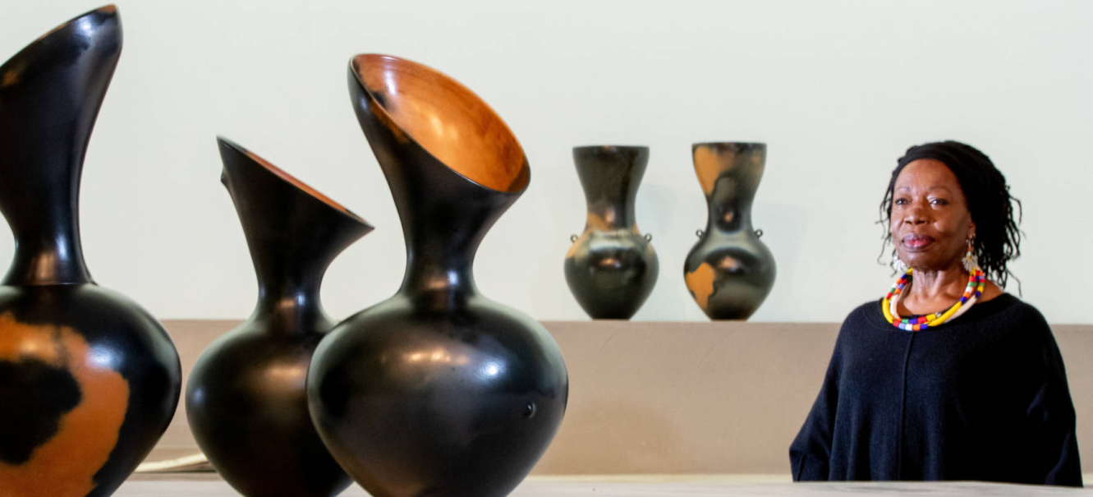
Magdalene Odundo:
Magdelene Odundo was born in Nairobi in 1950.
She received her early education in both India and Kenya.
She studied at college of art and design London.
Odundo’s artworks are redolent of the human body in a way that reminds the viewer strongly of the inherent connections between the simple vessel form and the concept of the body as a vessel. With simple curves and colour variations her sculptural vessels convey the depths of the connection between humans, earth, clay and vessels. The universality of her formal language has been deepened by her formal references to classical forms from ancient cultures all over the world.

Slide 10
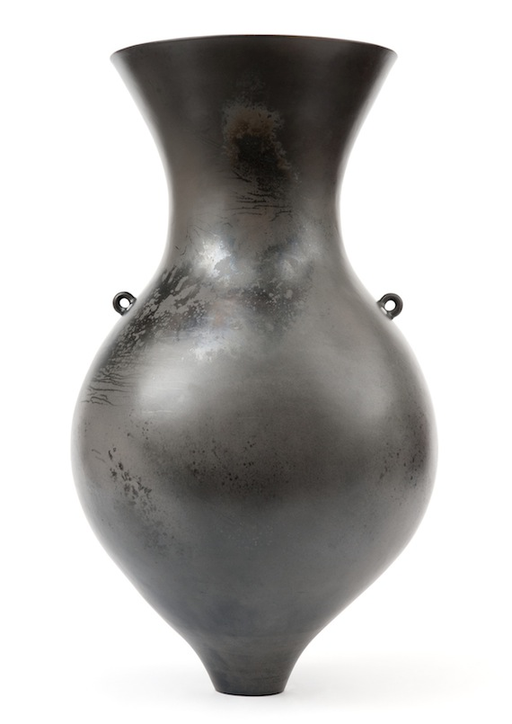
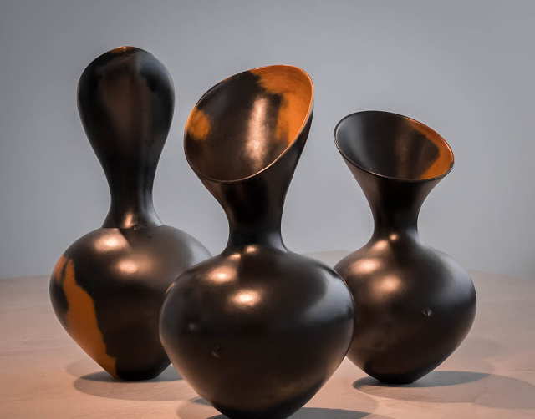
Her study of Greek, Chinese, and African forms have allowed her to find the simple, yet powerful shapes common to them all.

Slide 11
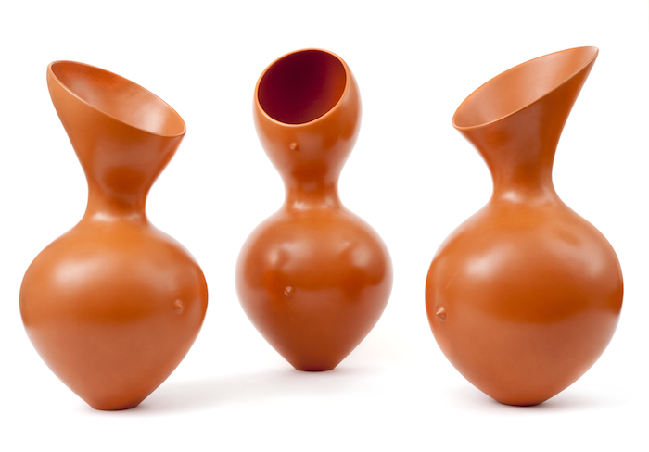
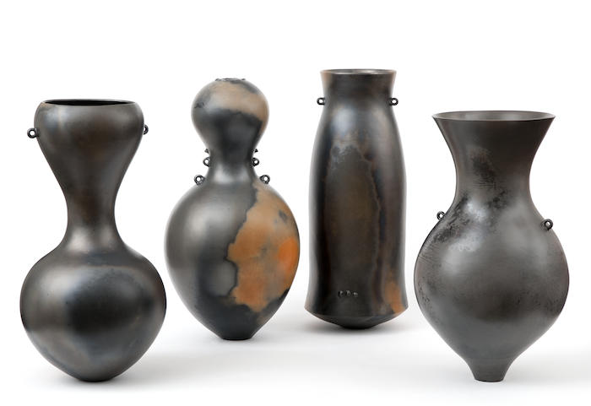

Slide 12
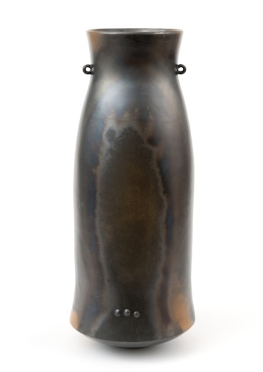
Odundo's ceramics are hand built, using a coiling technique. She does not use the wheel, preferring instead to shape her vessels without its restraints of rotational symmetry. Similarly, the surfaces on her vessels are not glazed but instead laboriously burnished, covered with slip, and burnished again. When thoroughly dry the pots are fired in a gas kiln, first in an oxidizing atmosphere, which turns them a naturally bright red-orange, and, as in this case, often a second time, enclosed in a special container filled with wood chips and shavings, so that the combustion of the wood fuel in an oxygen-poor, "reduced" atmosphere causes the clay to chemically alter and turn black.

Slide 13
Advantages of using Black pottery for cooking :
Specially designed for specific purposes, Longpi Pottery can be used both for cooking and storing foodstuff.
No adverse health effects – There is no use of chemicals making of this pottery. It is known to prevent morning sickness for pregnant women.
100 % Natural – made from clay, stone and cane, locally available and natural raw materials are used
100% Handmade – this generates revenue for the locals in Manipur Fire-resistant pottery due to the use of Serpentine rock.
Multipurpose – can be used on a open flame, in the microwave and is also dishwasher safe.
The pots are good for simmering and slow cooking for hours over a low flame, homogenizing and condensing meat and lentils.
The contents continue to sizzle for a long time after it is taken off the heat, ensuring that the food continues to remain hot.

Slide 14
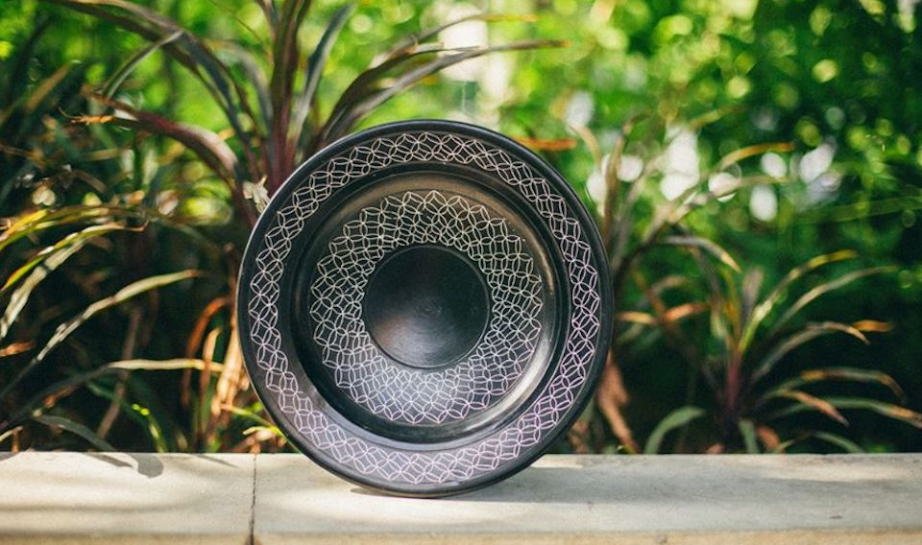
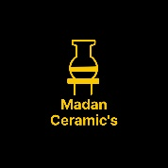
References:
Google & Dictionary of art terms
Thanks……….
Madan Singh
www.madanceramics.com

