Slide 1
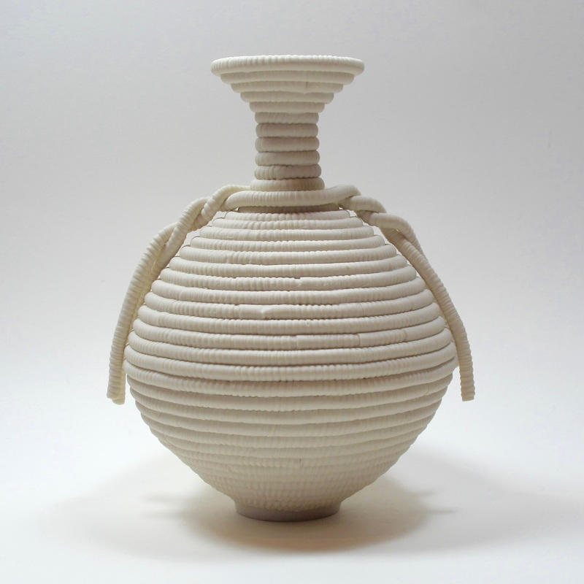
Coiling Process : Basic Approach

Slide 2
Coiled pots are constructed by gradually stacking and joining coils of clay one on top of the other. The coils can be left visible or can be smoothed away depending on your desired aesthetic end result. It is important that the coils join well during construction to avoid cracking or separation during the drying and firing process.
Types of coiling pottery:
There are two types of coiling pottery
Is visible out side
Is not visible after finishing
Is visible out side | Is not visible after finishing
Start with a handful of clay. | Start with a hand of small clay.

Slide 3
Roll it into a long coil either on a table or between your hands gently stretching it outward as you roll, until you have a coil of uniform thickness of about 1 to 1 1/2 inches. The lengths of the coils do not need to be the same. Some can be longer and some shorter. | Roll it into a long coil either on a table gently stretching it outward as you roll, until you have a coil of uniform thickness of about 1cm. The lengths of the coils do need to be the same. Some can be longer and some shorter.
Make the base of your pot by making a spiral from one coil, pressing the sides of the coils closely together and smoothing inside and out to make a smooth base of uniform thickness. | Make the base of your pot by slab process, pressing the sides of the coils closely together and smoothing inside to make a smooth base of uniform thickness.
Continue to roll out more coils or ropes of clay for the rest of your vessel. | Continue to roll out more coils or ropes of clay for the rest of your vessel.

Slide 4
Coiling:
Coiling is a great method to use when you want to create large and complicated shapes quickly. It is a practical technique to use when working on different irregular and soft shapes. There are different techniques when you work with coiling and you can either use round or flat coils when you make small bowls or cups you should use the rounded coils.
Link:
https://www.youtube.com/watch?v=dPNSjzWVU5c
https://www.youtube.com/watch?v=ds2iSVlTJ78

Slide 5
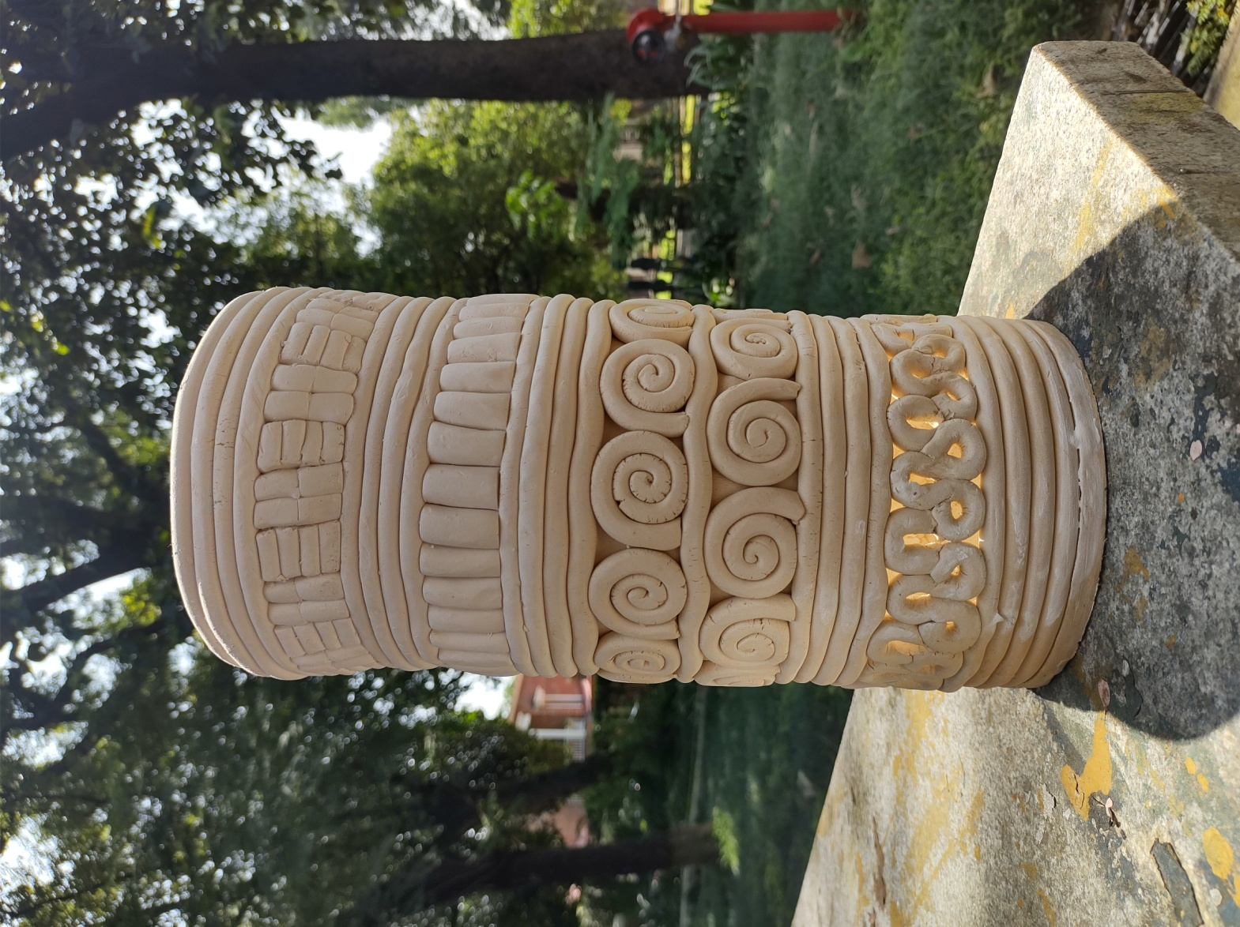
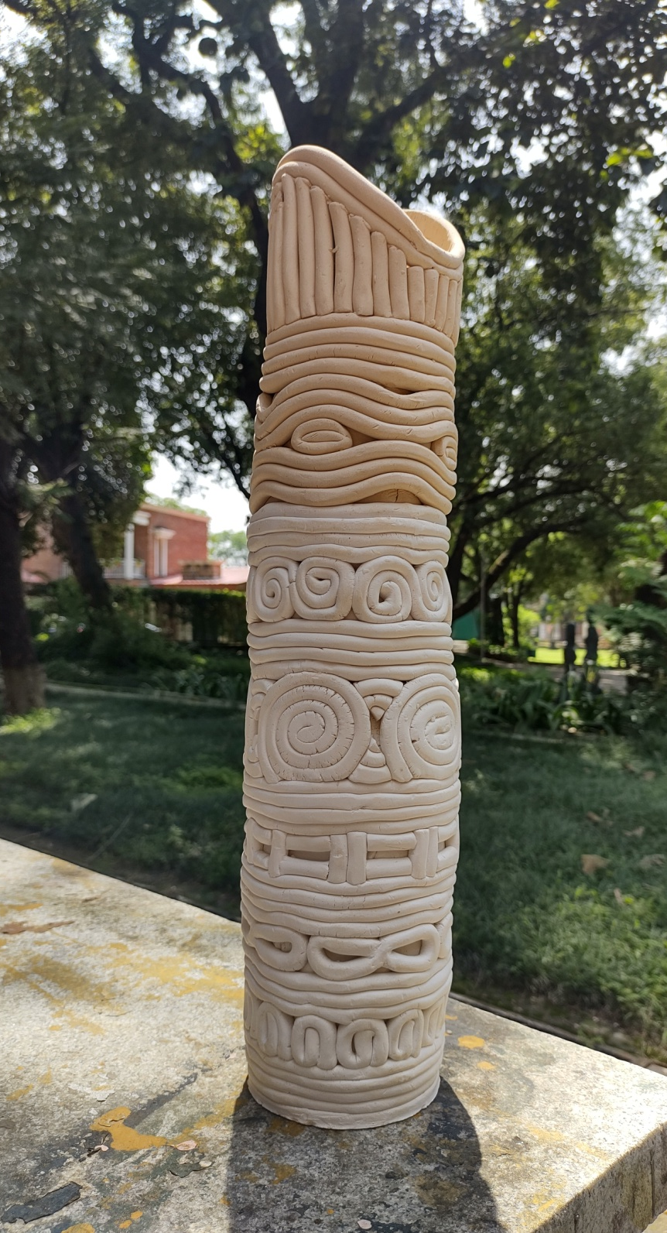

Slide 6
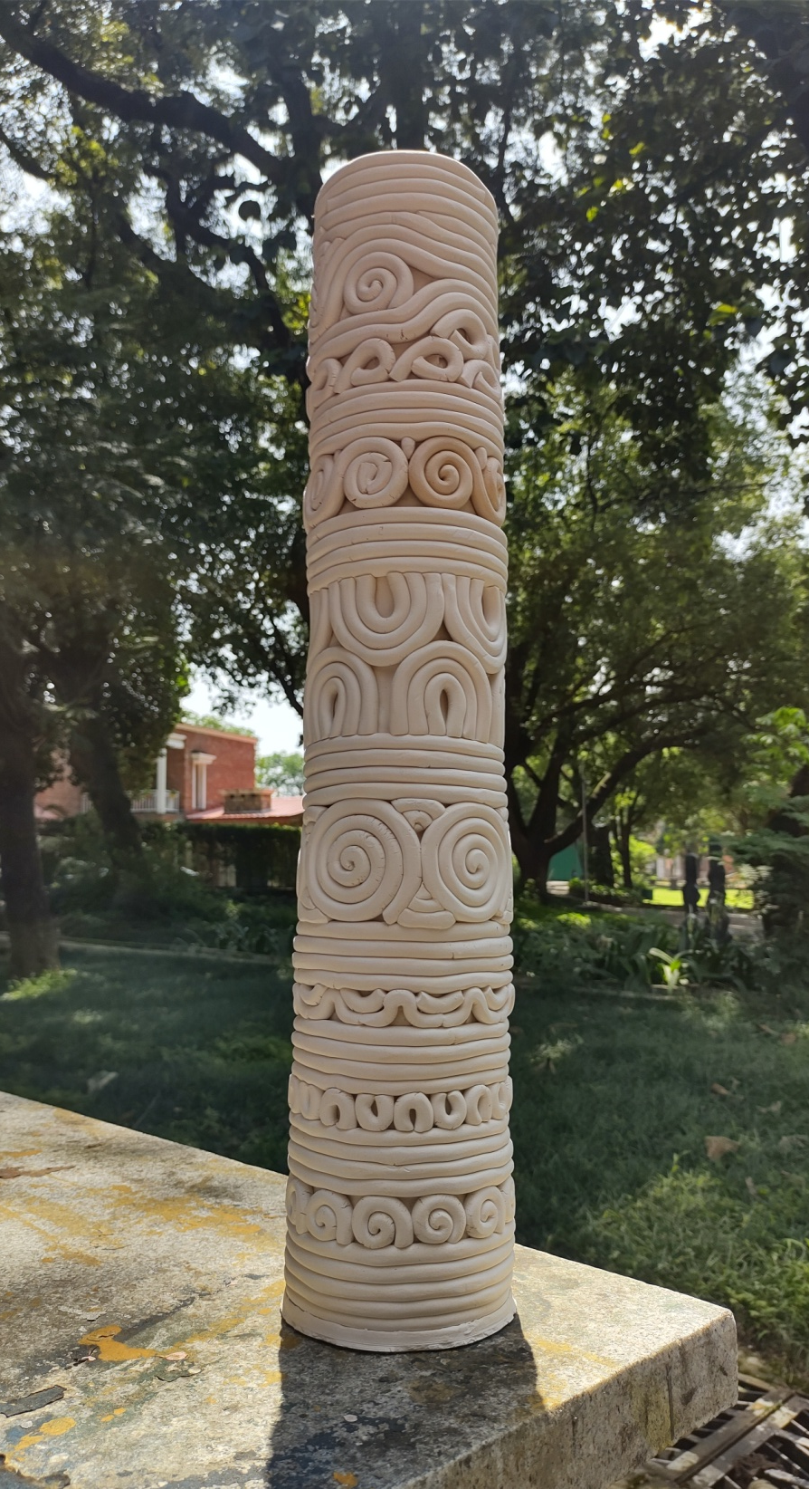
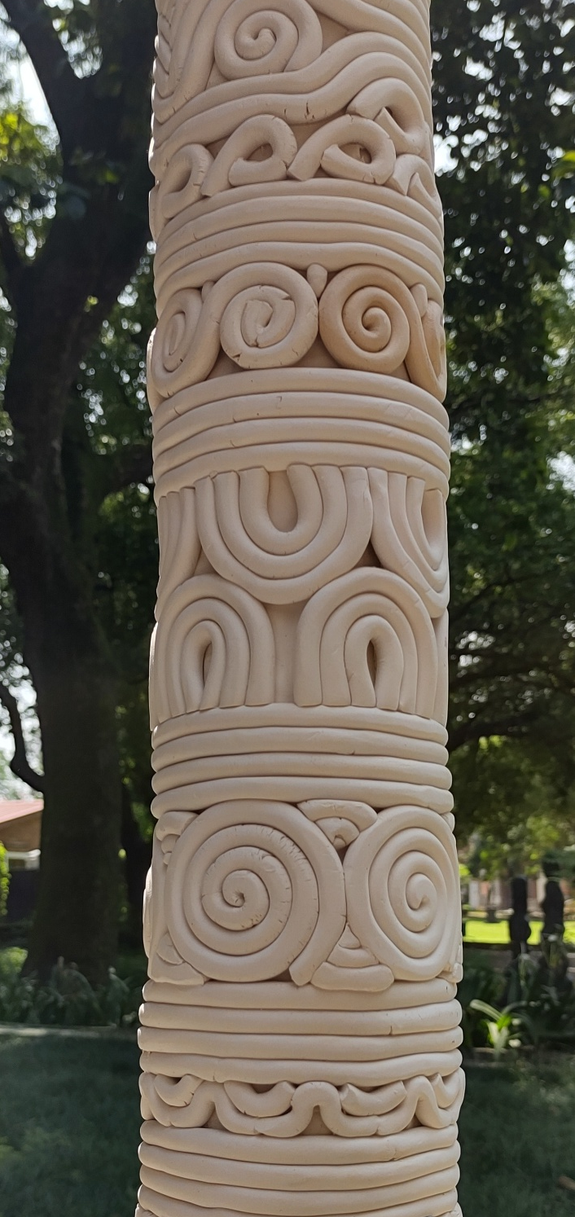

Slide 7
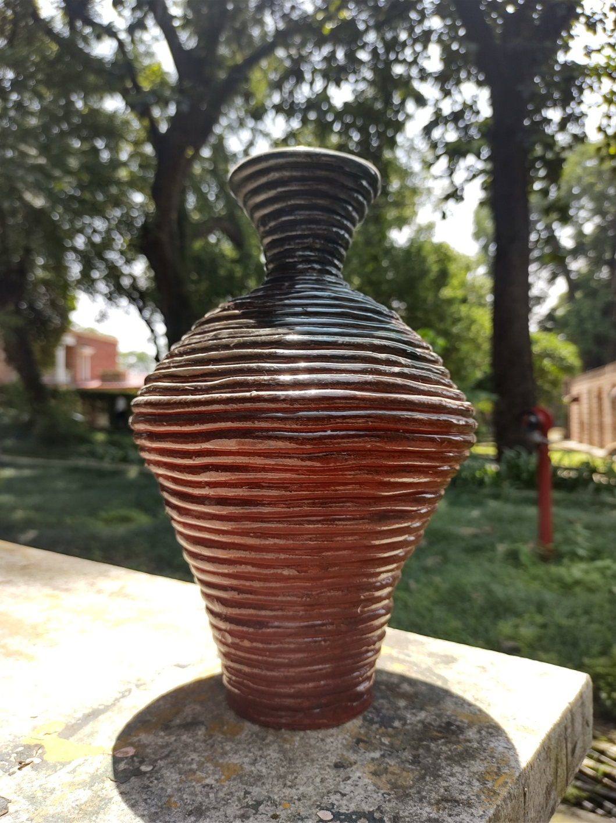
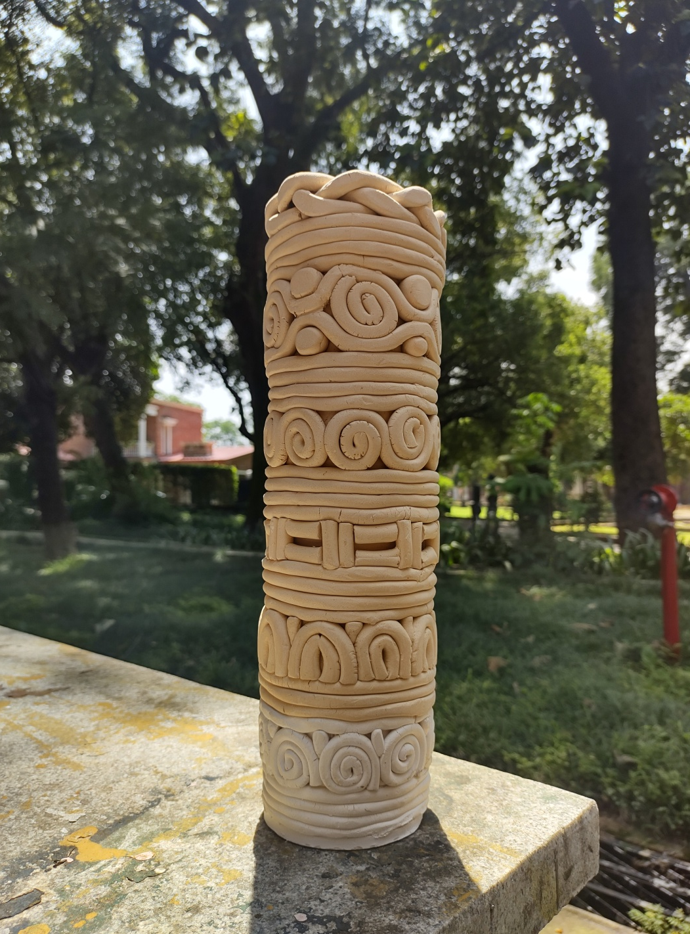

Slide 8
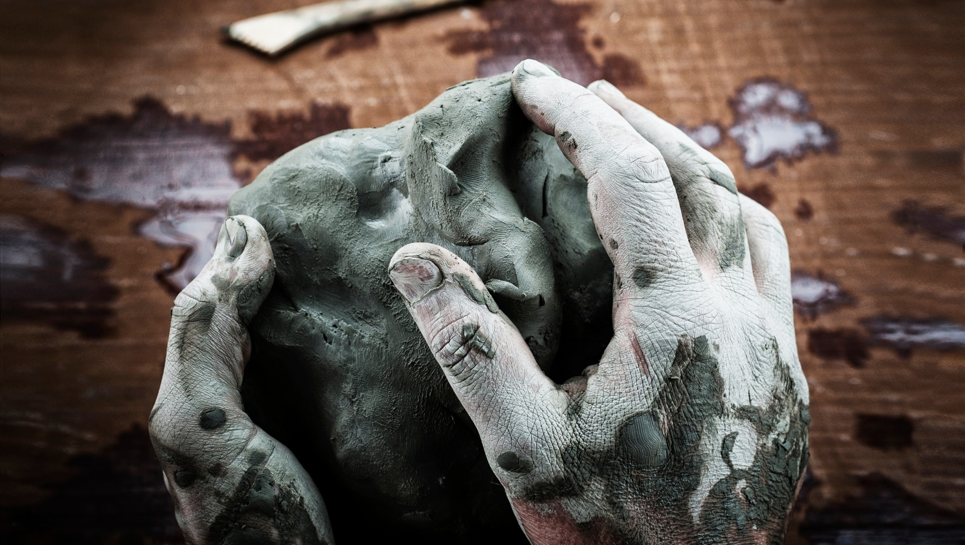
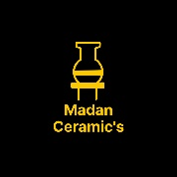
References:
Book: Ceramics
(A beginner's guide to tool and techniques),
Google and Own thinking
Thanks……….
Madan Singh
www.madanceramics.com

