Slide 1
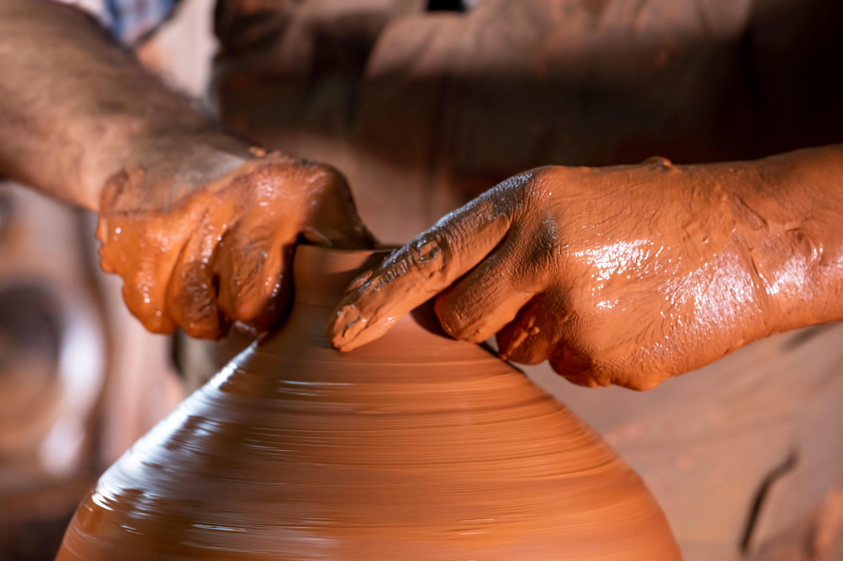
Black Pottery

Slide 2
This is one of the most common production way of tradition pottery, where the pots are turned black by stopping combustion at the end of firing period. This could be different ways, for example, by smothering the fire with fine dunk, damp grass or branches of trees, sticks of pine trees etc and then covering all of apertures of kiln.
Sometimes the pots are taken out of the fine and plunged into grass, sawdust, dunk and straw.
Black pottery sample have been formed in many places in Africa, in Asia, in Europe, in North and South America produced from prehistoric time.
Types of Black pottery:
There are two main black pottery methods :
Bonfire in 500-600 degree Celsius carbonization- firing into the pores of the clay body.

Slide 3
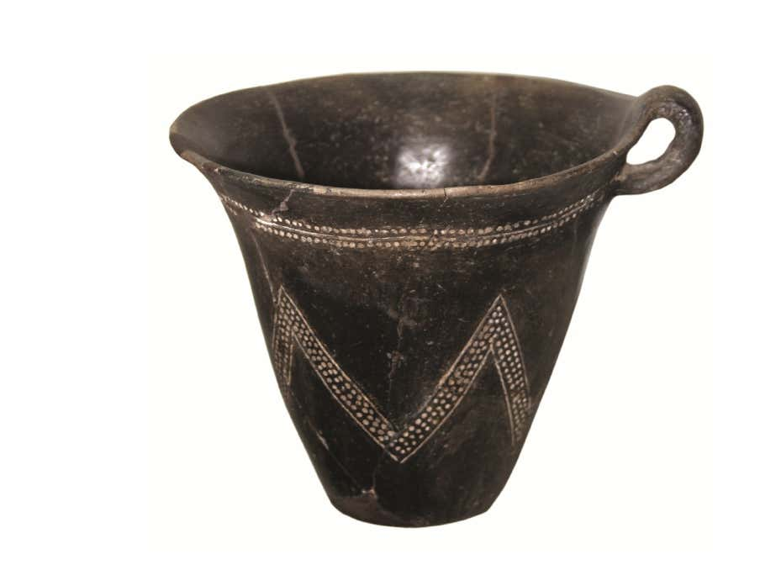
Reduction after firing above 800 degree Celsius and modification of red iron oxide to black iron oxide.
Some examples:
Early Bronze Age,Ilıpınar
Iznik Museum, Western Turkiye

Slide 4
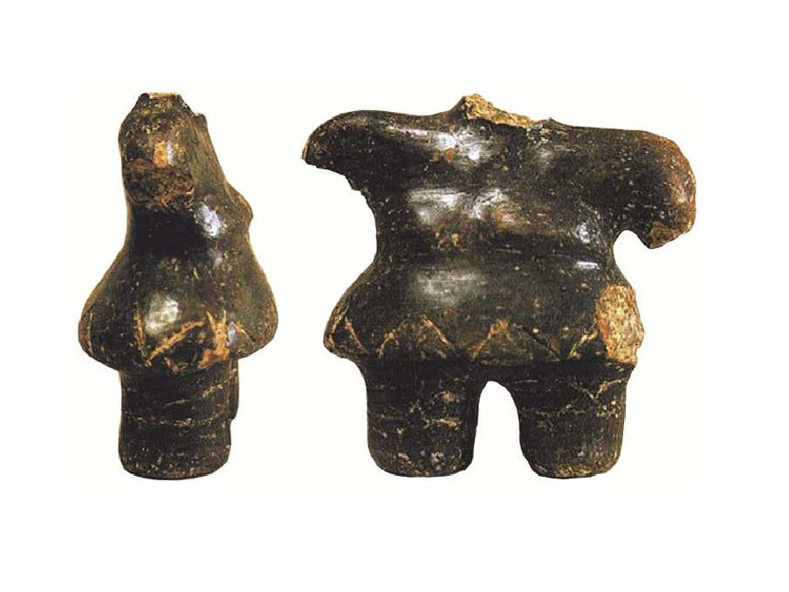
Prehistoric figurine, Pendik, Istanbul

Slide 5
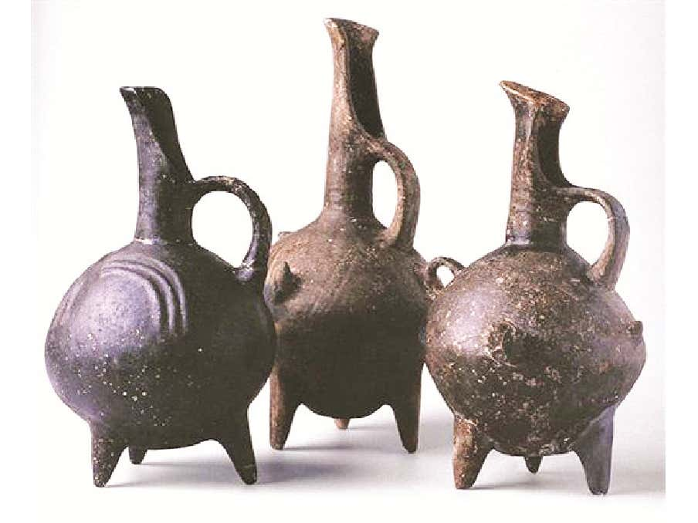
Early Bronze- Age, Yortan,Western Turkiye

Slide 6
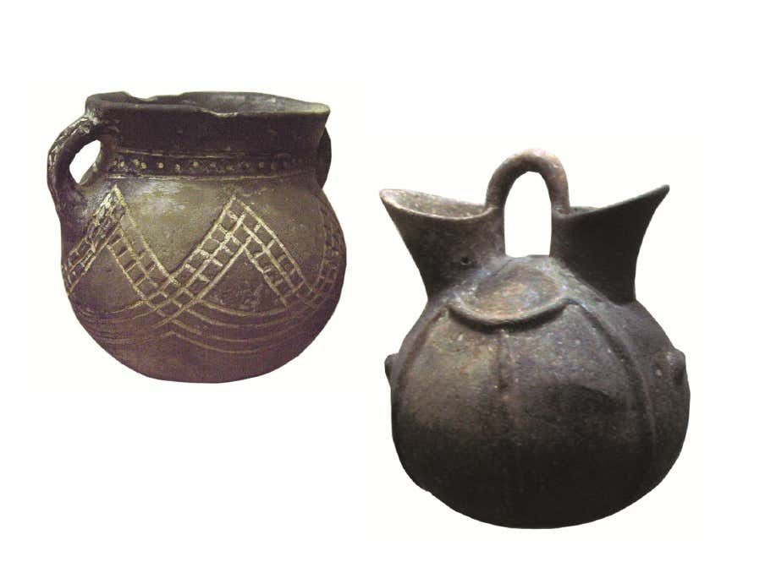
Early Bronze Age, Antalya Museum

Slide 7
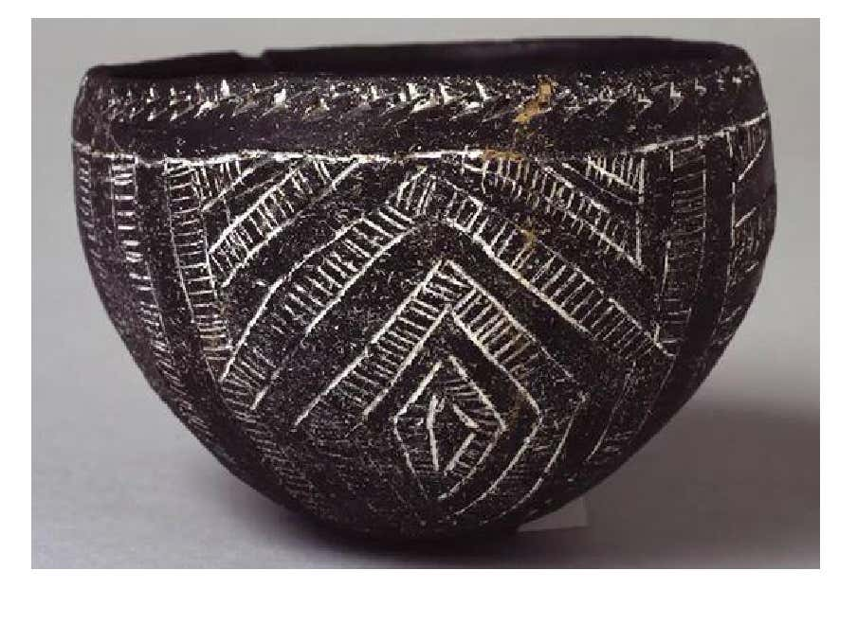
Nubian Incised Black Pottery Kerma, Egypt, 2050-1850 B.C.

Slide 8
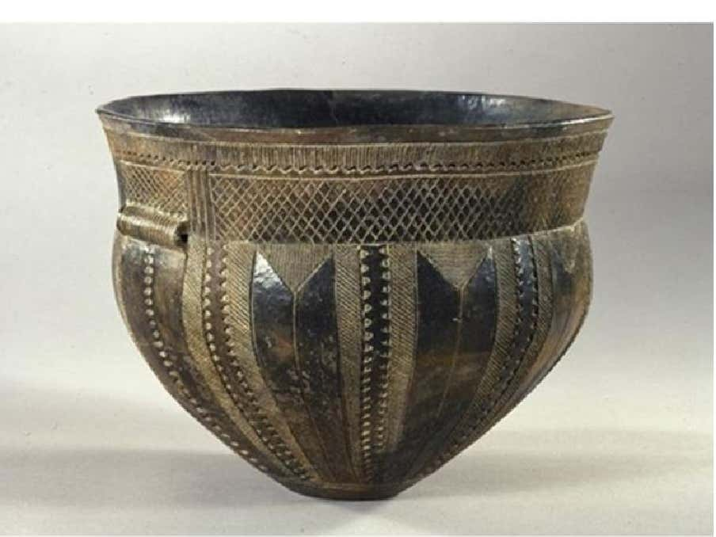
The vessel from Skarpsalling. 3200 BC.
National Museum of Denmark

Slide 9
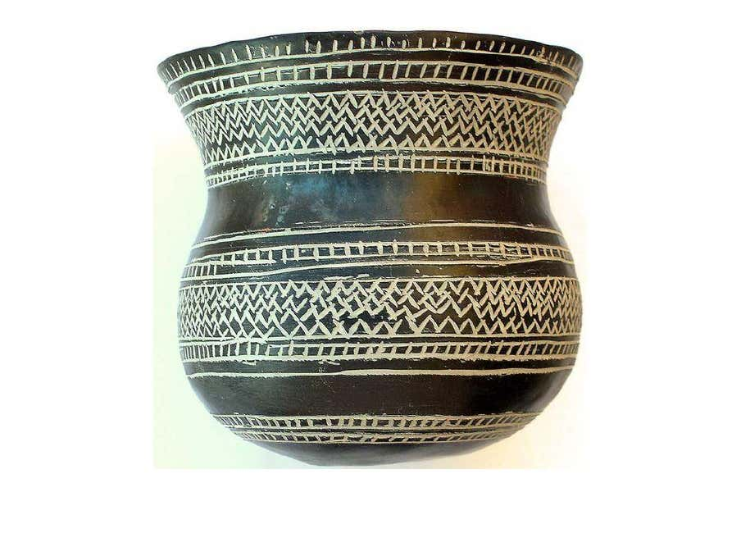
Prehistoric earthenware vessel decorated with incised geometric motifs filled with white paste. Early Bronze Age, Central Spain.

Slide 10
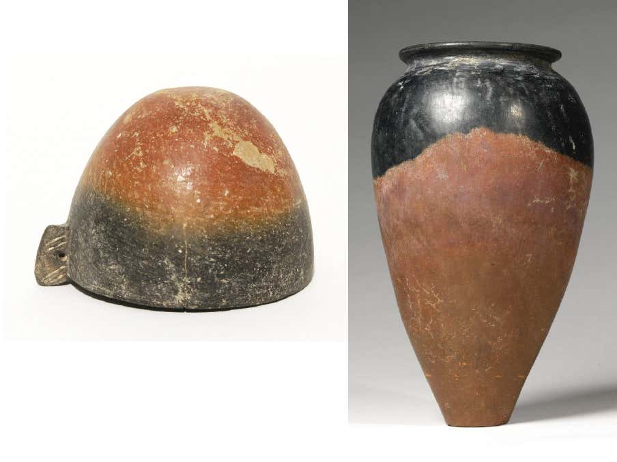
El Badara Egypt, 4000-3500 B.C.
Jar, Predynastic Period, Naqada II3600-3200 B.C.

Slide 11
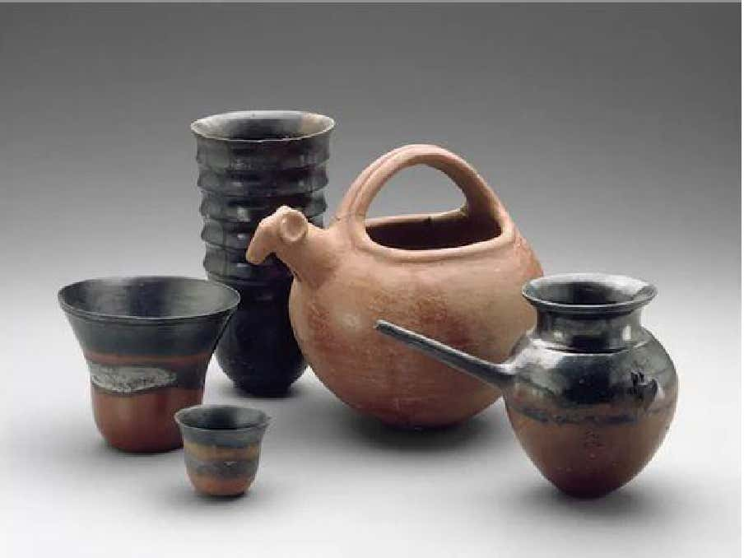
Nubian Pottery, Kerma, 1700-1550 B.C.

Slide 12
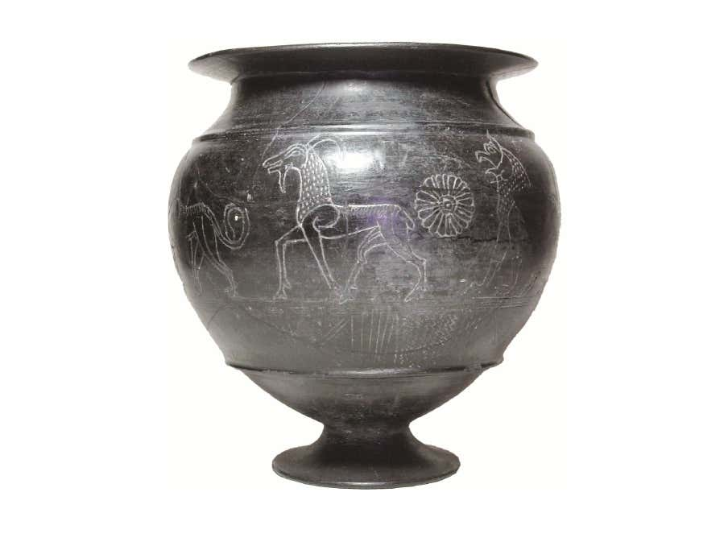
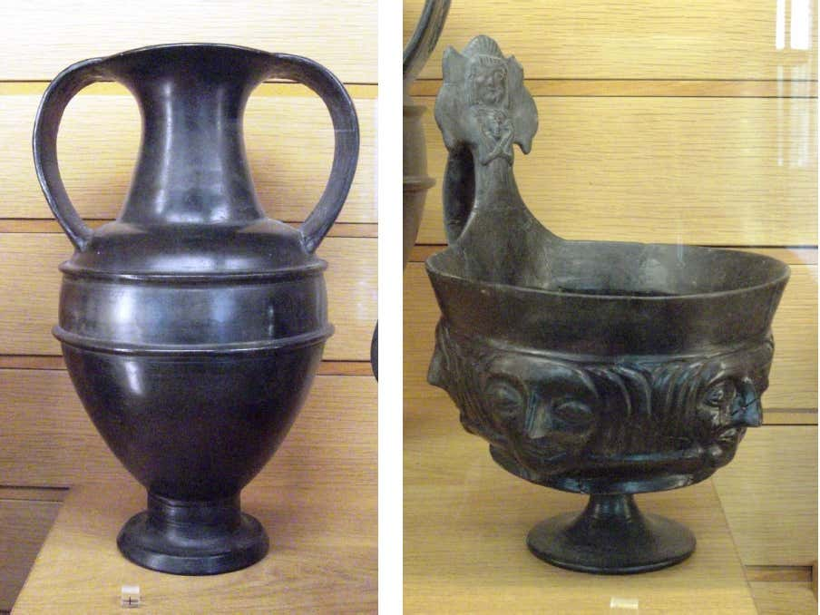
Etrüsk
buchero krater, 630-600 B.C., British Museum,

Slide 13
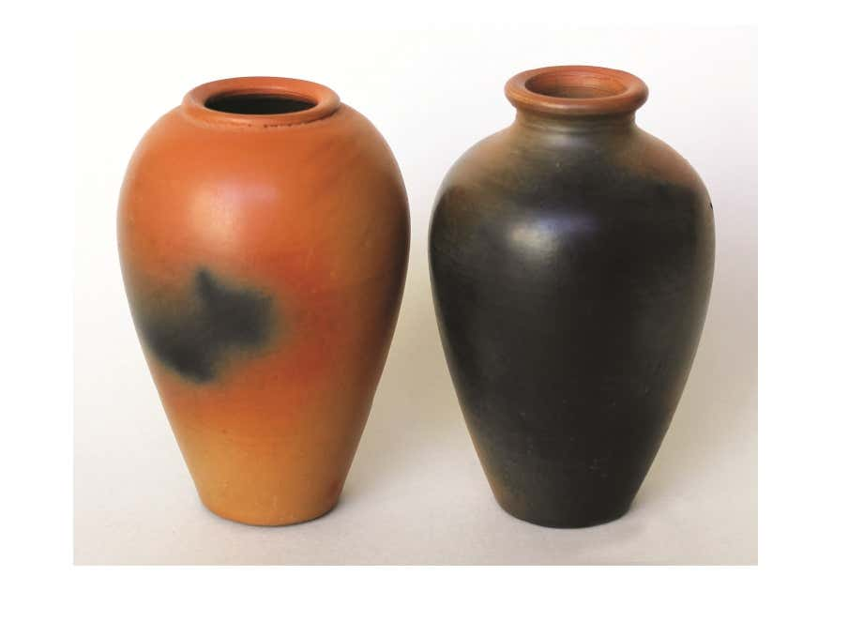
Uttam Nagar Village New Delhi, India

Slide 14
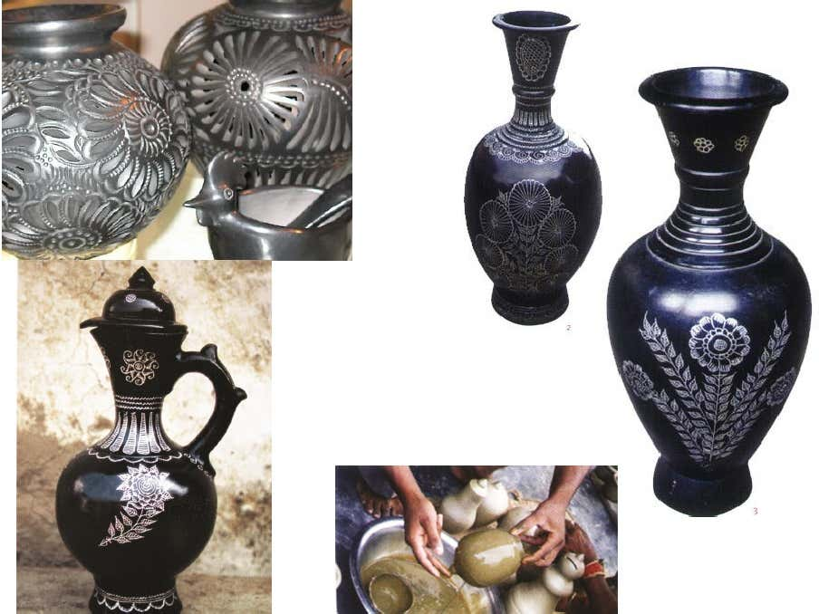
Uttar pradesh ShireAzamgarh /Nizamabad

Slide 15
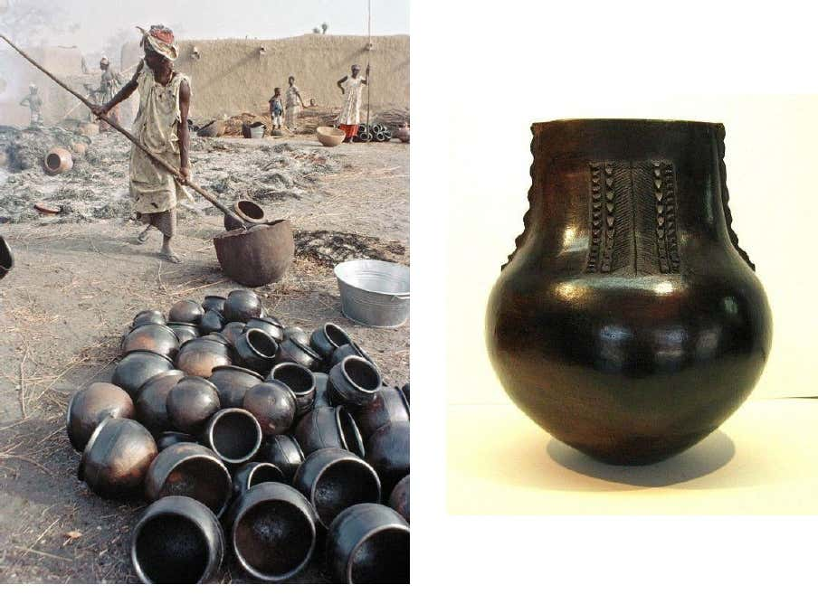
South African Black Pot for Beer

Slide 16
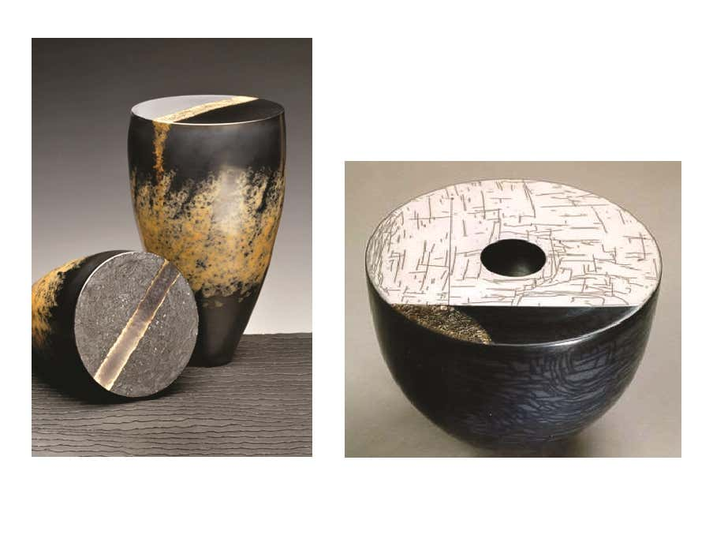
Philippe Buraud
Tjok Dessauvage

Slide 17
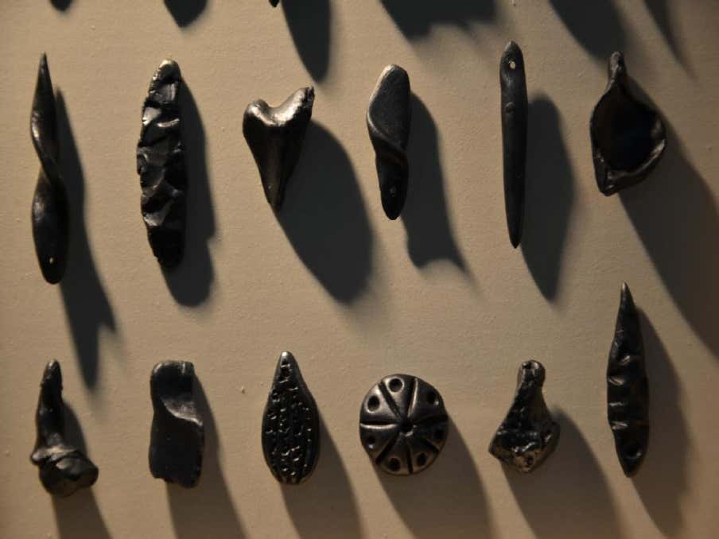
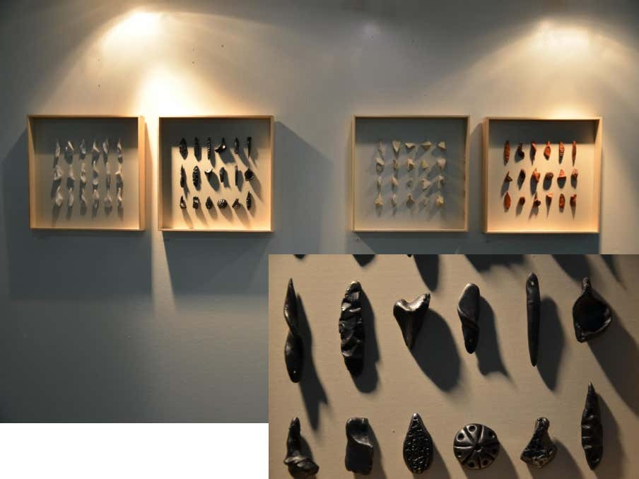
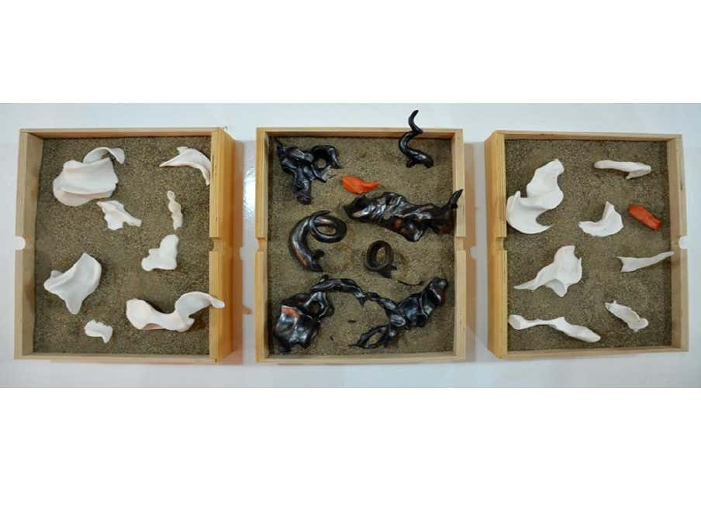
Sevim Çizer, 2016

Slide 18
A craft, a history in India:
“We have been hearing from our elders that once a kaji sahib (judge) in the Mughal administration saw black pottery by the Prajapati community in Gujarat. He was so impressed by the work that he brought some artisans to Uttar Pradesh, gave them land for housing and agriculture and asked them to continue the craft,” he recollects.
Centuries later, the descendants of those craftspeople, about 250 families, continue to make black pottery vases, tea pots, jars, utensils and decorative items for the domestic as well as overseas markets.

Slide 19
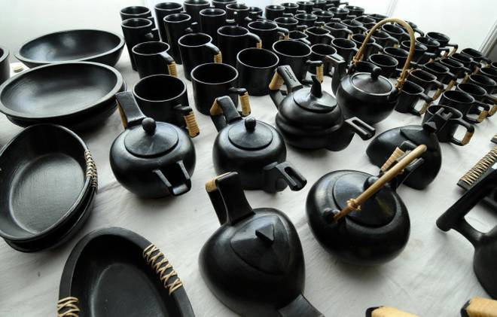
While black pottery is also practiced in some other places, he points out why Nizamabad is different. Manipur’s black pottery is without the silver patterns while Khurja pottery is glazed. Alwar in Rajasthan is well known for its sheer body pottery (kagzi) but the sandy soil is not suitable for Nizamabad-like black pottery.
Manipur’sblack pottery

Slide 20
How is black pottery made:
In Nizamabad, potters dig out clay from ponds during the dry months of April and May and store it inside their houses for use throughout the year. Their units have small pits into which the clay is filtered, mixed with water and left for some days. When it thickens, the clay is kneaded by feet or using machines to make it lump-free. It is then put on a potter’s wheel and shaped into utensils.
Prajapati points out that the pottery is partially dried in the sun to retain some moisture. It goes back on the wheel for ‘kharat’ or peeling off uneven surfaces. This also adds glaze. Kavis, a colour made using clay and water, is applied and the pottery is then left to dry. Mustard oil is then rubbed on it to make it shinier.

Slide 21
A fine iron needle is then used to draw intricate geometrical and floral patterns on the pottery. Women usually do this fine work though men also are experts in the art. The pottery then goes inside the bhatti (oven), which is then fully covered with cow dung cakes. “When the pottery is inside the oven, it is important to ensure that there is no scope for oxygen to enter and the heat level remains high. The presence of oxygen can turn the pottery red and it won’t get the black colour, which is the hallmark of Azamgarh,” Surendra explains.

Slide 22
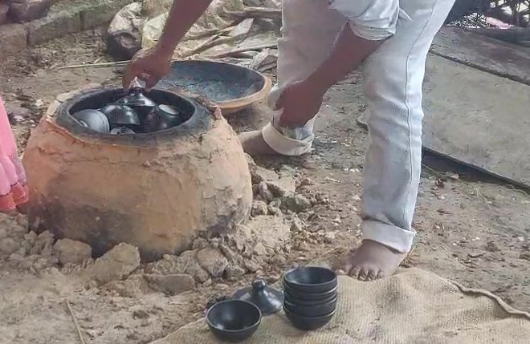
The oven cools down after 10 to 12 hours and then pottery is removed. A powdered mix of lead, mercury and zinc in equal proportion is now filled into the carved design, giving it a silver finish. “Water is then applied, rubbed and applied again to ensure that the silvery powder sticks permanently on the carved design,” he adds.

Slide 23
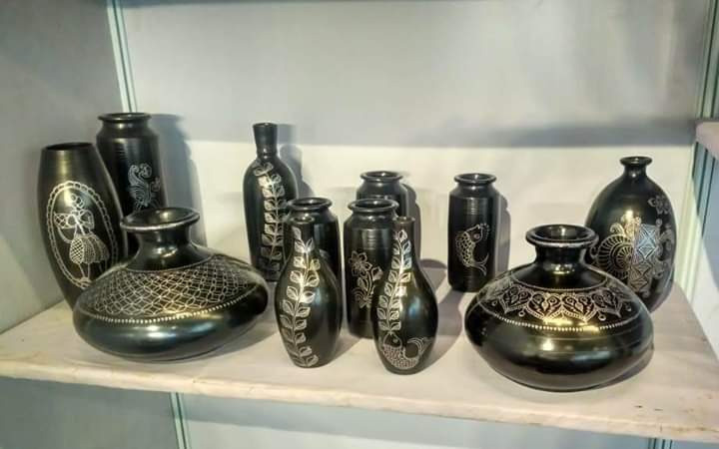
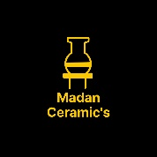
References:
Book: Ceramics (A beginner's guide to tool and techniques), Google and Own thinking
Thanks……….
Madan Singh
www.madanceramics.com

