Slide 1
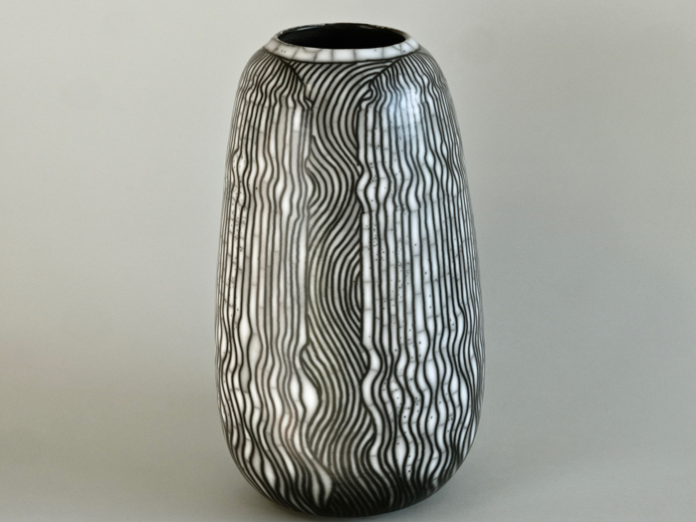
Modern Raku Process & Effect

Slide 2
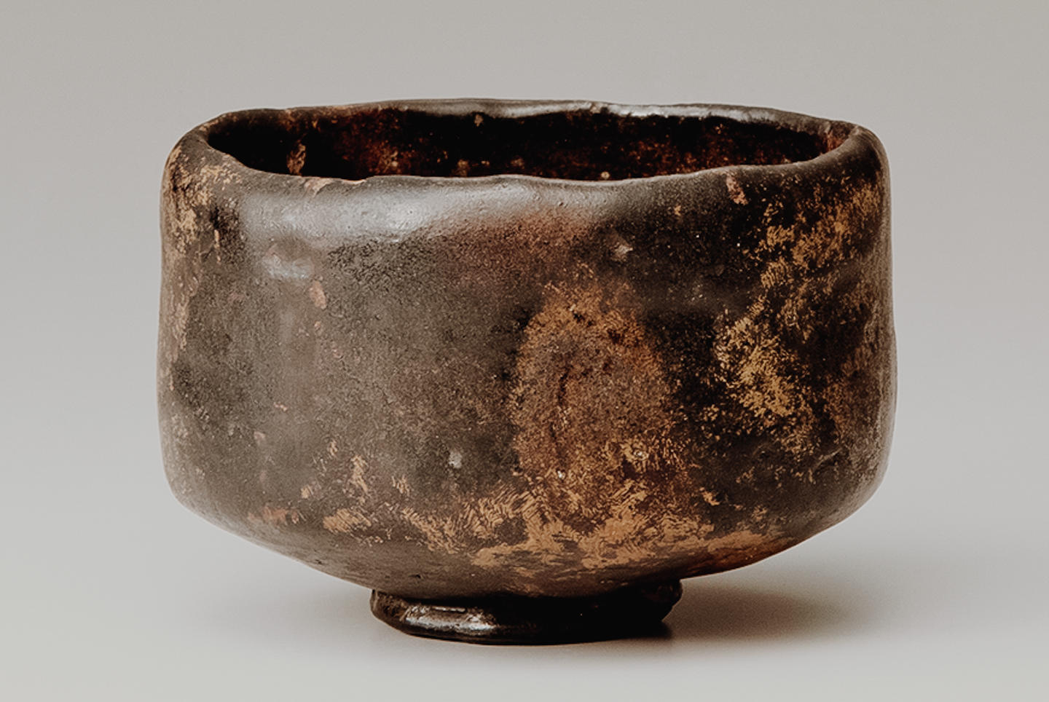
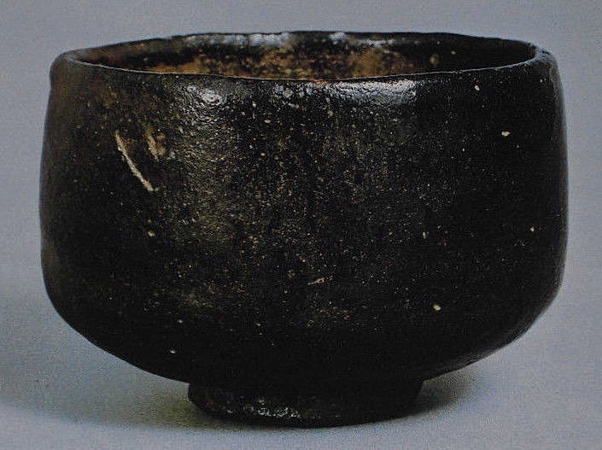
Japanese Raku :

Slide 3
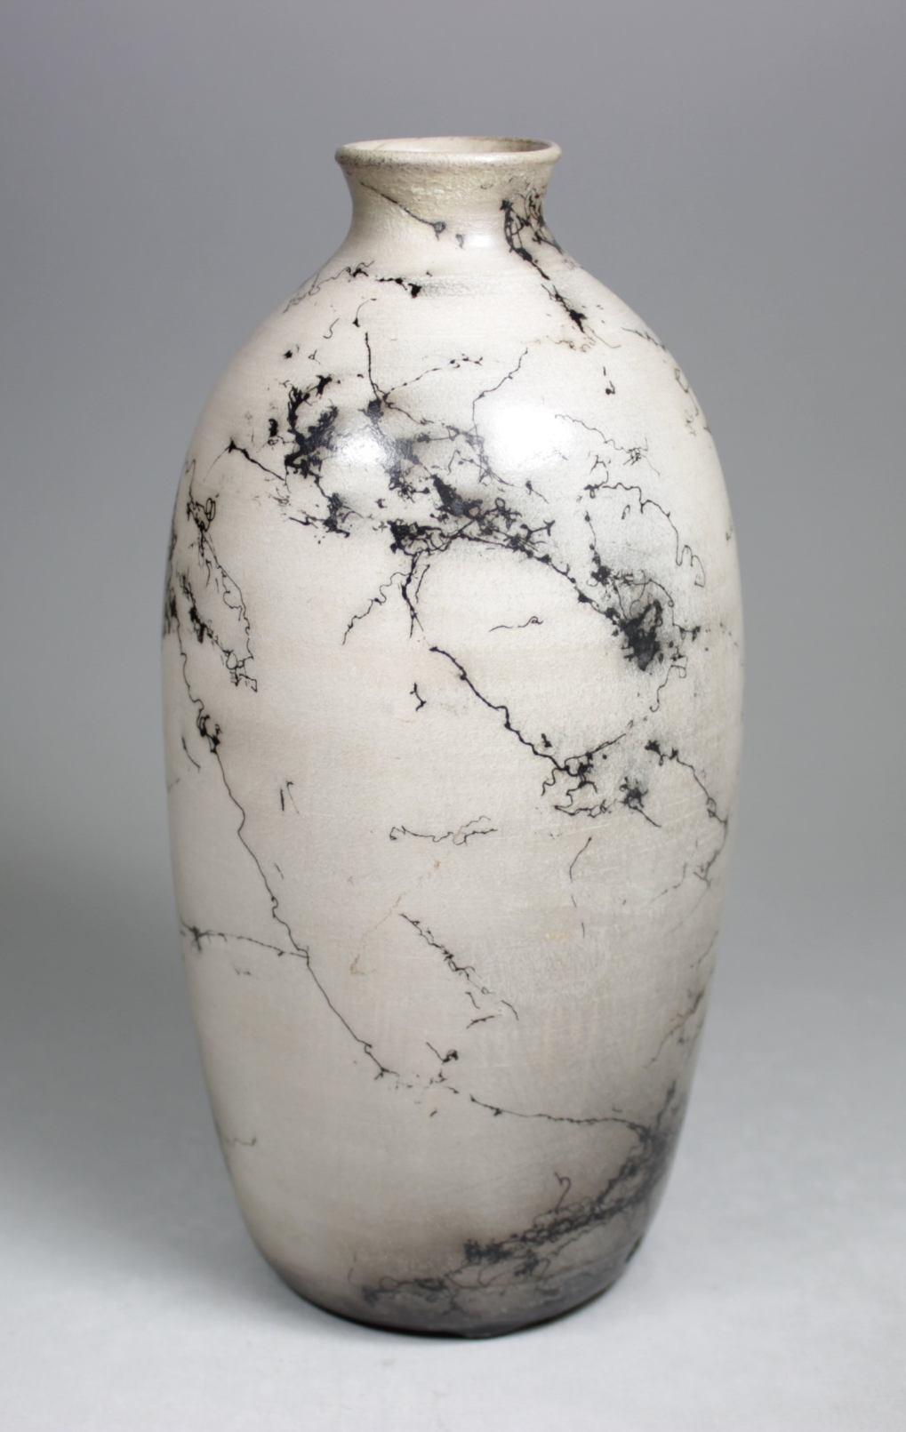
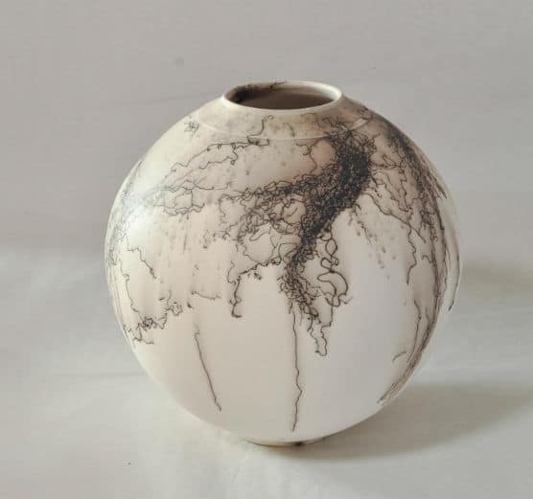
Horse hair base Raku

Slide 4
The General Process of Horsehair Pottery:
Horsehair pottery generally follows the following process:
The pottery piece is formed, then burnished. Burnished pottery works best, as the smooth unglazed surface accepts the carbon marking with the strongest effect.
The piece is fired to between 900 – 1050 degrees Celsius in a raku kiln. Using the raku kiln allows much easier access to the ware.
Once the correct temperature is reached, the incandescent pottery is taken from the kiln using long raku tongs and proper gauntlets and other protective gear. The hot pottery is placed on a non-flammable surface (such as a piece of broken kiln shelf) and the selected hairs are draped onto it.
Once the piece has cooled completely, it is washed to remove residue. It can then be waxed to bring out the markings.

Slide 5
Things to Know About Horse Hair Pottery:
Horsehair pottery requires a porous ceramic body in order for the carbon to permanently mark the surface.
Such a clay body is often rough and almost impossible to burnish if left "as is." In order to get that lovely smooth, buttery burnished surface, cover the piece with terra sigillata.
Another aspect to note is that horse hair pottery should never be considered functional ware. It is not food-safe and is also liquid permeable.

Slide 6
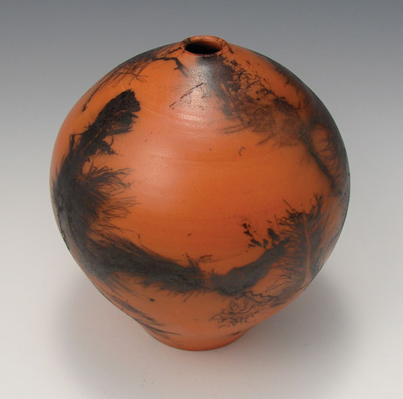
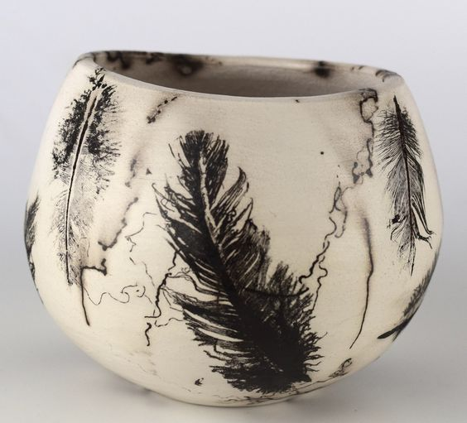

Slide 7
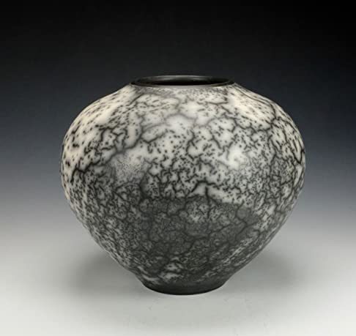
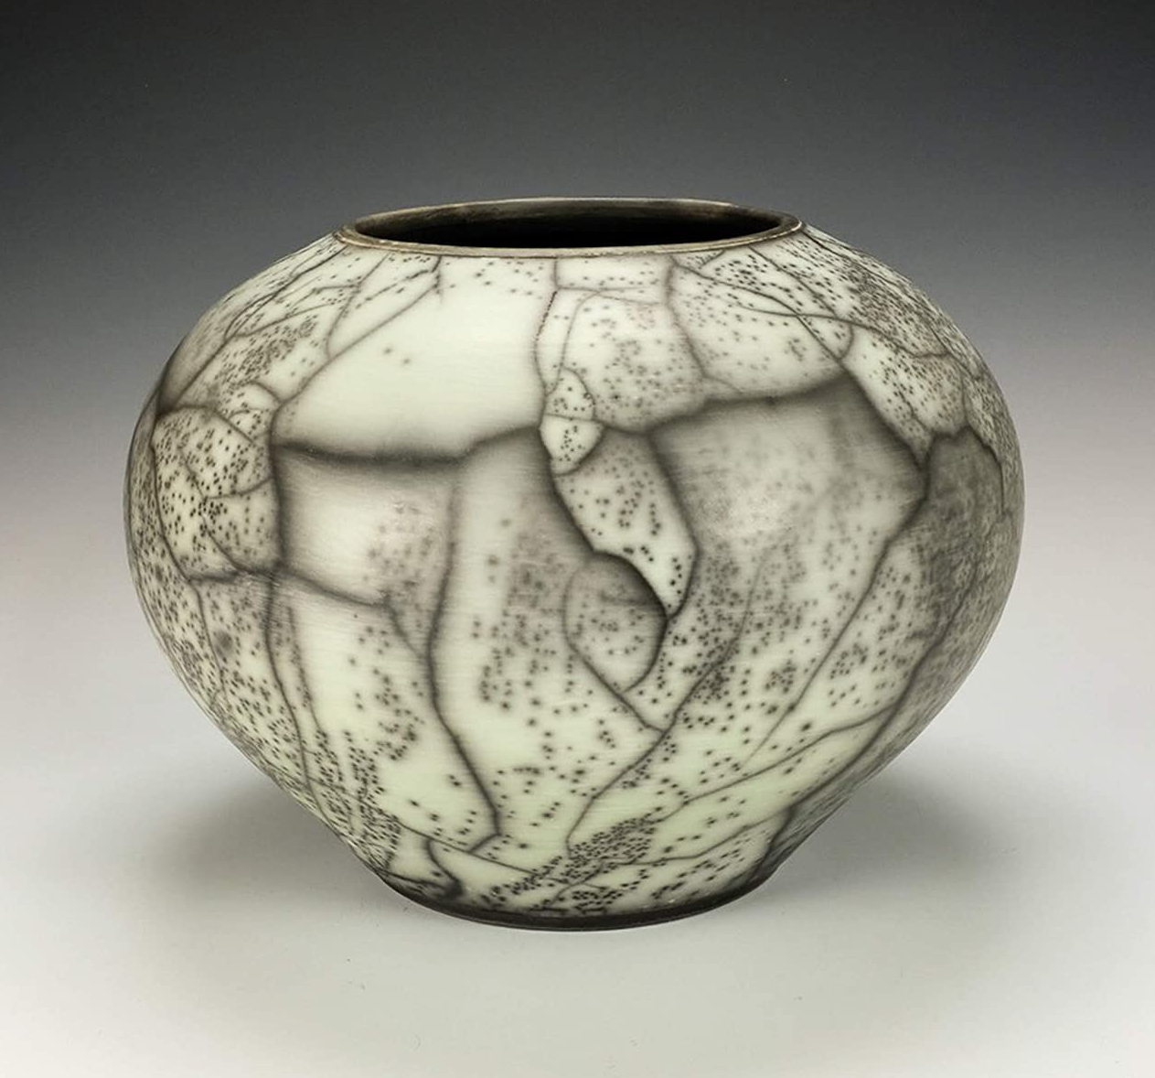
Naked Raku

Slide 8
The Naked technique is a different type of Raku where it is possible to obtain an amazing pattern. There are two forms of naked raku: the two-step technique (resist slip and glaze) and the one-step technique (resist slip only). Note the resist slip is different in both techniques. The clay for this type of the naked raku is really thin and porous to allow smoke to penetrate inside it. When pieces are dry, it is required to spread a slip called Terra Sigillata, onto the surface. This process needs to be repeated several times to obtain a shiny surface. Between each layer it is good to polish the surface with a t-shirt or a soft fabric. As soon as Terra Sigillata has been applied on to the creation, the surface must not be contaminated with fingerprints. You can for example, use cotton gloves.

Slide 9
The bisque is fired at a higher temperature than the common Raku. Afterwards we can apply a special slip to allow the glaze to come off at the end. The special slip must not dissolve during the second firing. If at all possible, it is suggested to utilise a simple white glaze to obtain the Naked effect.
The surface must be smooth to remove the slip easily between the surface of the clay and the glaze. Also a smooth surface allows the distinction between white (clay) and black (smoke) highlighting the pieces.

Slide 10
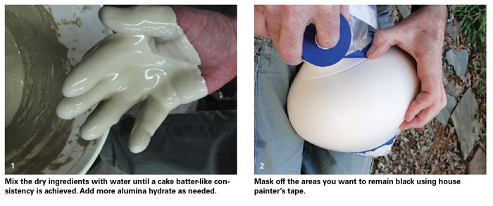

Slide 11
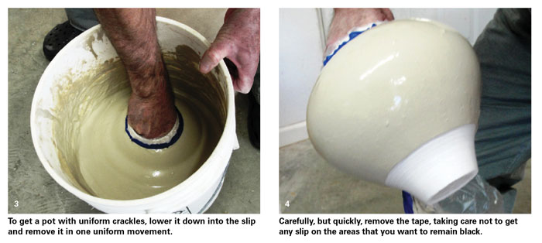

Slide 12
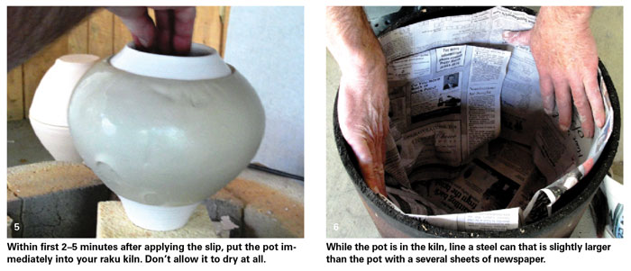

Slide 13
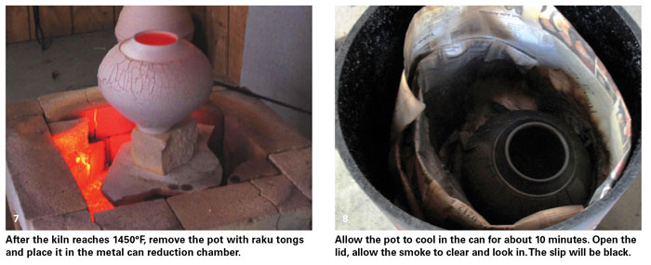

Slide 14
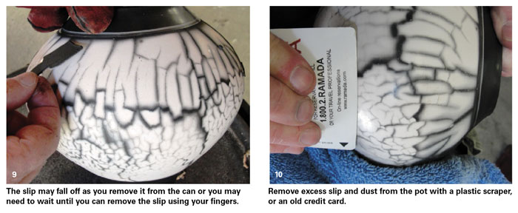

Slide 15
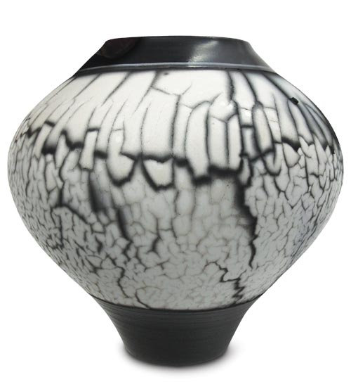

Slide 16
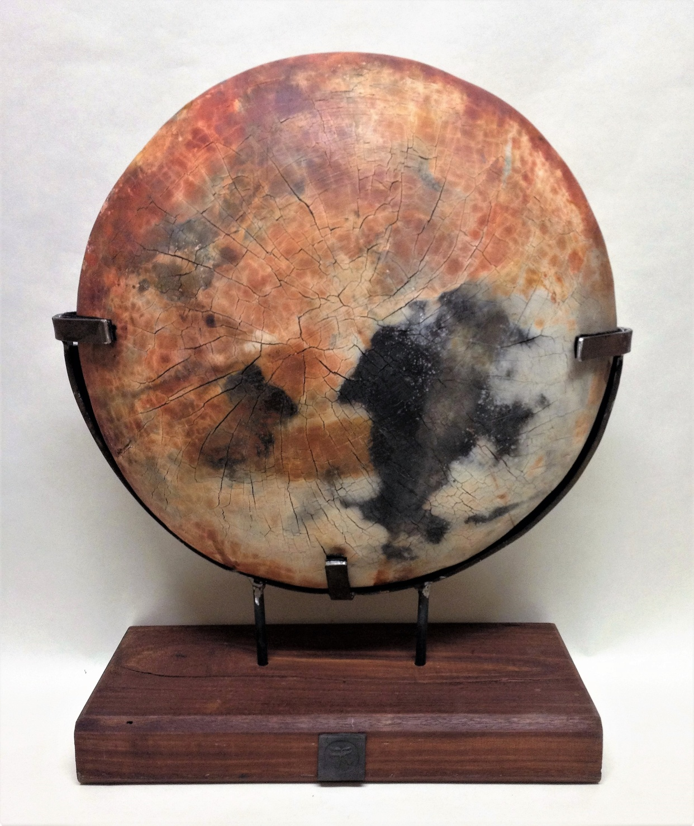
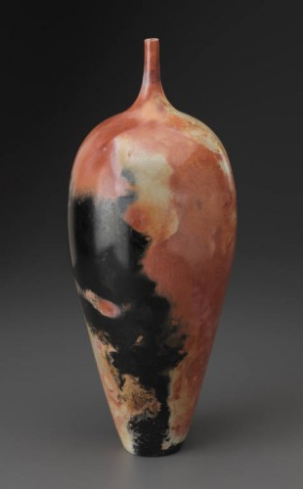
Barrel Raku

Slide 17
In this firing the pottery had previously been fired in electric kilns to turn it ceramic, this firing being done to enhance the appearance of the surfaces by introducing smoke and flashes of colour from burning other materials that wood.
The pots were burnished while leather hard to smooth the external surface, this was repeated as the pots dried. Very fine Terra Sigillata slip was then applied in several very thin coats to the dry surface, which produced a super smooth finish.

Slide 18
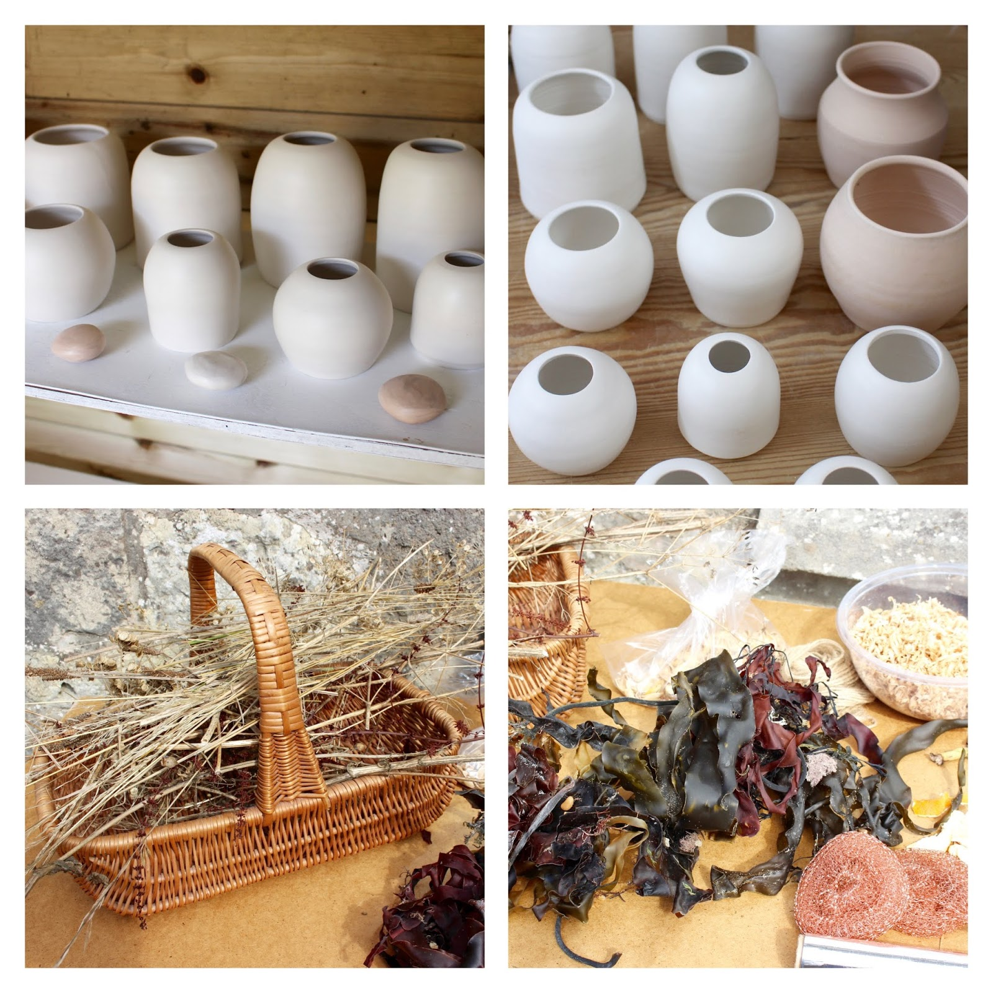

Slide 19
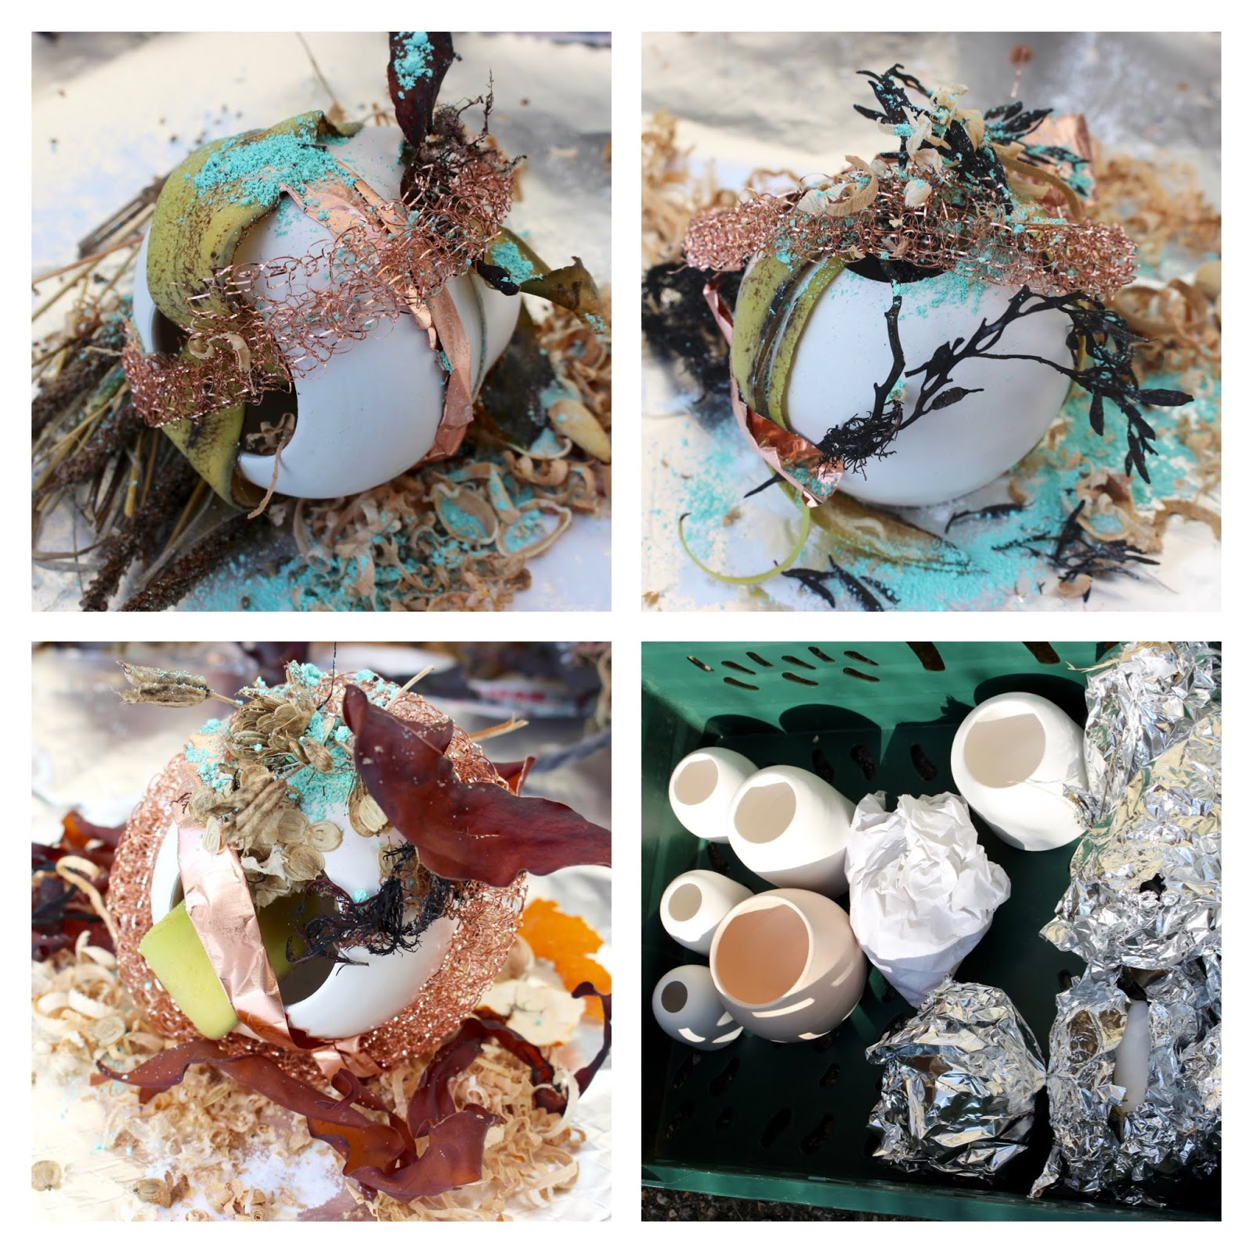

Slide 20
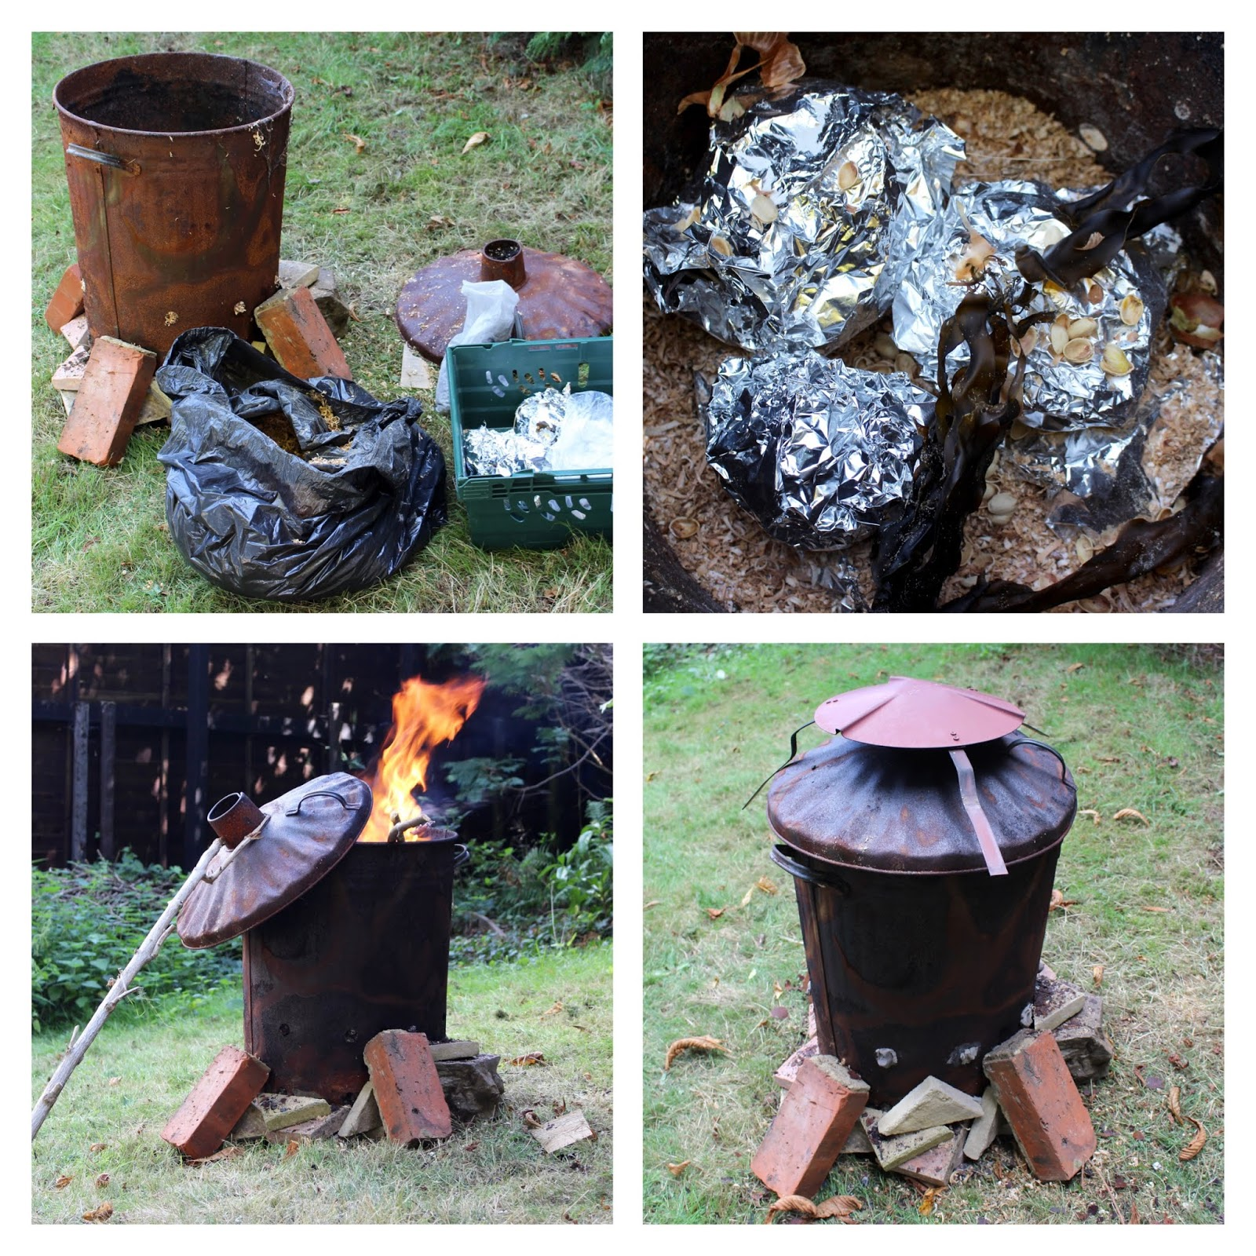

Slide 21
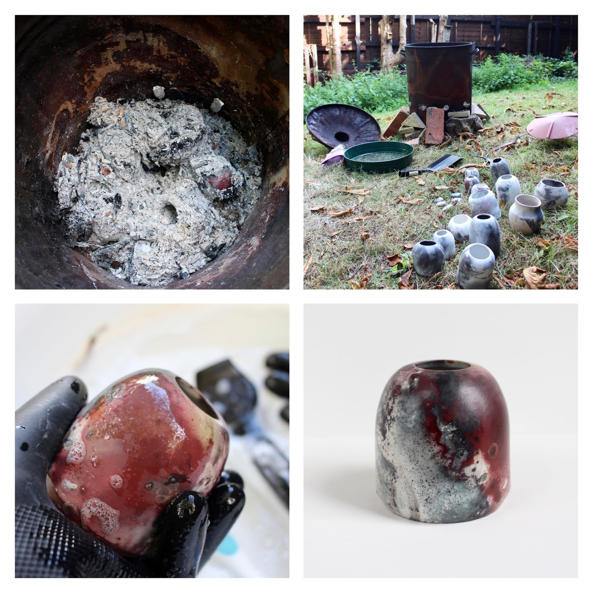

Slide 22
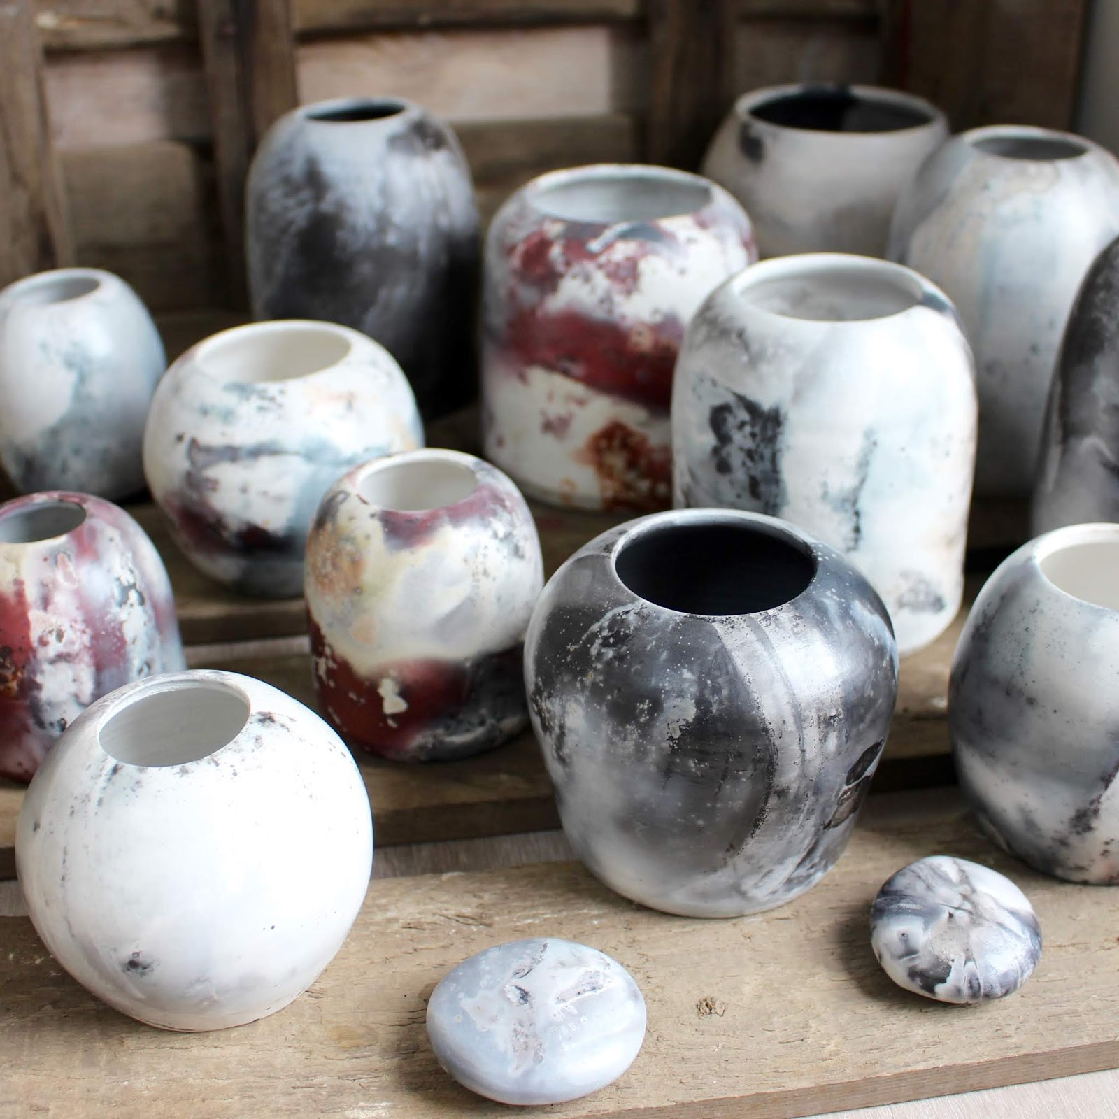
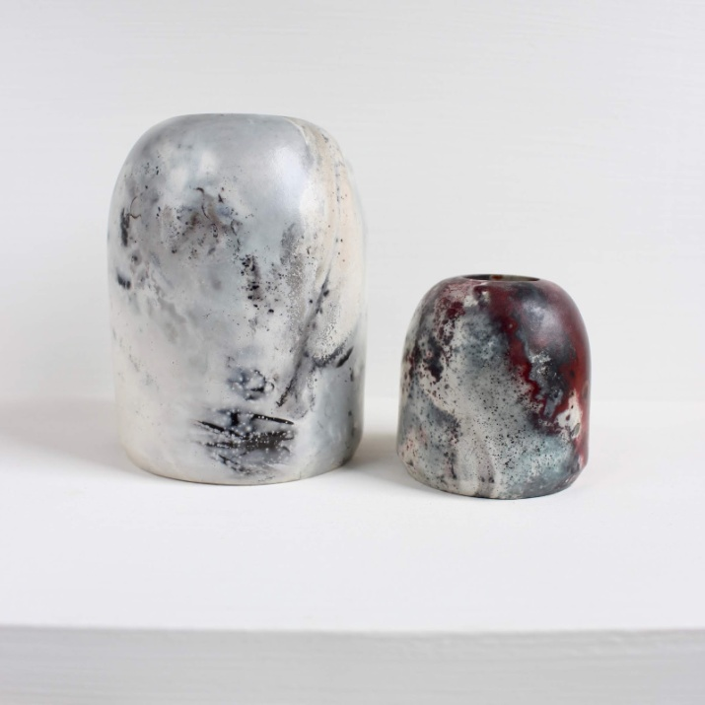

Slide 23
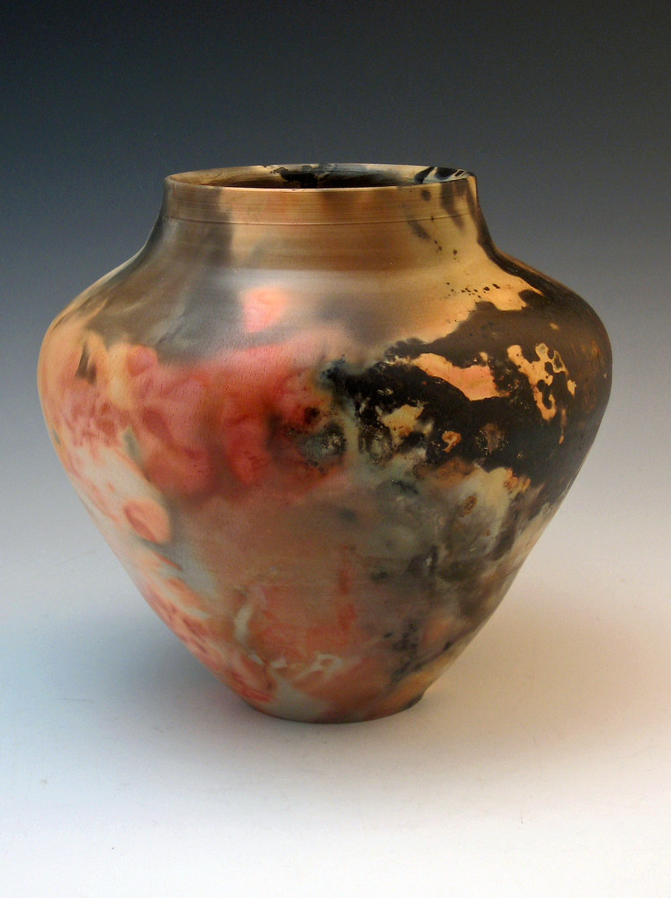
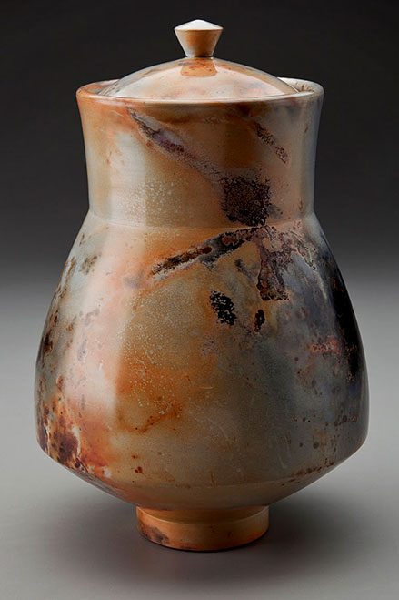
Saggar firing

Slide 24
The practice of making pots using raw materials and then burnishing them without glaze, stretches back to thousand’s of years ago. Saggar also has its own unique history. Saggar is a container used during the firing process to enclose or protect ware being fired inside a kiln. Traditionally, saggars were made primarily from fireclay. Saguaros have been used to protect, or safeguard ware from open fire, smoke, gases and kiln debris. The name is a contraction of the word safeguard. The use of saggars is widespread, including China, Korea, Japan and the United Kingdom. Saggars are still used in the production of ceramics to protect ware from the direct contact of flames and from damage by kiln debris.

Slide 25
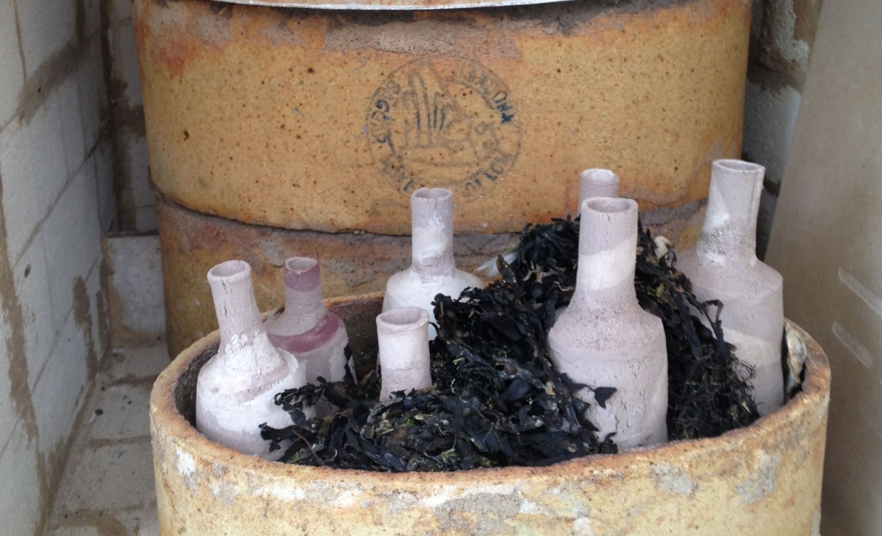
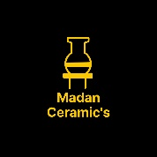
References:
Book: Ceramics (A beginner's guide to tool and techniques) & Google and Own drawing
Thanks……….
Madan Singh
www.madanceramics.com

