Slide 1
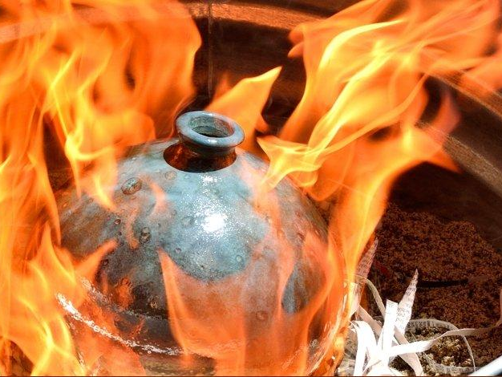
STORY OF FIRING
(OXIDATION AND REDUCTION)

Slide 2
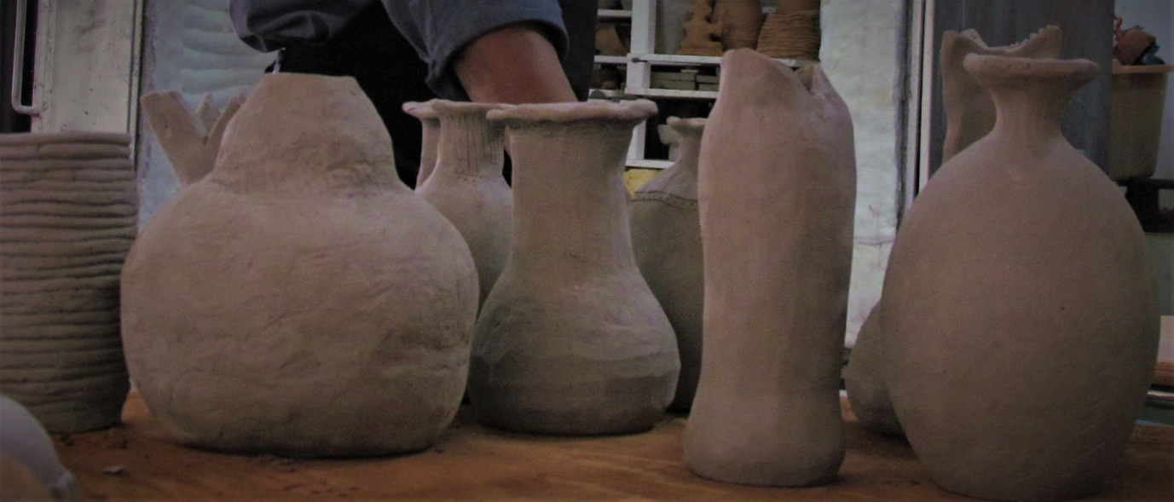
WHAT IS FIRING:
Firing is the process of bringing clay and glazes up to a high temperature. The final aim is to heat the object to the point that the clay and glazes are "mature"—that is, that they have reached their optimal level of melting. To the human eye, pots and other clay objects do not look melted; the melting that occurs is on the molecular level. This process is usually accomplished in two steps: bisque firing and glaze firing.
BISQUE FIRING:
Bisque firing refers to the first time newly shaped clay pots, or green ware, go through high-temperature heating.

Slide 3
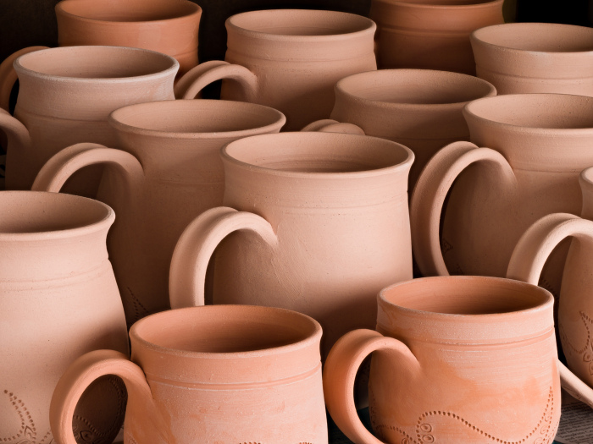
It is done to vitrify, which means, "to turn it glasslike," to a point that the pottery can have a glaze adhere to the surface. Green ware is fragile. To start, it must be bone dry. Then, it must be loaded into the kiln with a great deal of care. The kiln is closed and heating slowly begins. Slow temperature rise is critical. During the beginning of the bisque firing, the last of the atmospheric water is driven out of the clay. If it is heated too quickly, the water turns into steam while inside the clay body, which can cause the clay to burst.
CLAY TRANSFORMATION IN THE BISQUE FIRING :
When a kiln reaches about 660 degrees Fahrenheit, the chemically bonded water will begin to be driven off. By the time the clay reaches 930 degrees Fahrenheit, the clay becomes completely dehydrated.

Slide 4
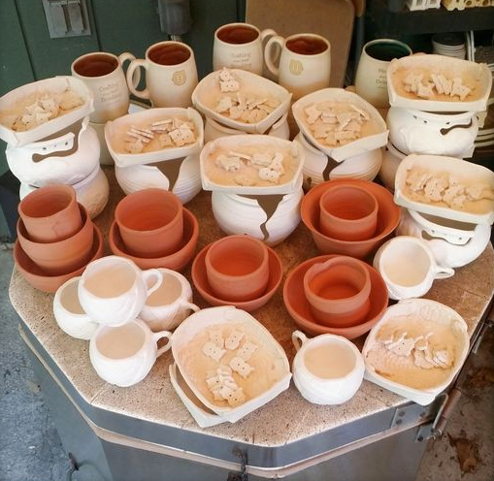
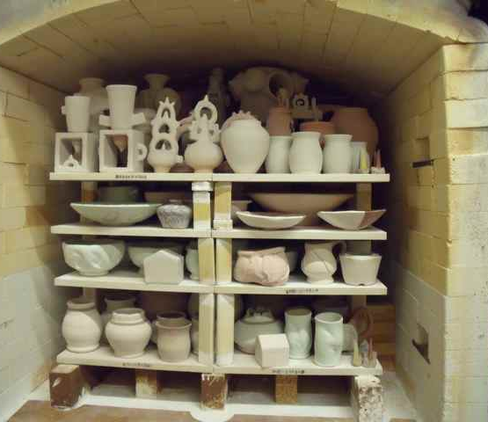
At this point, the clay is changed forever; it is now a ceramic material. The bisque firing continues until the
kiln reaches about 1730 degrees Fahrenheit. At this
temperature, the pot has sintered, which means it has
been transformed to the point that it is less fragile
while remaining porous enough to accept the application of glazes. After the
desired temperature has been reached, the kiln is turned off. The cooling is slow to avoid breaking the pots due to stress from the temperature change. After the kiln is completely cool, it is opened and the newly created ​"bisque ware" is removed.
GLAZE FIRING:
Ceramic glaze is an impervious layer or
coating applied to bisque ware to colour, decorate,
or waterproof an item. For earthenware, such
as fired clay pottery, tohold liquid, it needs a glaze.

Slide 5
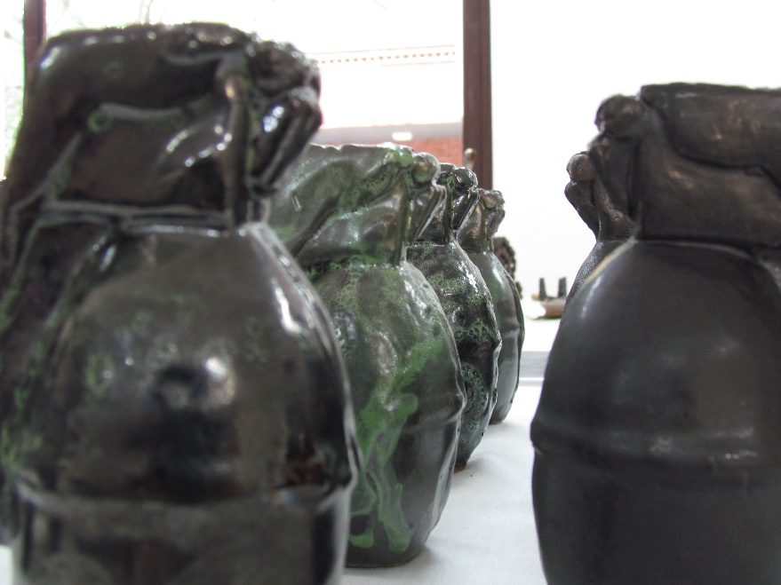
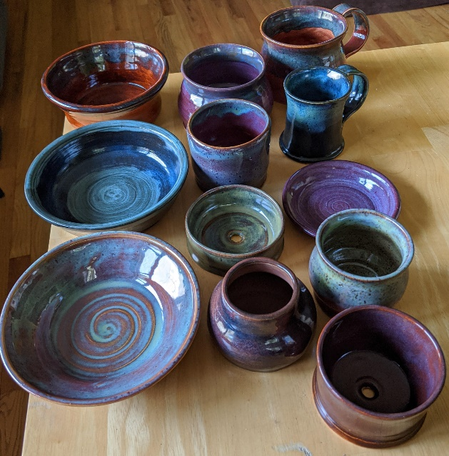
Potters apply a layer of glaze to the bisque ware, leave it to dry, then load it the in kiln for its final step, glaze firing. The glazed item is carefully loaded into the kiln for the glaze firing. It must not touch other pots or the glazes will melt together, fusing the pots permanently. The kiln is heated slowly to the proper temperature to bring the clay and glazes to maturity, then it is slowly cooled again. The kiln is opened and unloaded after it has cooled completely. This second kiln firing causes a remarkable change in the clay and glaze. It completes the transformation of pots from a soft, fragile substance to one that is rock-hard and impervious to water and time.

Slide 6
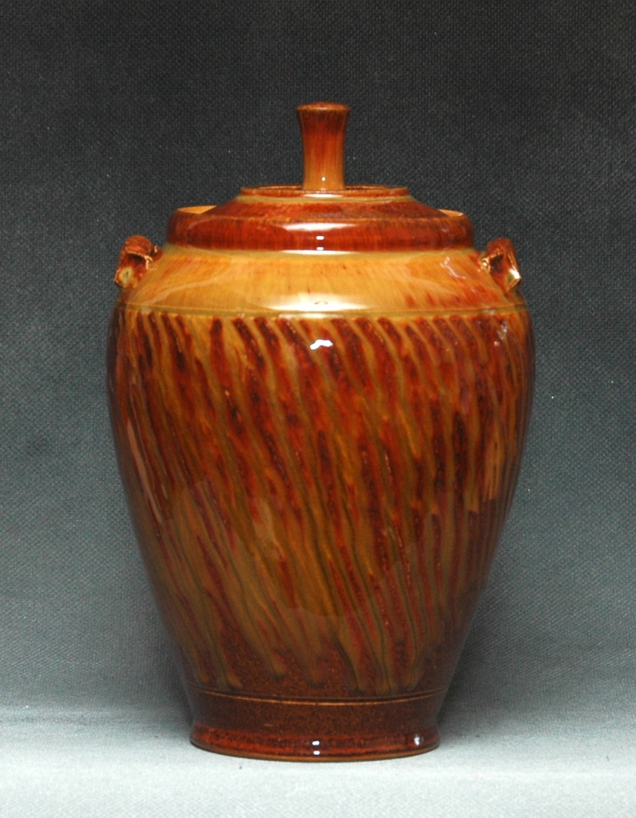
OXIDATION:
In an electric kiln oxidization is occurring as you bring the glaze towards its maturing point. Oxygen is entering the kiln through peepholes, a damper (if you have one), and other cracks or gaps in the kiln construction. The oxides (iron, copper, etc) added to the glaze mixture at this point are changing. In this process, the kiln has adequate oxygen
to interact with the glazes during the
firing stage. The results are most typically
bright and rich colours.

Slide 7
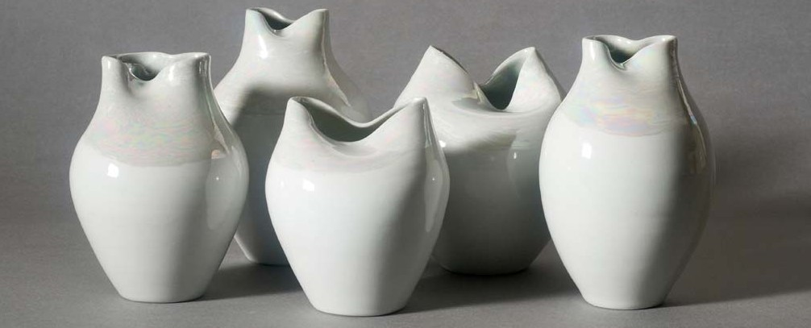
Most of the commercial glazes on the market are designed to develop specific colours under the conditions of Oxidation firing. This firing can be accomplished at low or high temperature ranges. Oxidation results are predictable in that they will match the colour intended by the manufacturer when fired to the temperature suggested by the manufacturer. For final results in the colour to be achieved, it is necessary for the presence of adequate oxygen during the last part of the firing process.

Slide 8
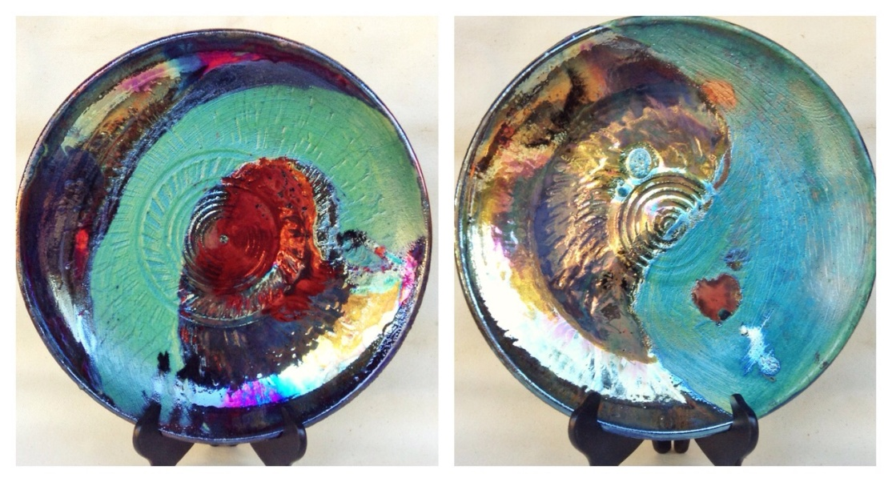
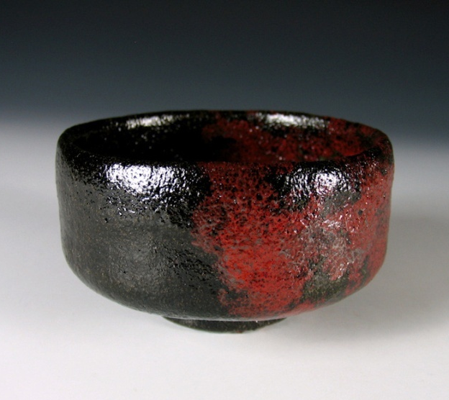
REDUCTION:
Reduction firing is favored by potters and is done using gas, propane or other fuel burning kilns or methods. Reduction firing is the exact opposite of Oxidation firing. It is the lack of oxygen in the last part of the process that is critical for the desired effects. Fuel burning kilns give the artist control of how much or how little oxygen enters the firing chamber and when Preventing oxygen from interacting with the glaze maturation creates unusual and
sometimes unpredictable results.

Slide 9
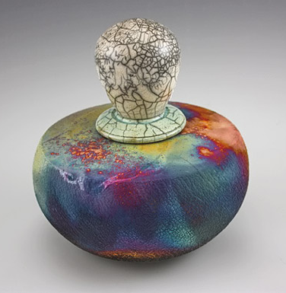
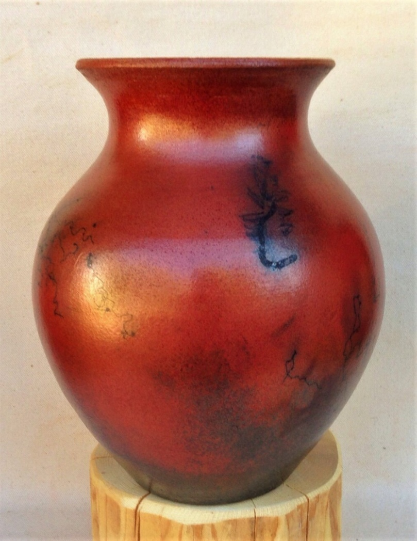
For example a red iron oxide will change to black, while a green copper oxide will change to an orange/red. There are many popular techniques that utilize reduction firing such as Raku, Horse Hair, Salt Glazing, and more.

Slide 10
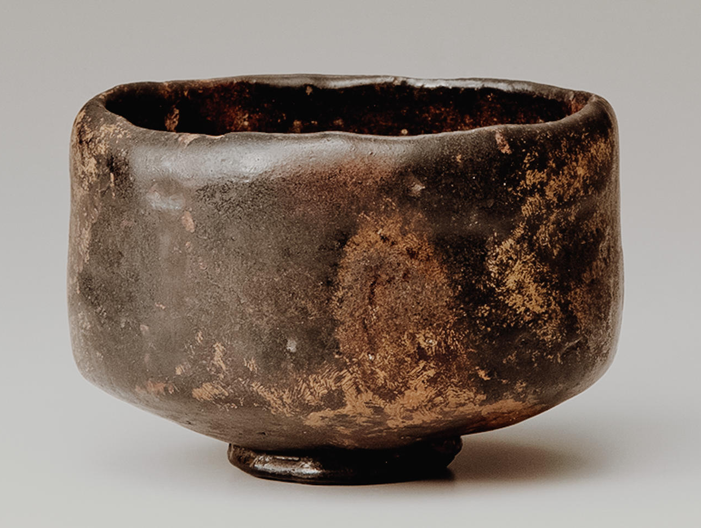
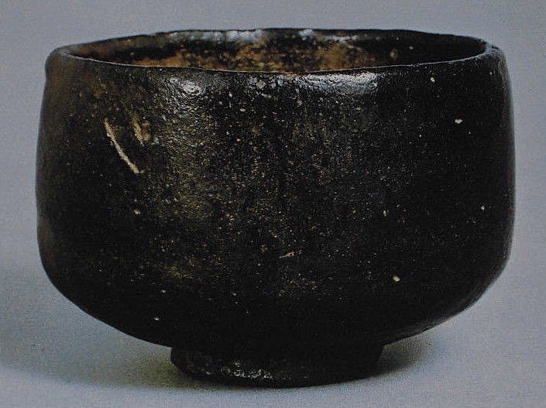
Result:
After firing of different Raku:
1-Japanese Raku:

Slide 11
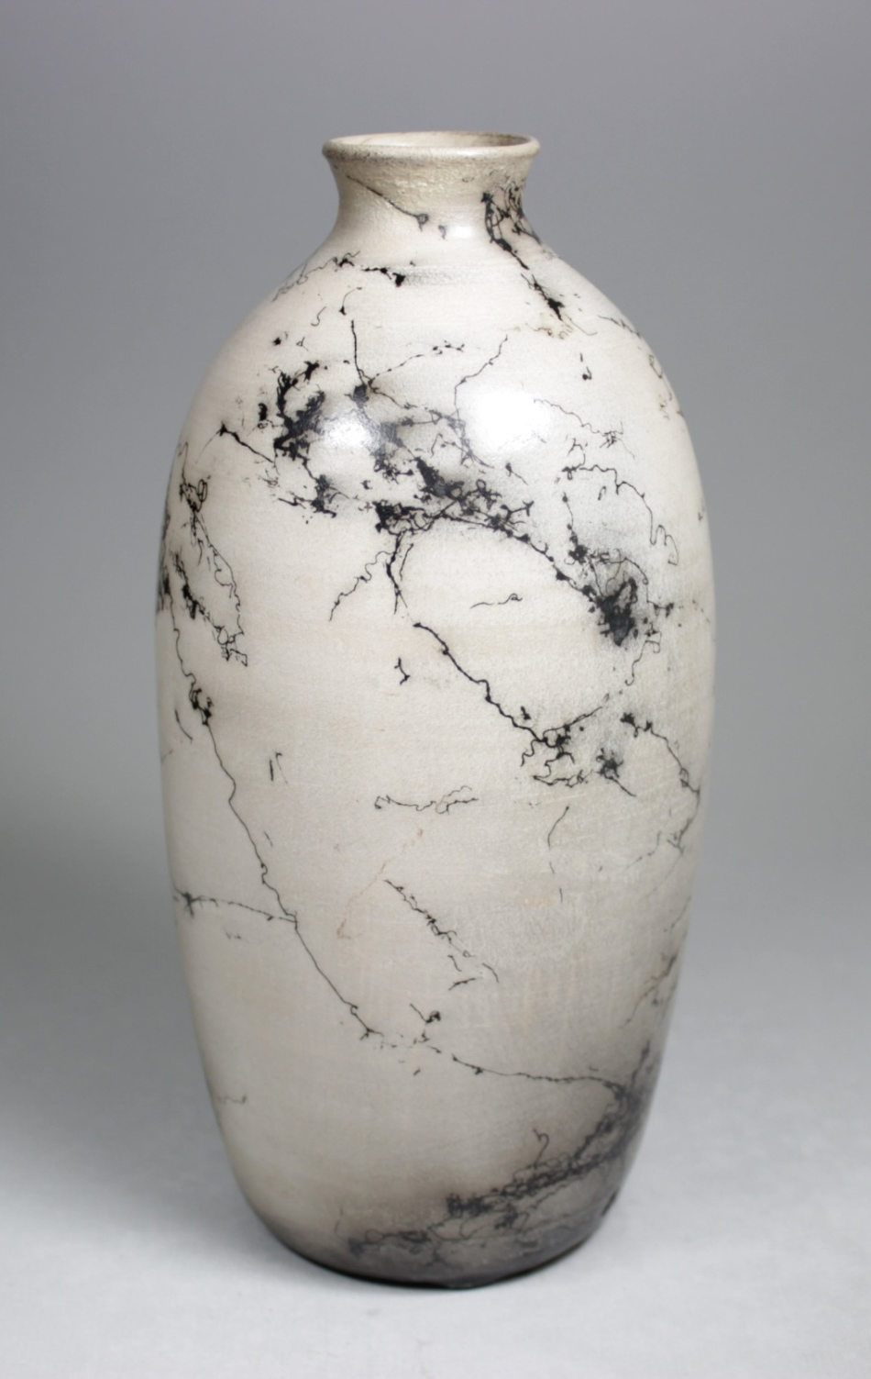
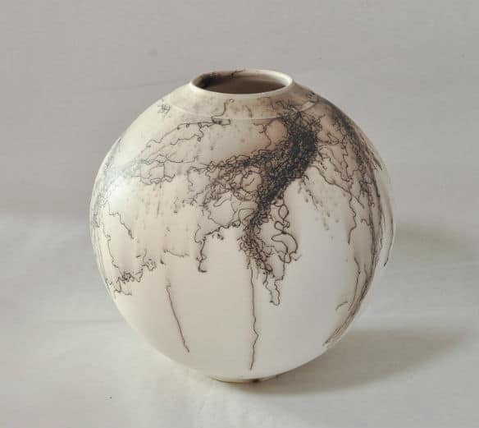
2.Horsehair Base Raku:

Slide 12
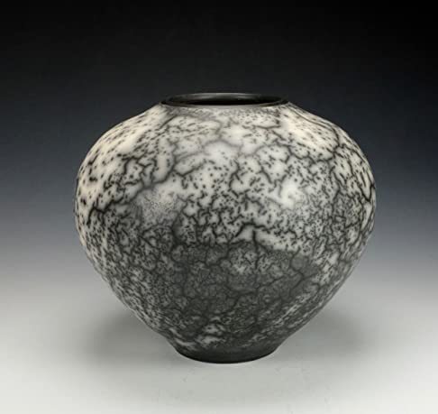
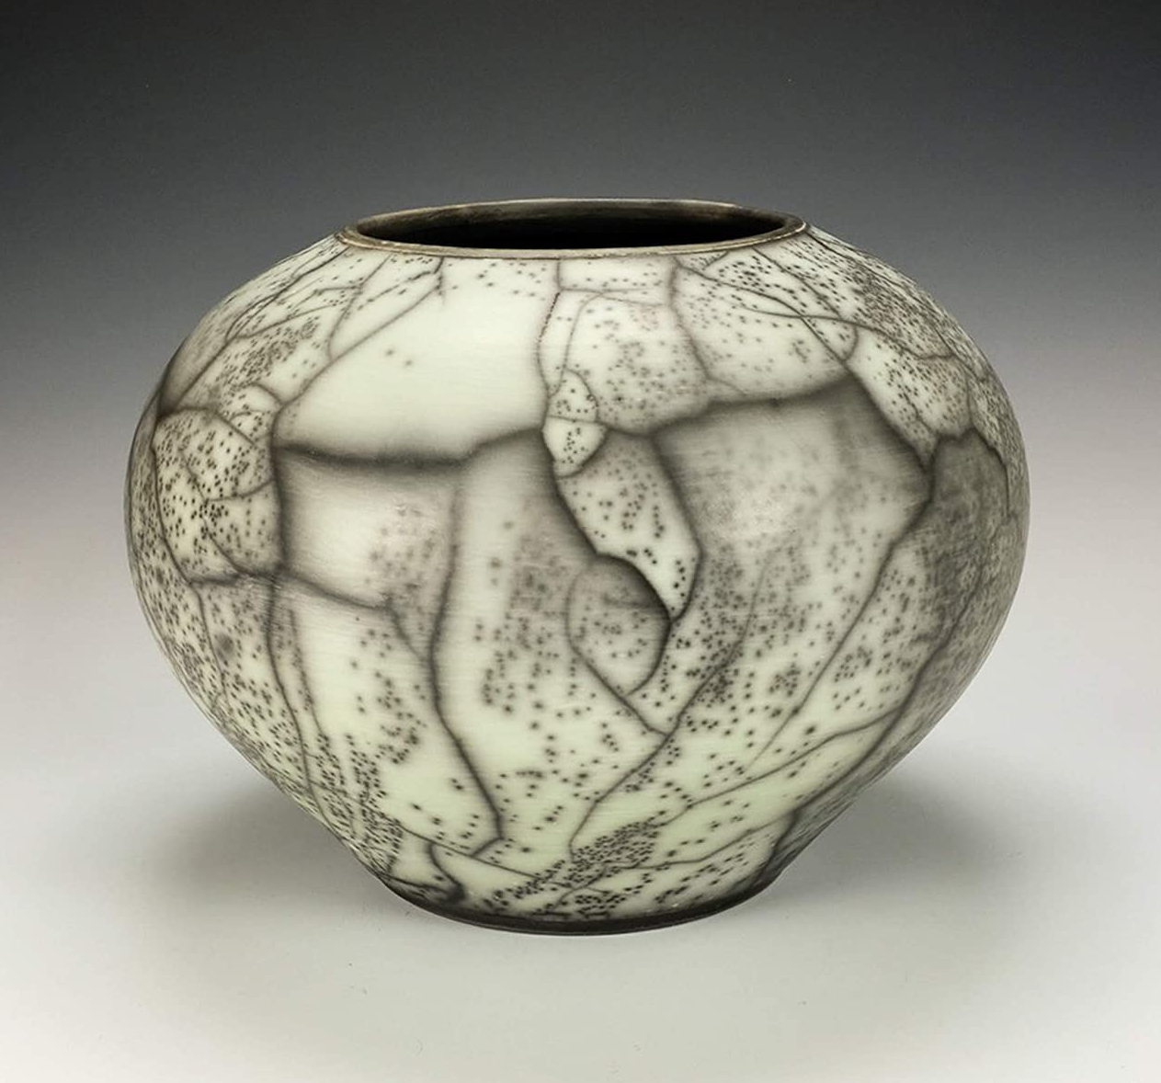
3.Naked Raku:

Slide 13
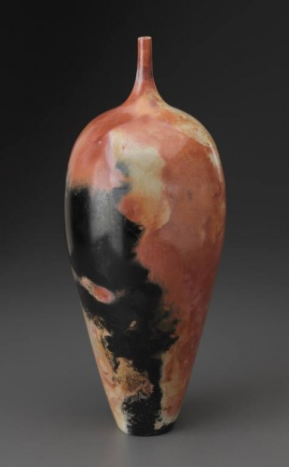
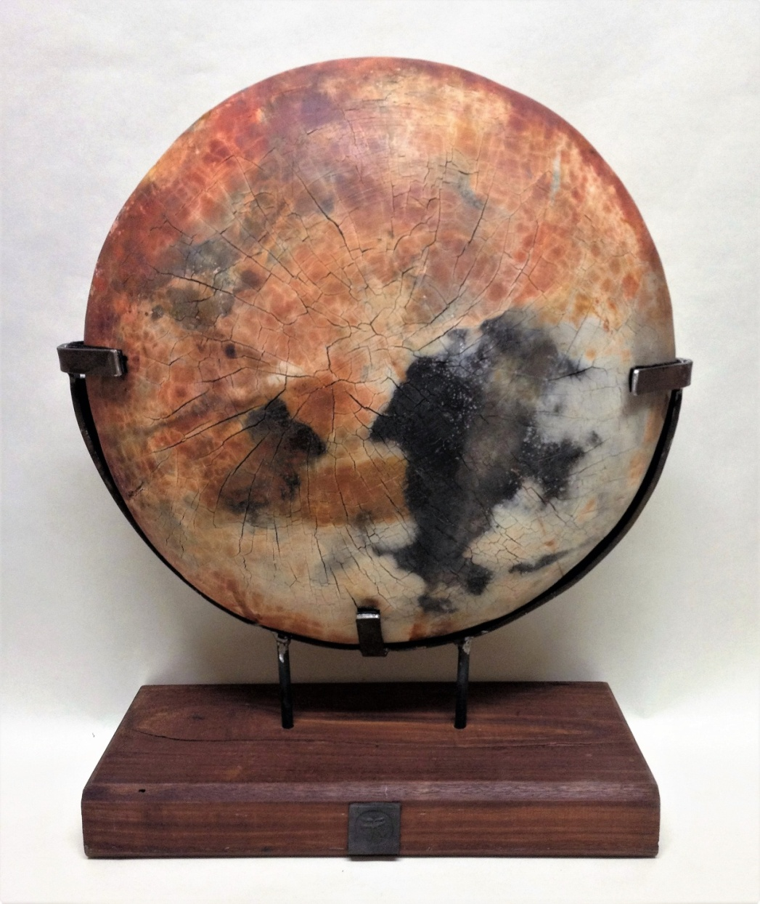
4.Barrel Raku:

Slide 14
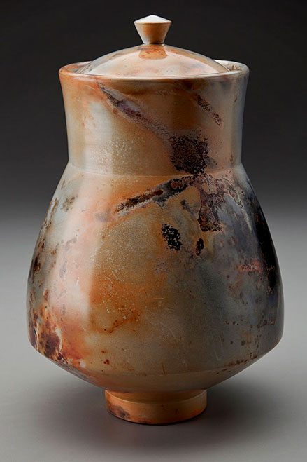
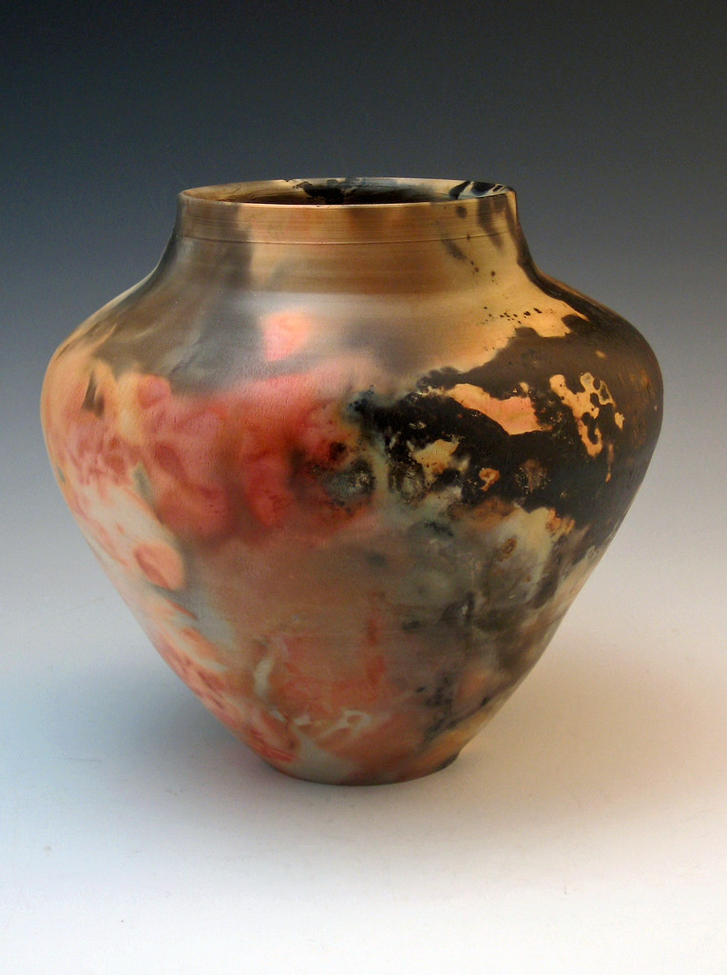
5.Saggar Firing:

Slide 15
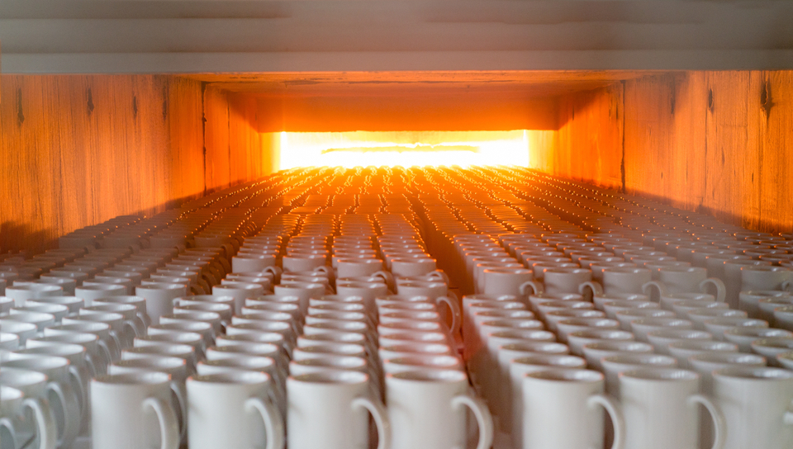
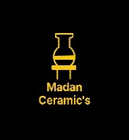
Thanks
References:
Book: Ceramics (A beginner's guide to tool and techniques) & Google
Thanks……….
Madan Singh
www.madanceramics.com

