Slide 1
Contemporary Indian Ceramics Artist

Slide 2
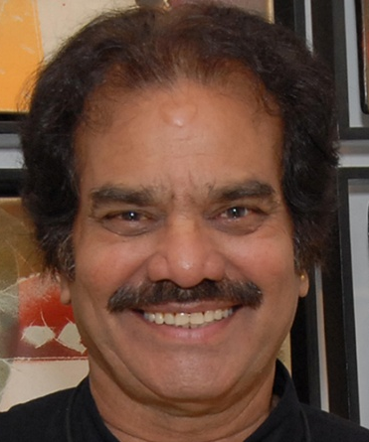
P R Daroz:
“Born in the southern Indian state of Telengana in 1944, Daroz
Pandurangiah is a renowned ceramic artist.”
Education and Honorifics
2004: National Academy Award, Lalit Kala Academy New Delhi 1998: Awarded senior fellowship b H.R.D. Department of Culture, Government of India, New Delhi 1990: Honorable Degree, 3rd World Ceramics Triennial, Zagreb, Yugoslavia Elected as a member of International Academy of Ceramics, Geneva 1989: Honored for creativity in ceramics by the Ceramics World Symposium, Yugoslavia
About the Artist:
Born in the southern Indian state of Telangana in 1944, DarozPandurangiah is a renowned ceramic artist who transforms a lump of clay into an unparalleled work of art with his magical hands and plentiful imagination. Having graduated in 1968 from the College of Fine Arts and Architecture, Hyderabad with a diploma in Applied Arts and Design in Sculpture, he went on to complete his MFA in 1972 from the Faculty of Fine Arts, MS University Vadodara with a specialization in ceramics. Awarded the National Academy Award, the ministry of culture for Ceramics by the Lalit Kala Akademi, Delhi.

Slide 3
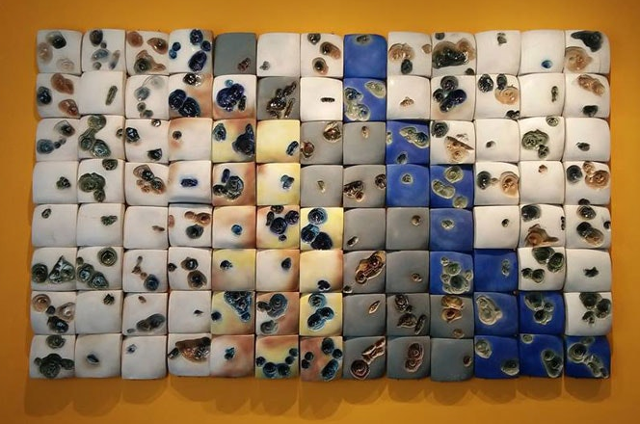

Slide 4
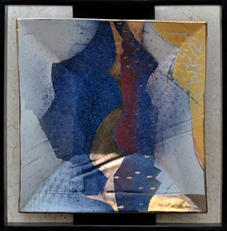
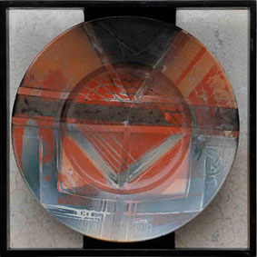
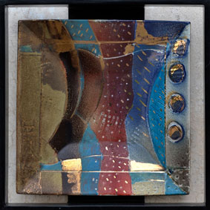
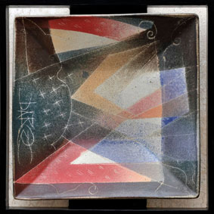
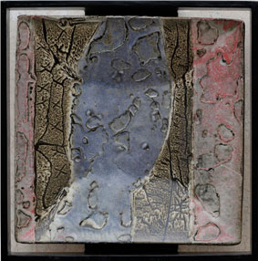
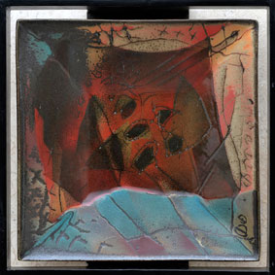
Fired canvas 2009:
P.R.Daroz's painterly vision on his series titled ‘Fired Canvas' creates a new dimension and path-breaking approach to the layering of glaze technique and firing of ceramics. Multiple firings with airbrushed stencils, resist decoration and layered glazes varying in density, these square format jewels of glaze on a simple dish,
create exquisite abstract patterns that meld and flow to produce a deceptively soft surface while retaining its hard glass patina from the essential process of kiln-firing. Daroz has taken the historically strong tradition of ceramic decoration for domestic tableware and wrought them into both an unique and distinct form of art and quotidian object. His use of the airbrush for spraying overlapping glaze layers with stencils has been a trademark of his unique glaze application style. It also suited his motto of ‘just borrowing from nature'- a constant source of inspiration for him.

Slide 5
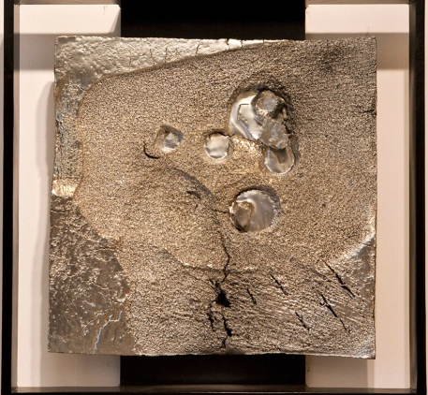
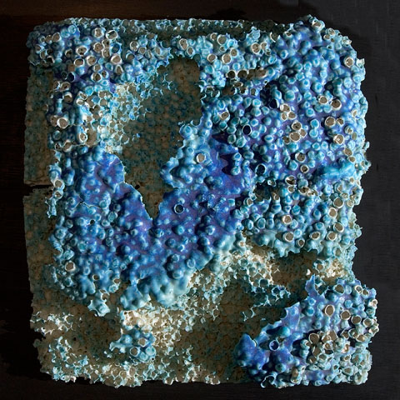
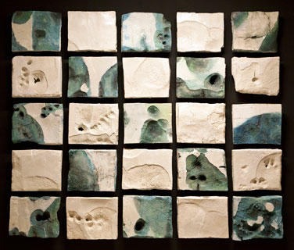
Sea bed 2007:
“My passion for seascapes started somewhere in 2004 after visiting Diu. Since then recording images from natural environment, specifically seascapes and rocks capes became my favourite preoccupations. After gathering information from various places I tried to translate my ideas in clay. Busy shores interest me, full of life with various plants and animals challenging between salinity and total immersion. Rocky shores are among the richest coastal habitats with sea anemones, crabs and urchins found at various levels, surviving low tide in tide- pools or damp crevices. They provided me with a plethora of visual ideas, the story of multiple challenges, that relates to any living being. The series is abstract. They are the memories in retrospect, of my trips to various coasts and cliffs in the past few years, memories which exist yet do not exist but proved to be a catalyst in my creative journey. Seascapes, corals and underwater rock formations on which the water has caused geometric patterns have been a constant source of inspiration for me.”

Slide 6
Luminous Excavations-2007- Porcelain
After a residency at Jingdezhen in China in June 2007, Daroz experimented in fine porcelain using the qualities of translucency and light in order to create his ‘Luminous Excavations' which refer the viewer to glimpses of archaic excavations of civilization in a minimal, highly controlled, flat aerial landscape using texture and facial structures to create a departure to the realm of abstract expressionism. This abstract imagery in ceramics is pieced together to express the past in a pure sensual feast. The residency in China allowed him the freedom to express and explore his concealed thoughts with freshness. His shedding of ornamentation and colour was a powerful change in his artistic direction. As he explains,“ The purity and freshness of porcelain surmounts
everything else. Flights of imagination took me to an elevated view of a geographically distinct landscape of a stark, surreal world- an excavated land with crumpled ruins and found objects...In this series of porcelain reliefs I have tried to capture the essence of historical data, the hallucinated representations of the lost cities and civilizations featuring its archaeology, agriculture, writings, trade and construction. All are pieced together to express the past in an abstract imagery, revealing only that which my senses could perceive”

Slide 7
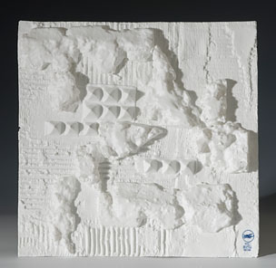
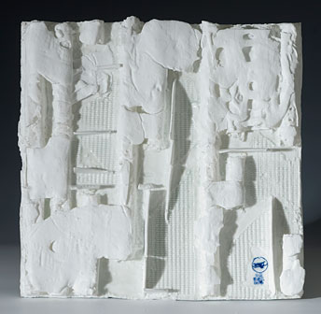
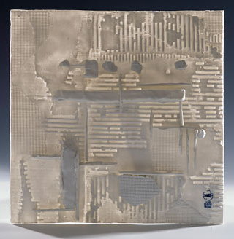
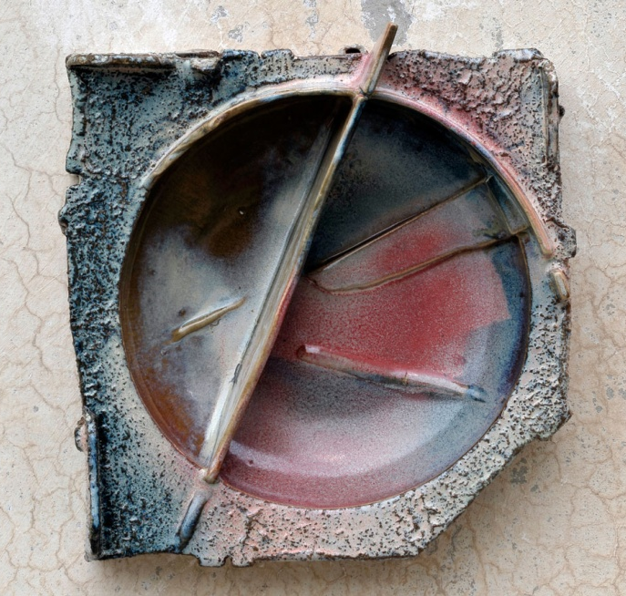
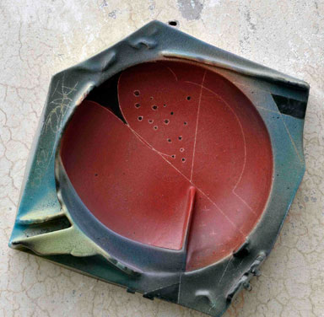
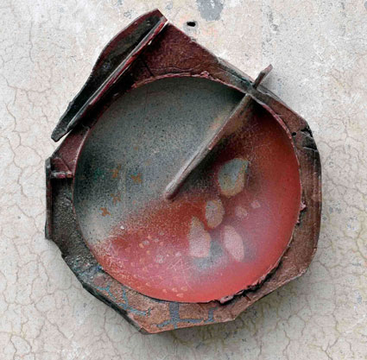

Slide 8
Earth Series:
Daroz is fascinated by weathered stone, ravaged by water and wind. He sees it as an unfinished carving which still allows the eye to have a continuity of the form as in a broken arch, where the viewer knows its completed form in his mind's eye. But Daroz exploits this technique by breaking the overall form as well, having a visual
Continuity with the combing and etching of script-like characters into geometrical patterns. The effect of slanting light on these buttresses and rhythmical reliefs creates a visual identity that is never tiring for the eye. As he reminisces “I was capturing images of the rocks of the Himalayas...an avalanche-stricken
Mountain side, the wind effects causing geometric formations, varying natural colours of rocks due to positioning of sun's rays, man-made, ruthlessly scarred rocks for making roads and ploughing, varying chemical properties affecting their hues, their overall power overwhelming everything else.... Bruised and scarred rocks standing strong against all odds, their strength attracting me’’.

Slide 9
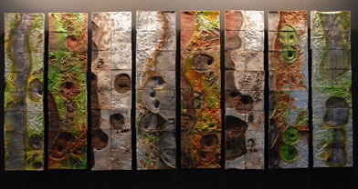
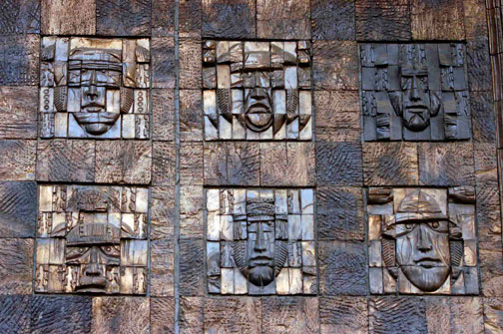
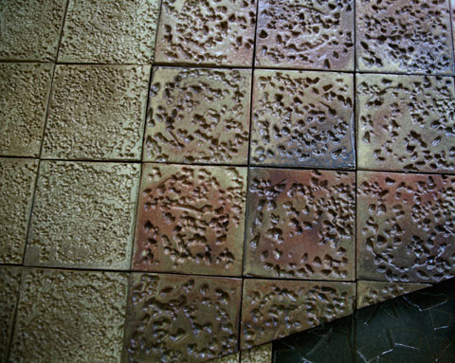
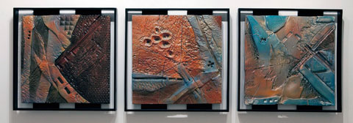

Slide 10
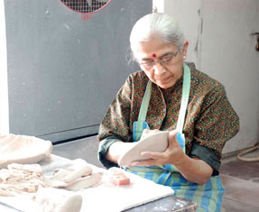
Jyotsna Bhatt:
Jyotsana Bhatt studied sculpture under Prof. Sankho Chaudhuri
at the M.S. University of Baroda and later ceramics at the Brooklyn
Museum Art School, USA. She taught at, and later headed the Department of Ceramics at the M.S. University until her retirement in 2002. Jyotsana Bhatt has been a mentor to several ceramicists, who as a result of her encouragement have turned into serious professionals in the field. In her career spanning over fifty years, she has been a part of several group exhibitions, workshops, art camps, and solo shows. Jyotsana Bhatt lives and works in Vadodara, Gujarat.
Artist Statement:
Being trained as a sculptor I like to sculpt my pots and treat them as ceramics sculptures, taking full benefit of this medium clay. The flexibility and plasticity it offers is enormous. After making simple geometric form like spheres and cylindrical- usually on wheel- I often cut and join the parts and then, twist, tilt, sketch and push them until the final form satisfies me. My other figurative work-animals and birds- are also done in a similar method, but with or without use of the wheel.

Slide 11
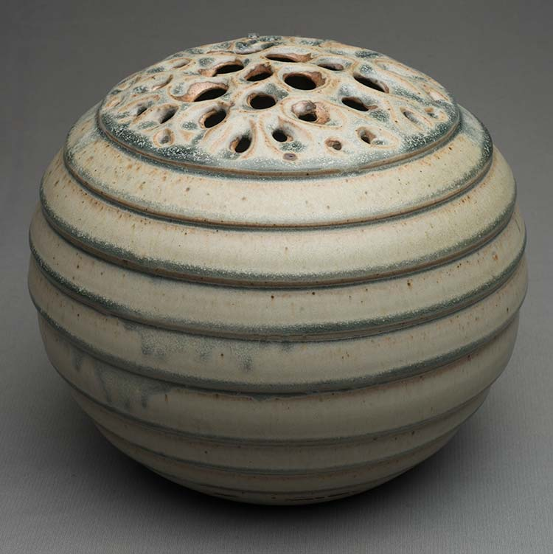
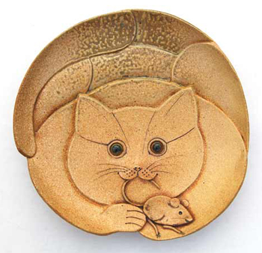
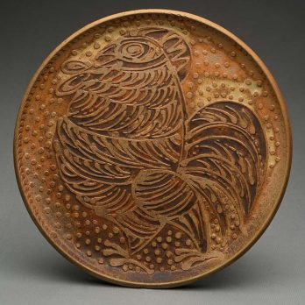
Functionality of these forms is not really essential. But, when it does not perturb the intended formal quality I associate functionality also. The glazes chosen are such that they enhance the forms. But at the times I leave my works unglazed so wood fire “open clay body” can also be enjoyed.
Working in ceramics has always been a pleasure for me. I have always preferred to work in small formats. There is never any complex, philosophical concepts or socio- political association intended behind my works. I really enjoy making visual forms that justifies bring out the uniqueness of the medium which is clay. My focus has remained divided between Utilitarian and Sculptural forms.

Slide 12
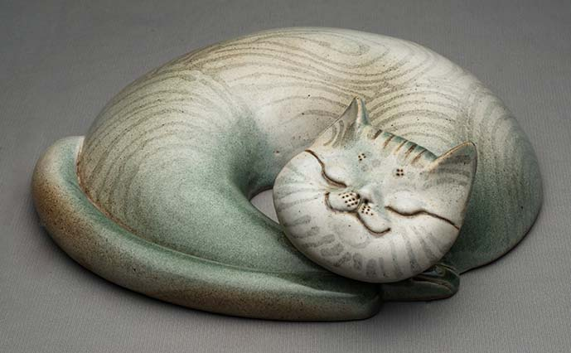

Slide 13
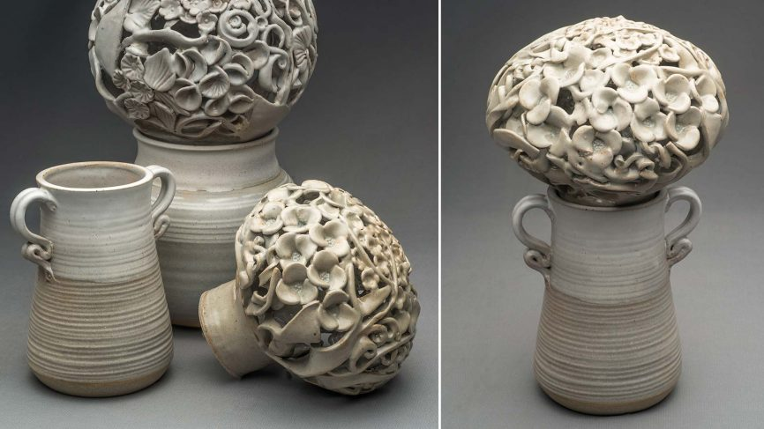
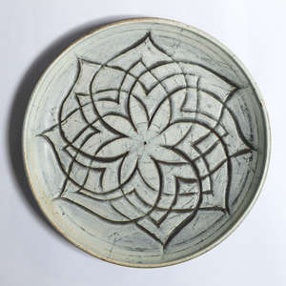

Slide 14
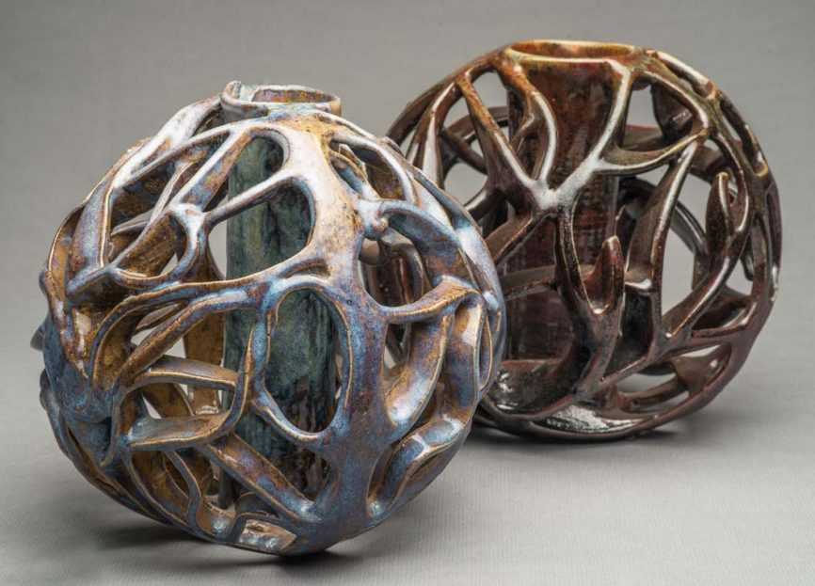
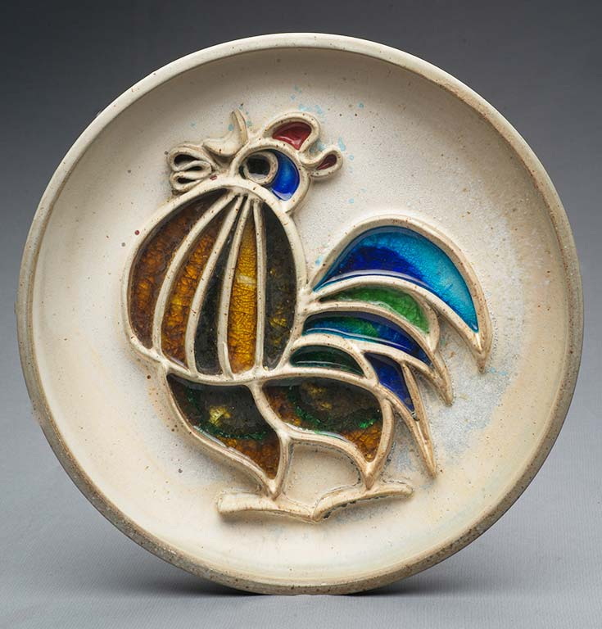

Slide 15
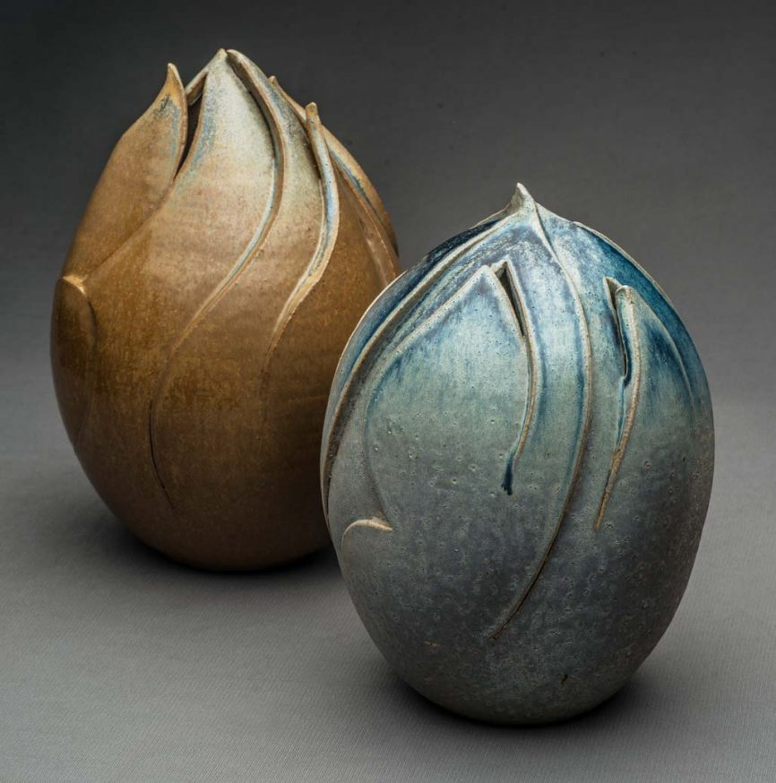
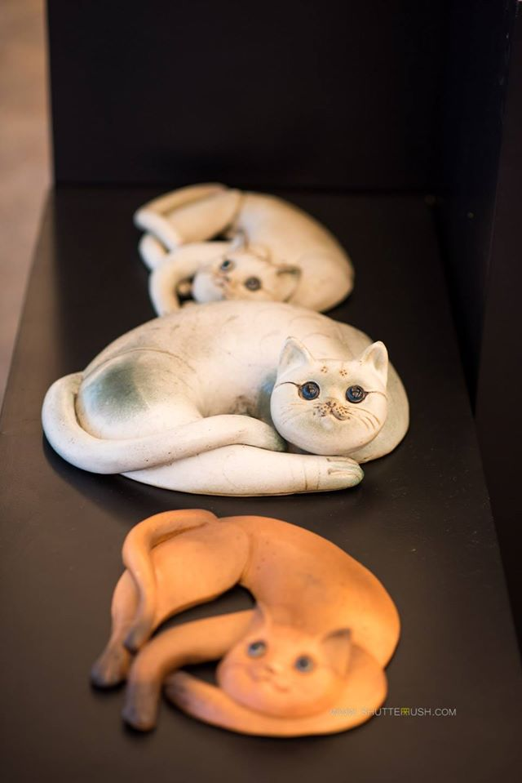

Slide 16
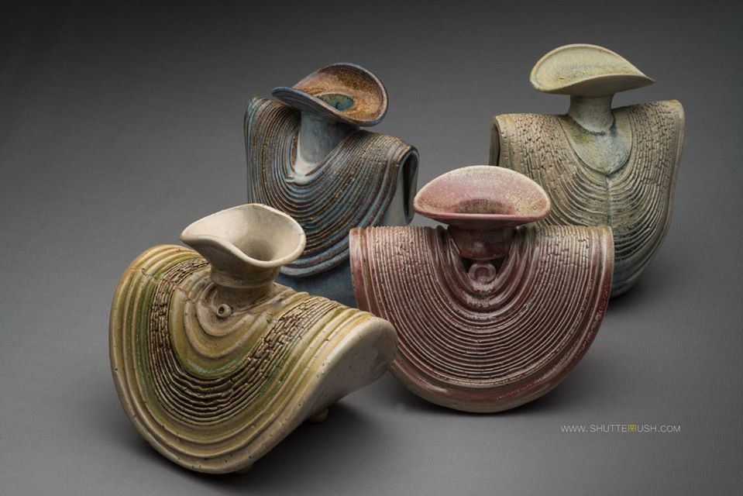
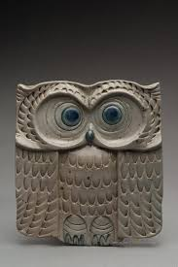

Slide 17
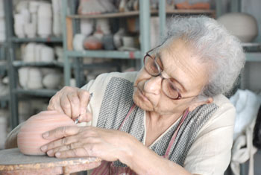
Ira Chaudhuri:
Ira Chaudhuri went to Viswabharati in 1945 to study art at
Kala Bhavana where she later met sculptor Sankho
Chaudhuri, who would then become her husband. She moved with Sankho Chaudhuri to Baroda where the latter was to head the Department of Sculpture in the newly formed Faculty of Fine Arts at the M. S. University of Baroda. Ira Chaudhuri’s pottery techniques were augmented by self-taught knowledge gained from any and all Industrial technical book available, publications, and from friends at the Department of Chemistry. Ira Chaudhuri taught and held charge of the Pottery section at the Faculty of Fine Arts making functional earthenware glazed pots and experimenting with the chemistry of making glazes.
Some of them got interested in tribal art. But there was no system to his collection: anything that he liked, could afford or could be carried away from classical bronzes to musical instruments or kitchen utensils. The best of his bronzes were acquired by the National Museum in 1980. A stint in Tanzania allowed him to add African objects to the collection.”

Slide 18
An Ira Chaudhuri creation, whatever form it may be, has a strong, robust shape. In the sweep of the lines, the graceful curves, the firm grip, the vitality of the form, her work recalls the verve of the best of the primitive traditions, be it the Harappan terracotta or pre Columbian pottery.
Ira Chaudhuri’s work process has always been a matter of interest and curiosity for everyone, including her students, fellow potters and admirers of her work.
“My goal is a ‘complete pot’. I think of a pot in its final state right from the beginning. I do not believe in throwing pots at random and then sitting down to think what will go on it.”
She has an instinctive and spontaneous way of designing her pots. You won’t see her sketching her design for every pot in the same uniform manner, but she’ll just come up with an impression with a couple of strokes which she might as well have made on a beach or on some rainy day. Then there are times such as the Kolam Design, when Ira Chaudhuri is surrounded by all her armour, like graph paper and scales, which assist her with her work.
“I do not possess extraordinary talent; in fact I am not a good craftsman at all. I don’t have nimble fingers, I am clumsy and untidy and an atrocious thrower. And since I do have average intelligence, I have tried to compensate with my brain what my hands lack.”

Slide 19
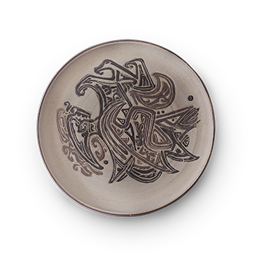
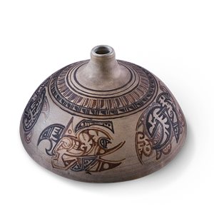
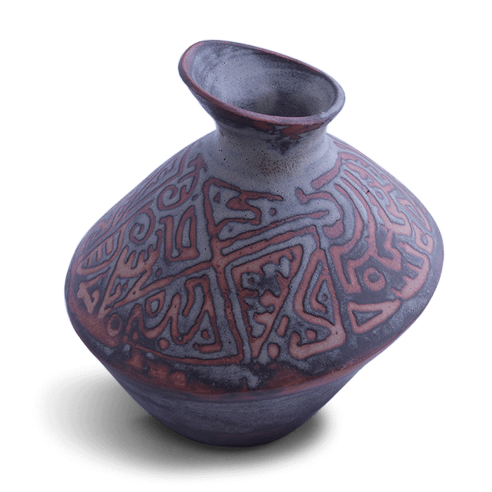
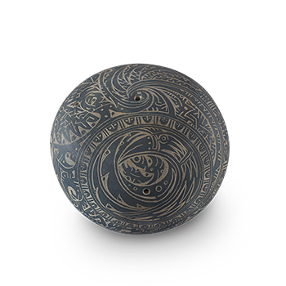
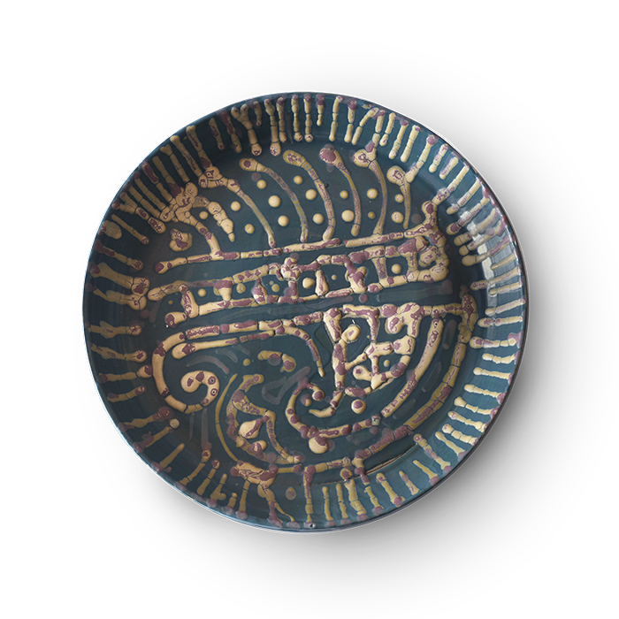
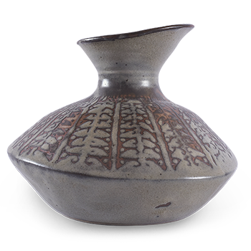

Slide 20
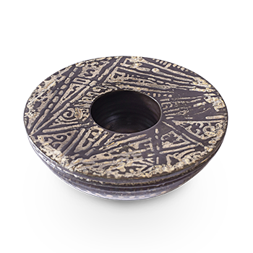
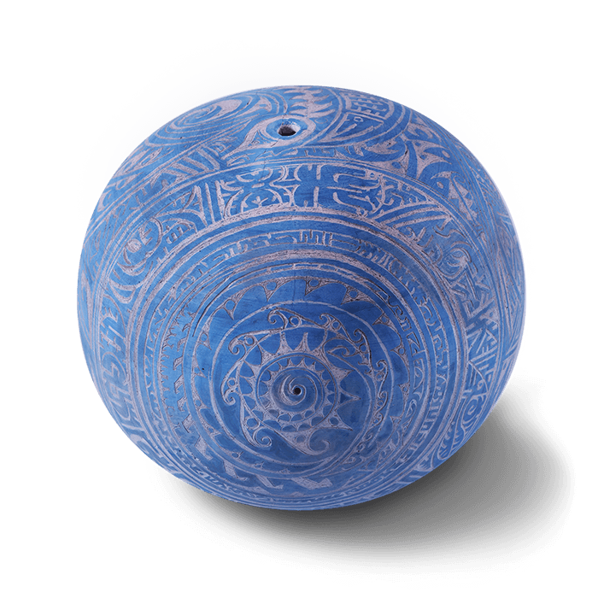
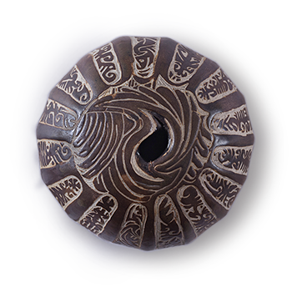
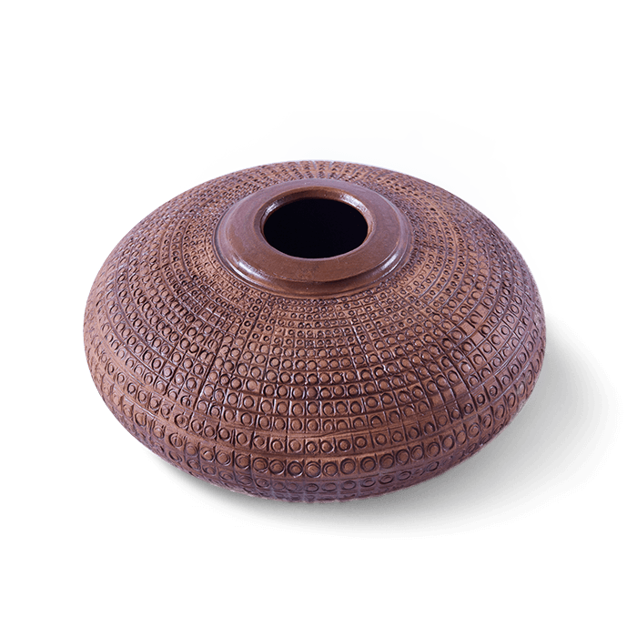
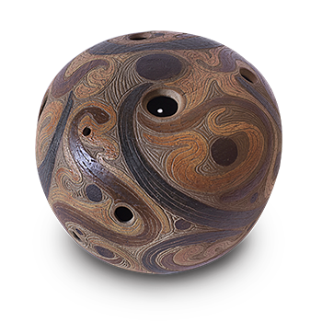
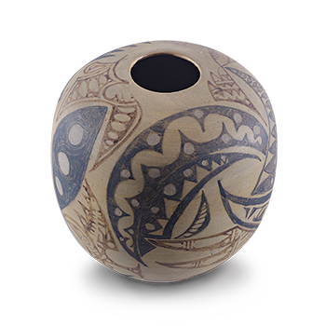

Slide 21
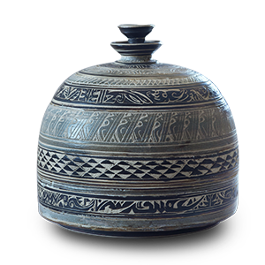
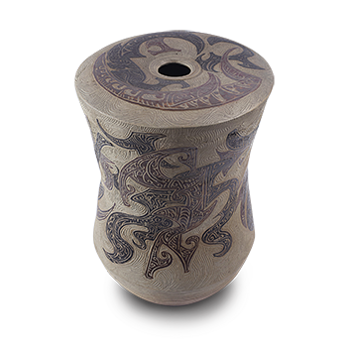
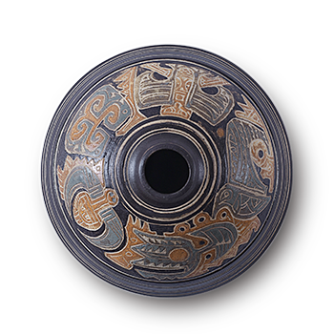

Slide 22
References: Google
Thanks……….
Madan Singh
www.madanceramics.com

