Slide 1
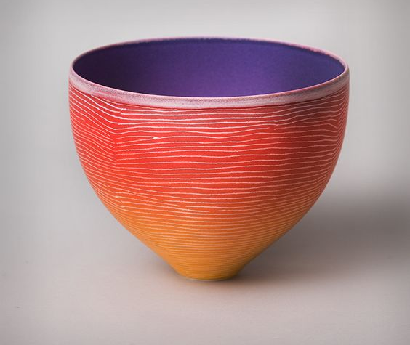
Development of three dimensional
form(3D)

Slide 2
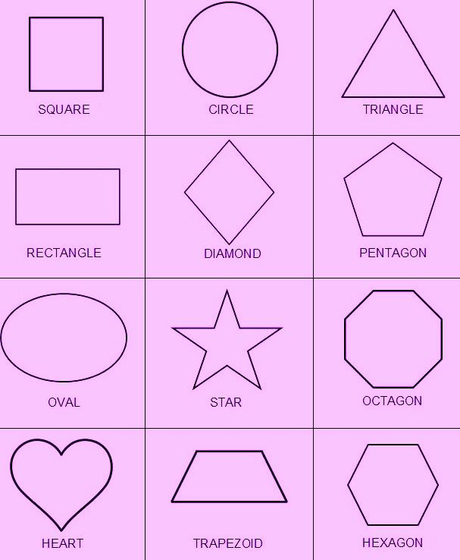
Before starting, first we have to understand is that what is the difference between form and shape:
Shape:
Shape is a two dimensional enclosed by a line. Shape are flat. They have only height and width. The two kinds of shapes are geometric and organic.
Link-
https://www.youtube.com/watch?v=beTDz9HSNOM
Geometric shapes are precise shapes that
looks as if they were made with a ruler other
drawing tools.
The five basic geometric shapes are: square,
circle, triangle, rectangle and oval.

Slide 3
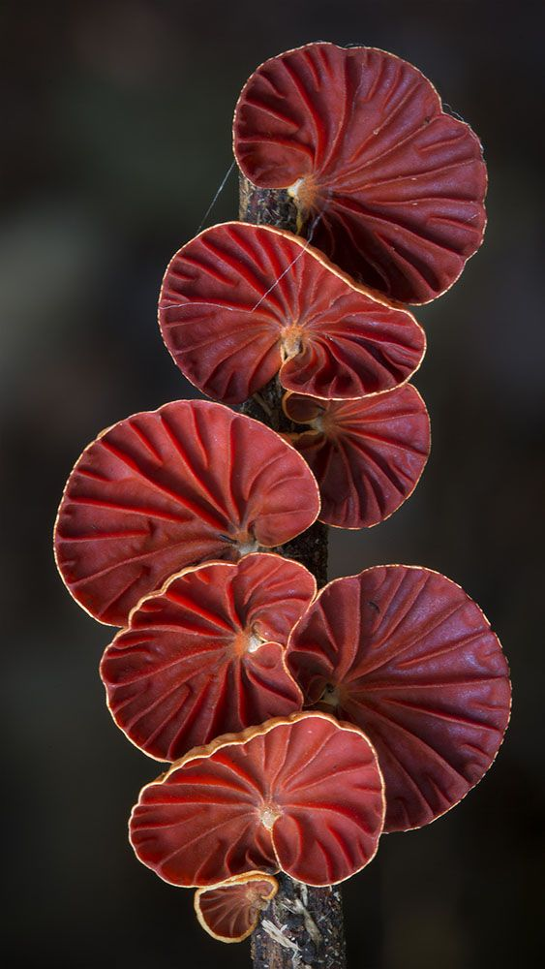
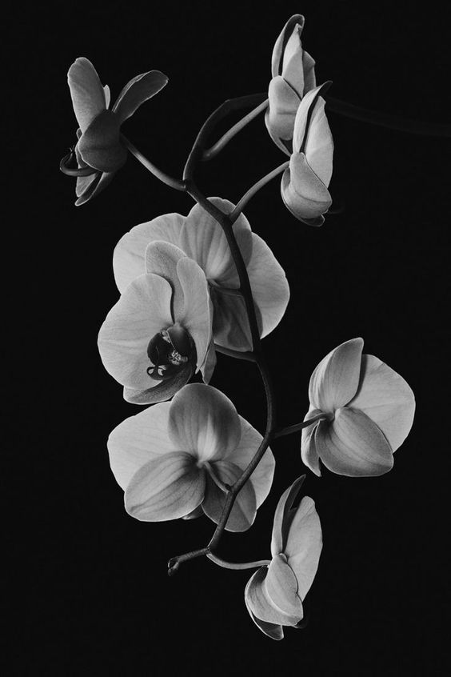
Organic shapes are not regular or even. Their outlines curve to make free-form shapes. Organic shapes are often found in nature.

Slide 4
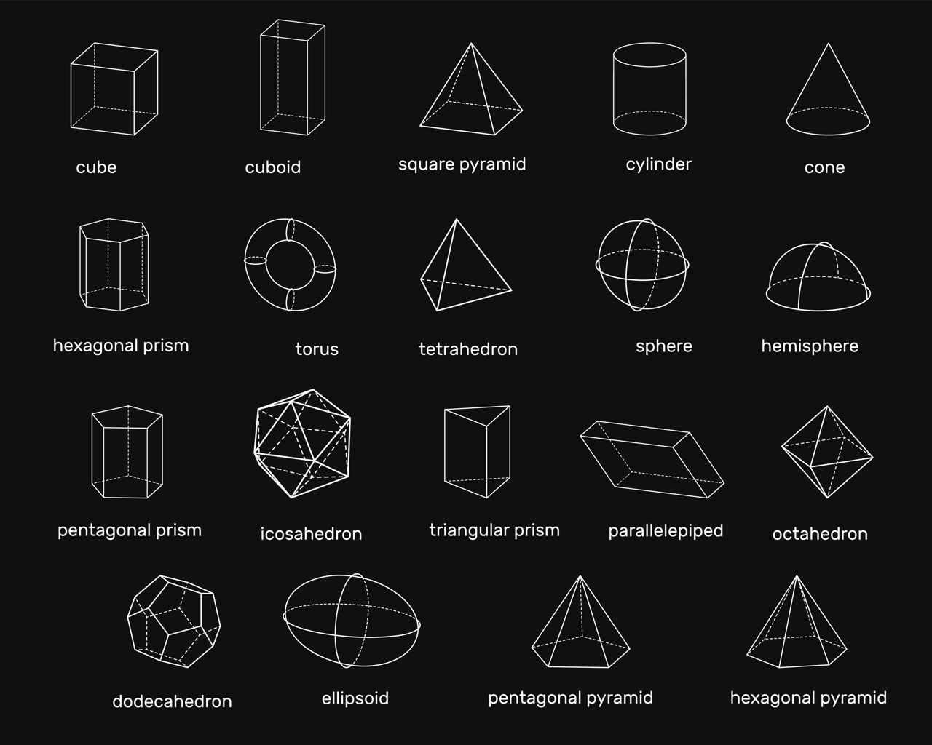
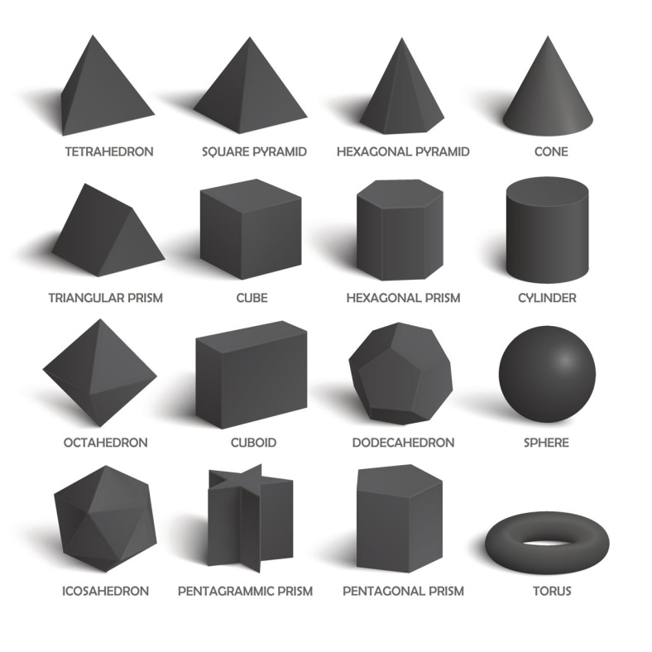
Form:
Form is an element of art that refers to an object with three dimensional height, width and depth. Like shapes, form are either geometric or organic.
Example for organic forms are leaves, stones and shells .
Shapes and Form are closely related. Like one side of a cube is a square.
A triangle is a shape. A pyramid is a form.
Link:
https://www.youtube.com/watch?v=B0brqlMp5sw
https://www.youtube.com/watch?v=vMr6eimcolc

Slide 5
You will learn basic elements of design or drawing in painting department .
Example –dot, line shape, form, space texture and colour.
Shape and form in ceramics :
There is amazing diversity in the shape and forms of ceramics, which is not surprising given that human beings have been making things from clay for almost as long as we have existed.
If we look forms from throughout history in enormous variety, and are wonderful source of inspiration for the maker.
Now we have a great choice of shape and form. Many forms can be made using one basic shape as a starting point. Which gives you some ideas for how to create and develop your own design.
The shapes are divided into six section types, with each section developing symmetrical forms from a basic shape. Each shape is to encourage the maker to develop the three dimensional forms according to his/her own vision on them.

Slide 6
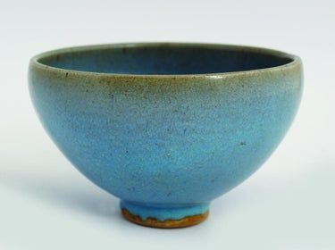
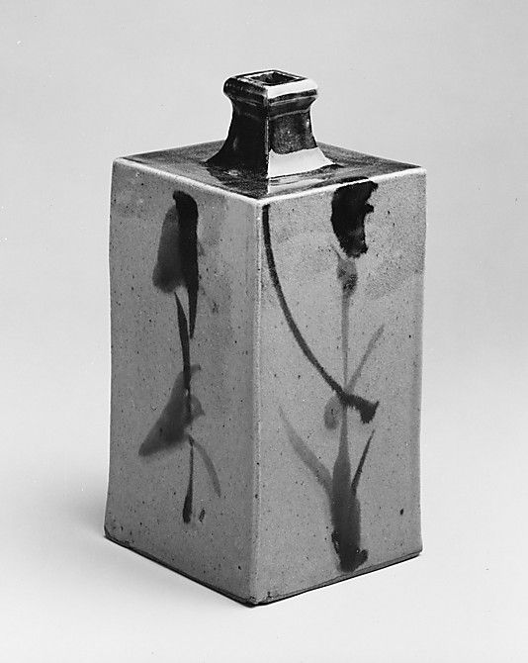
Round Forms :
These are both example of round forms that can be used as your basic shape, from which to create and develop forms.
Bottle Forms:
These are all examples of bottles forms that can be used as your basic bottle shape because a wide variety of forms can be developed from it.
Straight - Sided Forms :
These are all examples of straight sided that can be use as basic shapes. We can add curves and cut outs to enhance the form.

Slide 7
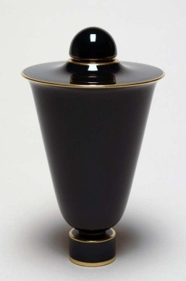
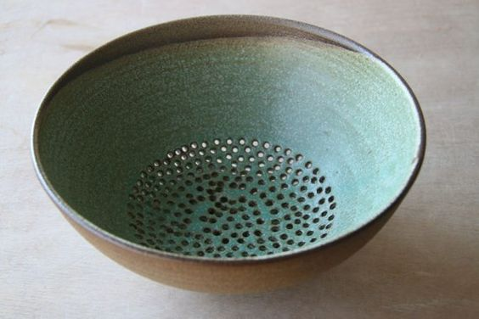
Conical Forms:
These conical shapes is highly versatile starting point, which to develop designs in ceramic - from plant pots to vessel and bottle forms, the possibilities are extensive.
Curved Forms:
Curved forms are feminine and aesthetically pleasing to look at. For these shapes to work properly. It is important to get the balance exactly right between the sizes of the base and the rim and the height of the piece. These forms can be use as your basic shape.

Slide 8
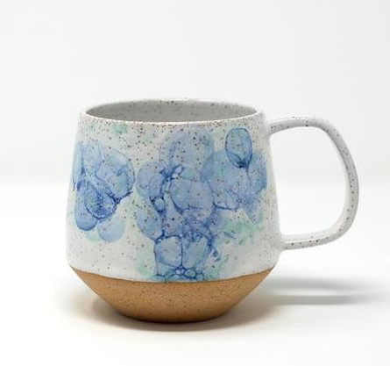
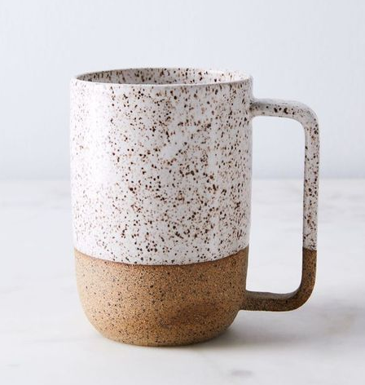
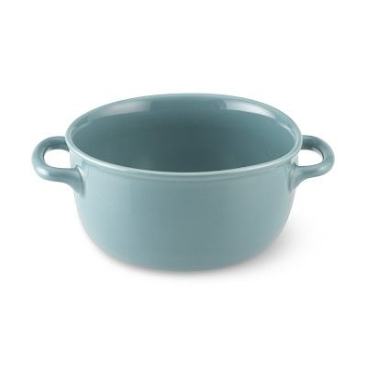
Drinking vessels :
A B
C D
A) curved, B) straight- sided , C)round and D)conical form In this section, we revisit four shape types on a much smaller state to produce cups, mugs and tea cups. Each of the four shapes types is divided into three, with the basic shape forming the cup that is then adapted to make a mug and tea cup.
With the reference of “Drinking vessels”, you have to create five different designs. It could be a tea-cup or mug. The design should be different from the reference. With the help of basic shapes ,you can add, build or raise the forms.

Slide 9
We know that most of works in functional pottery is three dimensional .
For example: tea pot, pen stand , jug set dinner set and flower pot etc.
Here we will understand development of three dimensional form through pen stand form.
Link:
https://www.youtube.com/watch?v=vMr6eimcolc
References:
I am attaching some references of pen stand, please see it and make your own design.
Assignment: First of all you guys will learn and understand development of three dimensional form (3D), after that you will design 5 pen stand 3D form in paper through pencil, colour pencil or as per your convenience. After doing the 3D design with pencil or colour pencil, you will arrange the photos in PPT.

Slide 10
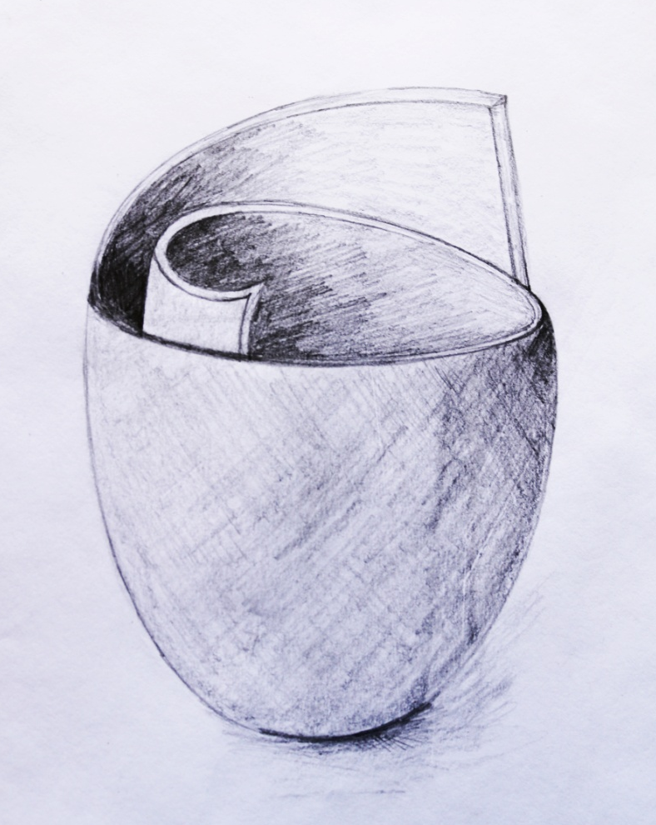
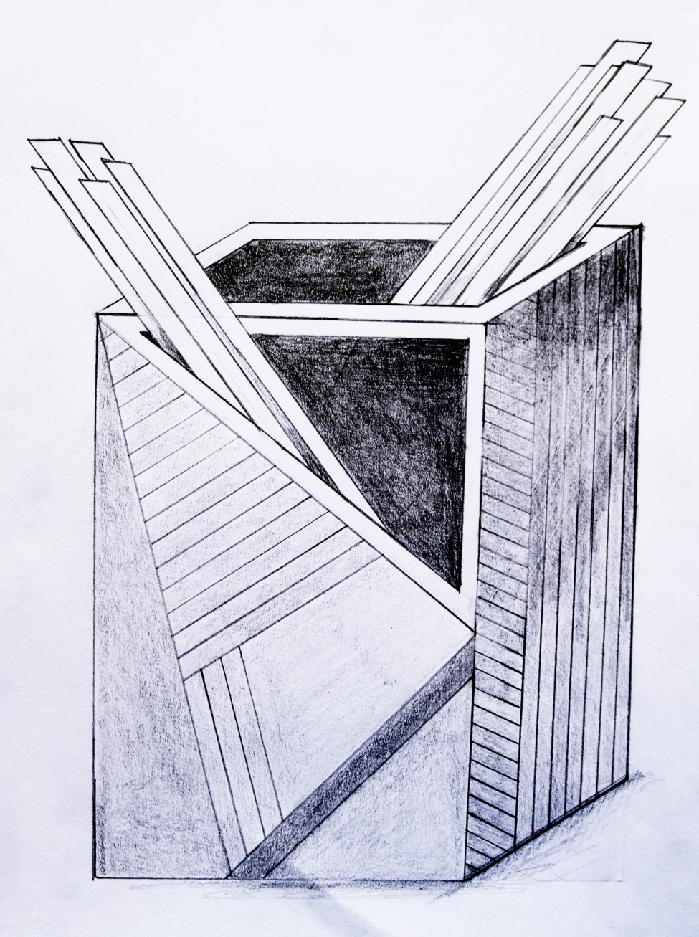
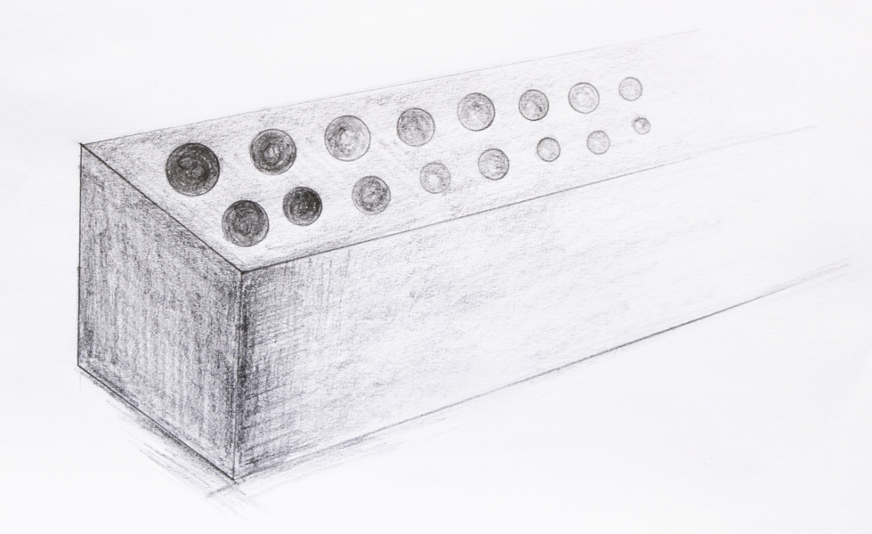
2
1
3

Slide 11
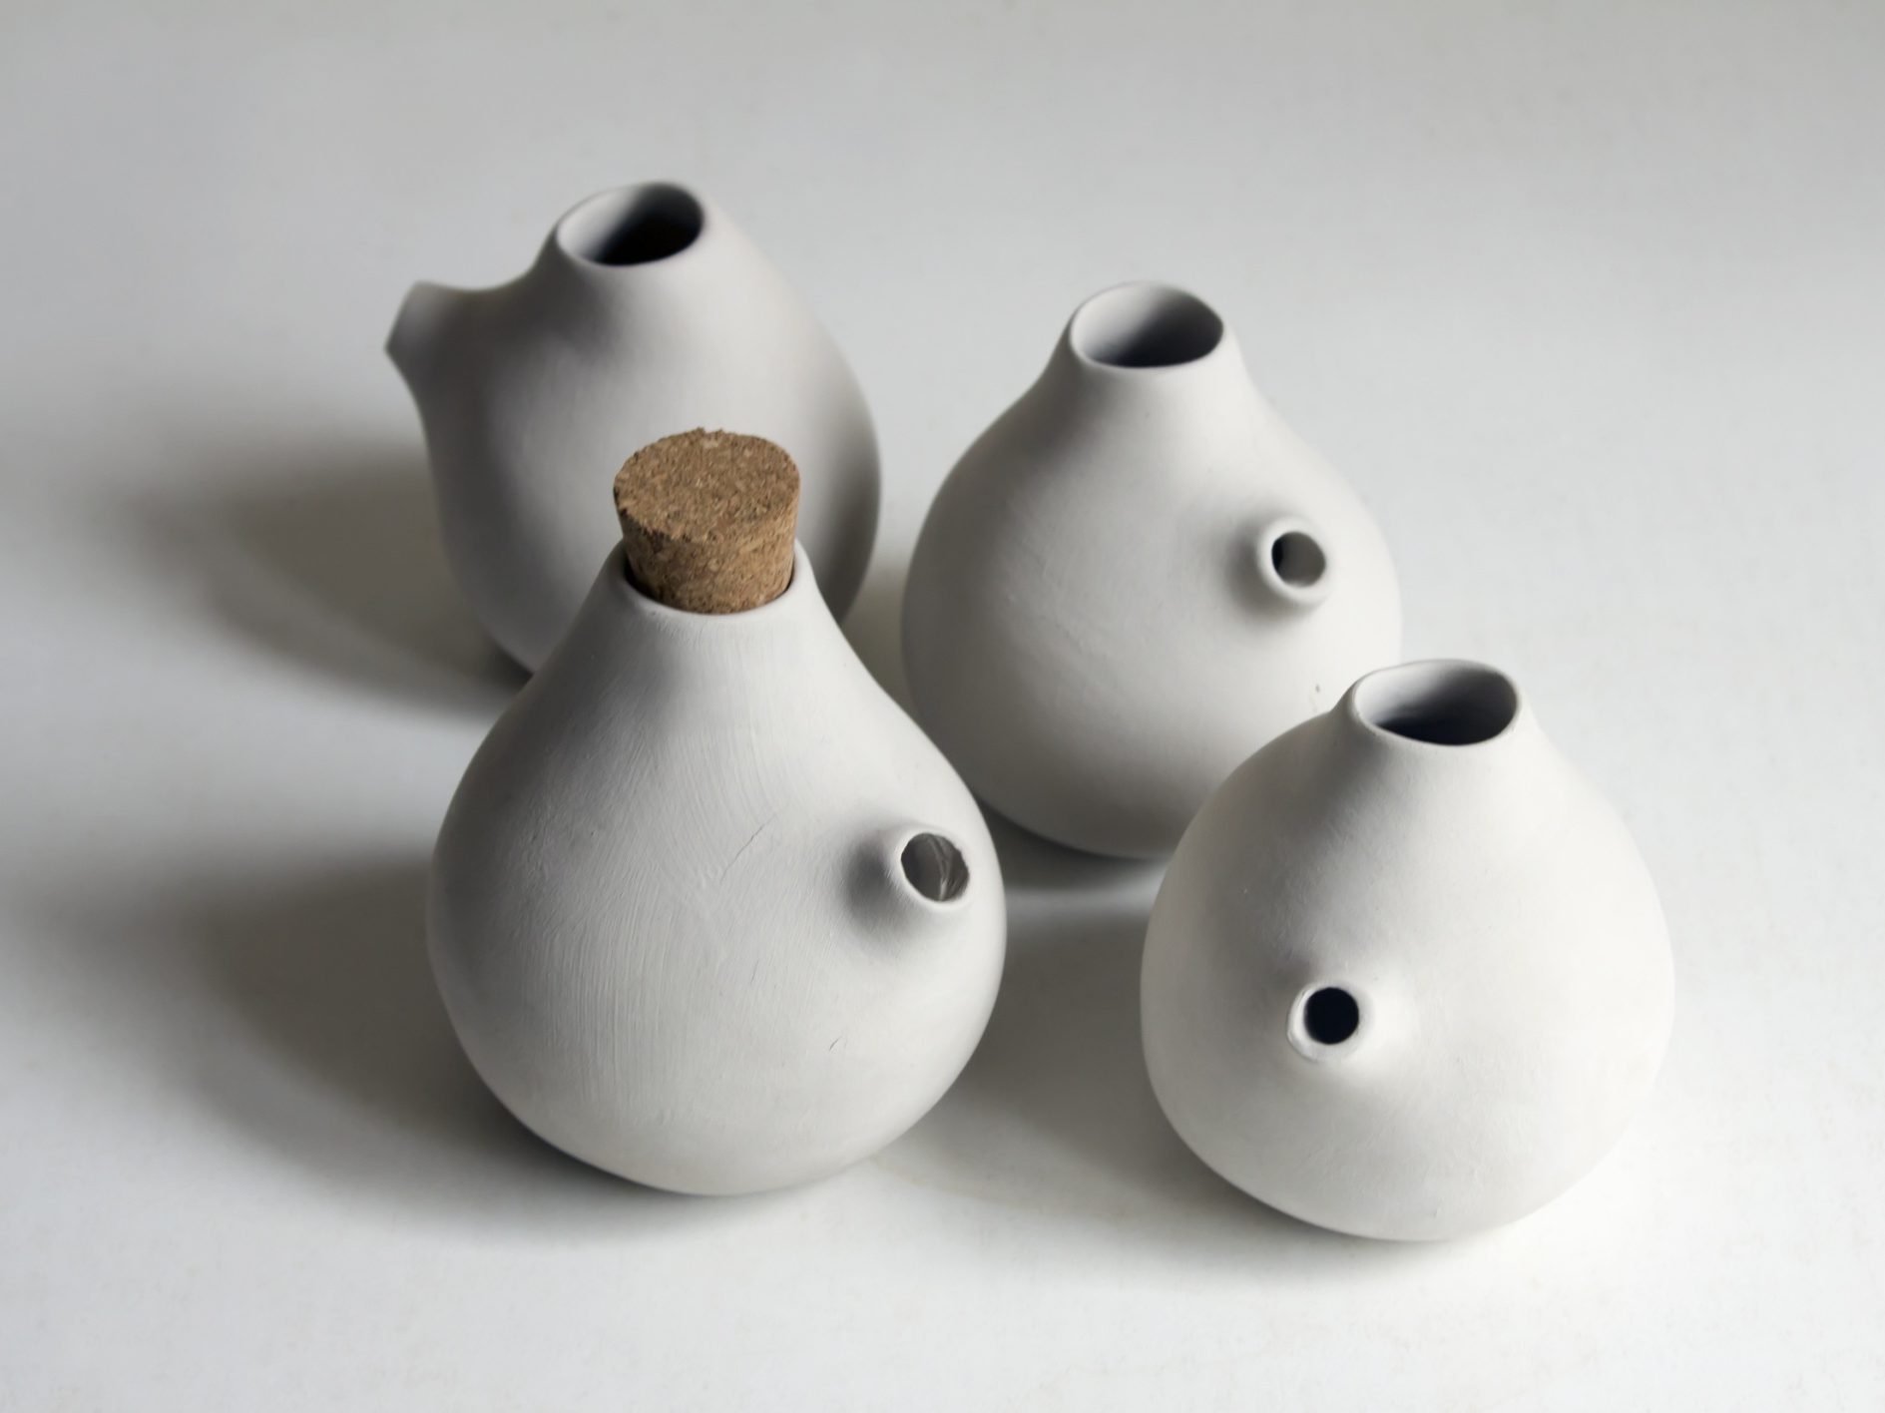
References:
Book: Ceramics (A beginner's guide to tool and techniques) & Google and Own drawing
Thanks……….
Madan Singh
www.madanceramics.com

