Slide 1
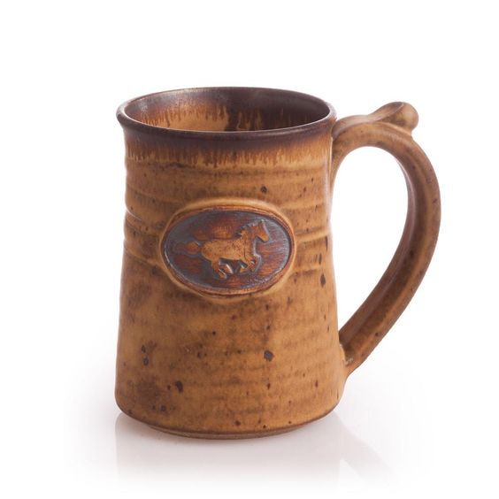
Functional approach of a design

Slide 2
Ceramics Designers’ Ways of Thinking:
For modern ceramics designers, strategizing and problem-solving involves finding a balance of aesthetic and functional attributes, using both “imaginative thoughts” and “rational thoughts”. Imaginative thought involves an artistic type of creating, whereby the designer follows his self-motivation to achieve an aesthetic purpose. On the other hand, ceramic designers are also responsible for ensuring their work is functional, solving design problems and making them relevant to real world consumer markets.
For example:
George Watson’s ceramic toaster (Figure 1) combines aesthetic and functional factors, creating a product that is attractive to consumers, both useful and beautifully designed . Watson notes that the toaster is “designed to engage the user, re-invigorating the social context of toasting by questioning everything about what we toast with today”.

Slide 3
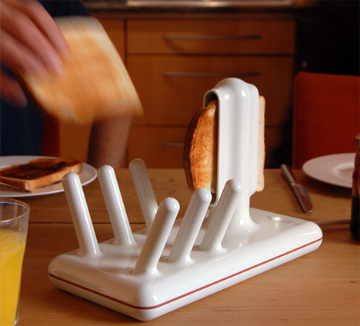
Productive Thinking:
For ceramicists, researchers found this notion very workable, as “designers must consciously direct their thought processes towards a particular specified end”.
At the Royal College of Art, Anna Osborne and Victoria Rothschild investigated ceramic and concrete tiles; their final designs suggest a concentration on certain limitations, such as the contrast between glossy ceramic and gritty cement, and the softness and whiteness of glass against the darkness of concrete . Finally, their results were easy to classify in purpose and category.

Slide 4
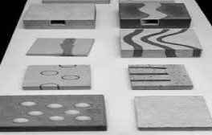
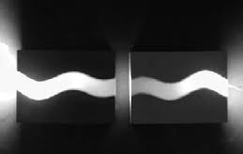
Functional approach:
The mean’s of functional having a special activity, purpose, or task.. That means all those products which are used in the routing of human life, we called them functional.
Hear we are talking about functional ceramics work. Functional pottery occupies the routine of human. We generally use ceramics products in during food, decoration or some time necessary.

Slide 5
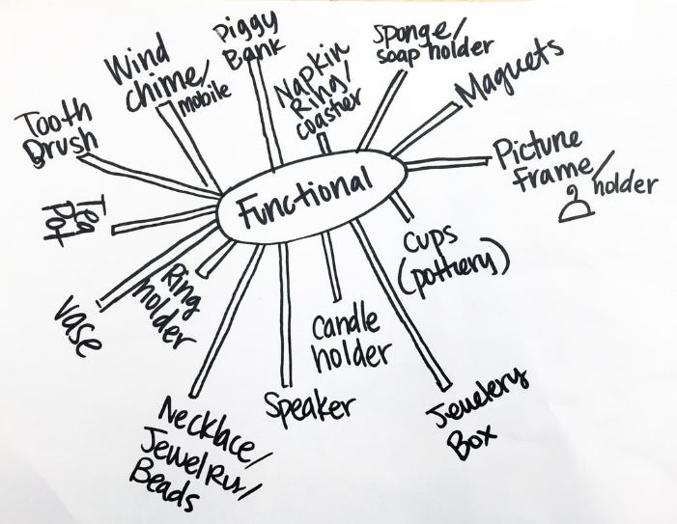
Functional pottery :
Any ceramics piece that is not purely decorative and has an intended use. (examples include, but are not limited to: teapots, plates, bowls, mugs, and
vases.)
Link:
https://youtu.be/zXKW0GgXDwE
https://youtu.be/_UDLbRqU0PM
Functional pottery is made for people to use and many potters feel that the pot isn’t complete until it is physically used for its job. But the meaning of function in relation to handmade pottery goes well beyond mere utilitarianism. It should be efficient, easy to use, comfortable in the hands, and give pleasure to the user at the same time.

Slide 6
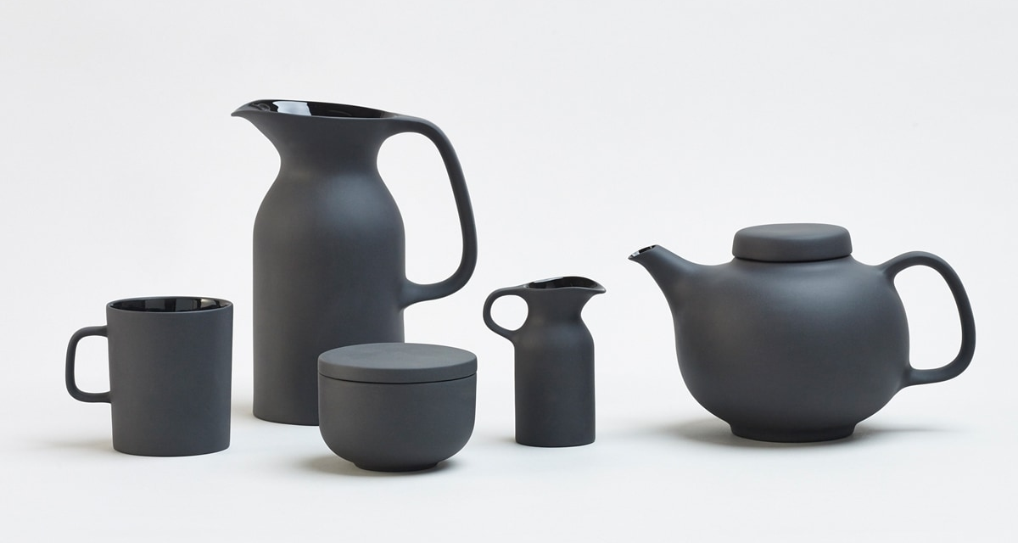
Design: The creation of a plan or convention for the construction of an object; the look of an object.
Functional Approach : Hand building with clay offers endless opportunities for creating a variety of ware and forms. You will be introduced to the basic techniques of pinching, coiling and slab process to enable you to create various functional forms.
For examples : Teapots, Mugs, Pen-stand, Plates and Bowls etc.
During coming sessions you will be explore and experiment with your materials. You will be more creative and brainstorming with new way of creating ,understanding and developing to achieve your ideas.

Slide 7
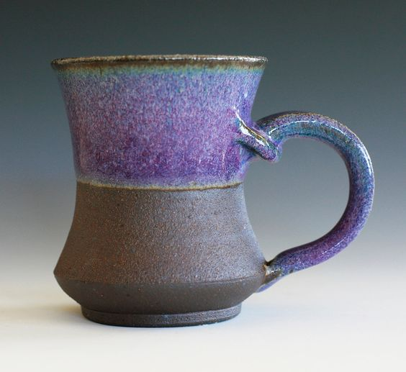
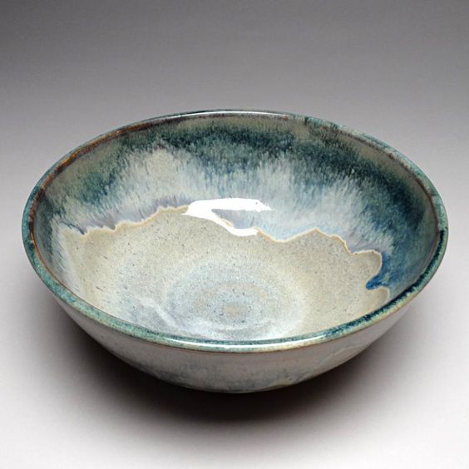
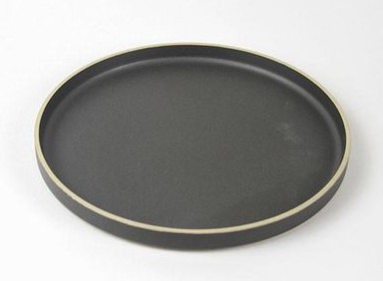
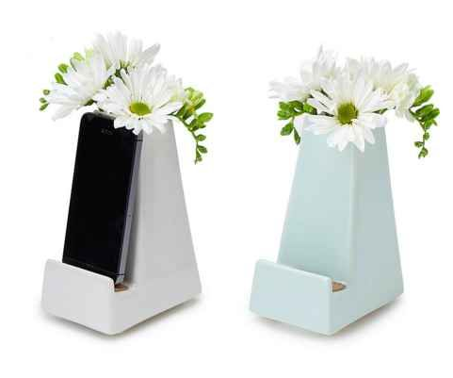

Slide 8
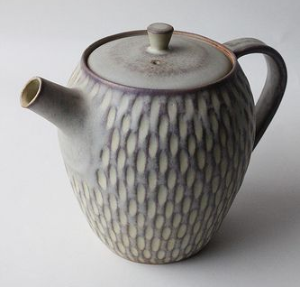
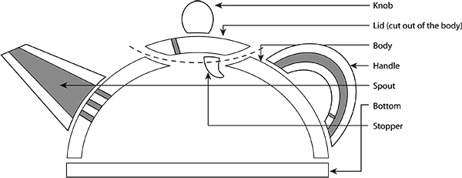
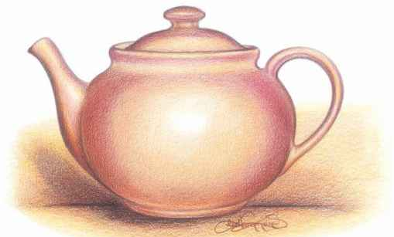
These ceramic teapot, bowl, tray and mug lesson plan is a good exercise before proceeding to the practical work in department.
These articles is an exercise in designing a three-dimensional structure as well as studying function, proportion, and surface an opportunity for students to think about teapot mechanics, while allowing you to experiment with design elements.
Some references to achieve your design:
1. Tea pot:
Link:
https://youtu.be/OQI71Iea-5U
https://youtu.be/C3pU39FJBBc

Slide 9
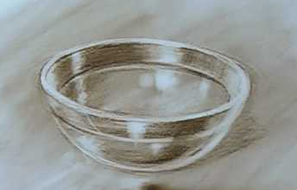
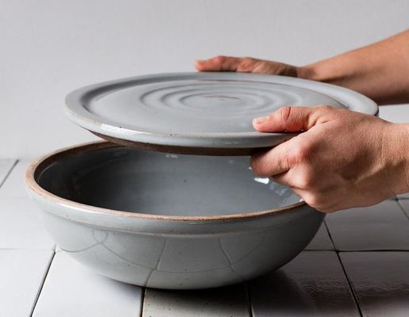
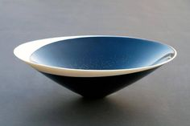
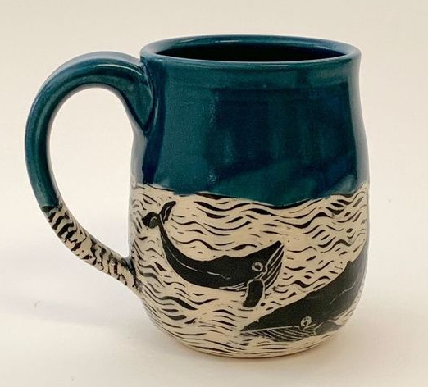
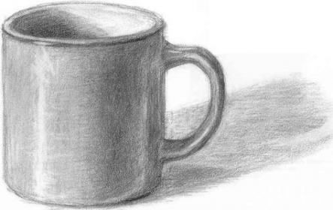
2. Bowl:
Link:
https://www.youtube.com/watch?v=0bKRJ8-gMr0
3.Coffee mug :
Link:
https://youtu.be/vWz6JJ9dIdk

Slide 10
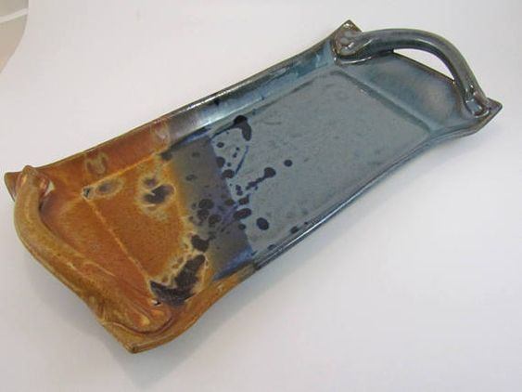
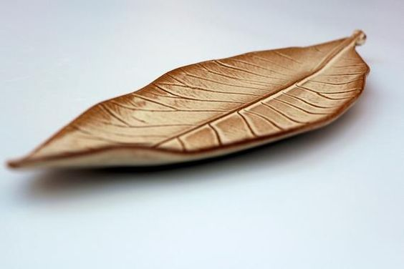
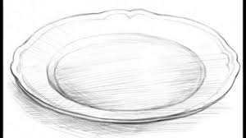
4. Serving tray :
Link:
https://youtu.be/ow-l3SyKds4

Slide 11
Assignment
Dear students,
Your assignment is to prepare two design of each articles that is (Tea pot, bowl, coffee mug and Serving tray ) total 8 design on paper with pen ,pencil or colours as per your convenience.
Drawing should be functional form.
It will include balance, proportion and shape.
It reflects your planning and form mechanics.
Your drawing should reflect your hand building skill and techniques and craftsmanship.
Some references are also given in this PPT. After finishing your drawing , take pictures and add this assignment with your previous PPT.

Slide 12
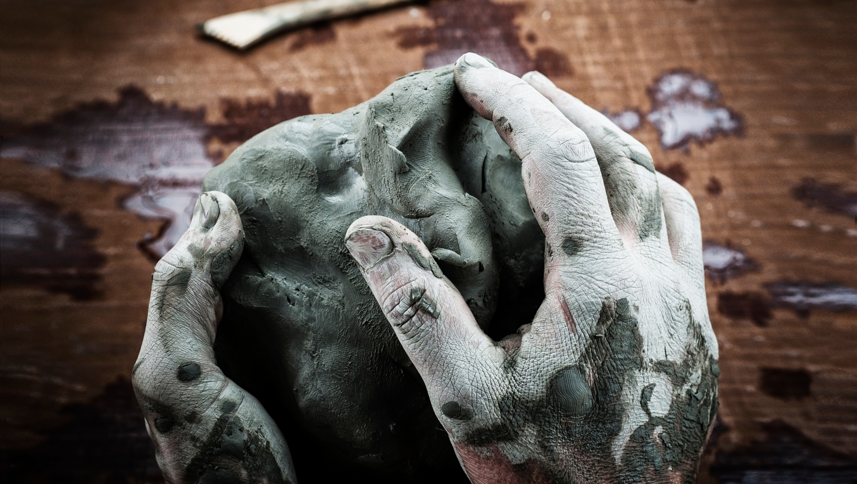
References:
Book: Ceramics (A beginner's guide to tool and techniques), Google and Own thinking
Thanks……….
Madan Singh
www.madanceramics.com

