Slide 1
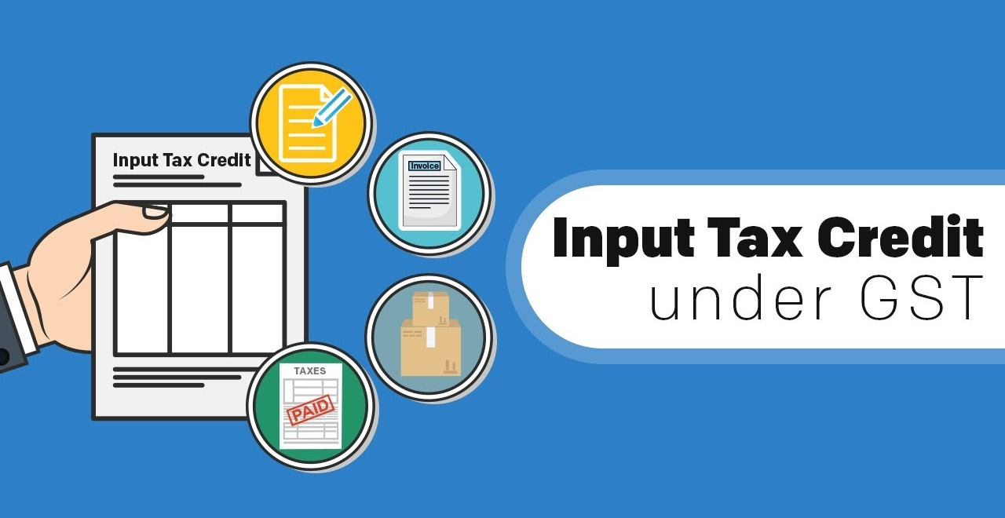
Institute of Cost Accountants of India, Cochin Chapter
Reuben George Joseph, FCA
August 19, 2022

Slide 2
Definitions
Inputs
“means any goods other than capital goods used or intended to be used by a supplier in the course or furtherance of business;”
Input services
means any service used or intended to be used by a supplier in the course or furtherance of business
Capital goods
means goods, the value of which is capitalised in the books of account of the person claiming the input tax credit and which are used or intended to be used in the course or furtherance of business;

Slide 3
Definition of input tax
IGST on imported goods
"input tax" in relation to a registered person, means the central tax, State tax, integrated tax or Union territory tax charged on any supply of goods or services or both made to him and includes—
GST under RCM
IGST on imported services
But does not include tax paid under composition levy

Slide 4

Clause (a)
motor vehicles for transportation of persons having approved seating capacity of not more than thirteen persons (including the driver), except when they are used for making the following taxable supplies, namely:—
(A) further supply of such motor vehicles; or
(B) transportation of passengers; or
(C) imparting training on driving such motor vehicles;
Clause (aa)
vessels and aircraft except when they are used—
(i) for making the following taxable supplies, namely:—
(A) further supply of such vessels or aircraft; or
(B) transportation of passengers; or
(C) imparting training on navigating such vessels; or
(D) imparting training on flying such aircraft;
(ii) for transportation of goods;
Other than business purposes
  Cannot avail
Partly for effecting exempted supplies
  Proportionate credit
List of items given in Sec. 17(5)
  Blocked

Slide 5
Clause (ab)
services of general insurance, servicing, repair and maintenance in so far as they relate to motor vehicles, vessels or aircraft referred to in clause (a) or clause (aa):
Provided that the input tax credit in respect of such services shall be available—
(i) where the motor vehicles, vessels or aircraft referred to in clause (a) or clause (aa) are used for the purposes specified therein;
(ii) where received by a taxable person engaged—
(I) in the manufacture of such motor vehicles, vessels or aircraft; or
(II) in the supply of general insurance services in respect of such motor vehicles, vessels or aircraft insured by him;
Clause (b)
the following supply of goods or services or both—
(i) food and beverages, outdoor catering, beauty treatment, health services, cosmetic and plastic surgery, leasing, renting or hiring of motor vehicles, vessels or aircraft referred to in clause (a) or clause (aa) except when used for the purposes specified therein, life insurance and health insurance:
Provided that the input tax credit in respect of such goods or services or both shall be available where an inward supply of such goods or services or both is used by a registered person for making an outward taxable supply of the same category of goods or services or both or as an element of a taxable composite or mixed supply;

Slide 6
(ii) membership of a club, health and fitness centre; and
(iii) travel benefits extended to employees on vacation such as leave or home travel concession:
Provided that the input tax credit in respect of such goods or services or both shall be available, where it is obligatory for an employer to provide the same to its employees under any law for the time being in force
Clause (c)
works contract services when supplied for construction of an immovable property (other than plant and machinery) except where it is an input service for further supply of works contract service;
Clause (d)
goods or services or both received by a taxable person for construction of an immovable property (other than plant or machinery) on his own account including when such goods or services or both are used in the course or furtherance of business.
Explanation.—For the purposes of clauses (c) and (d), the expression construction includes re-construction, renovation, additions or alterations or repairs, to the extent of capitalisation, to the said immovable property

Slide 7
Clause (e), (f), (g)
(e) goods or services or both on which tax has been paid under section 10;
(f) goods or services or both received by a non-resident taxable person except on goods imported by him;
(g) goods or services or both used for personal consumption;
Clause (h) and (i)
(h) goods lost, stolen, destroyed, written off or disposed of by way of gift or free samples; and
(i) any tax paid in accordance with the provisions of sections 74, 129 and 130.

Slide 8

#1
Tax invoice / debit note from supplier
#2
November 30th after the year end
Received goods / services
#3
Tax has been paid to the Govt.
#4
GSTR 3B filed
Date of furnishing of annual return
#5
Supplier has been paid in 180 days

Slide 9

No depreciation on ITC
Pay supplier in 180 days
Generate self invoice for RCM

Slide 10
Apportionment of credits & blocked credits
Sec. 17(1) & 17(2) read with Rule 42
Total input tax = T
Exclusively used for other than business = T1
Exclusively used for exempt supplies = T2
Credit not available u/s 17(5) = T3
ITC credited to electronic credit ledger (C1) =
T – (T1 + T2 + t3)
ITC exclusively
used for taxable
supplies = T4
Common credit
(C2) = C1 – T4
ITC attributable
towards exempt
supplies
(D1) = E / F x C2
E = Exempt supplies
F = Total turnover
ITC attributable
towards non-business
purpose
(D2) = 5% x C2
ITC attributable
towards business
purpose & taxable
supplies
(C3) = C2 – (D1+D2)

Slide 11

ITC relating to fully taxable supplies
ITC relating to fully exempt supplies
Common ITC
Avail 100%
Ignore 100%
Avail proportionately

Slide 12
History of Rule 36(4)
20% excess limit
Limit reduced to 10%
Limit reduced to 5%
Claim must match GSTR 2B
9 Oct. 2019
1 Jan. 2020
1 Jan. 2021
1 Jan. 2022
 | #1 | #2 | #3 | #4
ITC available on invoices received from suppliers | Rs. 10,00,000 | Rs. 10,00,000 | Rs. 10,00,000 | Rs. 10,00,000
ITC available in GSTR 2A | Rs. 8,00,000 | Rs. 8,00,000 | Rs. 8,00,000 | Rs. 8,00,000
Extra limit available | Rs. 1,60,000 | Rs. 80,0000 | Rs. 40,000 | Nil
Maximum claim possible | Rs. 9,60,000 | Rs. 8,80,000 | Rs. 8,40,000 | Rs. 8,00,000

Slide 13

Sec. 16(2)(aa) inserted w.e.f. Jan 1, 2022
Decision in Jai Maa Jwalamukhi Iron Scrap Supplier Vs State of U.P. (All. HC)
Rule 36(4) inserted w.e.f. Oct 9, 2021
Demand from GST department due to difference between GSTR 2A and GSTR 3B
No presumption that tax has not been remitted
Decision in Brindavan Beverages Pvt. Ltd. (SC)
Impossible to comply with provision
Denial not possible without efforts of revovery – DY Beathel Enterprises (Madras HC)
Denial solely on grounds of differences – CESTAT decisions
Notes:
Jai Maa Jwalamukhi
"The invoice is primary evidence of the transaction. Unless the revenue authority disputes its genuineness, it cannot be lightly overlooked. Perusal of the said order would reveal that other than the defect of non- production of books of account, assessing authority has also taken into consideration the fact that there were discrepancies arising on the basis of the details mentioned in the auto-populated GSTR-3B and GSTR-2A, filed by the petitioner. Even otherwise, in face of the admission, as to the genuineness and existence of the tax invoice and the e-way bills, mere existence of some discrepancies may not have ever led the revenue authority to the conclusion that tax had been evaded or the transaction had not been disclosed.“
Brindavan Beverages – vague notices are not acceptable.
Impossible
1. Recipient shall verify, validate, modify, delete details communicated to him. As per 38(1), GSTR 1 should be editable. This is not operational.
2. Recipient should be able to add missing details as per 38(2)
3. Modified, deleted or included entries should be communicated to supplier as per 38(3)
4. Supplier should be able to accept or reject and his GSTR1 would get modified as per 37(2)
5. Matching of inward supply and outward supply. Discrepancies to be informed to both as per 42(3)
6. If there is any error, supplier should be able to rectify GSTR 1
7. Unmatched entries would alert recipient that supplier has not paid tax under Sec. 42(3)

Slide 14
#1
Till 09.10.19
  For 2017-18, 2018-19 and 2019-20 (till 09.10.19), ITC on self assessment basis. No condition existing about ITC appearing in GSTR 2A
#2
09.10.19 to 31.12.20
  Rule 36(4) was inserted. Can be argued that it is ultra vires the Act. If ITC claim is within 20% / 10% bracket, no demand expected
#3
01.01.21 to 31.12.21
  GSTR 2B supposed to be used. ITC claim limited to 5% over and above credit appearing in GSTR 2B.
#4
From 01.01.22
  ITC can be taken strictly on the basis of ITC appearing in GSTR 2B

Slide 15
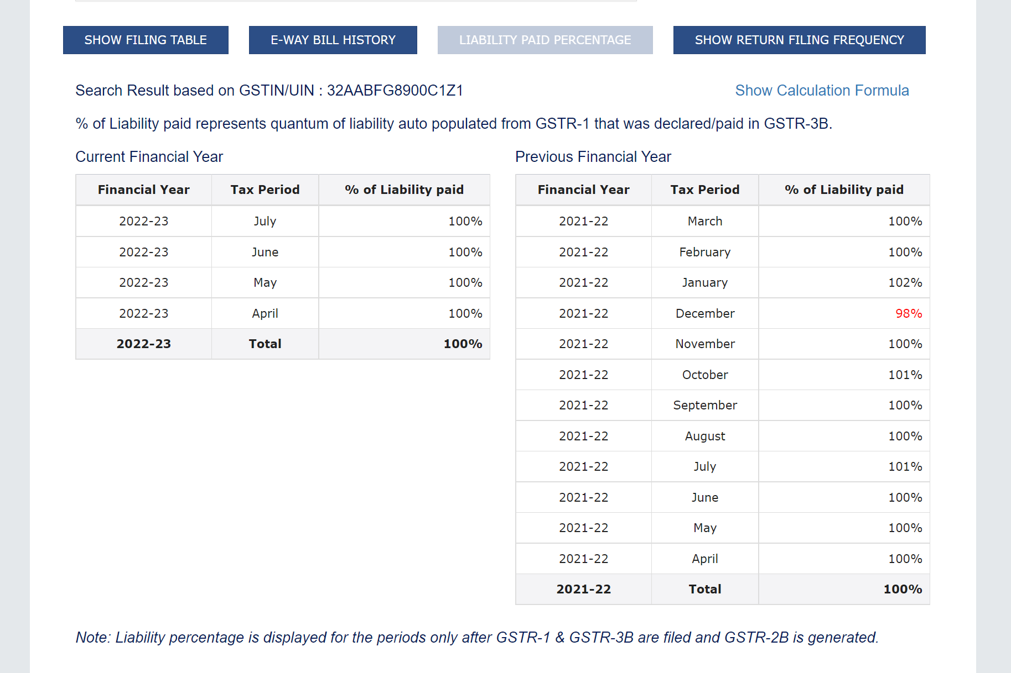
Limited way to ensure that tax has been paid by the supplier

Slide 16
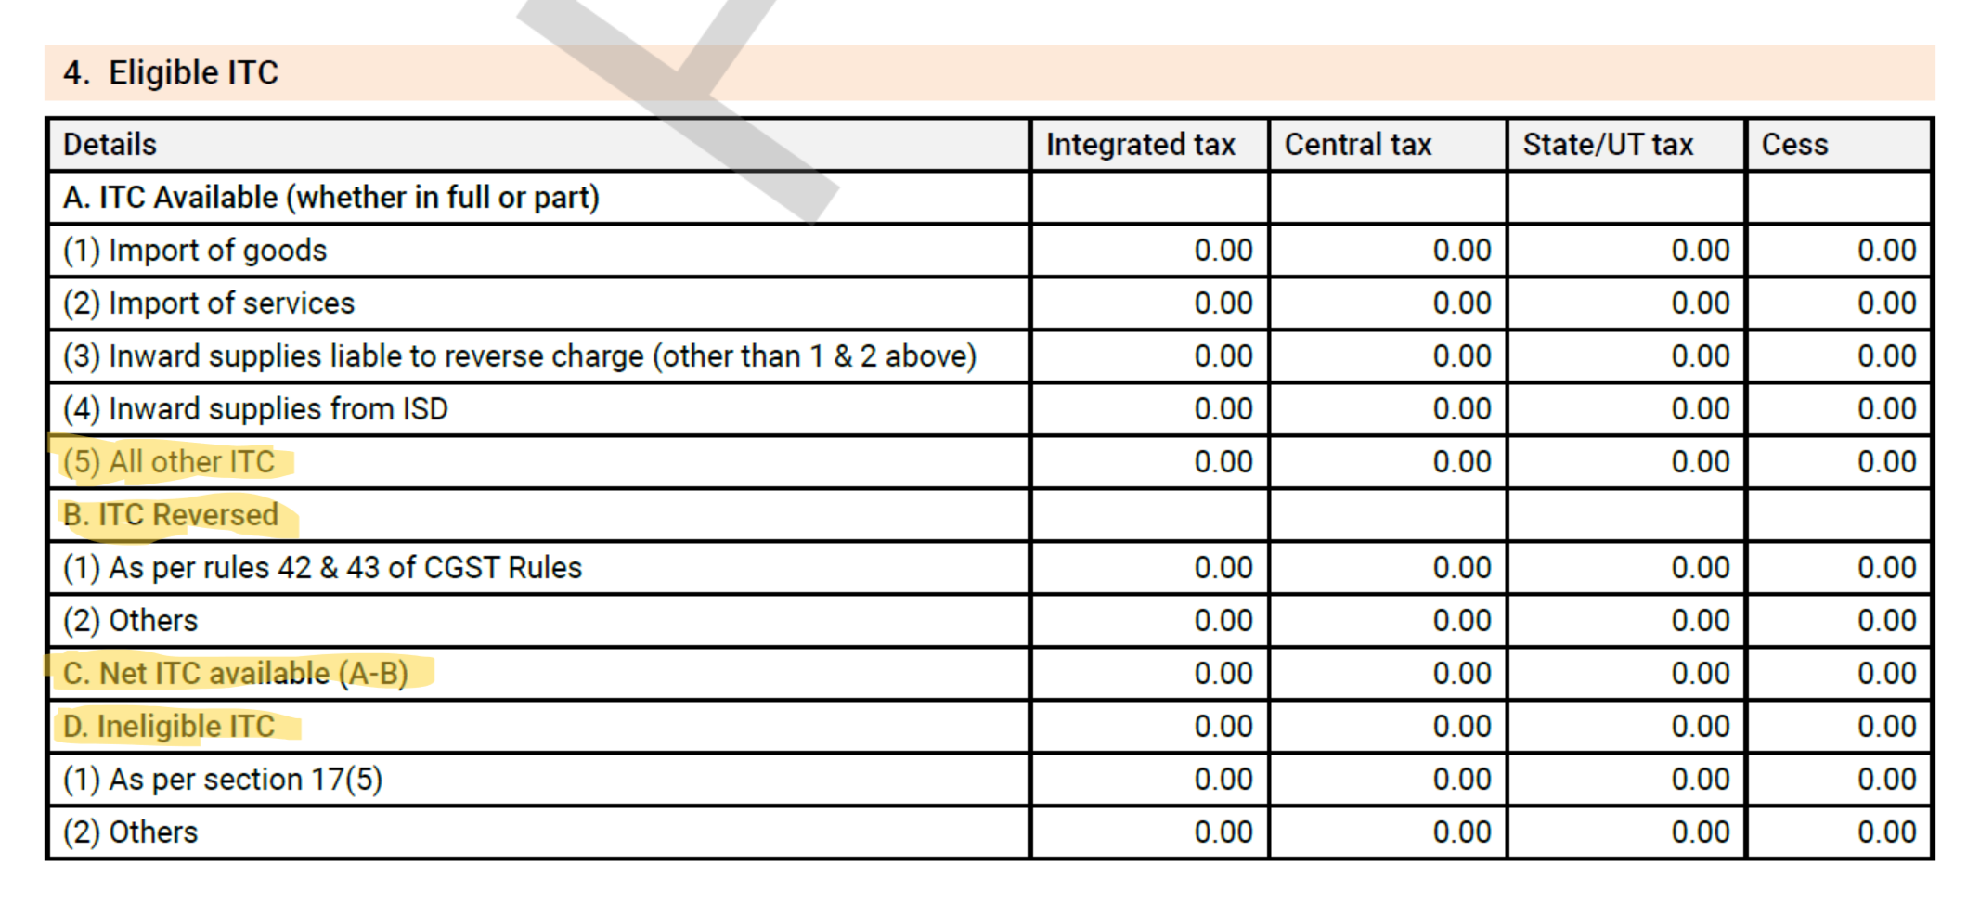
ITC
in
GSTR 3B

Slide 17
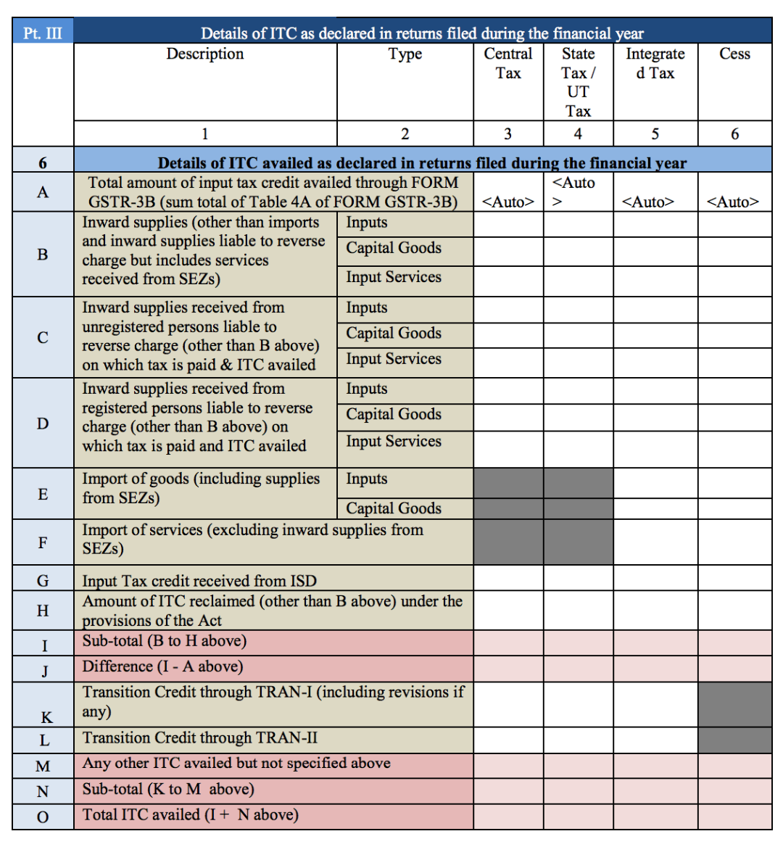
ITC
in
GSTR 9

Slide 18
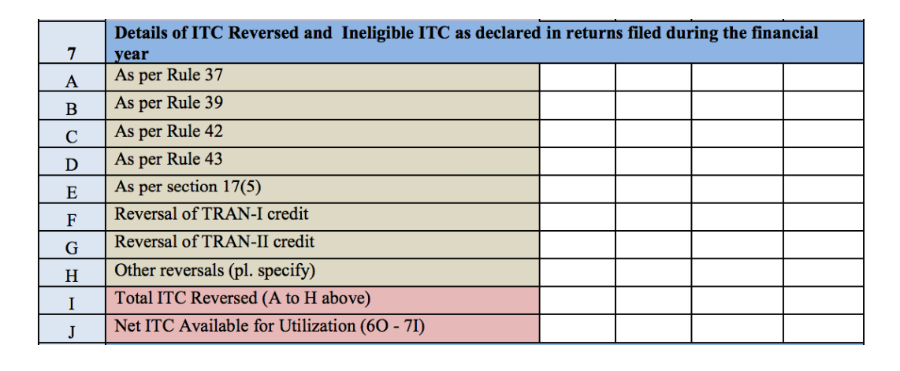
ITC
in
GSTR 9

Slide 19
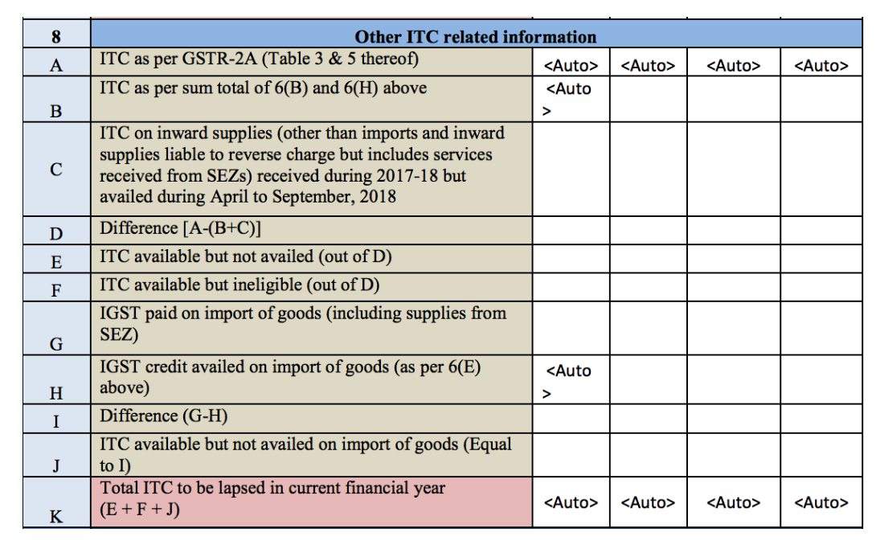
ITC
in
GSTR 9

Slide 20
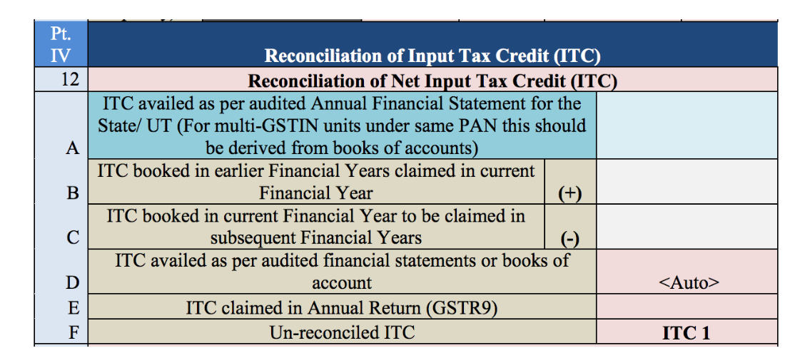
ITC
in
GSTR 9C

Slide 21
ITC on immovable property
Safari Retreats case
AAR decisions
Solar power plants
Air conditioning, fire extinguishers, electrical fittings

