Slide 1
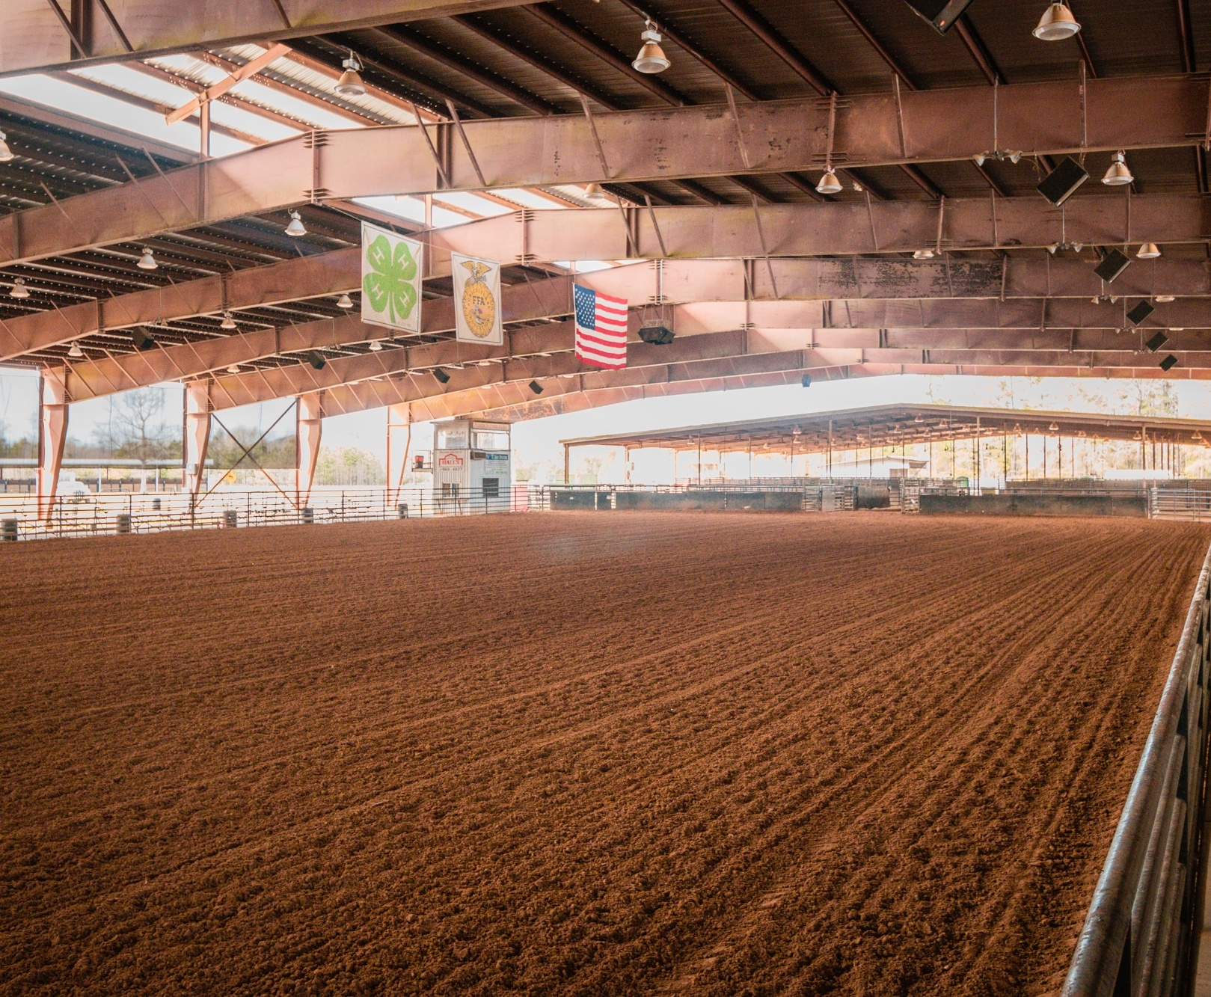
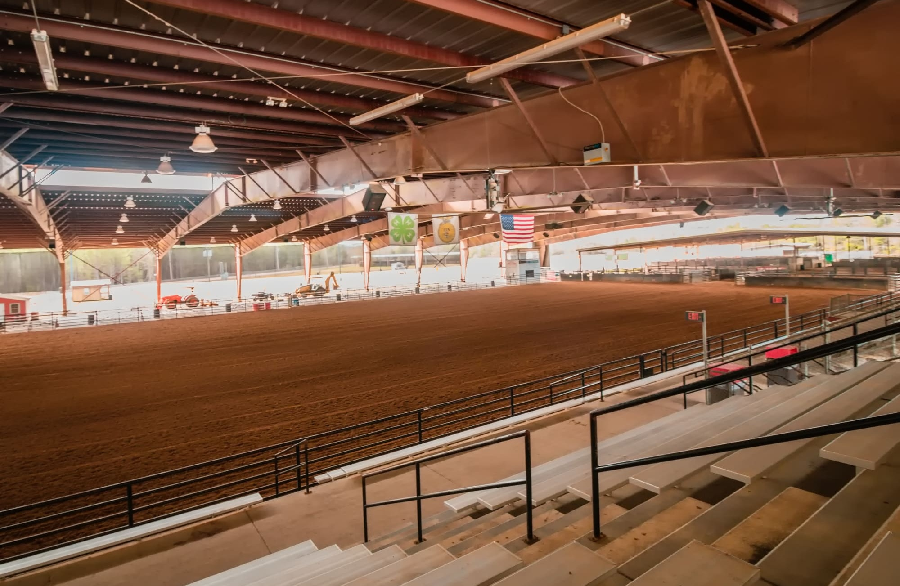
Tanya Carpenter and
High Road Productions, LLC
v.
Tangipahoa Parish, et al.
June 22, 2026

Slide 2
When a citizen speaks up about safety, public mismanagement, and fairness, government must listen — not retaliate… no matter how difficult, demanding, or even abrasive, that citizen may be.

Slide 3
Facts Not in Dispute

Slide 4
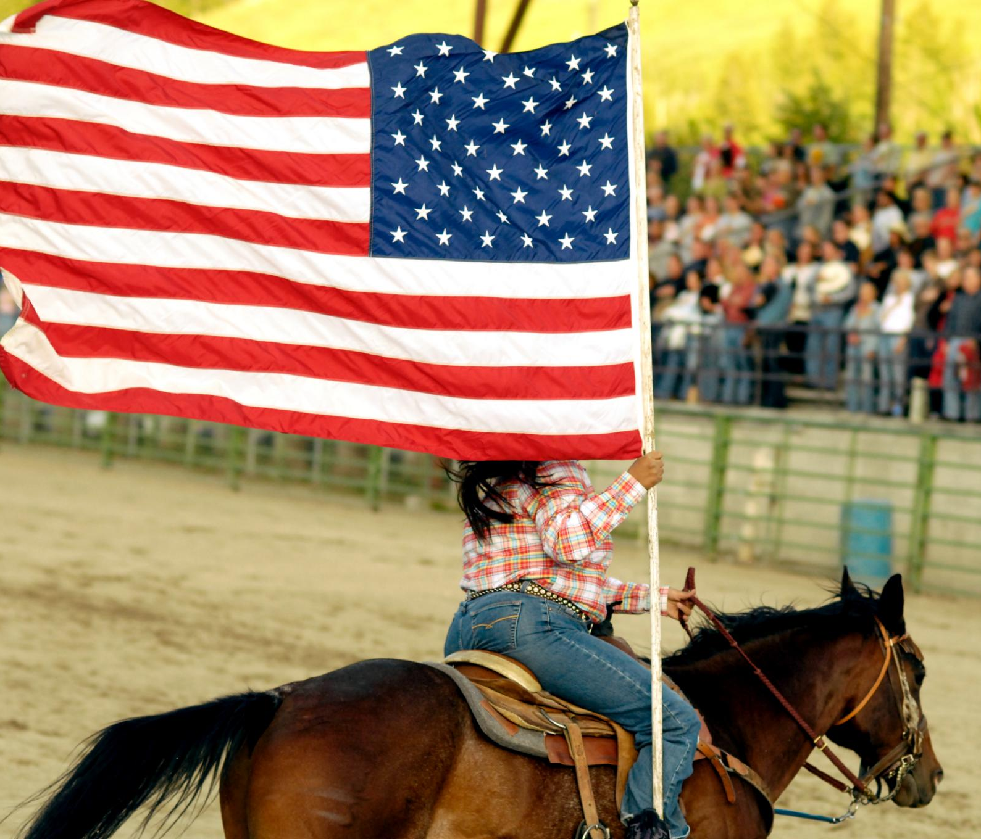
Who are the Plaintiffs
  Tanya Carpenter and her company, High Road Productions, LLC.
Barrel Race Promoter at Florida Parishes Arena
  Plaintiffs held barrel races at the Florida Parishes Arena through High Road Productions, LLC on Friday nights and NBHA (National Barrel Horse Association) sanctioned barrel races on Saturdays for twenty years from 2004 until October 2024

Slide 5
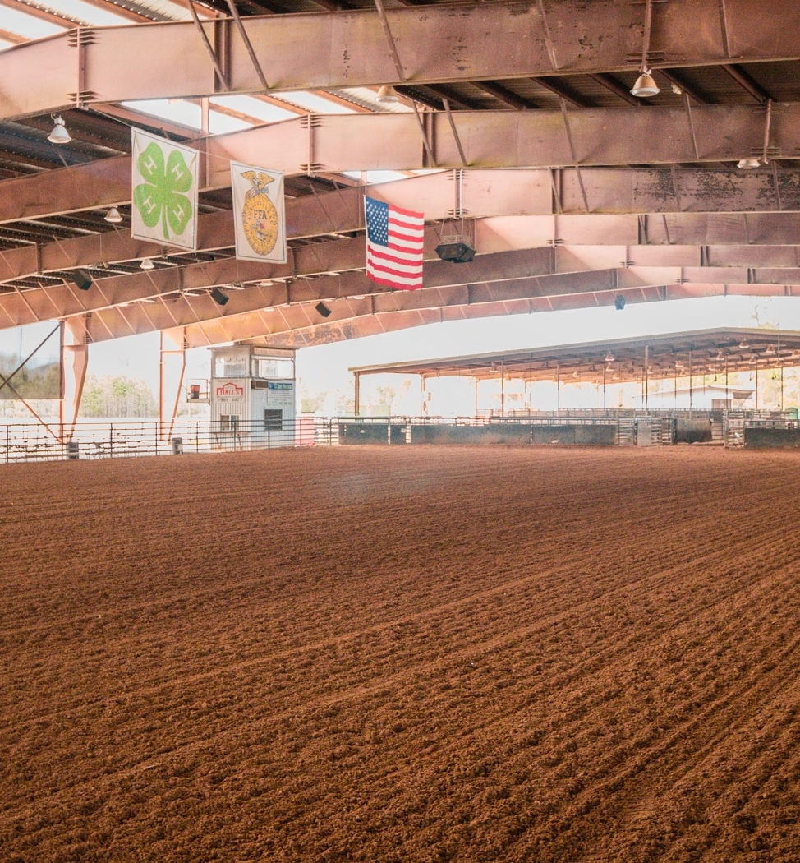
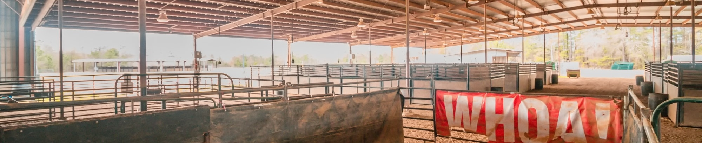
Florida Parishes Arena
  Florida Parishes Arena opened in 2004 and is owned by Tangipahoa Parish
Florida Parishes Arena Leadership
  Robby Miller is and at all relevant times served as Parish President.
  Kelly Wells served as Director and Toni Jean Catalano worked as Office Manager at Florida Parishes Arena.
Notes:
.

Slide 6
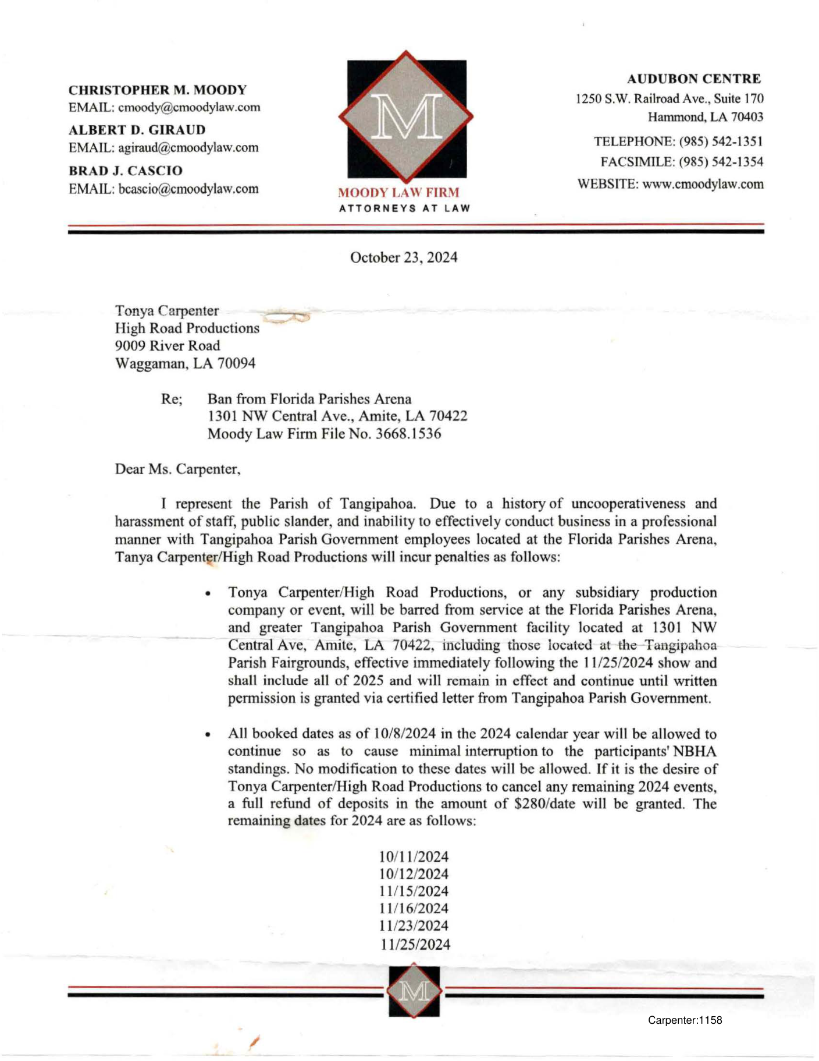
October 23, 2024 Tangipahoa Parish, through attorneys, sent a letter to Tanya Carpenter and High Road Productions, LLC
- barring them or any subsidiary production company or event from the Florida Parishes Arena, and greater Tangipahoa Parish government facility located at 1301 NW central Ave. Amite LA 70422, including those located at Tangipahoa Parish Fairgrounds
- effective immediately following the November 25, 2024 show and to include all of 2025 and such ban will remain in effect and continue until written permission is granted via certified letter from the Tangipahoa Parish government;.

Slide 7

Parish President Robby Miller Approved
  Barred Letter personally reviewed and approved by Parish President, Robby Miller.
No Notice
  Plaintiffs were not given advance notice of the intended ban prior to receiving the letter.
No Appeal
  The ban letter did not provide any procedure for plaintiffs to contest the decision.
Banned Until Parish Decides Otherwise
  As of the trial date, plaintiffs have not been allowed to return to the arena or facilities.

Slide 8
Plaintiffs’ Speech

Slide 9
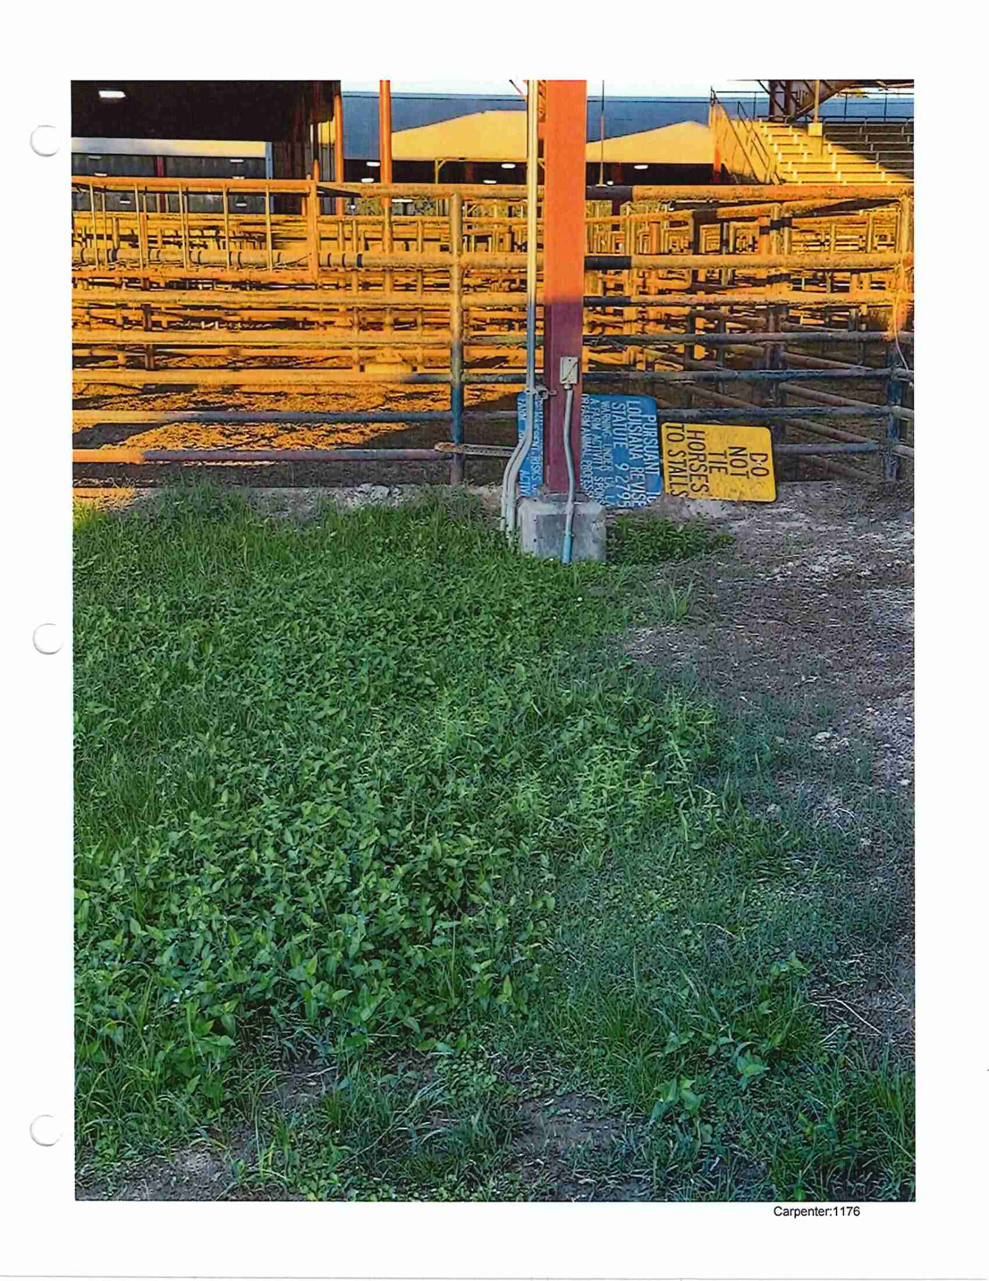
Alleged Speech
Safety and Design Complaints
  Plaintiffs raised detailed concerns about arena safety and defects including unsecure gates, lack of proper liability signage, lack of proper maintenance, and arena layout issues.
Maintenance and Equipment Issues
  Complaints included ground conditions, lighting problems, and equipment functionality affecting safety and successful operation of Plaintiffs barrel races.
Prior Incidents and Complaints
  Plaintiffs reported previous injuries and serious safety events to demonstrate real risks behind their concerns.
Communication with Parish Officials
  Complaints directed to arena management (Kelly Wells) and parish officials (Robby Miller) responsible for addressing safety concerns.

Slide 10
Alleged Retaliatory Actions

Slide 11
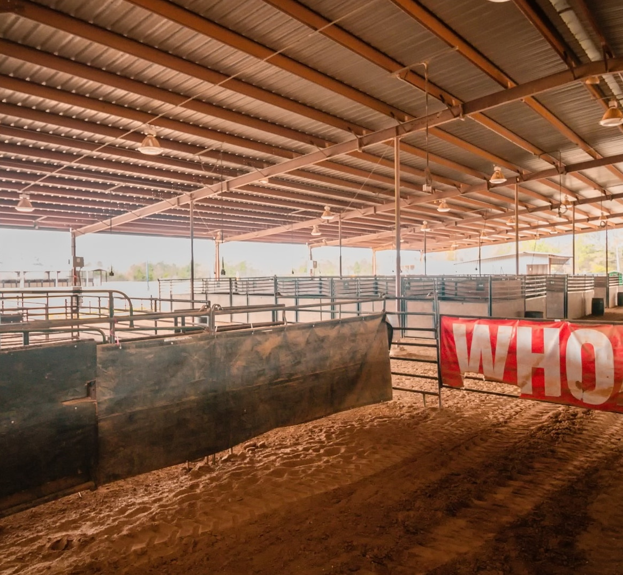
Specific Acts of Retaliation Alleged
Alleged Leadership Failures
  Plaintiffs claim that arena management failed to address safety issues, reflecting poor leadership after their speech.
Reduction in Parish Support
  Parish management decreased support from parish employees during Plaintiffs’ events.
Race Date Reductions
  Race dates held for more than a decade were not renewed and given to others after years of consistent scheduling, disrupting tradition, and effecting Plaintiffs’ ability to continue to draw crowds.
Inferior Equipment and Grounds
  Parish provided broken equipment and inexperienced staff to work and prepare grounds.
  Dangerous Double Booking of Car Show

Slide 12
Tanya Carpenter’s Journey from Most Productive Producer
at Florida Parishes Arena
to Banishment
COMPLAINTS ABOUT SAFETY AND MANAGEMENT
SEPT. 21, 2024
ESCALATION
Car Show On Top of Barrel Race
20+ YEARS OF
EVENTS AT ARENA
RETALIATION
BEGINS 2022/2023
OCT. 23, 2024
BARRED LETTER

Slide 13
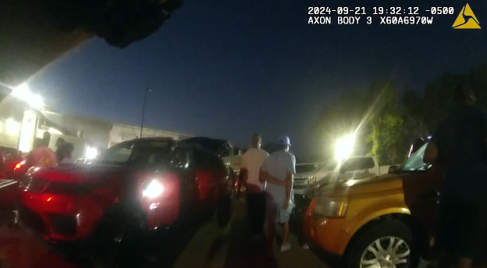
September 21, 2024 – Car Show – The Breaking Point
What Plaintiffs allege happened that day
A car show was scheduled at the same time as the Louisiana LA 06 State qualifier barrel race.
Plaintif’s complained about safety concerns involving noise, traffic, alcohol, marijuana, and event interference go unanswered.
Kelly Wells not at Arena. Animals and participants at risk of injury.
Plaintiffs allege that Toni Jean Catalano assaults Tanya Carpenter
Following Plaintiff’s outspoken speech about the car show—Kelly Wells and Robby Miller ban Plaintiff from public property at Florida Parishes Arena

Slide 14
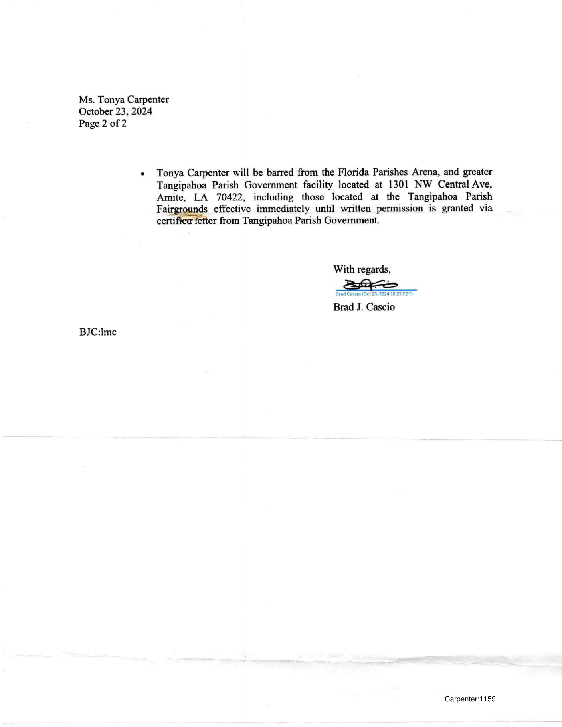
October 23, 2024 – The Banned Letter
Bars Tanya Carpenter / High Road Productions from Florida Parishes Arena and greater Tangipahoa Parish facilities
Effective immediately following the 11/25/2024 show
Includes all of 2025 and continues until written permission is granted by certified letter

Slide 15
Key Takeaways from the Letter
“Tanya Carpenter/High Road Productions, or any subsidiary production company or event, will be barred from service at the Florida Parishes Arena, and greater Tangipahoa Parish Government facility … including … the Tangipahoa Parish Fairgrounds”
“…barred from the Florida Parishes Areana, and greater Tangipahoa Parish Government facility at 1301 NW Central Ave., effective immediately until written permission is granted via certified letter
Same Law Firm That Sent Letter Now Representing Defendants

Slide 16
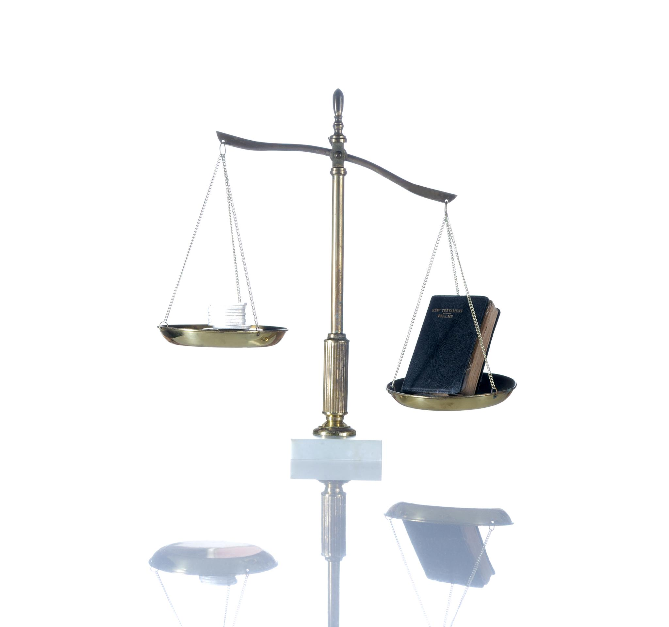
What Plaintiffs Will Now Prove
Plaintiff engaged In protective speech
Plaintiffs suffered retaliation rather than provided solutions
Plaintiffs barred from public property with no prior notice or right to appeal.
Plaintiffs were damaged by Defendants’ actions and their 1st and 14th Amendment Rights violated

