Slide 1

Stages of Belief
Loving without blame

Slide 2

Stages of Belief
This Photo by Unknown Author is licensed under CC BY-ND

Slide 3
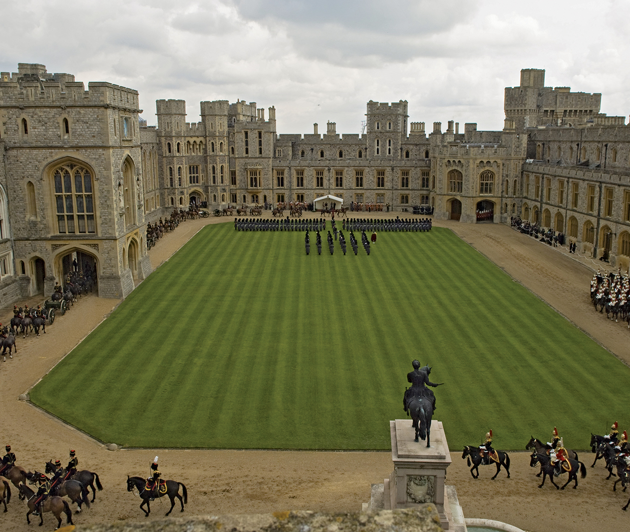
Simplicity
Inside the Fortress
Dualistic Thinking (Us or not-us)
  Little knowledge or concern about them
Black and white (Good/Bad)
Simple, uncluttered faith

Slide 4
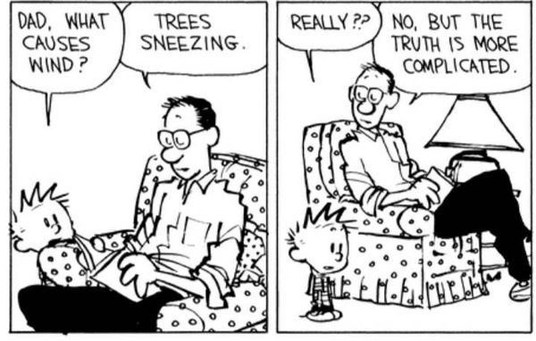
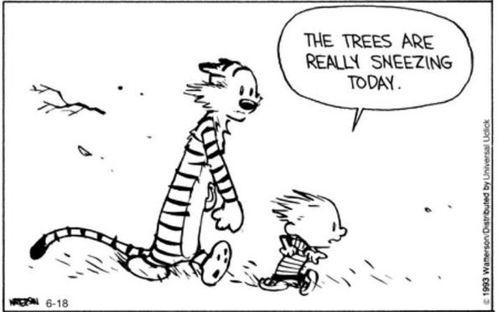

Slide 5
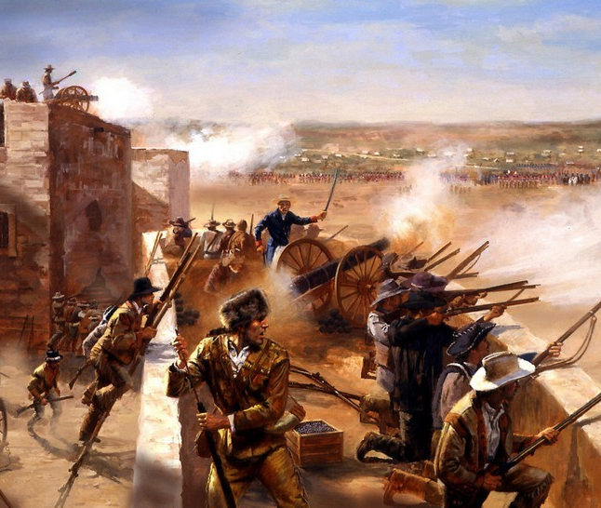
Complexity
Protect the Fortress
Zeal- attack the falsehoods
Engage with “them”
Capture and Convert

Slide 6
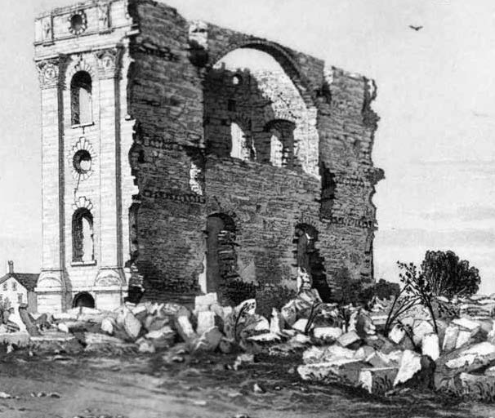
Perplexity
Fortress Collapse
Confusion and Pain
Loss and Betrayel
Dissonance
Question Everything

Slide 7

Harmony
Reconstruction
Relationships built on love and respect
Agree to disagree
Desire to learn from others

Slide 8
Others
Simplicity
What Stage do you see you in?
Simplicity
Complexity
Complexity
How you will respond to others depends on where you are….
Perplexity
Perplexity
Harmony
Harmony

Slide 9
Others
Simplicity
Simplicity
Complexity
Complexity
Perplexity
Perplexity
If you are in Simplicity:
Difficult to understand them
May be quick to assign a reason: sin, pride, learned
Tend to withdraw and avoid
Harmony
Harmony

Slide 10
Simplicity
Others
Simplicity
Complexity
Complexity
Perplexity
Perplexity
If You Are In Complexity:
Quick to Defend
Send Articles and Talks
Argue and Get Angry
Harmony
Harmony

Slide 11
Simplicity
Others
If You Are In Your Own Perplexity:
May Stir up your own doubts and confusion
Some retreat back to simplicity
May withdraw
Simplicity
Complexity
Complexity
Perplexity
Perplexity
Harmony
Harmony

Slide 12
Simplicity
Others
If You Are In Harmony:
Listen and Love
Sympathize with their pain
Note: Its not required for you to read all they are reading or leave the church in order to love and support them.
Simplicity
Complexity
Complexity
Perplexity
Perplexity
Harmony
Harmony

Slide 13
Myths
Many members struggle through a perplexity compounded by myths.
Such as:
The Nature of God (A loving God should/shouldn’t…)
Expectations of Prophets
The Ongoing Restoration
Cultural Myths taught as doctrine
Non-Doctrinal Teachings about the Eternities

Slide 14

Again
The goal is to love someone as they work their way through perplexity.
They expect to be judged and are often overly sensitive to anything that looks like it.

Slide 15

Question
What do I do with a family member who has left the church, who is overly angry, critical or sarcastic to family members who still believe?
This Photo by Unknown Author is licensed under CC BY-NC-ND

Slide 16

Essential
As Eric Huntsman frequently says: The answer is always “Jesus!” The essence of Jesus’ teachings is:
Be Kind to our neighbor
Be Loving
Serve one another
Be Non-judgemental
Forgive quickly and easily
Any relationship, regardless of belief, must have these elements to survive.

