Slide 1
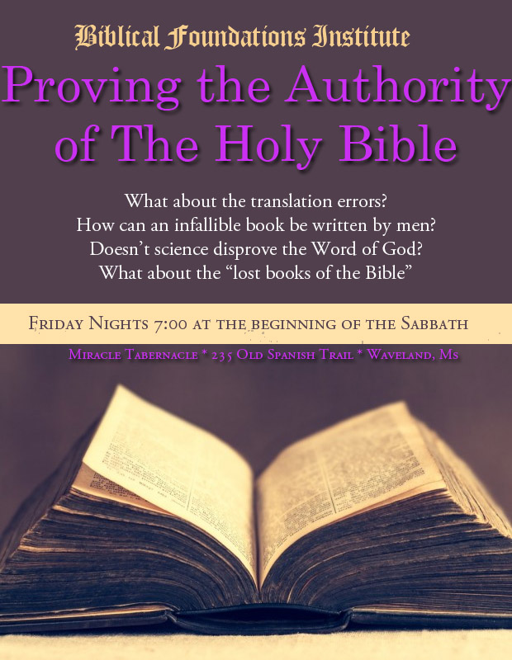

Slide 2
PROVING The Word of God
I Thessalonians 5:21
We are commanded to PROVE Gods Word
Why is the worlds bestseller completely misunderstood? II Tim 3:16-17 Hebrews 4:12

Slide 3
The Purpose of the Scriptures
II Tim 4:3-4
When men do not understand the purpose of scripture then all kinds of misinterpretations come.
Because Men do NOT like correction we use the scriptures to justify sin rather than condemn sin? Isaiah 30:10

Slide 4
Scriptural Authority
Who has blinded the whole world from understanding and why? Rev 12:9
Satan has no problem with you “enjoying the good book” as long as you don’t accept it as THE FINAL AUTHORITY.
Satan has no problem with the Bible – he quotes it from cover to cover. Matt 4:6 & II Cor 2:17

Slide 5
What the Bible IS NOT
A History Book – although it deals with history
A Science Book – although it deals with science
A Medical Book – although it deals with medicine
A Legal Book – although it deals with legal matters
A Geology Book – although it deals with geology
IT IS A SPIRITUAL BOOK Everything else is a Backdrop

Slide 6
SIN is the theme of the Bible
The Origins
The Results
The Cure
How to Ovecome
The Final Disposition

Slide 7
Don’t get bogged down
Moses painted the first eleven chapters in broad strokes covering a thousand years in these few chapters….. His goal was the beginning of Sin and the redemption from sin… and the whole story begins in Chapter 11
Israel is the whole POINT of the scriptures – it begins with Abraham- Adam and Eve were just a necessary part of the story

Slide 8
The Holy Spirit wrote the Bible and only the Holy Spirit can understand His writings
Isa 28:9-13
Mans greatest criticism against the Bible is the greatest proof OF the Bible- written by men
40 authors from 3 continents over two thousand years apart – 3 different languages – there is a perfect consistency of message
This defies explanation – it never contradicts it’s theme

Slide 9
Three Great Proofs of The Bible
History
Science
Prophecy

Slide 10
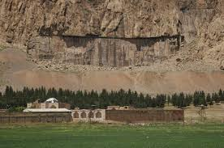
The Behistun Inscription

Slide 11
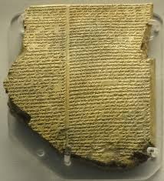
Tablets at the Ruins of Ninevah

Slide 12
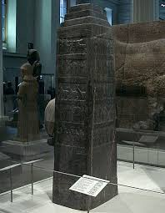
Shalmanesers Black Obelisk

Slide 13
Shalmanesers Black Obelisk

Slide 14
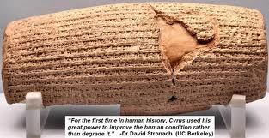
Drius Prism

Slide 15
More Historical Accuracy
The Hittites
The Captivity of Judah
The Writing of Moses
The Pool of Siloam
Joseph shaving
Kings of the Bible

Slide 16
The Proof of Science
Shape of the earth – Isa 40:22
The expanse of earth – Job 26:7
Stars of the Heavens – Jer 33:22; Heb 11:12
Ocean Currents – Job 38:16; Gen 8:2; Ps 8:8; Isa 43:16
The life of flesh – Lev 17:11,14
Circumcision – Gen 17:12; Acts 7:8; Luke 1:59
Eating Fat – Lev 3:17

Slide 17
Prophecy – the greatest proof
Isa 46:9-10; 45:21-23 – Here God mocks mortal men who think they have intelligence.
If the Bible has been accurate in its predictions, we must know and be willing to accept above all human pride that there is something greater than human behind those words—an almighty and powerful Being with the ability to predictand MAKE IT HAPPEN!

Slide 18
Prophecy – Tyre & Sidon
Eze 26:1:3-6
This great city was 1500 years old – nothing was more beautiful than Tyre
This prophecy came to pass just as God said it would! You can prove that.
But, the skeptic may say, how do you know the prophecy wasn’t written AFTER all this occurred? That is a valid question. But remember, the prophecy was not only concerning the specific destruction of Tyre, but also that Tyre was never to be rebuilt again! (v. 14)!

Slide 19
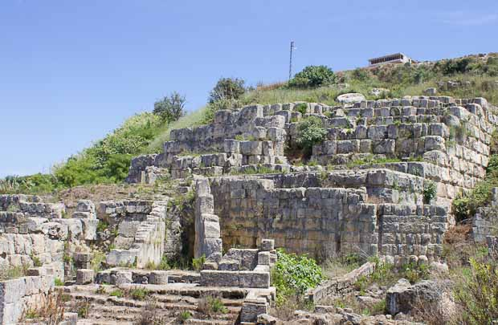
Tyre today – just as God said

Slide 20
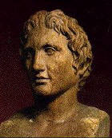
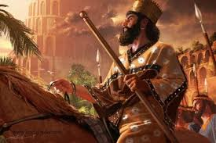
Alexander the Great The most amazing Bible Prophecy
250 years before Alexander The Great Daniel foretold his coming
Daniel 8:1-8 * Daniel 11:2-4
Daniel 8:15-22
KING CYRUS Isa 44:28
Prophesied by name a
century before his birth~~!!!

Slide 21
What about the translations?
No English translation is 100% accurate – only the original manuscripts are inspired
KJV of 1611 is the closest at about 96%
Translators were men with their own theological bent…. The proof is in Acts 12:4
The Old Testament is Hebrew & Aramic
The New Testament is Greek

Slide 22
Who preserved the Word for us?
Romans 3:2 – every jot and tittle was protected by blood!!!
66 books of the bible equal 12 – Gods Governmental Stamp
The written New Testament was Peters idea II Peter 1:12-15; II Peter 3:1-2; I Peter 3:5-16

Slide 23
Examples of Contradictions
Chapters and verse are the biggest hurdles in Bible Study – Eisogesis vs. Exogesis
All Men have not faith – II Thess 3:2, Rom 12:3, I Cor 12:9, Gal 5:22
Mt of Transfiguration – Matt 16:28, Mark 9:1, Luke 9:27 – Matt 17:9

