Slide 2
Christ the King & The Day of the Lord
There are six (6) days allotted to fleshly rule (Satan & Men) and there is one (1) day allotted to Christ the King.
Hebrews 3 & 4 tells us about a coming rest for the whole world
Anytime you see “Day of the Lord” it is the ONE DAY allotted to Christ during the period of TIME
Christ was born to be King over the whole earth not just the church
According to Paul who is still King of this earth? I Cor 4:4
Daniel knew that this coming day would be a LITERAL worldwide ruling government – more on this later
Millennial means 1,000
II Peter 3:8 – Matthew 12:8

Slide 3
Daniels Vision is about earthly governments
Daniel 2:28-44 – this entire vision is about governments upon the earth
In the days of the revived roman empire shall the Lord God set up HIS government – In our time!!!
Why is all these things being revealed to us now? It was prophesied to be revealed in OUR TIME – Daniel 12:4

Slide 4
Daniels Vision is about earthly governments
Daniel 7:13-22
Revelation 11:15
Preparation for this is WHY we’re called out of the world unto conversion…. We are preparing to SERVE WITH CHRIST in authority over the Nations
Matt 25:23
Luke 19: 11
Matt 5:19

Slide 5
The Two Coming of Christ
Both have a different purpose – the first coming was to QUALIFY for the Throne – the next coming is to OCCUPY the throne
John 18:36-37
Luke 1:31-33
Christ is awaiting THE TIME for His triumphant return – the time of Vengeance
Acts 3:19-21 (when all things will be restored to their original glory)

Slide 6
World conditions just before the Day of the Lord
Matt 24:22 & Rev 11:15-18; Rev 17:14
Devastation of Nuclear War will usher in the Millennium Reign of King Yeshua (Jesus)
He will return to RULE – Luke 17:24, Rev 19:14-15; (Matt 25:31)
Rev12:5
Zech 14:1-4
The Rod of Iron will be nothing nice –
Zech 14:12

Slide 7
He’s Descending & We’re Rising
Acts 1:9-11; Matt 24:30 ; I Thess 4:14-17
Luke 13:28 – with the OT prophets we will all be made immortal and receive eternal life
We will then descend with Christ out of the clouds to stand on the Mt with Him
The Judgment will take place where positions of authority will be granted in tis new ONE WORLD GOVERNMENT
We will then rule the nations with Christ

Slide 8
The Coronation & The Overthrow
This is when Christ receives His kingdom and Satan is dethroned by Christ & His Bride Church – Rom 16:20; Isa 14:16; Rev 20:1-3
No more Deception – but because of rebellious nature still existing UTOPIA will not come Immediately! But have no fear… GODS TEACHERS… will begin re-educating the masses
Obadiah 1:21& Isa 30:19-21

Slide 9
Prince of Peace
Isa 2:2-4; Micah 4:1-3; Zech 14:8
Prince of Peace and yet there’s never been peace – this is why we pray for the Peace of Jerusalem because we are in essence praying for His return!
Something must BRING THIS PEACE – What will it be? The LAW OF GOD which shall go out from Headquarters
Isa 11:6-9

Slide 10
Imagine the New World
No Illiteracy
No Poverty
No Famine and Starvation
No Crime
People will learn honesty and chastity and holiness unto the Lord
All will walk in the 10 Commandments
The Holy Spirit will be poured out on all flesh – Satan will be bound from our minds

Slide 11
Problem #1 – Population Explosion
Around the world the population is stripping our resources to sustain ourselves
The problem is this – only 10% of the earth surface is tillable or arable land and in 34 more years the population will double according to the United Nations
Yeshua (Jesus) Will solve this problem after He ends the war with His enemies

Slide 12
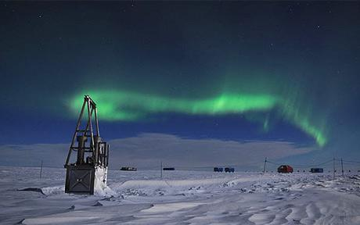
Population Problem Solved
He will simply make most of the earth tillable for food to come forth
Reduce the mountain ranges and raise up the valleys; change the weather patterns; make all the deserts green and fertile

Slide 13
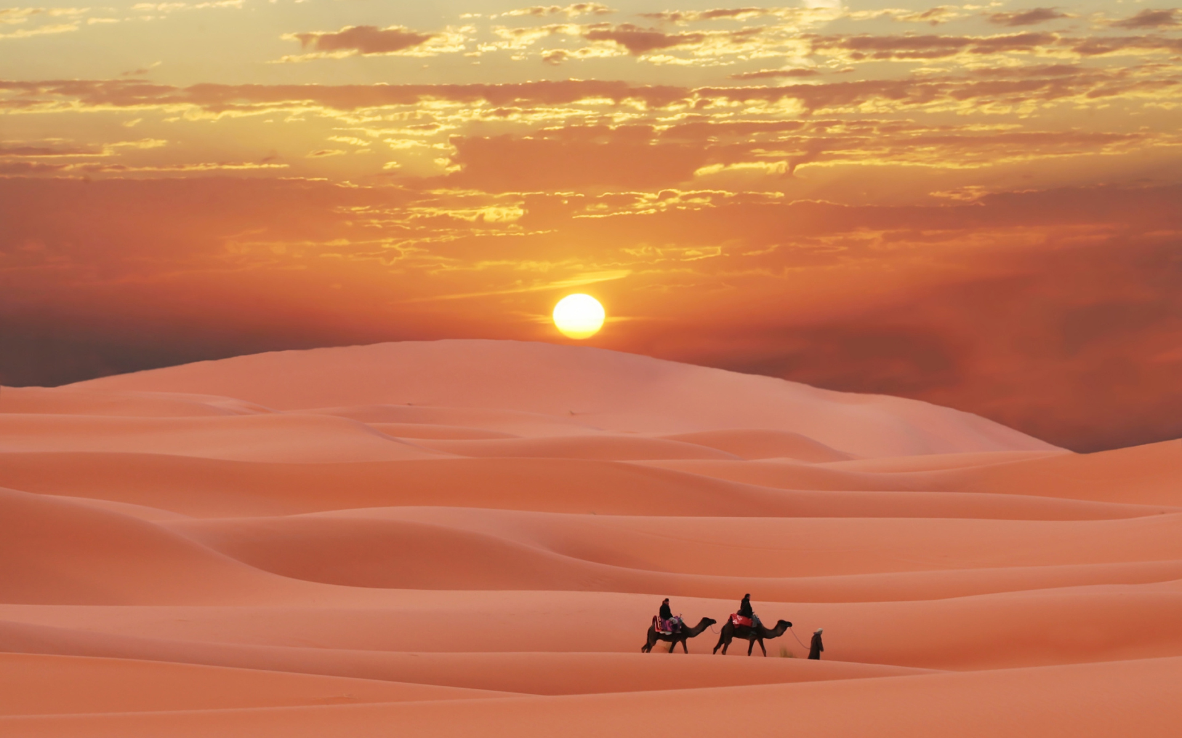

Slide 14
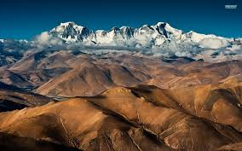
Isaiah 41:14-20
Isaiah 35:1-7

Slide 15
Pure Water lies beneath the earth
Story of California Earthquake that brought forth pure water
Does it sound incredible that God can do this? The mountains were “FORMED” and they can be “Re-formed” Amos 4:13; Psalms 90:2
Nahum 1:15
Rev 16:18; Zech 14:4

Slide 16
Wealth & Health & Prosperity
The earths greatest wealth lies beneath the seas and man cannot gather it; Oil, Gold & Silver – God has a plan to reduce the oceans – Isa 11:15; Isai 33:21-24
Perfect Health laws in The Day of the Lord – Isa 35:3-6 – Isa 58:8 (for those who obey the Commandments)
Jer 30:17; Jer 31:12-14 – Dancing in the Day of the Lord – Duet 28:1-5 – our OBEDIENCE will bring these blessings

Slide 17
One World Wide Language
Zeph 3:9
Isa 60:5 – Money for Gods people; wealth to finance the Kingdom
The Wealth of the world will be centered in Jerusalem – NEW MONEY
Hag 2:6-8 – Christ will dwell in the Temple with His bride
Gods great wealth will be on display in Jerusalem and around the world… beauty.. All things will be beautifully golden

Slide 18
Everyone will be a tither
Modern governments need 40% to 90% of your income – Christ government will operate on 10% - the FAIR TAX
There will be no democracy in tomorrows government – it will be a theocracy – No election campaigns.. Every governor and King will be INSTALLED by Christ after a lifetime of faithful service Matt 25:21- Isa 11:2-5

Slide 19
The Stages of Renewal
All Crime and Rebellion will be put down by force of this government of saints
Christ will re-educate and convert the whole world
Gods Law and Customs will be re-instated Zech 14:16 – 19
Matt 8:11 – Luke 13:29

