Slide 1
“Restoring Original Christianity”

Slide 2
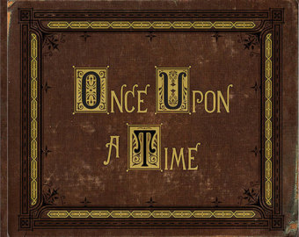
The Story that you were never supposed to know
“When the moon was stolen”

Slide 3
This story begins with . . .
The Sun, the Moon & The Stars
Gen 1:14
The most prophetic verse in the Bible – all end time prophecies refer to this one verse
The word “Seasons” is a gross mistranslation
It does NOT mean “seasons” but rather the word is “Moed” or “Moedim” in Hebrew; it means A DIVINE APPOINTMENT – a fixed meeting place

Slide 4
Why the change?
Did the translators purposely intend to deceive us? Hardly! However, because, like us, they were clueless as to the Hebrew roots of their faith – they had no idea what this Hebrew word meant.
They had no idea that this was referring to the appointed days, the feast day and the Sabbaths of Yahweh.

Slide 5
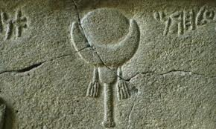
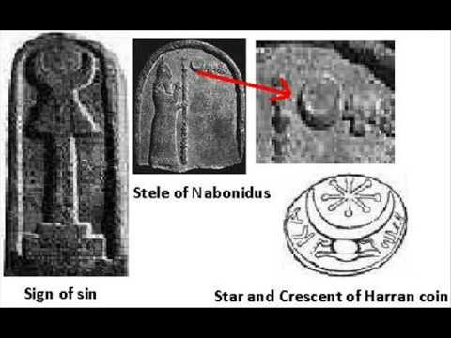
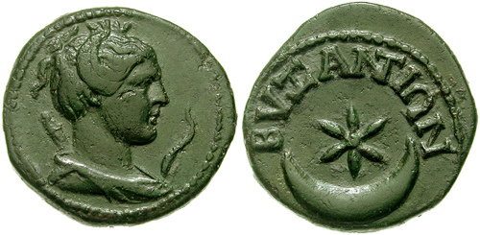
Why is this significant?
As you go through the annals of history you are going to discover Ha Shatan’s (Hebrew for Satan) cunning thievery.

Slide 6
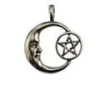
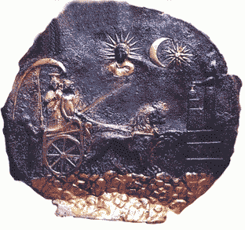
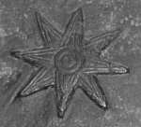
Why is this significant?
The entire army of Ha Shatan is built around PERVERTING the original! All of his workers are under these symbols! Wiccans, Pagans, Satanist,
Ancient Sumerian Star of Goddess Ishtar

Slide 7
What is the purpose?
Why would Lucifer care about the moon? Why would he hijack time?
The crescent moon is the sign that Yahweh chose for a new month . . it was placed there as a marker for His appointments with His people Guess who wants to stop these appointments?
Ancient Sumerian Star of Goddess Ishtar

Slide 8
Hijacking the Heavens
If he can remove the markers then we miss the appointments. Just like appointment cards for the doctor. If you lose that card you will probably miss that appointment. For the last 2,000 years we have been missing our appointments.
This image is 4,000 years old
Lucifer has created an anti-thesis or ANTI SYSTEM

Slide 9
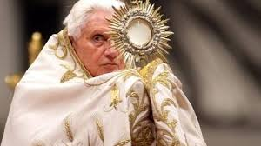
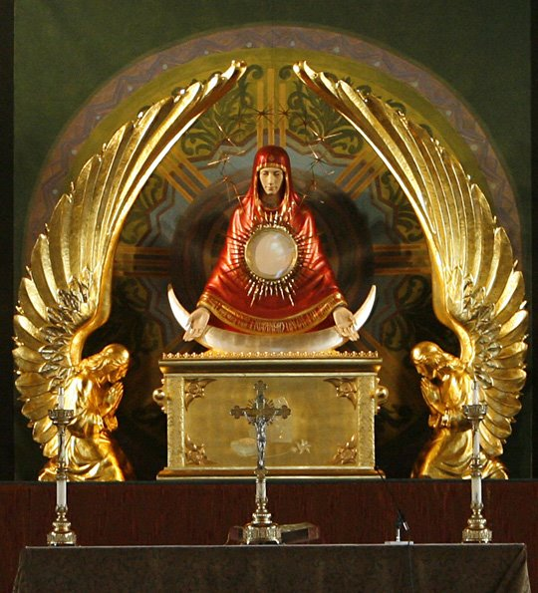
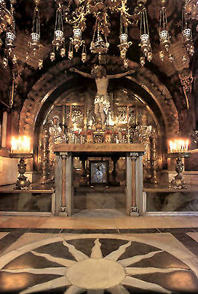
The Anti-System
COME OUT OF HER “My people”.. Anything she created, RUN FROM IT.. It is ANTI WORD
Exact same symbols of
Ancient Babylon
Worshippers of the SUN

Slide 10
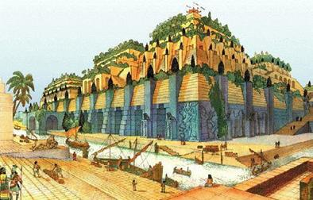
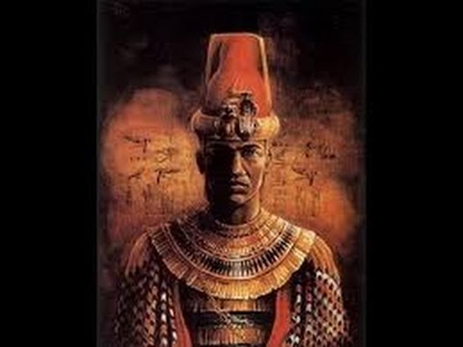
It all started with. . .
NIMROD, the grandson of Noah
He was king of the then known world… the most popular man on the planet… a mighty man – a god . He built the city of Babel & Ninevah. Where we find the 1st religions systems of the world

Slide 11
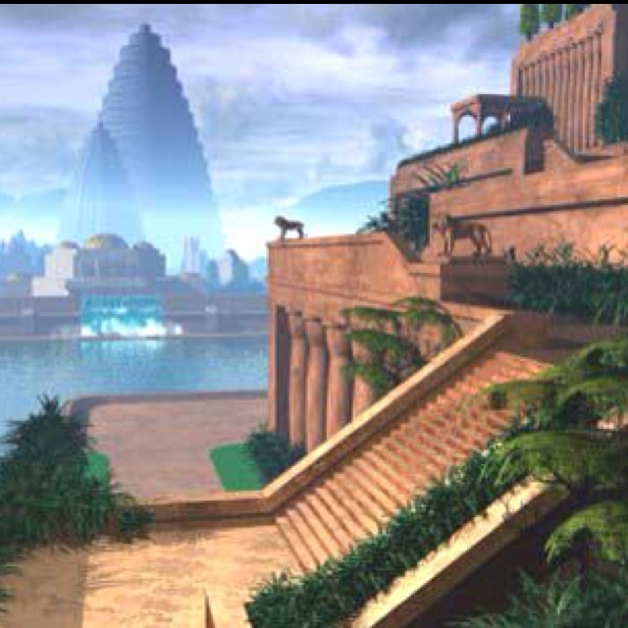
The Father of Babel
He created great armies, temples, towers….. He ruled right after the great flood of Noah.
His traits were rebellious towards Yahweh

Slide 12
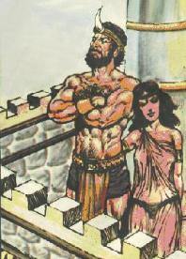
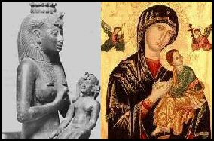
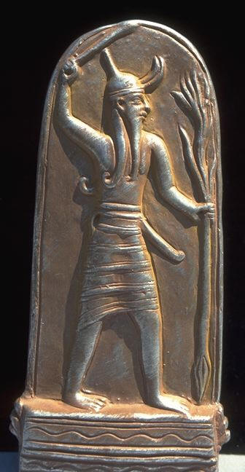
Nimrod married a woman
Her name was Semiramis – the King and Queen of the world!
Baal now ruled the Universe through the Sun
Eventually, as all men do, Nimrod died and the people deified him as a god – the SUN GOD or BAAL.
Anytime, you see Baal in the scriptures, he can always be traced back to Nimrod and when you see the ladies name ASHOROTH in the Bible, she can always be traced backwards to Semiramis and forward to Ishtar…. The names change in cultures but the PERSONS NEVER DO

Slide 13
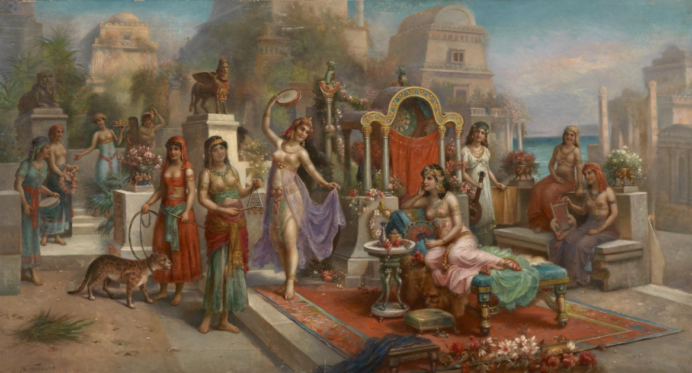
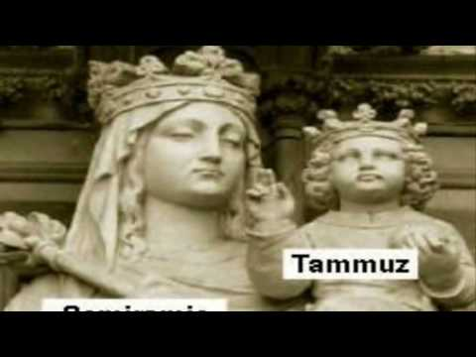
Semiramis – the whore of Babel
She became impregnated by the Sun’s rays. However, Yahweh knew the truth.. He knew she was a whore!
The name of her son from THE SUN was Tammuz
From Wikipedia - Hislop talked about legends of Semiramis being raised by doves. He referred to the writings by the church's Ante-Nicene Fathers to suggest that these stories began as propaganda invented and circulated by Semiramis herself, so her subjects would ascribe to her the status of Queen of Heaven and view her child as divine. Semiramis' child Tammuz, a god of vegetation as well as a life-death-rebirth deity.
He maintained that all divine pairings in religions e.g. Isis/Osiris, Aphrodite/Cupid, and others, are retellings of the tale of Semiramis and Tammuz, and that this was then applied to Mary/Jesus in Catholicism.

Slide 14
Tammuz – the Son of god
When he became a man – he began a sexual union with his mother Semiramis. He took his fathers place and ruled the world.
In his 40th year he was killed by a wild boar as he was hunting. Shortly afterwards Semiramis died also and her husband Baal rejected her and sent her back to earth in a giant egg. When she came out, the first thing she did was turn a bird into an egg laying rabbit.

Slide 15
Sounds like a fairy tale?
That’s exactly what it is – rather – a Babylonian legend, a fancy word for a lie of Babylon! Yet our churches preach this legend and practice it every year.
Eggs are the symbol of fertility among all pagan religions. A woman’s egg gives life.
Does the people of Yahweh, a separated people having any biblical authority to participate in such lies and paganism?

Slide 18
What about Easter Sunday?
In the practice of Ishtar's religion – this is the new name for Semiramis – she was honored on a very special SUN DAY, known as Ishtar’s Sunday.
This Sunday was always THE FIRST SUNDAY after the Spring Equinox. This is why even though the Passover is still one month away – EASTER must happen THIS SUNDAY – a month before He is even crucified!!!!
The March equinox marks the moment the Sun crosses the celestial equator – the imaginary line in the sky above the Earth’s equator – from south to north and vice versa in September.

Slide 19
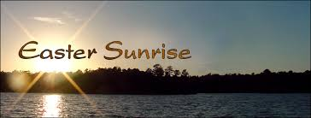
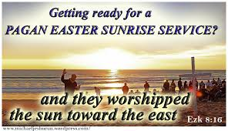
What happened on Ishtar’s Sunday?
It began in honor of her husband – Baal – the Sun God; so very fitting – a sunrise service
What happened at these Ishtar sunrise services?
Eggs were dyed RED… even this year at the white house – the official color of the Easter egg was RUBY RED… around the world, that is the official Easter Egg color . . .WHY?

Slide 20
It’s just an egg I Sam 7:3-4
At the sunrise service, the priest of Ishtar would impregnate virgins upon the altar of the Sun, to Baal. Then they would take the children born from the previous impregnation and sacrifice them to Baal and dye the eggs with their blood and thus the reason that there were red eggs….. Historical Facts!
Duet 12:1-4
Duet 12:31,32
40 Days Prior to Easter – they would set aside 40 days to WEEP for TAMMUZ, the Son of god. Then they would have a giant feast on ISHTAR Sunday where they would celebrate the death and resurrection of Tammuz. They would kill a boar and have Easter Ham. The Anti – Church system still keeps this today, they call it Lent

Slide 21
Lucifer has created a fraud
We have been deceived into his lullaby’s and we’ve trained our children in his lies. The entire time, mocking, rejecting and ridiculing the true celebrations of Yahweh for His holy people.
He has replaced the entire plan, the entire story with his own story; his own celebrations.
Need Proof? Let’s search the annals of History
Either we are Apostolic or not! We are not Messianic Jews, we are not into Judaism but rather we are APOSTOLIC

Slide 24
Roots – does roots matter?
The entire fruit of a tree are the results of what’s in the roots. You cannot change a tree just because you change it’s branches.
The customs of paganism always show up no matter what you re-name the holiday
THE HOLY DAYS HAVE HOLY ROOTS
Only Menorahs & Shofars and Biblical symbols show up

Slide 25
Let’s search our Apostolic roots
Can we find Easter, anywhere? Acts 12:4
Why does it Matter? Eph 5:27; Heb 5:12-14; Eph 4:13; Rev 11:1 – We are in the Measuring time!!!!
Perfection is not an option – we must become fully measured up for Millennium government. Free from the stains that our forefathers carried

Slide 26
Who observed Easter in the Word?
Did the early church observe Easter?
Did the Apostles observe Easter?
If not then why does a church built upon the example and teaching of THE APOSTLES observe these days?
There is no observance of Easter until 20 years after the last Apostle died. Ever wonder why? Because the ANTI SYSTEM was fully in place –
I John 2:18; II Thess 2:7;

Slide 27
Can you see the deception?
The entire church system has adopted the counterfeit; they have believed the ANTI SYSTEM story… yet when we try to teach them THE TRUE FESTIVALS – we are rejected… this is why we cry out – THERE MUST BE A WITNESS OF TRUTH IN THE EARTH TODAY -- -we are called to be that Witness!

Slide 28
Will you believe the scholars?
Notice this striking statement by a scholar associated with the Pontifical Gregorian University Press in Rome
There is a wide consensus of opinion among scholars that Rome is indeed the birthplace of Easter-Sunday. Some, in fact, rightly label it as “Roman-Easter” (From Sabbath to Sunday, Bacchiocchi, p. 201)

Slide 29
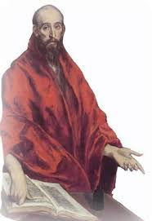
Will you believe the scholars?
https://en.wikipedia.org/wiki/Polycrates_of_Ephesus
In his Ecclesiastical History, the early Catholic historian Eusebius provides insight on the introduction of Easter. A contemporary of the Roman emperor Constantine, Eusebius described the late second-century controversy between Victor, Bishop of Rome and Polycrates, disputing over whether to celebrate Passover or Easter. Eusebius wrote

Slide 30
Will you believe the scholars?
“The Bishops, however, of Asia, persevering in observing the custom handed down to them from their fathers, were headed by Polycrates… We, said he, observe the genuine day; neither adding thereto nor taking there from For in Asia great lights have fallen asleep, which shall rise again in the day of our Lord’s appearing… Phillip, one of the twelve apostles…John, who rested upon the bosom of our Lord…Polycarp of Smyrna…

Slide 31
Tracing the roots – let’s follow them
All these observed the fourteenth day of the Passover according to the gospel, deviating in no respect, but following the rule of faith” (chapter xxiv)
Eusebis then proceeded to quote from a letter of Irenaeus, a second century bishop of Lyons, which traced the observance of Easter as a substitute for Passover back to the days of Sixtus, bishop of Rome (c. 116-126 CE)

Slide 32
Where are the Apostolic roots?
In other words, Easter Sunday was not observed by the professing Christian community until almost 20 years after the death of the Apostle John, the last surviving eyewitness to the crucifixion and the resurrected Yeshua.
If it really commemorated the events of Christ’s crucifixion and resurrection, surely it would have been observed from the beginning!

Slide 33
The lie of a Resurrection Sunday!

Slide 34
Why must there be a resurrection
So, isn’t Easter all about a resurrection – YES – but not THE resurrection!
In the Mystery cults, Tammuz/Mithras, was worshipped in spring with pagan rites. According to legend, after Tammuz was killed by a wild boar, he went into the under world.
But through the weeping of his mother (for 40 days – lent) he was resurrected. Each year a spring festival was held to dramatically represent this supposed resurrection

Slide 35
Do we not celebrate CHRIST resurrection? A million times yes
But we do it AT THE APPOINTED TIME – the feast of First fruits! When the first fruits was waved before Yahweh – there is a TIME for all things; Ecc 3:1
But – we do not just celebrate HIS RESURRECTION, we celebrate our resurrection with Him – the birth of all the FIRST FRUIT HARVEST – the church
What does Yahweh say about this ANTI-STORY? Jer 7:16-20; Jer 44:16-23; Eze 8:3-18

Slide 36
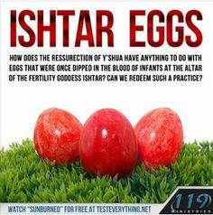

Slide 37
How did this change happen?
The church began with Hebrews; they knew the Sabbath, the Feast Days, The law of Yahweh, the Sacred name
As time passed Greek (Hellenized) thought and mythology began to be incorporated into the church beliefs.
The Bar Kochba revot in 135 CE left the Jews as enemies of Rome, and the church moved swiftly to distance itself from the Roman persecution of the Jewish remnant

Slide 38
How did this change happen?
As the church separated itself from the Hebrew root it was grafted into, pagan practices began to quickly infiltrate it
With the victory of Constantine in the early 4th century (300’s), the paganization of the church accelerated rapidly and was given the official state seal, protected and enforced by law
Overnight pagan temples became churches, and former pagan priest became “Christian” priests. Statues of Jupiter, became Peter, others represented other saints

Slide 39
How did this change happen?
The Council of Nicea and Imperial edicts sealed pagan practices, with Shabbat now being outlawed (replaced by the day to honor the sun god, called Sunday, not to honor Messiah) and the resurrection celebration (originally 3 days after Passover) moved to the pagan celebration of Easter
Constantine, in fact, was a Sun worshipper, professing Christianity for political reasons. He professed allegiance to Messiah was in reality a faith based on Mithra (Tammuz

Slide 40
His edict making Sunday the official day of worship was in honor of Deis Solis, Day of the Invincible Sunn-god, Yeshua
Deut 12:30:31
Now you know – the rest of the story! The Story that you were NEVER supposed to know. Also, you now know why the enemy MUST shut our mouths!!!!! Our influence must be destroyed

Slide 41
A flag stand in our community

