Slide 2
Once again, Paul?
Once again we are forced to re-visit the writings of the Apostle Paul
Why? Because, the modern Christian church as we know it is based upon Paul’s letters rather than the whole of the Word of Yahweh
The modern church is not founded upon the words or teachings of Christ as much as it is upon the writings of Paul
So, therefore, it is imperative that we know the meaning of his writings.

Slide 3
God always gives us test, His Bride will be a Proven Bride
In this lecture we will prove to you that there is a divine reason for these misunderstandings of Paul’s writings.
We will prove that Yahweh in His sovereign will designed to use the writings of Paul to separate the church from the Bride in these last days.
These writings are the “Stumbling blocks” placed on the journey into the kingdom of Yahweh… to test the hearts of the people!!!

Slide 4
Yahweh uses stumbling blocks
Why? Always for a purpose, the purpose of TESTING THE HEARTS OF HIS NATION
These letters of Paul have not as much to do with the letters themselves as much as they do with HOW YOU WILL INTERPRET THEM
These letters are the TEST OF YOUR HEARTS
Whether you will use them to drive you further into obedience to Yahweh or to drive you further away from obedience to His law, they are stumblingblocks

Slide 5
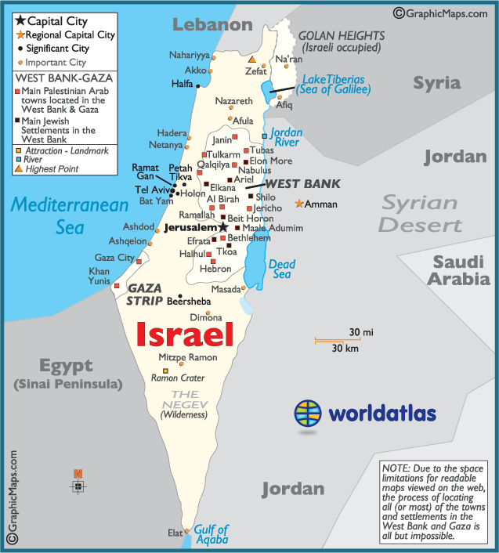
Let’s prove that Yahweh is interested in “where your heart is”
Duet 8:2
40 years, 40 is the number of test and purification. God deliberately placed them there in the wilderness to test their heart. To see if they would OBEY HIM.
They FAILED

Slide 6
They all failed the obedience test
Duet 1:34-39
600,000 souls all failed the test. They worshipped a god of their imagination, they broke the commands and they all forsook the laws of Yahweh
Except for TWO – there is always a double witness – there is always the TWO WITNESSES. Ex; Philadelphia & Smyrna
Moses failed to enter; only a new generation of obedience could enter to possess the land

Slide 7
The new generation
Who is this new breed led by? Commandment Keepers and men of faith
The old church age that disregarded law and sanctification was done away with
Yahweh will only have an obedient people who have been tested and tried and found to be “perfect before Him”
However, this new generation would also HAVE TO BE TESTED, no one is ever without a test.
Even those in the Millennium will be tested and thus why Satan will be unleashed

Slide 8
Enemies on purpose
Judges 3:1-8
Yahweh destroyed many of this new generations enemies of them by supernatural power. However, He left some ON PURPOSE why? TO PROVE THIS GENERATION
He didn’t want us MIXING with the other nations. He wanted our hearts to desire the ways, the customs and the laws of the God of Israel, not the gods of the other nations.
Just like them we give our sons and daughters to these other nations; witchcraft, rebellion, paganism, music, WE ARE IN AWE of the other nations

Slide 9
What was so appealing about the other nations?
They didn’t have our restrictive laws; they were FREE from the bondages of Yahweh’s instructions.
They were a people of grace with a god who understood their lust and their depravity and demanded nothing of them
The god of Christianity is appealing to us.. No Commandments, No Laws, No
After only 8 years… they were made slaves
A lawless life leads to a living hell

Slide 10
Slavery after Slavery
After we are set free from Egypt so many of the children of Yahweh are then placed in bondage or curses even in God’s church because of our choices to live in rebellion
How are you going to deal with the test, the circumstances when they come to you
Did Yahweh give Adam reigning authority without a commandment test? What makes you special? He didn’t have to put a tree
What are you going to do when it’s time to choose between His way or your way? Without the Holy Spirit we are doomed to fail this test

Slide 11
The Stumbling Blocks
Jer 6:19-21
Yahweh is not interested in worship YOUR WAY – He has a “Provided Way”
“I WILL LAY STUMBLING BLOCKS BEFORE THE PEOPLE” this is very key
Notice the “future tense”
A stumbling block is meant to hinder the destination. Everyone is trying to get into the kingdom of God but not everyone is qualified to get there and stumbling blocks will prove who is and who isn’t

Slide 12
Your heart will stop you, not the stumbling block
Your destination will stop at the obstacle or the stumbling block
It is meant to slow you down and test where you are in your heart
There will be many speed bumps. Your heart will determine if those bumps cause you to care for people or care only for self
Your reaction to the stumbling blocks will determine if you go forward. If you blow a tire for plowing through so be it
The intent of your heart is PROVEN at that point

Slide 13
Paul’s writings is one of the divine stumbling blocks
Ezekial 3:20 – only those who love sin will fall at God’s stumbling blocks.
Stumblingblock in Hebrew – “an object of enticement” such as an idol or a “cause to fall”
Paul’s writings are ENTICEMENTS to the carnal minded believer who coddles with sin. This is a stumblingblock to TEST YOUR HEART and to thus separate the WHEAT from the CHAFF or the BRIDE from the CHURCh
Why? To see if you would use the as your excuse to disobey the law of Yahweh

Slide 14
Peter saw the stumblingblock and warned us to not fall
I Peter 3:15
The grand Apostle saw the fall coming… He pleaded with UNLEARNED MEN to not even try to understand Paul’s letters.
He knew what they would do because of the iniquity of their hearts; they would TWIST the meaning to violate the law of Yahweh and as a result they would be destroyed
Only a few will survive Paul’s writings.
Over 2 billion read and preach from his letters without a clue as to what he’s saying

Slide 15
Notice the two trees in Paul’s Epistles
The perplexities of Paul’s writings seem to be dichotomous
However, Yahweh deliberately gives you two choices in Paul’s writings. FOR THE LAW or AGAINST THE LAW
This is your two trees !!!!
Rom 6:14 – Choice #1 Rom 6:15 – Choice #2
Now CHOOSE – reveal your heart by Paul’s writings.
You have no business quoting Paul without understanding THE SCRIPTURES

Slide 16
The misconception of grace
The age of grace did not begin in the New Testament – all through the Bible
Gal 5:17 – there is a war! There has always been a war and according to THE LAW OF SIN AND DEATH there is now way to win this war
Gal 5:18 – Those walking in obedience to Yahweh… are NOT UNDER THE LAW of sin and death --- here is where the church says AMEN
The Spirit of Christ sets you free from that law that says YOU MUST SIN
Gal 5:19 – Evidence of being led by the flesh. If any of these are in your life then you are still UNDER THE LAW.. The curse of it

Slide 17
Proof that paul believed in the law of god
Any of the things mentioned in that verse are all against THE LAW OF YAHWEH.
Gal 5:21 – those who do these things will FAIL THE TEST!!!!
Proof that you are not keeping the Commandments. What was the stumbling block? Vs 17
God says “let me see which on the people will pick” … they all choose “I’m led by the Spirit and not under the law”
How could everyone from Genesis be told to keep the commandments but then it all changes with Paul…. Another gospel?

Slide 18
A million times NO NO NO
Paul isn’t preaching a different gospel…. You are HEARING a different gospel because you have itching ears and you WANT TO HEAR a different gospel than the gospel of obedience
Don’t get TRAPPED in Gods trap for you called the PAULINE EPISTLES.. They are there to PROVE WHO YOU ARE

Slide 19
How do you avoid this trap?
You will always be safe in Pauls writings if you remember these two scriptures
I Cor 11:1, Paul follows THE MESSIAH, not a new gospel
Then find out what the Messiah said
Matt 5:17-19
Until ALL PROPHECIES are fulfilled the law will last… and they’ve not been fulfilled.. The Kingdom, the Sabbath, the Reunited Houses…
This is the goal of most Christians . . .LEAST

