Slide 1
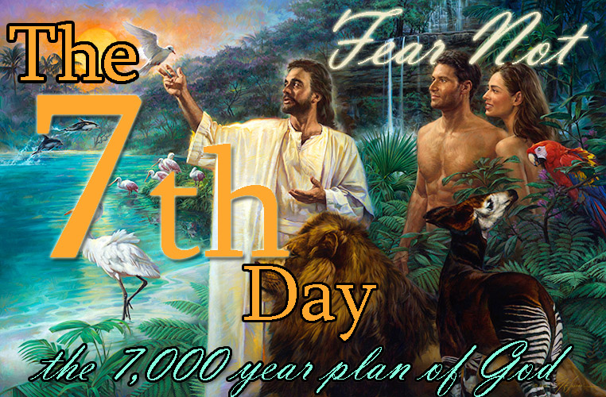
Biblical Foundations Institute
Lesson 16 Dr. J.S Vaughn

Slide 2
Something you MUST understand
Eternity has been interrupted by another one of God’s creations – TIME
God created the heavenly bodies as a galatical clock to keep up with that TIME
Gen 1:14 – the creation of TIME
Notice the two words “Seasons” & “Signs”
Hebrew for Signs – OWTH –
Signals and markers
Hebrew for Seasons – Mowed - Appointments

Slide 3
Why a Seven Day Creation?
Did God just pick a random number for creation? Couldn’t He have done it all in ONE DAY or One Second?
In this creation model is the PROTOTYPE of Gods plan for THE AGES!
These Seven Days are the blueprint for the TIME allotted to man – 7,000 years because one day with the Lord is equal to 1,000 years
Hidden in these days of creation is THEY MYSTERY OF TIME and ETERNITY

Slide 4
The Day of the Lord
To understand the DAYS of TIME you must understand what THE DAY OF THE LORD is
It is a major theme of the prophets – This day entails
The 2nd Advent
The Binding of Lucifer
The Judgment of the Nations
The Tribulation Period
The Messianic Kingdom Age
The Sabbath is always called THE DAY OF THE LORD because it is a foreshadowing of the coming KINGDOM MESSIANIC AGE

Slide 5
Scriptures that refer to this Day
Isaiah 2:12
Isaiah 13:6, 9
Ezekial 13:5
Ezekial 30:3
Joel 1:15
Joel 2:1, 11
Joel 3:14
Amos 5:18, 20
Obadiah 1:15
Zeph 1:7, 14
Zech 14:1
Malachai 4:5
I Thess 5:2
II Peter 3:10
Key Biblical Interpretation Clue
“In that Day” always refers to THE DAY OF THE LORD or the 7th Day
Also, “At that time”

Slide 6
How God (Yahweh) reckons a DAY
God created time and therefore God alone owns time and God alone correctly tells time!
His Days do not begin at midnight or at morning – they begin at SUNSET
Gen 1:1, 5, 8, 13, 19, 23, 3
Likewise THE SABBATH or THE 7th Day always begins at sunset – Each of the 7 days is a spiritual picture of 1,000 year timeframe
Psalms 90:4; II Peter 3:7-10

Slide 7
Why did God give us the Sabbath
God gave us the Sabbath to give us HOPE in hopeless world – hidden in this day is a PROPHECY for those who are watching and waiting!
This day is the FORESHADOWING of the coming DAY OF THE LORD – remember this well!!!!! Now, you will understand why Satan has so cleverly stopped the celebration of the 7th day
Please understand NOW why the DAY OF THE LORD will begin with GROSS DARKNESS – all new days begin with darkness!!!!! But there will be 993 years of LIGHT

Slide 8
How long will this Sabbath be celebrated?
Exodus 31:15-17; Isaiah 66:22-23
Let’s learn about “Eternity Past & Future” - in Hebrew
OLAM HABA
God ordained that from the creation of Adam and Eve until the end of the Messianic Age there would be 7 Days – and then ETERNITY FUTURE which will simply be a return to ETERNITY PAST – a return to the Paradise that existed before TIME WAS PLACED INTO ETENITY

Slide 9
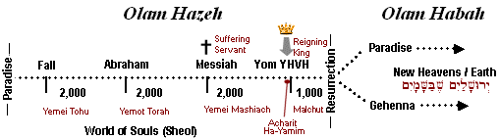
Get you days right
Matt 24:3
The
Messianic
Age
THIS PRESENT TIME
The 7 days of creation is a blueprint
For the 7,000 years of time

Slide 10
Jesus (yeshua) came on the 4th day
The timing of Christ coming was around 4,000 years after Adam…. The 4th day. Notice what was created on the 4th day – Gen 1:14 – Malachai 4:2
From Adam to Abraham – 2 days (1948 yrs)
Abraham to Egypt (290 yrs)
Wilderness to Joshuas Death (70 yrs)
The Period of the Judges (450 Yrs)
The Kings of Judah (513 yrs)
Babylonian Captivity (586 yrs) = 4,000 YRS

Slide 11
Gods Pattern is 6 and 7
Noah & the Flood – Gen 7:11-12 (600 yrs)
Moses & Mt. Sanai – Exodus 24:13-18 (6 days)
The Transfiguration – Matt 17:1-4 ( 6 days)
The Resurrection of Lazarus – John 11:1-6, 14, 39, 40-44
Notice Martha’s words – John 11:21-27
The Slaves in Egypt – Exodus 21:2
King Josiah – II Kings 11:1-4, 21
Steps of Solomon’s Throne – II Chron 9:18

Slide 12
The Marriage of Cana
John 1:19 – 2:1
This marriage happens over a 7 day period
John 1:19 – Day 1
John 1:29 – Day 2
John 1:35 – Day 3
John 1:43 – Day 4

