Slide 1
Body fluid and Circulation
Small organism like protists (i.e. amoeba, paramecium) colentrates and platyhelminthes are relatively large surface area to volume in ratio so substance are directly exchange between the organism and the surrounding medium (i.e. diffusion and cytoplasmic streaming is sufficient to circulate the materials).
In higher organism with increase complexity and wide range of activity to perform they have special circulatory system (i.e. responsible for the carrying nutrients, gases, wastes, hormones, secretion etc.).
The circulatory system must have 3 basic features:
Presence of transport or circulatory fluid like blood and lymph.
A pumping mechanism like heart.
A system of tubes (through which the circulatory fluid can move)

Slide 2
Function of the circulatory system
Transport of nutrients.
Transport of waste products.
Transport of intermediate metabolites.
Transport of hormones.
Uniform distribution of heat.
Transport of water, inorganic ions and various chemicals.
Defense against diseases.
Transport of respiratory gases.

Slide 3
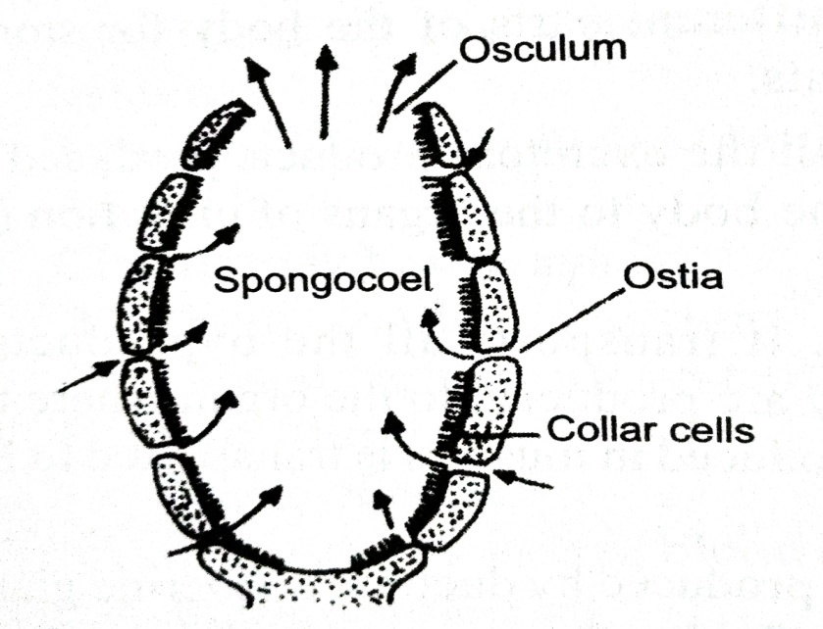
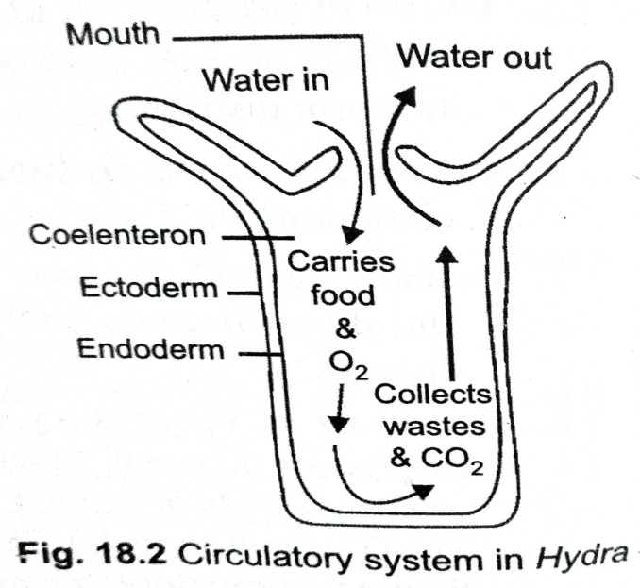
Types of circulatory system
1. Water circulatory system:
Lower animals (i.e. sponges and hydra) where water form the surrounding medium and acts as circulatory fluid.
Canal system:
It found in sponges in which water current enter through ostia (i.e. act as inhalant siphons) through which food and oxygen come in the body while water move moves through osculum (i.e. act as exhalant siphon).
Water filled cavity:
In all coelenterate posses coeleteron (i.e. single large cavity) lined by the endodermal cells that have a sigle opening through which water enter and eaves the animals.

Slide 4
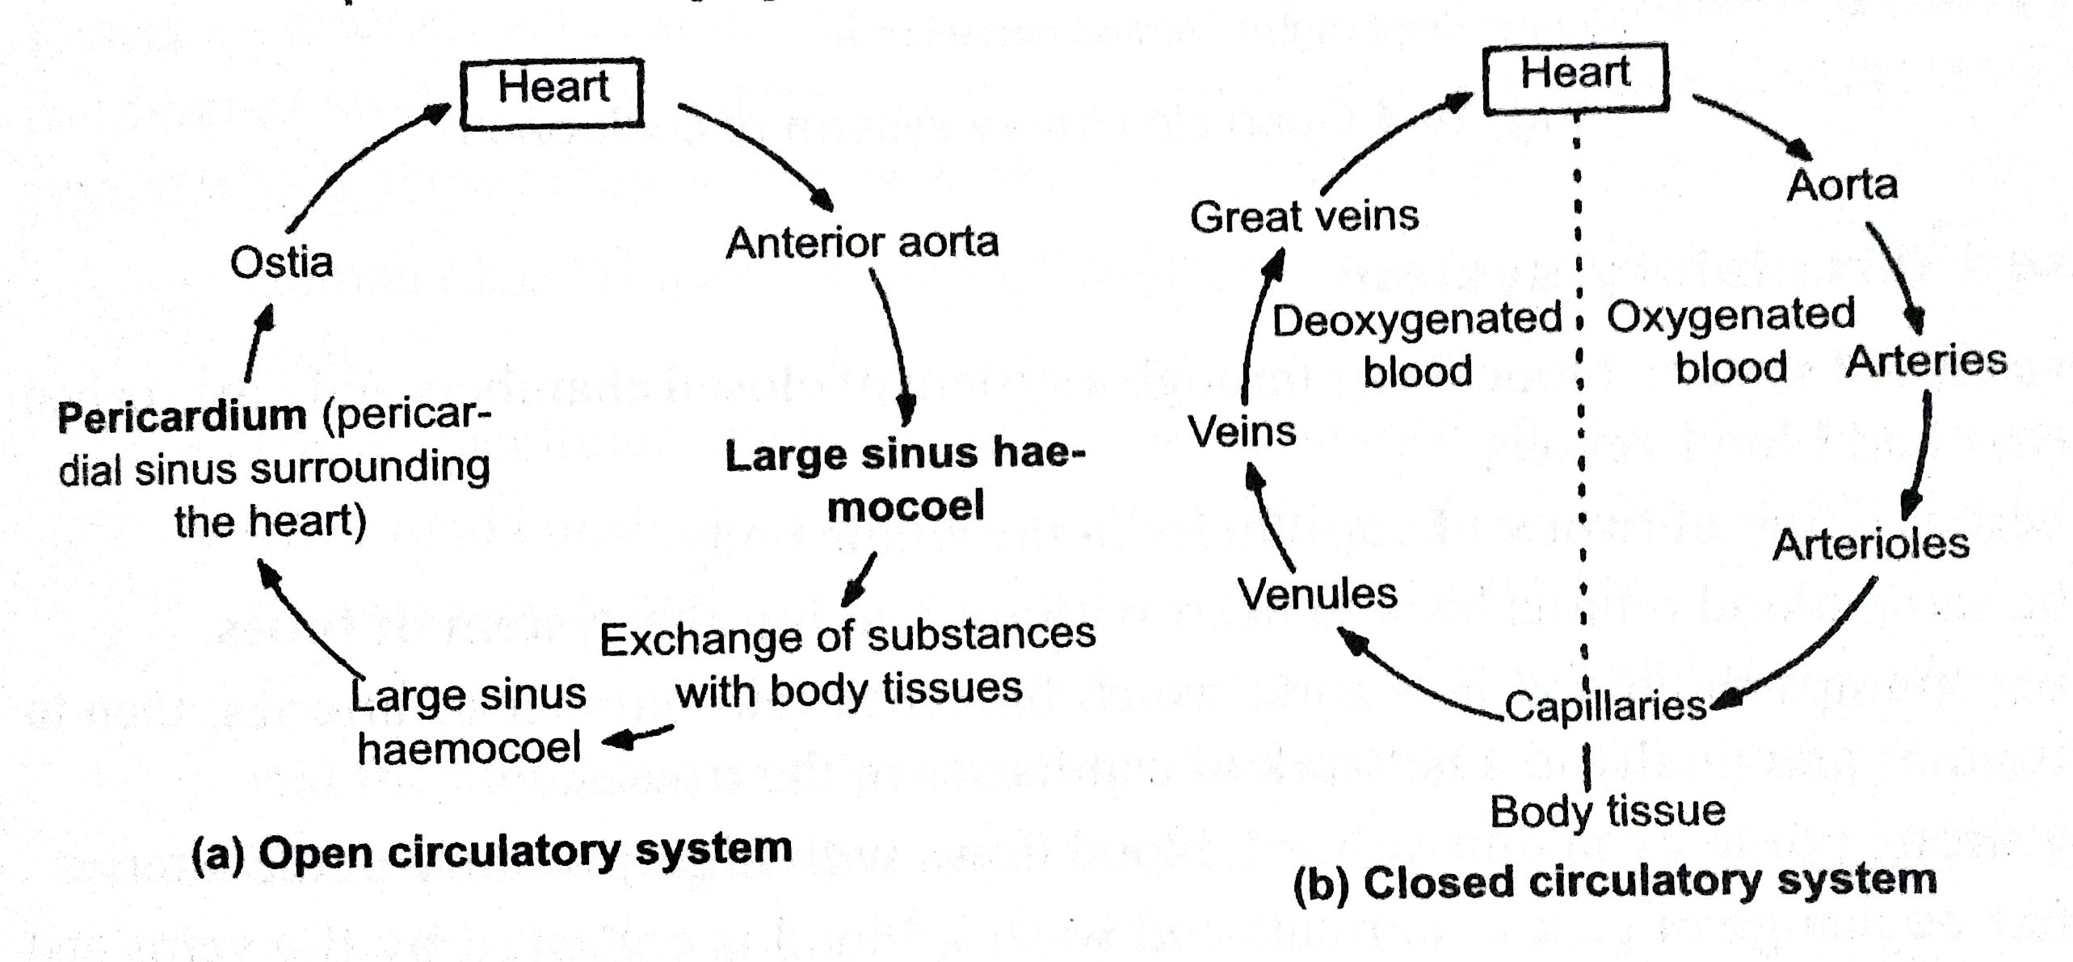
Blood vascular system:
In all higher animals where heart (i.e. pump and conducts the circulatory fluid to various tissues )and blood vessels (i.e. takes blood away from hear and veins bring back to lungs) together with circulatory fluid constitute a blood vascular system.
in higher invertebrates and vertebrates have two types of circulatory systems.
Open circulatory system
Close circulatory system

Slide 5
Open Circulatory system | Closed circulatory system
Blood are not flow through blood vessels nut also through open spaces called lacunae and sinuses. | Blood flows through a system of closed chambers and tubes called heart and blood vessels.
No capillary system, blood conveyed directly to tissues. | A fine network of capillaries
Blood flow under a low pressure | Blood flow under high pressure.
Blood seeps out of sinuses and returns to heart through open ended off veins. | Blood collected by veins and poured back into the heart through large closed veins.
Distribution of blood is poorly controlled. | Distribution of blood is well regulated.
Exchange of gases and nutrients directly between blood and tissues. | No direct exchange, here gases and nutrients pass through the capillary wall to tissue.
Blood return to heart slowly | Blood return to heart rapidly.
Found in most arthropods and some non cephalopod molluscs | Form din many invertebrates and all vertebrates.

Slide 6
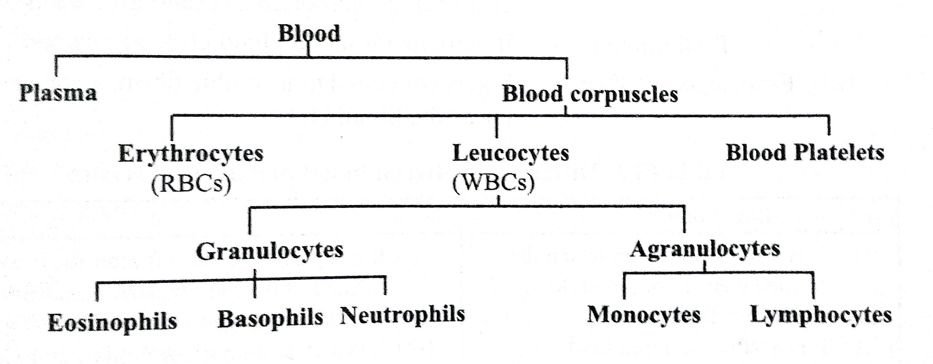
Human Blood
The blood consist of Plasma (i.e. straw colour aqueous fluid ) and blood corpuscles (formed elements of blood).
Plasma form extra cellular material of blood and constitutes 55% and the blood corpuscles form the reaming 45% of the blood.
Blood corpuscles include erythrocytes , leucocytes and blood platelets.
An adults contain about 5 liter of blood.

Slide 7
Blood plasma
It is pale yellow fluid form about 55% of blood by volume.
It is slightly alkaline and contain number of organic and inorganic substance in an aqueous solution.
Composition : water (90-92%), plasma protein (i.e. 7%; act as enzyme, antibodies and coagulating factors), inorganic compound (i.e. maintain pH of blood by buffering action).
Plasma protein contain three type of plasma protein:
Serum albumins:
It is most abundant and maintain osmotic concentration in blood
It bind with lipid, hormones and many drugs and help to retain water .
It’s fall lead oedema (i.e. large amount of water filtering out from blood into tissue that results hand and feet get swollen).
Serum globulin:
α globulin (i.e. bind with thyroxin and bilirubin),β globulin (i.e. bind with iron, vitamin A, D, and K with cholesterol), γ globulin (i.e. act as antibodies), Prothrombin (i.e. participate in blood clotting process).
3. Fibrinogen: it get converted to insoluble fibrin that forms the blood clots

Slide 8
Blood corpuscles
Erythrocytes (RBCs) | Leucocytes (WBCs) | Thrombocytes (Blood platelets)
Number varies from 4.5 to 5 million per cubic mm | Number varies from 7000 to 10000 per cubic mm³ | Number is generally around 250000 per mm³
Lack nucleus (except mammas have nucleated) | Nucleus is present | Frequently lack nucleus.
Cytoplasm has hemoglobin and hence cells appear red in colour. | Cytoplasm is colorless and devoid of hemoglobin | Cytoplasm is colourless
Transport oxygen and some carbon dioxide. | Protect against diseases or pathogen by phygocytosis | Initiate the blood clotting mechanism
Circular and biconcave in shape | Round or irregular in shape | Irregularly shaped cell fragments form from the cytoplasm of large cells.
Lack cell organelles | Produce in bone marrow and in the lymph glands
Average life span of about 120 days A after which it get destroy in spleen | Average life span is few days | Life span is 7 days

Slide 9
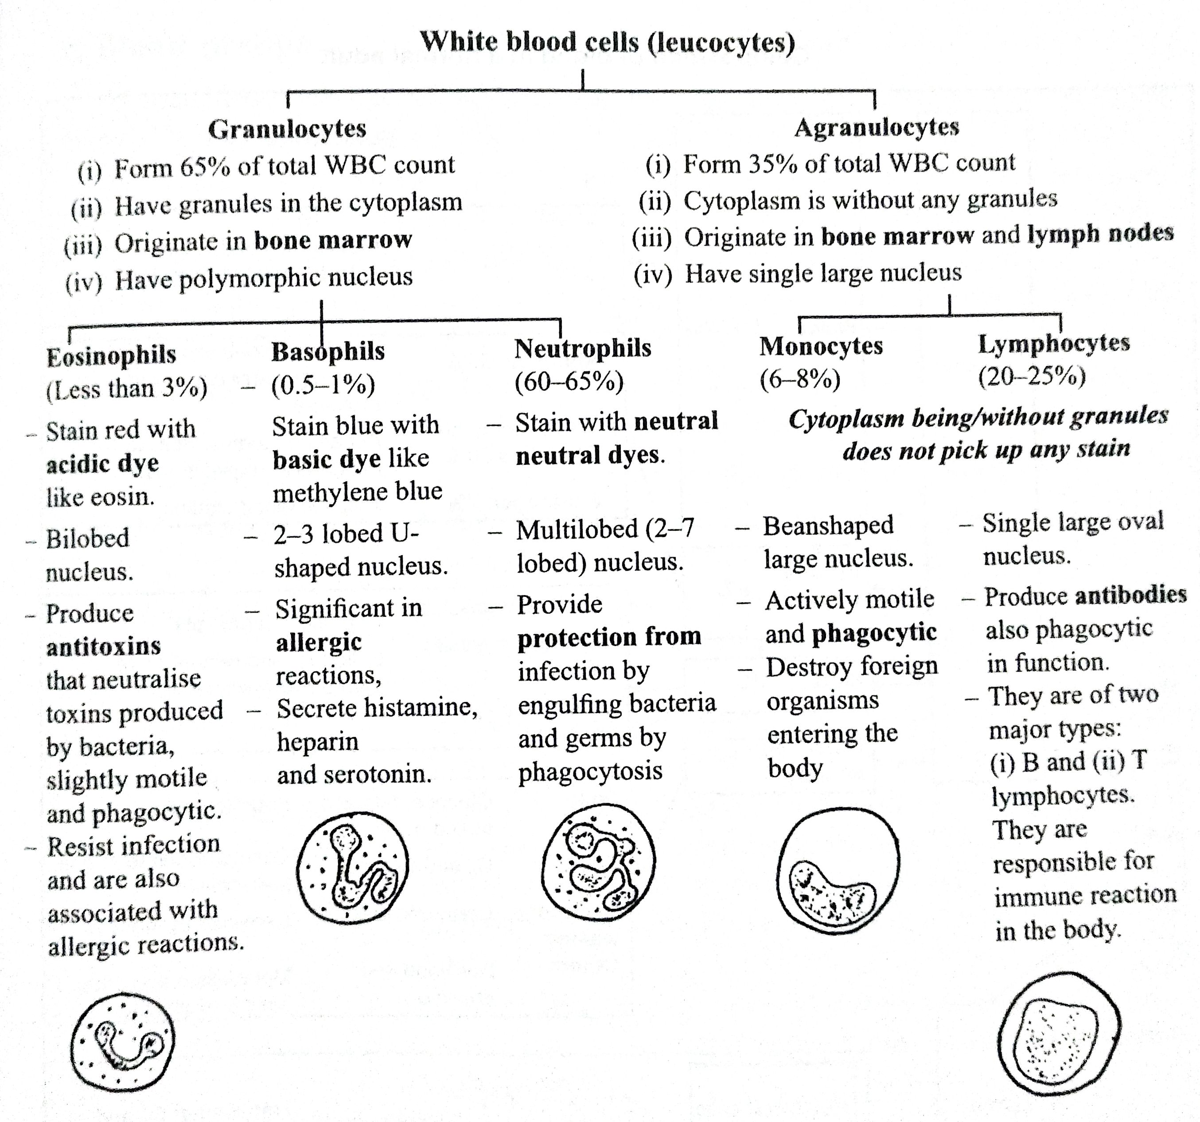

Slide 10
Blood group
There are 30 or more antigen present on surface of human blood cells that like ABO blood group and Rh blood group.
Blood group is important at the time of transfusion (i.e. needed at the time of surgery and accident when there is loss of blood).
Donor : individual that gives or donate the blood.
Recipient : individual who receives or take the blood.
Blood transfusion: transfer of blood from a healthy individual to another individual.
Antigens : specific protein that present on the red blood cells.
Antibodies : specific molecules (i.e. specific for antigen )that present in plasma.
Agglutination: clumping of cells due to antigen—antibodies reaction.

Slide 11
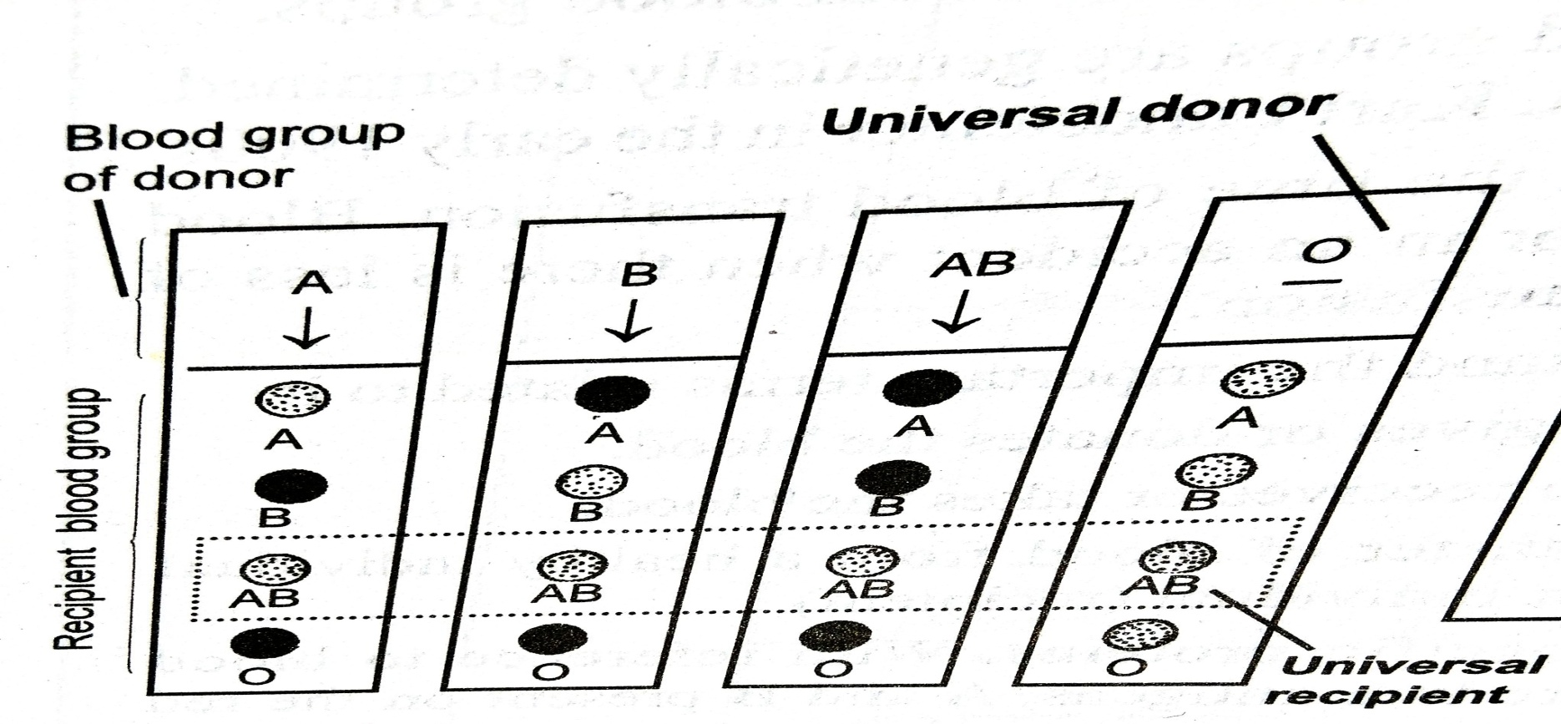
ABO blood group
Blood group | Antigen present on RBC | Antibodies present in plasma | Can donate blood to | Can receive blood from
A | A | Ab – b | A, AB | A, O
B | B | Ab- a | B, AB | B, O
AB | A and B | None | AB | A, B, AB, O
O | None | Ab – a and b | A, B, AB, O | O
Universal Donor – O, Universal Recipient - AB

Slide 12
Rh grouping or Rh Factor
1940 Landsteiner and Weiner discovered the presence of protein on the surface of red blood cells (RBC) and it was first discovered in the blood of Rhesus monkey.
Depending upon thee presence of this particular antigen on the red blood cells , blood groups are two type Rh ⁺and Rh ⁻ .
Generally 85-95% of people have Rh ⁺ factor while in India 90% of people have Rh positive.
Rh factor have importance in two conditions:
During the blood transfusion
During pregnancy because Rh ⁻ blood respond against Rh⁺ blood by producing antibodies against RH factors.
Rh⁺ blood transfuse in Rh ⁻ but Rh⁺ can not transfuse in Rh ⁻because Rh ⁻resond by producing the Rh antibodies that results clumping.

Slide 13
Erythroblastosis foetalis
OR
Haemolytic diseases of the newborn
During pregnancy if mother is Rh negative and child is Rh positive so if some of Rh⁺ RBCs of foetus may leak across the placenta to mother blood then Rh⁻ mother blood respond by producing Rh antibodies.
During the second pregnancy if the child is again Rh ⁺ then Rh antibodies of mother blood diffuse into the foetal blood and attack and destroy the foetal RBCs.
This lead massive destruction of RBCs and erythroblast (i.e. immature nucleated RBCs) get circulated and cause erythroblastosis foetalis or haemolytic disease of the newborn (HDN).
HDN lead to the birth of a premature results of destruction of RBCs which results jaundice due to excess of bilirubin (i.e. lead to brain damage also).
The blood of such child is completely replaced by transfusion of healthy blood at the time of birth.

Slide 14
Coagulation of blood
It is very complex process which involve less than 12 different factors.
Release of thromboplastin :
When blood flow out through wound then the blood platelets become expose to air and damage cells and ruptured platelets liberate thromboplastin.
2. Formation of thrombin:
Thromboplastin together with clotting factor and calcium ions acts on the prothrombin (i.e. plasma protein) and convert it into an active enzyme thrombin.
3. Formation of fibrin:
Thrombin act on fibrinogen (i.e. plasma protein) and change into insoluble fibrin.
4. Formation of blood clot:
Insoluble fibrin form a network in whicch RBCs , WBCs get trapped form blood clot.

Slide 15
Lymph and Tissue Fluid
Lymph flows through the lymphatic system (i.e. consist of a network of vessels, lymph organs like – lymph node, bone marrow, spleen and thymus).
Fluid in the intracellular space is called tissue or interstitial fluid (i.e. protein free) that from an immediate surrounding for the tissue for exchange of various substance.
Tissue fluid bath all the cells of the tissue and contain all the component of blood except RBCs and plasma protein.
Tissue fluid fills all the minute spaces between the cells and bring an exchange of material between the blood and the tissue.
Tissue fluid return back to blood by two mean:
Some of tissue fluid flow back into capillaries from the intracellular spaces.
Rest of the tissue fluid collects in lymph capillaries and fluid inside the fluid capillaries called lymph.
Composition of lymph:
It has similar composition of blood plasma and macromolecules found in blood except RBCs, blood platelets, plasma protein etc.
Lymph contain lymphocytes.

Slide 16
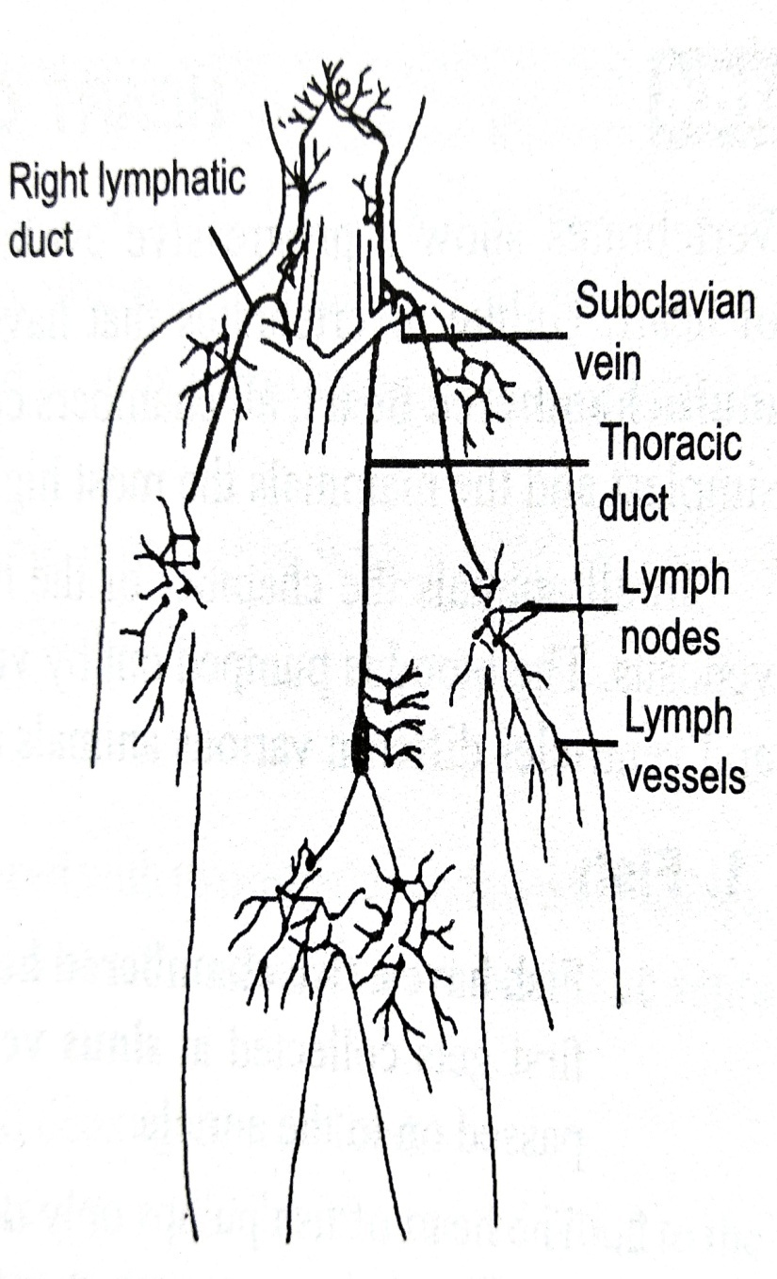
Lymphatic system
Number of lymph capillaries join to form the lymph vessels.
Smaller lymph unit and form large vessels through which whole of lymph put back into the venous blood through thoracic duct and right lymphatic duct.
These duct open into the Subclavian veins near the neck regions.
Lymphatic system has lymph gland and lymph node (contain lymphocytes that produce antibodies) at intervals.
Lymph system filter out bacteria germs or other foreign molecules an ingest them by phagocytosis.
Lymph node are abundant in neck arm and brain region.
Lymph vessels have semilunar valves that help the lymph to move in the forward direction only and stop their back flow.
The rate of lymph formation is equal to the rate of lymph returned in the body under normal conditions.
Oedema: is condition where the rate of lymph formation exceeds the rate of its return to the blood and accumulate around the cells is called oedema.

Slide 17
Function of lymph
Collection of interstitial fluid: is done by the lymph capillaries and put back to blood near the heart.
Absorbs fats and lipids from intestine : fats are first absorbs as chylomicron droplets into the lymphatic system and then passed on to the venous blood.
Carries lymphocytes and antibodies
Collect Co2 waste products, metabolite intermediate and synthesised products (i.e. plasma protein and hormones from tissues via tissue fluid).

Slide 18
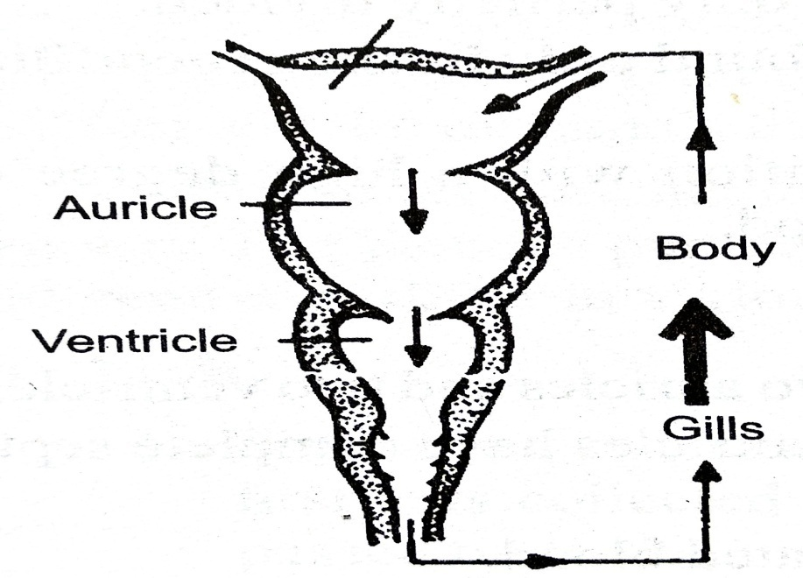
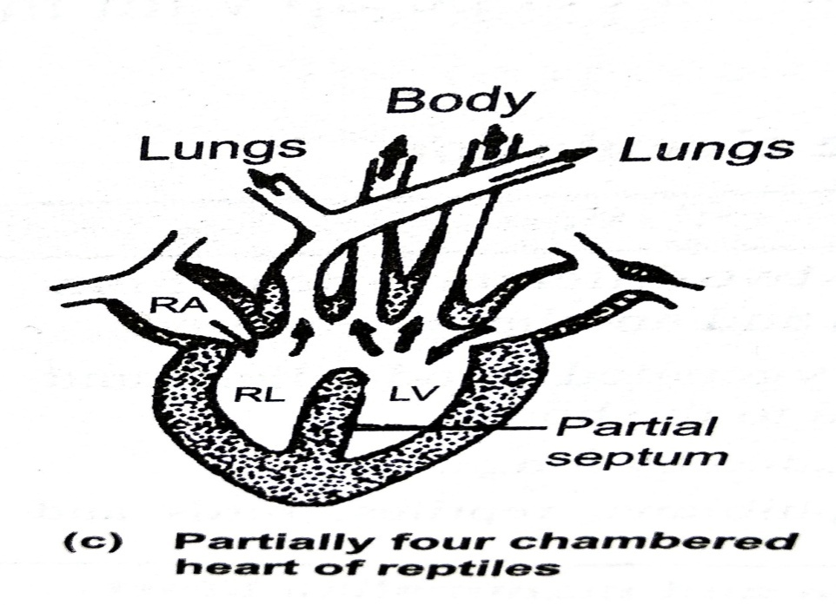
Heart of vertibrates
1. Fish:
It has two chamber heart with one auricle and one ventricle and the blood fist get collected at sinus venosus (i.e. present before the auricles and then passed on the auricle).
Heart of fish pump only deoxygenated blood which collected from all the body into sinus and then flow into arota through auricle and ventricle.
They have single circulation of blood flow (i.e. blood flow only once through in a complete cycle).
2. Reptiles:
They have incomplete four chambered (i.e. two auricles are completely divide by a septum but ventricle is only partially divided.
In crocodilian line have complete four chamber heart.

Slide 19
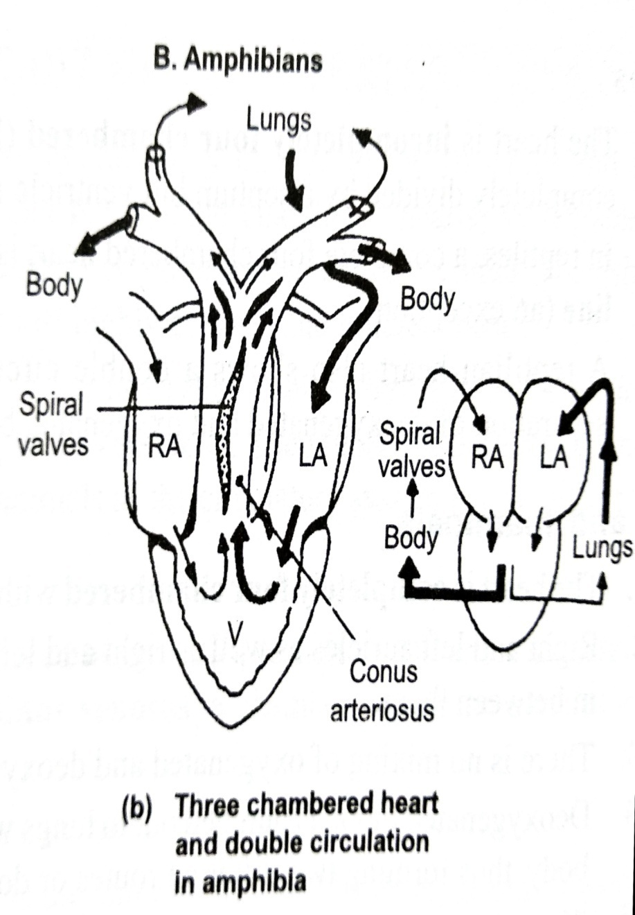
Amphibians
They have 3 chamber heart that consist of two auricles (i.e. completely partitioned by septum) and one ventricle.
Mixing of oxygenated and deoxygenated blood is prevented by the ridges and folds of ventricle surface and by the spiral valve that present at the base of conus arteriosus (i.e. blood vessels that receive blood from ventricle).
The spiral valve incompletely divides conus arteriosus in such a way that oxygenated blood is passed through the body and deoxygenated blood to the lungs.
They have double circulation of blood flow (i.e. blood flow through two different systems from heart one to the lungs from where it return back to heart after deoxygenation and another to the body).
Sinus vebosus collects the deoxygenated blood from anterior and posterior vena cava and pours the blood to the right auricles.

Slide 20
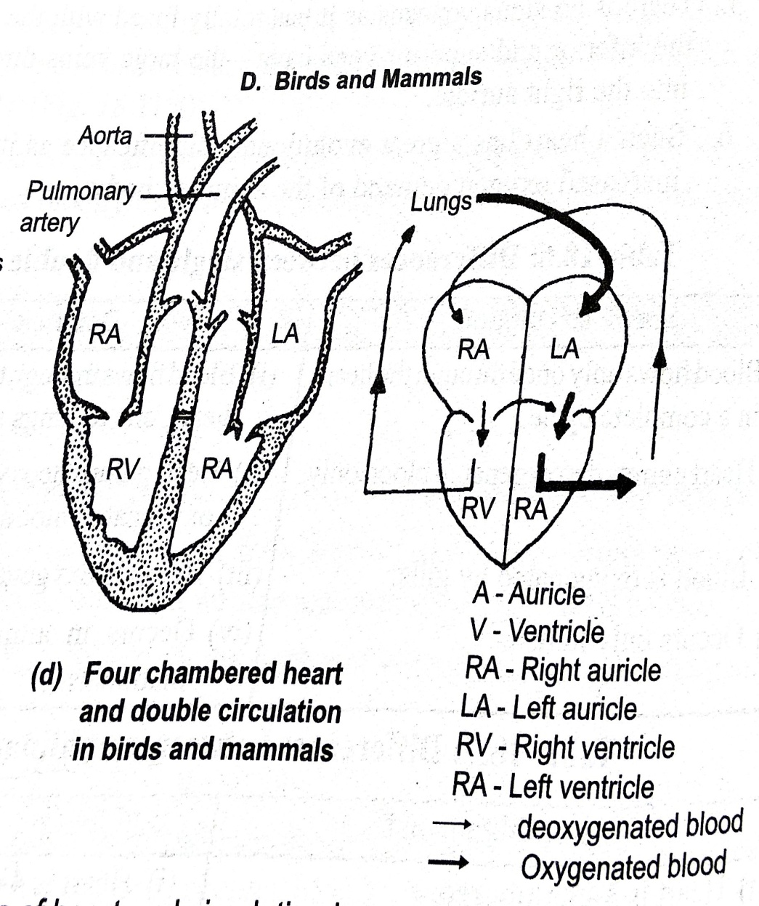
Birds and Mammals
Heat is completely four chambered with two auricle and two ventricles.
They do not have mixing of oxygenated blood and deoxygenated blood because left auricle, ventricle and right auricle and ventricle are completely divided by septa.
There is no sinus venosus so the inferior and superior vena cava directly pour the blood into the right auricle.

Slide 21
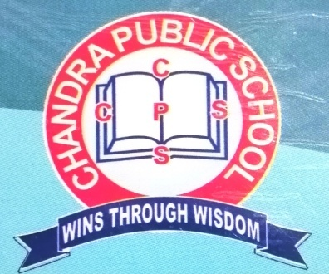
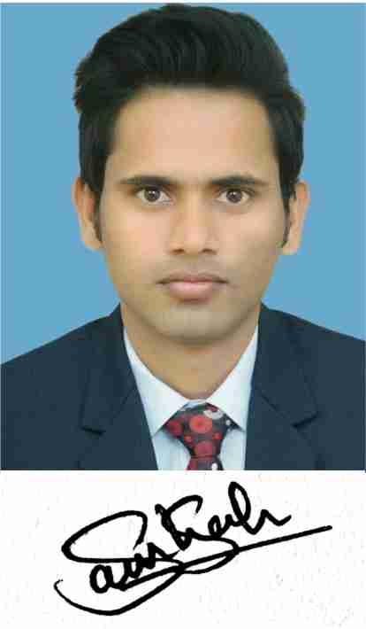
CHANDRA PUBLIC SCHOOL - MAU
Subject - Biology
Chapter – 16
Body fluid and Circulation
Session – 5
Topic: Human Heart
By –Shahanshah Shahid
PGT - BIOLOGY
Chandra Public School, Mau (U.P)
(Affiliated to CBSE- Delhi)

Slide 22
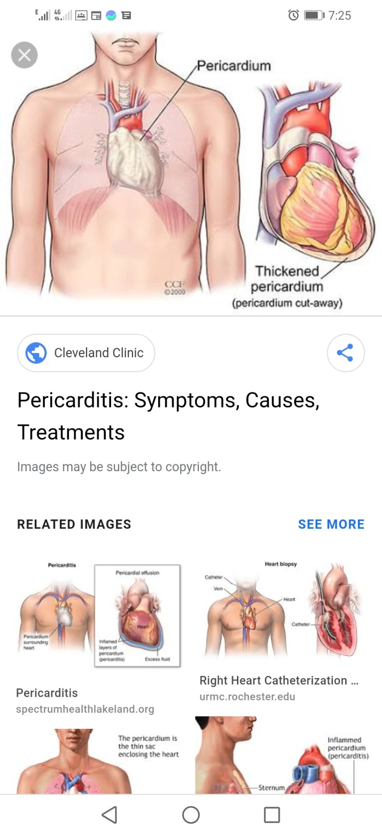
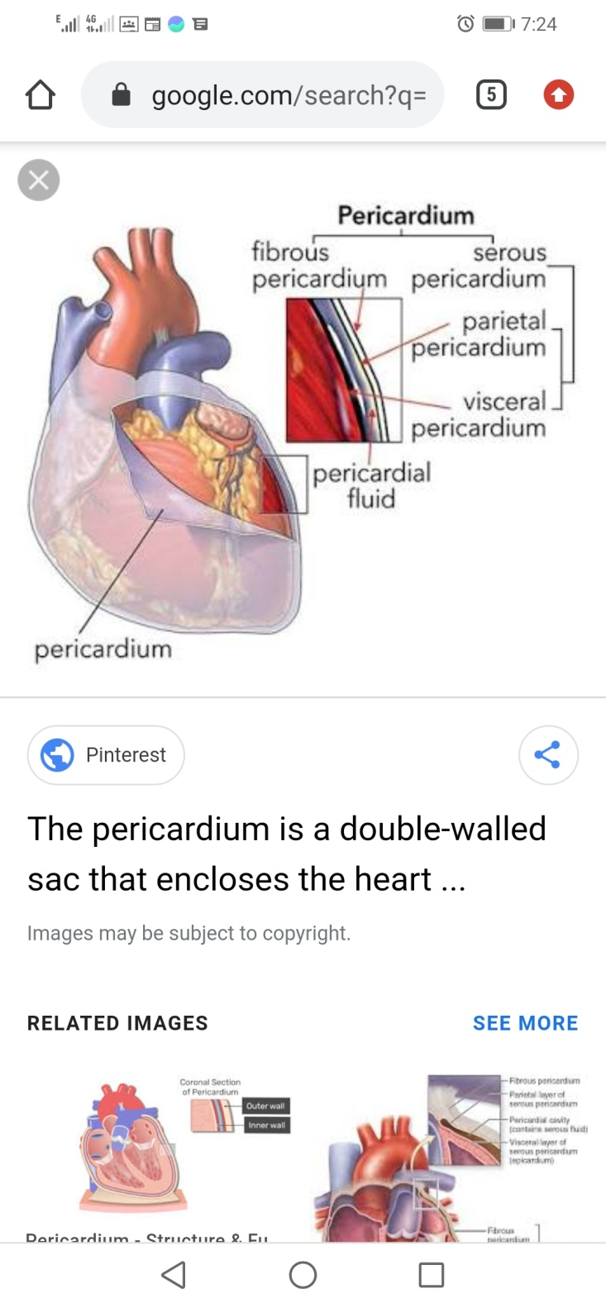
Human Heart
It is muscular pumping organs that lies above the diaphagram between the two lungs and its narrow end displaced to left side.
It enclosed in pericardium (i.e. double walled membranous sac) and in between the two membrane a pericardial fluid is present that protect heart from any shock.
It weight is near about 300gm.

Slide 23
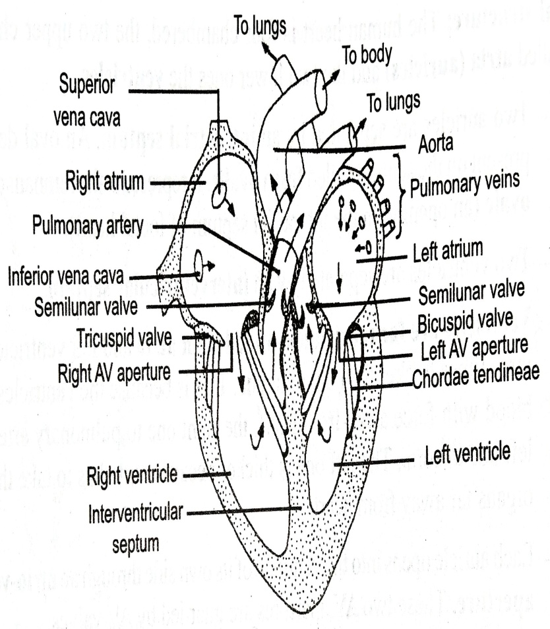
Internal structure
The human heat is four chambered (i.e. chambered in which two upper are called atria or auricle and two lower ones the ventricles)
Two auricle is separated by interartrial septum at which fossa ovalis (i.e. oval depression present on the septum).
It represent the foramen ovale (i.e. an opening in the interartrial septum of foetal heart).
Two ventricle is separated by interventricular septum.
The ventricle are far more thick walled than atria and left ventricle is at least three time thicker than right one (b/c the ventricle pump out blood with force away from heart while right one to pulmonary artery and the left one to arota).
# left one thicker because aorta has to take the blood to organs for away from heart.
Each auricle open in ventricle of its own side through artrio ventricular aperture (i.e. guarded by AV valves).
wall of heart is made up of cardiac muscle fibers (i.e. are branched and cross connected with each other forming a complex net like arrangement which facilitates the constriction of waves to pass quickly through heart chambers), connective tissues and tiny blood vessels.

Slide 24
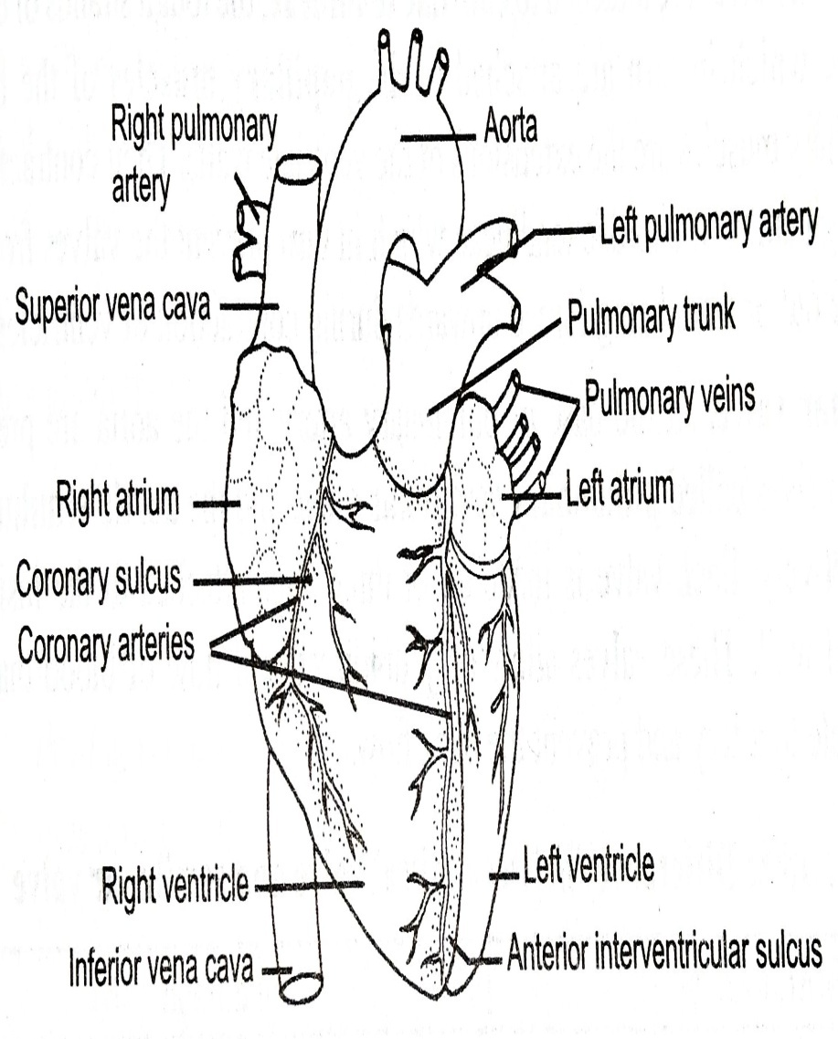
External structure
It show the following important grooves or sculci.
Coronary sulcus (i.e. transverse groove present between atria and ventricles).
On the ventricle there are two grooves:
Anterior interventricular sulcus
Posterior intervetricular sulcus
# These sulci house coronary arteries which supply blood to heart.

Slide 25
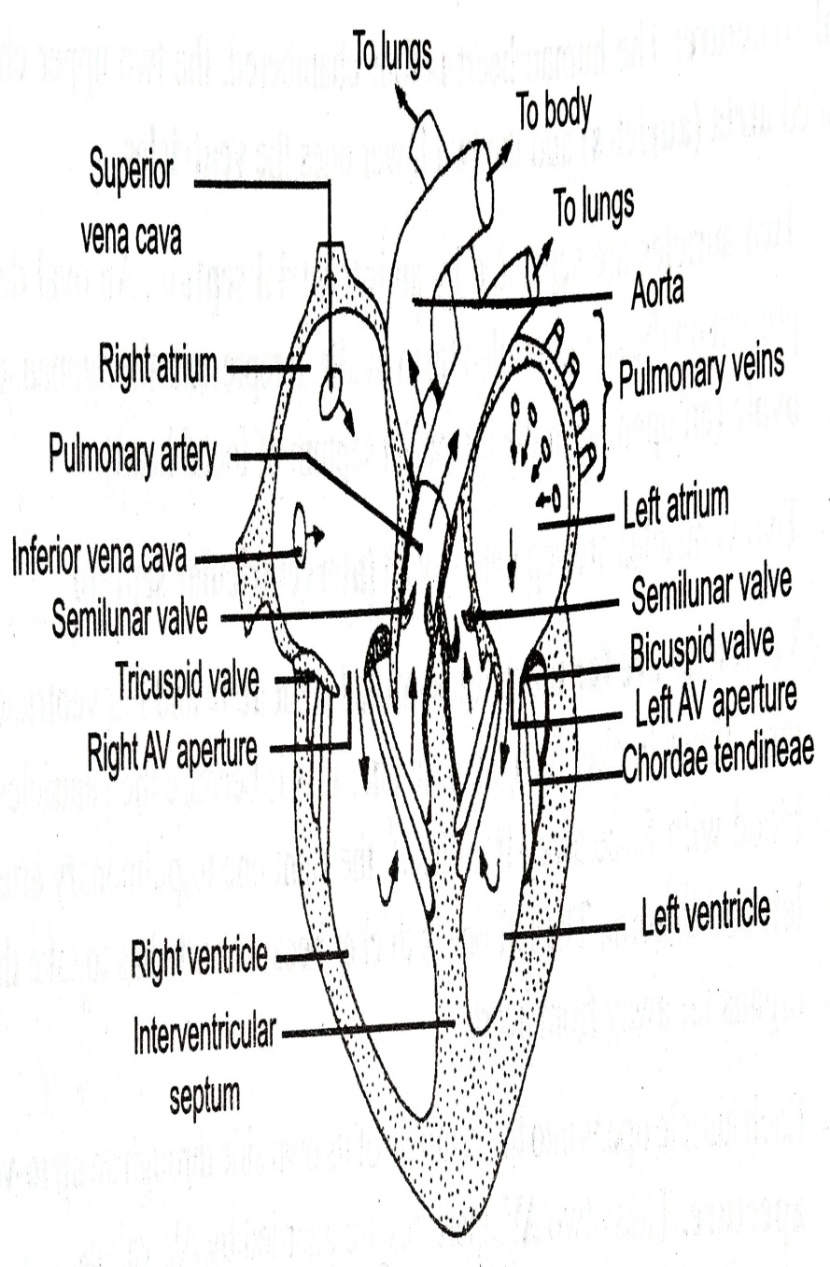
Valves in heart
Bicuspid valve:
It also called mitral or left AV valve.
Present between the left vetricle and allows the unidirectional flow of oxygenenated blood from atrium to ventricle.
It consist of two flaps or cusps.
Tricuspid valve:
Also refer right AV valve and consist of three flaps and allows the blood to flow from right atrium to right ventricle only.
Both valve attached o chordae tendineae (i.e. tough strand of connective tissue) which in turn attached to the extension off the ventricle walls.
The contraction bring the chordae tendineae tightening that prevent the valve from turning inside out or from being forced upward during contraction of ventricles.

Slide 26

3. Semilunar valve:
It present at the base of pulmonary artery (i.e. pulmonary semilunar valve) and arota (i.e. aortic semilunar valve).
Each valve made-up of three flaps that attached to the inside of the arterial wall.
These valves allow only unidirectional flow of blood (i.e. from ventricle to artery) and prevent the back flow.

Slide 27
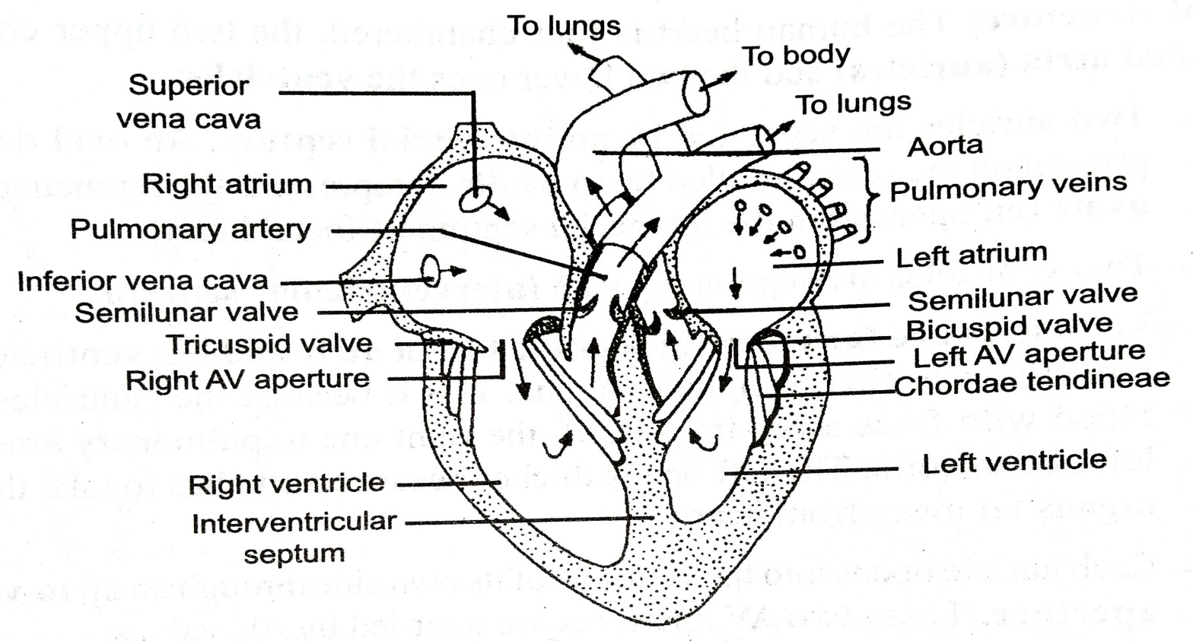
Major blood vessels
Right arterium receives the deoxygenated blood from whole body through superior and interior vena cava.
Left atrium receives the oxygenated blood from pulmonary vein.
Right ventricle forces blood into the pulmonary aorta which carries the deoxygenated blood to lungs.
Left ventricle forces blood into aorta that carries the oxygenated blood to the whole body.

Slide 28
Origin of Heartbeat
In different animal the heartbeat originate differently and accordingly the heat it could be:
Neurogenic – origin of heartbeat by specialized nerve fibres. Example: Invertebrates.
Myogenic – origin o heartbeat by specialized group of muscle fibers. Example: Vertebrates .
Sinoatrial node:
In the heart of mammals Sinoartrial Node or SA node (i.e. specialized area of cardiac muscle fibers ) present near the upper lateral wall of the right atrium.
It is actually a remnant of sinus venous that fused with right atrium.
It is also called pacemaker (i.e. generate each wave of cardiac impulse) so that each heart beat or cardiac impulse originates from here and then spreads throughout the two atria.
# the fibres of SA node have ability of self excitation and control the rate of entire heartbeat because it have high concentration of Na ions in the extracellular fluid and negative charge inside the nodal fibers so sodium ions always tend to enter inside (due to high conc. Of Na and presence of open channels) that results rise of membrane potential and generation of action potential causing the action potential.

Slide 29
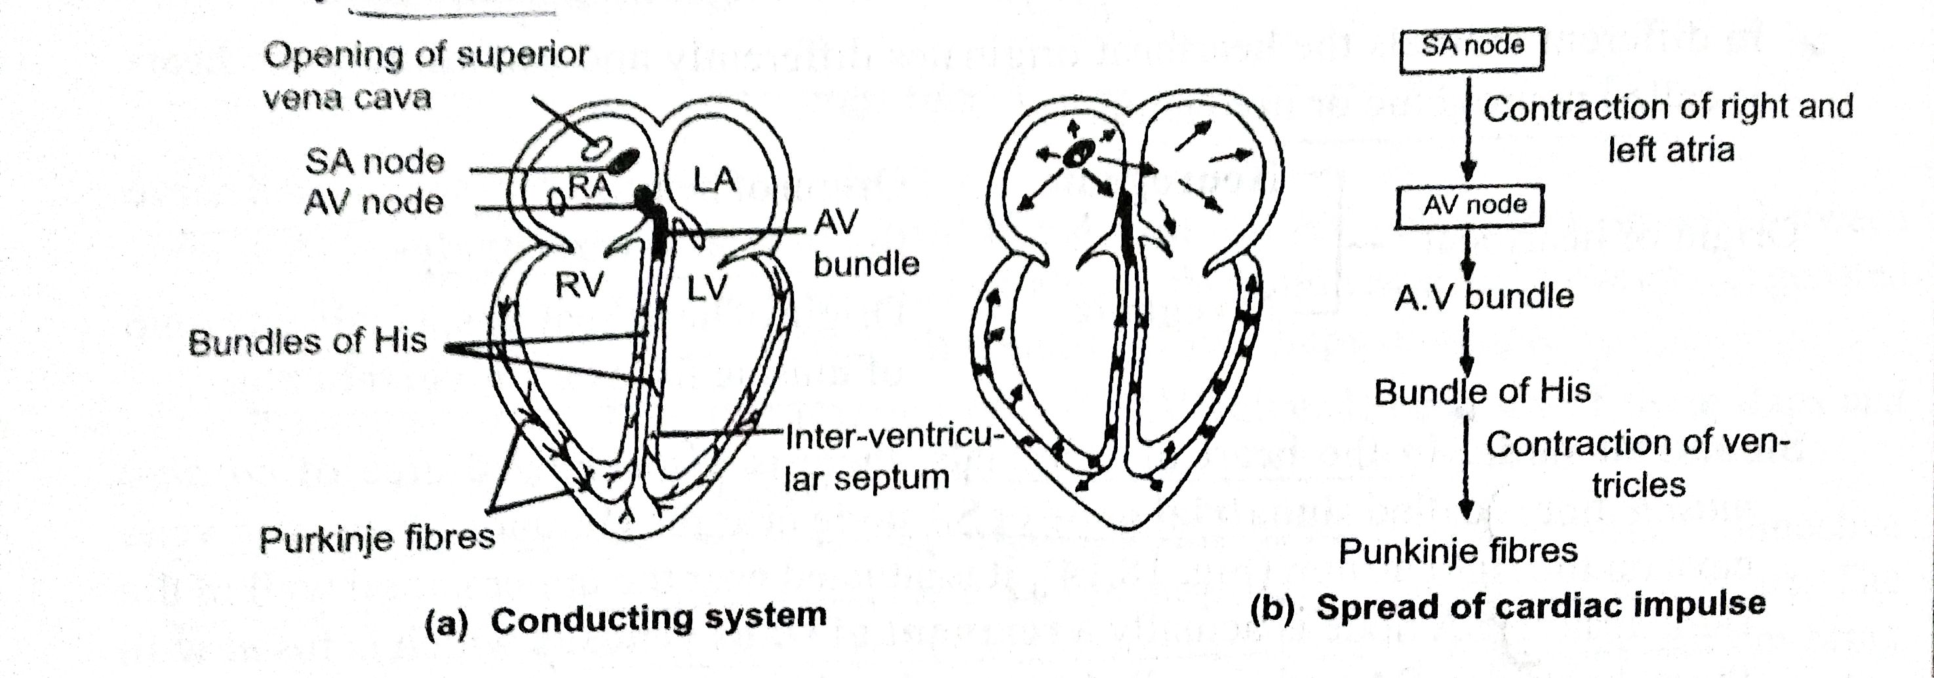
Conduction of heartbeat
The stimulus (i.e. in the form of a wave of electrical excitation or impulse) originates at SA node and spread to both atria and respond by contracting almost simultaneously.
The wave of contraction can not spread to ventricles as the artrial muscle fibers are completely separated from the ventricle muscle fibers and there is no continuation except at the muscles that form AV node.
The wave of excitation is picked up by atrio-ventricuar node or AV node (i.e. present close to the interartrial septum near the right AV aperture).
Av bundel (i.e. bundle of muscle fibres) that descends from the AV node along the inter artrial and the inter ventricular septa and it forms a continuity between atrial and ventricular muscles.

Slide 30
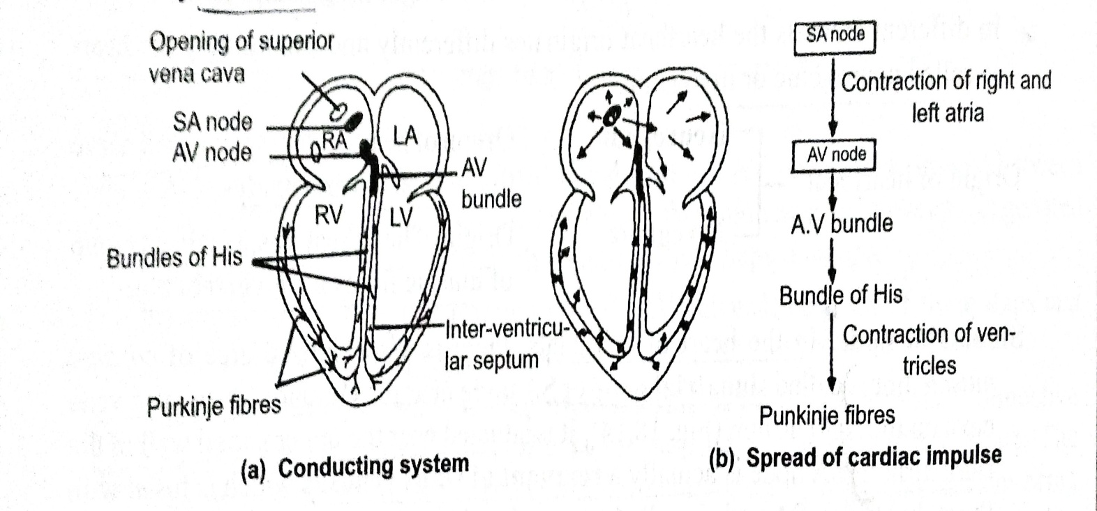
It receives the excitation from AV node and passes in to the bundle of His.
Bundle of His present in the interventricular septum (i.e. connect to the AV bundle) pass down the septum as right and left branches and conduct the impulse to the respective ventricles.
Purkinje’s fibres (i.e. fine network of fibres spreading all over the ventricle) arise from each bundel of His
The impulses travel through these branches and both the ventricles contract simultaneously.
# the ventricular wave begins from the apex of ventricle and spreads upwards so the wave of impulses takes time to pass from SA node to AV node or artrial systole is over before the ventricular systole starts.

Slide 31
Regulation of heart beat
Heart beat regulated through two ways:
Intrinsic control:
Heart beat originates and controlled by the SA mode which rhythmically generates the impulses throughout the lie time.
b) Extrinsic control:
In this cardiac impulse is self generated and controlled but hormones and neural impulses.
Hormones ( i.e. thyroxine, insuline, adernaline, non-adernalin and sex hormones ) directly act on the SA node and stimulate or inhibit the cardiac impulses.
In Nervous control the heart is under control of autonomous nervous system (i.e. it have two group of nerve fibers – parasympathetic and sympathetic).
Vagus nerve from parasympathetic system slow the heart rate while sympathetic nerves accelerate the heart activity .
The nervous control of heart lies in the medulla oblongata region of hindbrain.
There are number of chemoreceptor and stretch receptor in the carotid arch which also send impulses to medulla oblongata to increases or decreases the heart rate.

Slide 32
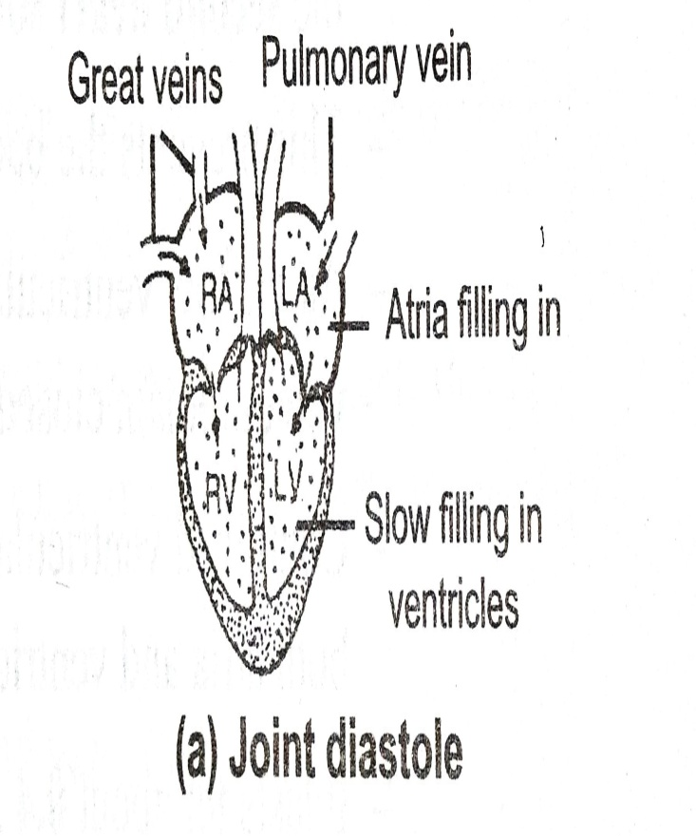
Cardiac cycle
Rhythmic contraction and relaxation of cardiac chamber occurs in a specific manner during one heartbeat forms cardiac cycle.
Systole: contraction of cardiac chamber.
Diastole: relaxation of cardiac chambers.
Joint diastole: relax state of both atria and ventricle.
The sequence of changes in cardiac chambers during one cardiac cycle are:
Artrial filling and joint diastole:
Filling of right artrium with deoxygenated blood from superior and inferior vena cava and left artrium with oxygenated blood from pulmonary vein.
As pressure increase in atria the bicuspid and tricuspid valves open and blood flow into the respective relaxed ventricle.
Pressure of blood is very low so semilunar valves of arteries remain closed and blood does not flow out of ventricle.

Slide 33
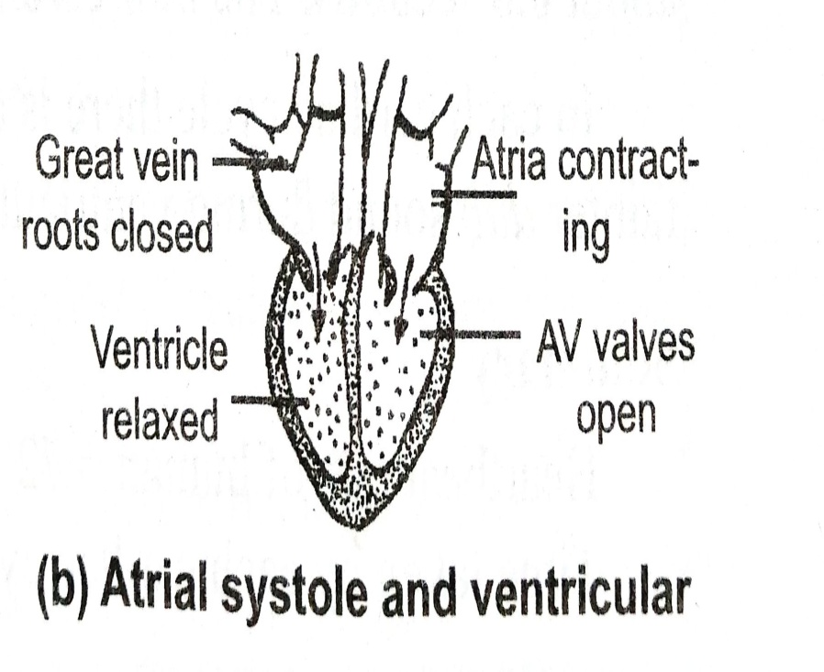
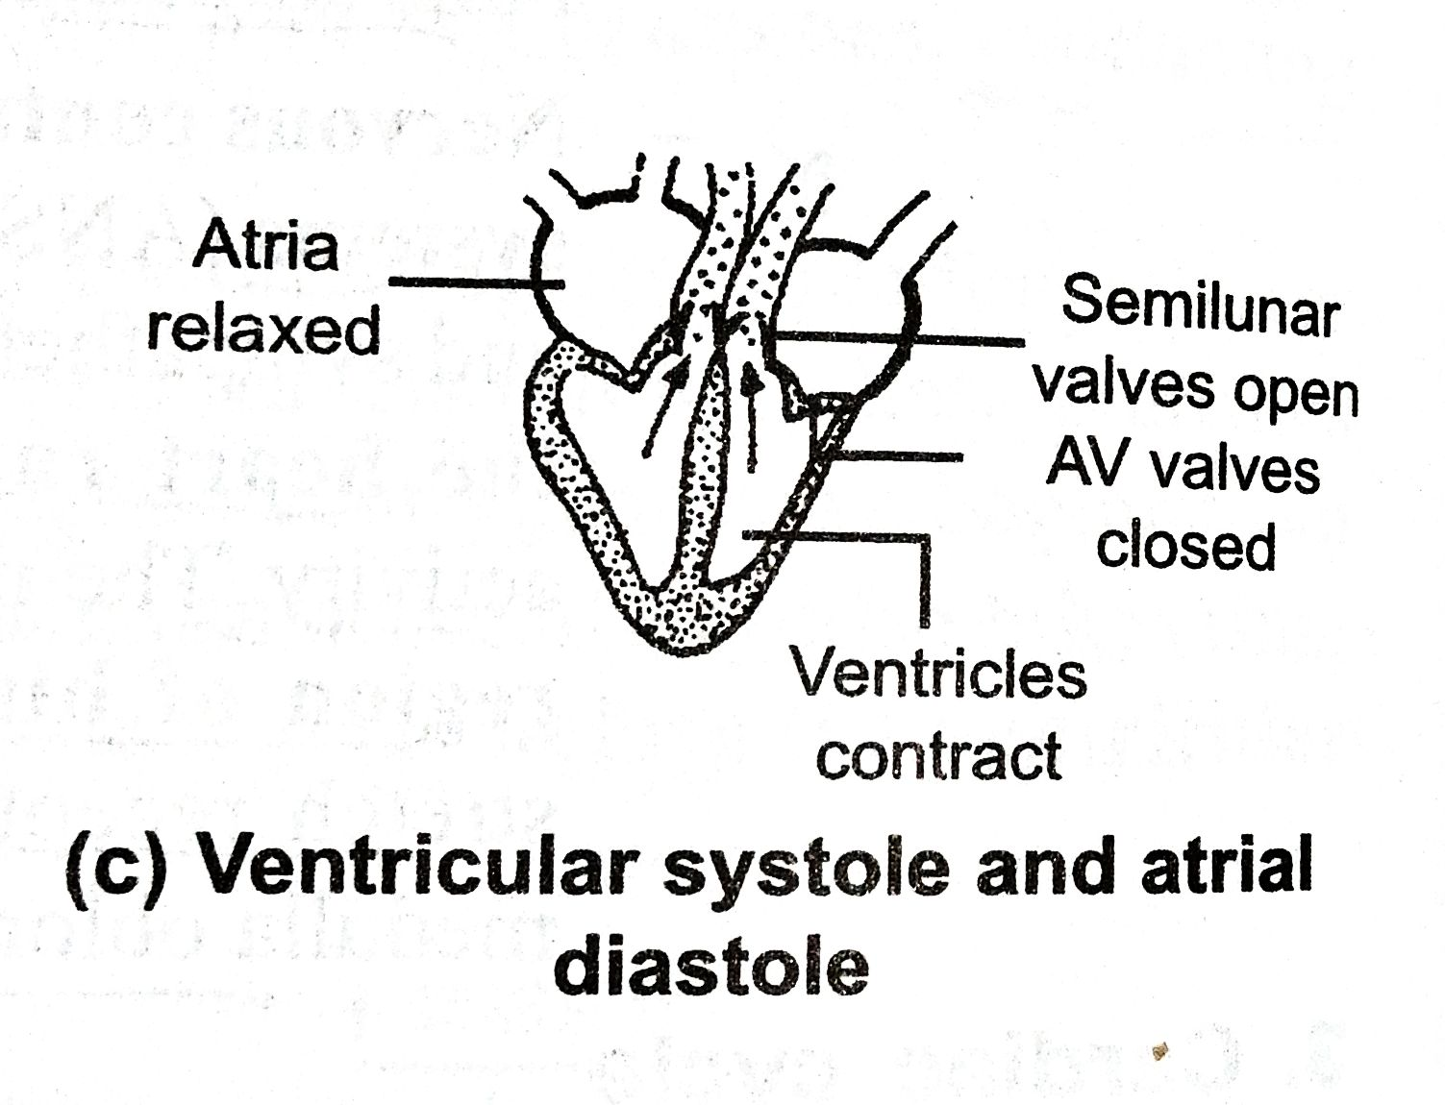
2. Arterial systole and ventricular diastole:
At the end of joint diastole the next heartbeat begins.
Two atria contract and forcing most of the blood to ventricles and simultaneously closing of superior and inferior vena cava b compression occurs.
Bicuspid and tricuspid valve is open and it last about 0.15 sec.
Ventricular systole and artial diastole:
Sharp closing of AV valves stop the back flow of blood to ventricles and produce first heart sound – lub.
Rise of ventricular pressure but it still lower the pressure in the grate arteries hence semilunar valve still closed.
Ventricle contract as closed chamber and then the ventricular pressure exceeds the pressure in pulmonary artery and aorta forcing the opening of simulunar valve and results flow of blood in grate arteries from ventricles.
It last about 0.25 sec.

Slide 34
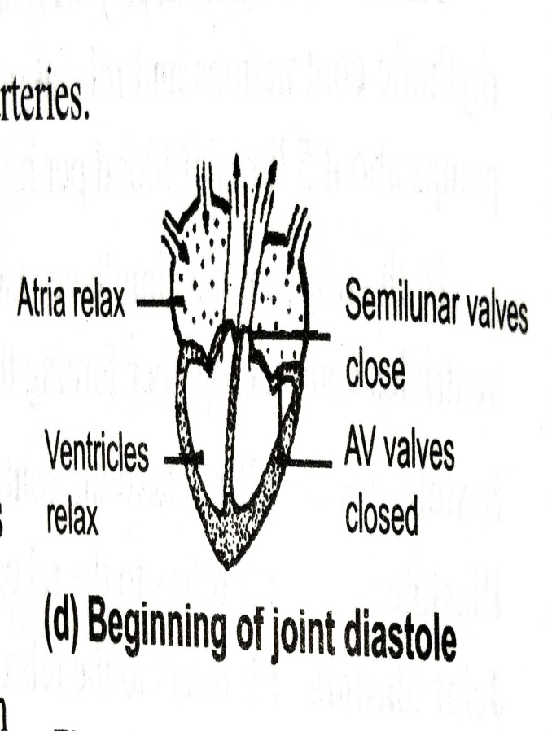
Ventricular diastole and atrial diastole:
Now ventricle relax and the pressure falls below to that in great arteries.
Closing of semilunar valves in pulmonary artery and aorta produces the second heart sound – dub and prevent back flow of blood into ventricles.
Here still ventricular pressure is grater than the arterial pressure AV valve remain closed.
Now continue ventricular diastole decreases the pressure tremendously and now both atria and ventricle are in joint diastole.
It last for about 0.4 seconds.
One complete systole and diastole of cardiac cycle takes about 0.8 seconds and new cardiac cycle begins with the artrial systole.
Summary:
Heartbeat rate of human = 72 times/min
Tame taken by each

Slide 35
Cardiac output:
Volume of blood pumped out by each ventricle per minute.
Cardiac out put of a healthy person is 5 liter or 5000mL.
Heart rate:
Number of times of hearts beats per minute.
Example: humans – 68 – 72, elephant – 25, rat – 300.
# smaller animal have higher metabolic rate hence need grater action o heart to pump more oxygen and nutrients to tissue.
Tachycardia :
Abnormal increase of heart rate.
It could b due to emotional stress, anxiety anger and excitements and over activity of thyroid gland.
Bradycardia:
Abnormal decrease of heartbeat rate.
It is due to under activity of thyroid gland.

Slide 36
Arterial pulse or pulse wave:
It is wave of distention followed by constriction experience in the arteries which results ventricular systole and diastole.
Pulse rate / min = heartbeat rate / min
Ventricle contract → blood flow in arteries (with force) →distention of wall of arteries→ felt pulse→ become fainter as blood move away and become low in capillaries.
Blood pressure:
Pressure excreted by the blood against the wall of arteries.
It occurs due to sudden flow of blood in during ventricular systole
Blood pressure is measure as two value like in man 120/80 mm of Hg (i.e. systolic pressure is 120 m of Hg and Diastolic pressure of 80 mm of Hg).
Systolic pressure:
Pressure experienced in the arteries which results contraction of ventricles.
In this distention occurs at the wall of arteries due to sudden rise in blood .
Diastolic pressure:
Pressure in arteries when ventricle relax.
Sphygmomanometer:
It is instrument use to measure the blood pressure in the bronchial artery.

Slide 37
Heart sound
Rhythmic closure and opening of valves cause the sound of heartbeat during cardiac cycle.
Two significant sound are produce during one cardiac cycle i.e. Lub and Dub
Lub | Dub
First sound in cardiac cycle | Second sound during cardiac cycle
Produce by closing of atrioventricular valves | Produce by closing of semilunar valves ( present at the base of pulmonary artery and aorta).
Occurs at the beginning of ventricular systole | Occurs at the beginning of ventricular diastole.
Duration is 0.16 – 0.19 sec and louder sound | Duration is 0.10 sec and fainter sound.

Slide 38
Blood vessels

Slide 39

Thank You

