Slide 1
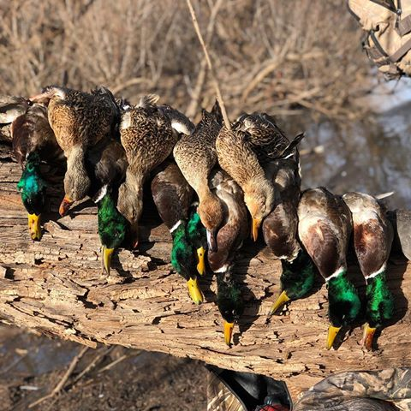
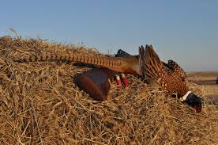
2021 Duck Season Warm Up
Fundraiser!
Saturday September 11th, 2021
(10 Mallards Per Person)
$300.00 Per Hunter
Breakfast 8am-9am
Warmup Trap Shoot 9am
Tower Shoot 10am
Lunch 1pm
Gun Raffles
50/50 Drawing
5 Shot Group Contest
A $50 deposit secures your spot. Balance due day of shoot.
Hunters Contact;(231) 578-6469
tpatricklaporte@gmail.com
Black Water Farms, LLC
6136 S Sullivan Rd
Nunica, MI 49448
www.blackwaterfarmsllc.com
All sponsor and raffle proceeds will be donated to the Lake Effect Chapter of the Michigan Duck Hunters.
All hunts include-
Country Breakfast
Warm up Trap Shoot
European Tower Shoot
Lunch
Additional Fund Raising Events
----------------------------------------------------------------------------------------------
Duck Season Warmup; 09/11/2021
Name;___________________________________________________
Address;_________________________________________________
________________________________________________________
Phone Number;___________________________________________
Email Address;____________________________________________
Add a caption for your photo here.
Company Name

