Slide 1
HERITAGE
MILITARY HONORS AND COURTESIES

Slide 2
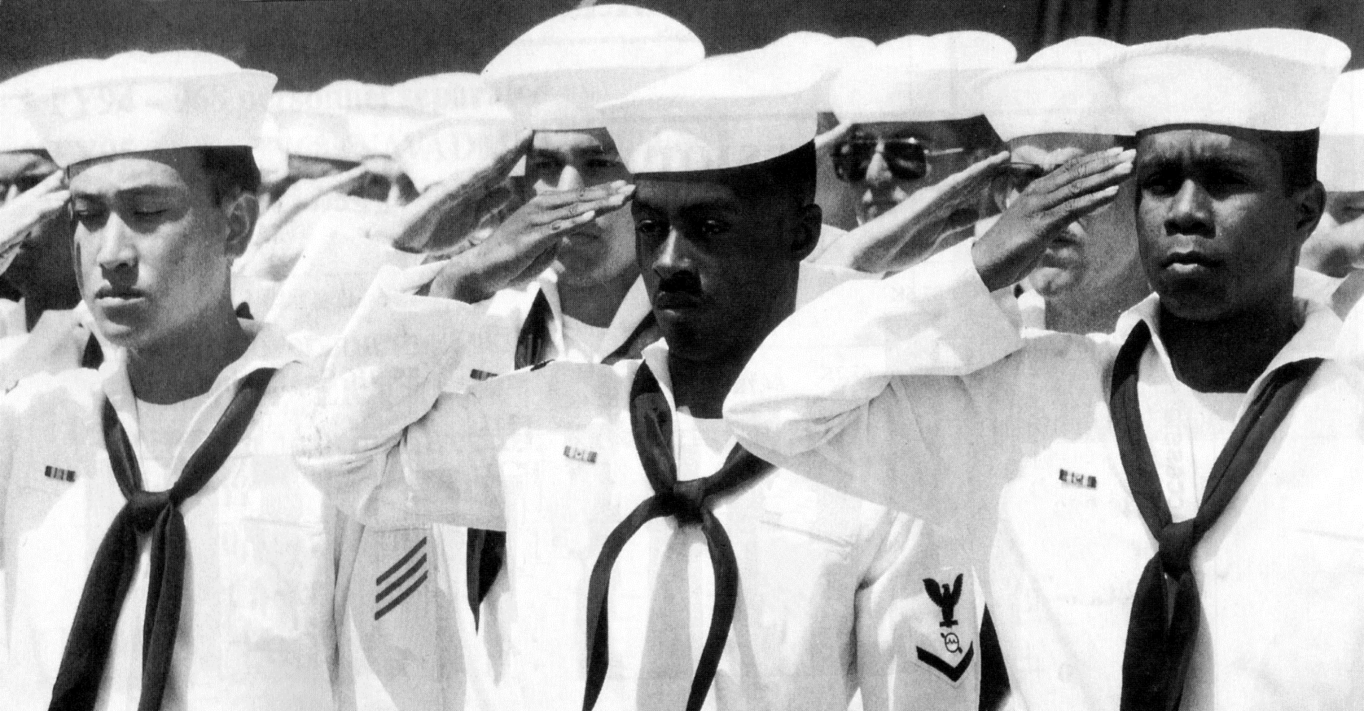
HAND SALUTE

Slide 3
HAND SALUTE
HAND SALUTE PROCEDURES
Face the person you are saluting
Salute from a position of attention
Upper arm should be parallel to deck or ground
Forearm inclined at a 45-degree angle with hand and wrist straight
Forefinger touching cap bill slightly over the right eye
Use a cheerful, respectful greeting

Slide 4
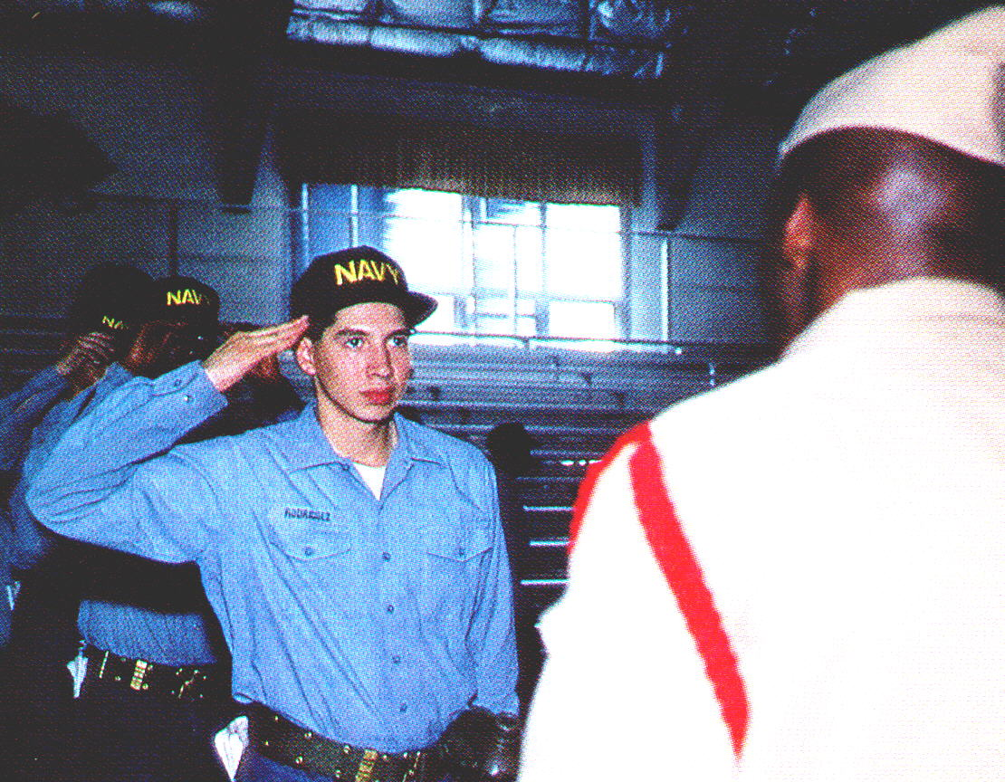
WHOM TO SALUTE
HAND SALUTE
All officers
Civilians who are entitled (e.g., President)
Those who are entitled because of duty status (e.g., Officer of the Deck)

Slide 5
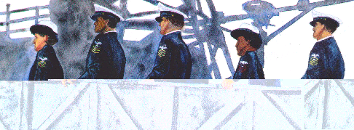
WHEN TO SALUTE
HAND SALUTE
ABOARD SHIP
IN A GROUP
OVERTAKING
REPORTING

Slide 6
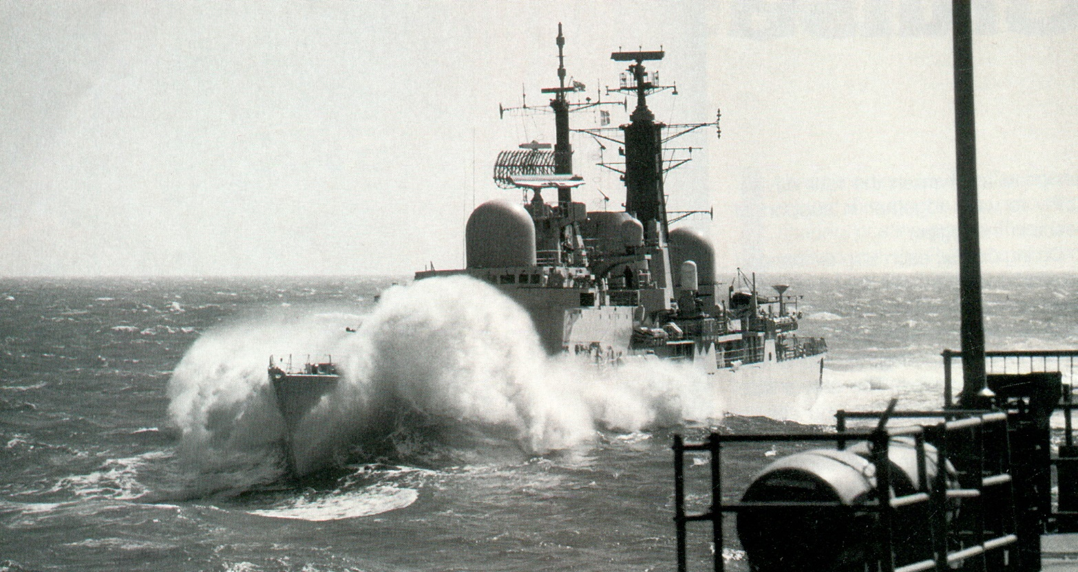
MILITARY
HONORS & COURTESIES

Slide 7
MILITARY
HONORS & COURTESIES
PASSING HONORS PROCEDURES
At the signal “ATTENTION,” all hands on deck come to attention and face outboard:
One blast - attention to starboard
Two blasts - attention to port
At the sound of one blast, all hands not in ranks salute.
At the sound of two blasts, all hands not in ranks bring hands back to their sides and remain at attention.
At the sound of three blasts, carry on.

Slide 8
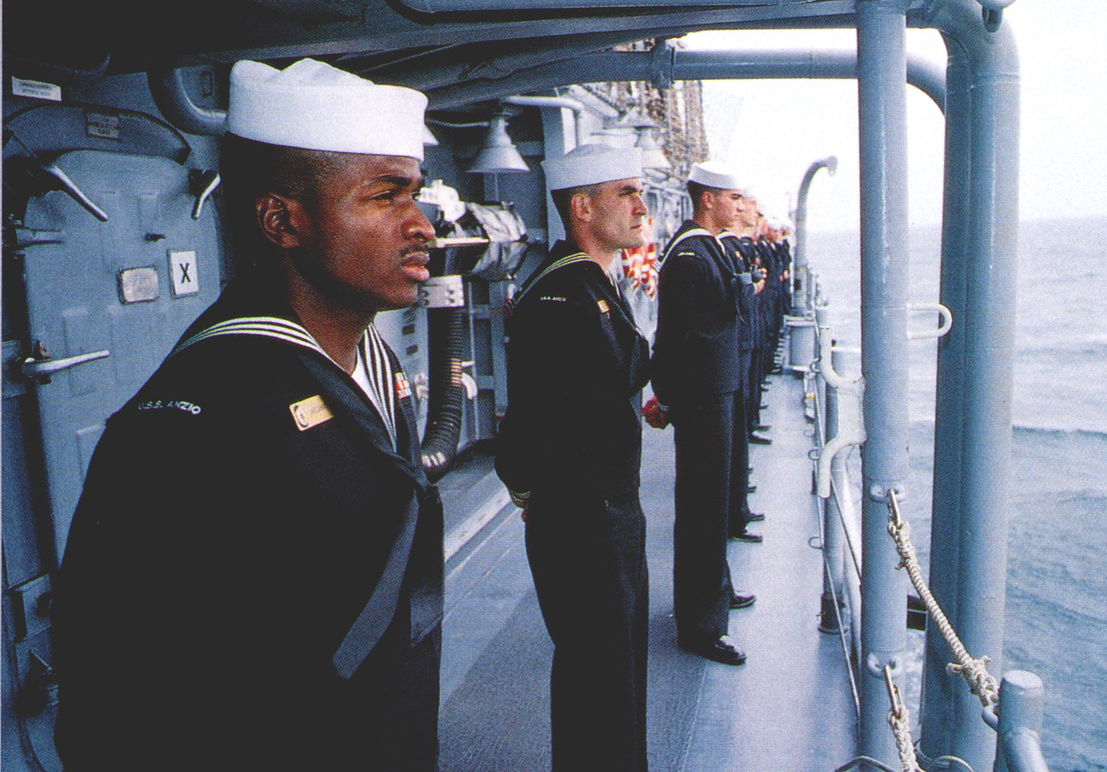
MILITARY
HONORS & COURTESIES
MANNING THE RAIL

Slide 9
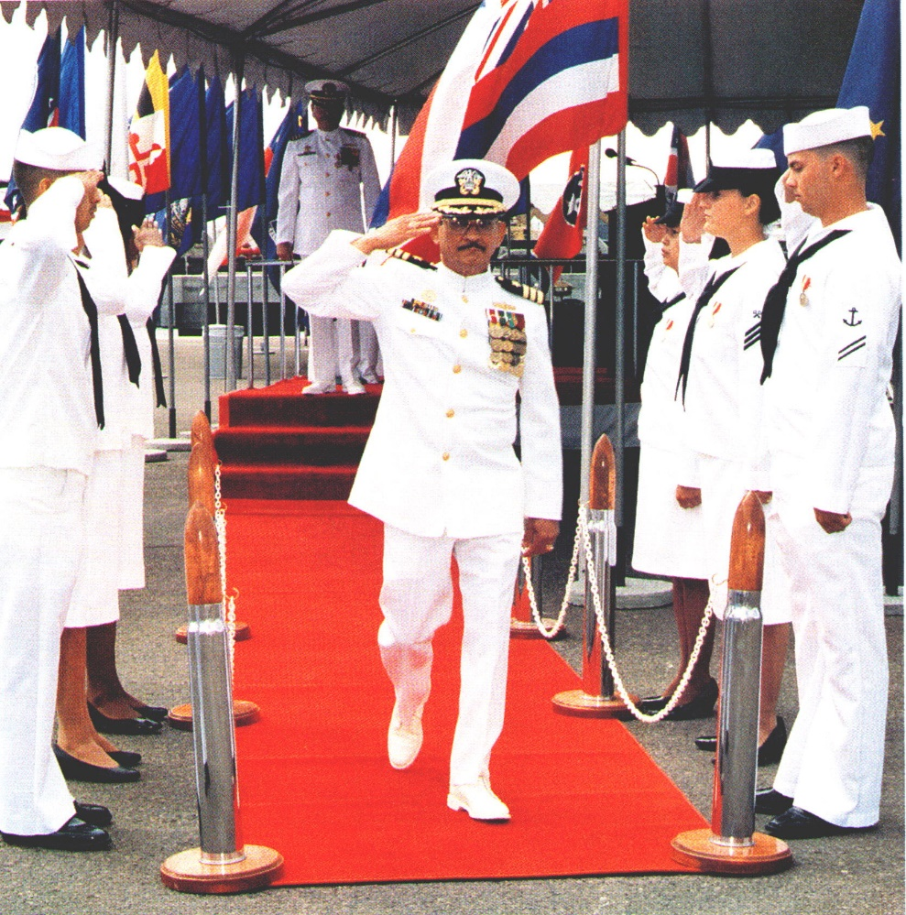
SIDE HONORS
MILITARY
HONORS & COURTESIES

Slide 10
GUN SALUTES
MILITARY
HONORS & COURTESIES
Rendered to high-ranking individuals, to nations, and to celebrate national holidays.
Only one gun is fired at a time with intervals of about five seconds.
During the gun salutes, personnel should maintain the hand salute until the last shot has been fired.

Slide 11
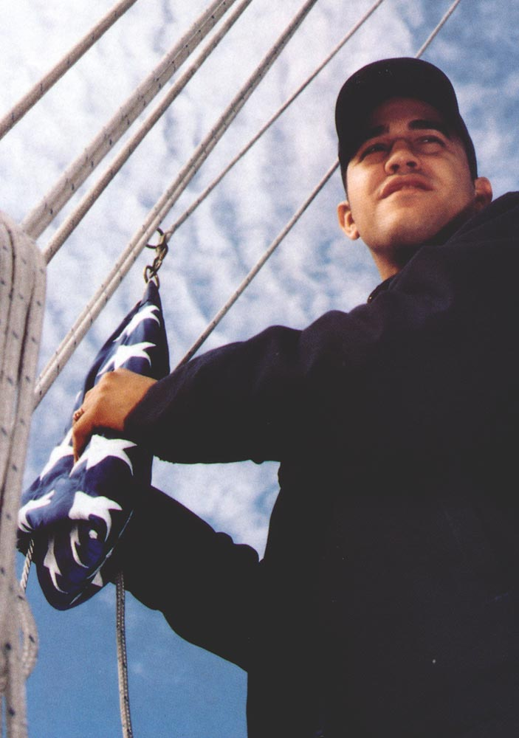
COLORS’ CEREMONY
Ceremonial hoisting and lowering of the National Ensign at 0800 and sunset and known as morning and evening colors.
Ships underway do not hold this ceremony because the National Ensign is flown all the time.

Slide 12
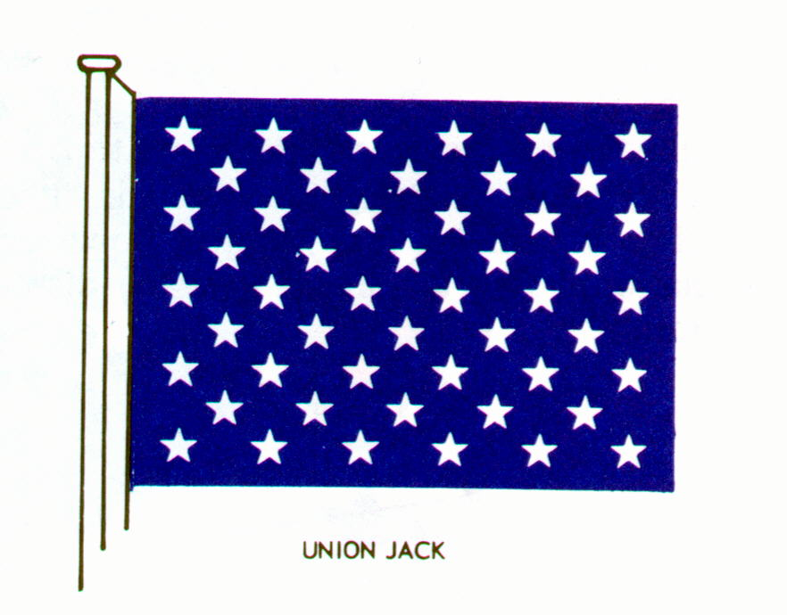
NATIONAL ENSIGN
COLORS’ CEREMONY
UNION JACK

Slide 13
COLORS’ CEREMONY PROCEDURES
COLORS’ CEREMONY
In uniform, but not in ranks, face the Ensign and give the hand salute.
In ranks, person leading ranks will call attention and salute.
While driving a vehicle, stop and sit at attention, but don’t salute.
In a boat, remain at attention whether standing or sitting.

Slide 14
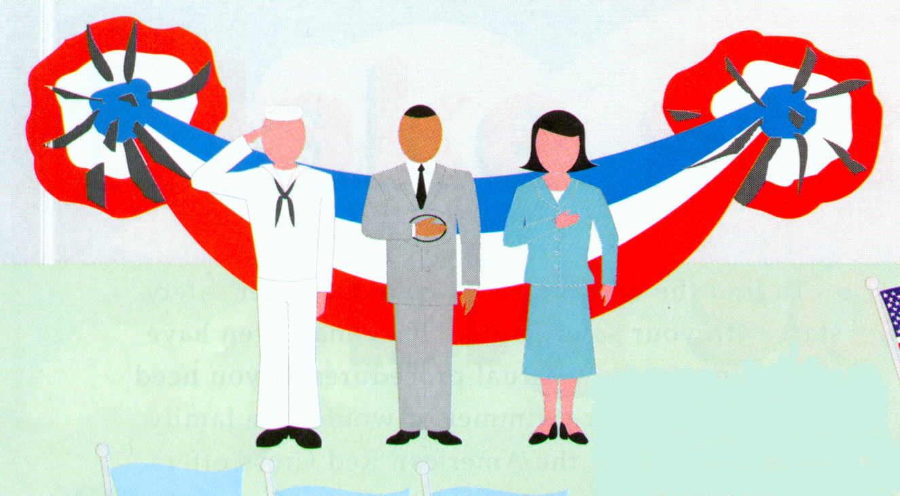
SALUTING DURING COLORS’
COLORS’ CEREMONY
In civilian attire, face the Ensign and place the right hand over your heart. If wearing a hat, place the hat over your heart.

Slide 15
Summary
HAND SALUTE
MILITARY HONORS AND COURTESIES
COLORS’ CEREMONY

