Slide 1
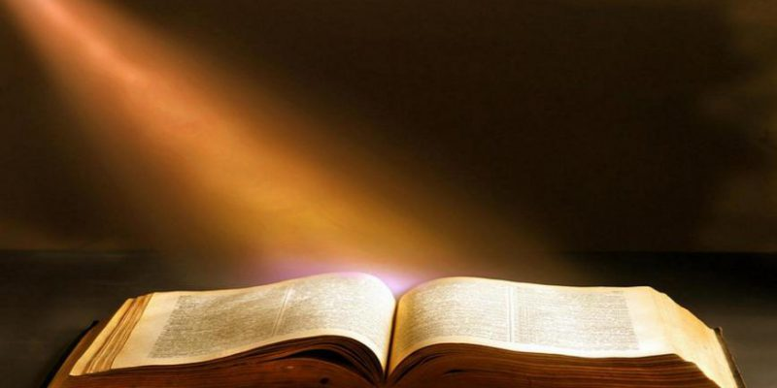
The Miraculous Nature of the Bible

Slide 2
Our Bible
Our Bible can be compared to no other book. Only those who have not read and studied it would dare to compare it to others. In all ways it is miraculous.

Slide 3
I. Miraculously Created & Preserved

Slide 4

The Bible is a collection of writings written over centuries by different authors at different times in different languages.
  The oldest parts were written 1,500 BC and the earliest before 100 AD.
  (The last books were written by John, the only Apostle said to die of natural causes: 1-3 John and Revelation.)
2. God inspired real people to write the
It was God-breathed (2 Timothy 3:16) to
40 authors over 1,500 years from
different walks of life including fisherman,
physicians and shepherds.
1.

Slide 5
Miraculously Created and Preserved (more)
The Gospels were eye-witness accounts of the life of Jesus. (Mark was written between 66-70 AD, from interviews with Peter. Matthew and Luke were written sometime between 85-90. John was written between 90-110 AD.
God gives witness that the Bible is totally trustworthy. The Bible claims to be God’s written word. Scripture is breathed out by God (2 Timothy 3:16), the words themselves came from God (1 Corinthians 14:36-38).

Slide 6
Miraculously Created and Preserved (more)
The Gospels were eye-witness accounts of the life of Jesus. (Mark was written between 66-70 AD, from interviews with Peter. Matthew and Luke were written sometime between 85-90. John was written between 90-110 AD.
God gives witness that the Bible is totally trustworthy. The Bible claims to be God’s written word. Scripture is breathed out by God (2 Timothy 3:16), the words themselves came from God (1 Corinthians 14:36-38).

Slide 7

II. Our Bible: Miraculously Preserved

Slide 8
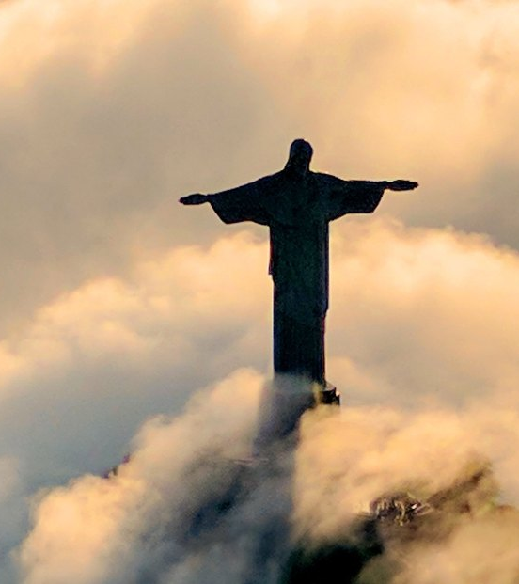
THE NEW TESTAMENT
  5,800 ancient Greek manuscripts.
  The earliest complete New Testament manuscript is from 325 AD and earliest fragment from second century AD.

Slide 9
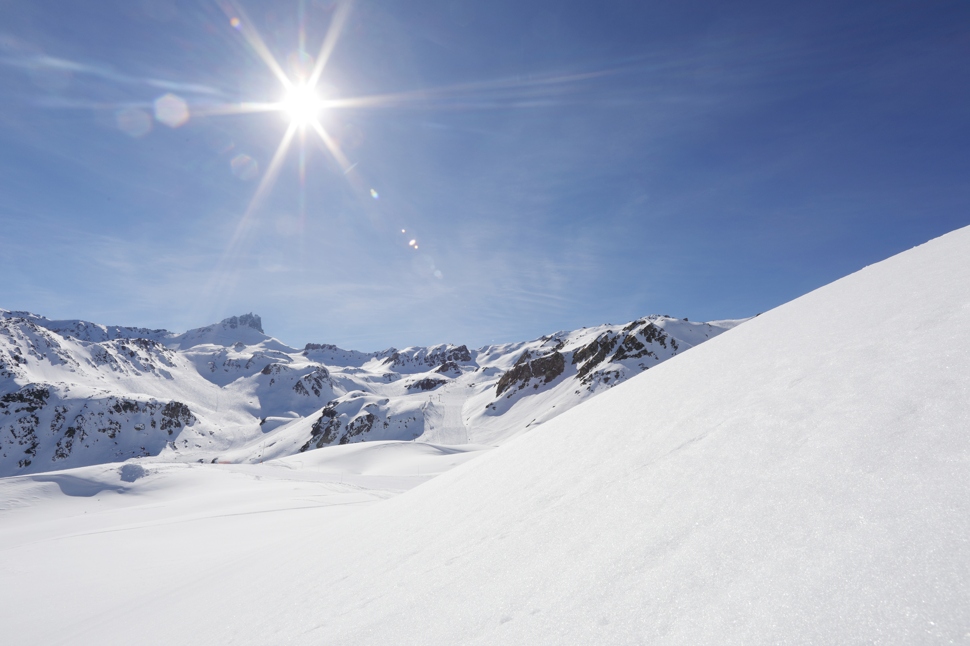
III. Our Bible: Miraculously Accurate

Slide 10
Fulfilled Prophecies
  The test for an Old Testament prophet was 100% accuracy, or he was put to death (Deut. 18:21-22).
  There are over 400 fulfilled Old Testament prophecies. (The exact number depends on how you count them. Several fulfilled parts are sometimes counted as only one prophecy or several.)

Slide 11
Fulfilled O. T. Prophecies Include:
The rise and fall of nations (Daniel 2, 7, 9, 11, 12).
Israel ( Jeremiah 29:14, Ezekiel 36:25-26 and 37:6-11).
Jesus Prophecies (handout).

Slide 12
Archeology
  After millions of man-hours of research, digs and evidence analysis, archeology has repeatedly confirmed the reliability of the Bible. It has been proven geographically and historically accurate, in the most exacting detail, by external evidence.

Slide 13
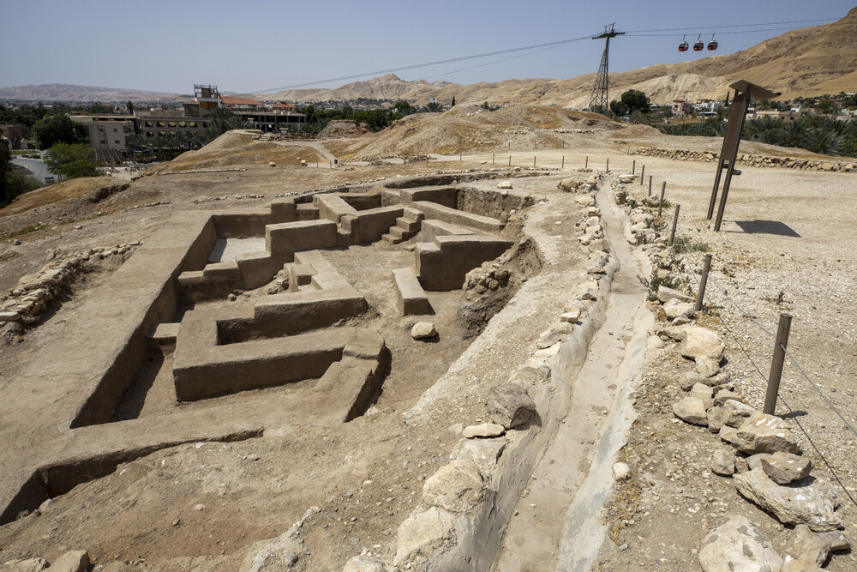
JERICHO
One of the world’s oldest towns, Jericho is mentioned several times in the Bible.

Slide 14
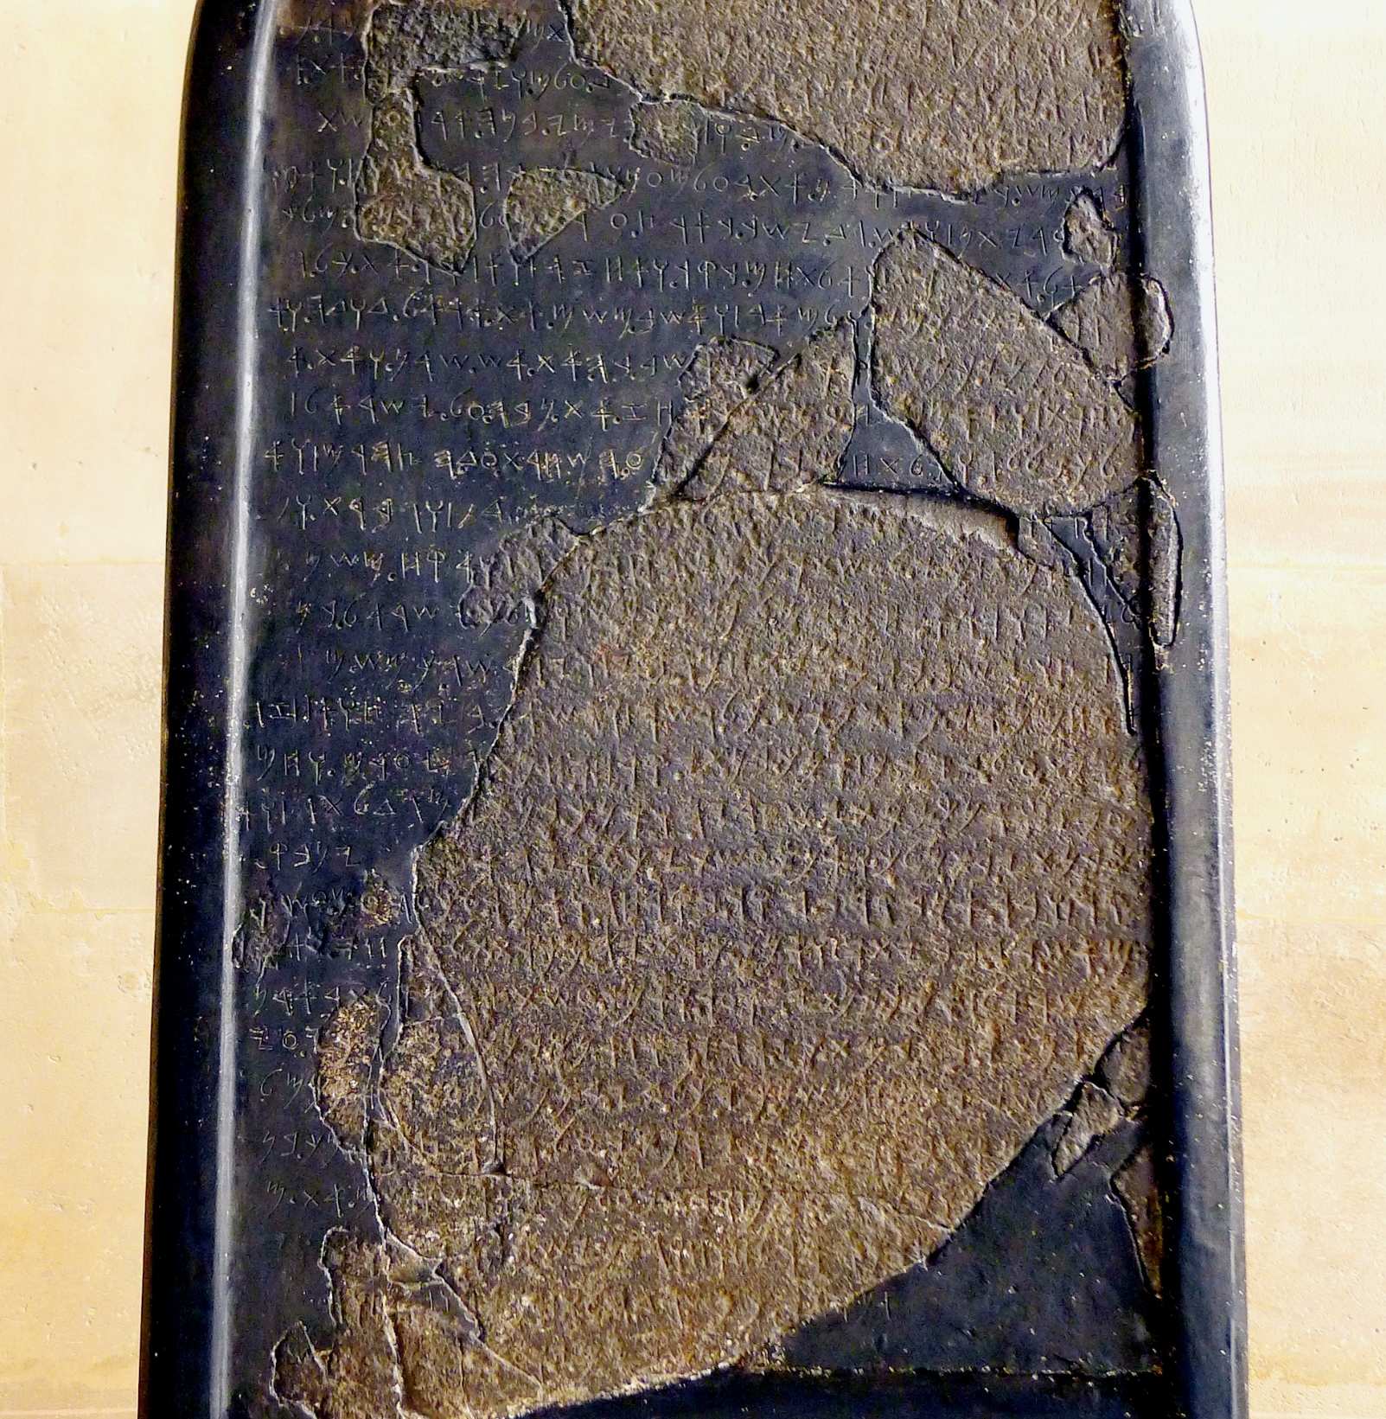
Mesha Stele
(Moabite Stone) in Madaba, Central Jordan
An extra-biblical account of Bible history which celebrates the victories and building works of King Mesha (Moab) during the reign of King Ahab.

Slide 15
Compiled by:
  Marcia L. Gillis, 2024
  Permission granted to duplicate and use this power point and the printed materials in this course to teach. No permission is granted to sell.

