Slide 1
DISCIPLE 102
CLASS 3 – SHARING YOUR FAITH

Slide 2
John 1:1-4 and Romans 6:23
1 In the beginning was the Word, and the Word was with God, and the Word was God. ² He was with God in the beginning. ³ Through him all things were made; without him nothing was made that has been made.⁴ In him was life, and that life was the light of all mankind.(John 1:1-4)
²³ For the wages of sin is death, but the gift of God is eternal life in Christ Jesus our Lord. (Romans 6:23)

Slide 3
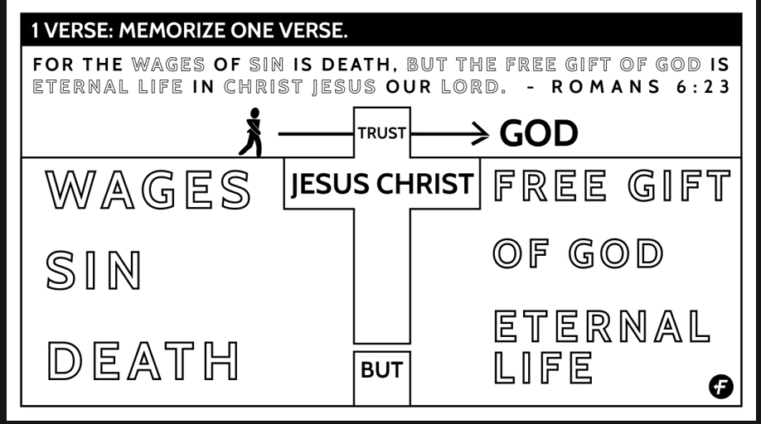

Slide 4
HOW TO SHARE YOUR TESTIMONY
"Always be prepared to give an answer to everyone who asks you to give the reason for the hope that you have.“
Peter 3:15

Slide 5
One of the most effective tools you have for sharing your faith is the story of how Jesus Christ gave you eternal life and how He has enriched your life.
The Apostle John wrote, testifying about his relationship to Jesus Christ:
"We proclaim to you what
we have seen and heard"
1 Jn. 1:3

Slide 6
You can also give testimony in casual conversation of what Christ has done for you that day, or how His peace/presence is helping you through some crises.

Slide 7
When the Apostle Paul stood before King Agrippa (Acts 26), he spoke simply, logically, and clearly about his 1. Life before salvation,
How he met Christ, and
What his life was like after conversion.

Slide 8
By following the steps outlined in this article, you will learn how to tell others in the same manner about how you came to know Christ. The choice of the right words, the flow of your story, and knowing how to begin and how to end are all important.

Slide 9
RELIGIOUS WORDS - POSSIBLE SUBSTITUTES
Believe, Accepted, Trusted or Relied on Christ for my:
Salvation, Sin, Disobedience, Breaking God's laws,
Turning my back on God.
Went forward, Decided to turn my life over to God,
Under the blood, God forgave the wrongs I had done,
Saved/Born Again, or Became a real Christian

