Slide 1
Disciple 102 – class 5
The new testament: the central focus on jesus

Slide 2
Romans 8:38-39
³⁸ For I am convinced that neither death nor life, neither angels nor demons, neither the present nor the future, nor any powers, ³⁹ neither height nor depth, nor anything else in all creation, will be able to separate us from the love of God that is in Christ Jesus our Lord.

Slide 3
NT: THE CENTRAL FOCUS ON JESUS
Jesus’ life, ministry, and words, were written down and passed on by His main followers. They spread this message throughout the world, in spite of terrible persecution.

Slide 4
In the new testament
“The Gospel of Christ was boldly proclaimed as God’s ultimate word, God manifested in human flesh. Christ, they said, came to show us what God was like, how He would save us, and how we should live.” For many it seemed crazy. For the thousands who believed,—this message completely changed their lives, just as it does today.

Slide 5
The New Testament has been preserved in more manuscripts than any other ancient work, having over 5,800 complete or fragmented Greek manuscripts, 10,000 Latin manuscripts and 9,300 manuscripts in various other ancient languages including Syriac, Slavic, Gothic, Ethiopic, Coptic and Armenian.

Slide 6
THE NEW TESTAMENT
Presents Jesus as more than a religious figure.
He is the personal fulfillment of centuries of promise, prophecy, waiting, and hope woven throughout the Old Testament, whose last book was written some 400 years before Jesus’ birth.
And the New Testament also repeatedly speaks of Jesus coming again, a second time, to establish a kingdom of justice, love, truth and righteousness.

Slide 7
Jesus is seen as fulfillment of the promises
There are over 50 predictions in the Old Testament about a coming Messiah, or Savior-Deliverer, and hundreds more about Jesus life, miracles and teachings the New Testament writers saw fulfilled in Jesus. In your notes are just a few.

Slide 8
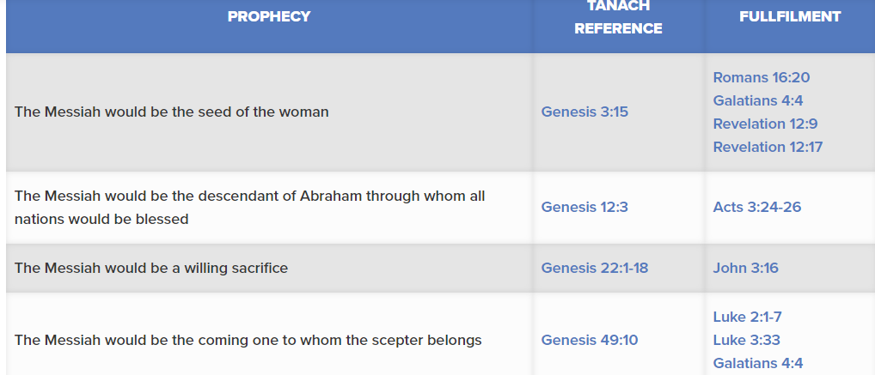

Slide 9
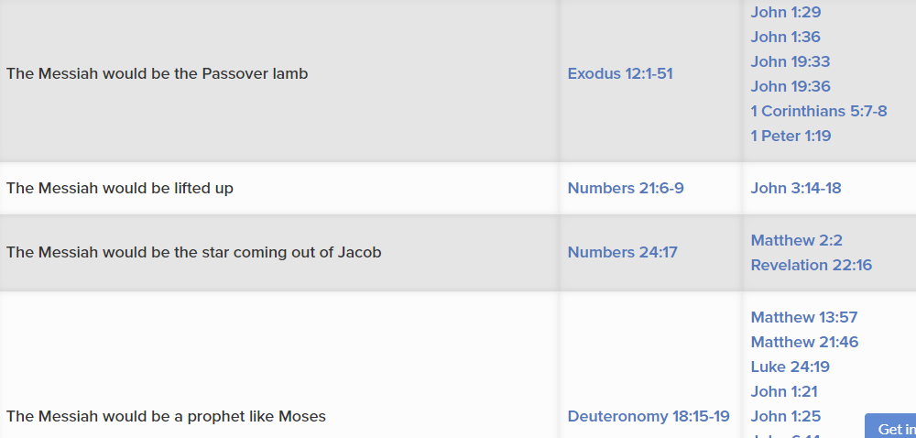

Slide 10
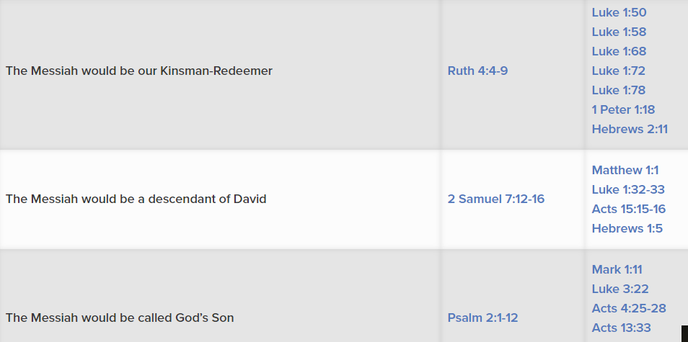

Slide 11
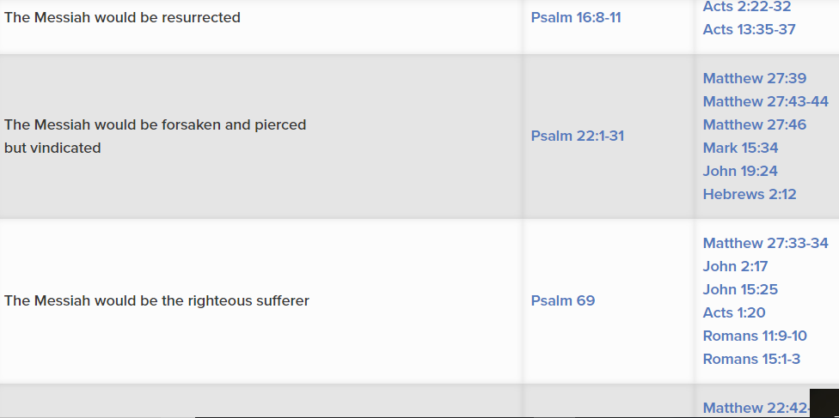

Slide 12
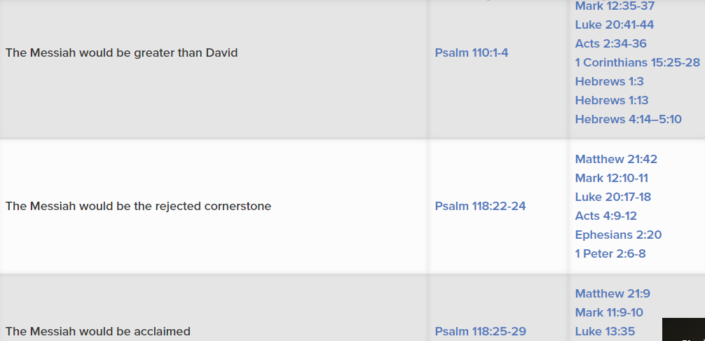

Slide 13
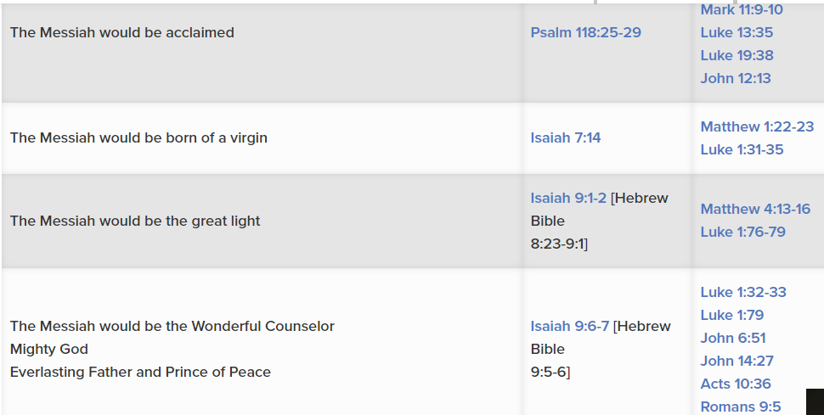

Slide 14
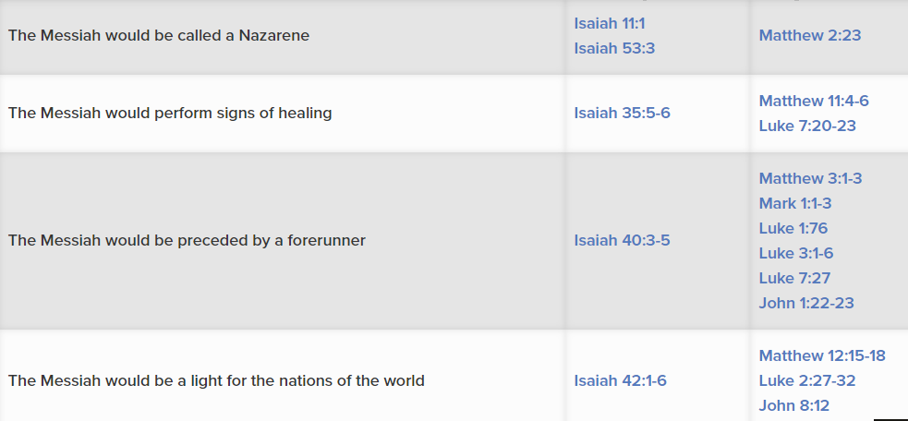

Slide 15
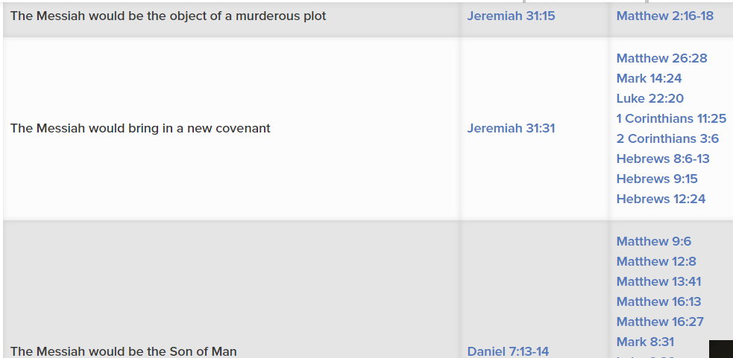

Slide 16
OTHER PEOPLE IN THE NEW TESTAMENT
He was one of the first disciples Jesus called, a major figure in the four Gospels and key in the Acts expansion of the early church. He wrote two New Testament books and is likely the eye witness source for Mark’s gospel. Peter had obvious flaws, impulsiveness and outright failures. Instead of being forgotten as a “loser,” he found forgiveness, renewed faith and anointing to provide critical leadership for the early church
PETER was a fisherman

Slide 17
Paul
Paul began as a persecutor of the church.
He was a Roman citizen and Pharisee.
His dramatic conversion led him to become perhaps the greatest missionary in the history (read it in Acts 9:1-12) of the church.
He is credited as the author of almost half of all the New Testament, far more than anyone else. Paul’s role was critical in interpreting how the Gospel was a universally available for all people, in all places and all times.

Slide 18
John
John is the author of five of the NT books.
On the cross, Jesus asked John to care for his mother.
John is the only apostle who did not die a martyr.
Most of his books were written near the end of his life.
As the last Apostle, he lived into the AD 90’s to provide important leadership for the churches in Asia Minor and other regions.
John calls himself the Apostle whom Jesus loved.

Slide 19
To Fully Understand the New Testament
You Need to Read the Old
The New Testament is deeply rooted in the Old Testament, even though it was written 400 years later. There are over 220 quotes of the Old in the New. In addition, there are 180 Old Testament allusions or references. 22 of the 27 New Testament books quote or refer to the Old Testament. These references include 58 of the 66 Old Testament books.

Slide 20
Gospels
The four Gospels are:
Narrative accounts of Jesus’ life.
They cover much overlapping material,
They are written from different perspectives.
Matthew targets a Jewish audience;
Mark is a briefer, fast-action gospel;
Luke, a Gentile doctor, writes more for the Greek mind;
John goes into more personal and theological reflection than the others.
Matthew
Mark
Luke
john

Slide 21
History
The Acts of the Apostles
is introduced by its author, Luke, as being a continuation of the Gospel of Luke.
It is the history of the early Christian church from the time that Jesus ascended into heaven, and the Day of Pentecost, until the time of Paul’s imprisonment in Rome, around the year 60 AD.
Acts

Slide 22
Paul’s Letters
Paul’s Letters were written to various churches and individuals, generally in response to a crises.
Some addressed problems in churches he had founded, or to encourage his close co-laborers.
Some were written while he was a prisoner (Ephesians, Philippians, Colossians, Philemon).
His writings include doctrinal material, end time themes and teachings with practical applications for everyday life.
A repetitive theme in Paul’s writings is to know Christ and make Him known.
Romans
1 and 2 Corinthians
Galatians
Philippians
Colossians
1 & 2 Thessalonians
1 & 2 timothy
Titus
Pilemon

Slide 23
General Epistles
The General Letters
Are those written by others besides Paul.
They were usually written to churches or groups of Christians to deal with needs, problems or questions that had arisen.
In these letter, believers are encouraged to stand strong in the faith, even though they were dealing with many difficulties.
They also warn against false teachings that were threatening the churches’ sound Gospel foundation.
Hebrews
James
1 & 2 Peter
1, 2 3rd John
Jude

Slide 24
Apocalyptic (end times)
Revelation
Was written by John, while a prisoner on the Island of Patmos, approximately 85-95 A.D.
Its purpose is to give encouragement and hope for all Christians to continue watching for the return and triumph of the Lord Jesus Christ.
It also is to warn of the Final Judgment that nonbelievers will endure at the end.
Revelation is full of wonderful God-given visions.
Revelation

Slide 25
Scholars have found a wealth of manuscripts, copies and fragments that substantiates the reliability of the New Testament writings far beyond that available for any other writings from the ancient world. The wealth of evidence is simply staggering.
In the chart on the next slide you will see how the New Testament compares to other ancient famous selections of literature, in regard to when the originals were written, the age of copies we have available and the number of copies available. It’s a startling comparison!

Slide 26
Author | Title | Date Written | Earliest Copy Available | Interval | # Copies For Com- parison
Herodotus Caesar Tacitus Piny (Various) | History Galic Wars Annals Natural History New Testament | 450 BC 50 BC 100 BC 100 BC 50-100 AD | 900 AD 900 AD 1100 AD 850 AD 250 AD | 1350 Yrs 950 Yrs 1000 Yrs 750 Yrs 200 | 8 10 20 7 5000+

