Slide 1
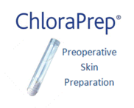
Final Skin Preparation

Slide 2
Patient has had an initial skin prep using 4% chlorhexidine (hibiscrub) diluted with equal parts warm water (50/50) to make a 2% solution

Slide 3
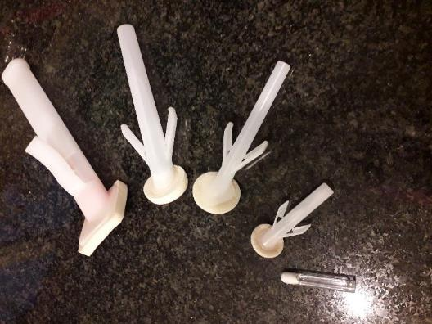
What size Chloraprep applicator should I use?

Slide 4
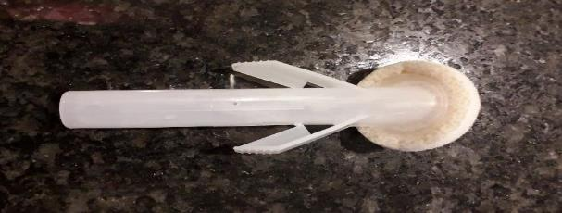
Sepp 0.67ml Size guide 8cm x 7cm Chloraprep 1ml Size guide 12cm x 12cm

Slide 5
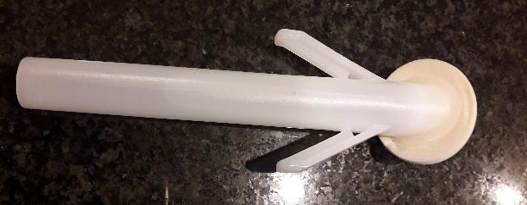
Chloraprep 3ml Size Guide 30cm x 30cm Chloraprep 10.5ml Size Guide 50cm x 50cm

Slide 6
Chloraprep 26ml Size Guide 100cm x 100cm

Slide 7
Wearing sterile gloves take your chosen applicator Hovering over intended incision site press the wings together to release the liquid Press the applicator down on the area to prime the sponge

Slide 8
Use a back and forth method. Initially focussing on your intended incision site area for 30 seconds then ‘colour in’ the rest of the clipped patch

Slide 9
Use pressure and friction. Use one half of the sponge to flatten hair at the end

Slide 10
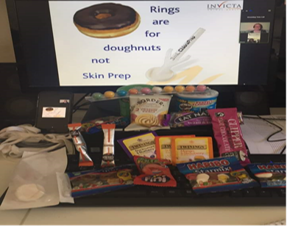
Applicators are single use. Discard of applicator appropriately after use Leave site to dry before drapes are applied
Visit www.invictavet.co.uk to book your practice in for a FREE online live surgical prep of the patient CPD. You will receive free samples and snacks to enjoy whilst you watch!

