Slide 1

Lupe Berretta
Understanding the complexity of Cardio-Obstetrics Care
A 6-hour in-person training designed for emerging public health and healthcare professionals focusing on cardio-obstetrics as a systems-level intervention.

Slide 2


6-HOUR TRAINING
Agenda Overview
The training is structured into five progressive modules, moving from foundational science to systems design to community implementation and evaluation. Today's demonstration focuses on a sample activity from Module 4.
Module 1: Pregnancy as a Cardiovascular Stress Test
Module 2: Cardio-Obstetrics as an Emerging Specialty
Module 3: Interdisciplinary Systems and Workflow Design
Foundational physiology and the reframing of pregnancy-related risk
Fellowship models, institutional structures, and workforce implications
Screening tools, EMR triggers, and multidisciplinary coordination
Module 4: Community Strategy and Measuring Impact
Module 5: Implementation and Evaluation Framework
Outreach design, self-efficacy, and evaluation frameworks
ADDIE model application and real-world deployment strategies
Sample Session Today: Community Outreach Impact Simulation, a hands-on activity from Module 4 demonstrating evaluation challenges in public health practice.

Slide 3
LEARNING OBJECTIVES
Training Purpose
This 6-hour in-person training prepares emerging public health professionals to understand, analyze, and act on the intersection of pregnancy and cardiovascular health. Each objective is measurable and tied to knowledge, systems analysis, and real-world application.
01
02
03
Explain the Connection
Analyze System-Level Breakdowns
Design Interdisciplinary Strategies
Articulate the relationship between pregnancy complications such as preeclampsia, gestational diabetes, and preterm delivery and long-term cardiovascular risk, grounding clinical knowledge in public health context.
Identify and evaluate the structural, clinical, and communication failures that contribute to preventable maternal morbidity across the continuum of care.
Develop actionable plans for screening, referral pathways, and community engagement that bridge clinical systems and population health approaches.

Slide 4

Emerging Workforce
Pretraining survey assessing familiarity with hypertensive disorders of pregnancy and postpartum cardiovascular risk
Baseline knowledge quiz on maternal mortality drivers
https://www.menti.com/alxyskkd6se9

Slide 5
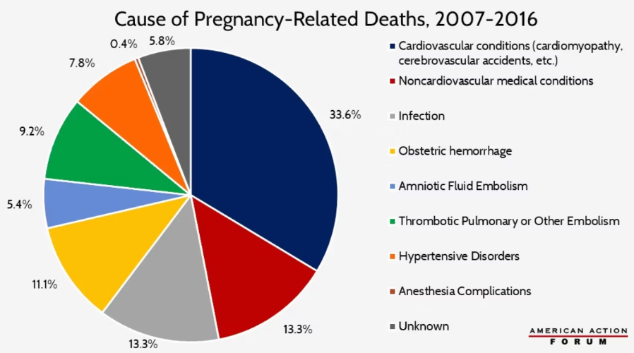
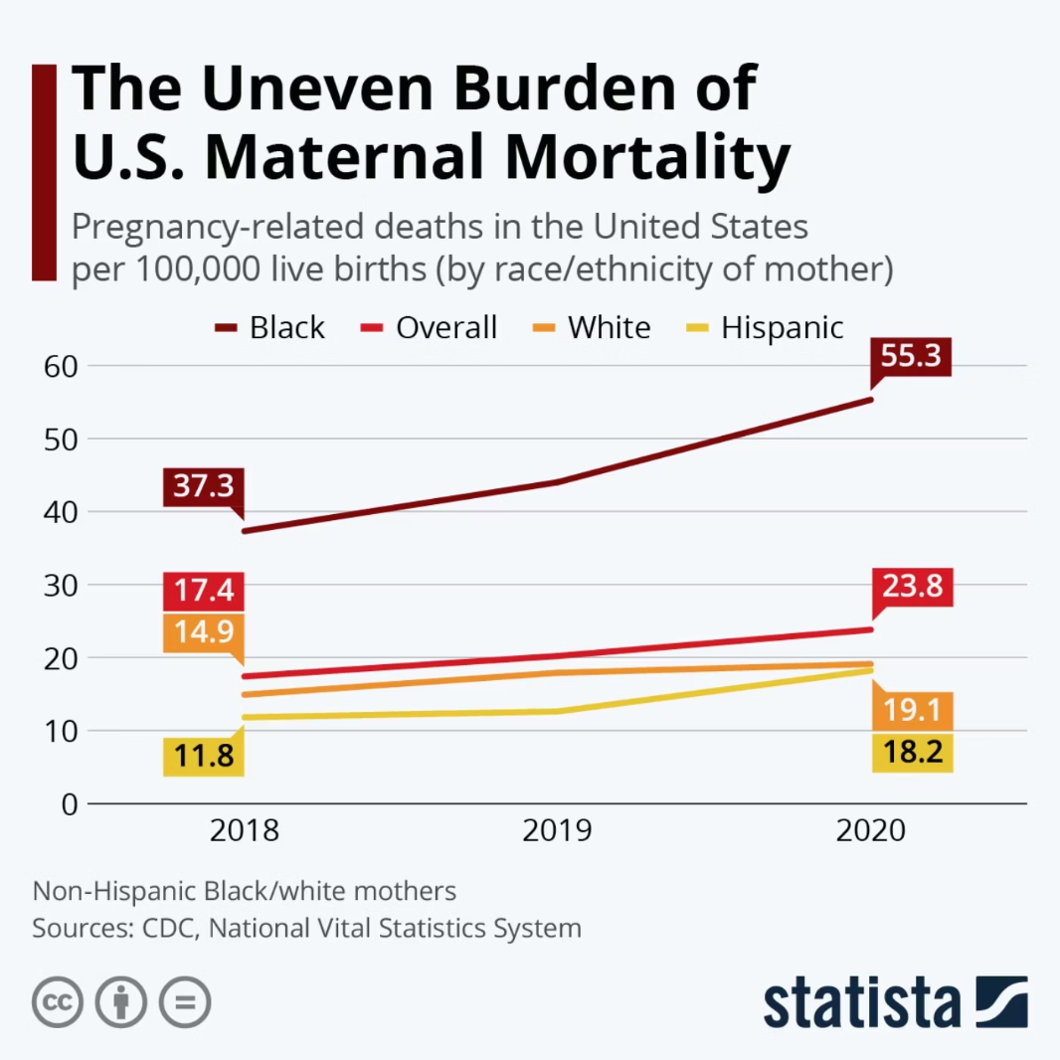
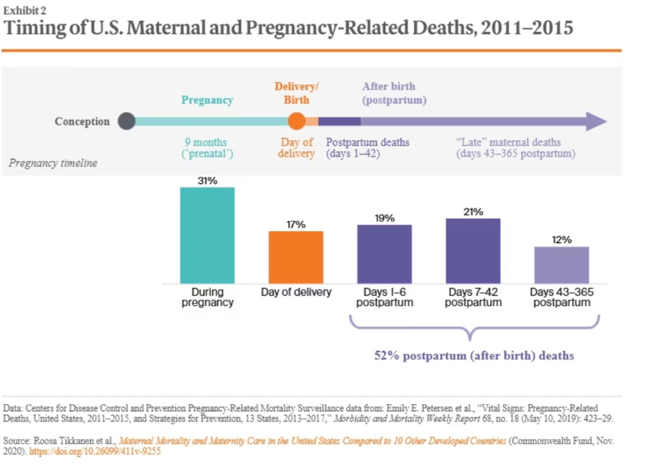
MODULE 1
Why Are We Here?
Black women in the United States are approximately three times more likely to die from
pregnancy related causes than White women
Hoyert, D. L. (2023). Maternal mortality rates in the United States, 2021 (NCHS Data Brief No. 474). National Center for Health Statistics. https://www.cdc.gov/nchs/products/databriefs/db474.htm Petersen, E. E., et al. (2019). Vital signs: Pregnancy-related deaths, United States, 2011–2015, and strategies for prevention, 13 states, 2013–2017. Morbidity and Mortality Weekly Report, 68(18), 423–429. https://doi.org/10.15585/mmwr.mm6818e1
U.S. Maternal Mortality vs. 10 Countries | Commonwealth Fund

Slide 6
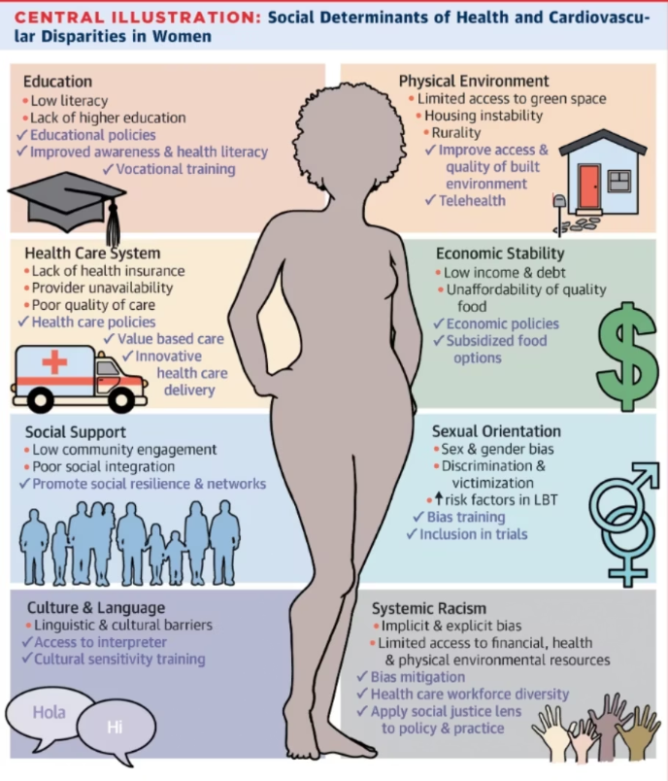
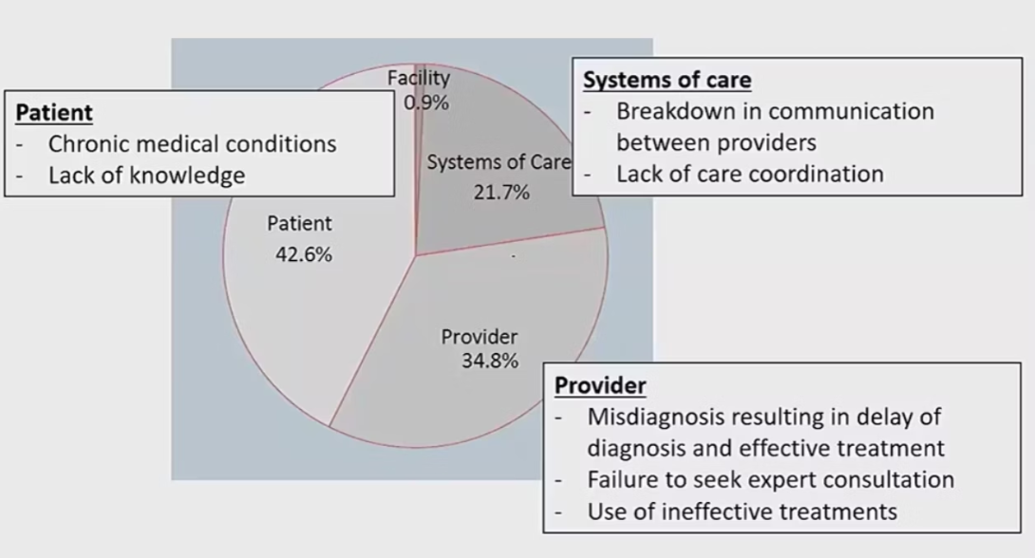
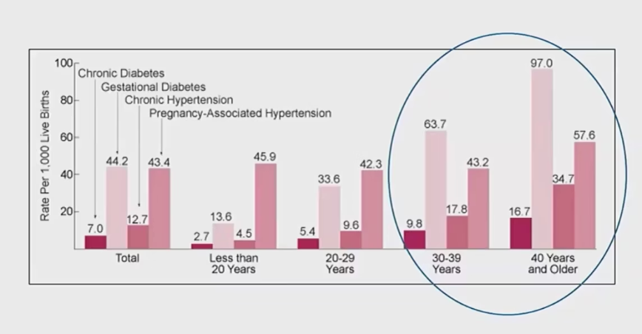
Explaining the Connection
Cardiovascular disease is the leading cause of pregnancy-related death in the United States. Hypertensive disorders of pregnancy including preeclampsia and gestational hypertension significantly increase a person's lifelong risk of developing heart disease, stroke, and heart failure. Yet research consistently shows that up to 80 percent of pregnancy-related deaths are considered preventable.
This is not only a clinical issue. It is a systems issue, an education issue, and a workforce preparedness issue. Public health professionals must understand:
01
02
03
Pregnancy as a Stress Test
Systems Failures
Interdisciplinary Solutions
Pregnancy unmasks hidden cardiovascular vulnerabilities
Breakdowns that drive preventable maternal morbidity
Coordinated strategies across clinical and community settings
Centers for Disease Control and Prevention. (2023). Pregnancy related deaths in the United States. https://www.cdc.gov/maternal-mortality/data-research/index.htm
Centers for Disease Control and Prevention. (2022). Severe maternal morbidity in the United States. https://www.cdc.gov/reproductivehealth/maternalinfanthealth/severematernalmorbidity.html American College of Obstetricians and Gynecologists. (2019). Cardiovascular disease in pregnancy. ACOG Practice Bulletin No. 212. Obstetrics and Gynecology, 133(5), e320 to e356. https://www.acog.org/clinical/clinical-guidance/practice-bulletin/articles/2019/05/cardiovascular-disease-in-pregnancy
American College of Obstetricians and Gynecologists. (2018). Optimizing postpartum care. Committee Opinion No. 736. Obstetrics and Gynecology, 131(5), e140 to e150. https://www.acog.org/clinical/clinical-guidance/committee-opinion/articles/2018/05/optimizing-postpartum-careBrown, M. C., Best, K. E., Pearce, M. S., Waugh, J., Robson, S. C., & Bell, R. (2013).
Cardiovascular disease risk in women with preeclampsia: Systematic review and meta analysis. European Journal of Epidemiology, 28(1), 1 to 19. https://doi.org/10.1007/s10654-013-9762-6
Honigberg, M. C., Riise, H. K. R., Daltveit, A. K., et al. (2019). Long term cardiovascular risk in women with hypertensive disorders of pregnancy. Journal of the American College of Cardiology, 74(22), 2743 to 2754. https://doi.org/10.1016/j.jacc.2019.09.052

Slide 7
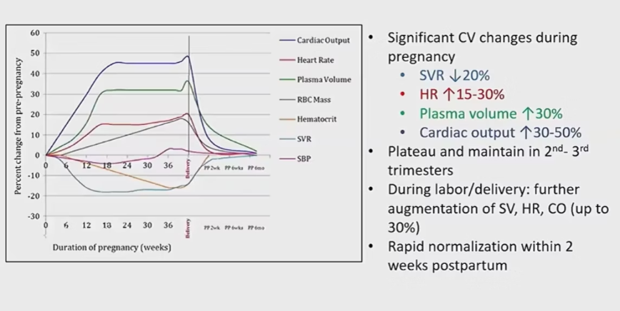
Pregnancy as a Cardiovascular Stress Test
Pregnancy places extraordinary demands on the cardiovascular system. During a healthy pregnancy, the body undergoes dramatic hemodynamic changes that test the heart's capacity and resilience:
"Pregnancy reveals risk. It does not create it."
Cardiac Output
Increases by 30 to 50 percent to support fetal growth
Blood Volume
Expands significantly, placing added pressure on the vascular system
Vascular Resistance
Systemic vascular resistance changes throughout gestation
Complications such as preeclampsia are early warning signs of future cardiovascular disease not isolated events.
Centers for Disease Control and Prevention. (2023). Pregnancy related deaths in the United States. https://www.cdc.gov/maternal-mortality/data-research/index.htm
Centers for Disease Control and Prevention. (2022). Severe maternal morbidity in the United States. https://www.cdc.gov/reproductivehealth/maternalinfanthealth/severematernalmorbidity.html American College of Obstetricians and Gynecologists. (2019). Cardiovascular disease in pregnancy. ACOG Practice Bulletin No. 212. Obstetrics and Gynecology, 133(5), e320 to e356. https://www.acog.org/clinical/clinical-guidance/practice-bulletin/articles/2019/05/cardiovascular-disease-in-pregnancy
American College of Obstetricians and Gynecologists. (2018). Optimizing postpartum care. Committee Opinion No. 736. Obstetrics and Gynecology, 131(5), e140 to e150. https://www.acog.org/clinical/clinical-guidance/committee-opinion/articles/2018/05/optimizing-postpartum-careBrown, M. C., Best, K. E., Pearce, M. S., Waugh, J., Robson, S. C., & Bell, R. (2013).
Cardiovascular disease risk in women with preeclampsia: Systematic review and meta analysis. European Journal of Epidemiology, 28(1), 1 to 19. https://doi.org/10.1007/s10654-013-9762-6
Honigberg, M. C., Riise, H. K. R., Daltveit, A. K., et al. (2019). Long term cardiovascular risk in women with hypertensive disorders of pregnancy. Journal of the American College of Cardiology, 74(22), 2743 to 2754. https://doi.org/10.1016/j.jacc.2019.09.052

Slide 8

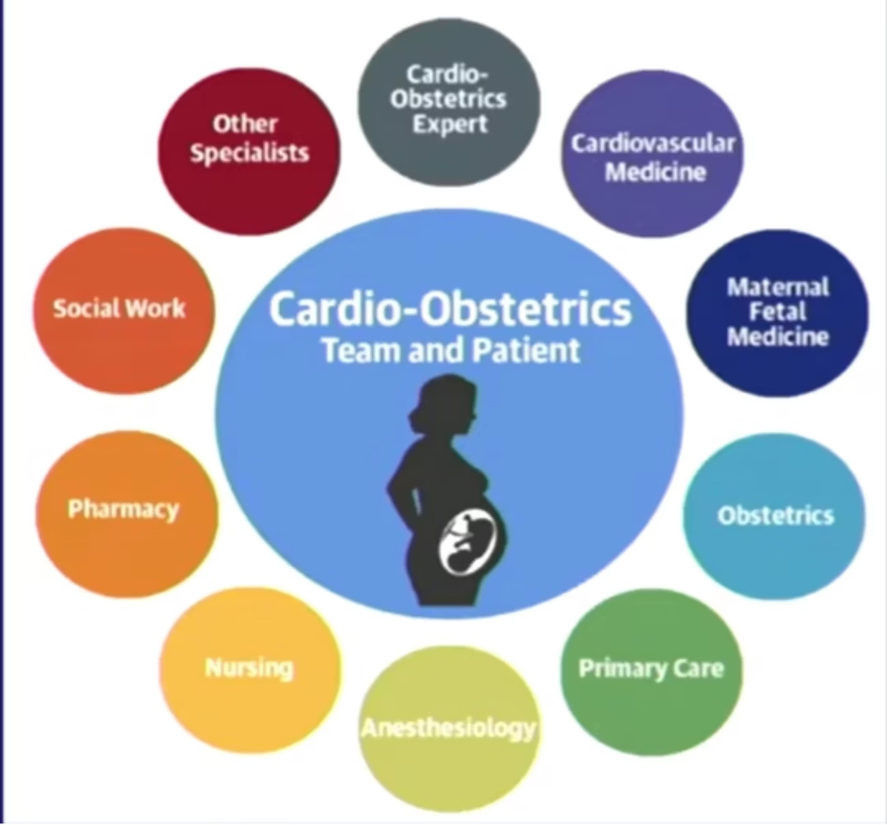
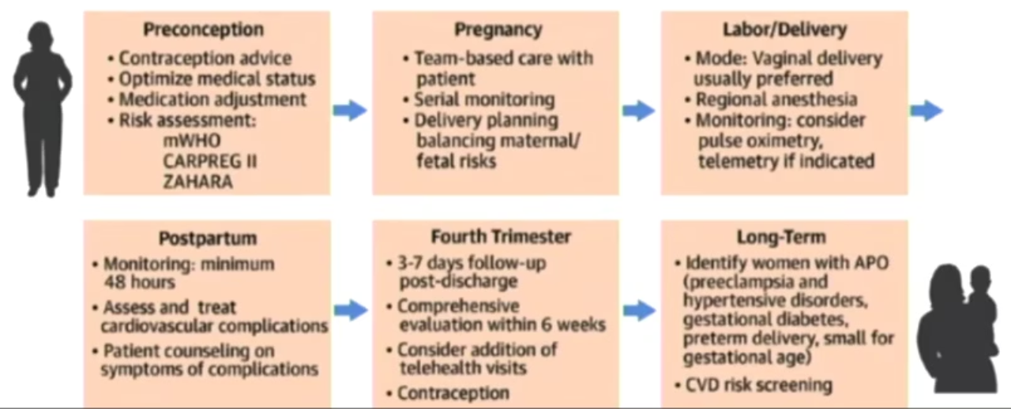
MODULE 2
Cardio-Obstetrics: From Concept to Specialty
The Evolution
Proven Institutional Outcomes
Cardio-obstetrics has existed conceptually for decades, but formal fellowship programs are recent and not yet widely adopted nationally. The field bridges cardiology and maternal-fetal medicine to provide specialized care for pregnant and postpartum individuals with cardiovascular risk.
Care Coordination
Standardized Risk Assessment
Seamless handoffs between obstetrics, cardiology, and primary care
Consistent screening protocols applied across populations
Reduced Severe Morbidity
Fewer adverse maternal cardiac events and ICU admissions
American College of Cardiology. (2020). Cardio obstetrics and the evolving landscape of cardiovascular care in pregnancy. Journal of the American College of Cardiology, 75(5), 498 to 510. https://doi.org/10.1016/j.jacc.2019.11.052
Mehta, L. S., Warnes, C. A., Bradley, E., et al. (2014). Cardiovascular considerations in caring for pregnant patients: A scientific statement from the American Heart Association. Circulation, 130(24), 2189 to 2242. https://doi.org/10.1161/CIR.0000000000000105
Arany, Z., Elkayam, U., et al. (2016). Pregnancy and heart disease: A scientific statement from the American Heart Association. Circulation, 133(17), 1695 to 1733. https://doi.org/10.1161/CIR.0000000000000458
American College of Obstetricians and Gynecologists. (2019). Cardiovascular disease in pregnancy. Practice Bulletin No. 212. Obstetrics and Gynecology, 133(5), e320 to e356. https://www.acog.org/clinical/clinical-guidance/practice-bulletin/articles/2019/05/cardiovascular-disease-in-pregnancy
Silversides, C. K., Grewal, J., Mason, J., et al. (2018). Pregnancy outcomes in women with heart disease: The CARPREG II study. Journal of the American College of Cardiology, 71(21), 2419 to 2430. https://doi.org/10.1016/j.jacc.2018.02.076
Ruys, T. P. E., Roos-Hesselink, J. W., et al. (2014). Pregnancy and delivery in cardiac disease: Results of the ROPAC registry. European Heart Journal, 35(11), 657 to 665. https://doi.org/10.1093/eurheartj/eht544

Slide 9
MODULE 3
Analyzing Systems Breakdown and Preventability
Maternal mortality is rarely the result of a single decision. It is a cascade of systems failures each one a missed opportunity for intervention. Understanding these breakdowns is essential to designing effective solutions.
Common Preventable Factors
Cardio-Obstetric Solutions
Delayed Recognition
Warning signs missed or minimized by clinicians
Failure to Escalate Care
Inadequate response when patient condition deteriorates
Poor Interdisciplinary Communication
Siloed teams that fail to share critical information
Lack of Structured Referral Pathways
No clear protocols for postpartum cardiovascular follow-up
Risk Screening Tools
Validated instruments applied at every touchpoint
EMR Triggers
Automated alerts that flag high-risk patients
Case Conferences
Multidisciplinary team reviews of complex cases
AIM Bundle Implementation
Standardized safety bundles for cardiac conditions
• Petersen, E. E., Davis, N. L., Goodman, D., Cox, S., Syverson, C., Seed, K., Shapiro Mendoza, C. K., Callaghan, W. M., & Barfield, W. (2019). Vital signs: Pregnancy related deaths, United States, 2011 to 2015, and strategies for prevention. MMWR Morbidity and Mortality Weekly Report, 68(18), 423–429. https://doi.org/10.15585/mmwr.mm6818e1
• Centers for Disease Control and Prevention. (2023). Maternal mortality review committees: A view into their critical role. https://www.cdc.gov/maternal-mortality/review-committees/index.html
• Main, E. K., Markow, C., & Gould, J. (2018). Addressing maternal mortality and morbidity through collaborative quality improvement. Obstetrics and Gynecology, 131(1), 12–18. https://doi.org/10.1097/AOG.0000000000002412
• Alliance for Innovation on Maternal Health. (2022). AIM patient safety bundles. https://saferbirth.org/aim/patient-safety-bundles/
• American College of Obstetricians and Gynecologists. (2019). Levels of maternal care. Obstetrics and Gynecology, 134(2), e41–e55. https://doi.org/10.1097/AOG.0000000000003383

Slide 10






MODULE 4
Community Strategy and Self-Efficacy
Moving from clinical systems to community engagement, effective public health outreach must address multiple dimensions simultaneously to create meaningful, lasting change.
Increase Knowledge
Build Self-Efficacy
Deliver accessible, evidence-based information about pregnancy-related heart health to communities
Empower individuals to recognize warning signs and advocate for their own care
Reduce Structural Barriers
Provide Clear Referral Pathways
Address transportation, insurance, and access challenges that prevent timely care
Connect community members directly to cardio-obstetric screening and follow-up services
Case Example — Citywide Baby Shower: A community health event designed to increase heart health awareness during pregnancy and the postpartum period through interactive education and resource distribution.
• Bandura, A. (2004). Health promotion by social cognitive means. Health Education and Behavior, 31(2), 143–164. https://doi.org/10.1177/1090198104263660
• Glanz, K., Rimer, B. K., & Viswanath, K. (Eds.). (2015). Health behavior: Theory, research, and practice (5th ed.). Jossey Bass.
• World Health Organization. (2008). Closing the gap in a generation: Health equity through action on the social determinants of health. https://www.who.int/publications/i/item/WHO-IER-CSDH-08.1
• Braveman, P., & Gottlieb, L. (2014). The social determinants of health: It is time to consider the causes of the causes. Public Health Reports, 129(Suppl 2), 19–31. https://doi.org/10.1177/00333549141291S206
• Centers for Disease Control and Prevention. (2023). Social determinants of health and pregnancy related health. https://www.cdc.gov/socialdeterminants

Slide 11


INTERACTIVE ACTIVITY

Slide 12
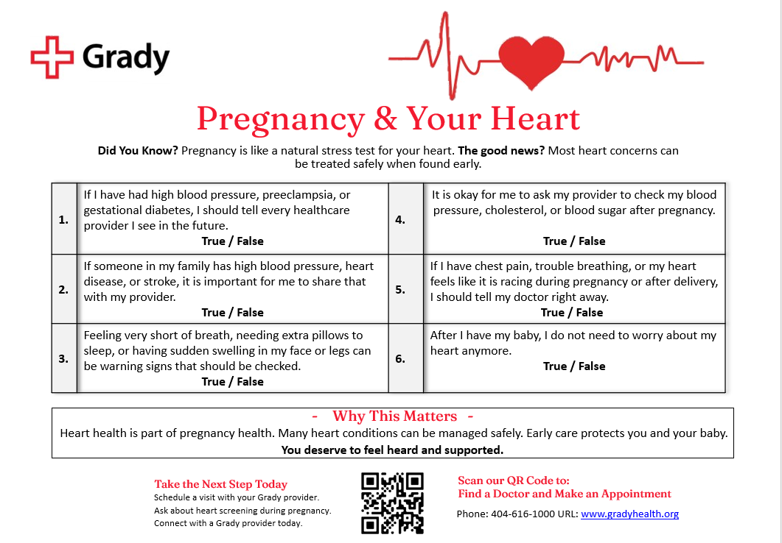


Slide 13

INTERACTIVE ACTIVITY
Did Our Outreach Work?
Let's put evaluation skills to the test. Consider the following data from the Citywide Baby Shower community outreach event:
20
5
100%
Trivia Sheets
Returned
Correct
Distributed at the event
Completed and submitted
Among respondents who returned sheets
Question for Discussion: Was this outreach successful? Take 5 minutes, consider the data, and decide. What does this evidence tell us and what doesn't it tell us?

Slide 14
Promote Learning Among the Public Health Workforce and Communities
Strategy to Influence Knowledge, Skills, and Attitudes
Use Best Practice Pedagogical Approaches
Applied retrieval practice through structured trivia questions
Designed messages around self efficacy theory
Used clear, behavior focused call to action
Integrated real world application through community deployment
Translated complex cardiovascular risk into 5th grade level language
Used interactive True/False trivia to promote active engagement
Embedded direct referral pathway through QR code linkage to care
Reinforced patient self advocacy and symptom recognition
Increased knowledge of pregnancy related cardiovascular warning signs
Improved confidence in speaking up about symptoms
Encouraged timely care seeking behavior
Connected education directly to clinical access

Slide 15
EVALUATION
Evaluation Discussion: Looking Deeper
The data from our Citywide Baby Shower tells an incomplete story. Knowledge is not the same as behavior change. Rigorous evaluation must go beyond correctness scores to capture meaningful outcomes.
What's Missing?
Stronger Methods
Low Response Rate
Higher response rate strategy - Only 25 percent of attendees returned trivia sheets. Future events could integrate real time completion or digital submission to increase participation.
Immediate QR scan tracking - While a QR code was provided, we did not capture real time scan analytics at the event to measure engagement volume.
On site appointment scheduling option - Adding a direct scheduling table or staff navigator could reduce drop off between interest and action.
Pre and post confidence assessment - A short self efficacy scale would better measure confidence in symptom recognition and self advocacy.
Demographic data capture - Anonymous demographic questions would allow assessment of whether highest risk populations were reached.
Follow up text or email pathway - Collecting opt in contact information would enable 30 and 60 day follow up to assess behavior change.
Behavioral outcome tracking - Future evaluation should measure completed appointments, not just scheduled visits.
Language accessibility expansion - Additional translated versions could improve equity of reach
Only 25% of sheets were returned — possible selection bias among the most engaged attendees
Knowledge ≠ Behavior
Measures knowledge recall, not actual health-seeking behavior or clinical follow-through
No Demographics
Cannot determine if the most at-risk populations were reached

Slide 16
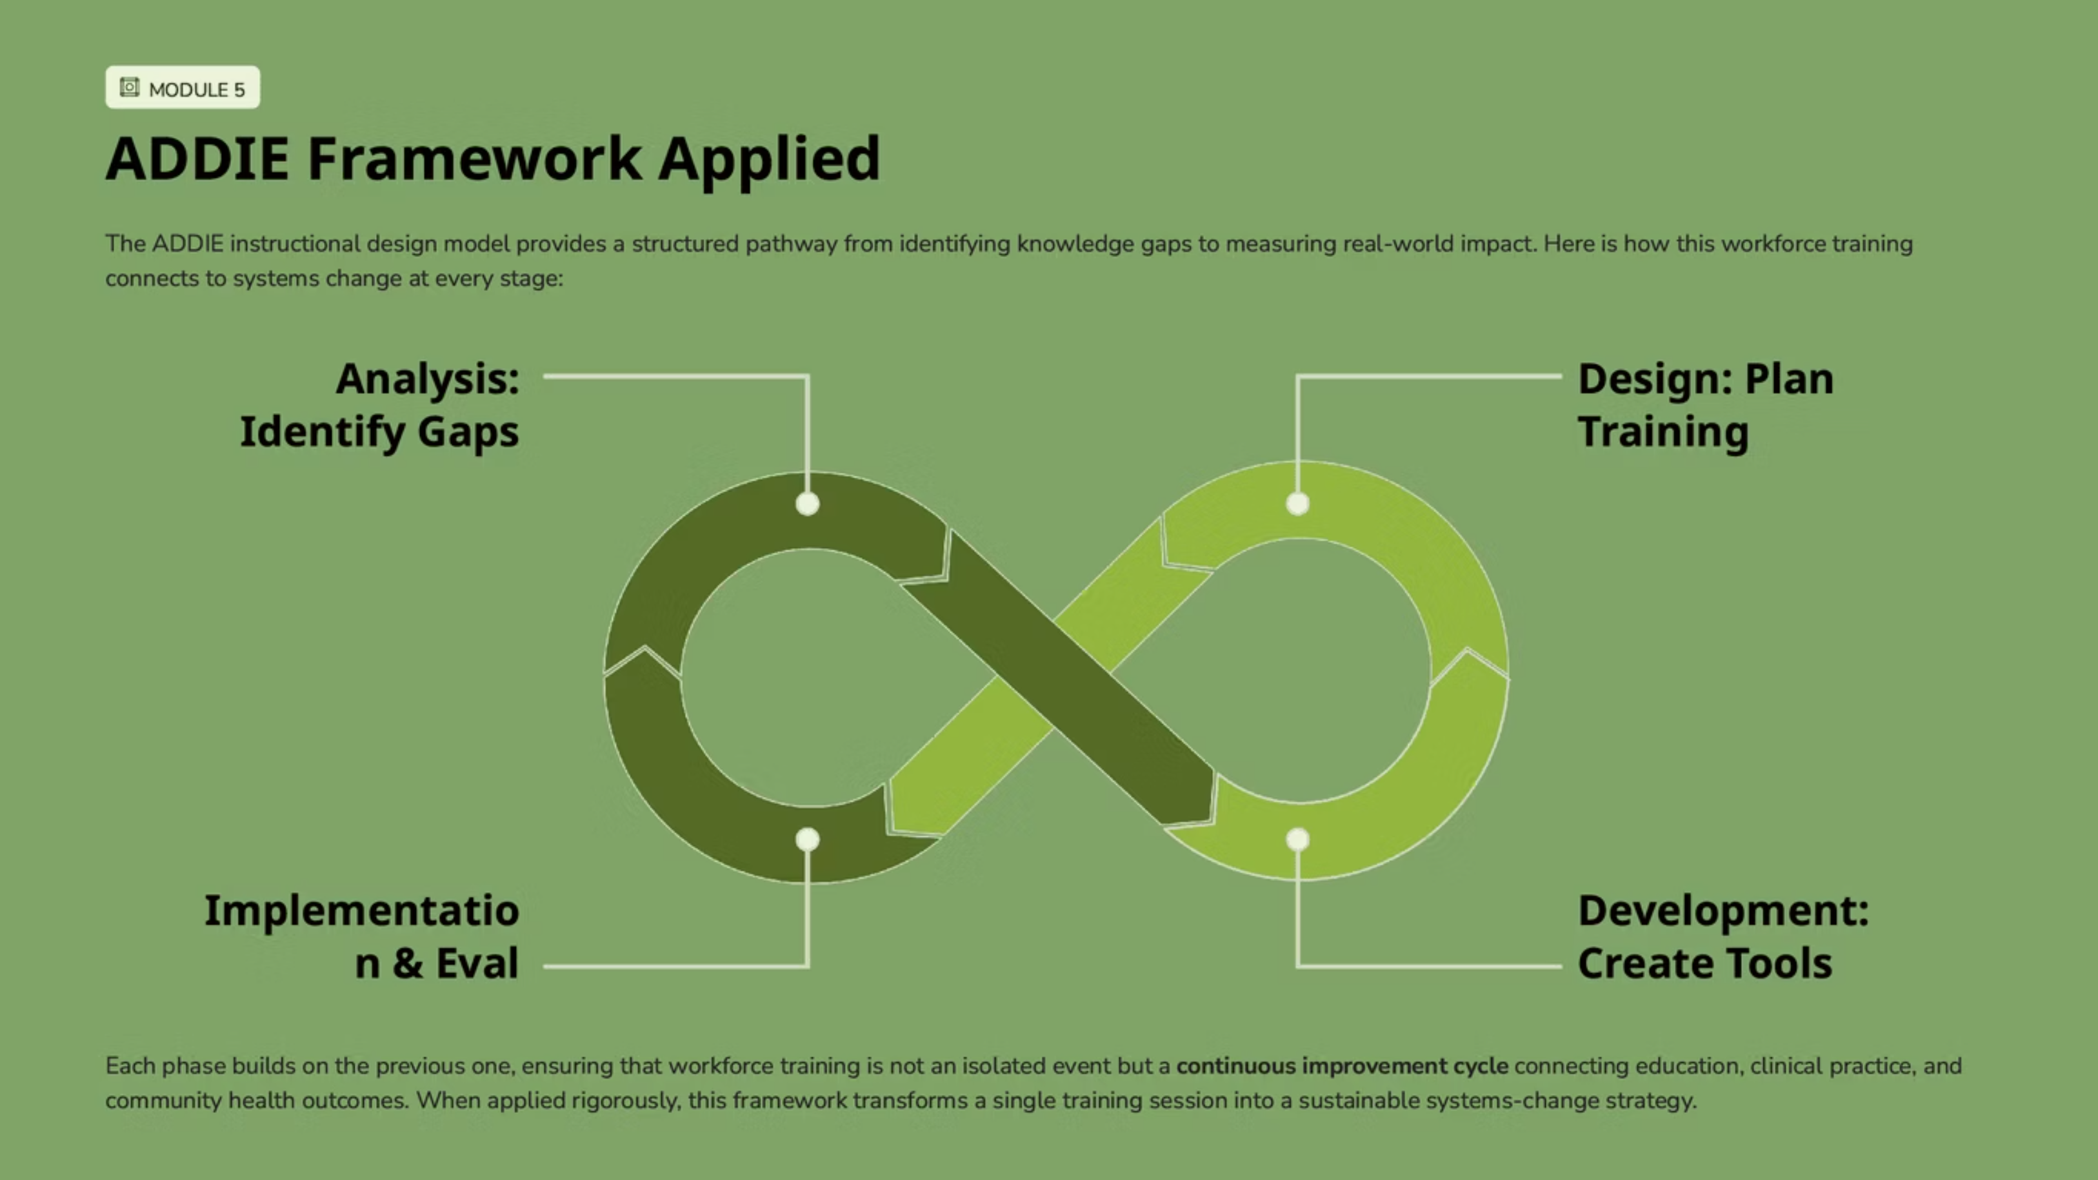

Slide 17





LOOKING AHEAD
Future Educational Pathways
Emerging Workforce
Established Workforce
General Public
Policymakers
Core competency training in pregnancy-related cardiovascular risk, awareness
Continuing education, workflow optimization, and integration of cardio-obstetric protocols into existing practice
Health literacy campaigns and self-efficacy programs that empower individuals to advocate for cardiovascular screening
Support for standardized cardio-obstetric programs, sustainable funding, and workforce development mandates

Slide 18


Slide 19
References:
• Alliance for Innovation on Maternal Health. (2022). AIM patient safety bundles. https://saferbirth.org/aim/patient-safety-bundles/
• American College of Obstetricians and Gynecologists. (2018). Optimizing postpartum care. Obstetrics and Gynecology, 131(5), e140–e150. https://doi.org/10.1097/AOG.0000000000002633
• American College of Obstetricians and Gynecologists. (2019). Cardiovascular disease in pregnancy. Practice Bulletin No. 212. Obstetrics and Gynecology, 133(5), e320–e356. https://doi.org/10.1097/AOG.0000000000003243
• American College of Obstetricians and Gynecologists. (2019). Levels of maternal care. Obstetrics and Gynecology, 134(2), e41–e55. https://doi.org/10.1097/AOG.0000000000003383
• Arany, Z., Elkayam, U., et al. (2016). Pregnancy and heart disease: A scientific statement from the American Heart Association. Circulation, 133(17), 1695–1733. https://doi.org/10.1161/CIR.0000000000000458
• Bandura, A. (1997). Self efficacy: The exercise of control. W. H. Freeman.
• Bandura, A. (2004). Health promotion by social cognitive means. Health Education and Behavior, 31(2), 143–164. https://doi.org/10.1177/1090198104263660
• Braveman, P., & Gottlieb, L. (2014). The social determinants of health: It is time to consider the causes of the causes. Public Health Reports, 129(Suppl 2), 19–31. https://doi.org/10.1177/00333549141291S206
• Centers for Disease Control and Prevention. (2023). Maternal mortality review committees. https://www.cdc.gov/maternal-mortality/review-committees/index.html
• Centers for Disease Control and Prevention. (2023). Pregnancy related deaths in the United States. https://www.cdc.gov/maternal-mortality/data-research/index.html
• Glanz, K., Rimer, B. K., & Viswanath, K. (Eds.). (2015). Health behavior: Theory, research, and practice (5th ed.). Jossey Bass.
• Main, E. K., Markow, C., & Gould, J. (2018). Addressing maternal mortality and morbidity through collaborative quality improvement. Obstetrics and Gynecology, 131(1), 12–18. https://doi.org/10.1097/AOG.0000000000002412
• Mehta, L. S., Warnes, C. A., Bradley, E., et al. (2014). Cardiovascular considerations in caring for pregnant patients: A scientific statement from the American Heart Association. Circulation, 130(24), 2189–2242. https://doi.org/10.1161/CIR.0000000000000105
• Petersen, E. E., Davis, N. L., Goodman, D., et al. (2019). Vital signs: Pregnancy related deaths, United States, 2011 to 2015, and strategies for prevention. MMWR Morbidity and Mortality Weekly Report, 68(18), 423–429. https://doi.org/10.15585/mmwr.mm6818e1
• Ruys, T. P. E., Roos Hesselink, J. W., Hall, R., et al. (2014). Pregnancy and delivery in cardiac disease: Results of the ROPAC registry. European Heart Journal, 35(11), 657–665. https://doi.org/10.1093/eurheartj/eht544
• Silversides, C. K., Grewal, J., Mason, J., et al. (2018). Pregnancy outcomes in women with heart disease: The CARPREG II study. Journal of the American College of Cardiology, 71(21), 2419–2430. https://doi.org/10.1016/j.jacc.2018.02.076
• The Joint Commission. (2019). Sentinel event alert 59: Maternal mortality. https://www.jointcommission.org/resources/patient-safety-topics/sentinel-event/sentinel-event-alert-newsletters/sentinel-event-alert-59-maternal-mortality/
• World Health Organization. (2008). Closing the gap in a generation: Health equity through action on the social determinants of health. https://www.who.int/publications/i/item/WHO-IER-CSDH-08.1

