Slide 1

The Problem: Heart Health in Pregnancy is Being Missed
Cardiovascular disease is a leading cause of pregnancy-related death in the U.S. — and many of these deaths are preventable.
Leading Cause of Maternal Death
Preventable with Earlier Action
Cardiovascular disease is a leading cause of pregnancy-related death in the U.S. (CDC, 2024)
Many deaths are preventable with earlier recognition and timely care (CDC, 2024)
Warning Signs Are Dismissed
Risk Continues Postpartum
The postpartum period remains a high-risk window for complications (AHA, 2023)
Symptoms like shortness of breath, chest pain, and severe headaches are often misunderstood as normal pregnancy discomfort
Public Awareness Gap
A critical gap in public awareness means missed opportunities to act and prevent avoidable maternal harm.
CDC, 2024 · AHA, 2023

Slide 2

CAMPAIGN OVERVIEW
Your Heart,
Your Pregnancy
Increasing public awareness of cardiovascular risk during pregnancy and postpartum
Focus
Target Audience
Core Message
Cardiovascular risk during pregnancy and the postpartum period
Pregnant and postpartum women, families, and community support systems
"If something feels off, speak up and seek care."
Approach
Awareness + recognition + action grounded in evidence-based communication and health equity (WHO, 2018; CDC, n.d.)
Centers for Disease Control and Prevention. (2024). Pregnancy-related deaths: Data from maternal mortality review committees in the United States. Preventing Pregnancy-Related Deaths | Maternal Mortality Prevention | CDC
Centers for Disease Control and Prevention. (n.d.). Hear her campaign. https://www.cdc.gov/hearher
Communicating About Public Health Toolkit. (n.d.). Communicating about public health.
Graves, L. E., et al. (2023). Cardio obstetrics: Moving beyond programming to action. American Heart Association Journals. https://www.ahajournals.org/doi/10.1161/JAHA.122.028141
Rudd, R. E. (2015). The evolving concept of health literacy: New directions for health literacy studies. Journal of Communication in Healthcare, 8(1), 7–9. 10.1179/1753806815Z.000000000105
Smith, H. J., Portela, A. G., & Marston, C. (2017). Improving implementation of health promotion interventions for maternal and newborn health. BMC pregnancy and childbirth, 17(1), 280. https://doi.org/10.1186/s12884-017-1450-1
2

Slide 3

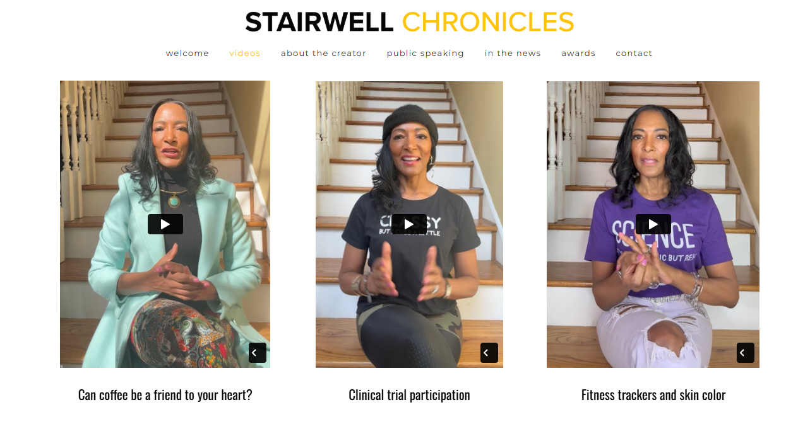
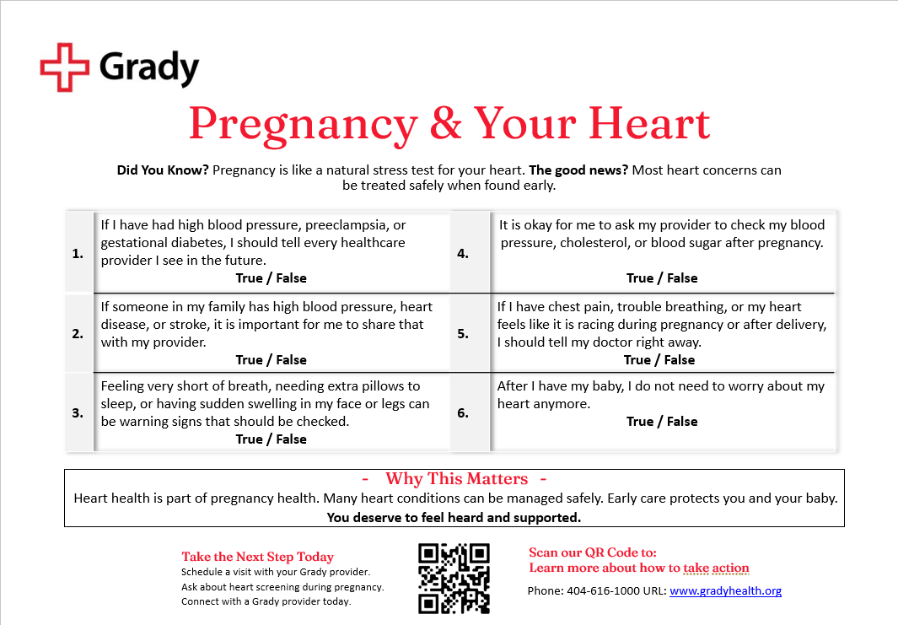
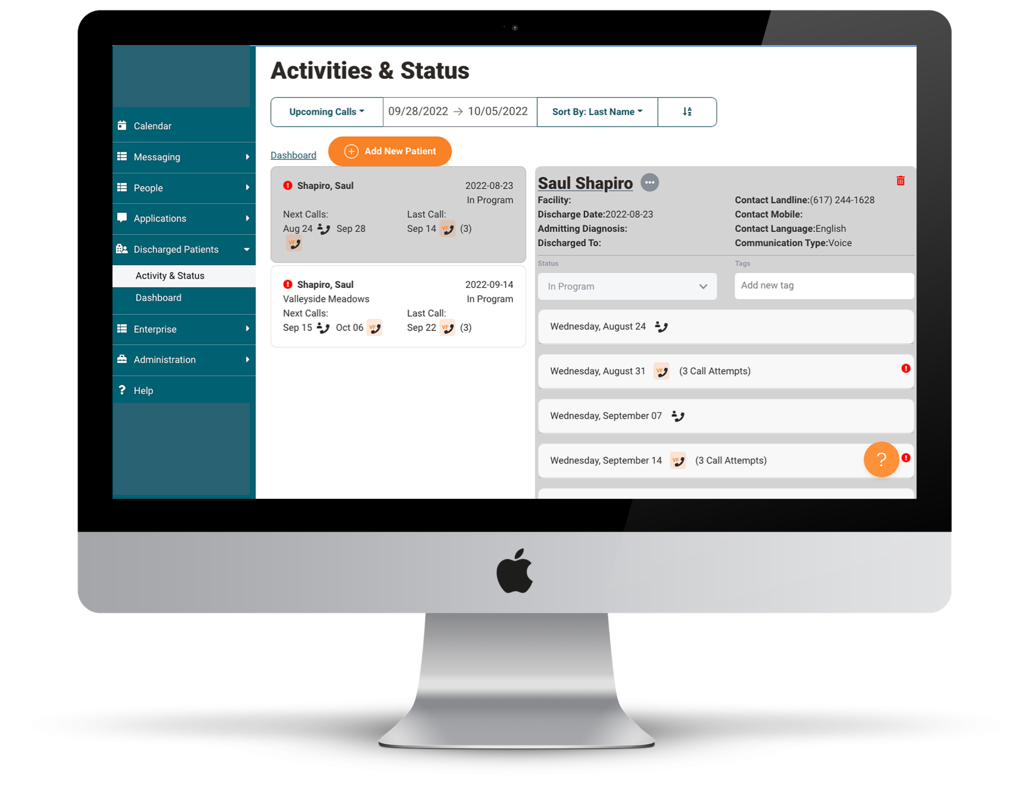


Campaign Products: Multi-Channel Engagement Delivery Strategy
A three-channel approach to reinforce learning and reach individuals across settings — from social media to clinical discharge.
Three-part carousel social media series inspired by Dr. Jane Morgan’s Stairwell Chronicles, using short, relatable storytelling to increase awareness and perceived risk (Communicating About Public Health Toolkit, n.d.)
Community-based flyer designed for events and clinical settings, incorporating plain language, visual cues, and a QR code linking directly to video content (Rudd, n.d.)
Video-based public service announcement reinforces warning signs and provides a clear call to action at hospital discharge and in the community (Centers for Disease Control and Prevention, 2024)
QR code integration connects social, clinical, and community touchpoints to extend engagement beyond a single interaction
Gamified true/false component promotes active learning and improves retention of key warning signs (Rudd, n.d.)
Multi-channel approach reinforces learning across settings and aligns with best practices for public health communication (U.S. Department of Health and Human Services, n.d.; Forbes Advisor, 2023)
Flyer with QR Code + Gamification
Plain language and visual icons designed for health literacy (Rudd, n.d.). A QR code links directly to the PSA video, and a "True or False" quiz reinforces knowledge through interaction.
Public Service Announcement (Video)
A 30–45 second video used at hospital discharge and accessible via QR code. Emotional, urgent, and action-oriented to ensure ongoing exposure to key messages in clinical and community settings.
3

Slide 4
Learning Objectives and Strategy
The campaign is grounded in health literacy, behavior change theory, and a strategic multi-channel framework.
Learning Objectives
Campaign Strategy
1
Recognize Warning Signs
Health Literacy
Identify cardiovascular complication symptoms during pregnancy and the postpartum period
Plain language and visuals (Rudd, n.d.) ensure messaging is simple, clear, and accessible
2
Understand "Not Normal"
Behavior Change
Symptoms are not typical postpartum experiences — they signal potentially serious conditions
Cues to action and increased perceived risk drive care-seeking behavior
3
Take Immediate Action
Seek care without delay when warning signs appear
4 Ps Framework
Product: Education + tools | Price: Reduce fear and knowledge barriers | Place: Hospital + community + digital | Promotion: Repeated, engaging messaging (Forbes Advisor, 2023)
American College of Obstetricians and Gynecologists. (2018). Optimizing postpartum care (Committee Opinion No. 736). Optimizing Postpartum Care | ACOG
American Heart Association. (2023). Cardiovascular considerations in pregnancy and postpartum. https://www.ahajournals.org/doi/10.1161/CIR.0000000000000772
Centers for Disease Control and Prevention. (n.d.). Hear her campaign. https://www.cdc.gov/hearher
Communicating About Public Health Toolkit. (n.d.). Communicating about public health.
Forbes Advisor. (2023). The 4 Ps of marketing: What they are and how to use them. https://www.forbes.com/advisor/business/4-ps-marketing/
Rudd, R. E. (2015). The evolving concept of health literacy: New directions for health literacy studies. Journal of Communication in Healthcare, 8(1), 7–9. 10.1179/1753806815Z.000000000105
Elrod, J. K., & Fortenberry, J. L., Jr (2020). Foundational elements of communication in health and medicine: avenues for strengthening the marketing communications mix. BMC health services research, 20(Suppl 1), 823. https://doi.org/10.1186/s12913-020-05604-9
Martin, C., & MacDonald, B. H. (2020). Using interpersonal communication strategies to encourage science conversations on social media. PloS one, 15(11), e0241972. https://doi.org/10.1371/journal.pone.0241972
4

Slide 5



Evaluation and Impact
Evaluation focuses on both reach and real-world behavior change — ensuring the campaign translates awareness into action.
Reach & Engagement
Social media views, shares, QR code scans, and PSA viewership
Learning & Behavior
Awareness of warning signs and self-reported care-seeking behavior
3-Month Follow-Up
Percentage of individuals attending postpartum follow-up appointments after exposure to campaign messaging
Continuous Improvement
Feedback loops and adaptation of messaging over time (CDC, 2024)
Three-month follow-up will assess care-seeking behaviors, including attendance at postpartum visits and requests for cardiovascular evaluation or referral, which are critical for early detection and prevention of complications (ACOG, 2018; CDC, 2024).

Slide 6
References:
American College of Obstetricians and Gynecologists. (2018). Optimizing postpartum care (Committee Opinion No. 736). Optimizing Postpartum Care | ACOG
American Heart Association. (2023). Cardiovascular considerations in pregnancy and postpartum. https://www.ahajournals.org/doi/10.1161/CIR.0000000000000772
Centers for Disease Control and Prevention. (2024). Pregnancy-related deaths: Data from maternal mortality review committees in the United States. Preventing Pregnancy-Related Deaths | Maternal Mortality Prevention | CDC
Centers for Disease Control and Prevention. (n.d.). Hear her campaign. https://www.cdc.gov/hearher
Centers for Disease Control and Prevention. (n.d.). CDC framework for program evaluation in public health. https://www.cdc.gov/evaluation/php/evaluation-framework/index.html
Communicating About Public Health Toolkit. (n.d.). Communicating about public health.
Forbes Advisor. (2023). The 4 Ps of marketing: What they are and how to use them. https://www.forbes.com/advisor/business/4-ps-marketing/
Graves, L. E., et al. (2023). Cardio obstetrics: Moving beyond programming to action. American Heart Association Journals. https://www.ahajournals.org/doi/10.1161/JAHA.122.028141
Rudd, R. E. (2015). The evolving concept of health literacy: New directions for health literacy studies. Journal of Communication in Healthcare, 8(1), 7–9. 10.1179/1753806815Z.000000000105
Smith, H. J., Portela, A. G., & Marston, C. (2017). Improving implementation of health promotion interventions for maternal and newborn health. BMC pregnancy and childbirth, 17(1), 280. https://doi.org/10.1186/s12884-017-1450-1
Elrod, J. K., & Fortenberry, J. L., Jr (2020). Foundational elements of communication in health and medicine: avenues for strengthening the marketing communications mix. BMC health services research, 20(Suppl 1), 823. https://doi.org/10.1186/s12913-020-05604-9
Martin, C., & MacDonald, B. H. (2020). Using interpersonal communication strategies to encourage science conversations on social media. PloS one, 15(11), e0241972. https://doi.org/10.1371/journal.pone.0241972

