Slide 1
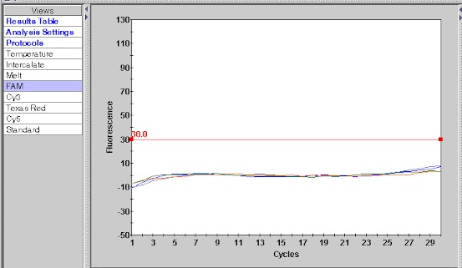
Vignette 10 Technical assistance
Technical Assistance via text message
Fastest method

Slide 2
Vignette 10 Technical assistance
Technical Assistance via email
Fast method

Slide 3
Vignette 5 Sample Testing
Technical Assistance via phone
Hit and miss method

Slide 4
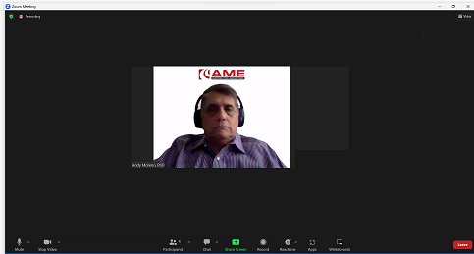
Vignette 10 Technical assistance
Technical Assistance via Zoom
Requires scheduling

