Slide 1
Vignette 2 PCR Lab Operations
The PCR Laboratory Operations

Slide 2
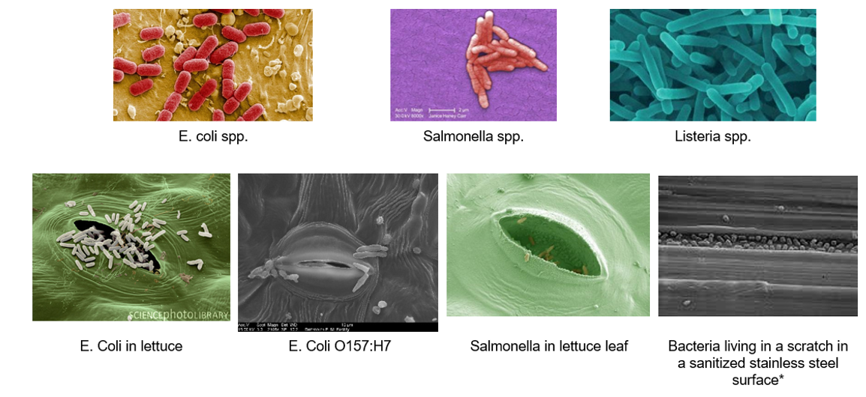
Vignette 2 PCR Lab Operations
Detection of bacterial contamination through testing

Slide 3
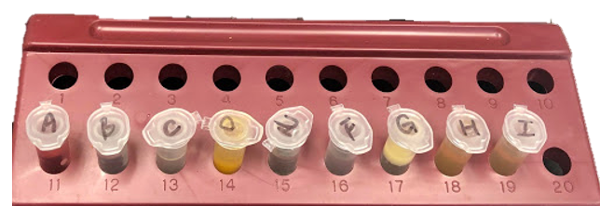
Vignette 2 PCR Lab Operations
Sample Collection

Slide 4
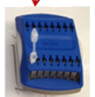
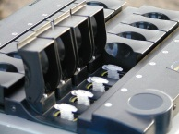
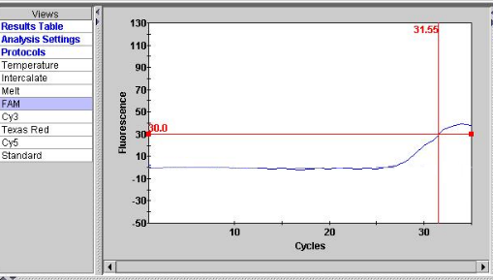
Vignette 2 PCR Lab Operations
Sample Testing

