Slide 1
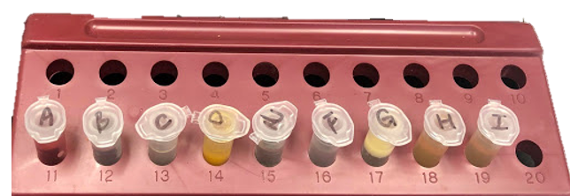
Vignette 4 Sample Preparation
Sample Preparation

Slide 2
Vignette 4 Sample Preparation
Each kit has unique preparation steps

Slide 3
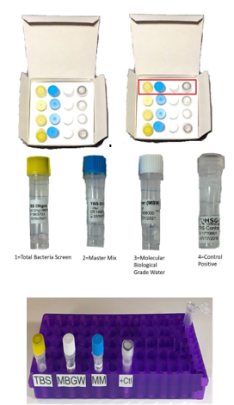
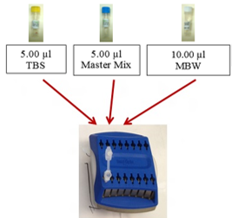
Vignette 4 Sample Preparation
Test formulation: 5 + 5 + 10 + 5

Slide 4
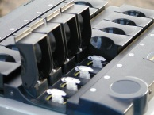
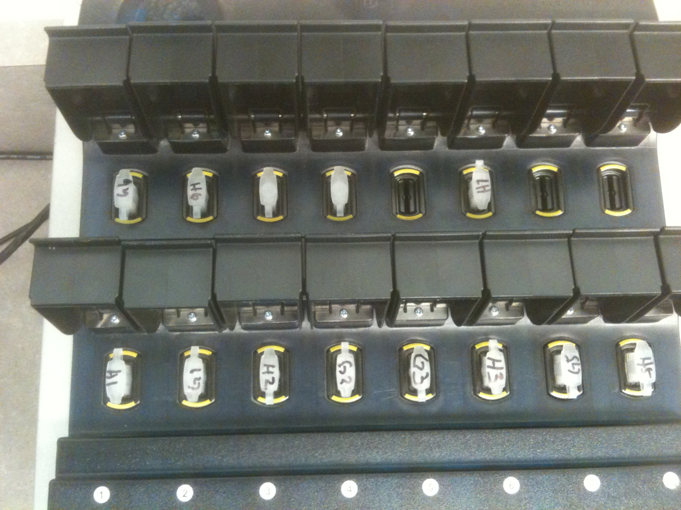
Vignette 4 Sample Preparation
Sample entry into DNA analyzer

